Slide 1

CPHA-CPMS learning package
Location, date

Slide 2


Activity instructions
Individual expectations
In your groups, discuss:
What hopes or expectations do you have for the course?
What, if any, concerns do you have about the course?
Individually:
1 expectation
1 hope
Notes:
Session 1.0: Online Intro Session

Slide 3
Course learning objectives
By the end of the course you will be able to:
Discuss the importance of guiding principles in child protection in humanitarian prevention and response actions
Describe child protection risks and protective factors through a socio-ecological model in humanitarian contexts
Explain the scope and range of child protection prevention and response strategies in humanitarian contexts
Suggest ways to ensure a quality child protection response through 6 key areas of programming highlighted in the Child Protection Minimum Standards
Suggest ways for working across humanitarian sectors to maximise protection outcomes for children
Describe the importance and potential challenges of incorporating selected cross-cutting themes into the child protection humanitarian response.
Notes:
Session 1.0: Online Intro Session

Slide 4

Next Steps
What to do next!
Complete Self Assessment, Task 1 and 2
Verify any visa requirements
Book travel arrangements in line with security requirements of own organisation
Ensure travel insurance is available and have the details ready for the trip
Ensure necessary accommodation arrangements are made
Notes:
Session 1.0: Online Intro Session

Slide 5


Activity instructions
Reflective learning practice
Download AnkiPro, or AnkiDroid
Click ‘Decks’
Click ‘New’
Name the deck
Click ‘Create new deck’
Click on the name of the deck, then ‘Create a card’
Front: Add a keyword or topic
Back: Add more details / your learning point
Continue with another card, or click the x
Notes:
Session 1.1: Welcome and Intros

Slide 6
Course learning objectives
By the end of the course you will be able to:
Discuss the importance of guiding principles in child protection in humanitarian prevention and response actions
Describe child protection risks and protective factors through a socio-ecological model in humanitarian contexts
Explain the scope and range of child protection prevention and response strategies in humanitarian contexts
Suggest ways to ensure a quality child protection response through 6 key areas of programming highlighted in the Child Protection Minimum Standards
Suggest ways for working across humanitarian sectors to maximise protection outcomes for children
Describe the importance and potential challenges of incorporating selected cross-cutting themes into the child protection humanitarian response.
Notes:
Session 1.2: Objectives and expectations

Slide 7
Reflective Practice
How is Child Protection in Humanitarian Action important in your current role and setting?
Notes:
Session 1.2: Objectives and expectations

Slide 8

CPHA and Guiding Principles
The UN CRC – Group Activity
In your group:
Read the summary of the UNCRC
Discuss which articles are most relevant to CPHA
Notes:
Session 1.3: CPHA and Guiding Principles

Slide 9
CPHA and Guiding Principles
Guiding Principles - Activity
In your group:
Put the puzzle together
Find the principles in the CPMS
Read the definitions
Read the examples and discuss:
Were the guiding principles taken into account?
If not, which were not considered and why?
What could have been done differently to align to guiding principles?
Notes:
Session 1.3: CPHA and Guiding Principles

Slide 10
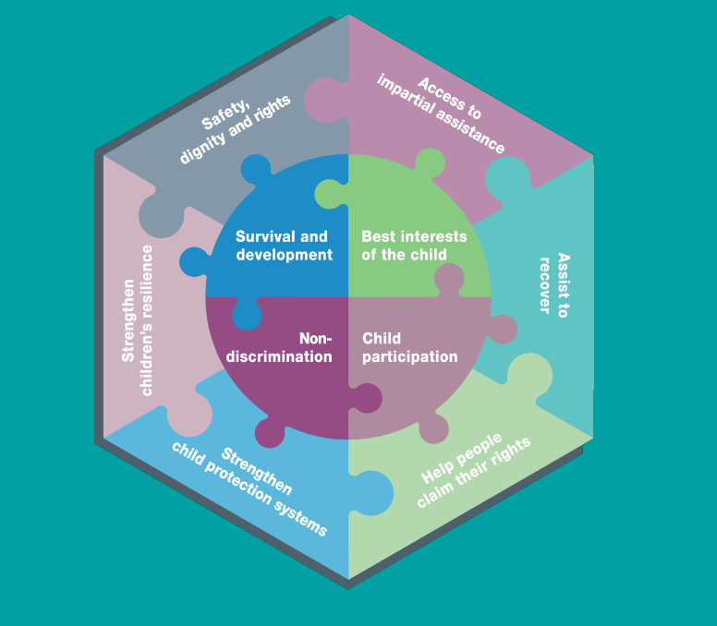
Guiding Principles
CPHA guiding principles
Notes:
Session 1.3: CPHA and Guiding Principles

Slide 11
CPHA and Guiding Principles
Reflective Practice
How is the UNCRC relevant to your own context?
What are the CPMS?
How are the CP guiding principles relevant to your context?
What is the child safeguarding reporting process in your own context?
Notes:
Session 1.3: CPHA and Guiding Principles

Slide 12
Child Development
Child development concerns:
Physical changes: body growth and maturation.
Cognitive changes: learning language, remembering facts, solving problems etc.
Emotional changes: learning to identify emotions in self and others.
Social changes: learning to interact with others and regulate our own behaviour.
Notes:
1.4 Connecting Child Development, Risk and Protective Factors and Socio Ecology

Slide 13
Activity instructions
Child development
In your group:
List examples of changes that occur in:
  Physical development
  Cognitive development
  Emotional development
  Social development
Notes:
Session 1.4 Connecting Child Development, Risk and Protective Factors and Socio Ecology

Slide 14
Child Development
Child Development stages
Infancy | Toddlerhood | Pre-school Children | Middle Childhood | Adolescence
0 – 12 months of age | 12 months to 3 years of age | 4 to 6 years of age | 7 to 12 years of age | 13 to 18 years of age
Notes:
Session 1.4 Connecting Child Development, Risk and Protective Factors and Socio Ecology

Slide 15
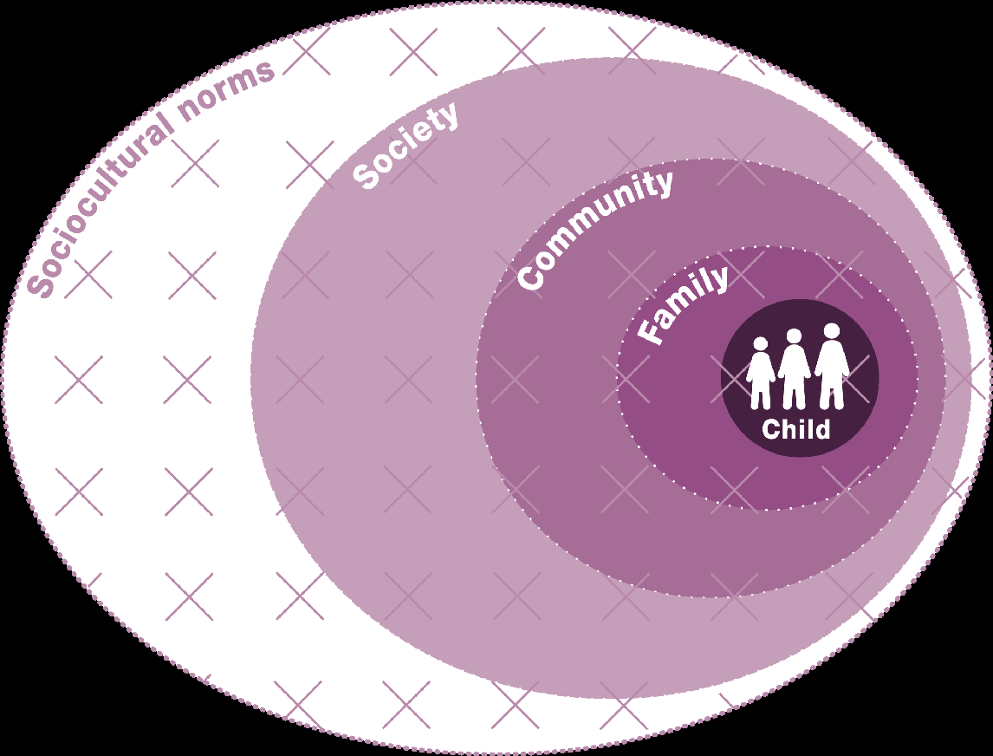
Socio-Ecological Model
Socio-Ecological Model
Notes:
Session 1.4 Connecting Child Development, Risk and Protective Factors and Socio Ecology

Slide 16
Risks and
Protective Factors
Reminder
Protective factors are those factors in children’s lives that enhance their healthy and positive development.
Risk factors are those factors in children’s lives that interfere with their development and make them more vulnerable
Activity! In your groups:
  Select a specific age group
  List and describe risk and protective factors for the selected age group
Notes:
Session 1.4 Connecting Child Development, Risk and Protective Factors and Socio Ecology

Slide 17
Reflective Practice
Connecting Child Development, Risk, Protective Factors and Socio-ecology
What more would you like to learn about children's developmental stages?
What can you do with what you have learnt about children's developmental stages?
What can you do with risk and protective factors and the socio-ecological model in your own work?
Notes:
Session 1.4 Connecting Child Development, Risk and Protective Factors and Socio Ecology

Slide 18
Prioritisation tool
Identify risk and protective factors
Score each factor for:
  impact
  feasibility
Plot the scores on the chart
Prioritise high impact high feasibility factors
Repeat for additional harmful outcomes to be prevented
Notes:
1.5 Risk and Protective Factors Prioritization Tool

Slide 19
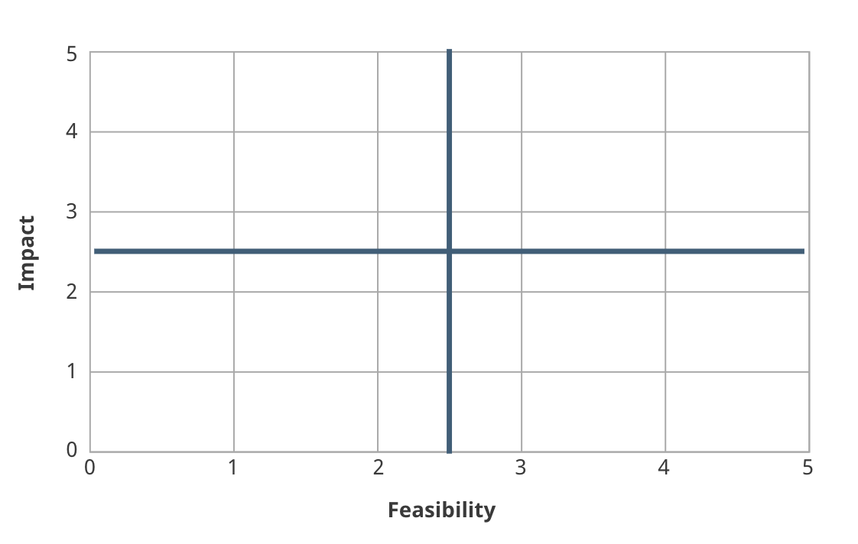
Access to secondary school
Food security
Positive relationship with caregiver
Poverty
Notes:
1.5 Risk and Protective Factors Prioritization Tool

Slide 20
Prioritisation Tool Group Work
In your groups (2 groups working on CAAFAG and 2 groups working on Child Marriage) follow the steps below:
    Convert the community’s ranking to scores for impact
    Score the factors for feasibility in the Cabo Delgado context
    Plot the combined scores on the blank chart
    Identify the priorities
20 min
Notes:
1.5 Risk and Protective Factors Prioritization Tool

Slide 21
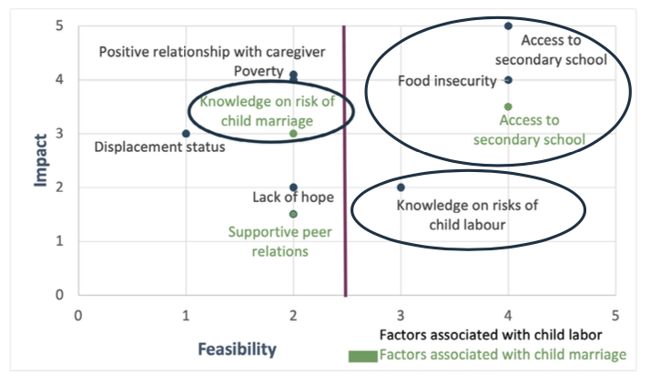
Notes:
1.5 Risk and Protective Factors Prioritization Tool

Slide 22
Reflective Practice
Do you think that the prioritisation tool might be useful in your context?
How do you plan to use the prioritisation tool?
Notes:
1.5 Risk and Protective Factors Prioritization Tool

Slide 23
CPMS Pillar 2
CP Risks
Standard 7: Dangers and injuries
Standard 8: Physical and emotional maltreatment
Standard 9: Sexual and gender-based violence (SGBV)
Standard 10: Mental health and psychosocial distress
Standard 11: Children associated with armed forces or armed groups
Standard 12: Child labour
Standard 13: Unaccompanied and separated children
Notes:
Session 1.6.: CP Risks Recap

Slide 24

CPMS Pillar 2
CPMS Risks Group Presentation
Prepare a 5 min presentation on key actions to prevent and respond to the assigned risk
15 minutes preparation time
!!!! Your presentation will be timed !!!!
Notes:
Session 1.6.: CP Risks Recap

Slide 25
CPMS Pillar 2
Reflective Practice
What made you curious during this session?
Is there a CP Risk you would like to learn more about?
Notes:
Session 1.6.: CP Risks Recap

Slide 26
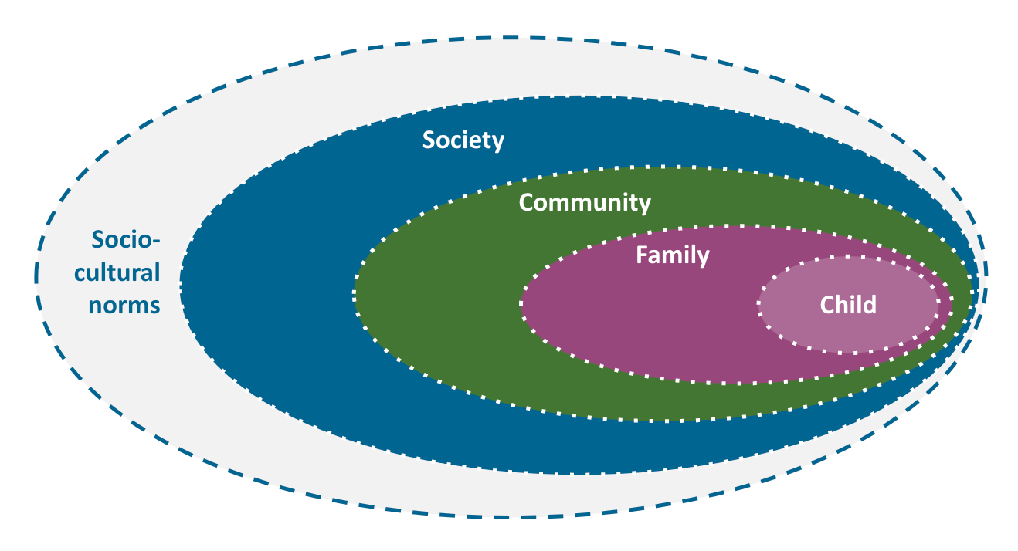
CPMS Pillar 3
CP interventions within the socio-ecological model - Activity
In your groups:
Draw the socio-ecological model
Discuss each card and decide where to place it on the model
15 min
Notes:
Session 1.7: Introduction to CP Prevention and Response Strategies

Slide 27
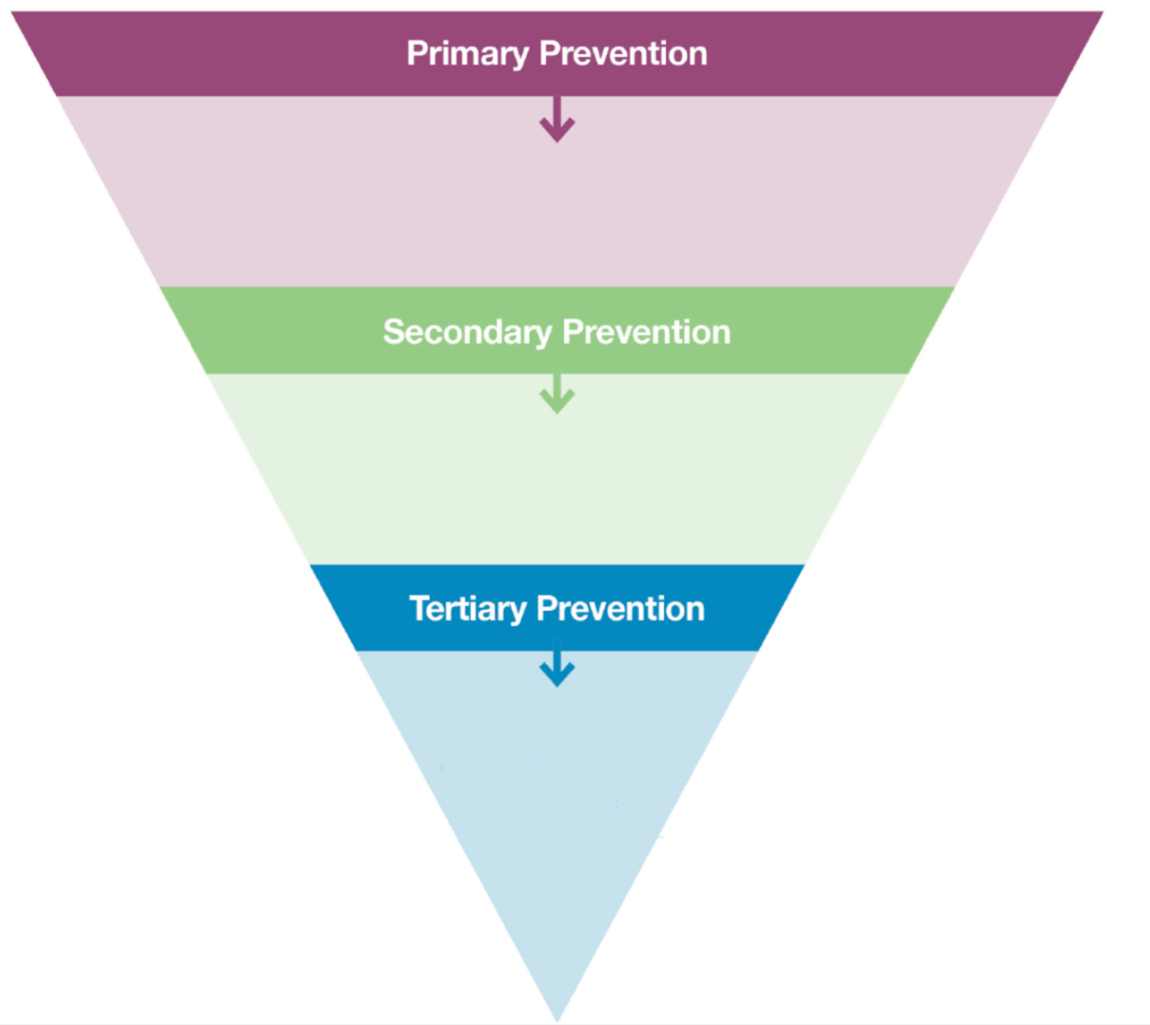
Prevention
Notes:
Session 1.7: Introduction to CP Prevention and Response Strategies

Slide 28
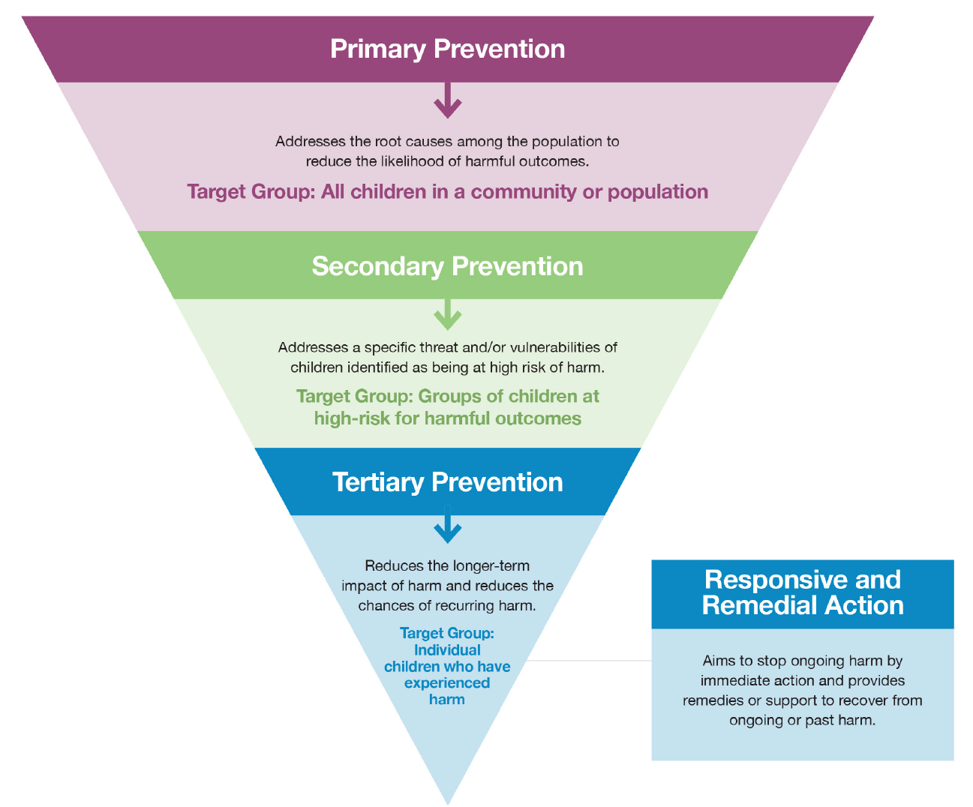
3 levels of Prevention
Notes:
Session 1.7: Introduction to CP Prevention and Response Strategies

Slide 29
Why Is Primary Prevention Important?
An ethical responsibility to prevent harm to children before it occurs whenever possible by all humanitarians
Improving the sustainability and long-term impact of humanitarian responses
Increased cost-effectiveness of child protection intervention
Notes:
Session 1.7: Introduction to CP Prevention and Response Strategies

Slide 30
Prevention, Response, Preparedness, Early action. What’s the difference?
Group work
Matching exercise
8 minutes
Notes:
Session 1.7: Introduction to CP Prevention and Response Strategies

Slide 31
Reflective Practice
What programmes are you implementing at the various levels of the socio-ecological model in your context?
How is CPHA prevention programming relevant to your context? And primary prevention more specifically?
Notes:
Session 1.7: Introduction to CP Prevention and Response Strategies

Slide 32
CPMS Pillar 3
CP Strategies – Group Activity
In your group:
Read the case study
Answer the questions:
  Which standard (15-20) is most relevant?
  What key actions are included/described?
  What other types of programming may be relevant to this standard?
Make notes on a flip chart
Notes:
Session 1.8 CP Prevention and Response Strategies

Slide 33
CPMS Pillar 3
Reflective Practice
What can you do now with what you have learnt about CP strategies?
What is the most important thing you have learnt today?
Notes:
Session 1.8 CP Prevention and Response Strategies

Slide 34
CPMS Pillar 1
Standards for a Quality Response
Coordination
Human resources
Communications and advocacy
Programme cycle management
Information management
Child protection monitoring.
Notes:
Session 1.9 Standard for a Quality Response

Slide 35
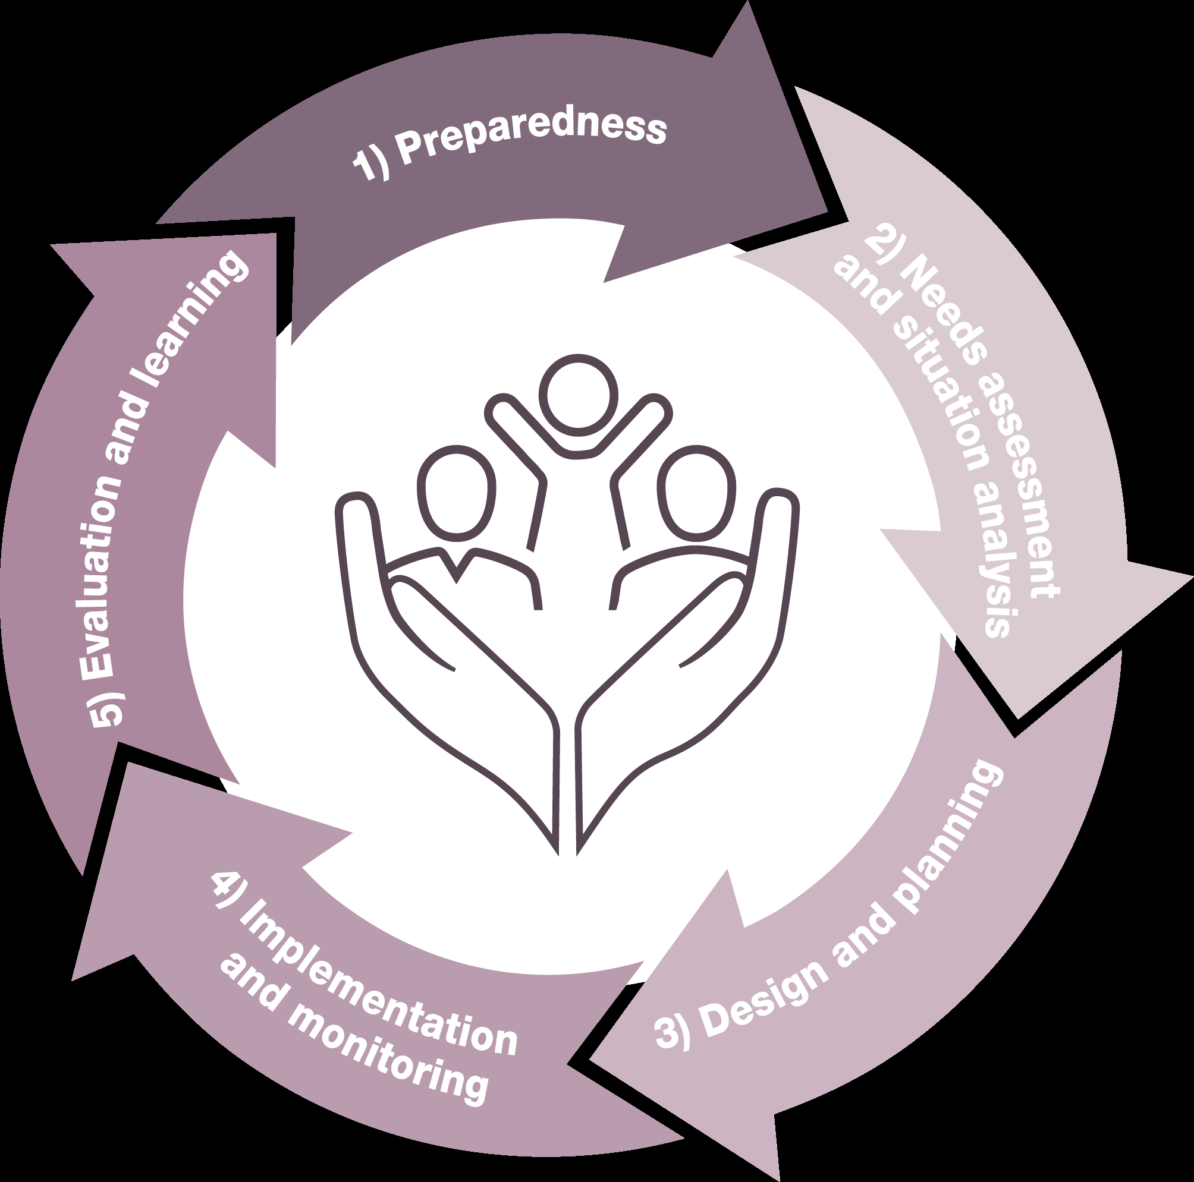
Programme Cycle Management Steps
Standard 4
Notes:
Session 1.9 Standard for a Quality Response

Slide 36
CPMS Pillar 1
Reflective Practice
What are the standards for quality CPHA?
Why is coordination paramount in CPHA?
What are the specific child protection considerations to make in programme cycle management?
Notes:
Session 1.9 Standard for a Quality Response

Slide 37
Standard 2 – Human Resources
Human Resource Management – Activity Instructions
In your group:
Discuss why HR Management is important for CPHA and a quality response
Draw pictures to illustrate your answers
15 min
Notes:
Session 1.10: HR for a Quality Response

Slide 38

CPHA Competency Framework
Quiz Time!
In your group:
Navigate through the CPHA competency framework to find the correct answer
Notes:
Session 1.10: HR for a Quality Response

Slide 39
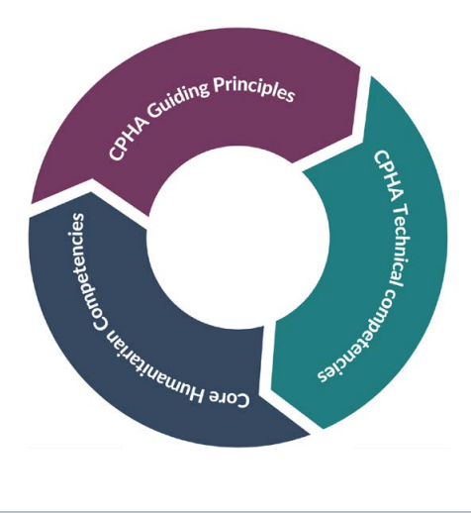
CPHA Competency Framework
CPHA Competency Framework Structure
Notes:
Session 1.10: HR for a Quality Response

Slide 40
Standard 2 – Human Resources
Reflective Practice
What can you do now with what you have learnt about Human Resources and Child Protection in Humanitarian Action?
Is there something that made you curious during this session?
Notes:
Session 1.10: HR for a Quality Response

Slide 41


Standard 3 Communication and Advocacy
Communications and Advocacy - Activity
In your group, make a list of do’s and don’ts for communication and advocacy in CPHA
Notes:
Session 1.11: Comms and Advocacy

Slide 42
Standard 3 Communication and Advocacy
Communication and Advocacy – Case study
- Keep in mind do’s and don’ts from previous exercise
- Pick one scenario
  What steps could you have taken to avoid this scenario?
  How will you address this scenario when/if it occurs?
  Take into consideration:
  Steps and action that could be taken at different stages of the process (including months ago)
  Play around with assumptions and create fictional realities
  Be creative and use your imagination
Notes:
Session 1.11: Comms and Advocacy

Slide 43
Standard 3 Communication and Advocacy
Reflective Practice
How do you use communication and advocacy in CPHA programmes in your context? Is there anything you would do differently?
Notes:
Session 1.11: Comms and Advocacy

Slide 44
Standard 5 and 6 Information Management and CP Monitoring
Information Management and CP Monitoring
Standard 5: Up-to-date information necessary for child protection action is collected, processed/analysed and shared according to international child protection principles and with full respect for confidentiality, data protection and information-sharing protocols.
Standard 6: Objective and timely data and information on child protection risks are collected, managed, analysed and used in a principled, safe and collaborative manner to enable evidence-informed prevention and response actions.
Notes:
Session 1.12: Information Management and CP Monitoring

Slide 45
Standard 5 and 6 Information Management and CP Monitoring
Information Needed in Child Protection
The emergency situation and coordination mechanisms
The overall response and the CP response
The situation of children in the given context
Information about specific children who are facing protection concerns
Notes:
Session 1.12: Information Management and CP Monitoring
Four broad categories of information need to be managed for child protection in humanitarian action (CPHA) - information about:
the emergency situation and coordination mechanisms,
the overall response and the CP response,
the situation of children in the given context, and
information about specific children who are facing protection concerns.
If, how and why information is shared needs to be carefully considered, and this standard provides guidance on this.

Slide 46
Activity instructions
Information Management
In your groups, brainstorm examples of information in each category:
The emergency situation and coordination mechanisms
The overall response and the CP response
The situation of children in the given context
Information about specific children who are facing protection concerns
Notes:
Session 1.12: Information Management and CP Monitoring

Slide 47

Activity instructions
Standard 5 and Standard 6
In your group, develop a radio advert, explaining:
What the standard means
Why it is important for a quality CP response
Top tips to implement the standard
Notes:
Session 1.12: Information Management and CP Monitoring

Slide 48
Activity instructions
Presenting Standard 5 and Standard 6
Listen to the radio adverts then let’s discuss:
What is this standard about?
What is the relevance of information management / CP monitoring for a quality response?
What tips did you hear?
Notes:
Session 1.12: Information Management and CP Monitoring

Slide 49
Activity instructions
Ethical considerations for data collection in Humanitarian settings
Match principles to their definition!
Notes:
Session 1.12: Information Management and CP Monitoring

Slide 50
Standard 5 and 6 Information Management and CP Monitoring
Reflective Practice
What have you learnt in this session?
What surprised you?
Notes:
Session 1.12: Information Management and CP Monitoring

Slide 51
Working Across Sectors – Pillar 4
Protection is recognised as the purpose and intended outcome of humanitarian action.
It must be at the centre of all humanitarian preparedness and response activities across sectors.
Why do all sectors have a role in supporting children’s protection and wellbeing?
Notes:
Session 1.13: Working Across Sectors

Slide 52
Protection mainstreaming
- The process of incorporating core humanitarian protection principles:
by promoting safety, dignity and access for all affected persons
and ensuring accountability to, and the participation and empowerment of, affected populations.
Notes:
Session 1.13: Working Across Sectors

Slide 53
Integrated approaches
Allows two or more sectors to work together to achieve a shared programme outcome(s).
Based on existing capacities and joint needs identification and analysis.
Notes:
Session 1.13: Working Across Sectors

Slide 54
Working Across Sectors – Pillar 4
Key Actions for ‘Working Across Sectors’ Activity
In your groups and referring to the assigned sector discuss the following questions:
What key actions are recommended for joint implementation by the CPMS for CP and this sector’s actors?
What key actions are recommended for CP actors to lead in working with this sector?
What competencies (beliefs and skills) does this sector need to carry out these actions effectively?
What successes have you witnessed or are you aware of?
What challenges do you predict? How could you mitigate these?
You have 25 min to prepare a 5 minute presentation.
Notes:
Session 1.13: Working Across Sectors

Slide 55
Working Across Sectors – Pillar 4
Reflective Practice
How is the centrality of protection important in your context?
What will you do to better cooperate with other sectors in your own context?
Notes:
Session 1.13: Working Across Sectors

Slide 56
‘Cross-cutting issues’ sessions

Slide 57
Accountability to Affected Populations
Commitment by humanitarians
Use power responsibly
Enable affected people
Build on pre-existing capacities
By:
  Sharing information
  Supporting participation and leadership
  Seeking and responding to feedback
Notes:
Session 2.1: Accountability to Affected Populations

Slide 58
Accountability to Affected Populations - Activity
In your groups read the case studies
Discuss the following questions for each of the case studies:
  Is the action described relevant to your context?
  Would you encounter challenges implementing this type of activity?
20 min
Notes:
Session 2.1: Accountability to Affected Populations

Slide 59
What does accountability to children look like in practice?
Regular, timely and accessible information sharing
Participation – discussing together, deciding together and working together with children
Proactively seeking feedback from children and handling their complaints
Monitoring, evaluating and learning: giving voice to children in our monitoring and evaluation exercises
Strengthening staff competencies for accountable programming
Notes:
Session 2.1: Accountability to Affected Populations

Slide 60
Reflective Practice
What can you do with what you have learnt today about accountability to children?
What is the most important thing you have learnt?
Notes:
Session 2.1: Accountability to Affected Populations

Slide 61
Adolescence
Characterised by:
rapid brain development and physical growth
enhanced cognitive ability
onset of puberty and sexual awareness
newly emerging abilities, strengths and skills
role in society
more significant peer relationships
transition from dependency to greater autonomy
Notes:
Session 2.2: Adolescents Programming

Slide 62
Activity instructions
Differentiated needs of youth and adolescents
In your group:
Discuss vulnerabilities and risks faced by the different age groups of adolescents and/ or youth in your own context
Make notes on a flip chart
Notes:
Session 2.2: Adolescents Programming

Slide 63
Activity instructions
Differentiated needs of youth and adolescents
In your group:
Discuss different ways to ensure young people’s participation in CPHA programming, across the 5 phases of the programme cycle
Notes:
Session 2.2: Adolescents Programming

Slide 64
Programmes for adolescents
Reflective Practice
What will you do differently for adolescents in your context after this session?
What surprised you today?
Notes:
Session 2.2: Adolescents Programming

Slide 65
Early Childhood Development
A period in a person’s life from conception to 8 years
A period of rapid and critical development, with 90% of a child's brain developed by the age of five
During this period quality nurturing care is vital for children’s physical, cognitive, linguistic and social-emotional development and to allow them to reach their full potential.
Notes:
Session 2.3: ECD

Slide 66
Principles to improve outcomes for children
Support responsive relationships
Strengthen core skills
Reduce sources of stress
Notes:
Session 2.3: ECD

Slide 67
ECD Programming Group Work
In your groups read case study
Discuss: What were the key ECD considerations and activities in the programmes described?
Present to plenary after 15 min
Notes:
Session 2.3: ECD

Slide 68
Reflective Practice
How is early childhood development relevant to child protection in humanitarian action programming? And in your context?
Are there any actions you will take as a consequence of what you have learnt?
Notes:
Session 2.3: ECD

Slide 69
Cash and Voucher Assistance
CVA refers to all programmes where cash transfers or vouchers for goods or services are directly provided to recipients. Modalities of Cash and Voucher Assistance include:
    - Cash Transfers
    - Vouchers
    - In-Kind
    - Service Delivery
Notes:
Session 2.4: Cash and Voucher Assistance

Slide 70
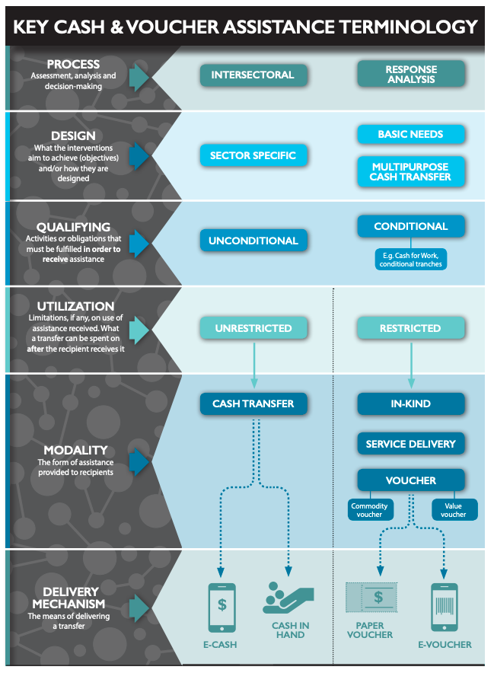
Cash and Voucher Assistance
Notes:
Session 2.4: Cash and Voucher Assistance

Slide 71
Activity instructions
Direct and indirect outcomes for child protection
In your groups:
Read the case studies
Agree which have a direct impact on CP outcomes and which have an indirect impact
15 min
Notes:
Session 2.4: Cash and Voucher Assistance

Slide 72
Cash and Voucher Assistance
Conditional and unconditional cash transfers
Unconditional transfers are provided to beneficiaries without the recipient having to do anything in order to receive the assistance.
A conditional transfer requires beneficiaries to undertake a specific action/activity (e.g. attending school, building a shelter, attending nutrition screenings, undertaking work, trainings etc.) in order to receive assistance
Notes:
Session 2.4: Cash and Voucher Assistance

Slide 73
Activity instructions
Conditional and unconditional cash transfers
In your groups, discuss:
the pros and cons of a conditional and unconditional cash transfer approach in CPHA
how cash transfer programming is or may be used to improve protection outcomes for children in your context
10 min
Notes:
Session 2.4: Cash and Voucher Assistance

Slide 74
Why is a CP and Safeguarding assessment important?
Cash and Voucher Assistance
Child protection risks: programming that uses CVA should take into account the challenges and risks that families and children face and whether gender, age, status or other personal characteristics may increase any CVA-associated risks.
Child safeguarding issues: As with all humanitarian interventions, all actors need to identify the possibility of humanitarian staff creating safeguarding risks for children and families.
Possible risk mitigation strategies: The information gathered can help programme teams to design programmes that proactively mitigate child protection risks and maximise protection benefits.
Notes:
Session 2.4: Cash and Voucher Assistance

Slide 75
Cash and Voucher Assistance
Reflective Practice
How is Cash and Voucher Assistance relevant to child protection outcomes?
What is the most important thing you have learnt in this session?
Notes:
Session 2.4: Cash and Voucher Assistance

Slide 76
Disability
Activity Instructions
In your groups:
List specific actions that CPHA actors could take to prevent and respond to CP risks to the child on their card
15 min
Notes:
Session 2.5: Disability

Slide 77
Disability
Essential Actions To Disability-Inclusive Child Protection
In your groups:
Read key actions
Sort them into the relevant step of the programme’s management cycle
15 min
Notes:
Session 2.5: Disability

Slide 78
Disability
Reflective Practice
What can you do for disabled children in your own contexts and programmes? Are there any gaps that you have become aware of?
Is there something you would like to learn more about?
Notes:
Session 2.5: Disability

Slide 79
Environmental Considerations
How the environment impacts children – Activity Instructions
On your own:
Walk around and look at the images
Think about the question:
What impact do the different environments have on children?
Notes:
Session 2.6: Environmental Considerations

Slide 80
Environmental Considerations
How humanitarian action impacts the environment
In your group, use the image and scenario and discuss:
What are the potential risks to the environment?
What mitigating measures could we put in place?
15 min
Notes:
Session 2.6: Environmental Considerations

Slide 81
Environmental Considerations
Reflective Practice
How are environmental crises impacting children in your context?
What can you do with what you have learnt today?
Notes:
Session 2.6: Environmental Considerations

Slide 82
Gender
Relevance of gender to CPHA - Activity
Divide your paper into 4
Listen to each story
Draw the child being described in one section of your page
Notes:
Session 2.7: Gender

Slide 83
Gender
CPHA programming should:
Be sensitive to the root causes of gender discrimination and inequality
Avoid reinforcing or continuing gendered power relations
Support gender equality whenever possible.
Notes:
Session 2.7: Gender

Slide 84
Activity instructions
Current challenges in our own work
In your pairs, discuss:
Current challenges in integrating gender inclusion into your work
What obstacles do you face?
What is complex or difficult?
Make a note of the challenges and choose your most important challenge
Notes:
Session 2.7: Gender

Slide 85
Gender
Opportunities for gender-sensitive CPHA interventions
One participant will be the ‘client’ and read their top challenge to the plenary.
Each remaining participant will respond with one sentence. This can be:
A suggested action
A question to further the client’s thinking
A source of further support or a resource
The client listens and notes down anything useful.
Notes:
Session 2.7: Gender

Slide 86
Gender
Reflective Practice
What can you do with what you have learnt today about gender in your own CPHA programmes?
What is the most important thing you have learnt?
Notes:
Session 2.7: Gender

