Slide 1
LOS CINCO PASOS DE LA PROGRAMACIÓN DE LA PREVENCIÓN

Slide 2
¿Cuáles son los pasos del ciclo de gestión del programa?

Slide 3
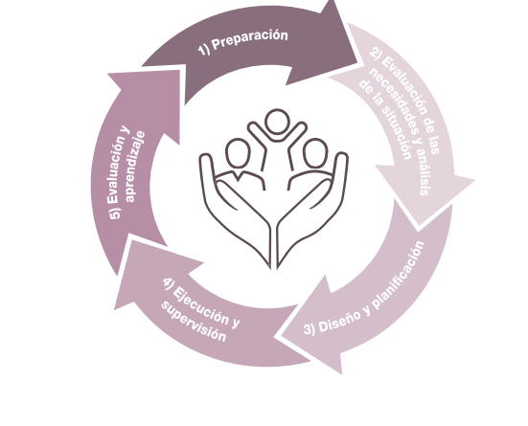
¿Cuáles son los pasos del ciclo de gestión del programa?

Slide 4
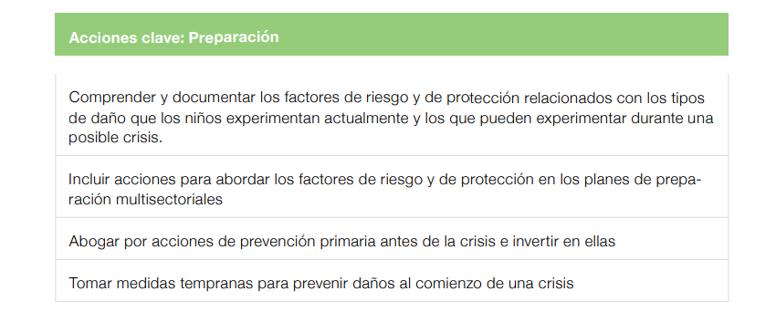
Paso 1
Preparación
Notes:
Emergency preparedness is the activities and measures taken before a crisis to ensure a rapid and
effective response.

Slide 5
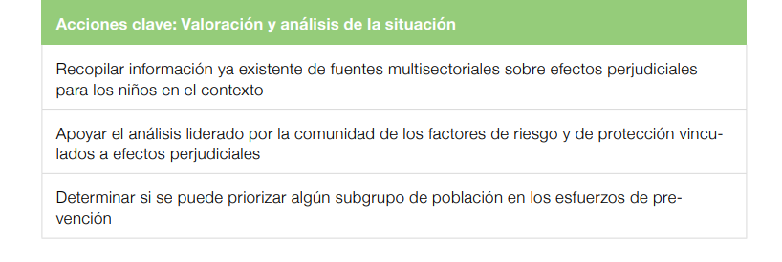
Paso 2
Valoración y análisis de la situación
Notes:
A primary prevention approach is based on a comprehensive analysis of the risk and protective
factors that impact whether children experience harmful outcomes. It goes beyond the question
of “What are the harmful outcomes to children occurring in this context?” (e.g., child marriage,
violence in schools, recruitment in armed forces, family separation). Prevention programming also
needs to know:
• “What are the risk factors leading to harmful outcomes for children?” and
• “What are the protective factors that can prevent children from experiencing harmful outcomes?”17

Slide 6
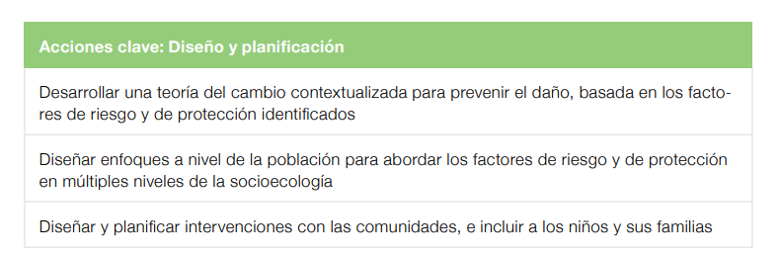
Paso 3
Diseño y planificación

Slide 7
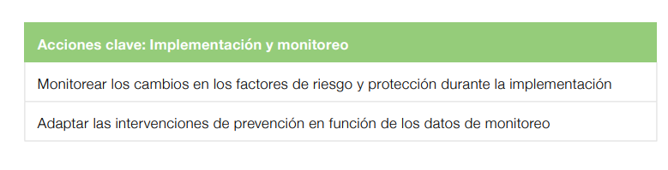
Paso 4
Implementación y monitoreo

Slide 8
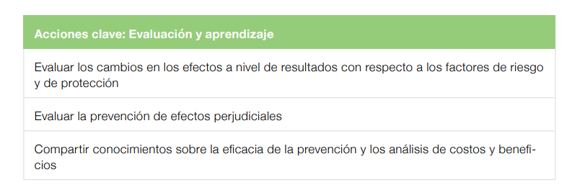
Paso 5
Evaluación y aprendizaje

Slide 9
Próximos pasos

Slide 10




Setting: 1 | Setting: 2 | Setting:3

