Slide 1



CPHA Competency Framework Training
Location, Country
XX-XX 20XX

Slide 2
Learning Outcomes
By the end of the session, you will be able to:
Explain the structure and purpose of the CPHA Competency Framework
Demonstrate how to use the CPHA Competency Framework to design a job description
Describe how to develop a competency-based interview using the CPHA Competency Framework
Describe how to use the CPHA Competency Framework as a tool for their own professional development evaluation and planning
Describe how to use the CPHA Competency Framework as a manager to conduct performance reviews.

Slide 3
Purpose
Contributes to improved child protection outcomes in humanitarian settings
Builds on CP Minimum Standards
Expected standards of performance
Sector-wide guidance
Notes:
The purpose of the Child Protection in Humanitarian Action (CPHA) Competency Framework is to contribute to improved child protection outcomes in humanitarian settings by providing an inter-agency set of technical and behavioural competencies required by CPHA practitioners.
The Child Protection in Humanitarian Action Competency Framework builds on the Minimum Standards for Child Protection in Humanitarian Action (CPMS) to articulate a set of recognised competencies for child protection in humanitarian action practitioners. It broadly describes expected standards of performance across a number of competency domains that can be applied to different roles within the sector.
It is a sector-wide guidance to advance the accountability, effectiveness and predictability of child protection prevention, preparedness, response and recovery programming for affected populations.

Slide 4
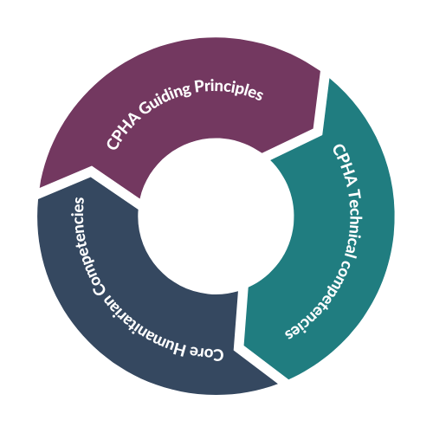
Structure
Notes:
Effective CPHA practitioners are expected to demonstrate competence in three main areas:
CPHA guiding principles competence
Technical CPHA competence
Core Humanitarian competence

Slide 5
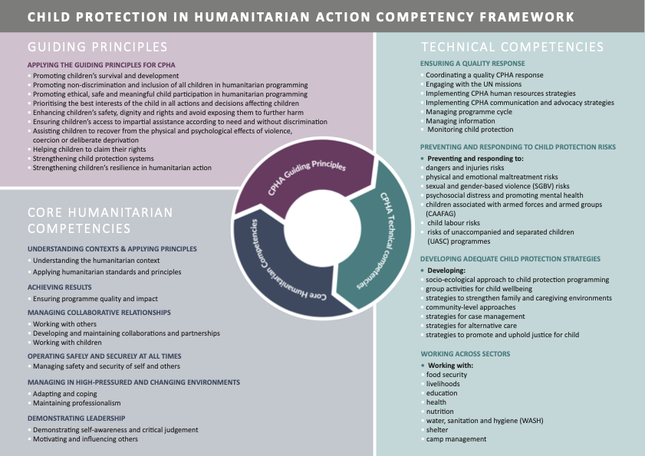
Notes:
The CPHA Competency Framework therefore comprises three main sections:
10 CPHA Guiding Principles competencies
4 Technical CPHA competency domains, with 29 technical competencies
5 Core humanitarian competency domains, with 11 core humanitarian competencies.
The CPHA competency framework groups competencies into competency domains, and sub-divides competencies into indicative behaviours. Definitions of these terms can be found in the box below.
A competency domain is a set of related competencies around a common area or thematic focus.
A competency is a measurable set of knowledge, skills or attributes required to effectively perform a task.
DIFFERENCE BETWEEN technical & core humanitarian competencies:
Technical competencies look at the technical knowledge, skills and experience in a specific sector
Core Humanitarian competencies are the overarching sets of behavior, how we manage our work and ourselves declined specifically for humanitarian professionals and in our annex for CPHA profe

Slide 6
Indicators
Behavioral indicators describes what effective performance looks like and provides an observable means of demonstrating competence at a given level.
Behavioral indicators are listed at 3 levels:
Level 1: implementation, or limited experience
Level 2 management, or some experience
Level 3: leading, or significant experience
Notes:
A behavioural indicator describes what effective performance looks like and provides an observable means of demonstrating competence at a given level.
Level 1 describes individuals predominantly involved in the implementation of child protection in humanitarian action activities, or those with limited experience in the relevant competency domain
Level 2 describes individuals predominantly involved management of child protection in humanitarian action activities, or those with some experience in the relevant competency domain
Level 3 describes those predominantly involved in leading child protection in humanitarian action programmes and strategic thinking, or individuals with significant experience in the relevant competency domain.

Slide 7
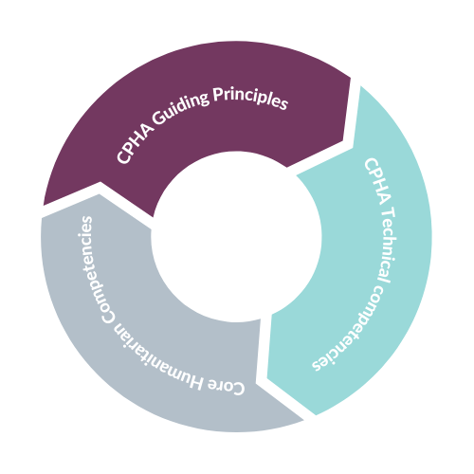
Guiding Principles
Describe expected behaviours that should be employed to role model the guiding principles that are essential to fully implementing child protection in humanitarian action programming.
Notes:
describe expected behaviours that should be employed to role model the guiding principles that are essential to fully implementing child protection in humanitarian action programming.

Slide 8
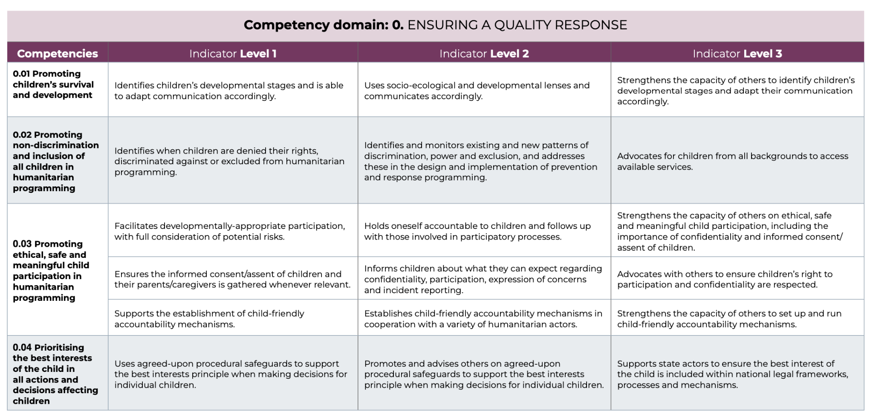
Notes:
For trainer: Go through this example and read through a couple of those indicators at the different levels and explain how they show the different levels of seniority and how they build on each other

Slide 9
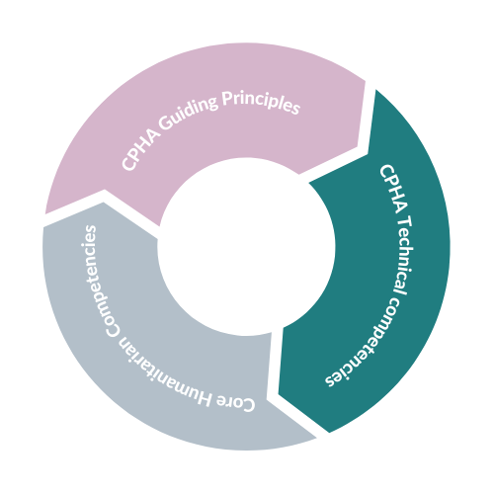
Technical Competencies
TECHNICAL COMPETENCIES:
A measurable set of knowledge, skills or attributes, and learned expertise in a specific technical area of child protection required to effectively perform a task.
COMPETENCY DOMAIN:
A set of related competencies around a common area or thematic focus. The CPHA competency domains align with the four pillars of the Child Protection in Humanitarian Action Minimum Standards
Notes:
Technical competencies are a measurable set of knowledge, skills or attributes, and learned expertise in a specific technical area of child protection required to effectively perform a task.
They are aligned with the revised 2019 version of the Minimum Standards for Child Protection in Humanitarian Action (CPMS)
A competency domain is a set of related competencies around a common area or thematic focus. The CPHA competency domains are defined across the principles and the four pillars of the Child Protection in Humanitarian Action Minimum Standards
Knowledge areas and skills that are listed with each competency are indicative only. They may be adapted to be more specific to the implementation context.

Slide 10
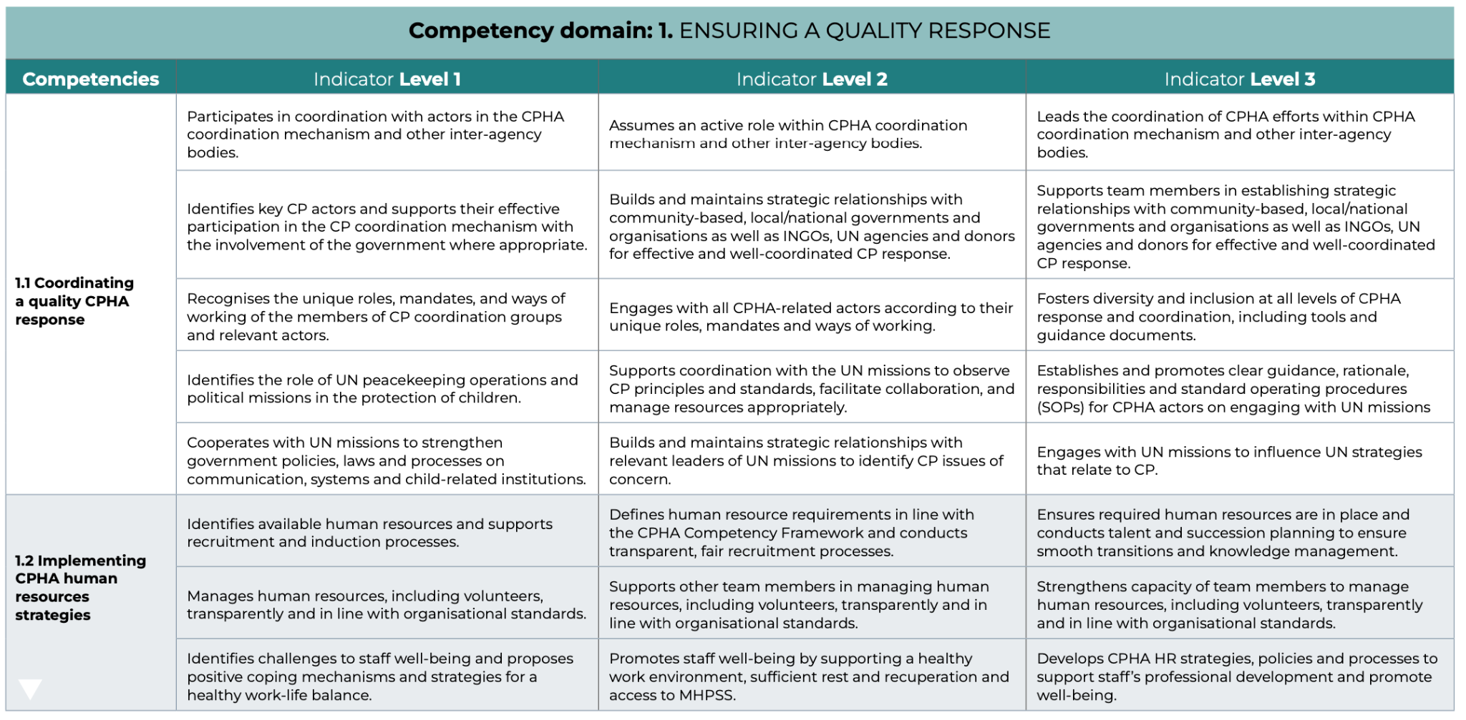
Notes:
For trainer: Go through this example and read through a couple of those indicators at the different levels and explain how they show the different levels of seniority and how they build on each other
Note that: It is important to note that given the breadth of the CPHA sector, no individual practitioner would be expected to demonstrate every technical competence listed in the framework. While all practitioners should demonstrate core humanitarian competence and competence in role modelling the guiding principles for CPHA, relevant technical competency domains and competencies should be identified based on role and context, and/or professional development priorities. With experience and career progression, as colleagues take on posts with increasing responsibility, they will be expected to begin to demonstrate behaviours at level 2 and level 3 in addition to the level 1 behaviours, but only for the technical competency domains that are relevant to their area of work.

Slide 11
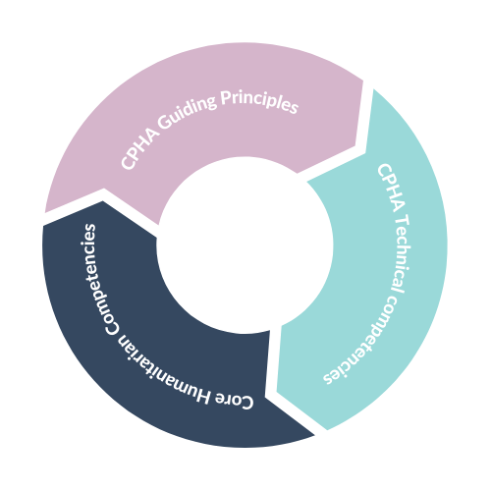
Core Humanitarian Competencies
Describe the core behaviours that child protection practitioners need to demonstrate to operate effectively in humanitarian settings.
These are adapted from the Core Humanitarian Competency Framework and identify child protection specific behaviours.
Notes:
describe the core behaviours that child protection practitioners need to demonstrate to operate effectively in humanitarian settings. These are adapted from the Core Humanitarian Competency Framework and identify child protection specific behaviours.

Slide 12
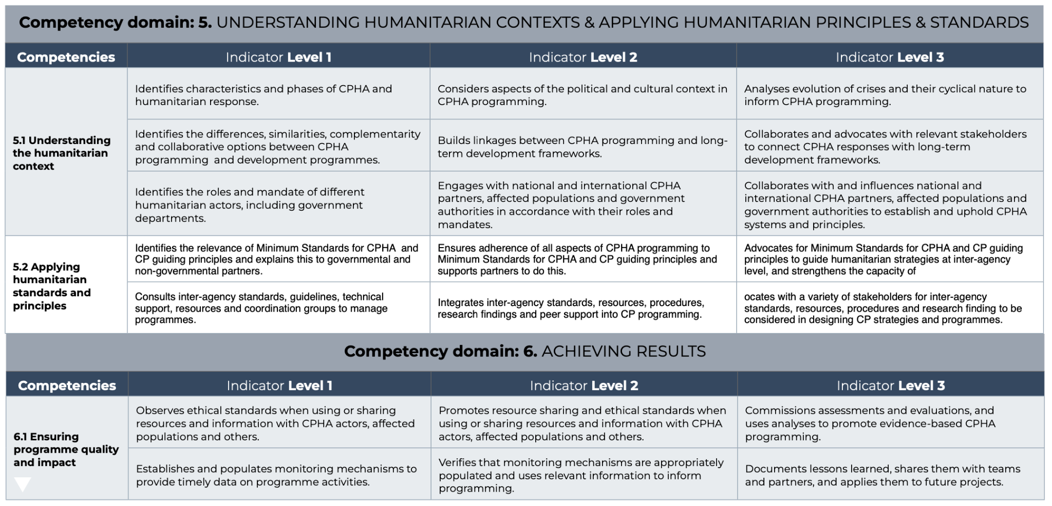
Notes:
For trainer: Go through this example and read through a couple of those indicators at the different levels and explain how they show the different levels of seniority and how they build on each other

Slide 13




Who can use the CF?
Individuals
Coordination groups
Organisations
Training and learning providers
Notes:
Individuals who work in the CPHA sector, or who aspire to do so, can use the framework to:
Reflect on their own capacities in order to identify strengths and areas for development.
Identify future career and development aspirations.
Organisations who employ child protection staff and/or volunteers can use the framework to:
Map CPHA capacity in order to identify strengths, gaps and priority areas for recruitment or development.
Inform planning and organisational design.
Recruit competent staff, through the development of competency-based job descriptions and selection processes.
Conduct performance management that is structured and aligned to an agreed set of standards.
Identify continued professional development steps for staff and teams.
Coordination groups can use the framework to:
Assess capacity strengths and gaps across a response.
Define priority areas for capacity strengthening, and inform capacity strengthening plans.
Training and learning providers can use the framework to:
Conduct targeted learning needs assessments.
Inform the design of learning programmes and products to support CPHA practitioners at all levels.

Slide 14
Use
01
02
03.1
03.2
Job description
Interview preparation
CPHA Practitioner self-evaluation
CPHA Manager performance evaluation of practitioner
+ Conversations with JPO Alumni
+ Mission, Programmes and Structure
+ Global Innovation
+ Humanitarian Action
+ OPSCEN
+ PARMO & PFP
+ JPO Timeline & PD Plan
+ The KAI Tool
+ The Art of Networking
+ UNICEF Values
+ Bridging Cultures & Generations
+ Performance Mgmt
+ Well Being
+ Phase I: Challenge
+ Phase II: Discovery
+ Phase III: Synthesis
+ Phase IV: Ideation
Tool & Guidance 1:
CPHA CF job description
Tool & Guidance 2:
CPHA CF interview planning
Tool & Guidance 3:
CPHA CF Performance evaluation
Tool & Guidance 3:
CPHA CF Performance evaluation
Notes:
Say: there are 3 accompanying tools to the CPHA Competency Framework (distribute if in a face to face meeting) and these are:
CPHA CF job description;
CPHA CF interview preparation;
CPHA CF performance evaluation: 3.1 Practitioner self-evaluation; and 3.2 Manager performance evaluation of practitioner

Slide 15
Tool 1 – Job Description CF Overview Template
01
Job description
Technical competencies
Competency Domain | Competency | Indicator | Level
Competency Domain | Competency 1 | Indicator 1 | 1
 |  | Indicator 2 | 2
 |  | Indicator 3 | 2
 |  | Indicator 4 | 2
 | Competency 2 | Indicator 1 | 3
 |  | Indicator 2 | 3
 |  | Indicator 3 | 3
 |  | Indicator 4 | 3
 |  | Indicator 5 | 3
 | Competency 3 | Indicator 1 | 1
 |  | Indicator 2 | 1
 |  | Indicator 3 | 1
Core Humanitarian competencies
Competency Domain | Competency | Indicator | Level
 | Competency 1 | Indicator 1 | 2
 |  | Indicator 2 | 2
 |  | Indicator 3 | 2
 |  | Indicator 4 | 2
 | Competency 2 | Indicator 1 | 3
 |  | Indicator 2 | 3
 |  | Indicator 3 | 3
 |  | Indicator 4 | 3
 |  | Indicator 5 | 3
ACTIVITY:
Take your own position
Follow the steps in the guidance document
Fill technical and core humanitarian competencies for own role
+ Conversations with JPO Alumni
+ Mission, Programmes and Structure
+ Global Innovation
+ Humanitarian Action
+ OPSCEN
+ PARMO & PFP
Tool & Guidance 1:
CPHA CF job description overview template
+ Phase I: Challenge
+ Phase II: Discovery
+ Phase III: Synthesis
+ Phase IV: Ideation
Notes:
Depending on the organization you work for job description templates can vary in their structure. Generally, required competencies are referred to as ‘job responsibilities’, ‘role requirements’ and ‘qualifications’.
The competency overview template is not shown in a job description but is the structured basis in the background in which you select competency domains, competencies, and indicators after you have defined the purpose and the scope of the role iand spelled out and the level of seniority and reporting line. The filled template then informs the content of the job description/ terms of reference. Very simple in it’s structure it also provides a set of questions to help you think through the necessary competencies for a role.
Present the various section of the first tool.
Start with the first exercise as an individual exercise where each participant uses their own job (with or without job description/ ToR) to write down, technical and core humanitarian competencies using tool # 1 template. Explain that we will not go as far as writing the full job description but they have a fully completed example within the tool.
Template can be provided via email to fill on computers if available during the session or printed to be filled in handwriting.
Participants will have 20 minutes to work on this individually with close support from the facilitator in case there are doubts.
After the 20 minutes have elapsed the facilitator can ask audience whether the template was easy to fill and ask if they had outstanding questions in plenary.
Facilitator will remind participants that the work they have done on tool # 1 will be built upon in the second exercise.

Slide 16
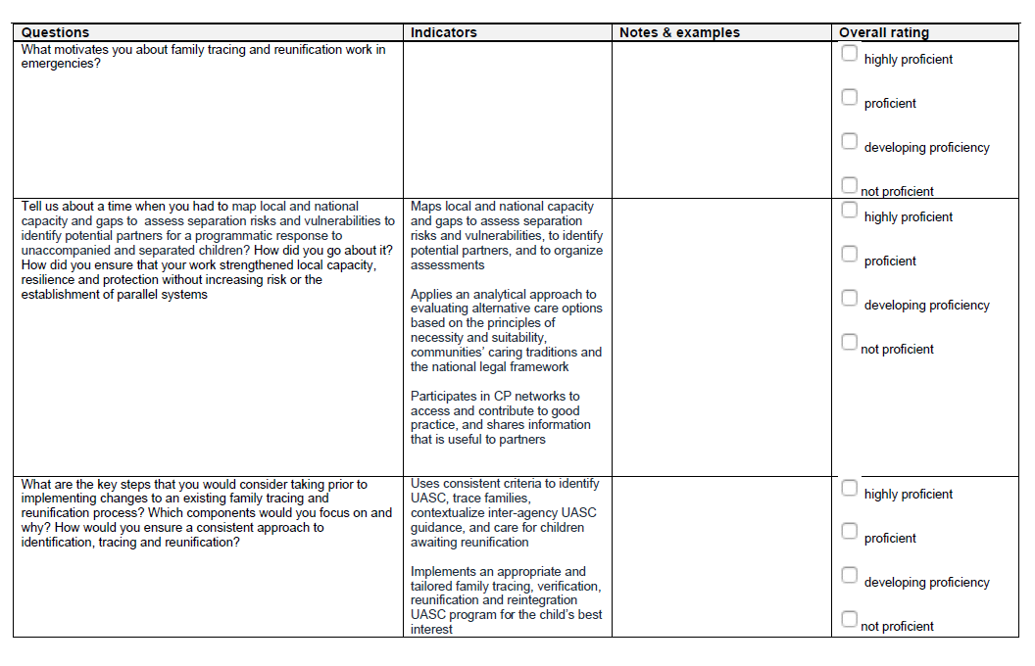
Tool 2 – Interview Planning
02
Interview Planning
Tool & Guidance 2:
CPHA CF interview rating grid
+ Phase I: Challenge
+ Phase II: Discovery
+ Phase III: Synthesis
+ Phase IV: Ideation
Notes:
This guidance is meant to help you take a competency-based assessment approach to interviewing, that is linked to the competencies selected for the job description/ terms of reference (as highlighted in the Job Description Competency Overview template).
All the interview questions should be based on technical and core humanitarian competencies that were identified in the job description for the specific role, and which are adapted from the CPHA Competency Framework.
For the interview rating grid the most basic format is to have the questions linked to indicators against which technical and core humanitarian competencies are evaluated. The grid format provides space to take notes and afterwards to rate the competency proficiency.

Slide 17
Tool 2 – Type of Questions
02
Interview planning
Motivational Questions
Technical Questions
Strength Based Questions
Contextualized Questions
Situational Scenario Questions
Tool & Guidance 2:
CPHA CF Interview rating grid
+ Phase I: Challenge
+ Phase II: Discovery
+ Phase III: Synthesis
+ Phase IV: Ideation
Notes:
One of the benefits of asking a motivational question is that it allows the candidate to share their passion, motivation, skills, experience and knowledge, which is relevant to the job position and about an area that they love and enjoy working in. This gives a positive and easy start into the interview.
Sample question: “What motivates you about family tracing and reunification work in emergencies?”
Technical questions go to the heart of the matter. They try to understand the technical knowledge, skills and experience of the candidate in a very specific and detailed way to assess the level of expertise of the subject matter.
Sample question: “ What are the key steps that you would consider taking prior to implementing changes to an existing family tracing and reunification process? Which components would you focus on and why? How would you ensure a consistent approach to identification, tracing and reunification”
Strength-based questions focus on the candidate’s strength and enable the candidate to display her/ his individual strong points and showcase any particular expertise, positive behaviors, impact, and achievements that make her/ him especially suitable for the position.
Sample question: “What do you feel are your key strengths in your current role and how are they relevant
for this position when establishing safe, ethical, confidential and accessible monitoring and communication channels for child protection programming?”
Contextualized questions are supposed to give a flavour of candidate past behavior and performance to understand what to expect from future behavior and performance of a candidate.
Sample question: “Tell us about a time when you had to map local and national capacity and gaps to assess separation risks and vulnerabilities to identify potential partners to start a programmatic response specific to unaccompanied and separated children risks”
Situational scenario questions usually try to uncover and assess the candidate’s ability to handle a given situation or issue and creativity to apply her/ his knowledge, skills and experiencein a complex context and the ability to make decisions and perform under pressure.
Sample question: “You just received a call from government social workers noting that a group of 10 unaccompanied children have just arrived in the nearest refugee camp and that there are not sufficient host families to cater for them. What steps would you consider taking?

Slide 18
Tool 2 – Type of Questions
02
Interview planning
ACTIVITY:
In groups of 2s and/or 3s
Choose a job description overview template from 1st exercise
Develop questions suited to explore competencies and indicators using different type of questions. Fill the interview rating grid.
20 minutes
Present back to plenary
Tool & Guidance 2:
CPHA CF Interview rating grid
+ Phase I: Challenge
+ Phase II: Discovery
+ Phase III: Synthesis
+ Phase IV: Ideation
Notes:
Group participants in groups of 2s or 3s
Provide Interview Grid Template (printed or in soft copy)
Ask participants to choose one job description, preferably one from the previous exercise that was well populated.
Ask participants to develop questions suited for the selected competencies and indicators using different type of questions and fill the interview rating grid. Allow 20 minutes for group work
Back in plenary ask each group to present one question they have drafted, say the type of question it is and to which indicator/competency it was related

Slide 19
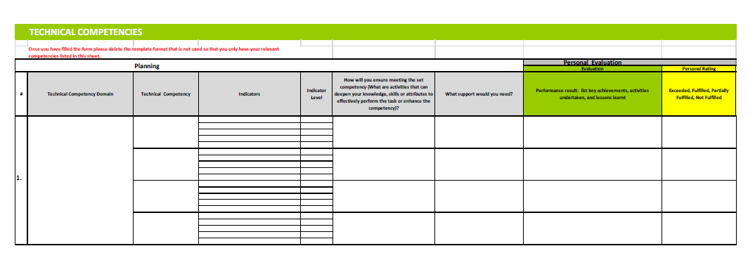
Tool 3 – Practitioner self-evaluation
03
CPHA Practitioner self-evaluation
PRACTICAL ACTIVITY:
Work individually
Follow the steps in the guidance document (on sheet 1)
Fill out: competency evaluation sheet 2 building on the identified competencies from the job description competency overview template
Tool & Guidance 3:
CPHA CF Performance evaluation
Notes:
Say: Practitioner and Manager Performance evaluation tool supports practitioners in different ways:
1 – Firstly it helps in undertaking a self-evaluation on their competencies in regard to the position they are occupying
2 – Secondly, it can support the process of professional performance evaluation of practitioners and help guide the discussion between them and their managers
3 – Thirdly, this tool can also be used as a basis to define learning and development needs and opportunities for the practitioner
Go through the excel file and how it is built by either showing it sharing your screen or handing print outs. Remind everyone that sheet 1 has all the instructions in case you need to go back to them.
Ask participants to work individually for 20 minutes. Each participant uses their own job and the tool filled in the first exercise to complete their own self evaluation.
Ask if they have any questions

Slide 20
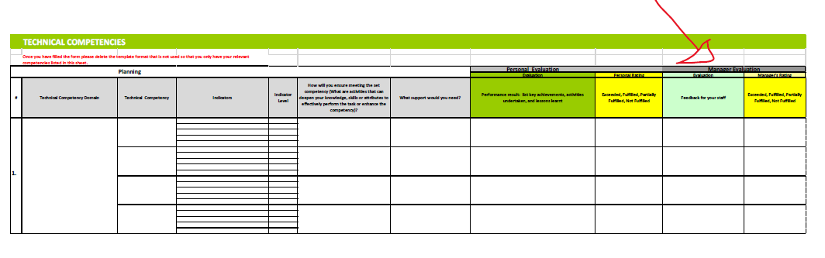
Tool 3 – Manager evaluation of practitioner
03
CPHA Manager staff performance evaluation
Tool & Guidance 3:
CPHA CF Manager staff performance evaluation
Notes:
Say: you can use the filled form to validate and discuss your self-evaluation with your manager and if you are a manager you can ask the colleague you are supervising to fill in the self-evaluation part before moving into filling the second part of the sheet which is dedicated to managers. Show the relevant section on the excel sheet.
Explain the recap sheet.
Ask again if there any outstanding questions
Thank everyone for participation (evaluation)

Slide 21
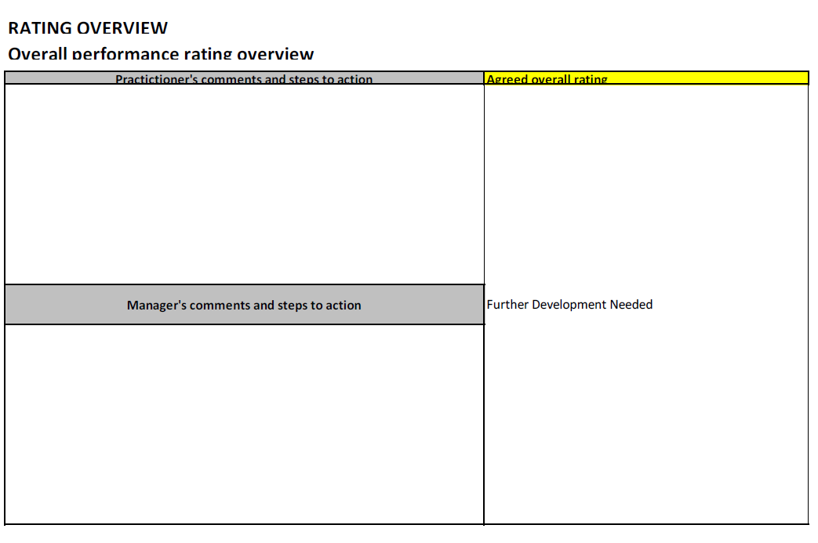
Tool 3 – Rating overview
03
CPHA Manager staff performance evaluation
Tool & Guidance 3:
CPHA CF Manager staff performance evaluation
Notes:
Explain the recap sheet.
Ask again if there any outstanding questions
Thank everyone for participation (evaluation)

