Slide 1
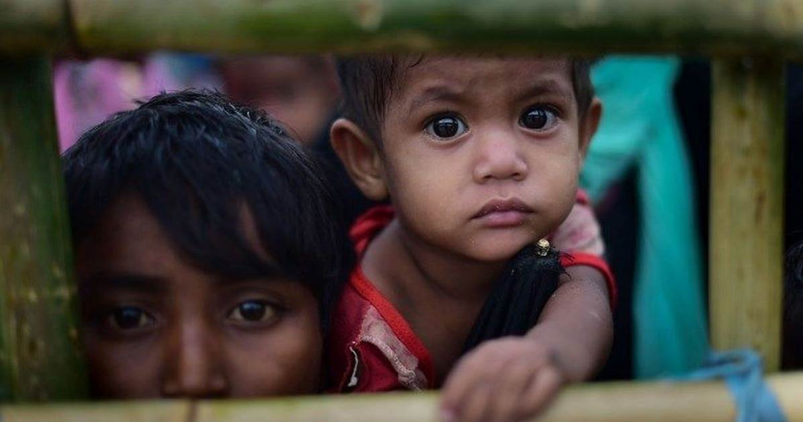

UASC TOT
Module 4.4 – Reintegration and Follow Up
By the end of the session participants will be able to:
Describe reintegration of UASC
Describe the importance of follow-up after reunification
Compare the roles and responsibility of stakeholders after reunification
Create a plan for strengthening local capacity

Slide 2
What might have changed?
Severe poverty in the family/location
Conflict in the area
Death of a family member (especially if main carer)
Re-marriage of a parent
Prejudice/discrimination as a result of experience during separation
Lack of access to education, employment, and basic health services (that children accessed in their displacement location)
The child/young person e.g. used to independence
Notes:
Do not provide the answers to participants, ask them to come up with them themselves, use slide for a recap at the end of the discussion.

Slide 3

Activity 1: Follow Up
You have 15 mins to complete the following activity with your partner.
Brainstorm what factors would necessitate prioritisaton of follow up for children who have been reunified?
Consider:
The child’s relationship with his/her family and community
The existing assets, relationships, and resources available to the family and the level of services in the community to support and protect children and families.
Circumstances of the child related to his/her separation
Circumstances into which the child will return, including the amount of possible preparation

Slide 4
Who is responsible for UASC after they have been reunified?
Children become the responsibility of the family and community.
Involve local authorities and other organisations concerned with the protection of children;
Promote ownership by the local community;
Develop local capacity through involving key community members in the design, implementation and evaluation of follow up programmes and providing training, mentoring and other support.

Slide 5

Follow up preferably through local child welfare systems or community structures
Feeds into an effective case and information management system,
Is linked with and adheres to national statutory processes where they exist,
Incorporates clear referral pathways (e.g. for psychosocial support, legal aid)
Ensures the capacity exists to supervise, support and review the work practices of those carrying out follow up
Has clear criteria for closing cases.

Slide 6
What do we mean by follow up?
Follow up refers to a range of activities for children and their families to facilitate their reunification – elements likely to include:
Monitoring the quality of care arrangements;
Providing emotional and/or practical support to a child
Working with the child/family regarding one of the specific issues identified during preparation for reunification;
Long term specialised, culturally appropriate responses may need to be identified for some children;
Facilitating referrals to the relevant services or programmes

Slide 7

Activity 2 – Identifying Stakeholders and their Capacity
In your groups, look at pgs. 267 - 270 of the Handbook and highlight the key points for each aspect related to reintegration:
Who has responsibility for follow up after reunification?
What role does strengthening local capacity play in supporting reintegration?
What elements need to be included in follow up after reunification?
What is the role of families and communities after reunification?
After 15 mins come back to plenary and go through the 4 questions with the group.

