Slide 1
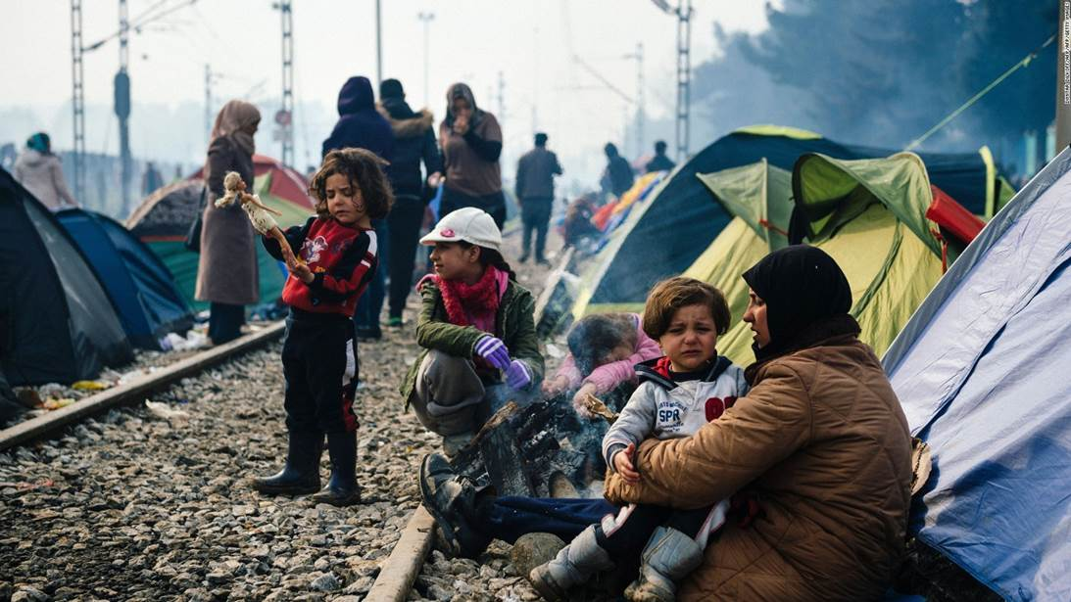

UASC TOT
Module 4.3 - Reunification
By the end of the session participants will be able to:
Describe the principle of best interests.
Explain how to use assessment forms to assess if reunification is in the child’s best interests
Describe the steps for preparing a child and their community for reunification

Slide 2
Reunification
Even in clear cut circumstances, reunification is a major step for the child and their family and the decision on whether or not children should be reunited following successful tracing should be taken by senior level staff only when:
The verification process has been completed and is positive
The living conditions the child will be returning to have been assessed
The child, child’s current carer/s or guardian and family member/s with whom the child will be reunited are all in agreement that reunification is in the child’s best interests
The local authorities and community leaders have been informed and are in agreement(where relevant). Any special necessary ritual is prepared for.
The security situation has been assessed and it is safe to go ahead with reunification

Slide 3
Steps in family reunification
Reunification is usually understood to be the process of bringing together the child and family or previous caregiver for the purpose of establishing or re-establishing long term care.
Preparation phase
Carrying out the reunification (child, family, community)
Follow up and monitoring
Reunification can be easier or more difficult partially due to the time period of separation.
A reunification plan should be agreed with clear timelines and stakeholders.

Slide 4

Activity 1: Preparing for Reunification
Use your copy of Handout Case Studies from Module 3.5 - Verification.
In your group, take 20 mins to brainstorm the following questions:
  What are the issues in preparing the that stakeholder?
  What strategies could be used?
  How will we do the actual reunification?
Be ready to deliver a 3-minute overview on how to prepare their stakeholder/s for reunification.
After 20 mins each group to present their overview in plenary.

Slide 5
If the decision is NOT to reunify the family (after determining the best interests of the child in the case and following national legal requirements), then a clear decision should be taken, where possible according to national legislation.
Children’s participation would be key in such a decision and a formal BID process would be required for refugee UASC and in the absence of national legal procedures.
The alternative care option should be clearly defined, monitored and contact between the child and their family should be maintained where appropriate.

Slide 6

Activity 2 – Plenary Discussion
The Child’s Story
Review the story and identify:
Where there was need for proper verification and how this could have been done.
What measures needed to be taken for proper preparation and
reunification

