Slide 1
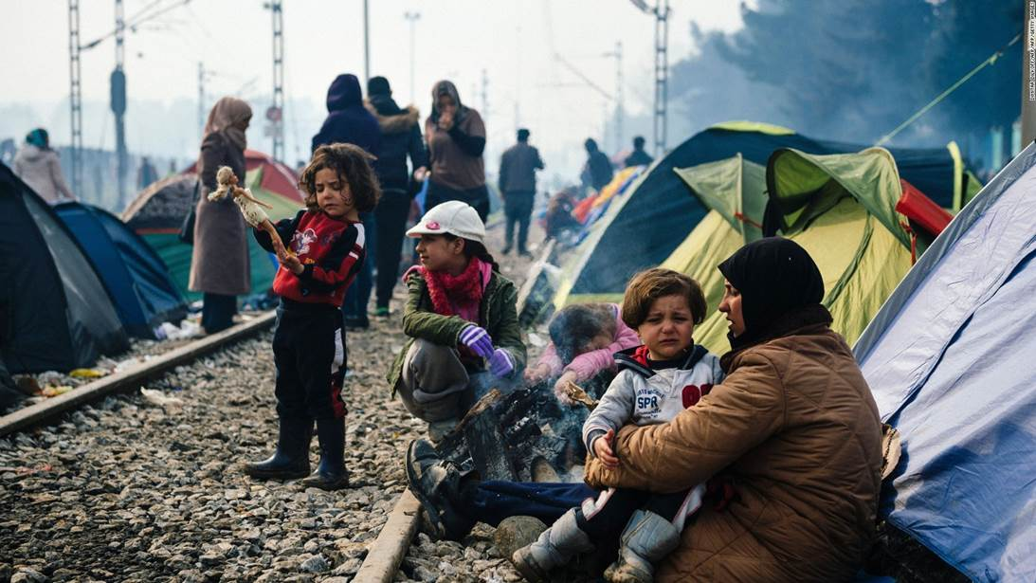

UASC TOT
Module 3.5 – Verification for Family Reunification
By the end of the session participants will be able to:
Describe the role of verification for family reunification
Explain key steps in conducting verification

Slide 2
Introducing Verification
Verification is the process of establishing the validity of relationships and confirming the willingness of the child and the family member to be reunited.
There are two elements to verification:
Validating family ties,
Assessing whether reunification is in the best interests of the child

Slide 3
VALIDATING FAMILY TIES
Children, especially infants, very young children or those unable to communicate effectively, can be handed over to the wrong person.
This could be a genuine mistake, from a desire to replace a lost child by parents whose own children are dead or missing, or to use a child for labour or exploit in other ways.
In conflict or post conflict situations, a child could be claimed for malicious reasons such as to take revenge on a family or remove a witness to killings.

Slide 4
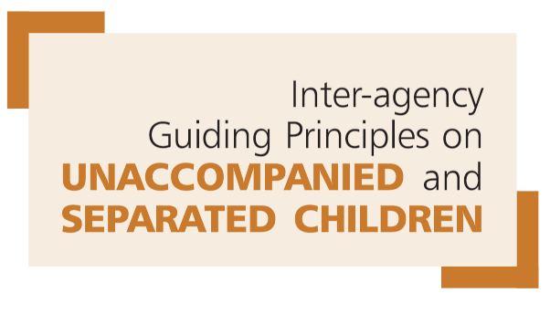
ASSESSING WHETHER REUNIFICATION IS IN THE BEST INTERESTS OF THE CHILD:
“when tracing is successful, an assessment should verify that family reunification is in the best interests of the child. In cases where there are serious concerns, it may be necessary to involve the appropriate authorities, existing welfare systems, other agencies and local communities for any further action or future support required.”

Slide 5
INFORMATION FOR DECISION MAKING
Is reunification in the best interests of this particular girl or boy?
Highlights any problems which need to be addressed during the preparation period before reunification takes place.
The process should consider the views of the child and the family members, confirm that both parties are willing to go ahead and assess the conditions and circumstances the child will be reunited into. Legal guardian should also be involved and heard in the process.

Slide 6

Activity 1 - How do we do verification?
Take 15 mins to read your Case Study and use the Verification Forms, including the Child Under 5 form, to answer these questions:
1. What questions would you need to ask to do verification? Think back to the work on Module 8 on documentation and also use the Verification Sample Forms as a guide. We are looking for the different specific questions that you would ask, to which person and ideas as to why you selected that question.
2. How will you double check the data? What methods will you use? Here we are looking for detail on any particular concerns you have and the types of data you want to double check and why.
3. What steps should you take? You need to work out who you need to talk to, who needs to be informed, who you should also bring into the process etc.
4. What decision would you make? You need to say what you think your final decision would (probably) be and what the key reasons were for that decision.

Slide 7
Verification with Infants, Young Children, and Children with Difficulty in Communicating
Adult claimants should be requested to:
Pick the child’s photo out of a number of photos.
Describe the child
Describe the clothing, jewellery or objects the child was wearing or carrying at the time of separation.
Recall the place where the child was left and how the separation occurred.
Identify any words or phrases the child knew before the separation
Name locations or places the child knew at the time of separation.
Whenever possible, ask the relatives’ neighbours for corroboration of claims.
Also ask them to recall any information they know about the place and date of separation between the claimant and the child.

Slide 8
When further assessment is required (I)
What was the reason for separation – in the case of voluntary separation have the original issues been resolved?
Is there a history of relationship problems in the family prior to separation, in particular neglect of the child, violence or abuse?
Have there been significant changes in the family since separation, for example death or illness/disability of family member/s?
Are the family willing to provide care for the child/is the child willing to return to the family?
If the family have concerns about reunification are these related to lack of material resources or financial capacity to care for another family member? Or are they concerned about the way the child will fit in, related to behavioural, social or emotional issues?

Slide 9
When further assessment is required (II)
What concerns does the child have about reunification and what can be done to address these? Are there specific impacts resulting from his or her experiences since separation for example association with armed forces or armed groups or GBV.
Does the child require health care beyond that which is normally available in the community to which he or she will return, or would the conditions make it difficult to provide optimal care?
Is there any hostility to returning children in the community to which he or she will return, what is the situation of the family within the community and how much social support do they have?
Is there continuing insecurity in the home area, is this likely to place the returning child at risk, how much does this affect the day-to-day life of the family?

Slide 10
Verification/Assessment for Refugee UASC
Family reunification should be the priority for refugee UASC whether:
in the country of asylum
in the country of origin, through voluntary repatriation
in a third country.
As a minimum, a Best Interests Assessment (BIA) should be conducted to assess whether reunification is indeed in the best interests of the child. In some exceptional circumstances, a Best Interests Determination (BID) is required prior to family reunification.

