Slide 1
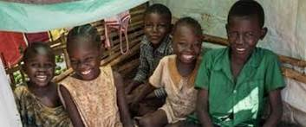

UASC TOT
Module 3.4 – Family Tracing
By the end of the session participants will be able to:
Describe spontaneous, informal, and formal family tracing methods
Explain best practice in family tracing and cross border tracing

Slide 2
Definition of Family Tracing?
Tracing, in the case of children, is the process of searching for family members or primary legal or customary care-givers.
The aim of tracing is to find a long-term family- based care solution that is “in the best interests of the child”.
Reunification with parents or other close relatives, although other durable solutions may be identified depending on the wishes of the child and their best interest.
The term also refers to the search for children whose parents are looking for them.

Slide 3
Spontaneous Tracing
To support existing tracing practices:
Ensure regular communication (and referrals, where needed) with community leaders undertaking spontaneous tracing.
Ask community leaders and clan elders to be focal points for community- based tracing.
Connect communities or children with resources to facilitate tracing
Work closely with communities, where possible, to ensure complementary methods, avoid parallel processes of family tracing and make linkages between formal and informal methods.
Notes:
Spontaneous tracing comprises many instances of family tracing and reunification
Organizations should support existing tracing practices where they do not pose a risk to UASC. To support existing tracing practices:
Ensure regular communication (and referrals, where needed) with community leaders undertaking spontaneous tracing.
Ask community leaders and clan elders to be focal points for community- based tracing, so that they can support inquiries into the whereabouts of relatives from those communities or clans.
Connecting communities or children with resources to facilitate tracing – for example, by providing a phone or phone credit to a child or community focal point who can help make or receive calls for children and their families
Organisations should work closely with communities, where possible, to ensure complementary methods, avoid parallel processes of family tracing and make linkages between formal and informal methods.

Slide 4
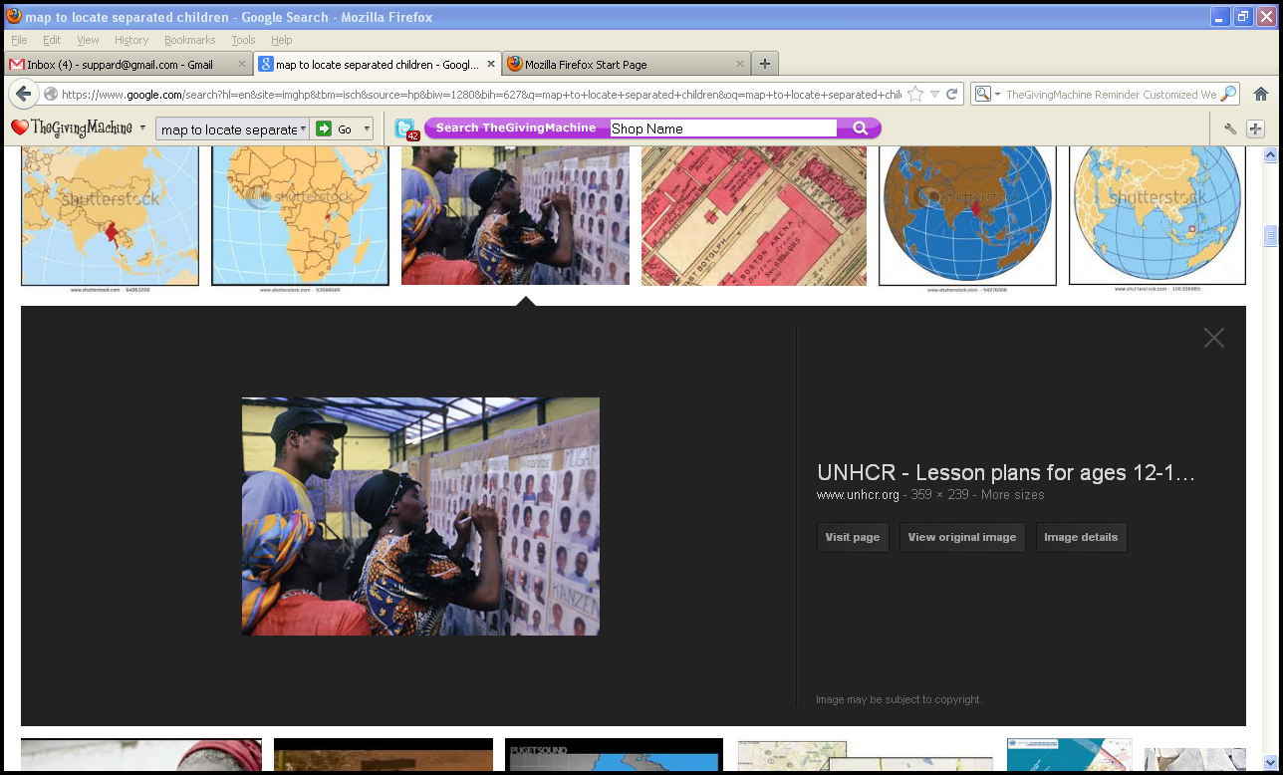
Formal Methods of Tracing
Think about the Formal Method of Tracing your group has been allocated.
Refer to pg. 230 of the Handbook Ch 11.2.
Summarise the method and analyse:
    Who the tracing method includes and excludes?
    How resource intensive the method is?
    What are the safeguarding risks?
    Any pros and cons?
Write your answers on flip charts and display them and at the end of the session for a gallery walk during the break.

Slide 5
Activity 1 - Good Practice Using Case Study
Your group has either Activity 1 - Case Study 1 or Activity 1 - Case Study 2.
Using your Case Study, you will answer either questions 1 and 2 or 3 and 4.
  1. What steps would you take before you begin tracing to ensure good practice, maximise the likelihood of a positive outcome, and minimise any additional risk to the child?
  2. What methods of tracing do you think would be suitable and why? How would you minimise the risk of any further harm throughout the process?
  3. What additional information would be helpful and how could you obtain this? Are there any limiting factors, if so what could you do about those?
  4. When should tracing be discontinued and how should that decision be made?
Take 10 minutes and then reconvene in plenary to present your answers.

Slide 6
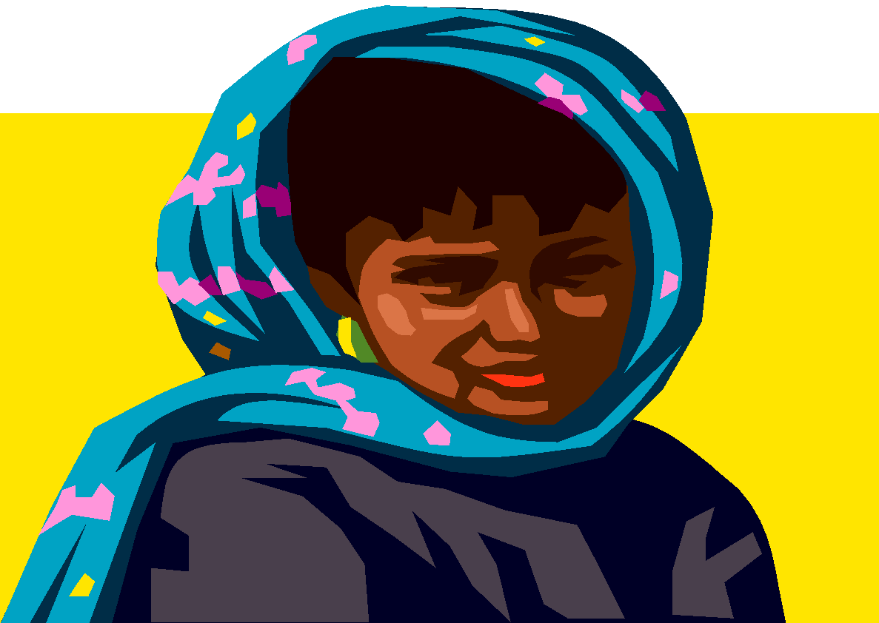

Cross Border Tracing
The ICRC and the National Red Cross and Red Crescent Societies have a mandate to trace across international borders. Non-governmental agencies and any other implementing partners should therefore coordinate all cross-border tracing with these organisations, and work through UNHCR in the case of refugees.
(IAGP UASC, 2004)

Slide 7
Activity 2 – Cross Border Tracing Components
Use the cards given to match cross border tracing programme components with relevant indicators/activities.
10 mins

