Slide 1


UASC TOT
Module 3.2 – BIA, BID, and Information Management
By the end of the session participants will be able to:
Describe the purpose of Best Interests Assessment (BIA) and Best Interests Determination (BID) and their use in case management for UASC
Describe in simple terms key principles and components of information sharing protocols

Slide 2



IM4CM
What constitutes Information Management 4 Case Management?
4 components
Forms for documenting individual cases;
Data Protection Impact Assessment (DPIA)
Data protection and Information-sharing and data protection Protocol (DPISP)
Information management system

Slide 3

IM4CM in the CPMS
Internal Systems
Standard 5: Information management (p. 89) “Up-to-date information necessary for child protection action is collected, processed/analysed and shared according to international child protection principles and with full respect for confidentiality, data protection and information-sharing protocols.”
Standard 18: Case management (p. 197) “Children and families who face child protection concerns in humanitarian settings are identified and have their needs addressed through an individualized case management process, including direct one-on-one support and connections to relevant service providers.”

Slide 4
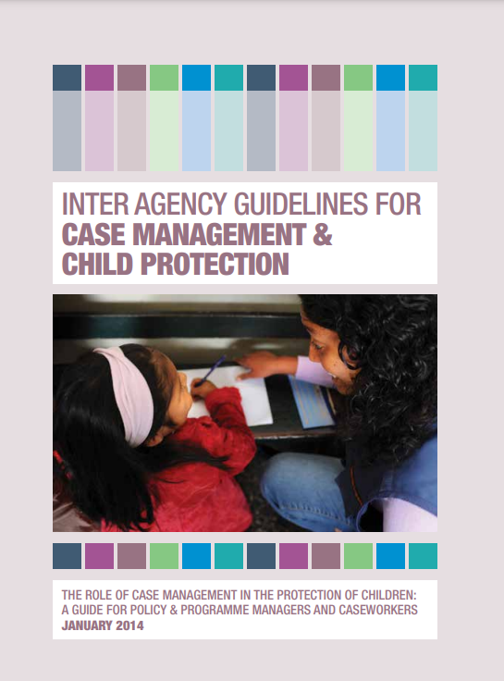
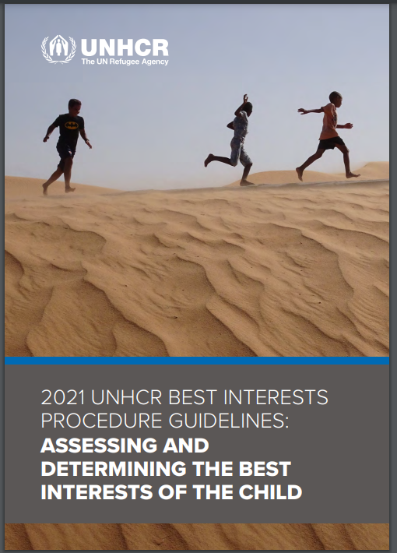
The Inter-agency Guidelines for Case Management and Child Protection highlight that after it is decided that case management is an appropriate approach to addressing child protection risks and vulnerabilities then it is imperative to set up a “safe and confidential system for collecting, storing and sharing information”
The UNHCR Best Interests Procedure Guidelines highlight that “safe and ethical collection, storage, sharing and analysis of information on children during the best interest procedure can enhance the response for individual children as well as child protection programming more broadly
IM4CM

Slide 5
Information 4 Case Management Tools
Informed by the development of context-specific case management procedures
Should be used to support and formalize inter-agency data protection and information-sharing standards and practices
Roll-out of DPIA and development of DPISP is usually led by the child protection coordination body in the country
DPIA and DPISP
DPIA should be conducted as soon as the need and scope of humanitarian case management is confirmed within a maximum of three months
Contextualization of DPISP to be initiated as soon as possible, for signature within a maximum timeframe of three months

Slide 6

Activity 2 – Summarise Key Components of an ISP
Work individually.
Use Tool XX– Global DPISP Template.
Take 10 mins to identify and summarise in their notes the key components of a DPISP

Slide 7
UNHCR
Best Interests Procedure
UNHCR BIP is used where:
There are cases of refugee UASC who are to be resettled, repatriated, or reunified across country borders.
There are issues of accessibility in implementing the national case management procedure or a national case management procedure is not available.
BIP is required by certain governments in relation to resettlement and ensuring the exercise of free and informed choice in cases of voluntary repatriation.

Slide 8
Best Interests Procedure
An appropriate BIP:
Promotes adequate child participation without discrimination;
Gives due weight to the views of the child in accordance with age and maturity;
Involves persons with relevant expertise in decision-making;
Balances all relevant factors to assess the best option; and
Fulfils all the child’s rights.

Slide 9
Activity 1 – Using the BIA and BID Report Forms
In your groups:
Read – Sample Best Interests Assessment Form, UNHCR
Read – Best Interest Determination Report Form, UNHCR
Answer the following questions:
  What is the form you have been assigned?
  What is the purpose
  When do you think is the form used and how?
Take 10 mins

Slide 10
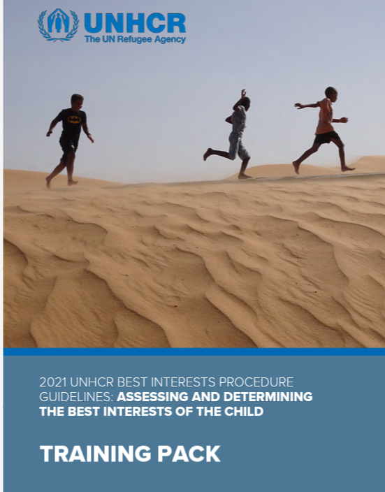
UNHCR Training Resources on BIP
  2021 UNHCR Best Interest Procedure Guidelines: Assessing and Determining the Best Interest of the Child
  Forms at this link https://www.unhcr.org/what-we-do/reports-and-publications/handbooks-and-toolkits/bip-toolbox/forms

