Slide 1
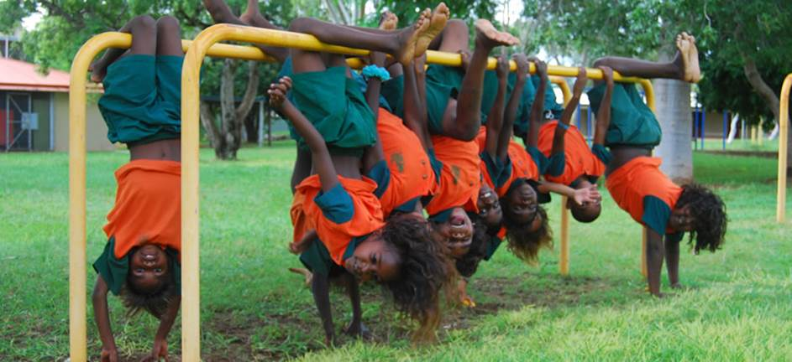

UASC TOT
Module 2.3 – Planning for UASC
By the end of the session participants will be able to:
Describe priority actions in emergency response to UASC
Explain the importance of prioritising actions using a triage system

Slide 2
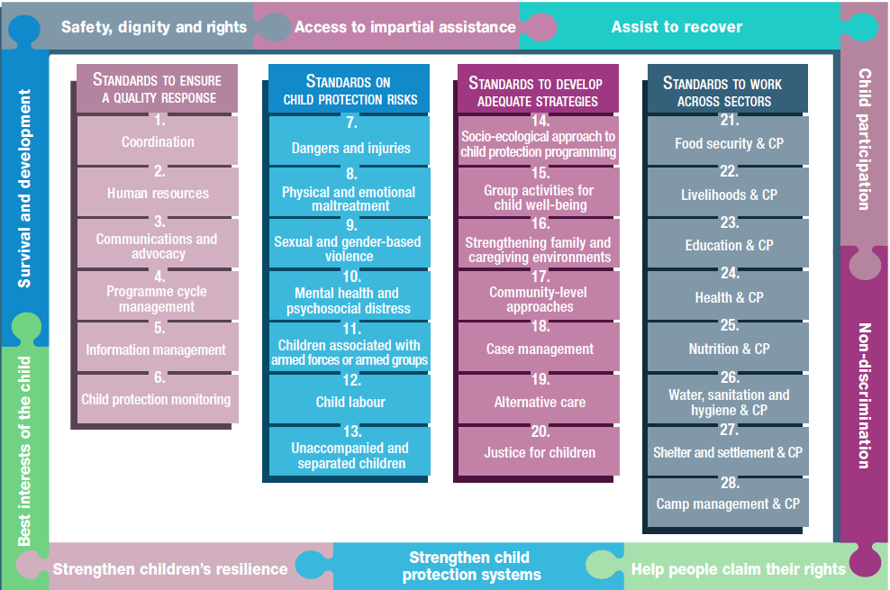
Standard 13
Notes:
This is an overview of the CPMS structure: there are 28 Standards across 4 pillars and 10 CPHA principles threaded throughout.
You can find this overview on the back of the CPMS handbook or in the online handbook; it’s a practical way of locating quickly a specific topic.
Standard 13: Unaccompanied & Separated children is in Pillar 2 “Child Protection Risks”

Slide 3




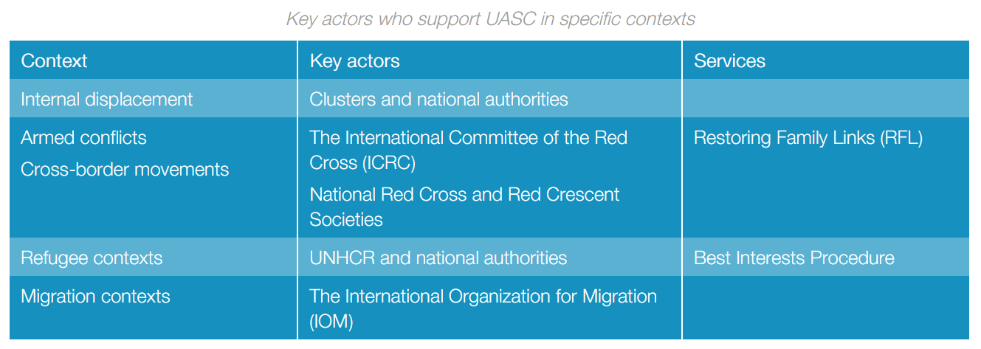
“Family separation is prevented, and unaccompanied and separated children receive care and protection in timely, safe, appropriate and accessible ways in accordance with their rights and best interests.”
Notes:
Standard 13 states: “Family separation is prevented, and unaccompanied and separated children receive care and protection in timely, safe, appropriate and accessible ways in accordance with their rights and best interests.”
It calls for coordinated efforts to prevent and respond to child separation and provide assistance, protection and services to UASC (including in refugees context and cross border situation) [🡪 the displacement icon] Contextualised measures for preventing separation are especially important in non-camp or urban contexts where communities may be dispersed.
Practical actions include:
- Attaching identification tags or wrist bracelets to babies, young children and children with disabilities;
- Teaching children key information about their family identity, home and emergency meeting points; and
Advocating with authorities and other actors to address policies, procedures or practices that are contributing to separation.
Carrying documentation that verifies children’s legal identity, if safe
Informing families of the importance of birth registration
Training relevant actors on methods for preventing separation, for identifying UASC & about response actions (including focal points and border and immigration officials)
Discussion Prompt: Who is involved in UASC support in each specific context?
Specific contexts call for specific actors: the standard identifies the key actors involved in national or international family tracing activities, depending on the context (internal displacement, refugees, migration, cross-border situations, armed conflicts).
-> discuss contextualized settings in the country you are in, and click to show the table
Note that in the case of refugee contexts, there are specific procedures & services to put in place, like the Best Interests Procedure

Slide 4

Activity 1 – Identifying Priority Actions in UASC Response
You are a core group of experienced CP workers from a small number of international NGOs – the first to arrive in country. The response from the international community will grow over the coming days.
At an emergency meeting convened by UNICEF you have been requested to take on a lead role in planning and initiating a response to UASC, working with government and other local actors where possible.
Develop a draft plan of action for the initial emergency response i.e. the first 5 days. You do not need to go into detail about how the actions would be implemented. You should be able to provide a rationale for your decisions.
After 20 mins reconvene in plenary to present your plan.
Refer to pgs. 154 – 155 of Standard 13 of the Minimum Standards for Child Protection in Humanitarian Action.

Slide 5

Using a triage system
What? A triage system is a structured way of deciding on priorities.
When? Most relevant in rapid onset emergencies e.g. earthquake, tsunami.
In other emergencies documentation of all UASC should be carried out before tracing begins in order that information is not forgotten by children.
Why? Amongst the UASC there are likely to be some whose family are close by and easy to locate e.g. by mobile telephone – “traditional” approaches to IDTR may mean opportunities are lost to rapidly reunite some of those UASC.
However, in addition, an initial assessment of the level of risk to children should also be made i.e. physical, emotional, security issues

Slide 6
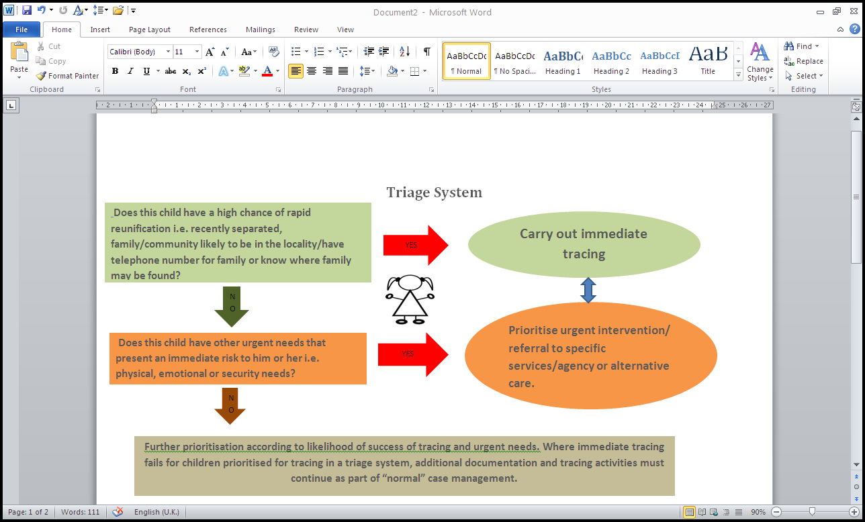

Slide 7
Activity 2 - Prioritising Actions through a Triage System
We are going to do a role play in your group.
The purpose of the role play is to practice using a system of triage.
Take 5 minutes to read the role play cards and ask for any clarifications.
Then in each group one person should take the role of the child and two people should take the role of child protection workers. The remaining person/s should observe the interview.
Then switch roles for the second role play card so you each take on a new role.
After 15 mins complete the role play and come back to plenary.

