Slide 1
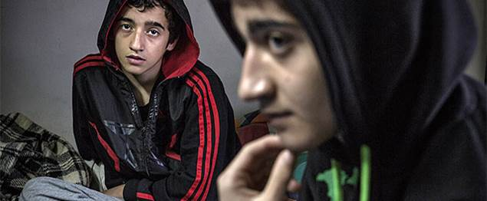

UASC TOT
Module 2.2 - Assessment of Separation and Risk of Separation
By the end of the session participants will be able to:
Explain the importance of mapping local and national capacity, including the capacities of refugee populations in refugee settings, in order to respond to UASC prevention and identify critical gaps in response services
Describe the role of Rapid Assessment of UASC
Develop Key Informant questions to assess separation for use in a Rapid Assessment

Slide 2
Child Protection Rapid Assessment
Aim: to give an indication of the scope of urgent child protection related needs (in this case UASC) among the affected population within the immediate post-emergency context.
Most useful in situations in which a rapid response is required for example in the aftermath of a rapid-onset emergency.
Limitations: does not replace a more comprehensive assessment or on-going efforts to establish more robust mechanisms for data collection.

Slide 3
Rapid Assessment of Family Separation
Assessment of UASC should be conducted at the earliest possible opportunity
Active involvement of communities including children
Numbers are likely to be higher than those identified through initial rapid assessment or those indicated from population registration statistics
Can be difficult to establish the scale of separation due to mixed migration or complex and multi-layered problems, including pre-existing separation
Causes and types of separation?
Use a range of methodologies in a variety of sites

Slide 4
Guiding Principles/Ethical Considerations
Do No Harm
The Best Interest of the Child
Confidentiality of information & informed consent
Recognition of children’s and communities’ capacities
Consideration of information already available
Non-hindrance of urgent action
Commitment to action upon availability of CPRA results

Slide 5


Activity 1: Communicating the Objectives of an Assessment
In your pair, assign roles:
Someone about to undertake a rapid assessment for UASC;
A community member/official
2. Use the case studies to conduct a role play.
In role a, explain the definitions of unaccompanied and separated children and the objectives of the assessment.
3. The roles then are switched using the second case study.
Feedback on the exercise in plenary and discussion around useful tips on how to ensure that everybody understands the terminology and objectives.

Slide 6
Sample Tools
Desk Review
Urgent Action Form
Site Report
Key Informant Interview
Direct Observation

Slide 7
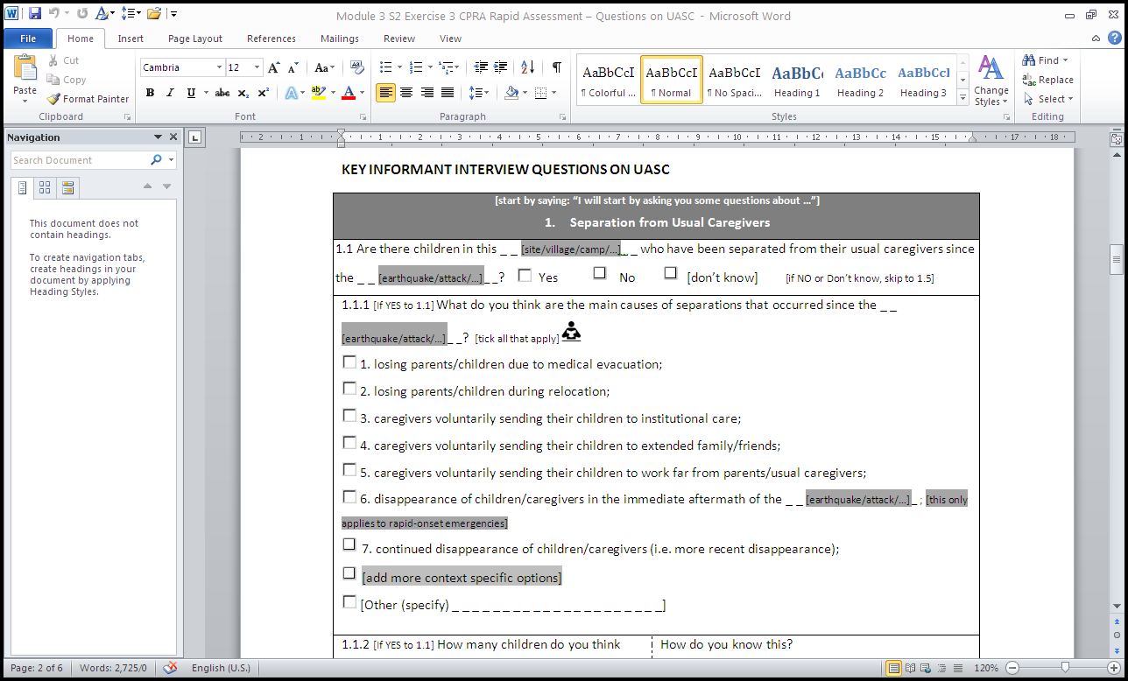
Activity 2 – Develop Key Informant Interview Questions
Refer to the Simulation Situation Analysis (SitAn) provided on Day 1 to complete this Activity.
Use the information in the SitAn to review the Key Informant UASC Interview Standard Tool to:
Identify who in the population described in the SitAn could be interviewed for a KII
Identify what changes need to be made to contextualise the tool for use in Country X.
Take 20 mins.

Slide 8
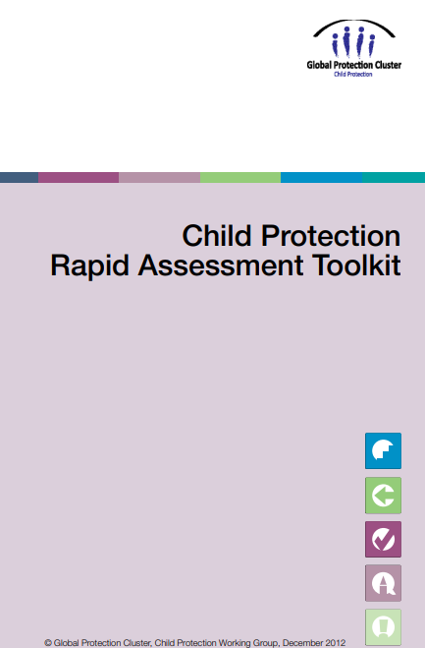
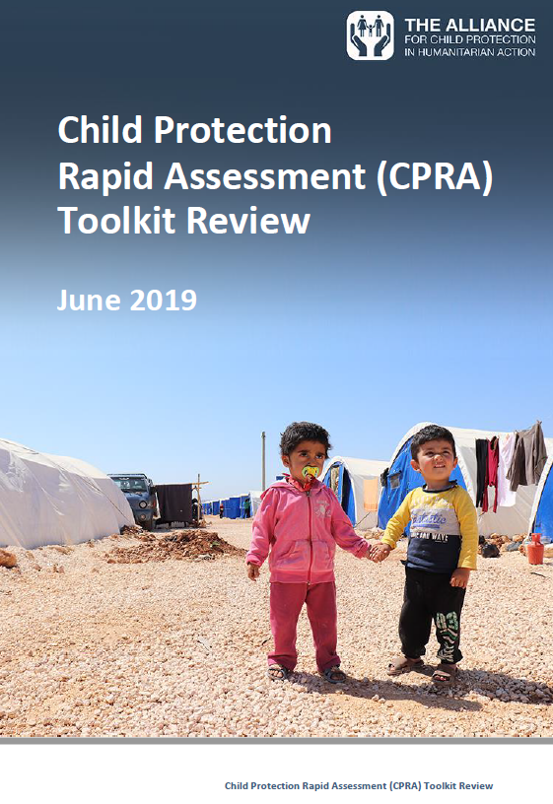
Child Protection Rapid Assesment Resources
CPRA Toolkit
CPRA Toolkit review

