Slide 1

UASC
TOT
Day 1 Review

Slide 2
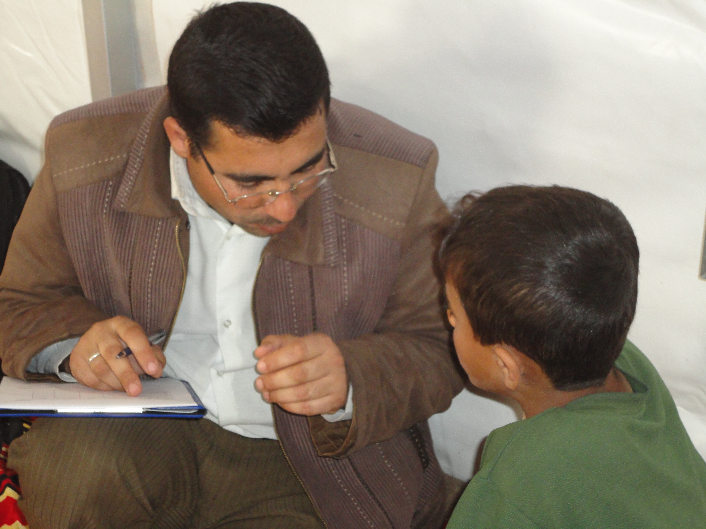
Day 4
Simulation
Apply learning from the training in a simulated real-life situation.
Participants will work together to achieve a common goal
An example to participants of the challenges associated with effective coordination of a UASC response

Slide 3
Simulation
Groups
Each group is a different stakeholder in the coordination mechanism
Groups will be given various tasks to complete during the Simulation
Groups will complete Homework Tasks on Days 1, 2, and 3 of the training in preparation for the Simulation

Slide 4

Homework – Simulation Activity 1
Roles, Responsibilities, and Function of a Coordination Group
Spend about 45 mins sometime before the first session starts tomorrow morning, reading the information contained in the Organisation Package and Situation Analysis and discussing as an Organisation:
  Why their organisation is a member of the Child Protection Coordination Group
  If they think their organisation currently works with UASC and what sort of work they do to support UASC.
  What capacity their organisation has to support a response for UASC affected by the earthquake described in the Situation Analysis

