Slide 1


UASC TOT
Module 1.5 – Coordination
By the end of the session participants will be able to:
Describe the importance of coordinating an emergency response to UASC
Identify context-based coordination structures and roles in emergency response to UASC
Suggest ways to overcome challenges to effective coordination
Describe the role of SOPs and referral pathways in ensuring a coordinated response to UASC

Slide 2
Possible consequences of poor coordination
Reduced “buy in” of government and local actors
  Less effective response
  Challenges for transition and handover to local capacity
Duplication of activities
Inconsistency in approaches and practice.
Endangers a comprehensive response for UASC
Potential for negative impact on tracing and reunification
Notes:
Failure to ensure strong coordination with government and local actors:
can diminish the chance of their “buy in” = less effective response and less potential for positive change (where this is required) in the longer term
is incompatible with eventual objective of transition and handover to local capacity
Potential for duplication of activities, obstacles to information exchange and inconsistency in approaches and practice.
More difficult for additional protection and any other needs of UASC to be addressed: coordination with child protection, protection and other humanitarian programmes is essential to ensure a comprehensive response.
Potential for negative impact on tracing and reunification

Slide 3
What should be considered before establishing any mechanism for coordination?
Is there currently a CP coordination mechanism?
Can that mechanism meet the needs of coordinating the emergency response or be strengthened to do so?
Governments have primary responsibility for protection of children; is it appropriate/possible to work with & through existing govt. structures?
What extra efforts might be required to facilitate the involvement of government and national actors? for example ensuring key materials are translated.

Slide 4
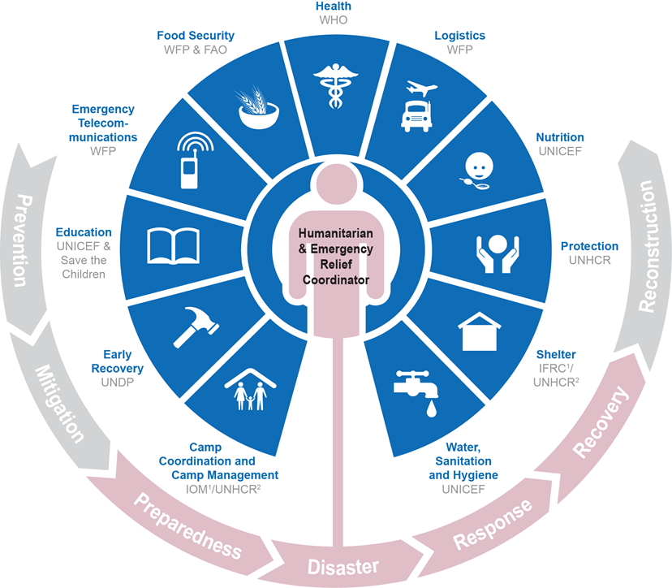
Coordination of UASC in emergencies:
within a Cluster System

Slide 5

Inter-agency UASC Task Force
Not a formal part of the cluster structure
Operates within a collaborative framework
Under the wider umbrella of The Alliance for Child Protection in Humanitarian Action

Slide 6
Lead organisation/chair for the UASC coordination group/groups; i.e. government, UNICEF /UNHCR, Coordination groups can also be co-chaired.
Coordination with ICRC and other components of the Movement (including National Societies).
T.O.R. for the coordination group
Decision making processes; which organisation has the authority to make which decisions where it is not possible to reach consensus
Mechanisms for communication between the groups at different levels (if more than one group)

Slide 7

Activity 1 - Priority Tasks for a UASC Coordination Mechanism
Read the Handout_Role and Tasks of a Coordination Group for UASC
Identify the priority tasks for a newly formed coordination group for UASC (bearing in mind there may be a need for coordination groups at more than one level i.e. national, provincial levels)
Identify your top 5 priority tasks and why you chose these tasks.

Slide 8
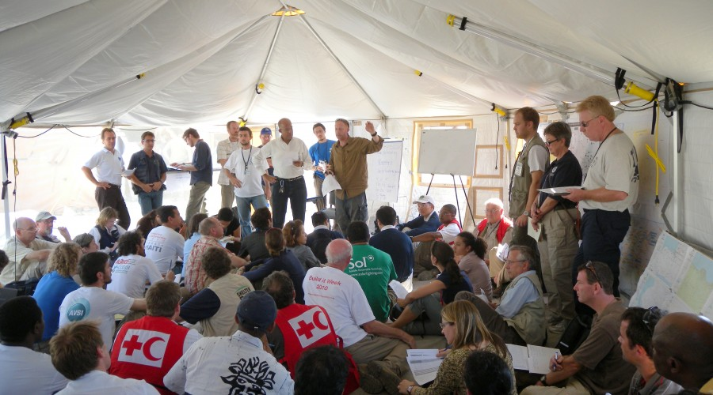
Challenges to effective coordination
What are the challenges associated with coordination in a UASC response?
What actions can be taken to overcome these challenges?

Slide 9
Standard Operating Procedures
A document that aims to regulate coordination among operational agencies and implementing partners on working modalities.
Distinct from information-sharing protocols (ISPs), which are necessary whenever confidential data is exchanged among agencies.
The ICRC and Red Cross Red Crescent National Societies do not sign SOPs/ISPs, with the exception of a global Memorandum of Understanding between the ICRC and UNHCR

Slide 10
Activity 2 – TORs, SOPs and Referral Pathways
You are in 4 groups. Each group has a different sample SOP, TOR, or Referral Pathway.
Read through the document and identify its key features.
15 mins to discuss. Be ready to discuss how these documents can be used to ensure better coordination and interventions for UASC.

