Slide 1

UASC TOT
Module 1.3
Preventing Separation
By the end of the session participants will be able to:
Describe the 3 levels of prevention and how these apply to UASC programming
Identify risk factors and protective factors relating to family separation
Give examples of messages on prevention of separation for different audiences

Slide 2
What is primary prevention?
Primary prevention is about identifying and addressing trends or patterns of risk facing children within the population, as opposed to identifying individual cases of children at risk for service provision. Primary prevention aims to reduce the risk of harm for all children within a population or a sub-group of the population.

Slide 3
What does “at the population level” in primary prevention mean?
A population can refer to a whole society or a part of it; for example, a specific geographic community and include all the children within that community. It can also refer to a sub-group of children within the broader society; for example, all children living in refugee camps within a country, or all children aged one to five years old in the broader society.

Slide 4
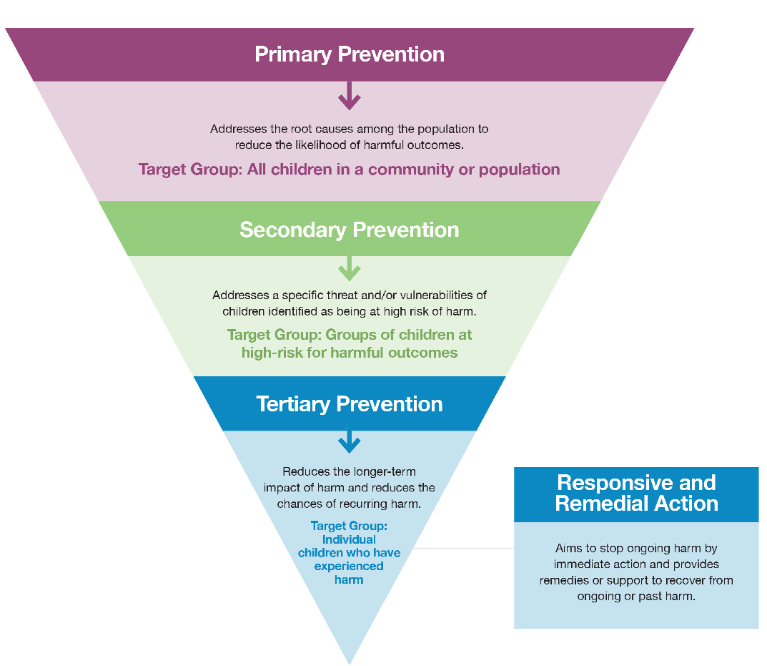

Slide 5
Activity 1 – Discussion in Pairs – Primary, Secondary and Tertiary Prevention
Take 10 mins to discuss these questions with your partner before sharing with the wider group:
  Generate examples for each level (primary, secondary and tertiary prevention) related to preventing family separation.
  Identify the target groups for primary, secondary and tertiary prevention.

Slide 6
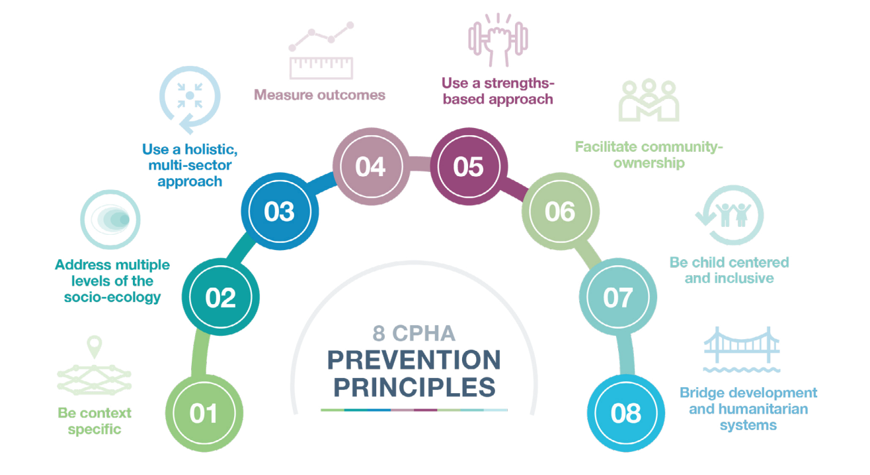

Slide 7
Applying Secondary Prevention to prevention of family separation
Secondary prevention – addresses the specific threat and/or vulnerabilities of children identified as being at risk of family separation;
The target group is all children identified as being at high risk of family separation

Slide 8
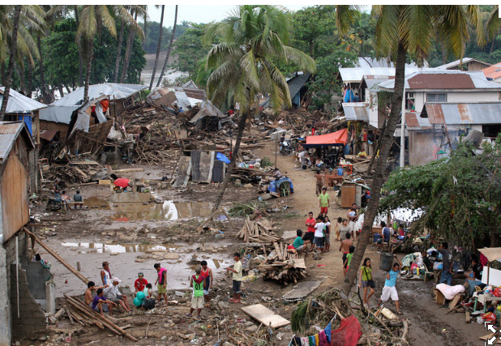
The devastating tropical storm that hit Northern Mindanao in the Philippines in December 2011 affected some 600,000 people in 13 provinces, damaging bridges, roads and destroying houses. (unocha.org)

Slide 9
Developing messages and information relating to prevention of separation
Culturally and socially appropriate
Public information campaign
Standard child protection messages (where possible) adapted to context
Messages should be in local languages/dialect
Include materials in picture form for those unable to read
Child friendly
Use a range of relevant/appropriate media e.g. SMS messages, local radio, leaflets, putting up posters or announcements, drama groups or making announcements in public places.
Developed with input from local communities including children, be tested before use and should focus on positive actions

Slide 10
Activity 2 – Analyse Risks in a Case Study and Develop Messages Relating to Prevention of Separation
Use the information in your Case Study to develop at least 2 - 3 messages to prevent separation in this context.
Think about different target audiences including;
  Children
  Parents/carers
  Communities etc
Develop specific messages for each audience using the information in the Case Study.
You have 15 mins to complete the Activity.
Each group will then share 1 message and explain the context and target audience for their message.

