Slide 1
Marco de Apoyo Psicosocial

Slide 2
Objetivos de la Sesión
Al finalizar la sesión, los participantes podrán…
Definir términos clave
Conocer 4 categorías principales de los síntomas de angustia
Identificar al menos 3 tipos de intervención que apoyen a los niños, niñas & familias que muestran señales de angustia psicosocial
Identificar 3 documentos de guía para implementar actividades psicosociales en emergencias
Notes:
By the end of the session participants will …
Be able to define key terms relating to Mental Health and Psychosocial Support (MHPSS)
Know the four main categories of symptoms of distress
Be able to identify at least 3 types of intervention, other than CFS, that support children and their families who are showing signs of psychosocial distress
Be able to identify 3 key guidance documents to implementing PSS activities in emergencies

Slide 3
Esquema de la Sesión
Definición de términos clave
Impacto psicosocial en emergencias
Objetivos del programa de apoyo psicosocial
Planificación de programas de apoyo psicosocial

Slide 4
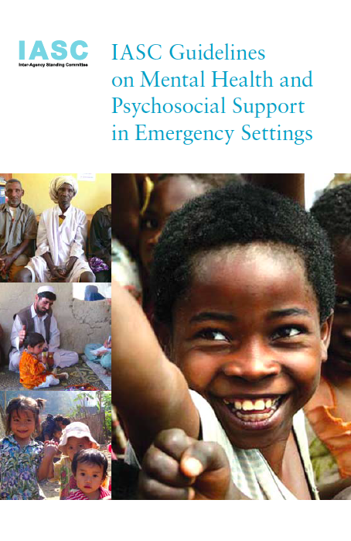
Guía del IASC sobre Salud Mental & Apoyo Psicosocial en Emergencias, 2007
Notes:
Underline that the IASC Guidelines on MHPSS is the key document guiding the content of this session, and supporting all psychosocial support work in emergencies

Slide 5
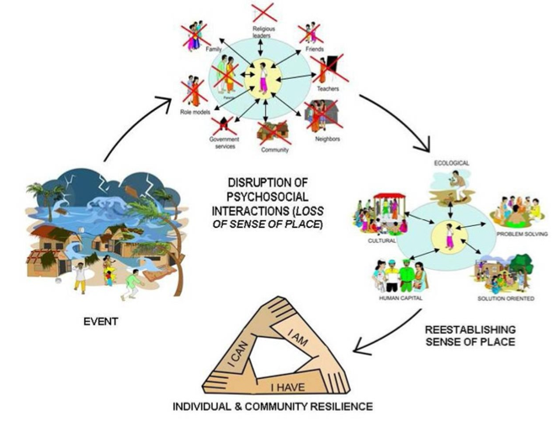
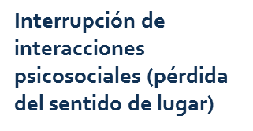

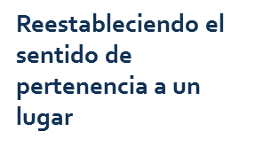
Ciclo de bienestar psicosocial en emergencias
Ciclo de bienestar psicosocial en emergencias
Interrupción de interacciones psicosociales (pérdida del sentido de pertenencia a un lugar)
Resiliencia Individual & de la Comunidad
Notes:
This is a diagrammatic representation of the session we will be doing
Talk through the cycle quickly, pointing out that this session’s objectives are to understand what can cause psychosocial distress (event), impact of the event on people’s lives (what is disrupted by the event), how PSS works to re-establish order and finally leads to wellbeing, building on individual resilience and community capacity
In previous session we looked at the wider impact of the disruptive event on the child and community, we will now look specifically at the psychosocial impact and how we respond to re-establish a sense of place and build on resilience

Slide 6
¿Está de acuerdo?
“Todos los niños y niñas en una emergencia están traumatizados y necesitan ayuda profesional”
“Lo más importante es ayudar a que los niños y niñas en este campamento superen la violencia que experimentaron al huir”
“Si un niño o niña empieza a hablar espontáneamente de lo que pasó durante una actividad de grupo, es importante dejar que termine su historia y que diga lo que tiene en mente”
Notes:
Depending on how talkative the group is either do only these three or continue to the next slide and do all 6 (three on this slide, three on the next)
SPEND ONLY A TOTAL OF 10 MINS ON THIS ACTIVITY (slide 4 and 5)

Slide 7
¿Está de acuerdo?
“Los niños/niñas pequeños (menores de 5) están muy afectados por lo que vivieron y por ende necesitan que los adultos tomen el control y decidan por ellos”
“Es importante no permitir que los niños/niñas vean cómo usted se siente, ya que los puede alterar más”
“Es bueno pedirla a los niños/niñas que escriban o dibujen sus experiencias de la guerra”
Notes:
Depending on how talkative the group is either do all 6 (three on this slide, three on the previous one) or just do the three on the previous slide

Slide 8
Definición de términos clave

Slide 9
Definición de términos clave
  La Salud mental es el estado psicosocial de los individuos
  La angustia es ansiedad, tristeza o dolor
  El trauma es una reacción más extrema; un tipo de daño a la psiquis que ocurre como resultado de un evento severamente angustiador
Notes:
Mental health is a term used by medical practitioners to refer to the psychological state of individuals. Being in good mental health is defined by WHO as: "a state of well-being in which the individual realises his or her own abilities, can cope with the normal stresses of life, can work productively and fruitfully, and is able to make a contribution to his or her community.” Health workers will refer to work they are doing to help address psychological concerns or mental health problems in the same way child protection or education workers refer to psychosocial problems. More clinical and severe concerns (e.g. post traumatic stress disorder, schizophrenia and bipolar disorder) would be categorised as mental health concerns rather than psychosocial distress
Distress: is anxiety, sorrow, or pain, is a normal and common reaction to an abnormal event
Trauma: is a more extreme reaction. Psychological trauma is a type of damage to the psyche that occurs as a result of a severely distressing event. When that trauma leads to post-traumatic stress disorder, damage may involve physical changes inside the brain and to brain chemistry, which changes the person's response to future stress

Slide 10
Definición de términos clave
  Psicosocial relación directa entre lo psicológico & social, influyendo entre ellos continuamente. Dónde…
  Psicológico: pensamientos, emociones, sentimientos & comportamiento
  Social: contexto en el que vivimos, cultura, tradiciones, espiritualidad, relaciones & actividades
  Primeros auxilios psicológicos (PFA, por sus siglas en inglés) respuesta apropiada para una persona en sufrimiento que necesita apoyo
Notes:
Psychosocial indicates direct relationship between psychological & social, each influencing the other continually. Where…
Psychological: mind, thoughts, emotions, feelings and behaviour
Social: context in which we live, culture, traditions, spirituality, relationships with immediate and extended family, community, school and professional activities
Psychological first aid (PFA) describes a suitable, supportive response to a fellow person who is suffering and who may need support. (IASC, 2007) It is a communication tool, a way of communicating and supporting an individual to help them to get better
Read all text on slide, then summarise with the following:
All children go through psychological and social development as they grow up
To develop healthily, children need a stable and secure environment for their psychological and social development
Emergencies may have a severe impact on children’s psychological and social development because they may disrupt the stable and secure environment
Just before turning to the next slide you should try to find a way to create a very loud noise, bang, or thump – see notes on the next slide for more details

Slide 11
Impacto psicosocial de una emergencia

Slide 12
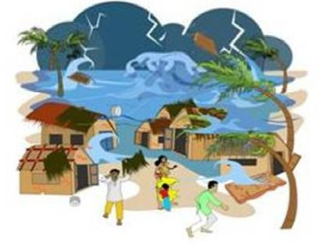
Evento
Notes:
Just before turning to this slide find a way to create a very loud noise, bang, or thump. Beating on some drums, someone walking in clapping hands or stomping feet loudly or banging pots together. The noise should be sudden and create some surprise. Try to make sure it is not a noise which resembles either gunshots or bomb-blasts as participants may have lived through those noises recently. The aim of this exercise is not to create real distress, but just to make us think about our reactions to surprise events.
Discuss with the group:
Traumatic events are powerful & upsetting incidents (experiences that are life threatening or with significant threat to physical or psychological wellbeing) that intrude on daily life.
A traumatic event involves a single experience, or an enduring or repeating event or events, that completely overwhelm the individual's ability to cope or integrate the ideas and emotions involved with that experience
Distress and or trauma is a normal reaction to a traumatic event. Traumatic events do not lead all those who live through them to be traumatised. The majority will be distressed, only a small number will be traumatised.
Examples of traumatic events include: a flood, cyclone, drought, earthquake, tsunami, mass displacement, conflict, fighting, political violence, civil unrest. Acts of violence such as an armed robbery, war or terrorism, interpersonal violence such as rape, child abuse, or suicide of a family member or friend, involvement in a serious motor vehicle accident
Other less severe but still stressful situations can trigger distress or trauma in some people. Intensity of the event doesn’t necessarily determine degree to which someone is affected, each individual reacts differently. Pre-existing stressors/conditions; the current daily stressors; & traumatic event the individual lived through as well as individual resilience all play a part in the degree to which someone shows distress

Slide 13
Piense en un momento o experiencia difícil de su infancia o de un niño/niña que usted conozca de una emergencia:
    ¿Qué pensaba el niño/niña?
    ¿Qué sentía el niño/niña?
    ¿Cómo actuaba el niño/niña?
    ¿Cómo afectó esto a la familia del niño/niña?
    ¿O la comunidad del niño/niña?
Notes:
IMPORTANT NOTE: Remind participants that it is very important that they are careful not to think of things that may distress them, it is better to think of another child than yourself if this activity will upset you

Slide 14
Efectos psicosociales de las emergencias en niños y niñas
Categoría | Síntoma
Física | Alerta excesiva, pendiente del peligro, asustado fácilmente Fatiga / agotamiento y sueño interrumpido Dolores generales, dolor estomacal, mojar la cama
Comportamiento | Evitar lugares / actividades que les traen recuerdos, retracción social, aislamiento Pérdida de interés en actividades normales, deja de jugar Malcriadez, retroceso en habilidades/comportamientos, deja de hablar Llorar, demasiado apegado o independiente Cambio en apetito o hábitos de alimentación
Emocional (Sentimientos) | Temor, enmudecimiento, desapego, depresión o tristeza Culpabilidad o remordimiento, abrumado, desesperanzado Ira e irritabilidad, ansiedad y pánico
Cognitiva (Pensamientos) | Pensamientos intrusivos y recuerdos del evento / flashback o escena retrospectiva Imágenes visuales del evento / pesadillas Mala concentración / memoria o desorientación / confusión El desempeño en la escuela se ve afectado Cambio en creencias religiosas, pérdida de la fe
Notes:
The way distress manifests itself differs by age – refer participants to the relevant handout
Some signs of distress are universal, others vary from one context to another depending on culture
Ask the group if they can identify certain “signs” listed here that they think would not happen in this culture?
Are there additional signs which happen here that are not listed?

Slide 15
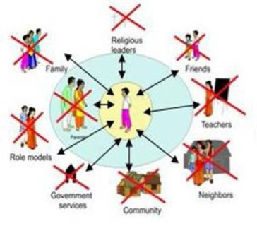
Vidas Interrumpidas
Líderes Religiosos
Familia
Amigos
Maestros
Modelos ejemplares
Servicios Gubernamentales
Vecinos
Comunidad
Notes:
Ask everyone to get up and walk around, no need to bring their things with them, then ask them to sit in a different place to where they started. Act as if you are going to restart the session. But then ask them to get up again and move around again, so they sit elsewhere (still not their original seats). Again, pretend you are going to start session, then seem to change your mind. Finally ask them to stand up one final (third) time to come back to their original places.
When there is a traumatic event, a child’s environment is disrupted.
The child’s psychosocial supports and interactions are disrupted and change. They do not have the things they are used to or need.
This leads to a loss of sense of place.
Daily stressors can exist prior to emergency, but can also result from the event (poverty, loss of home and livelihoods, lack of services, etc.) and also contribute to distress or even potentially trauma
The humanitarian response itself may cause distress (the way distributions are targeted or given out, presence of strangers in the community, etc). Efforts should be made to keep this form of stress to a minimum
Each child reacts differently, to different sources of stress that come before, during or after the event

Slide 16
Resultados sociales de la angustia
Impacto psicosocial en niños y niñas
Habilidades/comportamientos (Ejem. Agresividad, comportamiento arriesgado, retraído)
Espiritualmente /valores (pérdida de fe, cambio de valores)
Impactos sociales en niños y niñas
Relación con otros (familia, amigos, maestros)
Roles nuevos o cambiados, oportunidades y responsabilidades (Ejem: cuidar a hermanitos, abandono de la escuela, trabajar)
Impacto en el funcionamiento de la Familia
Tensiones familiares
Impacto en el funcionamiento de la Comunidad
Divisiones y conflictos

Slide 17
¿Qué o Quién ayudó al niño/niña a sobrellevar la dificultad? (Factores de Protección)
Notes:
Risk and protective factors we discussed in the last session… are there any additional ones to add now you have a specific example in mind?

Slide 18
Objetivos del trabajo Psicosocial

Slide 19
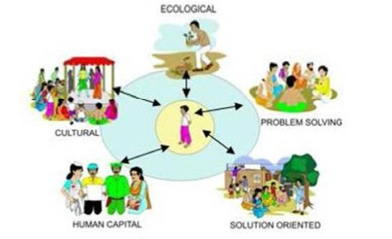
El objetivo del trabajo psicosocial es…
Ecológico
Resolución de Problemas
Cultural
Capital Humano
Orientado a la solución
Notes:
Establish a sense of place for the child within the new community
By creating a new sense of order, structure and routine – building on what is familiar, what exists, and the child’s own resilience
And giving other new supports

Slide 20
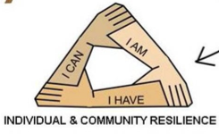
Factores de Protección
Resiliencia Individual & de la Comunidad: Yo Puedo, Yo Soy, Yo Tengo
Notes:
Experience shows majority of children have strong resilience on which we can build to rapidly recover & develop as members of their communities
I HAVE = Rebuild relationships, trust, a sense of belonging.
I CAN = Resume activities, safe space to rebuild confidence and competence in my activities.
I AM = Strengthen spirituality, rediscover hope in the future, make sense of what happened.
“I have, I can, I am” represent the components of a person and what makes up their world. It is essential to understand these components and what they bring to a person in order to understand how to assist them to use their internal and external resources to cope after a difficult event.

Slide 21
Programación Psicosocial
El objetivo de la programación psicosocial es proteger y promover el bienestar psicosocial por medio de:
Reduciendo los factores de riesgo i.e. Prevenir que los niños y niñas sean expuestos a situaciones que son dañinas a su bienestar psicosocial
Fortaleciendo los factores de riesgo i.e. si están expuestos para apoyar su resiliencia y recuperaciónn
Notes:
Aim of psychosocial programming is protect and promote psychosocial wellbeing by:
Reducing risk factors i.e. stop children from being exposed to situations that are harmful for their psychosocial wellbeing
Strengthening protective factors i.e. if they are exposed, to support their resilience and recovery
Refer back to exercise done with Slide 14: activities to strengthen protective factors and reduce or prevent risks…

Slide 22
Factores de Riesgo y Protección…
Factores de Protección
Fortalecer el cuidado a la comunidad & la familia
Promover el desarrollo holístico positivo
Apoyar la participación del niño, niña & joven
Mejorar la habilidad de una persona para funcionar bajo estrés
Factores de riesgo
Asegurar un ambiente seguro & estable
Desarrollar actividades de concienciación
➔ Restauración de prácticas & recursos interrumpidos por la crisis o construirlos mejor
Notes:
Psychosocial support work contributes to reduction of risk and promotion of protective factors by…
Strengthen family and community care-giving structures for children - Strengthen local networks that enable child protection, care, and wellbeing, such as women’s groups or religious networks
Promote children’s holistic development and age-appropriate physical, cognitive, and emotional competencies - Reduce long-term negative psychological effects
Support children’s and youth’s voice and full participation in all phases of programming
Improve person’s ability to function under stress
Foster a secure and stable environment for children - Reducing risks to children’s safety and emotional well-being while promoting an environment conducive to positive development, effective coping, and resilience
Carry out awareness raising activities so adults (parents, teachers, other adults in contact with children) understand risks to children and how to prevent these
➔ All the above contribute to restoration of practices & resources disrupted by crisis, or even possibly a process of building back better

Slide 23

Si estas contento y lo sabes...
Si estas contento y lo sabes, da palmaditas. Clap, Clap.
Si estas contento y lo sabes, da palmaditas. Clap, Clap..
Si estas contento y lo sabes y realmente quieres mostrarlo, da palmaditas, Clap, Clap.
... Zapatee el piso. Stamp stamp
... Grite Hurra. Hurra
... Haga los tres. Clap clap. Stamp stamp. Hurra
Notes:
If you're happy and you know it
Clap your hands. Clap, Clap.
If you're happy and you know it
Clap your hands. Clap, Clap.
If you're happy and you know it
and you really want to show it
If you're happy and you know it
Clap your hands. Clap, Clap.
If you're happy and you know it
Stamp your feet. Stamp stamp
If you're happy and you know it
Stamp your feet. Stamp stamp
If you're happy and you know it
and you really want to show it
If you're happy and you know it
Stamp your feet. Stamp stamp
If you're happy and you know it
Shout hurray. Hurray
If you're happy and you know it
Shout hurray. Hurray
If you're happy and you know it
and you really want to show it
If you're happy and you know it
Shout hurray. Hurray
If you're happy and you know it
Do all three. Clap, clap, stamp stamp, hurray
If you're happy and you know it
Do all three. Clap, clap, stamp stamp, hurray
If you're happy and you know it
and you really want to show it
If you're happy and you know it
Do all three. Clap, clap, stamp stamp, hurray
[End with round of applause]
[http://www.youtube.com/watch?v=FrsM9WggCdo]

Slide 24
Cómo podemos reducir los factores de riesgo & fortalecer los factores de protección:
Reestableciendo…
El sentimiento de pertenencia
Un lugar seguro para estar
La relación con amigos & familia
Apegos personales
La estimulación intelectual
La rutina normal / vida diaria
El sentido de control sobre la vida de una persona
La oportunidad de expresar dolor & emociones
Notes:
A sense of belonging
A safe place to be - Ensure child is in a stable and nurturing family style environment
Relationship with peers
Personal attachments
Intellectual stimulation
Normal routine / daily life - Enhance routine and structure in children’s lives. Re-establishing age and gender appropriate daily routines, including schooling, recreational activities, community activities
Sense of control over one’s life
Opportunity to express grief and other emotions – not to be forced

Slide 25
Estrategias para fortalecer el bienestar psicosocial, continuación…
Movilizando el sistema de apoyo a niños y niñas
Oportunidades para que los niños/niñas se expresen
Habilitarlos para particiar en & contribuir a la comunidad & ayudar a construir un futuro más positivo
Fortalecer as habilidades de vida/subsistencia de los niños/niñas
Proveer apoyo a los cuidadores
Notes:
Mobilising a child’s support system to better protect and care for the child
Provide opportunities for children to express themselves (in schools, children’s clubs, etc). Let them talk through what they have experienced, in a way they choose to
Enable them to participate in and contribute to their communities and help build a more positive future – engage them in DRR so they feel empowered to help themselves, their friends and their family. This will reduce sense of fear going forward
Strengthen children’s life skills to overcome adversity
Provide support for caregivers (families, teachers etc.). Help them to deal with their own stress, help them to understand the stress their children are experiencing and support them in ways to deal with children’s stress.

Slide 26
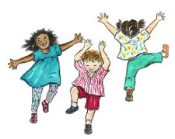
Levántate y baila…
Notes:
Ask participants to get up and dance on the spot
For those who are less comfortable doing this, tell them they can sway on the spot, jump, skip, walk around the room, clap, whatever movement makes them feel comfortable

Slide 27
Planificación de Progamas de Apoyo Psicosocial

Slide 28
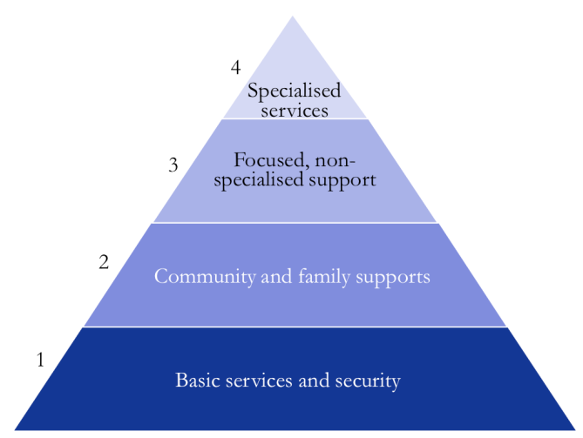
Pirámide de intervención para la salud mental & apoyo psicosocial en emergencias
Niños/niñas que pueden ocasionarse daño a ellos mismos o a otros, aquellos con señales persistentes de angustia, depresión, anciedad o con Desorden de Estrés Post-Traumático
4. Servicios Especializados
3. Apoyo enfocado, no especializado
Niños/niñas que muestran signos normales de angustia y que requieren algo de apoyo para regresar a su comportamiento de antes de la emergencia
2. Apoyo a la comunidad y familia
Niños/niñas que nececistan apoyo y rutina para reestablecer el bienestar mental
1. Servicios Básicos y Seguridad
Niños/niñas con alta resiliencia, muestran señales normales de angustia inicialmente, encuentran su propia forma de adaptación, regresan a su comportamiento de antes de la emergencia
Notes:
Talk through the diagram above. Highlight the following:
War and natural disasters cause distress for individuals & societies
Most individuals & societies are able to cope
Sometimes levels of distress reach such great proportions people struggle to cope
Trauma happens when an individual cannot cope
The likeliness of speedy recovery increases when appropriate support is provided at an early stage, and the risk of long-term mental health problems is reduced dramatically
All children (and communities) need level one support, this will help PSS wellbeing
All the levels build on each other. Each level needs to be in place for a community to support all children who have varying needs, including helping them to access specialised help
Ask the group to vote for which level they think most children fall into? What level of supports most children need to recover?

Slide 29
Planificación de intervensiones psicosociales – actividad
Divídase en 4 grupos – asigne a cada grupo uno de los cuatro niveles
En base a su experiencia, identifique QUÉ intervenciones o actividades podemos hacer en ese nivel de la pirámide. Escríbalas en las tarjetas verdes (5 min.)
Piense en QUIÉN debe dirigir las diferentes actividades en ese nivel. Escríbalo en las tarjetas rojas (5min.)

Slide 30
Interrogantes de la actividad de planificación de intervención
Sin entrar en los detalles de cada plan:
  Todos los grupos ponen respuestas en la pirámide
  ¿Qué tipos de actividades están incluidas? Hay actividades que sean:
    ¿Actividades específicas de protección de la niñez?
    ¿Actividades integradas con otros sectores?
  ¿Por qué escogió las actividades que seleccionó?
  ¿Dónde está el enfoque de la mayoría de la actividad? ¿Porqué?
  ¿Quién es el responsable de ejecutar estas actividades?
Notes:
Without going into detail of each of the plans please share your thoughts on the following:
All groups come and stick answers on to pyramid
What types of activities have you included? Are there activities that are:
Specifically child protection activities?
Activities integrated with other sectors?
Why did you chose the activities you did?
Where is focus of most activity? Why?
Who is responsible for delivering these activities?

Slide 31
Funciones y responsabilidades
Todas las intervenciones humanitarias impactan positiva o negativamente en el bienestar psicosocial
Se necesitan todos los niveles de apoyo
Participación de todos los sectores en cubrir las necesidades del nivel 1
Respuestas sociales del grueso del programa de Salud Mental y Apoyo Psicosocial (MHPSS, siglas en inglés)
Notes:
All humanitarian interventions impact positively or negatively on psychosocial wellbeing
All levels of support are needed
Engagement of all sectors in meeting needs at level 1
Social responses form the bulk of MHPSS programming - e.g. Child Friendly Spaces linked with CP networks, work in schools, behaviour of parents & adults in community

Slide 32
Funciones y responsabilidades
Los actores de Protección de la Niñez en Emergencias (CPiE) enfocan su trabajo en el nivel 2 & 3
Los actores de CPiE también tienen una función en otros niveles – referencias para apoyo de nivel 4, asegurar que sea amigable con niños/niñas, que la actividad 1 tenga enfoque en la niñez
Notes:
All humanitarian interventions impact positively or negatively on psychosocial wellbeing
All levels of support are needed
Engagement of all sectors in meeting needs at level 1
Social responses form the bulk of MHPSS programming - e.g. Child Friendly Spaces linked with CP networks, work in schools, behaviour of parents & adults in community
CPiE actors focus their work on level 2 & 3 when members of community are not able to provide this form of support – note that all levels are essential, other actors step in for other levels, we must lobby to enable that to happen where possible
CPiE actors also have a role at other levels - referral to level 4 supports, ensuring child-friendliness / child-focus of level 1 activity
Mental health actors support the top level, specialised services
Summarise stating that:
Whilst all levels of support need to be made available, most children need 2 or 3 levels of support (the bottom two or three levels). Some children may return to being “well” without any external support (family, friends and community supports suffice). But it is hard to identify those that have such high resilience, children may have hidden symptoms of distress, so we should aim to be including all children in PSS activities
Important to identify and REFER for proper specialised support those children who show signs of putting themselves or others in danger, or who have persistent deeper signs of distress, who do not seem to be reverting to pre-emergency behaviour

Slide 33

Dibuja algo que te haga feliz
Toma una hoja de papel tipo A4 y dibuja algo que te haga feliz

Slide 34

Pirámide de intervención para la salud mental & apoyo psicosocial en emergencias
Asesoramiento, tratamiento de desórdenes moderados y severos de salud mental. Plan sólo puede hacer referencias a este nivel para un diagnóstico y apoyo.
4. Servicios Especializados
Grupos de apoyo, programas de compañeros a compañeros, primeros auxilios psicosociales. Requieren capacitación y superfición significativa.
3. Apoyo enfocado, no especializado
2. Apoyo a la comunidad y familia
Promoveer y/o proveer actividades diarias tales como ir a la escuela, asistir a actividades sociales y de juego, eventos comunitarios, etc.
1. Servicios Básicos y Seguridad
Re-establecer la seguridad y servicios básicos (agua, comida, albergue y servicios de salud) para toda la comunidad
Notes:
Level 1: The majority need support which addresses daily stressors. The kinds of response activities for this include: Re-establishing security, safety and basic services (water, food, shelter and health services) for the whole community, providing information about these services so that the element of uncertainty is removed, ensuring that services can be accessed in a dignified way, etc.
Level 2: Promote and / or provide everyday activities such as schooling, regular play, social, recreational and learning activities; supporting community initiatives such as community events, establishing community spaces such as communal kitchens, places for spiritual activities, etc. CFS and TLS activities can be on this level, and activities that allow them time to carry out “normal” pre-emergency activities which contribute to their learning and development
Level 3: Focussed support for children at higher risk of developing mental disorders – depending on the context, these can include: child mothers, separated and unaccompanied children, children showing more severe but still ‘normal’ signs of distress, can all benefit from this type of support. Family tracing, support groups, peer-to-peer support programmes and psychosocial first aid can all be part of this level of services. These activities require a higher level of training, but do not require specialised staff.
Level 4: Referral to specialist services for diagnosis and support. This is for a minority of children. Treatment for this level of trauma and distress require long-term extended, professional and trained support. Starting a counselling process without completing it poses a danger to mental health. This is why we are not, as short term humanitarian responders, provide these forms of services.

Slide 35
Tipos de apoyo psicosocial 1
Participar con otros sectores para mejorar el entorno
Apoyar a la comunidad para ayudar a los niños y niñas
Re-establecer rutinas
Trabajar con adultos para ayudar a identificar & lidiar con la angustia
Notes:
Engaging with other sectors to improve environment e.g. making camps child friendly
Supporting the community to help children e.g. community run child friendly spaces, working with religious leaders or youth
Re-establishing routines that existed in the community before – e.g. setting up school classes, starting up children’s clubs, choir groups, religious services
Working with adults to help them identify and deal appropriately with signs of distress – training teachers, doctors, nurses, humanitarian workers, parents, and any other adult who may have contact with children, on how to talk to children appropriately, how to identify severe distress, to give them knowledge of the referral pathways
Facilitator can go through list one-by-one and ask who has worked on this kind of thing before. Suggest to participants if they have not done one particular area of work, but would like to learn more, that they approach someone who put their hand up for that category of work, during one of the breaks to discuss their experiences.

Slide 36
Tipos de apoyo psicosocial 2
Apoyar a la familia para ayudar a sus niños/niñas
Integrar módulos psicosociales en el currículo escolar
Referir a niños y niñas a servicios especializados
Trabajar directamente /uno-a-uno con los niños y niñas
Involucrar a los niños y niñas
Notes:
Supporting the family to help their children e.g. parents discussions group, helping adults deal with their stress so they do not pass it on to their children
Integrate psychosocial modules into school curricula – supporting teachers to identify and refer cases of distress, giving them skills to communicate positively to overcome distress
Referring to specialised services – e.g. psychologists who can give clinical psychological support to severely distressed or traumatised children
Working directly / one-on-one with children e.g. social work
Engaging children in campaigns, advocacy and sensitisation efforts - Opportunities for children to talk and express themselves - Clubs, groups, committees - encouraging the feeling that they have can influence their future , protect themselves and contribute to protection of others
Facilitator can go through list one-by-one and ask who has worked on this kind of thing before. Suggest to participants if they have not done one particular area of work, but would like to learn more, that they approach someone who put their hand up for that category of work, during one of the breaks to discuss their experiences.

Slide 37
Formas de apoyo para problemas psicosociales comunes
Experiencias de niños y niñas | Cómo las personas pueden ayudar
Interrupción y caos | Re-estableciendo rutinas diarias apropiadas por edad (escuela, actividades recreativas y comunitarias) Mejorar la rutina y estructura Proveer opciones apropiadas por edad
Falta de cuidado de la familia | Asegurar que el niño/niña esté en un ambiente familiar estable y que lo cuide Trabajar con los padres/madres para cuidar mejor a sus hijos/hijas Proveer apoyo a los cuidadores (familias, maestros, etc.)
Separación de su comunidad | Re-establecer prácticas y enlaces comunitarios Proveer oportunidades para que los niños y niñas participen en la vida comunitaria
Pérdida de amigos o retracción | Ayudar a los niños y niñas a construir amistades Generar habilidades de cooperación y comunicación en los niños y niñas
Pérdida del disfrute de la vida diaria, temores, desesperanza | Proveer oportunidades para que los niños y niñas se expresen, que participen y contribuyan en sus comunidades y para un futuro más positivo Fortalecer las habilidades de vida y subsistencia de los niños y niñas para sobrellevar la adversidad

Slide 38
¡Tome Nota!
Casi todos los niños y niñas muestran algún cambio. Estas reacciones son normales.
Con el acceso a los servicios básicos, apoyo y seguridad, la mayoría de los niños/niñas regresan a la normalidad.
Los problemas Leves / Moderados ⬆ después de la emergencia
Un pequeño % tienen enfermedad mental severa
Toda la acción humanitaria impacta positivamente
Notes:
Nearly all children will show some changes in emotions, behaviour, thoughts and social relations in the short term
These reactions are normal, and with access to basic services, support and security the majority of children will regain normal functioning
Mild or moderate mental health problems may increase slightly after an emergency
A very small percentage of people will have severe mental illness or trauma
All humanitarian interventions impact positively or negatively on MH and PSS well-being

Slide 39
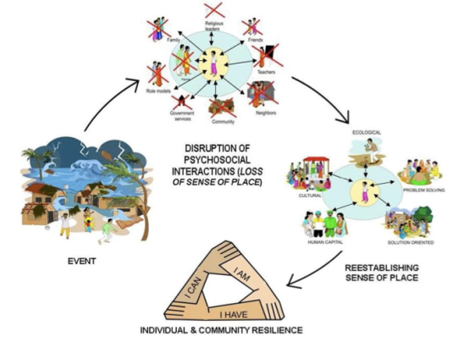

Reflexión sobre esta sesión
Resiliencia Individual & de la Comunidad
Notes:
Discussion in plenary:
Ask participants to think back over the PSS session and consider the different feelings they had when there was…
The gentle calming music when they arrived?
The loud bang with the “event” slide?
The exercise where we kept asking them to move from one seat to another?
The singing?
The dancing energiser?
The drawing activity?
Overall how did each of these activities make them feel? Take one or two comments for each, not more
Do they feel PSS work could help children after emergencies (the shock) to feel better?
Use these discussions to raise the point that to help children after a shock event (the big bang) and the following chaos, we need to use different methods to appeal to different children (talking, thinking and reflection, dancing, listening to music, sense of order and structure) in order to make them feel better
Note: Diagram taken from: “Global Tool Kit of Orientation and Training Materials Used to Disseminate and Implement the Inter-agency Standing Committee Guidelines on Mental Health and Psychosocial Support in Emergency Settings” Prepared by Nancy Baron for the IASC Reference Group on Mental Health and Psychosocial Support in Emergency Settings, March 2009)

Slide 40
Recursos Clave

Slide 41
Recursos Clave
Guía del IASC sobre Salud Mental & Apoyo Psicosocial en Emergencias, 2007
Estándares Mínimos de INEE
Save the Children 2008 “Child Friendly Spaces in Emergencies: A Handbook for Save the Children Staff” (Espacios amigables para niños/niñas en emergencias: manual para personal de Save the Children)
CPWG 2011 Guidelines for Child Friendly Spaces in Emergencies (Guía para espacios amigables para niños/niñas en emergencias)
UNICEF 2010 “Inter-agency Guide to the Evaluation of Psychosocial Programming in Humanitarian Crises” (Guía de inter-agencia para evaluación de programas psicosociales en crisis humanitarias)
Guía PFA (www.cpwg.net)
Materiales para capacitaciones y otras guías en www.mhpss.net
Notes:
Have copies of each of these guides available to show to the participants

Slide 42
Recap

Slide 43
Recap. de los objetivos de la sesión
Al finalizar la sesión, los participantes podrán…
Definir términos clave
Conocer 4 categorías principales de los síntomas de angustia
Identificar al menos 3 tipos de intervención que apoyen a los niños, niñas & familias que muestran señales de angustia psicosocial
Identificar 3 documentos de guía para implementar actividades psicosociales en emergencias
Notes:
By the end of the session participants will …
Be able to define key terms
Know 4 main categories of symptoms of distress
Be able to identify at least 3 types of intervention that support children & families who are showing signs of psychosocial distress
Be able to identify 3 key guidance documents to implementing psychosocial activities in emergencies

