Slide 1
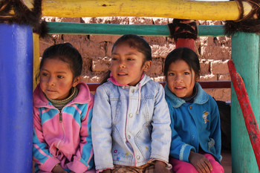
Espacios Amigables para Niños y Niñas
Reclutamiento & Selección
Alejandro Kirchuk for SC/ Peru/ 2012

Slide 2
Objetivos
Al finalizar esta sesión, los participantes conocerán:
Los seis pasos del ciclo de reclutamiento y selección
Ocho principios de orientación para el proceso de reclutamiento y selección
Por lo menos cinco métodos para atraer candidatos y cinco métodos para seleccionarlos

Slide 3
Esquema de la Sesión
Términos clave
Etapas del reclutamiento & proceso de selección
Planificar las necesidades de RH
  Consideraciones
  Mapeo de la fuerza laboral
  Estructura del equipo
  Competencias & descripciones de trabajo
  Apoyos
  Selección
  Nombramiento

Slide 4
Definición de términos clave
Descripción de trabajo:
Detalles de las tareas, funciones & responsabilidades asociadas con el trabajo
Especificación de personas:
Perfil del tipo de persona que se necesita
Reclutamiento:
Proceso de atraer, filtrar, seleccionar & nombrar
Notes:
Job description: Details and description of tasks, functions, responsibilities associated with a given job
Person specification: profile of the type of person needed to do a job. It is part of the job description
Recruitment: the process of attracting, screening, selecting, and appointing a qualified person for a job. Recruitment/placement is the starting point of an organization’s overall employment policy. It covers both hiring new talent and reassigning serving staff, including those on inter-agency transfer, secondment or loan.

Slide 5
Candidato:
Una persona que envía su solicitud para una posición
Entrevista: Proceso en el cuál un empleado en potencia es evaluado por el empleador para establecer si la persona es apropiada para el trabajo
Selección:
Proceso para determinar cuál candidato es el más apropiado para el trabajo
Notes:
Candidate: a person who applies for a job
Interview: process in which a potential employee is evaluated by an employer to establish whether they are suitable for a position of employment
Selection: process of determining which candidate is most suitable for, competent to do it. As well as ensuring that they are interested in doing the job

Slide 6
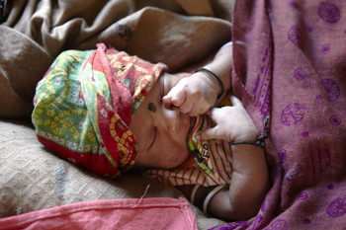
Proceso de selección & Principios
India 2011 / Hall for SC

Slide 7
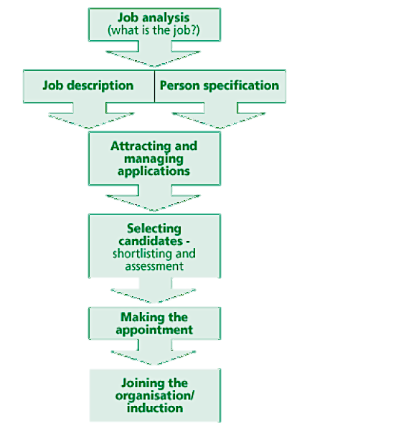
Pasos principales del reclutamiento & el proceso de selección
1
Planificación de las necesidades de RH
2
3
Seleccionar al equipo
4
5
6
Unirse a la Organización
Notes:
The main stages of the recruitment and selection process
Job analysis
Job description & person specification – 1 & 2 make up the planning of HR needs
Attracting and managing applications
Selecting candidates
Making the appointment - steps 3, 4, & 5 make up the process for selecting the team
Joining the organisation – includes logistics. Induction touch on here but cover in more detail in the “strengthening the team” session later
We will cover these in 3 main sections of this session – 1. Planning HR needs 2. Selecting the team 3. Joining the organisation

Slide 8
Principios de Directríz
  Ser transparente
  Ser oportuno
  Efectividad de Costo
  Equitativo
  Asegurar que no haya conflicto de interés
  No hacer daño
  Culturalmente apropiado
  Coordinar
Notes:
Be transparent - Need to be fair and transparent – go through an open recruitment process, do not promote individuals without being clear about why, how long for, on what basis
Timely – set a schedule for recruitment and stick to it. Involve others in the organisation in planning of recruitment (logs, HR, operations management, etc). Give feedback to candidates when you say you will
Cost effective – consider costs of different methods when choosing selection process
Be equitable - Be fair and impartial. Reflect policy of equal opportunities for all / diversity & non-discrimination. Consider the ethnic, religious, racial, & gender balance in the community you will be working with. Ensure that those with disabilities are also fairly recruited into your team to promote diversity in the workplace.
Ensure no conflict of interest – any links between those selecting & candidates /possible future employees must be declared & influence this may have on selection process must be discussed
Do No Harm – be aware of any community level tensions or conflicts. Do not demonstrate a bias in your recruitment towards one ethnic / religious / racial / national group that may exacerbate existing prejudices. Ensure your staff team is representative of the population you are here to help. Ensure your team reflects neutrality of the agency.
Ensure the way you operate is culturally appropriate
Coordinate with other agencies and with other sectors/teams within your own agency – Two main reasons: 1. You need to plan resourcing and logistics with other teams. 2. You also need to make sure you are not competing with other agencies (different salary scales), or undermining capacity of your partners by recruiting all their staff

Slide 9
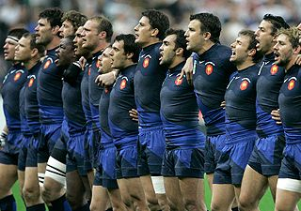
Notes:
Before including this slide, do confirm that participants in this context are familiar with the game of rugby, they do not need to know rules or understand the game, but they should have heard of it.
Thinking about this session, what we are really talking about is a team, how you identify the team, build a team, make them work together to achieve a goal.
This is a picture of the national French Rugby team, one of best teams in the world. Each individual player is considered one of best players in the world. The captain’s job is to make the best use of ALL the different strengths in that team. That is what we are talking about today, how to select individuals for their different strengths, train them and enable them to become a team and support them so they continue to reach their full potential. Each player is different, we are choosing them as individuals, because they fit together, with different strengths and weaknesses to make a strong whole.
We will look now at how to choose the range of people we need to make the team

Slide 10
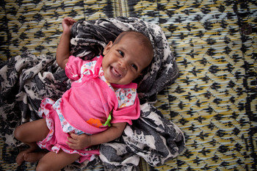
Planificación de las Necesidades de Recursos Humanos
Kenya 2011 / Crowley for SC

Slide 11
Análisis de trabajo:
Preguntas para considerar:
    Necesidades de Programa
    Coordinación & representación
    Cómo trabajará con socios
    Estructura de gerencia de línea
    Por cuánto tiempo necesita el personal
    Fuerza laboral disponible
Notes:
Questions to consider when planning no. of positions & roles they will fill
Programme needs:
Areas to be covered
What was agreed with other agencies with regards to the support you would be giving to the emergency response.
How many CFS you will have in these areas?
How many children will come to each CFS?
What activities are you running out of your CF Spaces (FTR, GBV, case management). Will these all need specific focal points?
What mix of paid staff vs. community volunteers will you have to fill these positions?
Based on above you will need to estimate the number of staff you need per site – this can always be increased or decreased later if you review properly how it is going
What are needs in terms of coordination of CF Space work at community, district and national level. What representation, policy and advocacy work will be associated with this? What percentage of more senior staff or management time will you need to allocate to this.
How will you work with and through partner agencies
Are you directly implementing? Or supervising work of partners? How will you work with other agencies (UN, International NGOs, local NGOs, community based groups, government). Will this take more or less staff time?
Line management structure
Will technical staff be line managing your technical teams, or will they be managed by operations (field office managers, base managers, etc.)
How will you supervise and monitor the activities in the CF Space programme ? Who will do it? How often will they visit the CFS?
How long do you need staff for? How long will you be in critical emergency phase, transition, early recovery?
Workforce available – what workforce is available. The next slide will look at this in more detail

Slide 12
Mapeo del personal disponible
Durante el proceso de evaluación de necesidades de CP
  ID de personas trabajando con niños y niñas
  Haga un mapa de las respuestas de la comunidad
  Est. la capacidad a nivel de la comunidad
  Identifique al personal y los recursos disponibles
  Te permite ver los vacíos para llenarlos
Notes:
During CP needs assessment process:
Identify individuals skilled in working with children – teachers, nurses, social workers – who are not currently employed, maybe they are also displaced
Identify community level committees that existed before, not only CP or PTA committees, but all forms of groups and committees who meet regularly, who you could work with and train to identify and refer cases or engage in awareness raising
Establish capacity of people at community level to provide support for children – what do they do already to respond to cases of vulnerable children (out of school, survivors of abuse, separated from family) – does this indicate less or more need for community level staffing
Staffing and services already available – what are the organisations and staff working at different levels, what are they doing, how will you work with them, could they second staff to your organisation?
Enables you to see human resources available to you at community level and gaps for you to fill

Slide 13
Individuos que pueden componer su fuerza laboral
  Voluntarios individuales de la comunidad
  Miembros de comité
  Personal pagado
  Personal transferido de equipos pre-existentes
  Personal de socios
  Personal temporal
  Equipos de respuesta rápida
Notes:
People you can draw on to implement your programme:
Individual community volunteers
Committee members
Paid part-time, full-time, short-, medium- or long-term staff
Permanent staff from pre-existing teams who change role
Partner staff
Secondees (government, local NGO, schools, etc.)
Rapid response teams – global, regional and national
Key messages:
Wherever possible, select animators and CFS staff from the affected group, identifying natural helpers by asking to whom boys and girls go when they need help and support. (From Guidelines for CFS in Emergencies)
Considering this whole range of options will enable you to fill roles needed in creative and different ways suitable to the context and in way that makes your actions sustainable

Slide 14
Descripciones de trabajo
Categorías clave:
Ubicación, duración, salario & beneficios
Nivel de contacto con los niños y niñas
Supervisor – líneas de mando
Funciones & Responsabilidades / Deberes : finanzas, admin., RH, actividades en espacios CF, trabajo con las comunidades
Competencias: Esenciales, deseables
Notes:
It is a really important part of transparency that a Job Description exists, including the person specification, and that criteria of suitability for the role are established and documented so that people know about them. This ensures transparency and fairness.

Slide 15


Especificación de Persona: Competencias que busca
Desarrollo de actividades para niños y niñas
Consejería
Supervisión de Personal
Administración
Representación & negociación
Idioma local
Monitoreo & Evaluación
Coordinación
Finanzas & presupuesto
Movilizar un Equipo
Enlace con la Comunidad
Habilidades profesionales
Notes:
Can you call out some forms of skills or competencies we want different staff and volunteers to have?
Each piece of the puzzle is different
These are some examples skills and competencies you will look for among members of your team?
Do you need all your staff to have all these skills?
Do not answer out loud, but do you think you as an individual would score 10 out of 10 for all these skills of you were tested on them.
The likelihood is not… [facilitator can identify some areas of weakness they have at this point if they are comfortable with sharing this, and how in teams they have worked in they have identified others who can address the gaps]… we seek to build a team of different people who each have different skills… and then they make the whole picture we are looking for
Are there other skills your team members have which are not listed here? Facilitator should clarify that we are talking about skills that are relevant to their CF Spaces work and meeting objectives of CFS, give feedback on those skills called out and how they contribute to objectives of CF Spaces.

Slide 16
Actividad
Hacer una lista corta para la entrevista
¿Cuáles son las cualidades clave y más importantes que busca en su personal?
Escriba las 3 cualidades más importantes que buscará, cada una en un papelito diferente
Notes:
You are short listing for interview – it is an opportunity for seeing some personal qualities – you need to think about what the key personal qualities might be?
Write down 3 qualities each on a separate post-it note

Slide 17
Buzón de Prioridad
Divida el grupo en 4 grupos de 5 personas
Use una cajilla de prioridad para negociar lo deseable, imp. & esencial
Descarte cualquier duplicado
Deseable
Importante – max. 3
Esencial – max. 3
Notes:
Break into 4 groups of 5 people
Use priority box to negotiate the most important qualities / competencies
You have 10 mins for this
2 mins per group to present your priority boxes at the end

Slide 18
Personal que se necesita para la implementación de la actividad
Tiempo Completo
Animadores
Supervisores de CFS
Oficiales de Programa de CP
Medio Tiempo
Divulgación
Trabajadores de Casos
Capacitadores especialistas
Gerente de programa de CP
Notes:
Depending on the scale and nature of your CF Space programme you will likely need full time support from…
CFS / CP Technical Team: Animators, CF Space supervisors, CP Programme Officers
And you will need part time support from:
Outreach, case workers, Specialist trainers, CP Programme manager

Slide 19
Estructura del Personal
Animadores / facilitadores – 2 en sitio
Gerente de CFS – 1 en sitio
Coordinador de CFS / Supervisor – cubriendo 10 – 15 CFS
CP / Oficial de Programa de Educación – el personal de la agencia supervisa a los coordinadores
Puntos Focales – divulgación
Notes:
Animators / Facilitators – Responsible for the implementation at the CFS; works directly with children – minimum of two on site at any given time, depends on no. of children & size of space
CFS Manager – this can be one of the 2 animators if it is a small CF Space. It should be clear that they fill this management role. Responsible for: The manager’s main responsibilities include: - Daily administration & Finances; - Completing monitoring reports - Assessment & assurance of quality care in the CFS; - Assistance in the development & implementation of programmes & activities; - On site HR for staff and volunteers: Recruitment; appoint staff or focal points for specific activities (ie. inspection of equipment), supervision & evaluation of performance; & identification of training & capacity building needs
CFS Coordinator - If there are several CFS established in one area, there should be an appointed coordinator, supervised by the child protection officer/education officer. He/she is responsible for the different CFS; a recommended structure is 10-15 spaces within a 2-hour radius. Follow-up visits should be conducted by the coordinators on a weekly basis to - Provide ongoing support& Problem solving, - Observe children and the activities, - Ensure referral systems are functioning effectively
CP / Education Programme Officer – agency staff – oversee work of coordinators - Can cover a wide region, need only check-in on sample of CFS at intervals
Focal points – Outreach in community - There may already be a range of formal and informally organised recreational and play activities set up in the area. Focal points can be appointed to promote and enhance the recreational activities on behalf of the CFS. These individuals can help to organize/link other programmes. Focal points are encouraged to consult with camp managers, parents, caregivers, elders, children and other family members for available resources in the community.
From principles:
At present, there is no universally accepted management system for CFSs, or names for the various roles and positions involved in establishing and running CFSs. A common structure is to have a supervisor (international or national staff) - with expertise in child protection, emergency education, and/or psychosocial support - who supervises several “area managers” who oversee multiple CFSs and also national staff who train and support the people who implement particular CFSs. Usually, each CFS has a supervisor who oversees the CFS operations and the people who work in it, including the people (staff or community volunteers) who work specifically with children. In this document, the term ‘CFS workers’ refers broadly to all the people who actively organize activities for children in the CFSs or visit CFSs regularly to support the people working there. The term ‘animators’ refers specifically to people (staff or volunteers) who conduct activities with children on a regular basis, while the term ‘activity specialists’ refers to people who come in occasionally to conduct a specific activity such as traditional dancing.

Slide 20
Ejemplo de Cote d’Ivoire 2011
Gerente de Programa de Protección de la Niñez
Oficial de CP para CFS – W
Coordinador de CFS – Guiglo
Coordinador de CFS – Man
Oficial de CP para CFS – S
GBV
CFS Blolequin
Aline –Gerente
Marie Chantal – Animador
CFS Ziaglo
Beatrice – Gerente
Valerie - Animador
CAAFAG
Punto focal de GBV
Movilizador de la Comunidad
Punto focal de FTR
FTR
Gerente de Programa/ Director / Jefe / Coordinador: Principal a nivel de la agencia, gestión del programa – cubre todos los aspectos de CP, Educación o Violencia Basada en Género (GBV)
Oficiales Principales de CP – personal de la agencia – 100% CFS, cobertura sobre todo el país / cierta área
Coordinadores de CFS – Cubren área específica, incluyendo de 10 a 15 CFS
Gerentes de CFS & Animadores/ Facilitadores – implementación de actividades – incluye por lo menos un gerente
Puntos focales – divulgación y extensión con la CFS como base – apoyan otros aspectos de CP / Educación / GBV o aseguran un mayor alcance de las actividades
Notes:
Just to remind you, not everyone has to have all the skills. All the qualities we look for in the team. All have a different role to play.
Even if have same job title – give example of a team you have worked with, where individuals in same “position” had different strengths

Slide 21
Apoyo de otros equipos para implementar el CFS
Equipo de logística: adquisicioens, conductores, personal de seguridad
Oficial de Finanzas
Oficial de RH
Oficial de M&E / rendición de cuentas
Traductores
Equipo Admin. - aseadores
Otros sectores
Debe:
  Informar de las necesidades, plan y presupuesto
Notes:
Staff support from other teams – this list reflects fact you will need a proportion of other staff individuals time, to be able to deliver your programme, including:
Logistics / procurement staff, drivers, security
Finance officer
HR Officer
M&E / accountability officer
Translators – can be shared with other teams, or you can hire your own
Admin – cleaners
Other sectors
There are many support roles that are essential: translators, Administrative staff, Finance officer . You may need them specifically to work for CFS programme, or may work full time for CP/ Education programme, or could work for other sectors in the organisation. All these posts depend on the scale of programme and thus amount of work you have for them to do, as well as the funding you have available to pay them. E.g. in Myanmar team was so large SC had 2 finance team members, 3 M&E staff, and two administrators for the CP programme, a large part of which was CFS. Admin & finance can be one combined post. Other responses, are smaller, with smaller funding (e.g. Bangladesh Sidr 2008, Cote d’Ivoire 2011, the funding smaller so just draw from support from other teams
Key message: For these roles you need to be in touch with the other operations and support teams, be clear on your support needs, planning and timelines as well as the budget you have available - including them in planning processes, budget for a proportion of their salaries

Slide 22
Otras consideraciones clave
¿Tiene los recursos?
¿Tiene la autoridad para reclutar?
¿Cómo asegurará la colaboración inter-agencial?
Notes:
Do you have the resources? Do you have enough funding coming in to support the payment of salary and other associated costs (such as benefits, transport needs, materials, computer, desk, etc) for the position?
Do you have the authority to recruit? Or do you have to seek authorisation and or agreement from others such as HR, admin and finance teams?
How will you ensure inter-agency collaboration?
Do not offend other agencies you collaborate with by creating competition for staff – offering higher salaries, or positions with greater responsibility - have an idea of other agencies’ needs and plans for mobilising staff too – confirm with staff that they will serve their full notice periods – whilst respecting confidentiality of the individual candidates inform other agencies if multiple staff are applying for roles with your organisation and this may leave their team under-staffed
Discuss possibility of jointly paying staff positions, seconding from other organisations or to other agencies – this can help you meet your needs and support staff development and sustainability, you can also jointly advertise jobs reducing costs
Negotiate with government, local NGO partners and communities with regards to how they can all support to response and work together – explore possibilities of secondments, training staff, etc.
3 way conversation on notice periods – discuss with staff member and previous employer when their start date with your organisation will be – do not leave other partner organisations struggling

Slide 23
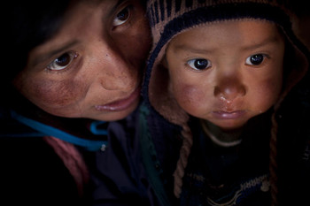
Selección del equipo
Peru 2012 / A. Kirchuk for SC

Slide 24
Atrayendo Solicitantes
  Use anuncios de radio o TV
  Mensajes de texto
  Afiches, letreros y murales
  Converse con los líderes de la comunidad
  Envíe a “griots” ( comunicadores tradicionales de boca en boca)
  Trabaje con las agencias nacionales en asociación
Notes:
Use radio or TV announcements depending on the technology available in the context
Text messages
Posters and/ or billboards and / or signs
Work with national partner agencies to identify community level volunteers
Seek advice & authorisation from community leaders
Send out individuals who can spread messages for you. Many cultures have griots, town criers, or other traditional means of sending out messages in the community. to call for interested parties to come forward to apply for roles

Slide 25
Selección de candidatos: métodos
  Cartas de portada, CVs & Formularios para aplicar
  Identifique individuos durante actividades
  Entrevistas 1 a 1 o grupos pequeños
  Taller de ½ día o 1 día
  Prueba
  Referencias o recomendaciones
    Criterios de selección alineados con la especificación de trabajo
Notes:
The selection method you choose will depend on the situation, time you have, location, access, post you are recruiting for etc
Cover letters, CVs & application forms – you may want to ask people to submit an application in writing, and based on this you may identify certain candidates you would like to take forward, and others who are not suitable for the post
Identify individuals during activity implementation – if you see some highly active and passionate individuals who report to have worked as teachers, nurses or in another role with children, approach them and ask if they are interested
Interviews on 1-to-1 or in small groups
½ - 1 day workshop to identify candidates
Test – may ask them to do a supervised written test (writing a communication item, report, letter, doing a budget), role play, presentations, in-tray exercise
Any interview & tests need to be designed in line with the functions of the role – identifying how candidates meet job specification
Individuals who are referred or recommended by community, leaders, partner agencies or government representatives
Key messages:
Make sure the selection method you choose is suitable to the context & the position. You are in a rush because it is an emergency, but you must still adhere to best practice and HR principles
Before starting selection process ensure you criteria of suitability are agreed, transparent & relevant to the job

Slide 26
Selección de candidatos: Mejores Prácticas
  Entrevista & prueba alineada con la función
  Recomendaciones & refs v.imp
  Proceso de reclutamiento armonizado
  Habilidad complementaria & competencia
  Construir la capacidad local y nacional
  Monitoreo y mantención de registros a lo largo del proceso
Notes:
Test and interview in line with skills and functions of the role – e.g. if written skills not important, do not do a written test but do a team work exercise
Recommendations and references – sometimes you may not have time for interviews and this is all you have to rely on – but do always carry out CP checks. References are very important for roles in the organisation where staff and volunteers will have contact with children. (confirm they behaves appropriately with children)
Harmonised recruitment process – same process throughout the country – same questions and procedures and criteria
Recognise need for different skills and competencies that are complementary – select staff to fill a role, but also consider how there skills will contribute to the skills of others in the team they will be working with
Seek to build local and national capacity to meet needs rather than recruit international staff, as this is more sustainable in addressing long term concerns in-country
Monitoring and record keeping throughout process - Clear record of all stages, steps and decisions made. These records need to be retained in case any decisions are challenged and / or feedback is requested. It is also helpful to maintain records and monitor candidate profile via a confidential equal opportunities questionnaire

Slide 27
En la selección, sea consciente de…
  Tendencia de mirar positivamente a quienes son similares
  Hacer estereotipos
  Encaje persona-trabajo vs. encaje persona-org.
  La publicidad requiere respaldo
  Afecta cómo las personas ven la organización
Notes:
Tendency of recruiters to look positively on similarities with themselves and negatively on differences (halo and horns effects)
The stereotyping effect. Interviewers sometimes assume that particular characteristics are typical of members of a particular group. In the case of sex, race, disability, marital status or ex-offenders, decisions made on this basis are often illegal. However, the effect occurs in the case of all kinds of social groups.
The person-job fit approach concentrates on measuring the candidate's attributes in relation to the specific job vacancy. The person-organisation fit approach considers how well suited the candidate is to the organisation. The traditional approach to recruitment and selection is based on the view that organisations should specify the requirements of the job as closely as possible and then look for individuals whose personal attributes fit those requirements. Person-organisation fit approach stress that an important consideration in recruitment is how suited the applicant is to the organisation – its style, approach, pace of change and informal ways of working. In other words, you need to think beyond whether someone simply has the technical skills to perform in the job and assess their fit with the culture of the organisation.
All advertising requires effective back-up: recruitment administration, shortlisting, filing, and reference processes
Selection process affects how people view the organisation – if they are not respected and treated appropriately during the recruitment process, they will view the organisation negatively, and may tell others about this negative perception

Slide 28
Actividad: Selección
Revise las preguntas de la entrevista que se le asignaron individualmente
Decida si cada pregunta es apropiada o no
Si no, piense en POR QUÉ no es apropiada
Tiene 5 minutos

Slide 29
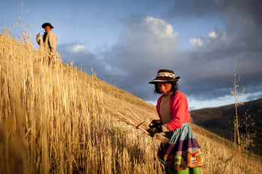
Nombramiento de los candidatos seleccionados
Peru 2012 / A. Kirchuk for SC

Slide 30
Hacer la oferta
  Haga la oferta al candidato seleccionado teniendo en cuenta de hacer la verificación debida
  Informe a los candidatos que no fueron seleccionados
  Haga las debidas verificaciones:
  Referencias laborales
  Verificaciones médicas
  Aprobación de protección de niñez
  Permiso de trabajo/visa
  Evidencia de calificaciones (Ejem: licencia para conducir, habilidades de idiomas)
Notes:
Make offer to selected candidate pending due diligence checks
Inform unsuccessful candidates
Carry out due diligence checks:
Employment references
Pre-employment medical checks
Child protection clearance – where appropriate
Work permit/visa checks and applications
Proof of qualifications necessary for the job (e.g. chartered accountant, driving license, engineering qualification)

Slide 31
Nombramiento de Personal
Emita carta de nombramiento
Adjunte al contrato
    Términos de referencia
    Duración
    Clausula de Protección de la Niñez
    Descripción de trabajo
Notes:
Contracts
Terms and conditions
Child Protection Clause
Attach job description

Slide 32
Unirse a la Organización
Peru 2012 / A. Kirchuk for SC

Slide 33
Apoyos que se necesitan para el equipo del personal
    Logística: Espacio, vehículos, escritorios
    Finanzas: Salarios y pagos
    RH: Contratos, copias de políticas, inducciones
    Otros sectores
    ¿Cuándo, dónde y cuántos?
Notes:
Staffing needs additional supports, you need also to plan the following supports when increasing your staff team and ensure they are in place before the staff start working:
Logistics: space, vehicles, desks
Finances: salaries and payments
HR: Contracts, copies of policies, inductions
Other sector: especially collaboration with Education, Health, WASH, etc. What time will you need from them? How will you work with them? Will you share some posts (such as community mobilisers, behavioural change communicators, facilitators) with these other teams
Time line – you need to provide information on when you plan to recruit, how many, where, etc
You need to make sure this is all in place before you hire

Slide 34
Asegúrese de que como mínimo se de lo siguiente:
Confirmación de que el contrato se firmó y se le dio una copia al miembro del personal
Inducción
Información de Políticas y Procedimientos
Notes:
Contract signed
Contract needs to be signed by both the staff member and a representative from the organisation.
A copy should be kept by the organisation and a copy given to staff member. In some cases this is not feasible before the start date, in these cases it should happen on the first day of work at the latest
Induction (further detail in the training session)
This includes a briefing on the organisation, and the programme (plans and objectives), explaining what the organisation and/or the team are trying to achieve
What is expected of the selected staff member, their role, what can they expect from others, etc. Covers activities they will be expected to carry out, the tools they will use, activities to be done, schedules
Introductions to key contacts within the team, organisation and externally
Briefing on Organisational Policies and Procedures
Codes of Conduct, guidance on behaviour, child safeguarding policies
Procedures such as how to order equipment, get salary, book leave, organise vehicles, etc

Slide 35
Actividad de Recap.
Repase el documento de los Principios (Diapositiva 7) & Etapas de Reclutamiento & Selección (Diapositiva 8)
Se le asignará una etapa del proceso a cada grupo de 4 personas
Debe pensar en acciones clave que se pueda llevar para asegurar que el apego a los principios
10 min.

Slide 36
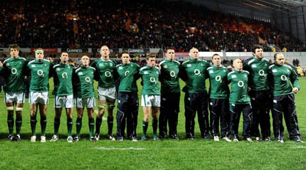
Notes:
Going back to our Rugby team?
What can you see about these different players? Do they all look the same? - Discuss the team positions and the different roles / qualities required
No, they are not all the same, each one is individual, different heights, weights, with different skills and abilities. This range of difference is needed to make the team work.
Its much the same in whatever field we are working.
decide we need a team
carefully consider what we want the team to achieve
plan the structure of the team
advertise posts
applicants apply - at this stage applicants are self selecting – applying shows motivation AND formal qualifications and experience
We short list for interview – an opportunity to see some personal qualities
When we appoint we often still know very little about the level of required skills each individual has
We simply have to let people have a go – almost certainly people will require some support training of some kind

Slide 37
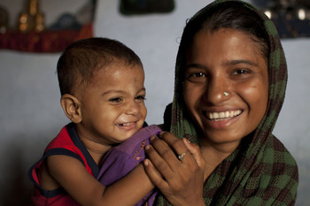
Recursos Clave
Change photo
India 2012/ Suzanne Lee for SC

Slide 38
Referencias Clave
People in Aid, 2008, Guía de la politica & Plantilla: Reclutamiento & Selección
Save the Children, 2008, CFS Handbook (Manual para Espacios Amigables para Niños y Niñas) – p.15-16 & Anexos 20 – 23
UNICEF, Guía Práctica para desarrollar CFS, p.74-78

Slide 39
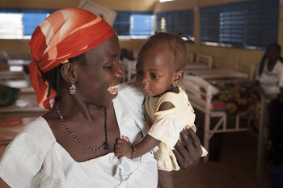
Recap de la Sesión
Niger 2012 /
J.Hyams for SC

Slide 40
Recap.
Los participantes podrán…
Definir los siguientes términos: monitoreo, evaluación, indicadores y rendición de cuentas
Comprender la importancia del monitoreo participativo, la evaluación y los mecanismos de rendición de cuentas
Comprender los enlaces entre los sistemas administrativos y M&E y mecanismos de rendición de cuentas

Slide 41

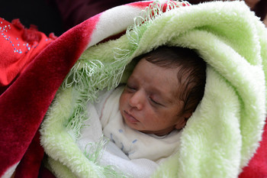
Final
Lebanon 2012/ Tarling for SC
Lebanon 2012/ E. Lima for SC

