Slide 1
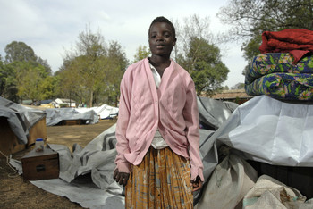
Recursos Humanos para los Espacios Amigables para Niños y Niñas
Kenya 2008/ F. Courbet for SC

Slide 2
Objetivos
Los participantes…
Comprenderán los términos fundamentales de Recursos Humanos
Conocerán por qué las prácticas efectivas & eficientes de recursos humanos son esenciales para los programas de espacios amigables para niños y niñas
Conocerán las seis etapas de la selección de recursos humanos & el ciclo de
Conocerán los principios subyacentes de recursos humanos en agencias humanitarias

Slide 3
Esquema
Definición de términos clave
Movilización de personal & el ciclo de fortalecimiento
Desafíos clave para la dotación de personal para CP
Establecer la política & práctica

Slide 4
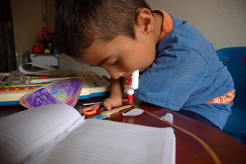
Definiciones
Colombia 2008 / D.Alder for SC
Notes:
Colombia. 2008. Dan Alder. SC

Slide 5
Definición de términos clave
Competencia:
Experiencia, habilidades y comportamientos requeridos para ejecutar un trabajo particular con efectividad
Fuerza laboral:
Aquellos que trabajan sólo para una organización o aquellos que están disponible para trabajar en el contexto donde está trabajando la organización Recursos Humanos (RH):
Grupo de individuos que componen la fuerza laboral de una organización
Notes:
Competency: Experience, skills, behaviours required to perform effectively in a given job, role or situation. Competencies are what a person has or can acquire, i.e. a characteristic, attitude, skill, aspect of one’s self-image, or body of knowledge and behaviour which s/he uses.
Work-force: Used to describe those working for a single organisation or those that are available for work in the context where the organisation is working – here we will use this term to describe those who are external and internal to the organisation, who we can see as available to help us achieve our mission
Human resources: Set of individuals who make up the workforce of an organization. Here we will use this term to describe all paid staff (part or full time, long, medium or short term), volunteers, partner staff and committee members working with and for your organisations to help deliver CF Space programme objectives

Slide 6
Personal:
Todas las personas empleadas por una organización particular
Desarrollo de Capacidades:
Fortalecimiento de destrezas, competencias & habilidades de las personas & comunidades
Supervisión:
Forma para medir el avance del trabajo de un individuo que forma parte del personal, el bienestar personal y profesional & el desarrollo de habilidades
Notes:
Staff: All the people employed by a particular organisation. In this case we are referring to those working for the organisation who are benefitting from a formal contract and salary
Capacity building: Capacity building often refers to strengthening the skills, competencies and abilities of people and communities. It also involves the establishment of conditions that will allow individuals to engage in the "process of learning and adapting to change”
Supervision is the process to ensure personal and professional welfare of staff, progress of their work, as well as a means to support staff to make sure they are professionally challenged and develop. It is a process that helps build their skills and that helps them to improve the quality of their work. It is also the primary source of support to staff undertaking work that can at times be demanding and stressful. Supervision will involve an individual face - to - face meeting between a staff member and their manager or practice supervisor

Slide 7
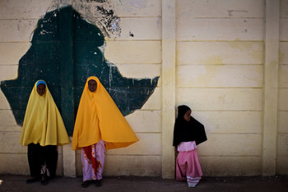
Movilización del personal & ciclo de fortalecimiento
Ethiopia 2009/ Guy Calaf for SC
Notes:
Staff mobilisation & strengthening cycle

Slide 8
Movilización del personal & ciclo de fortalecimiento
Establecer política & práctica
Aprendizaje, capacitación & Desarrollo
Gestionar, Apoyar y Supervisar
Terminación de la relación laboral
Seleccionar el equipo
Planificar las necesidades de RH
1
6
2
5
3
4
Notes:
Identifying your staff, volunteer & support needs – developing a team structure, clarifying roles and responsibilities. Mapping out what volunteers and community groups you will need to be able to create outreach
Policies and practices – what is your compensation scheme, what benefits will groups and individuals get, what roles and responsibilities will they have – all this needs to be documented and transparent
Recruiting, selecting and identifying the individuals or community members and groups who will help you meet those needs – firstly by mapping who is available, then by going through a selection process - sharing the information on policies and practices with those who are identified to help
Learning, training & development – knowing what the competencies are – identifying skills needed - putting together a training plan to address the gaps
Managing, supporting and supervising – ensuring performance, appropriate behaviour and wellbeing
Ending the working relationship – being open and honest on duration, and what will happen when programme ends, giving advance warning
This can feed back into re-recruitment if you have new programmes starting or another emergency.
1st session (this current session) today we will cover policy
2nd session: planning resource needs & selecting your team
3rd session: Learning, training & development
4th session: managing, supporting, supervising & ending the working relationship

Slide 9
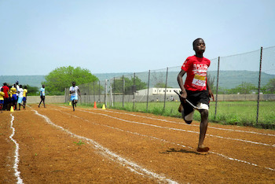
Desafíos
Mozambique 2012 / Save the Children

Slide 10
Desafíos Clave para Dotación de Personal de CP
  Los programas de CP se enfocan en los recursos humanos en vez de los materiales
  Equipo de expansión rápida durante una emergencia
  Otras agencias & sectores están reclutando
    La financiación puede ser limitada
    La capacitación global es limitada
  Protección nacional de la niñez es limitada en muchos países (fuerza laboral social)
Notes:
Child protection programme focus on human rather than material resources
Humanitarian responses require rapidly expanding a team in emergency context
Other agencies & sectors all recruiting at same time for similar roles
Child protection is an emerging discipline in humanitarian response - Competency framework established 2010, CPiE Standards 2012
Funding for CP maybe limited – and often is – Child Protection is the second most under-resourced sector in humanitarian responses (CPWG Report “Too Little Too Late)
Global training opportunities are limited - CPTS 2005 – 2011 training entry level CP workers, Diploma being established for mid-level workers not yet started
National child protection (social workforce) limited in many countries where we work as welfare state under-developed

Slide 11
Como resultado, nosotros…
  Dependemos fuertemente en una variedad de formas de recursos humanos para hacer que nuestros programas funcionen
  Personal pagado, voluntarios, miembros de comités comunitarios
  Tenemos que invertir bastante en la capacitación de personal, socios y voluntarios para poder trabajar con niños y niñas y apoyar en las actividades de CP

Slide 12
¿Cuáles son algunos de los desafíos del reclutamiento & gestión de personal en este contexto?
Notes:
E.g. may include:
Recruitment of people with backgrounds unsuitable for working with children;
Large staff numbers required for CP programme implementation
Staff pulled from CP as they are not seen as “life-saving” or quanitfiable programmes
Unsuitable people get recruited leading to risk for children and the organisation;
All staff across all sectors need training to understand CP and the documentation needs to be in place.

Slide 13
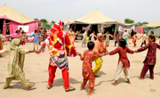
Establecer la política & la práctica
Pakistan / Plan International

Slide 14
Establecer la política y la práctica
  Asegúrese de apegarse a la ley nacional y la política de la organización
  Consulte con el personal en la etapa de desarrollo
  Informe a todo el personal de su contenido
  Haga referencia a ello en los contratos
  Comparta las versiones escritas
Notes:
Ensure you adhere to national legislation & organisation policy
Consult with staff when developing all policy and practice - We consult our field staff when we develop human resource policy: We recognise that we must implement, monitor and continuously develop our human resource policies in consultation with the people who work for us. We aim to include field personnel in this process, whether they are full-time, part-time, temporary, short-term or long-term members of our staff.
Brief all staff on content of all policies developed
Ensure they are referenced in contracts
Share written versions – pin them up on walls, distribute copies (one per staff member)

Slide 15
Lista de políticas clave & procedimientos
  Políticas:
  Permiso, salud & seguridad, paga equitativa & oportunidades, beneficios, VIH/SIDA, diversidad
  Códigos de Conducta: Política de CP, fraude, etc.
  Procedimiento con directrices para la práctica:
  Escalas salariales
  Funciones y responsabilidades
  Términos & condiciones
  Herramientas de evaluación, aprendizaje & desarrollo
Notes:
Policies:
Leave, health and safety, security, equal pay and opportunities, benefits, HIV/AIDS, diversity (gender, disability)
Codes of Conduct – fraud, child protection, whistleblowing, etc.
Practice:
Salary scales in line with others agencies, other sectors, other geographical regions
Documented roles and responsibilities
Terms and Conditions harmonised & documented
Appraisal and learning & development tools tools designed and rolled out to managers

Slide 16
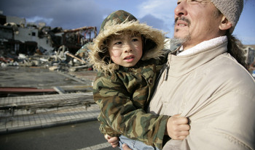
Japan 2011 / J.Walker for SC
Notes:
Jensen Walker for SC. 2011. Japan

