Slide 1
History of Child Friendly Spaces

Slide 2
Session objectives
By the end of the session participants will…
Know the history of Child Friendly Spaces
Start to recognise some of your own and other participants experiences with Child Friendly Spaces

Slide 3

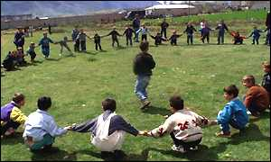









History of Child Friendly Spaces
1989
1999
2004 - 2009
Notes:
Just to put in context the work that is happening now… this is a pictorial representation of the history of CFS
1989: The United Nations Convention on the Rights of the Child (UNCRC) is a comprehensive, internationally binding agreement on the rights of children, adopted by the UN General Assembly in 1989. (Includes right to play – Article 31, freedom of expression – Article 13, right to education – Article 28, right to rehabilitation and psychosocial support, etc)
1999: UNICEF and ChildFund (then Christian Children’s Fund) both set up “Safe Spaces” in Kosovo
It is a young area of work, with little evidence of success
Only recently been able to make interagency advances to increase harmonisation and set standards – with increased recognition of work being done
2004/5: Hundreds of CFS established in Aceh, Indonesia, Sri Lanka, and Southern India after the Indian Ocean Tsunami by child-focused agencies including: IRC, UNICEF, Save the Children, World Vision, etc
2006: World Vision’s “Children in emergencies manual.” includes chapter on CFS
2007: INEE - Draft INEE Good Practice Guide on Emergency Spaces for Children (ESC)
2008: ChildFund and Save the Children both publish CFS Handbooks
2009: UNICEF (2009) publish: “A practical guide for developing child friendly spaces”

Slide 4





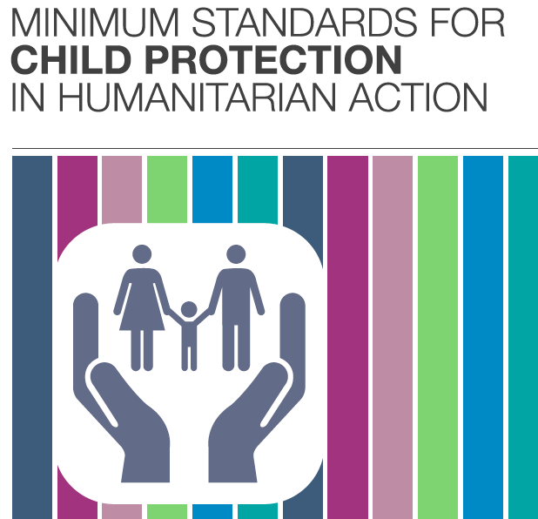
2010 – on-going
2011
2012
Notes:
2011: Protection principles, including mention of set-up of CFS, included in SPHERE manual
2010 – 2012: The Global Education Cluster, INEE, Child Protection Working Group, IASC Reference Group on Mental Health and Psychosocial Support and GBV Area of Responsibility support a process of inter-agency reflection, analysis and learning that aims to improve practice concerning CFSs as part of a wider program of learning for the strengthening of practice that interconnects CFS, school-based psychosocial support and peace-building.
2010 Draft CFS Toolkit
2011 Draft CFS Guidelines,
2012/2013 Training module development
2012 CPWG Produce "Minimum Standards for Child Protection in Humanitarian Action" In the minimum standards there is a section on CFS in the section on "Standards to develop adequate child protection strategies"

Slide 5
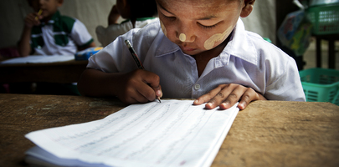
What is your experience with CFS?
Kibae Park for UN / Myanmar
/ 2011
Notes:
Grid:
What does it look like, what is the physical space like?
Who are the children inside it? What age, gender, race, religion etc are they?
Who is running it?
What are the children doing inside the space?

Slide 6
Your involvement with CFS
Take the map of the journey of your life we did during the introductory session
Add the following information:
  When did you first do work to set-up or run a CFS
  When did you last or most recently do work to set-up or run a CFS
  If you have never worked on CFS directly: When did you first hear about the idea of CFS? And how?
Notes:
Draw a history of key events in your life. It can be a mix of person and professional facts. Need to use only drawings, symbols or colours. Only share things you are happy to talk about with the whole group.
Now add the following information?
When did you first use a CFS? What year was it? Which country were you in? What kind of emergency? Who were you working with? If you have never directly worked on or with a CFS note on the history map when you first heard about CFS?
When did you mostly recently use a CFS? Where? What for? What was your role?
From what you have seen in CFS you have worked with:
What do you think is positive about CFS?
What do you think are the challenges in working with CFS?
Wrap-up
We will be sharing some of those experiences you have had throughout the workshop
We will discuss what works well and some of the challenges we confront along the way
Together we will try to generate ideas for finding solutions to the challenges appropriate to the context we are working in here

Slide 7
Discussion
From what you have seen or heard about CFS:
  What do you think is positive about CFS?
  What are the challenges in working with CFS?

Slide 8
Reason for increasingly frequent use
Potential for rapid deployment
Low relative costs per child
Scalability and adaptability of activities to diverse contexts
Tangible protection action
Notes:
There are a number of factors that have contributed to the frequent adoption of a CFS model in humanitarian emergencies.
These include:
potential for rapid deployment,
low relative costs,
scalability and adaptability of activities to diverse contexts (UNICEF, 2009).
They are also an especially visible and tangible action on behalf of protection actors. Child protection is something other sectors often struggle to understand, and CFS are a visible product of the work, which those in other sectors see the value of more clearly
The inherent flexibility of a CFS model, although originally intended for children aged 7 to 13, potentially accommodates children of all ages.

Slide 9
Some impact of CFS to date
Increased sense of safety & decrease in sexual exploitation and rape
Decrease in physical injuries since the start of the CFS intervention
Positive psychosocial outcomes for children / wider community
Increase social & emotional well-being of children
Limited evidence – though some increase in community knowledge & awareness of child protection concerns and available services
Notes:
Lack of overall rigour in M&E for CFS impact, but following are some initial findings from 2012 review of evidence:
Increased sense of safety and decrease in sexual exploitation and rape, were documented in 5 cases
Some studies noted a decrease in physical injuries since the start of the CFS intervention
All ten studies reported positive psychosocial outcomes for children and/or the wider community.
Eight studies indicated increases in social and emotional well-being of children, although in only four studies was this documented by difference between baseline and follow-up (rather than through retrospective judgments). In only one of these did the design allow such change to be reliably attributable to CFS. There was generally little documentation regarding sex differences in social and emotional well-being of children. However, one study reported girls having more difficulty accessing CFS services due to culturally inappropriate activities and the layout of the CFS compound acting as a deterrent to engagement
Increased community knowledge & awareness of child protection concerns and available services was noted in 3 studies – though evidence and robust documentation of impact in support of community engagement and/or involvement in CFS activities is limited. The influence of CFS on increasing community capacity for the protection and support of children was seldom reported on in detail.
There are other outcomes reported – such as improved understand of rights, assisting in process of identifying especially vulnerable children or children who have survived CP incidents – but we lack rigorous evidence
Outcomes depend on the nature of the emergency, and the form of the CF Space used in response

Slide 10
Key resources

Slide 11
Key resources
“Child Friendly Spaces: A Structured Review of the Current Evidence-Base,” 2012, Alastair Ager and Janna Metzler
“Guidelines for child friendly spaces in emergencies,” 2011, Child Protection Working Group, Global Education Cluster, INEE, & IASC.

