Slide 1
Child Friendly Spaces: Introduction to the training

Slide 2
Session objectives
By the end of the session participants will know…
The aims of the workshop
Understand the approach and ways of working
Know each other better

Slide 3
Session outline
Getting to know each other
Background to the workshop
Participants’ expectations
Objectives of the workshop
Workshop approach
Workshop agenda

Slide 4
Background to the workshop

Slide 5
Child Friendly Spaces defined
Are safe spaces where communities create nurturing environments in which children can access free & structured play, recreation, leisure & learning activities
Provide educational and psychosocial support & other activities that restore a sense of normality and continuity
Designed & operated in a participatory manner
Variable in design
Notes:
Are safe spaces where communities create nurturing environments in which children can access free & structured play, recreation, leisure and learning activities - try and be as safe as possible, sometimes in some contexts, cannot guarantee safety
May provide educational and psychosocial support and other activities that restore a sense of normality and continuity
Designed & operated in a participatory manner, often using existing spaces in the community and
Variable in design and target group - may serve a specific age group of children, or a variety of age ranges, different abilities. They may be a designated physical space, or maybe an activity in an open space

Slide 6
History of this project
2010 Global Education Cluster, INEE, Child Protection Working Group, IASC Reference Group on Mental Health and Psychosocial Support and GBV Area of Responsibility support inter-agency process
Aim to improve practice concerning CFSs as part of a wider program of learning
Notes:
In 2010 Global Education Cluster, INEE, Child Protection Working Group, IASC Reference Group on Mental Health and Psychosocial Support and GBV Area of Responsibility support a process of inter-agency reflection, analysis and learning that
Aims to improve practice concerning CFSs as part of a wider program of learning for the strengthening of practice that interconnects CFS, school-based psychosocial support and peace-building

Slide 7
Outputs of interagency project
Completed:
Systematic analysis of inter-agency commonalities & differences of approach regarding CFS
Principles for implementing CFSs
Preliminary, draft toolkit - tools from many sources
On-going:
Capacity building & tool development
Checklist for field workers
Notes:
A systematic analysis of inter-agency commonalities and differences of approach in developing, implementing, and evaluating CFSs.
Principles for implementing CFSs developed that drew on written materials and practitioner insights from many different countries and emergencies.
A preliminary, draft toolkit comprised of tools from many different sources, including the four agency manuals that had been reviewed as part of the inter-agency analysis of commonalities and differences.
Capacity building and tool development, which includes the development of the current training
Development of a checklist for Field Workers – an accessible, user friendly tool that can be used by workers in the field in the aftermath of an emergency

Slide 8
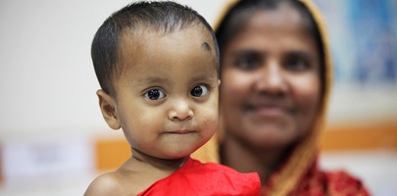
D. Ohana for UN/ Bangladesh / 2011
What are your expectations of the workshop?
Notes:
UN Photo/David Ohana

Slide 9
Workshop objectives

Slide 10
By the end of the 4 day training participants will have ...
Increased knowledge regarding mental health and psychosocial wellbeing of children in emergencies
Improved skills in supporting and strengthening teams working with children
Awareness of key resources available to them at national, regional and global level
Notes:
Increased knowledge regarding mental health and psychosocial wellbeing of children in emergencies, examples of different ways of working in CFS, models of CFS, understanding of different elements of management and planning for implementing CFS,
Improved skills in supporting and strengthening teams working with children, we will look at theory and put in to practice some key skills with regards to communicating with children, mobilising communities and working with teams
Awareness of key resources available to them at national, regional and global level – we will have the opportunity to understand what resources exist to support staff implementing CFS – that is electronic resources, on-line materials, manuals, guides, tools and individuals (agency and Cluster staff) as well as very importantly the support available in-country

Slide 11
Increased knowledge:
Key stages of child development and adolescence
How emergencies impact upon child development
Main elements of psychosocial support programmes in emergencies
Guiding principles of Child Friendly Spaces

Slide 12
Improved skills:
How to plan a child friendly spaces programme
How to work with existing structures, communities, & systems to build upon existing resilience & capacity & ensure wellbeing of children
How to supervise, support & train frontline staff working in CFS
How to mobilise resources for the CFS programme

Slide 13
Familiarity with key resources
Familiar with websites with access to range of key resources
  Mental Health and Psychosocial Support Network (mhpss.net)
  Child Protection Working Group (cpwg.net/)
Familiar with key resources on following two slides

Slide 14



Key resources – theory and principles
Notes:
Child Protection Working Group, Global Education Cluster, INEE, & IASC, Guidelines for child friendly spaces in emergencies, 2011
IASC Guidelines on Mental Health and Psychosocial Support in Emergency Settings, 2007
Child Protection Working Group (CPEG) Minimum Standards for Child Protection in Humanitarian Action, 2012

Slide 15
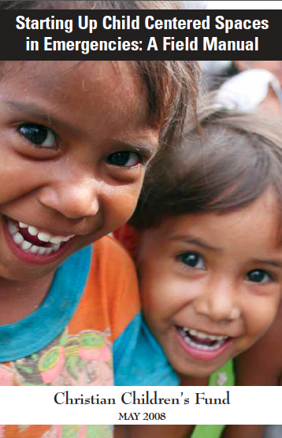

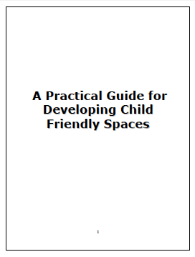


Key resources – detailed practical guidance
Notes:
CCF, Starting up child centred spaces in emergencies, 2008
Save the Children, Child Friendly Spaces Handbook, 2008
UNICEF, A practical guide for developing child friendly spaces, 2009
World Vision, Children in Emergencies Manual, 2006

Slide 16
Workshop approach

Slide 17
Approach
Interactive and participatory
Using range of different ways to communicate
Participants should ask questions immediately they occur, rather than wait until the end of a session

Slide 18
Ways of working
Participatory and experience sharing
Mixed media
Positive and solution focused
Equality and respect
Facilitators adapt to feedback
Punctuality and time-keeping
Notes:
Participatory and experience sharing – Drawing on all participants’ previous experience, recognising wealth and range of skills and experiences of the participants
Mixed media – Group activities, reading, visuals, action, listening
Positive and solution focused – we want to look at solutions not problems. When we discuss challenges we should seek ways to find solutions.
Equality of participation and respect for diversity – Listening and mutual respect
Facilitators will try to adapt the workshop sessions to feedback received as we go along, as far as possible or feasible working within resource constraints
Punctuality and time-keeping – this is very important and part of respect – keeping on time enables full and rich discussions - facilitator will have to go ahead and start sessions even if all participants are not there so as to be able to complete all work that needs to be covered during the 4 days

Slide 19
Evaluation and Feedback mechanisms
Evaluation forms - completed throughout the week
Evaluation flipchart - can add comments at any time
Two volunteers for each evening to collate verbal feedback during the course of the day and bring to trainers at 7pm
Notes:
Evaluation forms
To be completed throughout the course of the week and handed in on the last day
Evaluation flipchart
Participants can add comments at any time – please be specific and constructive – this will be reviewed at the end of every day
Verbal feedback
Two volunteers for each evening to collate feedback during the course of the day and bring to trainers at 7pm – need to select to volunteers for today now

Slide 20
Workshop agenda

Slide 21
Workshop agenda
 | Day 1 Theoretical background | Day 2 Preparedness and start-up | Day 3 Running the CFS programme | Day 4 Human resources
1 | Welcome and introductions | Preparedness | Ways of working | Staffing your team
2 | Child development & emergencies | Needs assessment and planning | Planning activities in the CFS | HR Management
3 | Psychosocial support framework | Community mobilisation | Administration Monitoring & Evaluation | Staff wellbeing
4 | Child Friendly Spaces purpose & principles | Resources and logistics | Exit strategies | Outstanding questions Close
Notes:
Indicate the copies of the week’s agenda distributed to each participant
Day 1 of the workshop gives theoretical foundations.
Day 2 and 3 follow the project / programme planning cycle (see next slide)
Day 4 focuses on staffing, supporting and strengthening the capacity of the human resource team

Slide 22
Stages of programme planning
Prepare
Coordinate
Undertake assessment
Set objectives based on assessment
Plan & implement activities based on objectives
Monitor and evaluate
Close / transition project
Notes:
The agenda follows the project cycle, which flows from preparedness to coordination, assessment, objectives, planning, implementation, M&E and closure. With lessons learnt feeding back into preparedness when a project ends.
Day 2 & 3 of the workshop will cover each of these stages of programme / project planning.

Slide 23
Journey of life

Slide 24
Draw the Journey of your Life
Divide flipchart into 6 sections
Mark with ages
Draw pictures of key events e.g.:
  Move town / start school or university / new job / get married / have child
  Use as little writing as possible
  Only put things you are comfortable talking about
  You have 10 minutes to draw
5 years old and under
6 - 10 years old
11 - 15 years old
15 - 18 years old
18 - 29 years old
30 + years old
Notes:
Divide flipchart into 5 sections
Mark with ages: 0-5, 6- 10, 11 - 15, 15 - 18, 18 years old +
Draw pictures of key events, examples might include:
Move town
Start school or university
Change job
Get married or have children
Use as little writing as possible
Only put things on paper that you are comfortable talking about in the group, these will go on the wall at the end of the day
You have 10 minutes to draw
These need to be kept throughout the day as we will be adding to them, and then at the end of the day we will put them on the wall

