Slide 1
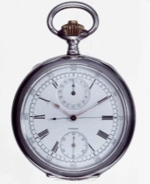
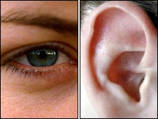
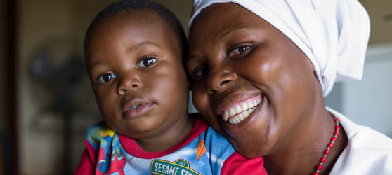
Day 2 Reflection and Today
M3 – S2

Slide 2

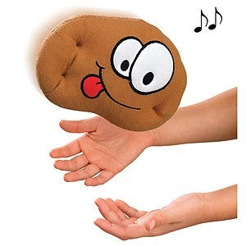
Review of Day 1 and 2 – Hot Potato…
We have a very hot potato
Toss the hot potato around until the music stops
Whoever has the potato when the
music stops… needs to take a question
Time to answer
Hot Potato… Hot Potato…

Slide 3
