Slide 1


Session 4 – Strengthening your team
Child Friendly Spaces (CFS) Module 4

Slide 2
Learning Outcomes
Participants will be able to…
Name the 5 stages of the capacity strengthening process.
Identify at least 3 of each of the following forms of learning: educator, experience and exponent.
Explain three ways to carry out performance evaluation of learning outcomes.
Output: Draft learning strategies

Slide 3
Stages of Capacity Strengthening process
1. Identify learning & development needs
2. Put in place learning strategy
3. Set clear objectives
5. Monitor & evaluate the training
4. Plan way to meet needs
Notes:
Identify learning and development needs
Individual, team, inter-sectoral, inter-agency
Put in place learning strategy
Individual learning and development plan
Organisational team capacity building strategy
Interagency capacity building strategy
Set clear objectives of any learning
Make them SMART – don’t aim to do too much
Plan way to meet needs
Consider the different training options (on next slide)
Ensure you consider the logistics needs fully (room, refreshments, accommodation, admin, staff, transport, etc.)
Monitor the impact of the training
Is material learnt being implemented? Is refresher or more in-depth learning needed? Is a different way of learning needed?
Evaluate the training
Ensure it is improved and adapted based on outcomes of evaluation
The red arrow to the left reminds us we must consider new training / learning strategy if we realise after evaluation that original learning needs have not been met

Slide 4
Identifying learning & development needs
Notes:
Vietnam 2008. Kullwadee Sumnalop. for SC

Slide 5
When do you identify learning needs?
Job description
Selecting candidates
Joining the organisation
Management & supervision
Notes:
Put the four headings (Job description; Selection; Joining organisation; Management and supervision) on the wall and ask people to put a small post-it note on the one they think is correct. Alternatively you can place on the floor and people can place rocks or sticks on one they think is correct answer… do not tell them they are allowed more than one vote. Only if someone asks tell them they can have as many votes as they like.
Afterwards, in plenary, facilitate a discussion about when and how you identify learning needs. Ask the group the following questions:
What did you choose? Why?
Did anyone choose all 4? Why?
How do you identify learning needs?
When does the process of identifying learning needs start? At what stage do you identify learning needs?
Summary points:
Maybe when writing job description, we already know that it will be hard to find people with all these skills in the locations where we need them. We should start thinking than about how we would have people to be able to do their jobs. This process of understanding limitations, recognising development needs and planning how to meet the learning needs, then should be on-going throughout the time you work with someone.
During selection process certain gaps in skills may be identified, these should be noted
Almost certainly people will require some support / training of some kind. Initially we give blanket training, the induction, this includes rules and procedures of the organisation, codes of practice, programme objectives, what is the organisation / the team trying to achieve, what is expected of them, what can they expect from the team, etc – If they don’t have this information they will not feel confident - This is REALLY important – ALL team members need to have a shared understanding of the overall aim and how they fit into the picture
When we appoint someone we often know very little detail about their skill level, and if it is a new job, we may know relatively little about the level of required skills to achieve objectives of the job, we simply have to let people have a go, and monitor
Then we will give more tailored trainings and supports, for individuals, teams, organisation or even inter-agency groups

Slide 6
How do you identify learning needs?
Selection process
Interview
Performance management
Feedback from others
Team meetings
Monitoring visits
Programme evaluations
Notes:
Selection process – when you are reviewing someone’s resume/ curriculum vitae or getting a recommendation, you may be able to identify strengths and weaknesses of individual candidates or people in the workforce in general – note this and consider this later
During interview – individuals or trends may show up, demonstrating certain areas of weakness
Performance management – one-to-one meetings with staff point to certain learning needs, they explain challenges & areas of learning
Feedback from others – discussions with other staff about individuals, other managers, or other agencies may indicate indiividuals or teams need certain support
Team meetings – staff may discuss or identify their own learning needs
Monitoring visits – on-site visits and observations
Programme evaluation – formal evaluations

Slide 7
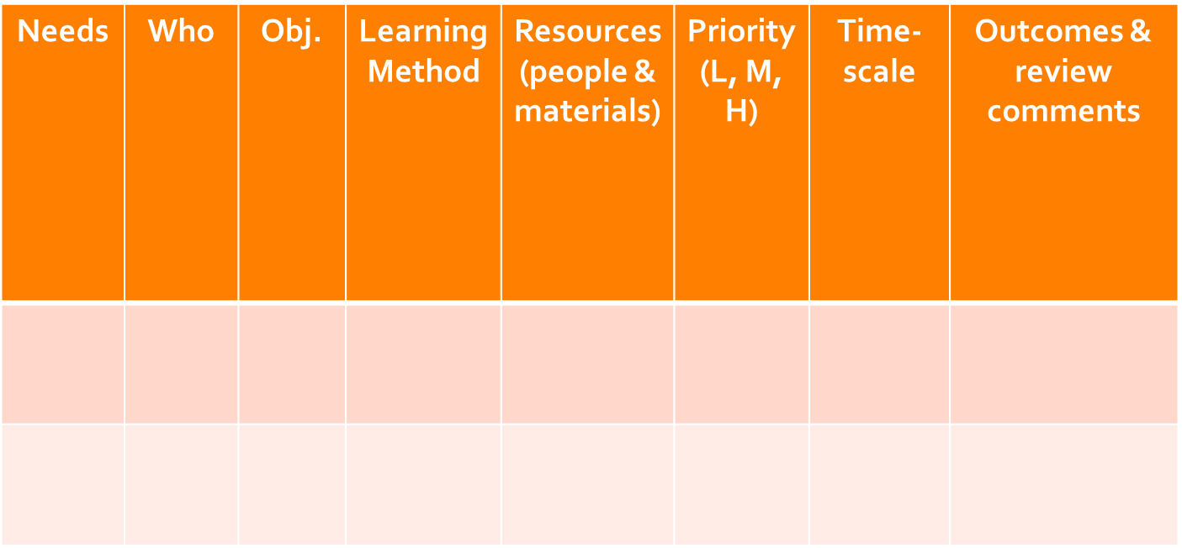
Learning Strategy
Notes:
Needs – Learning need / competency - What learning needs have been identified? What gaps in competency exist?
Who – Who has the need. Is it one individual, a team, an organisation or inter-agency group? Don’t give names of individuals, give the job titles or role and locations.
Learning objectives - What should the learner know, be able to do, or how will they approach work, after the learning? What do we hope to achieve by ensuring this learning?
Learning method – Way to meet need - How they will the needs be met - What cost effective methods or media might be suitable which also relate to how the individual or team learns best?
Resources – costs, materials, resource people you will need to meet the needs using method identified
Priority – High, Medium, or Low
Timescale – when will you meet the need, by what date should the learning have been completed? The level of priority should give an indication of when you want this to happen.
Outcomes and Review Comments - Use for notes from feedback and review meetings

Slide 8

Learning strategy I
Break into groups by area, agency, sector or logical clustering
Try to complete columns 1 & 2
Without giving identifying information:
  ID competencies your teams are missing [NEED]
  Who needs support on this topic?
  You have 10 mins
Notes:
Groups by area / agency / or other
Without giving identifying information – that is naming names of individuals, or specific CFS
Need: Identify competencies that you think your teams do not have, which are essential to CFS work. Gaps in skills listed. Some area which you think your team needs to strengthen.
Who: Don’t give names of individuals, give the job titles or role and locations.
DO NOT START WRITING OBJECTIVES YET, WE WILL COME TO THIS LATER

Slide 9
Plan ways to meet learning needs

Slide 10
Learning methods
Educators
Academic institutions,
Seminars,
Workshops,
Books,
Programme or partner reports, Evaluations
Exponents
Coaching,
Mentoring,
Buddying,
Colleagues,
Friends
Experience
Live organisational challenges,
Having a go,
Making mistakes,
Other’s mistakes,
Shadowing,
Job rotation
Notes:
Educators (someone or something that educates people)
Academic institutions, Seminars, Workshops, Books, Programme or partner reports, evaluations
Experience
Live organisational challenges issues, Having a go, Making mistakes, Other’s mistakes, Shadowing
Exponents (A person who has and demonstrates a particular skill, esp. to a high standard.)
Coaching, Mentoring, Buddying, Colleagues, Friends

Slide 11
At a minimum you should ….
Organize progression of training that prepares animators & staff to facilitate range of activities in CFS.
Arrange for more experienced CFS workers to mentor less experienced workers.
Build up resources such as books & manuals that enable ongoing learning.
Notes:
The following points are taken from CF Spaces guiding principles, and they represent the minimum actions we should all take to ensure staff and volunteers working in CF Spaces develop skills to do their jobs:
Organise a progression of training workshops that prepare animators and staff to facilitate range of activities: play and recreational activities and performing arts activities such as song, dance, theatre, and drawing; build literacy, numeracy, and life skills for children; enrich animator or staff understandings of child development, inclusion, protecting children; and address topics such as emerging protection threats and how to address them, how children and youth have been affected by the conflict/emergency, and appropriate means of providing psychosocial support – this must include training on the guiding principles
Arrange for more experienced CFS workers to mentor less experienced workers
Build up resources such as books and training manuals that enable ongoing learning

Slide 12
Monitoring & evaluating learning

Slide 13
Levels of learning evaluation
Did learning process happen? [PROCESS]
Do participants think learning method was good? [REACTION]
Did participants change attitudes, increase knowledge or learn a skill? [LEARNING]
Does learning translate into change in practice? [PERFORMANCE]
Does change in practice improve wellbeing of children & their families? [IMPACT]
}
Output level
}
Outcome level
}
Impact level
Notes:
Process evaluation: Looks at output level. Did the learning happen?
Reaction evaluation: Quality of output: Measures reaction of participants to whole, or section, of learning. Asks question: “Do participants think the learning method was good?” Feedback essential for facilitators to improve effectiveness & quality. Feedback must be continually sought to ensure that the facilitator can tailor the programme to the distinct preferences of the group. It is what we assess most often.
Learning evaluation: Outcome at individual level. Is there observed behavioural change? It measures changes in participants’ skills, knowledge, attitudes & practice by comparing pre-training standards with post-training results. Starts during training. Post-training can be after the completion of specific parts of the event. Ways of monitoring whether or not the participants can do the things set out in objectives must be built into the programme.
Performance evaluation: Outcome at organisational level. Does the learning lead to change in practice? Measures change in participant’s job performance over time that can be attributed to training (comparing participant’s performance before & after attendance). Checks identified training needs (the basis of the training) have been met. Performance evaluations can only be conducted several weeks or more after learning & then repeated several months later to check for further changes over time.
Impact evaluation: This is long term evaluation. Usually outside remit of facilitator. Normally carried out by training officers/departments/ external evaluators when organisation needs to know how effective its overall approach to training is. Entails a comparison of the productivity, effectiveness or performance of all or part of the organisation, before & after whole programme of learning. Impact then assessed to find out if there is a difference brought about by learning. Asks: Does the change in practice improve the wellbeing of children and their families?
Do you have objectives that fit into each of these categories?

Slide 14
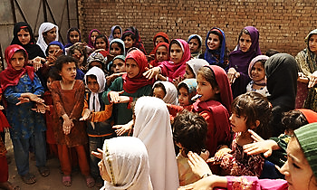


Slide 15

Notes:
This slide is for the end of each session… prompts for questions, check in and even a 5 minute break, ice breaker as needed.

