Slide 1
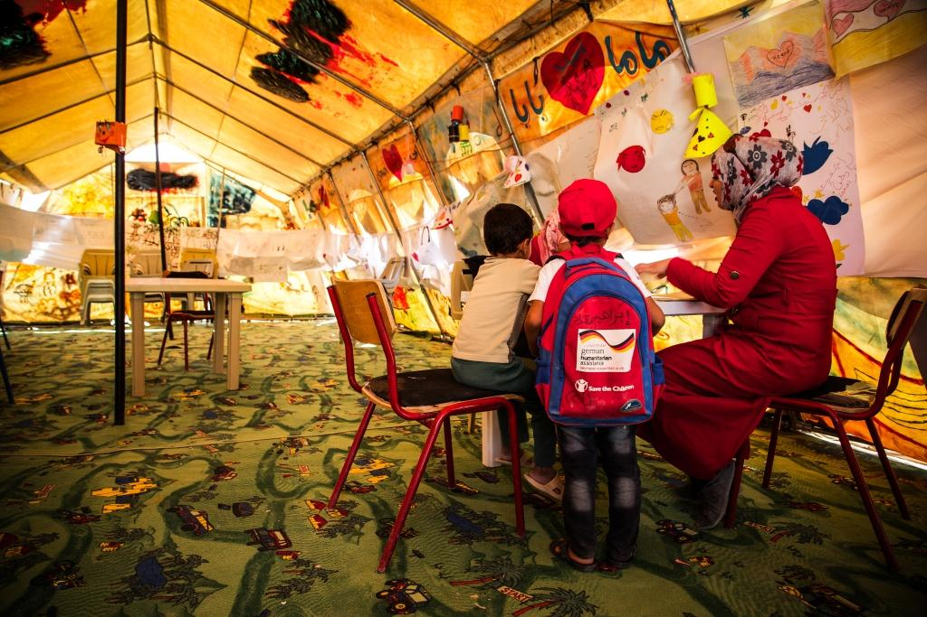

Session 2 – Human Resources management
Child Friendly Spaces (CFS) Module 4

Slide 2
Learning Outcomes
Participants will be able to…
Identify 5 approaches of a good manager.
Recognise signs of stress & burnout in ourselves and others.
Identify self care & coping strategies that can help alleviate stress.

Slide 3
Management and supervision techniques

Slide 4
Reflection
Think back to the best manager you ever had…
What made them a good manager?
What did they do for you?
What did they do for your team?

Slide 5
Good management is…
Motivation & leadership
Providing what people need in terms of direction & vision
Giving support to achieve those objectives
Providing for material resources
Notes:
Good management is about motivation & leadership
Providing what people need in terms of direction and vision in order to meet the organisational goals
Giving support to achieve those objectives – providing an enabling environment
Providing for material resources

Slide 6
Benefits of good management
Increase motivation & commitment
Team building
Reduced staff turnover
Improve quality & efficiency
Feed into M&E processes
Accountability
Improve org’l image & reputation
Notes:
Increased motivation & commitment to work / reduced staff turnover - people work harder and perform better together in a more collaborative way
Team building - Relationships – with managers and within teams are better
Reduced staff turnover - People are happier in their work and don’t want to leave
Above contribute to increasing the quality of the programme and increasing efficiency – the open lines of communication also ensure staff understand better what they need to do which also improves efficiency
Indicators from supervision can feed into Monitoring & Evaluation processes to monitor programme implementation
Accountability mechanisms can draw from information given through feedback, or can be a method to feed back regarding complaints made
Better management, reduced turnover and happier staff teams can contribute to an improved image and reputation of the organisation

Slide 7
# 1 reason employees leave jobs is a poor relationship with their immediate supervisor.
Notes:
The Gallup Organization – gallup.com provides data-driven news based on U.S. and world polls, daily tracking and public opinion research

Slide 8

Activity
In groups of 3 brainstorm list of 3 things a manager can do to motivate their team
Write ideas on flip chart / manila paper
Asterix (*) or underline which ideas you feel you can go back and use in your workplace
Total 10 mins

Slide 9
Example methods
Performance management / Work plan
  Objectives, activities, learning & development needs
Supervision visits
One-to-one meetings
Team meetings
Feedback
Team outings / team building activities
Notes:
Performance management / work-planning – prepare a document outlining objectives, activities, and learning & development needs to enable them to meet objectives
Supervision visits – going to site of programme activities, visiting CF Spaces, observing staff member’s work
One-to-one meeting to discuss progress, activities, learning needs, concerns, successes, get & give feedback to staff
Team meetings – to discuss programme activities, progress, challenges and successes
Feedback can be given from other team members or staff from other teams to understand performance
Team outings / team building activities to encourage a team spirit

Slide 10
Considerations
Feasible activities depend on:
Staffing ratios
Location / access / communication
Logistical support
Financial resources
Emergency time constraints
Where 1-to-1 is not possible you need to be creative.
Notes:
What is feasible in terms of management method is based on:
Staffing ratios – cannot expect good supervision if manager is supporting too many staff
Location / access / communication – ensure that location is conducive to management. If not physically located near each other, or if there are problems of access – issues of security, road/ transport damage, natural disaster may cut off certain parts of your team - then you need to make sure you have sufficient ways to communicate to compensate for distance. Phone, skype, etc must be feasible
Logistical support – vehicle has to be available for supervision visits
Financial resources – need money to enable supervision meetings, but also to allow for learning and development etc
Emergency may not have time for formal performance management reviews
-> Need to be creative about ways to provide support, encouragement and leadership in these cases, at a minimum give feedback – positive and constructive – on performance on a regular basis verbally so as to ensure teams are encouraged and understand what is expected of them

Slide 11
Staff wellbeing

Slide 12

IFRC, 2009
Notes:
This is the guiding document to refer to when looking for further guidance on managing staff and volunteer stress

Slide 13
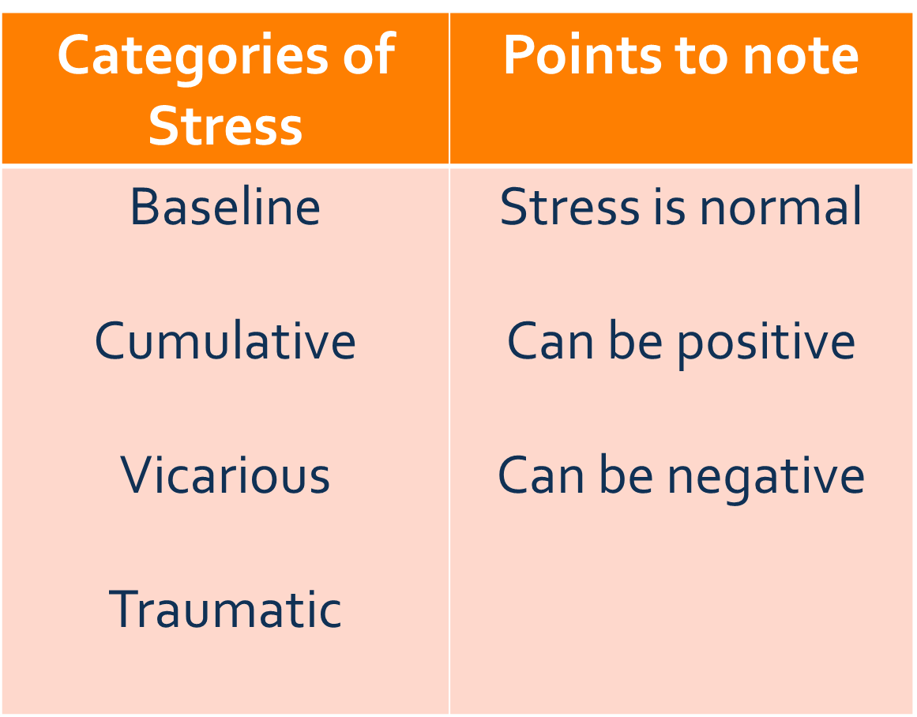
Notes:
Stress is normal: it is the body’s natural reaction to physical & / or emotional challenge
It can be positive: activating a person’s body, mind & energy – give energy for work
Can be negative: Stress becomes distress when lasts too long, occurs too often or too severe
Baseline / basic / underlying stress: May be caused by various sources of tension at individual, emotional, family or social level. May increase by change in day-to-day environment (away from family, bad communication, work with new people, different culture, etc.). Normally decreases after the first few weeks of a new assignment
Need to be prepared & develop coping strategies
Cumulative or baseline stress: Results from accumulation of various stress factors, follows prolonged exposure to work & non-work stress factors, including heavy workload, poor communications, lack of basic comforts, feeling powerless
Most frequently encountered by humanitarian workers – staff must ensure it remains within reasonable limits
Vicarious stress or secondary traumatic stress response: Occurs in response to witnessing or hearing about traumatic events happened to others
Can trigger similar signs & symptoms as triggered by direct exposure to traumatic events
Traumatic stress or critical incident stress: Result of traumatic event in which aid worker seriously threatened by harm or death
E.g. assault, witnessing death or extreme suffering, being within range of gunfire, kidnapping, accidents, bombings, being exposed to natural disasters
May develop into Post Traumatic Stress Disorder (a pathological condition which will require referral to a medical health specialist)

Slide 14
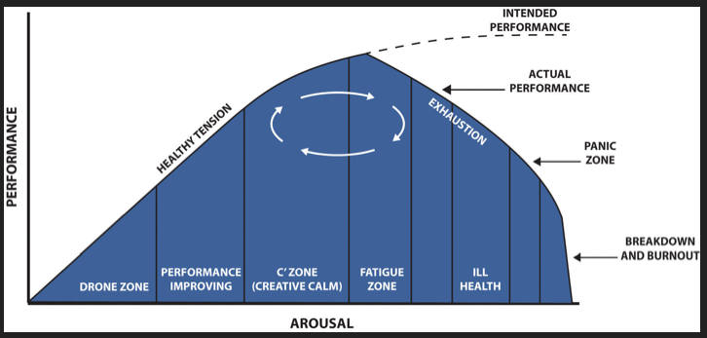
Stress curve
Notes:
The picture below may help to explain the stress curve in slightly different terms (due to copyright it cannot be used in the presentation)
As pressure builds up, you produce adrenaline, this gives you energy to do more faster. But if it builds up too much without being able to use it all, you have physical symptoms such as acid stomach. Other stress induced symptoms can cause reduced performance, such as loss of sleep, deteriorating memory, panic, etc

Slide 15
Causes of stress
Living conditions
Workload. Lack of leisure / social life
Relationships & communication
Insecurity, threat to wellbeing, health risks
Challenge to values, ideals, beliefs
Financial concerns
Notes:
Difficult living conditions
Heavy workload or inactivity. Lack of leisure activities, social or cultural life
Relationships and communication - Cultural differences, Lack of space and privacy/personality conflicts, Stress related to the worker’s family Stress of accompanying partner, Lack of communication with family back home. Coming home - Communication with family, friends, colleagues, Going back to “ordinary” life can itself cause stress as people remember what they are missing, or feel the contrast of lives they lead
Insecurity (War/security incidents, Target for attack or robbery)
Threat to well-being/health risks (Living under security constraints, Threat of after-effects or reoccurrence of disaster, Risk of accidents and illnesses, Lack of medical infrastructure)
Challenges to a person’s values, ideals and beliefs (Exposure to acute consequences of war, disasters or human carnage, Exposure to the ongoing suffering and trauma of victims, Corruption, ambiguous situations or motivations, Hostility of beneficiaries/unmet needs of beneficiaries)
Financial instability (Worry about future job opportunities)

Slide 16
Reflection: Signs of stress
Think of your personal signs of stress
  Physical symptoms
  Emotional reactions
  Mental signs
  Behavioural change
  Change in spiritual / religious or moral beliefs
Note these down for yourself
Try to think what stress levels you have at the moment
Notes:
Think of your personal signs of stress
Physical symptoms
Emotional reactions
Mental signs
Behavioural change
Change in spiritual / religious or moral beliefs
Note these down for yourself
Try to think what stress levels you have at the moment

Slide 17
Stress outcomes at work…
Job turnover / absenteeism
Accidents in the workplace
Physical health concerns
Burn out
Wider issues in workplace (not accomplish tasks, tension, etc)
Workplace inefficiencies
Notes:
Job turnover / absenteeism
Accidents in the workplace
Physical health concerns
Burn out
Wider issues in workplace (not accomplish tasks, tension, etc)
Workplace inefficiencies

Slide 18
Reflection: Prevention & response
Put answers to each of the following question on individual post-it notes:
What can be done to prevent stress in the workplace?
What are your coping strategies?
Notes:
Need to ensure you have in place both prevention and response mechanisms to reduce stress in the work-place
These must be things that you can realistically do given the staffing, communication, time and resource constraints you currently have

Slide 19
Categories of coping mechanisms
Come and place post-it notes on wall at front, categorising into:
Work related coping strategies:
    Improved supervision
    Assisted coping
Personal coping strategies:
    Psychological
    Physical
    Social

Slide 20

Notes:
This slide is for the end of each session… prompts for questions, check in and even a 5 minute break, ice breaker as needed.

