Slide 1
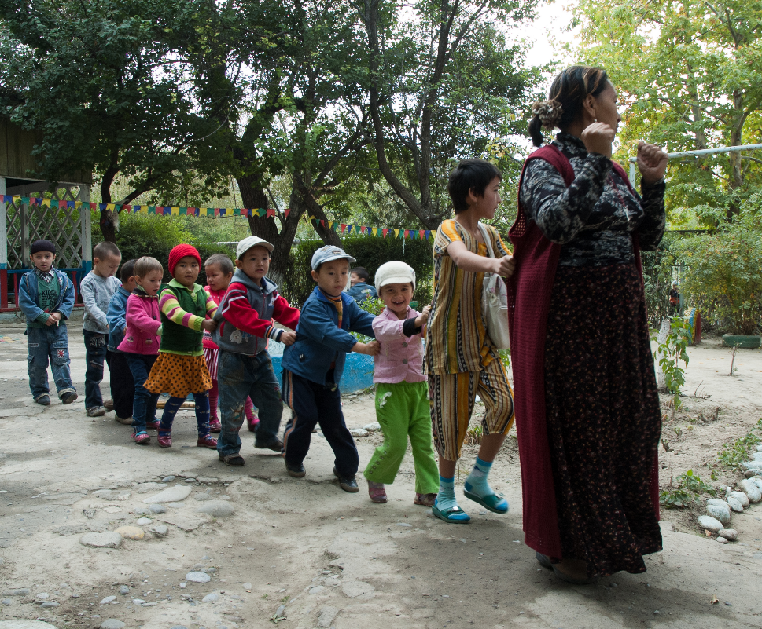

Session 4 – Planning Activities
Child Friendly Spaces (CFS) Module 3

Slide 2
Learning Outcomes
Participants will…
Know the three categories of outcomes for children expected to result from activities in the CF Space
Be able to name the issues that need to be taken into account when developing schedules (CAGED SPORT)

Slide 3
Key activities in the CF Space

Slide 4
Objective of activities
“Provide opportunities for children to play, acquire contextually relevant skills, and receive social support, thus strengthening their wellbeing”.
  Obj 2. CFS Guidelines.
  Thus, every day each child should have a chance to: play, acquire skills, access social support.
  Remember also for full development need to consider:
  Physical; social & emotional; and cognitive (intellectual, communication & speech) development.
Notes:
To develop in a healthy manner, children need stimulation and play on a regular basis. Particularly in very stressful environments, many children also need the psychosocial support gained through participation in an engaging and supportive environment.
Where education is disrupted, learning must not stop, as children’s development is so crucial to their overall present and future wellbeing
The UNCRC states that children have a right to education, play and support to recover psychologically

Slide 5

Brainstorming activities

Slide 6
Brainstorming activities
Break into 3 groups
Each group identify examples of activities for these subject :
  Which activities help children PLAY?
  Which activities help children ACQUIRE SKILLS / LEARN?
  Which activities help children gain SOCIAL SUPPORT?
You have 5 minutes
Each group has only 3 mins to feedback at the end
Notes:
Divide into four small groups.
Each group come up with examples of activities which address the subject they are assigned.
How do children PLAY?
How do children SOCIALISE?
How do children LEARN?
How do children EXPRESS THEMSELVES?
You have 5 minutes
Each group has only 3 mins to feedback to the larger group.
(Note: small groups can present to the larger group their ideas on a flip chart using words and/or pictures or they can demonstrate actions.)

Slide 7
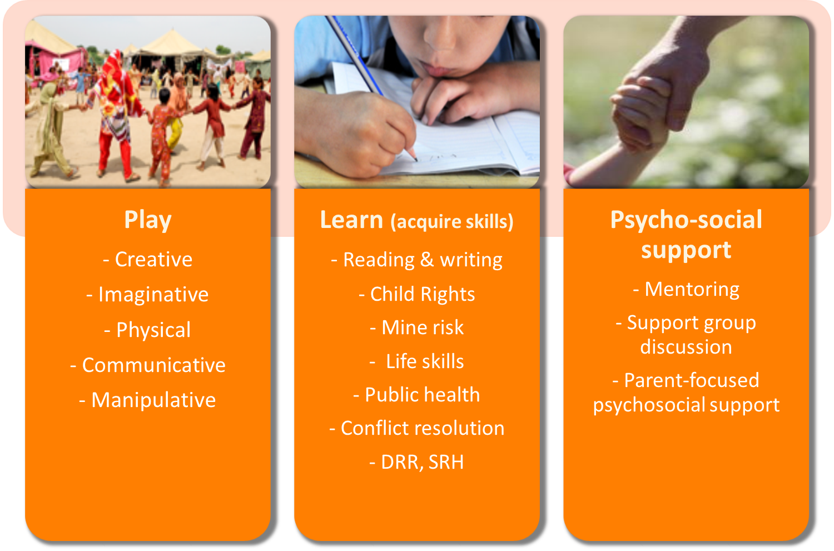
Notes:
Ideally you would have a range and mix so that activities appeal to all different children in the CF Space
Play activities include: Creative, Imaginative, Physical, Communicative, & Manipulative play – include sports & recreation, cultural & artistic activities
Learning: Noon-formal education including reading, writing & numeracy (varying options depending upon level of children’s education prior to emergency and presence of education programming). Child Rights and Mine Risk education, among other things. Learning can be more conventional forms of learning such as literacy and numeracy, or it can can be livelihoods, public health messaging, HIV awareness, sexual and reproductive health, etc depending on the context and needs of children and the community
Life-skills: Disaster risk reduction, sexual reproductive health, public health messaging (on prevalent diseases and prevention), conflict resolution and thus peace-building, encouraging child‐to-child or group interaction & awareness raising – some can be considered part of the learning objective – can be presented as games – part of resilience building
Psychosocial support: Mentoring, support group discussion, parent’s PSS, etc - can be included in the play activities
All these different categories contribute to children: playing, socialising, learning & expressing themselves in different ways
Schedule does not have to include all of the activities listed under each heading. Depends on context, needs of children, duration of the programme, what children were doing before the emergency.

Slide 8
Scheduling activities within CF Spaces

Slide 9
Schedule format
Schedule format harmonised.
Visible & available to all.
Formats understandable to people with low literacy.
Minimum information: Day, time, activity, location, resources, staff responsible, children involved.
Notes:
Schedule format harmonised – across various CF Spaces, within the CF Space. Everyone should be familiar with the format and have access to copies of the schedule
Visible & available to all facilitators, supervisors, children, families & community
Formats understandable to people with low literacy
Minimum information included in the schedule should be: Day, time, activity, location, resources, staff responsible, children involved (gender, age, ability, etc) - mapping out which resources you need for which activity ensures you do not have two simultaneous activities that require the same facilitator or resources

Slide 10
Schedule timing
Time to set-up & clear away, breaks
Time to get to/ from site
Don’t coincide with school
Consider community uses for space
Coordinate with other sectors
Consult children, families, community
Different times different age groups
More shorter time slots if too many children
Notes:
Allow time for set-up & clearing away each day – at beginning and end of day as well as in-between activities
Scheduled breaks – including for drinking and eating
Allow time for children to get to & from site in day light
Do not coincide with schooling – you should not be competing with the formal education system and creating a “pull” factor away from school
Consider community uses for the space – if you have agreed they can have use of the space, allow enough time for them to set-up and run their intended activities
Coordinate with other sector responses – e.g. if parents are engaging in cash for work, it may be useful for CFS activities to care for children whilst they are working, or to drop children at CF Space whilst they are going to a food distribution
Consult children, families and community on the ideal hours of operation
Different time slots for different age groups to fit with their other activities
Shorter time slots more often if too many children - If there are very large numbers of children, consider providing shorter sessions for more children, rotating children (e.g. some children engage in center based activities while others do activities in the community), and mobilizing community members to conduct activities in satellite locations

Slide 11
Schedule content
Balance between structured activity & free play
Range of categories of activity each day
Simultaneous activities allowing children to choose
Simultaneous activities for diff. categories of children
Regular community events
Create routine
Consider outreach activities
Notes:
Establish a balance between structured group activities and free play
Include range of different activities through the course of each day, so that each child engages in some of the activities the like most. Remember different activities will appeal more to different children
At a specific time, set up different activities in various locations and allow children to choose their activity
Simultaneous activities for different groups of children – for example different skills and ability levels can be targeted in the same time period, giving options for children who are less able in one area to still attend sessions at the same time as their peers
Organise occasional community events that allow children to demonstrate their skills to parents and communities and encourage support for children.
Ensure you have routine by re-establishing old routines or building new ones. A sense of routine is one of the reasons for which we have CF Spaces. Giving children routine is a way in which we can reassure them. Whilst you may want each day of the week to be different, you can make each week the same, you can start each day at the same time, and take the breaks at the same time.

Slide 12
Developing your schedule

Slide 13

Scheduling Activity
In 5 groups, assigned:
  Girls & boys – 0 – 6
  Girls & boys – 6 – 12
  Girls 13 – 18
  Boys 13 – 18
  Children with disabilities
Plan 2 – 3 days of activities for the group of children assigned, use the example schedule format & adapt this or CFS schedule format you use in your programme.
No formal feedback at end, group discussion in plenary.
You have 30 mins.

Slide 14
Plenary questions
What were the challenges in developing schedule for you?
What were specific points you discussed for the group you were thinking about?
What are factors or considerations that affect your choices of activity / schedule?
What would you do when you need to cater to all these different groups in 1 schedule?

Slide 15
Remember….
Ensure the three categories of activity - PLAY, ACQUIRE SKILLS, RECEIVE SOCIAL SUPPORT, as identified in the CFS Objective, are all covered each day.
Ensure variety of ways to achieve this through the week.
Routine in scheduling as far as possible – reassuring for children.
Notes:
Ensure the categories of outcomes for children (play, acquire skills / learn, receive social support) are covered each day
Have a variety of ways in which you in which you achieve this through the course of the week
Have a routine in scheduling as far as possible as this also provides comfort and reassurance for children. For example, repeat the same schedule each week

Slide 16
Factors Affecting Choice of Activities

Slide 17
Planning activities for Jan

Slide 18
How to select activities: Cross cutting issues to take into account
C: Capacity of facilitators
A: Ages & stages of development
Ge: Gender sensitive
D: Diverse needs
S: Space constraints
P: Participation of children & community
O: Outreach
R: Resources – limitations / availability
T: Traditions (culture) & time constraints
= CAGED SPORT
Notes:
C: Capacity of facilitators – what skills do they have? What forms of activities are the able to deliver? What have they been trained for?
A: Ages & stages of development – what age groups of children are you supporting? What level of development? Any specific development needs?
Ge: Gender sensitive – consider the different likes and dislikes for girls and boys? What activities are appropriate in the given context for girls vs boys?
D: Diverse needs – consider the full range of different factors that can affect appropriateness of different activities in context – religions, ethnic groups, language skills, etc
S: Space constraints – what size is the space you have for CF Space activities? Do you have outdoor space, or only indoor space? Is the space outside safe for certain activities?
P: Participation of children & community – ensure you get their inputs on the types of activities children usually engage in and enjoy. Consider activities also that communities may wish to use the space for, as this will increase community ownership of the space.
O: Outreach – do the activities need to be mobile covering large areas through outreach? Or will you do stationary / fixed location activities in combination with mobile activities? In which case you need to consider how many staff / facilitators will be mobile, how many will stay in one place, and what the impact on resources and equipment needs will be?
R: Resources – What are the limitations / availability of resources? Can you buy all you need to be able to run the activities you have selected?
T: Traditions / cultural concerns – what is suitable and appropriate in a certain context. In addition try to integrate traditional song, dance and ceremonial activities into your schedule
Time constraints – how many hours will you operate? Are the activities you have identified feasible in this timeframe?

Slide 19
Review schedule
Review the schedules you drafted with CAGED SPORT in mind.
Are the activities able to address the full range of cross cutting issues? Are they realistic with regards to certain constraints identified in CAGED SPORT?
Do they meet all these different needs?
What revisions would you need to carry out?

Slide 20
Key messages

Slide 21
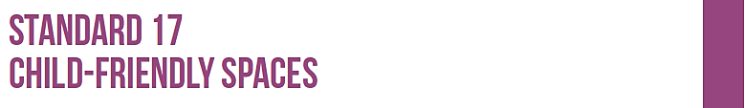
  Set up clear guidelines, programmes and schedules for activities with children.
  Set up a programme of activities that looks at the needs of children and communities overall, and coordinate with other agencies and sectors to provide support such as health and hygiene education, breastfeeding groups and spaces, supplemental feeding, information on humanitarian help, etc.

Slide 22
Key messages
Ensure the three categories of activity - PLAY, ACQUIRE SKILLS, RECEIVE SOCIAL SUPPORT - are all covered each day.
Children & communities should be consulted on the content & schedule.
A range of issues needs to be considered when planning your activities – CAGED SPORT.
Notes:
Every child needs to be given opportunities during the day to play, learn/ acquire skills, access social support (as identified in the CFS Objective) are all covered every day
Have variety in way you achieve this through the course of the week
Have routine in scheduling as far as possible
When planning the activity schedule children and communities should be consulted on the content and schedule of activities. Children should be able to give ideas on how to plan each individual session’s activities. And children should be able to choose from a variety of different activities during each session
There is a range of issues that need to be considered when planning your activities. These can either restrict the types of activities you can deliver (such as space limits, resource constraints, and capacity of animators) or they may influence the range of activities you need to include (diversity, gender, age, outreach, traditions)

Slide 23
Key resources

Slide 24
Resources
CCF, Starting up child centred spaces in emergencies.
Save the Children, Child Friendly Spaces Handbook.
UNICEF, A practical guide for developing child friendly spaces.
World Vision, Children in Emergencies Manual.
Specific references for activities targeted at adolescents, ECD, children with disabilities, etc. are included on USB sticks / CDs. E.g. UNESCO manual on Embracing Diversity, Moving forward toolkit: A guide for practitioners in the field of sport for youth in emergencies.

Slide 25

Notes:
This slide is for the end of each session… prompts for questions, check in and even a 5 minute break, ice breaker as needed.

