Slide 1
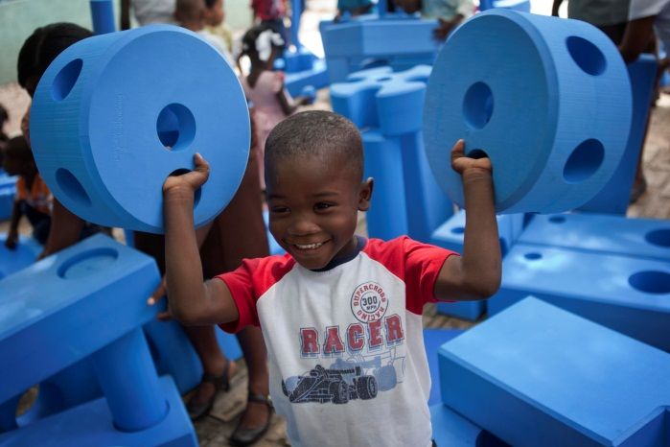
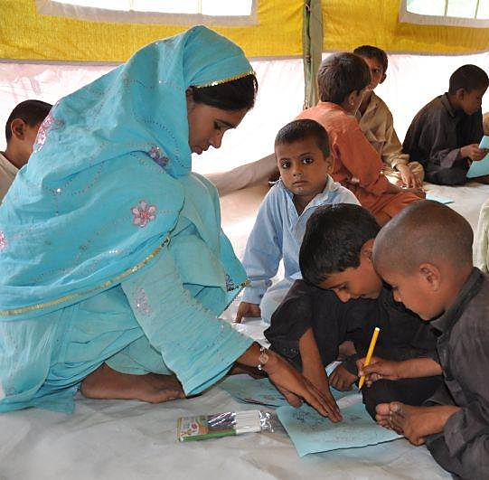
Monitoring, evaluation, accountability & administration
Child Friendly Spaces (CFS) Module 3

Slide 2
Learning Outcomes
Participants will be able to…
Define the following terms: monitoring, evaluation, baseline, control group & accountability
Understand the importance of participatory monitoring, evaluation and accountability mechanisms to ensure respect, dignity and rights of affected populations
Understand the links between administrative systems and M&E and accountability mechanisms

Slide 3
Defining key terms

Slide 4
Define key terms
        Monitoring: systematic & continuous collecting, recording & analysing information about project.
        Evaluation: assessment at one point in time of the progress of a project or programme.
        Baseline: Measure of a characteristic you are seeking to change before programming begins.
        Comparison / control group: people receiving no intervention that in every other way resemble those receiving intervention.
Notes:
Monitoring is systematic & continuous collecting, recording & analysing information in routine systematic way. Information that is about the progress of a project or programme over time. Enables us to check progress against plans. It is useful for identifying strengths and weaknesses in a project or programme and for providing the people responsible for the work with sufficient information to make the right decisions at the right time to improve its quality. Enable evaluations at intervals
Evaluation: assessment at one point in time of the progress of a project or programme. Somewhat like a review. An evaluation usually more formal than a review, often carried out by external researchers for independence. It is an assessment at one point in time that can have different purposes, including verifying whether objectives have been achieved, what impact project had on different stakeholders & how it can improve in the future
Baseline: A baseline is a measure of something before programming begins. Good baseline measures provide a basis for measuring these same things at the end of the project, and seeing what change has occurred
Comparison group / control group: a group of people that receives no intervention that in every way — except their not receiving an intervention — is as similar as possible to those receiving the intervention – this allows comparison and enables us to draw conclusions as to the way in which programme contributed to change. There are ethical considerations with regards to control groups / comparison groups if engaging them in your work does not lead to them having programme benefit but does incur costs such as using their time, or raises hopes and expectations

Slide 5



Let’s take e.g. of a nutrition programme trying to monitor change in child size resulting from their intervention.
Measure size at beginning – this is the baseline.
Measure size at the end. Cannot assume this is impact, maybe child would have grown without help.
So need baseline & end size of target group as well as a comparison / control group to see if change is same or greater for child in your programme.
Notes:
Let’s take e.g. of a nutrition programme trying to monitor change in child size resulting from their programme intervention
They would measure the size of all the children taking part in their programme at the beginning of intervention – before they receive any treatment or support – this is the baseline
Then they would measure the size of the children at the end of their programme intervention.
The challenge is they cannot assume that the change over time is 100% a result of their programme. That this is the impact of their work, maybe the children would have grown without their programme’s help
So they need baseline data, end size data for the children targetted & beginning and end size data for a comparison / control group to see if the change over time is the same or greater for children in their programme
Reference:
UNICEF, (2011) Inter-Agency Guide to the Evaluation of Psychosocial Programming in Emergencies

Slide 6
Accountability
OPT / P.Pellegrin for SC / 2009

Slide 7
Accountability explained
        How an org. balances needs of diff. groups in decision-making & activities, not just meeting needs of most powerful (e.g. donors and government).
        Ensuring women, men & children involved in planning, implementing & judging response.
        Ensures project has impact women, men & children want to see.
Notes:
How an organisation balances the needs of different groups in its decision-making and activities. Most NGOs have processes in place that will meet the accountability requirements of more powerful groups such as project donors or host governments
However, accountability also means making sure that the women, men, and children affected by an emergency are involved in planning, implementing, and judging our response to their emergency too
This helps ensure that a project will have the impact they want to see
References:
Active Learning Network for Accountability & Performance in Humanitarian Action (ALNAP) http://www.alnap.org/
Humanitarian Accountability Partnership - The HAP Principles of Accountability
Established in 2003, Humanitarian Accountability Partnership – HAP – International is the humanitarian sector's first international self-regulatory body. Members of HAP are committed to meeting the highest standards of accountability and quality management. 87 INGO members, globally from Africa, Americas, Asia, Europe and Middle East

Slide 8
Accountability includes for example…
        Publicising information on programme plans in ways full range of actors understand.
        Feedback mechanisms – getting back from affected communities.
        Sharing information on progress of programmes.
        Participatory processes for engaging range of actors in monitoring & evaluation.

Slide 9
Principles of accountability
        Commitment to humanitarian standards & rights.
        Setting standards & building capacity.
        Communication.
        Beneficiary participation at all stages.
        Monitoring & reporting on compliance.
        Developing feedback mechanisms and addressing complaints.
        Implementing partners – adhere also to principles.
Notes:
Commitment to humanitarian standards and rights - Members state their commitment to respect and foster humanitarian standards and the rights of beneficiaries
Setting standards and building capacity - Members set a framework of accountability to their stakeholders* - Members set and periodically review their standards and performance indicators, and revise them if necessary - Members provide appropriate training in the use and implementation of standards
Communication - Members inform, and consult with, stakeholders, particularly beneficiaries and staff, about the standards adopted, programmes to be undertaken and mechanisms available for addressing concerns
Participation in programmes - Members involve beneficiaries in the planning, implementation, monitoring and evaluation of programmes and report to them on progress, subject only to serious operational constraints
Monitoring and reporting on compliance - Members involve beneficiaries and staff when they monitor and revise standards, Members regularly monitor and evaluate compliance with standards, using robust processes, Members report at least annually to stakeholders, including beneficiaries, on compliance with standards. Reporting may take a variety of forms
Addressing complaints - Members enable beneficiaries and staff to report complaints and seek redress safely
Implementing Partners - Members are committed to the implementation of these principles if and when working through implementation partners
Reference:
Taken from Humanitarian Accountability Partnership - The HAP Principles of Accountability available at:
http://www.hapinternational.org/pool/files/principles-of-accountability-and-members-poster-english-jan-2010.pdf

Slide 10
Relationship between accountability, M&E & admin
Accountability
Monitoring & evaluation
Accountability includes: participatory M&E, sharing programme plans, seeking feedback,
Administrative systems

Slide 11
Plenary question
        What are the challenges to setting up accountability systems in this setting or context?
        Individually write 1 main challenge on a VIPP card / post-it note.
        Fold them up and hand-in to facilitator.

Slide 12
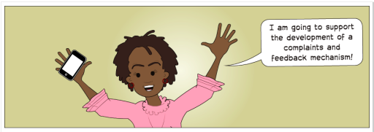
How to ensure accountability
Inform beneficiaries and stakeholders.
On-going consultation.
Establish systematic feedback mechanisms.
Respond, adapt, and evolve in response to feedback received.
Notes:
Provide public information to beneficiaries and other stakeholders on their organisation, its plans, and relief assistance entitlements.
Conduct ongoing consultation with those assisted. This should occur as soon as possible at the beginning of a humanitarian relief operation, and continue regularly throughout it. ‘Consultation’ means exchange of information and views between the agency and the beneficiaries of its work.
Establish systematic feedback mechanisms mechanisms that enable:
Agencies to report to beneficiaries on project progress and evolution
Beneficiaries to explain to agencies whether projects are meeting their needs, or if not, how they can be improved
Beneficiaries to explain to agencies the difference the project has made to their lives
- Methods include through the M&E system and through complaints and feedback mechanisms
Respond, adapt, and evolve in response to feedback received, and explain to all stakeholders the changes made and/or why change was not possible.

Slide 13
Steps to set-up a feedback mechanism
        Ask people how they’d like to give feedback.
        Tell people how to give feedback & tell them it’s their right.
        Make access to feedback process as easy & safe as possible.
        Describe how feedback will be handled.
        Learn from feedback & mistakes.
        Give beneficiaries a response to their feedback.
        Review how feedback mechanism is working.
Notes:
Ask people how they would like to complain/provide feedback
Tell people how to complain & tell them it is their right to do so
Make access to the complaints process as easy and safe as possible for all groups of the population – literate, illiterate, men, women, children, disabled, old, etc etc. Ensure there are differing techniques to reach out to different groups.
Describe how complaints will be handled – tell the population what will happen after the submit feedback
Learn from complaints and mistakes – make sure you act on and adapt programming according to feedback and complaints received
Give beneficiaries a response to their complaint – if it was given anonymously, share feedback broadly, explaining what the feedback was and what changes have taken places accordingly
Review how complaints mechanism is working – at intervals review who is giving feedback, how, where? Adapt your complaints system if you see some groups are not inputting or some locations are not getting input. You may need different systems in different locations

Slide 14
Principles of Feedback Mechanisms
        Confidential and safe
        Available at community level
        Sensitive to local context
        Easily accessible to children & marginalised
        Connect to existing community & government structures
        Complement existing monitoring bodies
Notes:
Be confidential and safe, recognising the many risks associated with reporting allegations in situations of extreme vulnerability
Handle any complaint of sexual exploitation and abuse against children and adults, regardless of whether the perpetrator is a representative of an international organisation or from the local community
Be available at the community level
Be sensitive to the local context and build upon positive local norms, values and structures
Be easily accessible for children and young people, as well as reaching out to marginalised groups
Connect to existing community and government structures as much as possible
Complement and build upon existing related monitoring bodies associated with the international community
Participants should understand that their feedback or complaints will not have an impact on their continued receipt of program services. Complaint and response structures must also be culturally-sensitive and situation-appropriate, and be sensitive to unequal distributions of power and cultural norms. For example, it may not be easy for a female to disclose a complaint to a male and vice versa.
Taken from Save the Children UK (2008). No One to Turn To: The under-reporting of child sexual exploitation and abuse by aid
workers and peacekeepers,

Slide 15

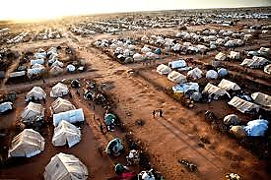
Case study: Dadaab, Kenya
      Ifo Camp, Dadaab, North Eastern Kenya:
        1 of 3 camps making up Dadaab
        130,004 refugees, 55% children
Notes:
Dadaab Refugee camps, Kenya - Dagahaley, Hagadera and Ifo camps - host 372,551 refugees from Somalia (97%), Ethiopia, Sudan and small populations from other neighbouring countries. The majority of refugees reside in Ifo. Ifo Camp has a population of 130,004. Approx. 55% children. Save the Children is the only child-centred organization in Dadaab. Piloted feedback mechanism in Ifo to learn lessons before roll out
Reference:
Save the Children (2011) “Guide to a child friendly complaints system. Lesson learnt from Dadaab Refugee Camps” a case study highlighting how a child-friendly system has been set up in Dadaab Refugee camps in northern Kenya.
For guidance on the 10 steps to setting up a Complaints Response Mechanisms, see the video available at: http://aimstandingteam.wordpress.com/2012/03/08/save-the-childrens-short-video-on-complaints-and-response-mechanisms/
www.hapinternational.org/pool/files/guide-to-a-child-friendly-crm-lessons-from-dadaab-kenya-final-draft.pdf

Slide 16
Lessons learnt from Dadaab
        Consultation with children
        ‘Information’ / ‘feedback’ desks for children
  Steps include: Physical set-up + staff training + awareness raising + receive feedback + keep records + adapt prog. + feedback
  Set-up in CFS in camp & host communities
  Deal with general complaints / feedback
  Refer to NGO if esp. sensitive case or not satisfied
        Beneficiary Reference Groups (BRG)
        Review / evaluate feedback mechanism
Notes:
Consultations with children - Asked children how felt comfortable to feedback
Set up “Information or “Feedback desk,” named that way to make them more approachable to children and acceptable to community
Physical set-up – train staff – raise awareness – receive feedback – keep records
These were to be set up in all Child Friendly Spaces (CFS) in the camp and host community; at the new arrival registration point and the SC camp offices.
Earmarked to deal with general complaints mainly project related complaints and/ or information e.g. operations, beneficiary targeting etc. – about all programming (FSL, CP, etc)
Beneficiaries referred to Save the Children if: sensitive complaints, mainly: PSEA/GBV and staff misconduct, or if someone is not satisfied with the way feedback was dealt with
Beneficiary reference groups (BRG) established: attached to each information desk. Group consists of 9 members: 4 camp leaders (2 male and 2 Female), 3 religious leaders and 2 teachers. Meeting for religious and camp leaders to select representatives. After explaining purpose of BRG, leaders are requested to elect their representatives to the group.

Slide 17
Let’s look at the challenges people mentioned.
Notes:
Cultural issues can prevent people talking or complaining
It may be that certain groups of people, especially most vulnerable, are not used to being asked for their views
The way you are asking people to give feedback can prevent them from inputting
Many more challenges maybe identified in your context. Review the way your system is working at intervals and work on trying to find ways to address these challenges

Slide 18
Plenary question
        Any ideas on how to overcome challenges?
        How is accountability currently ensured in your programmes in-country, how can it work better?
Notes:
One way of ensuring accountability is a participatory M&E system
Another key methods is a functioning and effective complaints mechanism

Slide 19
Child friendly feedback mechanism
Design & nature of Feedback & Response Mechanism (FRM)
Environment & location of the FRM
Approach to the feedback
Staff skills: people with skills to work with children
Eg.: feedback mechanisms through child protection committees, anonymous youth peer-to-peer, complaints boxes, radio & drama
Notes:
Design and nature of the Complaints & Response Mechanism (CRM): The mechanism is informed by children’s ideas and needs about what is preferable to them.
Environment and location of the CRM: this needs to be a place known to children, easily accessible, safe for them and where confidentiality is guaranteed. A place where they are treated with respect, understanding and calmness; allowing children to freely share their concerns.
Approach to the Complainant: child friendly language and approach need to be used, this means you should keep it simple, clear and understandable
Staff and skills: the CRM needs to be led by people with skills to work with children. This includes: child friendly ‘interviewing’ skills, active listening, tolerance and patience. Staff need to give time to children to communicate or make a point; to be happy and positive and show kindness to the child and a willingness to help; using visual materials or images on the desks so that younger children understand.
This guidance is based on work done in Dadaab camp in Kenya.

Slide 20
Monitoring & Evaluation
London / SC / 2012

Slide 21
M&E – Purpose
Monitoring & evaluation is important because it:
        Provides accountability to beneficiaries & donors
        Indicate areas for improvement in quality of program by suggesting areas for modification
        Ensures learning from the programme is fed into broader initiatives
        M&E integral part of programme from beginning & throughout. Key step in programme design process enable you to effectively implement programme.
Notes:
Monitoring and evaluation is important because it:
Provides accountability to beneficiaries & donors
Can indicate areas for improvement in the quality of the program by suggesting areas for on-going modifications
Ensures learning from the programme is fed into broader initiatives
M&E integral part of programme from beginning & throughout. Key step in programme design process enable you to effectively implement programme

Slide 22
M&E – Principles
        How:
  Inter-agency & collaborative where possible
  Use participatory & ethical methods throughout
        What:
  Process as well as outcome
  Have baseline, end point & comparison group
  Multiple data sources to confirm findings
        Data:
  Disaggregate findings – sex, age, vulnerability
  Ensure you have capacity to process data gathered
Notes:
How:
When possible, conduct inter‐agency, collaborative evaluations, which can improve coordination and yield conclusions that apply more widely. These should be inter-agency and inter-sectoral
Use participatory methods of monitoring and evaluation that engage children and youth and invite community members’ views. – e.g. when setting and developing objectives and indicators, get children and families to support development of wellbeing indicators
Data collection methods must be ethically implemented -
Ensure you have informed consent & conduct interviews appropriately
Respect privacy and confidentiality
What:
Evaluate not only process (output) indicators such as the number of children who participate regularly but also outcome indicators such as children’s psychosocial well‐being that are relevant, measurable, and developmentally appropriate.
Have baseline and end‐point measures of outcomes concerning changes in children’s lives,
Where possible, use a comparison group to enable comparisons with other interventions or sites where no CFS had been implemented. To manage the ethical issues that can arise in making comparisons, consider strategies such as wait‐list comparisons (e.g., compare girls and boys who participate in CFSs with children who have not had CFSs but are about to begin participating in CFSs) or roll out process comparison – may not be feasible in emergency
Draw on multiple sources to confirm findings – talk to variety of people, adults, children, leaders – this is called “triangulation of data” - this enables you to confirm views of individuals – and reduces the possibility of bias or subjective views you may get influencing the results and conclusions you come to
Data:
Whenever possible, collect sex‐ and age‐disaggregated data, as well as looking at information with regards to other forms of vulnerability and exclusion
Ensure that you have the capacity to process and assess all the data gathered

Slide 23
M&E – Key steps
Have a clear purpose: What measuring & why
Develop M&E plan at outset use participatory methods – builds on programme logframe
Develop tools for data collection, entry & analysis
Train CFS workers & staff on how & why
Risks & disruptions identified & addressed
Regular monitoring carried out by all
Carry out more formal evaluations at intervals
Review & process data for project adjustment
Notes:
Have a clear purpose – clarify aims & procedures with all those involved (staff, beneficiaries, partners, volunteers, etc) – what it is you are measuring and why
Develop at outset / early in the project a monitoring and evaluation plan. Use participatory methods to establish the goal, objectives and indicators. This will help shape your programme
Develop suitable tools for data collection, entry & analysis – ensure they are clear and usable (by those who will be using them) as well as harmonised across the whole programme
Train selected CFS workers and staff on how & why to monitor program activities effectively.
Potential risks & disruptions identified & addressed
On a regular basis monitor …
…Via animators the registration of children, parental consent, children’s informed consent attendance, behaviour during the activities, follow‐up of children who missed activities, activity planning and whether activities include girls as well as boys and highly vulnerable children.
…Via supervisors through site visits monitor and check: staffing, schedules, stocks, activities, facilities, etc (CFSs should be monitored on an ongoing basis to track development of CFS & to identify gaps in levels of community mobilization, quality of activities, safety, logistical support, etc ).
…Via agency staff the quality of the activities, animators’ skill levels, adequacy of supplies and logistics supports, protection threats in the area, and the implementation of the code of conduct, etc.
CFSs should be evaluated periodically by senior staff or independent people who are experienced in monitoring, to determine whether the activities are producing meaningful improvements in the lives of the children
Findings from all these various forms of monitoring and evaluation should continuously be reviewed and processed to ensure learning is leading to adjustments in programming

Slide 24
Developing indicators

Slide 25
Developing your indicators
        For all objectives we need to define how we would measure results. This involves identifying indicators
        An indicator is simple, clear statement. Helps measure & communicate change. Tells you what it is you want to measure
Notes:
For all objectives we need to define how we would measure results. This involves identifying indicators
An indicator is a simple, clear statement that helps measure and communicate change. It tells you what it is you want to measure
These need to be:
Consistent with the social and cultural context
Relevant to all the different groups involved
Can use methods such as problem tree to identify indicators – problem tree is a process of drawing a diagram of a tree to help people brainstorm the root causes (roots of the tree), the issues to address (the trunk of the tree) and the outcomes of the issue (the branches) – it can help you identify the actions that need to be taken to address the root causes not only respond to the outcomes

Slide 26
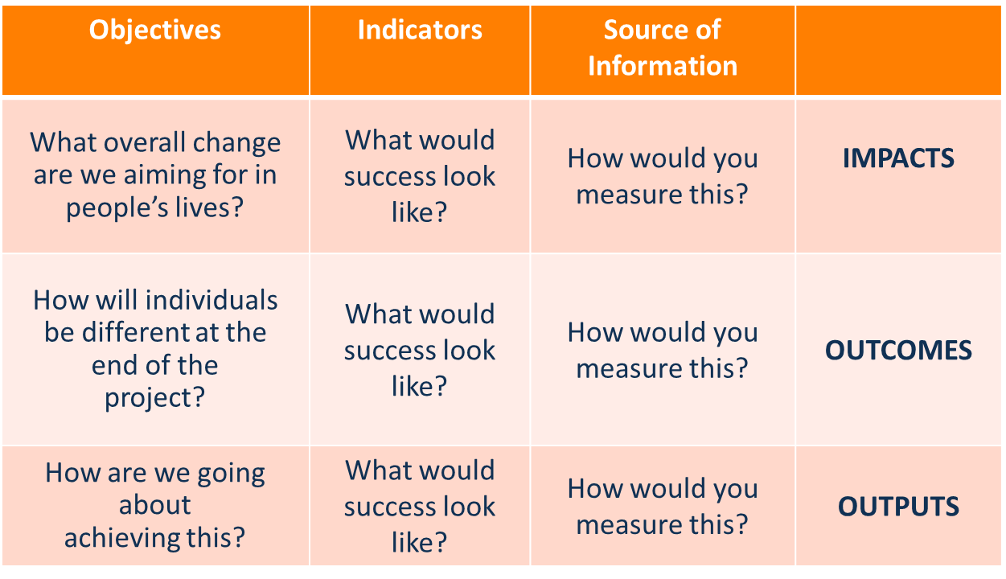
A guide to development of indicators
Notes:
Reference:
UNICEF, (2011) Inter-Agency Guide to the Evaluation of Psychosocial Programming in Emergencies

Slide 27
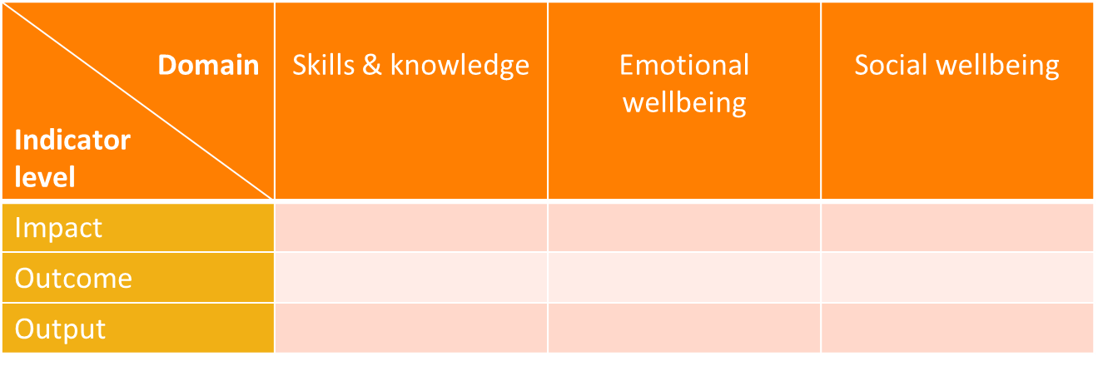
Selecting Indicators
        Try to measure change on three key aspects or domains:
  Skills and knowledge
  Emotional well-being
  Social well-being
        On three levels: impact, outcome and output
Notes:
Try to measure change in three key areas: skills and knowledge (Some measure of acquisition of skills), Emotional well-being (Some measure of improved emotional adjustment) and Social well-being (Some measure of improved social functioning)
Reference:
UNICEF, (2011) Inter-Agency Guide to the Evaluation of Psychosocial Programming in Emergencies

Slide 28
Developing your indicators

Slide 29

Developing indicators
        Break the room into 6 groups
        Each group take one of the Objectives of CFS (2 groups will each do same Obj.)
  Mobilise communities around the protection & wellbeing of children, incl. vulnerable children;
  Provide opportunities for children to play, acquire relevant skills & receive social support;
  Offer inter‐sectoral support for all children in the realization of their rights.
Notes:
Room break into 6 groups
Each group take one of the Objectives of CFS (2 groups will each do same Obj). Note these are the specific objectives from the CFS Guidelines. If there is a joint Inter-agency strategy for CFS in-county you may want to take the objectives from that strategy instead
Mobilize communities around the protection & wellbeing of children, incl. vulnerable children;
Provide opportunities for children to play, acquire relevant skills & receive social support;
Offer inter‐sectoral support for all children in the realization of their rights
Identify 2-3 indicators for the objective you have been assigned

Slide 30
Developing indicators continued
        In your groups identify 2-3 indicators for the objective you have been assigned – 10 mins
  Do you have at least 1 for output & 1 for outcome? Give another 5 mins if not
  This is one of the first steps in developing an M&E plan

Slide 31
Developing your M&E plan & tools

Slide 32
Planning how you will collect data
Step 1: Identify indicators against your objectives
Step 2: Decide how you will collect data to measure progress against your indicators – Survey? FGD? KIIs? Etc?
Step 3: Decide who will collect this data –Animators? Supervisors? Agency staff? External?
Step 4: Who will you collect this data from? – Parents? Children? Animators? Others?

Slide 33
M&E – Range of methods for data collection
        Psychosocial wellbeing indicator self-assessment
        Parent interviews
        Youth / child interviews
        Pre- / post- survey of animators
        Participatory Focus Group Discussions
        Observations
        This range of methods for collecting data can be used in both monitoring and / or evaluation.

Slide 34
Choosing between data collection methods
        The indicator & the kind of data required
        Technical difficulty
        Cultural appropriateness of the method
        Ethics
        Barriers to participation
        Resources & time constraints
        Identify other risks / assumptions
Notes:
Indicator & kind of data required – what the indicator & objectives are determine forms of information you need to be able to measure progress towards achieving those objectives – whether you need quantitative or qualitative information etc - Based on the problem (your objective) you established your indicators. Then based on these you can draw out the questions you need to answer to establish progress against your indicators - this then enables you to decide the data you will gather
The technical difficulty & adaptability of the method to a particular level of expertise of staff you have in-country - Ensure staff and participating individuals have necessary skills and competencies to carry out M&E methods you have identified
Cultural appropriateness of the method - will it make people feel comfortable learning, communicating, and interacting?
Ethics – what are the pros and cons of the method you are considering with regards to ethics. Will children and community members have raised expectations of support if they are asked to give further detail on needs, or will the method for data collection take so much time so as to create opportunity cost? Etc?
Barriers to participation - e.g., levels of literacy, command of language used, social class, physical challenge, age, and time constraints
Resource & time constraints: What resources are available? Logistical, staffing, technological (data base, etc) and financial. Example: Quantitative methods are often on a larger scale, and so more costly in terms of assets (eg, computers and vehicles), human resources (eg, paid enumerators) and time. Clarify any time constraints – e.g. funding or reporting deadlines
Identify other risks or assumptions - access & security constraints – choose method which has challenges you are able to overcome

Slide 35
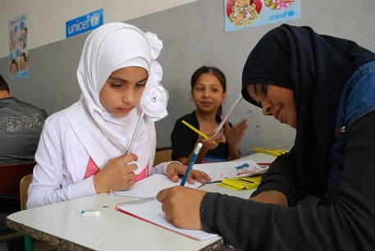
Agreeing key M&E tools
Lebanon / UNICEF/ 2012

Slide 36
Agreeing M&E tools
        Break into 5 groups
        Each group assigned a subject
How will we count children coming to CF Spaces?
How will we monitor wellbeing?
How will you determine the baseline?
How will you agree minimum standards for CFS?
What steps can we take to put in place a child friendly feedback mechanism?
        Produce written record of steps you will take
        20 mins
Notes:
Break into 5 groups
Each group assigned a subject
How will we count children coming to child friendly space?
How will we monitor wellbeing? How will you determine your wellbeing indicators?
How will you determine the baseline against which we are monitoring progress?
How will you agree minimum standards for CFS in this context?
What steps can we take to put in place a child friendly feedback mechanism?
Produce written record of steps you will take
20 mins

Slide 37
M&E – Data collation, storage & analysis
        Have system to organise, store & analyse data
        Do not collect too much data
        Secure storage of information, maybe database
        Train staff
        Analyse data
        Feedback – for accountability & confirmation
        Adapt project based on analysis
Notes:
Systems & procedures to properly organize, analyse & store data collected is part of M&E plan. Need clear & understandable system to file, code & secure data. This is an area that needs expertise and/or further training
Do not collect more info./data than can be entered into system or process for analysis
You must store data about project and children securely. A storage system of file folders (paper - hard copies) can be kept in a locked filing cabinet and/or an electronic computer-based filing system can be kept in password-protected files. Security & confidentiality is required for any child-specific data - child’s name, personal details & other sensitive information. Only staff with permission should have access to the information. Note this has resource requirements in terms of filing cabinets and designated computer to ensure security of the information
-- May set-up database. If you have large amount of data from different locations. If well done it also helps with confidential storage of the data
Trained staff should be involved in analysing data. If quantity of data is very high, or scale of programme is very large, you may need a staff member whose job is 100% support to development of M&E system, data processing & analysis
Analysis - You should analyse all the data you collect & collate regularly, at pre-agreed intervals. Analysed & consolidated information from data can be presented in written reports, data tables, in presentations or verbally
Feedback - Give feedback to stakeholders. They have right to information (accountability) & information needs confirmation. Conduct meetings to discuss data & findings with children, community & staff so they can confirm findings, give inputs on how to address challenges being faced or ways to continue good work
Change, adapt or modify project based on analysis of on-going M&E data collected.

Slide 38
Administration
USA / S. Thompson / SC / 2012

Slide 39
Administration includes…
        Briefing information / guidance documents
        Documentation and tracking of supplies
        Documentation of any costs or spending
        Activity plans and schedules
        Information on children and animators
    Contact information for children’s guardians
    Contact information for animators
    Attendance log
    Registration information
Notes:
Activity plans and schedules
Documentation and tracking of supplies
Documentation of any costs or spending
Information on children & animators
Contact information for children’s guardians
Contact information for animators
Attendance log
Registration information
Clarify that here we are not referring to a certain group of individuals within an organisation, but the function of administration that all staff are engaged in in one way or another

Slide 40
Purpose of CF Space administration
        Support M&E
        Ensure quality of programme
        Ensure smooth running of CFS
        Document spending at CF Space level
        Safety & security
        Support case management
Notes:
Support M&E – data and information collected can feed into reporting, can help supervisors monitor information such as ratio of animators to children, number of children occupying the space, etc – all indicators of quality
Quality of programme – ensure adult: child ratios suitable, that activities are designed appropriately for ages and genders attending, that range of activities addressing different development needs are being included, etc
Ensure smooth running of CFS – schedules and registers of children and animators ensures that everyone knows where they should be when, ensure sufficient supplies are available on time, schedules are planned, etc
Document information on spending at CF Space level – feeding into budgeting and reporting on financial aspects of the programme
Safety & security – ratio of staff to child, security & health incidents can be tracked, as well as stock levels of first aid materials etc can be monitored through admin, which ensures safety and wellbeing of children. Contact information for parents enables you to be in touch in case of harm or injury. Can give indicators, red flags for areas of concern, so if you have high drop out rates maybe there is physical punishment. Or maybe security issues are preventing children from attending.
Can support case management process – indicators for wellbeing can include presence, attendance, behaviour, which is noted in CFS administrative processes

Slide 41
Steps to putting in place administration system
        Formats for admin. designed & harmonised
        Filing system set-up
        Clarity on responsibilities – included in JDs
        Agreed flow of administrative information
        Training on admin systems
Notes:
Formats for administration (registration, stock monitoring, etc) need to be designed and harmonised across CF Spaces and agencies as far as possible
Filing system set-up – for on-site confidential and safe filing of administrative information, for copying and then for filing in centralised locations
Clarity on roles and responsibilities: There needs to be clarity on who is responsible for which aspects of daily administration
Agreed flow of administrative information - Agreed way that information will be collected, collated and processed – so everyone knows when they need to submit, how, who to and in what format – document this and display in CFS
Training on admin system given to all animators and staff – this should cover all of the above (forms, filing system, roles and responsibilities, and flow of information)
Staff, volunteers and parents should have a designated time to conduct administrative duties
If possible, a space, which is separate from children, should be allocated to enable privacy for official tasks - Separate admin space allows the staff to carry out both official and non-official tasks without disturbing the children at the CFS. It also helps ensure privacy when carrying out some more sensitive and confidential duties
Feedback to those inputting so they can understand the purpose of the information they gather – they can see the value of their work and can also have a sense of progress, issues etc.

Slide 42
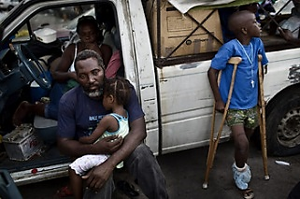
Wrap-up activity
Haiti / Marco Di Lauro for SC / 2010

Slide 43
Wrap-up activity
        Consider questions on the next slide
        Decide if you think if question would be used for administrative purposes, for M&E or as part of an accountability mechanism
        Select the option(s) you think it fits into
10 mins

Slide 44
Questions / information to consider
Name of each child attending CF Space
Details of vulnerability of each child
No. of children attending CF Space
Punctuality of the children
No. of volunteers participated in training
Reported cases of physical violence in CF Space
No. of animators in CF Space
No. of children dropped out of CF Space
Average number of times children come every week
Level of supplies in stock (No. of pens, Amount of paper, Etc.)
No. of complaints submitted to CF Space management
Punctuality of the animators
Number of investigations into behaviour of CFS animators
Age and gender of each child
Feedback from community regarding activities in CF Space
Concerns reported by community regarding CF Space

Slide 45
Conclusion
Accountability
Monitoring & evaluation
Administrative systems

Slide 46
Key resources

Slide 47
Resources
Accountability:
          Oxfam, 2007, Good Enough Guide
          Active Learning Network for Accountability & Performance in Humanitarian Action (ALNAP) http://www.alnap.org/
          Humanitarian Accountability Partnership (HAP) http://www.hapinternational.org/
M&E:
          Child Protection Monitoring & Evaluation Reference Group: http://www.cpmerg.org/
          UNICEF, (2011) Inter-Agency Guide to the Evaluation of Psychosocial Programming in Emergencies

Slide 48
Key points

Slide 49
Key points
        Participatory M&E & feedback mechanisms are an essential part of accountability.
        Feedback mechanisms & M&E system should be developed at outset, in a participatory way.
        Regularly review how your M&E and accountability systems are working.
        Complaint, response or feedback mechanisms must always be culturally-sensitive and situation-appropriate.
Notes:
Participatory M&E and feedback mechanisms are an essential part of accountability, ensuring programme success, enabling agencies to meet needs of affected populations appropriately, and ensuring respect of dignity and rights of those targeted by programmes
Feedback mechanisms & M&E system should be developed at outset of CF Space programming in a participatory way (involve volunteers, staff, affected population, community members & leaders, donors & governments)
Regularly review how your M&E & accountability systems are working involving all stakeholders in the review of the system
Complaint, response or feedback mechanisms must always be culturally-sensitive and situation-appropriate, and be sensitive to unequal distributions of power and cultural norms

Slide 50

Notes:
This slide is for the end of each session… prompts for questions, check in and even a 5 minute break, ice breaker as needed.

