Slide 1
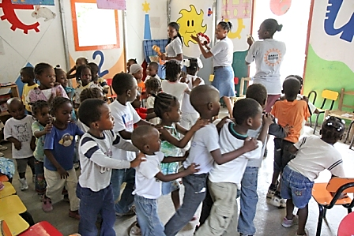
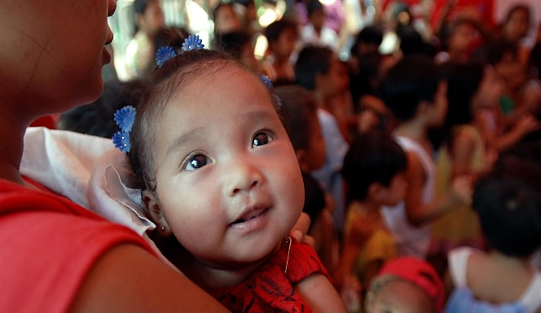
Resourcing & logistics
Child Friendly Spaces (CFS) Module 12

Slide 2
Learning Outcomes
By the end of the session participants …
Will be able to identify main factors influencing site selection
Know factors influencing choices with regards to equipment for the CF Space
Understand importance of preparing a logistics & procurement plan

Slide 3
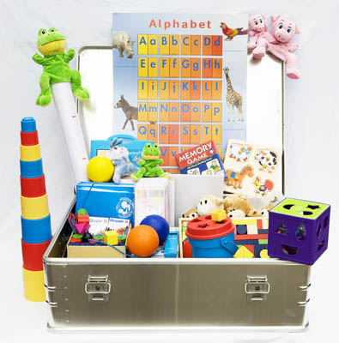
Resources & logistics
Throughout the different parts of this session we will cover the following topics:
  Transport
  Storage
  Supplies and equipment
Notes:
We will discuss the issue of costs and financing your programme supply needs throughout this session across all these subject areas. As well as what human resources you need to support these elements of logistics.

Slide 4
Defining key terms and concepts

Slide 5
Key terms
Logistics: Organisation of services or supplies.
Procurement: Action or occupation of acquiring equipment and supplies.
Virtual stocks: stocks held by suppliers on behalf of the agency.

Slide 6
Site selection & CF Space Set-up

Slide 7

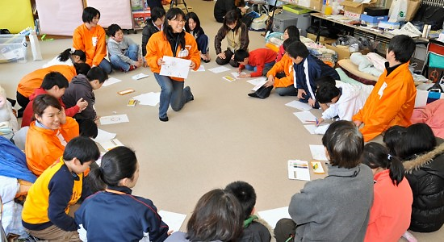
Site selection & set-up

Slide 8
Site selection and CF Space set-up
Divide into groups.
Brainstorm different things you need to consider when selecting site & designing the space (tent, pre-existing building or outreach activity).
Draw a picture for each of the things to consider.
10 mins
Note - we want you to think about the space itself, not the equipment inside that children will use.

Slide 9
How to ensure suitable site selection
Work with community
Understand ownership of site
Locations where vulnerable children gather?
Talk to children to assess & mitigate risks
Assess environmental impact
Review “physical risks” checklist
Consider needs & risks of often excluded
Consider changes over seasons / year
Work with other teams & sectors – water, health
Notes:
Work with community to ensure site selection & set-up is appropriate
Understand ownership of site / land being considered - Does it have particular owners who only occupy it certain times of the year?
Note if there are locations where vulnerable children already congregate
Talk to children to assess risks and mitigate them
Is there a water source and are there health facilities near by?
Assess environmental impact – if building using wood, consider including budget to replant trees
All of the above does depend upon what is available and what is appropriate

Slide 10
Lay-out and design of your CF Space
In same groups decide how you will lay-out the inside of the space.
Draw pictures or write words explaining how you will use space inside and outside CF Space for various activities.
10 mins

Slide 11
Layout of the CF Space

Slide 12
CF Space Layout
CF Space should have:
  Indoor and outdoor spaces
  Secure storage area for materials
  Secure area for first aid kit & confidential files
  Space for staff to do administrative tasks
Divide the CF Space into separate areas or zones
Consider different uses at different times of day
Consider number of children you can fit in space
Provide access for children with disabilities
Plan resource needs to make multiple use possible
Notes:
If possible have indoor and outdoor spaces to allow for team games and sports activities, as well as space for activities such as reading and facilitated sessions.
A secure storage area for the materials; if a secure area is not available, night guards or security personnel are required to ensure that materials are not damaged or stolen.
Secure area for first aid kit & confidential files
Space for staff to do administrative tasks
You should divide the Child Friendly Space into separate areas or zones by marking out areas for different activities or for different groups with ropes, curtains, etc. By dividing your space, you can conduct a number of different activities at the same time. Child Friendly Spaces can be divided and cordoned off according to ages, gender specific areas, or types of play that will be conducted – quiet play, active play, and structured activities.
Consider different uses at different times of the day – will this be used by different age groups in morning, afternoon or evening? Will parents and community use it?
Consider number of children you can fit in space you have available to you – what is safe
You must think of how you can provide access for children with disabilities (for example, by providing ramps for wheelchair access in addition to or instead of steps).
Plan resource needs to make multiple use of the space possible - e.g. enabling community meetings or parenting classes

Slide 13
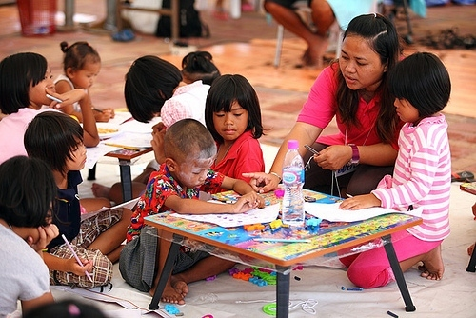
Equipping the CF Space

Slide 14
Equipment needs
Look inside the CF Space kits.
Look at diagram you drew for CF space site selection and lay-out.
Consider the different stages of the project cycle.
Now in your groups consider:
  What equipment will you need?
  List this separately or on side of picture.
  5 mins

Slide 15
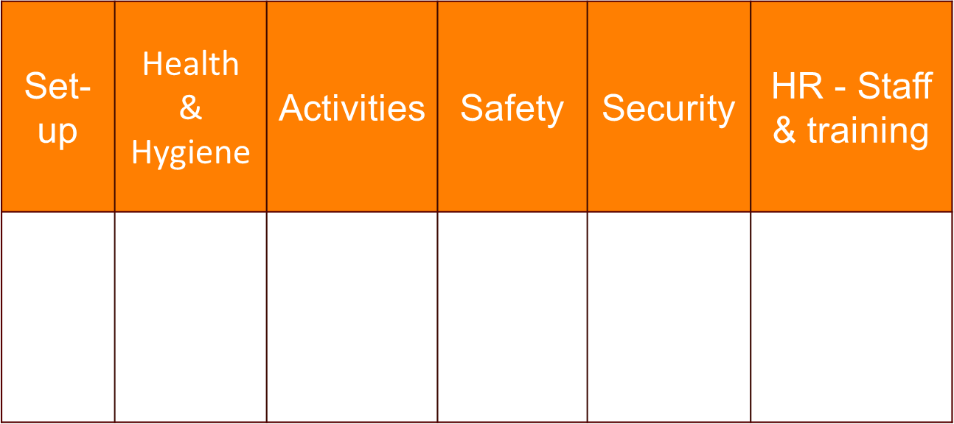
Main categories of Equipment - SHASS
Notes:
There are many ways to categorise the different types of equipment you buy. Here main categories we have identified for the acronym SHASS which can help us remember
See kit lists of individual agencies for details of what they should order:
SHASS: Set-up of space, Health and Hygiene, Activities, Safety, Security, Staff & training

Slide 16
How to select activities / equipment - take into account:
C: Capacity of facilitators
A: Ages & stages of development
Ge: Gender sensitive
D: Diverse needs
S: Space constraints
P: Participation of children & community
O: Outreach
R: Resources – limitations / availability
T: Traditions (culture) & time constraints
= CAGED SPORT
Notes:
ST: Take into consideration space & time constraints
T: Traditional and culturally relevant
A: Age appropriate
Ge: Gender, activities that appeal to boys & girls
D: Consider diverse needs
C: Capacity of facilitators
P: Participation
Many of the factors affecting equipment selection also come into play here, so think of a reduced CLASHING MG, here it is CP STAGeD

Slide 17
IMPORTANT NOTE:
When preparing programme plans, also prepare a logistics & procurement plan which shows resourcing needs over time.
Notes:
IMPORTANT NOTE:
When preparing programme implementation plans, also prepare a logistics & procurement plan which shows resourcing needs over time. This should cover supplies and equipment that are recurrent and one off, as well as staff to support that (support time needed from logistics team, drivers, guards etc), transport and storage. This enables you to clearly know your costs and budget flows too.
If you don’t:
Logistics and procurement teams will be busy doing other work when you need them
Resources and equipment will arrive to site late (if at all) delaying all your programme activities
You will have unplanned and unforeseen costs and delays
Budgets will not be accurate and you may not have necessary funding

Slide 18
REMEMBER:
To consider outreach or mobile activities as an alternative method of delivery. You do not need to have a fixed physical space to create a child friendly space.

Slide 19

Notes:
This slide is for the end of each session… prompts for questions, check in and even a 5 minute break, ice breaker as needed.

