Slide 1
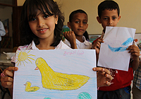
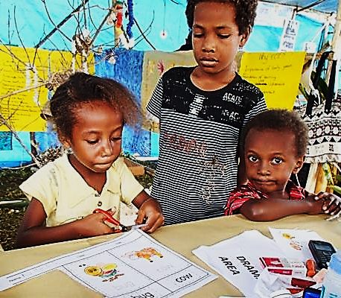
Session 2.2 – Needs assessment
Child Friendly Spaces (CFS) Module 2

Slide 2
Learning Outcomes
By the end of the session participants will …
Know five reasons why we need to understand child protection concerns & the psychosocial situation of children in order to plan our post-emergency CFS response
Be able to identify the key sources of information that help us to plan our CFS programme response after an emergency

Slide 3
Defining key terms

Slide 4
What is a child protection needs assessment?
  A process for establishing:
  Impact of a disaster or conflict on children & their families.
  Main child protection concerns & risks faced by those affected by disaster.
  Available capacity to respond, including coping mechanisms of affected population.
Notes:
A process of establishing:
Impact of a disaster or conflict on children & their families
Main child protection concerns & risks faced by those affected by disaster
Available capacity to respond, including coping mechanisms of affected population
Reference: CPWG (2012) CP Minimum Standards in Humanitarian Action, CPWG (2011) Child Protection Rapid Assessment: Short Guide

Slide 5
What is involved in the process?
  Set of activities necessary to understand situation, including:
  Review of secondary data
    Collection, up-dating & analysis of data pertaining to affected children (needs, capacities, resources).
    Infrastructure & general socio-economic conditions.
  Primary data collection – key informant interviews, & observation.
Notes:
Set of activities necessary to understand situation, including
A review of secondary data - Collection, up-dating & analysis of data pertaining to affected children (needs, capacities, resources, etc.) as well as the state of infrastructure and general socio-economic conditions in a given location/area
Primary data collection, including information derived from consultation with those affected by the disaster i.e. key informant interviews, & observation

Slide 6
Emergency response needs are the difference between the total sum of all children’s requirements & risks
minus communities’, families’ & children’s own capacity to respond.
Needs
Requirements and risks
faced by children
Community & children’s capacity to respond

Slide 7
CF Spaces needs assessment purpose
  Establishes whether CF Spaces are needed, safe & contextually appropriate.
  If CFSs are needed, then the assessment should also help to identify HOW CFSs can be established in an effective manner

Slide 8
What we need to know

Slide 9
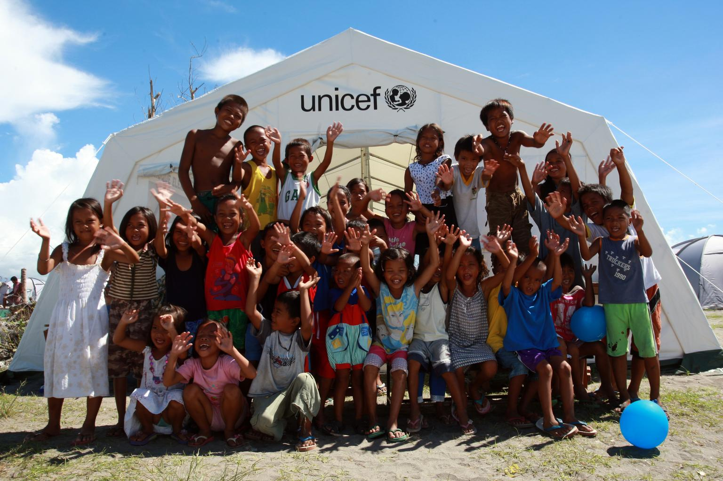
What would your most important needs assessment question be?

Slide 10

What are the top questions you need answered?
  Individually think up your top 2 questions for a needs assessment to establish whether CFS are needed.
  2 mins
  Go into pairs / threes, and choose two questions of the 4/6 you have in total, you can combine questions if you like.
  3 mins
  Now go into groups of 4/5/6 and rank your questions.
  3 mins
Notes:
Release each component step by step so that participants don’t know what is coming.

Slide 11
What information do we need?
  PSS wellbeing of children, families & communities
  Child protection concerns & threats
  How children are spending their time
  Community actions, structures & coping mechanisms
  Community engagement & inclusivity
  Feasibility
  Site selection
  Safety & security
Notes:
PSS wellbeing of children, families & communities – Adults too as this will have an impact on children & would determine the kind of activities needed in the CFS
Child protection concerns – What are the main protection threats (physical and psychosocial) to children and youth? Specific child protection concerns that may require tailored CFS activities, staffing or may indicate risks with certain forms of design of CFS
E.g. (1), if GBV problems – then include sexual reproductive health awareness raising sessions, and appoint a GBV focal point and case management system; E.g. (2) if separation is an issue carry out some prevention activities, and have FTR focal points; E.g. (3) if children are volunteering to join armed forces and groups consider peace-building sessions; E.g. (4) if there have been high rates of abduction of children from schools – having a visible CFS may create a target for attack
How do needs vary for diverse groups of children? E.g., by sex, religion, ethnicity, sexual orientation, disability, etc.? Who are children with greatest need. Certain groups of children may be excluded from other community, PSS or education activities or are showing greatest need for protection / PSS and thus you should be target of CFS activities
How are children spending their time? Does this vary for girls and boys or according to other social categories? What types of play do girls and boys usually engage in within the culture and could these be organized in the CFSs?
What are patterns of vulnerability? Which girls and boys are highly vulnerable and may need additional support to participate in CFS activities? How do patterns of threats and vulnerability vary for diverse groups, e.g., by sex, religion, ethnicity, sexual orientation, disability, etc.?
Community actions and structures, willingness, responses so far. Community responses to external actors’ interventions. If the community is hesitant to engage with unknown external actors, you may wish to work with CBOs or local NGOs. Are there other protective practices that people did before the crisis that they aren’t being done now and that could be restarted? What is the acceptance of families and communities of this type of intervention? Is the community or camp able to organize itself to help children? Who are the key people in the community or camp who support children or that child go to when they need help? How can we involve them in CFS?
Community engagement & inclusivity: How does the community view the establishment of a CFS? Is the community likely to develop a spirit of ownership in developing a CFS?
Feasibility: How feasible and safe would CFSs be in the present context for girls and boys? Would a CFS help to diminish, or may it increase threats (e.g., are there risks to children in accessing the CFS?)? Would a CFS strengthen the existing support for children, or would it duplicate efforts?
Site selection: Access to community – how will you reach the community? Government allowing access to specific areas? Access to health, water & sanitation facilities. Is the site hazard free. Are there potential risks due to conflict and fighting? Are there potential risks posed by weather, natural disaster? Is it possible to easily evacuate if necessary?
Security situation - security issues historically as well as social tensions that may create future possible security risks
(See page 8 – 10 of Guidelines for Child Friendly Spaces in Emergencies)

Slide 12
How we get the information we need

Slide 13
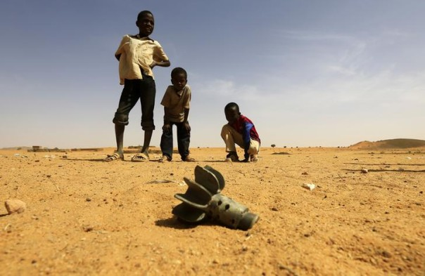
How will you get the information?
Notes:
Coordinate your activities – not all individuals from all agencies need to necessarily take part in the needs assessment, it is best to be cost effective and efficient, pool resources and information
Ensure staff are trained on how to interact with those who are distressed
Triangulate your information – All assessors may have some bias, discuss findings and observations, try to confirm that findings are consistent and realistic
Consider how those affected will feel – best not to interview children directly, don’t want to repeatedly ask people same questions
Observation cannot tell you all you need to know about a situation – not all protection and psychosocial needs are visible – we need to carry out Key Informant Interviews as well
Some children are in hard to reach locations, we may need more creative ways to understand their situation. As we should plan how we will respond to their needs to, either remotely or how we will respond once we do have access to them
We need information on coping strategies as well as needs before we can decided if CF Spaces are feasible, suitable and needed

Slide 14
How will you get the information?
  Coordinate with other actors
  Talk to other sectors / other agencies, staff who have been on field visits, government reps, etc
  PSS questions in multi-sectorial assessment
  Data sex & age disaggregated
  Range of different information sources:
  CP, education, other sector needs assessment
  General updates & photos
  Social welfare services / Gov’t baseline data
  Other ideas of sources, material specific to context?
Notes:
Coordinate with other actors – can do interagency / cluster assessment. Don’t need to all go out and carry out assessments – not efficient, cost effective or respectful to those affected
Talk to other sectors / other agencies, staff who have been on field visits, gov’t reps, etc
Get PSS questions incl. in multi-sectorial assessment
Lobby to have data sex & age disaggregated
Range of different information sources:
CP, education, other sector needs assessment – KII & FGD
General updates: Security sitrep, OCHA Update
Photos of situation, families & children
Social welfare services
Gov’t baseline data
Material specific to context? Other ideas of sources?

Slide 15
How the assessments should be done?
  Assessments should…
  Encourage community participation and actively engage children and young people, parents, women’s groups, youth groups, religious and community leaders, etc.
  Disaggregate data according to gender, age, & other relevant dimensions to ensure inclusivity.
Notes:
Encourage community participation and actively engage children and young people, parents, women’s groups, youth groups, religious and community leaders, etc
Disaggregate data according to gender, age, and other relevant dimensions in order to ensure inclusivity – we need to capture information on the needs of different groups of the population

Slide 16
RARELY need a SEPARATE Child Friendly Spaces needs assessment –
Wherever possible, questions relating to CF Spaces should be addressed through coordinated, inter‐agency assessments within or across clusters and sectors
Notes:
Though you do need information to inform your decisions, there should be no separate child friendly space needs assessment…
Your decisions regarding CF Space programming should be made when planning how you will address child protection, education and psychosocial wellbeing needs as a whole, not independently

Slide 17
How we use the information

Slide 18
The way we use need assessment data and report
We need this information to enable us to:
  Clarify PSS needs of children & families
  Understand existing supports
    Thus we can plan our response appropriately
  Have baseline for monitoring purposes
  To be able to justify to donors our activities
  For advocacy and awareness raising

Slide 19
What indicates need to set-up CF Space

Slide 20
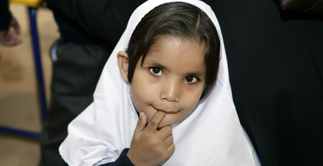
What indicates need for set-up of CFS?
Notes:
Ask participants to give their views on what information gathered through a needs assessment would indicate that Child Friendly Spaces are needed as part of your programme?
After 5mins discussion note the following key points:
Child Friendly Spaces are not the only activity that we might do in an emergency response to protect children. They are one mechanism that enables us to provide immediate and rapid start up of a community-based approach to addressing psychosocial support needs, while allowing us time to find out the more in-depth needs of children and families. They are typically part of a package of supports for children and their families, and they must be seen and presented as such
Yes, need for CFS - Examples of information that indicates a need for CFS programmes:
Children are showing signs of distress
Children are exposed to physical risks due to lack of care for them during the day time
School’s are not in session
Parents are engaged in recovery efforts and are unable to provide care and support needed by children
Certain age group (in range 0 – 18) or category (such as disabled, working children, girls, etc) of children are being excluded from other support activities
No, should not have separate stand-alone CFS activities - Examples of information that indicates a need for CFS programmes:
Pre-existing community groups are running and managing child and adolescent-friendly activities (you may want to support them to do the work they have started)
Schools are continuing lessons and there is little to no evidence of out-of school children (you may wish to support PSS activities in school setting)

Slide 21
Indication of need for CF Spaces
  Would a CFS help to prevent or diminish threats & protection concerns?
  Would a CFS strengthen the existing supports for children and fill a gap in their needs?
  Would CF Spaces present a safe way of reaching children?
  Do communities and children find a CF Space intervention suitable and appropriate to context?
  Is it possible for activities girls and boys normally enjoy to be organised in some form of CF Space?

Slide 22
CF Spaces as part of wider programme of support
  Child Friendly Spaces are not the only activity that we might do in an emergency response to protect children.
  They are 1 mechanism that enables us to provide immediate and rapid start up of a community-based approach to addressing psychosocial support needs, while allowing us time to find out the more in-depth needs of children and families.
  They are typically part of a package of supports for children and their families.

Slide 23
When CF Spaces are NOT appropriate
  If children have access to other means of meeting their needs for education, protection, and psychosocial support.
  If CFSs are likely to become places where children are attacked or recruited by armed groups.
  If CFSs are likely to expose girls to sexual harassment or attack, when on way or attending CFS.
  For specific children whose needs require specific training or one-on-one support or for children whose behaviour puts others at risk.

Slide 24
Key resources

Slide 25
Key resources
  CPWG, Global Education Cluster, INEE, & IASC (2011) Guidelines for child friendly spaces in emergencies – pages 8 – 10.
  INEE Minimum Standards for Education, IASC Guidelines on MHPSS and CPWG Minimum Standards for Child Protection.
  Child Protection Working Group (2011) Child Protection Rapid Assessment: Short Guide.

Slide 26
Key points

Slide 27
Key points
  PSS and child protection needs may or may not indicate a need for CF Space programming. Depends also on specific context, psychosocial support & CP needs of children, existing community responses, gaps in services & risks.
  Typically you will not need to not carry out a separate needs assessment for CF spaces.
Notes:
PSS and child protection needs may or may not indicate a need for CF Space programming. Whether or not you implement CF Space activities and the form they should take depends on the specific context, the psychosocial support and child protection needs of children, existing community responses, the gaps in service delivery and any possible risks and threats
Typically you will not need to not carry out a separate needs assessment for child friendly spaces, you should draw from information regarding child protection, education, mental health and psychosocial support needs

Slide 28

Notes:
This slide is for the end of each session… prompts for questions, check in and even a 5 minute break, ice breaker as needed.

