Slide 1
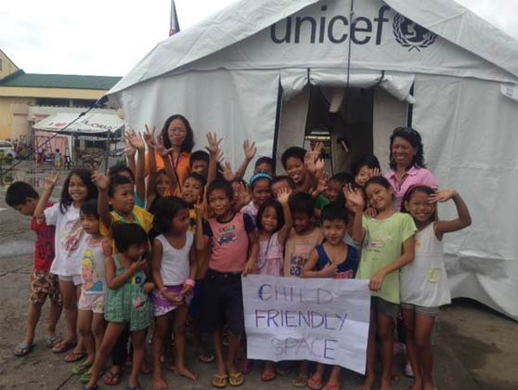
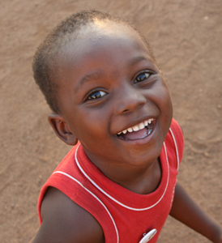
Session 1 – Preparedness for CF Spaces
Child Friendly Spaces (CFS) Module 2

Slide 2
Learning Outcomes
By the end of the session participants will …
Be able to define preparedness
Know the six key areas of action that can be taken to prepare for set-up of CF Spaces in the case of an emergency

Slide 3
Defining key terms

Slide 4
Preparedness
Knowledge and capacities developed to…
  … recognise hazardous events that are potentially coming
  … cope and deal with the effects of the event(s), and
  … get ready for the next phase in the emergency project management cycle.
  It is a continuous cycle of planning, organizing, training, ensuring availability of supplies, evaluating response and improving activities.
Notes:
Knowledge and capacities developed by governments, professional response and recovery organisations, communities, individuals and children
To recognise hazardous events that are potentially coming – to effectively anticipate
To cope and deal with the effects of the event(s), to respond and recover from the impacts of the event
and to get ready for the next phase in the emergency project management cycle.
It is a continuous cycle of planning, organizing, training, ensuring availability of supplies, evaluating response and improving activities
Preparedness covers all the measures that can feasibly be taken
Disaster-preparedness refers to activities and measures taken in advance of a disaster to ensure an effective response to the impact of hazards, including issuing timely and effective early warnings and the temporary evacuation of people and property from threatened locations. It is often called simply “preparedness” and can also apply to the state of readiness to respond as demonstrated by organizations, NGOs or government departments.
- Reference: CPWG (2012) CP Minimum Standards in Humanitarian Action and INEE (2011) The Minimum standards for education: preparedness, response, recovery

Slide 5
Recap on stages of project cycle
Preparedness
Coordination
Assessment
Setting objectives based on assessment
Planning based on objectives
Implement activities according to plan
Monitor and evaluate
Close project
Lessons learnt feed into future preparedness
Notes:
Prepare
Coordinate
Undertake assessment
Set objectives based on assessment
Plan based on objectives
Implement activities according to plan:
Address basic services and security issues
Mobilise family and community support
Develop structured psychosocial programs (if needed / possible)
Train staff
Establish referral to appropriate mental health services
Monitor and evaluate
Close project
We are focusing here on Steps 4 & 5, how you set your objectives and then design the programme plan to meet those objectives –
Identify the problem through assessment (we discussed this in the previous session)
Information assessment will help to enable identification of support needs and gaps in service delivery. This will indicate whether or not you need to develop a programme to respond to children’s PSS needs.
Set objectives based on assessment
If you feel there is a need, then you will need to establish what your programme hopes to achieve. This is done through setting objectives.
Do you want or need CFS as part of way to address problem?
CFS are not always the answer, may be other more effective ways to address children’s needs in this context
CFS in most cases should be part of wider programme plans addressing education, protection and mental health and psychosocial support needs
If you decide they are to be part of your programme – then you need to plan the resources, actions, staffing and support you will need to deliver the “a – e” of the CFS approach

Slide 6
Risk Management Cycle
Preparedness
Response
Recovery
Prevention
Mitigation
Emergency response
Disaster risk reduction
Notes:
Preparedness: A state of readiness, reducing risks, increasing ability to respond faster
Response: The act of responding; reply or reaction
Recovery: Restoration or return of children, families, communities and institutions to former and/or better state or condition (notion of building back better). Timing depends on context.
Mitigation: The action of reducing the severity, seriousness, or painfulness of something
Prevention: The action of stopping something from happening or arising
Emergency management is the generic name of an interdisciplinary field dealing with the strategic organizational management processes used to protect against hazards or risks that can cause events like disasters or catastrophes and to ensure resiliency. Emergency management (or disaster management) is the discipline of dealing with and avoiding risks.
Key points:
This model serves to demonstrate & show the link between risk management, development programming, preparedness & emergency response, which is an on-going process.
This model is very simplified - activities undertaken may belong to several different stages in the cycle at the same time, depending on the context. The stages may not happen in this order, or they can happen at the same time. Recovery activities often begin during the response phase, etc.
Work on child protection, and in Child Friendly Spaces in particular, should fit within and consider the different stages of this cycle. Preparedness (what we are discussing now), response (the set-up and management of CFS), recovery (the phase out of the CFS), prevention (work that can happen through the CFS to raise community and children’s awareness of the risks to children in future emergencies) and mitigation
In this session we are focussing on preparedness. Work on mitigation of risks and prevention of protection concerns should be carried out as part of wider protection, education, GBV programming, but are not specific to Child Friendly Spaces
Reference: Plan International DRR in Education and Child Protection in Emergencies training materials

Slide 7
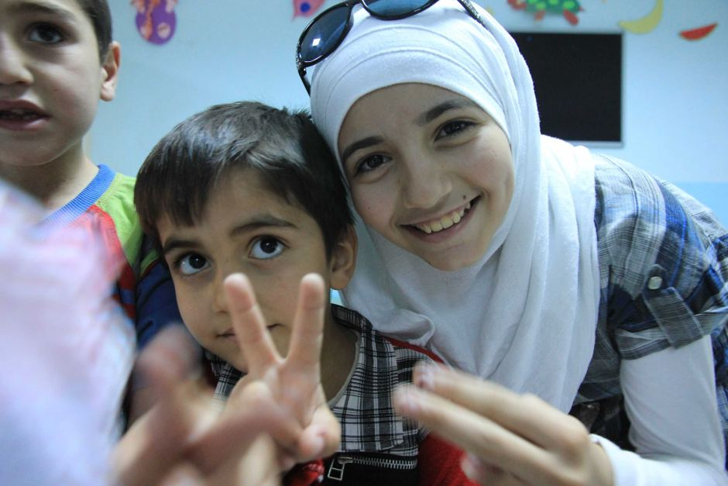
Preparedness activity

Slide 8
Core Elements of CF Space Preparedness

Slide 9

Minimum core elements of CFS preparedness
Five building blocks:
Coordination
Human resources
System & tool development
Logistical considerations
Financial resourcing
Foundation:
Community engagement
Notes:
These are the five building blocks and the foundation which enable you to plan for the CF Space activities you want to deliver if there is an emergency.

Slide 10

Preparedness activity
Split into 6 groups
Each group takes one of the 5 Building Blocks or the Foundation of CF Spaces preparedness
Try to come up with longest list possible of things to consider under the heading your group has been assigned
You have 4 mins
Notes:
For this activity you are not thinking about the type of CF Spaces programme you want, or the design of your CFSs, but rather the things you would need to discuss and prepare for any type of CF Spaces work
Remember to consider different types of emergencies (natural disaster, conflict, man-made, etc) that could occur

Slide 11
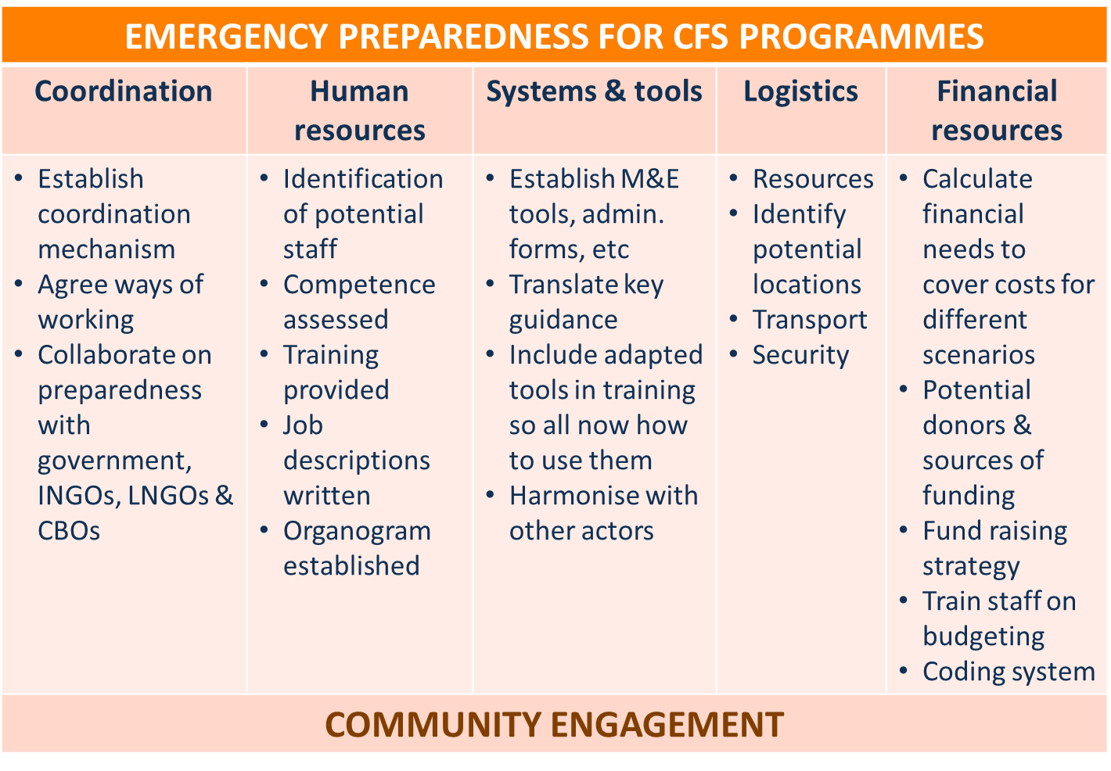

Slide 12
Pre-emergency work with communities regarding CF Spaces
    Baselines of child population & community
    Understand cultural context. Adapt tools to context
    Have idea of capacities at community level
  Map existing community mechanisms
  Know resources available
    Community awareness including:
  Risk reduction strategies, CFS response plans
    Support/set-up children’s groups
Notes:
Working with communities is the foundation of all these forms of preparedness:
Carry out community awareness activities including:
Risk reduction strategies – ensure communities are aware before any emergency of the main things they can do to prevent risks to children
CFS response plans – ensure that communities have participated in discussions on how will respond, know expectations regarding their role, understand existing community structures, who are most vulnerable in the community, who can support children in an emergency
Map existing community mechanisms – clubs, groups, committees and structures that exist prior to emergencies
Have idea of capacities at community level – individuals with skills who could work on CFS project (such as teachers, nurses, child facilitators, child protection focal points, etc), as well as community behaviours and responses to ensure child wellbeing
Know resources available – toys, games, spaces, buildings that can be used
Baseline knowledge of child population – know what vulnerable groups exist, where they are, what their regular daily activities are (child work, education, health issues, nutrition, etc), how community responds to and deals with children
Understand cultural context – any ethnic or religious divides or points of consideration when designing CFS – be aware of potential negative and positive repercussions of an external agency coming in and supporting, setting up or running CFS
Support or set-up children’s groups pre-emergency – these could have clear guidance on what their role would be if an emergency hit. This could also be a way to engage children in system-wide planning for emergency preparedness

Slide 13
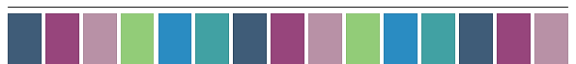




Slide 14

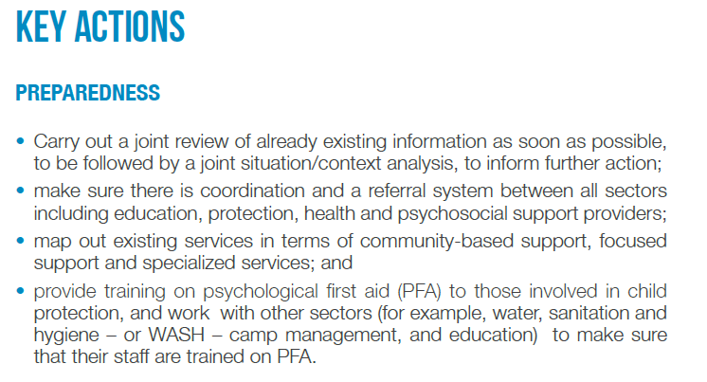
Notes:
Carry out a joint review of already existing information as soon as possible, to be followed by a joint situation/context analysis, to inform further action
Make sure there is coordination and a referral system between all sectors including education, protection, health and psychosocial support providers
Map out existing services in terms of community-based support, focused support and specialized services, &
Provide training on psychological first aid (PFA) to those involved in child protection, and work with other sectors (for example, water, sanitation and hygiene – or WASH – camp management, and education) to make sure that their staff are trained on PFA

Slide 15
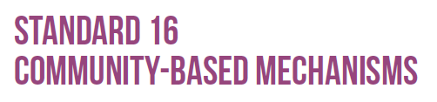

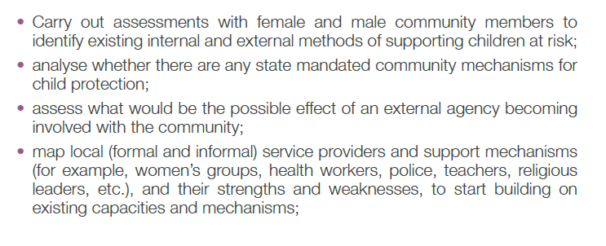

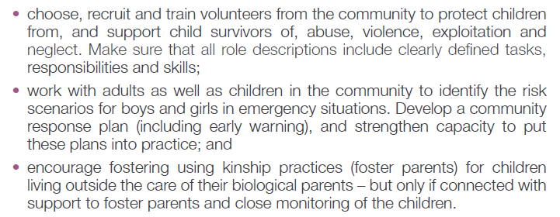
Notes:
Relevant preparedness actions from CP Minimum Standards 16 - Community-based mechanisms
Carry out assessments with female and male community members to identify existing internal and external methods of supporting children at risk;
Analyse whether there are any state mandated community mechanisms for child protection;
Assess what would be the possible effect of an external agency becoming involved with the community;
Map local (formal and informal) service providers and support mechanisms (for example, women’s groups, health workers, police, teachers, religious leaders, etc.), and their strengths and weaknesses, to start building on existing capacities and mechanisms;
Choose, recruit and train volunteers from the community to protect children from, and support child survivors of, abuse, violence, exploitation and neglect. Make sure that all role descriptions include clearly defined tasks, responsibilities and skills;
Work with adults as well as children in the community to identify the risk scenarios for boys and girls in emergency situations. Develop a community response plan (including early warning), and strengthen capacity to put these plans into practice; and

Slide 16
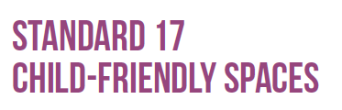
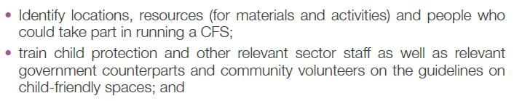

Notes:
Identify locations, resources (for materials and activities) and people who could take part in running a CFS;
Train child protection and other relevant sector staff as well as relevant government counterparts and community volunteers on the guidelines on child-friendly spaces; and
Consider various ways of creating safe spaces for children in communities, and how to link them with the larger protection systems.

Slide 17
Creating linkages

Slide 18
Essential linkages
    Preparedness plans for CFS must link to:
    Overall organisation preparedness plans
    Sector plans (at interagency level too)
  Education response plans
  Child Protection response plans (CFS plans are embedded in & part of child protection plans)
  Mental health and psychosocial support plans
    Government response plans
    Community practices
Notes:
Preparedness plans for CFS must link to and coordinate with:
Overall organisation preparedness plans- be clear what operational support, other sectorial inputs, finance and admin inputs will be needed and also planned for
Sector plans (at interagency level too), eg:
Education response plans
Child Protection response plans
Mental health and psychosocial support
Government response plans
Community based networks
What community based systems and mechanisms already exist, how will you link in with these? What children’s groups or groups working with children are already functioning?

Slide 19
Key points

Slide 20
Key points
    Preparedness is a key element of effective response. Without it we cannot address PSS needs of children & communities as well and as fast as we need to.
    Community engagement is foundation of good preparedness.
    Preparedness plans for CF Spaces need to be part of wider plans for responding to children’s needs.
Notes:
Preparedness is a key element of effective response. Without it we cannot address psychosocial support needs of children and communities as well and as fast as we need to
Community engagement is the foundation of good preparedness planning. If there is an emergency, existing community based mechanisms enable us to more rapidly understand the context, needs, resources available and thus set-up the programme response needed given the situation
Preparedness plans for CF Space set-up and activity implementation need to be part of wider plans for responding to children’s needs with regards to education, mental health and psychosocial support, and child protection, and linking with all sectors. They should not be stand-alone

Slide 21
Key resources

Slide 22
Key resources
INEE Minimum Standards for Education, IASC Guidelines on MHPSS and CP Minimum Standards in Humanitarian Action.
Plan International (2010) Child-Centred DRR Toolkit.
Agency specific guidelines on emergency preparedness planning, procurement, logistics and programme budgeting.
Notes:
INEE (2011) The Minimum standards for education: preparedness, response, recovery
IASC (2007) Guidelines on MHPSS
CPWG (2012) CP Minimum Standards in Humanitarian Action
Plan International (2010) Child-Centred DRR Toolkit

Slide 23

Notes:
This slide is for the end of each session… prompts for questions, check in and even a 5 minute break, ice breaker as needed.

