Slide 1
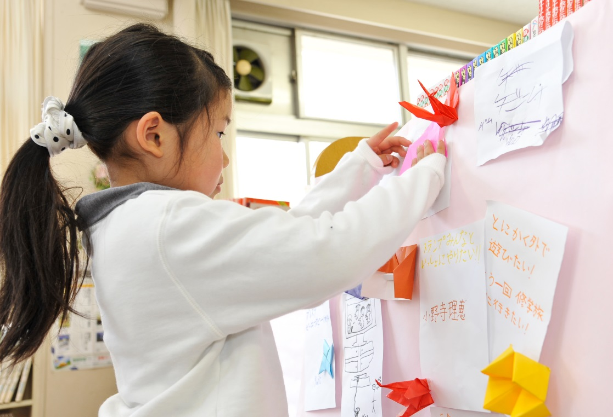
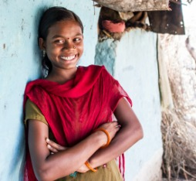
Session 4 – CFS Purpose & Principles
Child Friendly Spaces (CFS) Module 1

Slide 2
Learning Outcomes
By the end of the session participants will …
Know the three main objectives of CFSs
Be able to name the five guiding principles of CFS
Identify 5 actions that enable realisation of principles

Slide 3
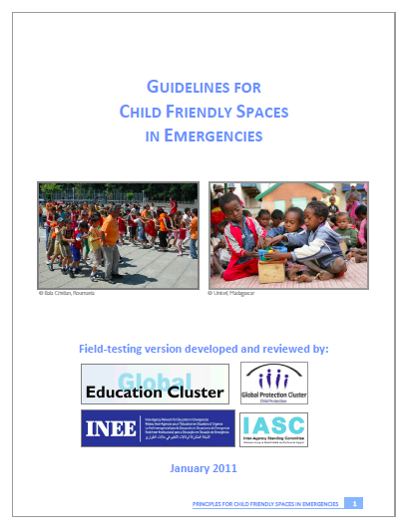
Guidelines for Child Friendly Spaces in Emergencies
Notes:
The purpose of these principles is to give practical guidance to the field teams that establish CFSs in different types of emergencies and contexts. They are also intended to guide advocacy efforts and donor practices in emergency settings where protection and well-being ought to be high priorities.

Slide 4
Defining key terms

Slide 5
Child Friendly Spaces
Are safe spaces where communities create nurturing environments in which children can access free & structured play, recreation, leisure & learning activities.
Provides educational and psychosocial support & other activities that restore a sense of normality and continuity.
Designed & operated in a participatory manner.
Notes:
Reminder of the definition of what a Child Friendly Space is:
Are safe spaces where communities create nurturing environments in which children can access free & structured play, recreation, leisure and learning activities
May provide educational and psychosocial support and other activities that restore a sense of normality and continuity
Designed & operated in a participatory manner, often using existing spaces in the community and may serve a specific age group of children, or a variety of age ranges
Child Friendly Spaces (CFS) are implemented under many different names such as ‘Emergency Spaces for Children’, ‘Spaces Spaces’ and ‘Child Centered Spaces”. All these programs have the same focus and activities, and are part of the larger humanitarian protection response. CFSs are not a collection of activities focused on one specific area only but rather a community program to create a larger protective environment for children during emergencies. They are initiated through rapid support to communities to provide physical safety, psychosocial activities and educational assistance for children and they are a key programmatic intervention to protect children and youth during the acute response phase of an emergency or in areas of continuing crisis.
Although different agencies call CFSs different things — for example safe spaces, child centered spaces, child protection centers or emergency spaces for children — the interventions are all part of a common family of supports for children and young people.
For the purpose of this training we will mostly use the term “child friendly spaces” or CFS

Slide 6
Purpose: CF Spaces’ support to children & their families

Slide 7
Purpose of CFSs
Support resilience & well‐being of children & young people who have experienced disasters through community organised, structured activities in safe, child-friendly, stimulating environment.
Primary participants in CFSs are children
Notes:
The purpose of CFSs is to support the resilience and well‐being of children and young people through community organised, structured activities conducted in a safe, child friendly, and stimulating environment. (Note, that whilst agencies attempt to ensure safety by vetting staff, setting up structures that are suited to context and should not cause injury or harm, carrying out protective activities, no one can guarantee 100% safety, and CFS can be attacked, vulnerable to natural disasters, etc, as anywhere else in an emergency context)
The primary participants in and beneficiaries of CFSs are children (people under 18 years of age), although in some contexts, CFSs may also engage and benefit young people who are beyond 18 years of age. And the space may be used to support parents and community members at certain times of the day.

Slide 8
Specific objectives
Mobilise communities around protection & wellbeing of all children.
Provide opportunities for children to play, acquire contextually relevant skills, & receive social support, thus strengthening their wellbeing.
Offer inter‐sectoral support for all children in the realisation of their rights.
Notes:
Guidelines for Child Friendly Spaces – based on idea of building consensus across three different communities of practice: the IASC Reference Group on Mental Health and Psychosocial Support in Emergency Settings, the global Child Protection Working Group, and the global Education Cluster.
Have found certain objectives are shared by all CFS, in different contexts after different types of emergencies, implemented by full range of agencies.
The specific objectives are to:
Mobilise communities around the protection and wellbeing of all children, including highly vulnerable children – strengthening already existing community level protection mechanisms
Provide opportunities for children to play, acquire contextually relevant skills, and receive social support, thus strengthening their wellbeing - emotional well-being, social well-being, and/or skills and knowledge
Offer inter‐sectorial support for all children in the realisation of their rights.
We will talk later in training about how CFS tackle specific and different protection risks

Slide 9
CF Spaces’ contribution to wellbeing and child development
Notes:
Although different agencies call CFSs different things — for example safe spaces, child centered spaces, child protection centers or emergency spaces for children — the interventions are all part of a common family of supports for children and young people.
For the purpose of this training we will mostly use the term “child friendly spaces” or CFS

Slide 10
CF Spaces’ benefits for child and community wellbeing
        Build individual & community resilience
        Aim to strengthen protective & reduce risk factors
        Restore normality
        Maintain culture & traditions
Notes:
Basis / foundation for programming:
The notion of individual and community resilience – CF Spaces support mobilisation of communities to protect their own children - Build resilience through learning of ways to protect themselves, understanding risks facing them, increasing awareness of themselves and their communities
Aim of strengthening protective and reducing risk factors provide – e.g. through life-skills activities for children, behavioural change communication and awareness raising on certain concerns and issues
Restoring normality is a prime concern - Restoring opportunities for normality, such as establishing trusting relationships in safe places with predictable routines and also strengthening community networks is most beneficial for children and their families.
Maintain culture & traditions – CF Spaces allow for transmission of traditions, stories, songs and cultural celebrations. Allowing children to feel a link with their community, culture and heritage in disrupted contexts

Slide 11
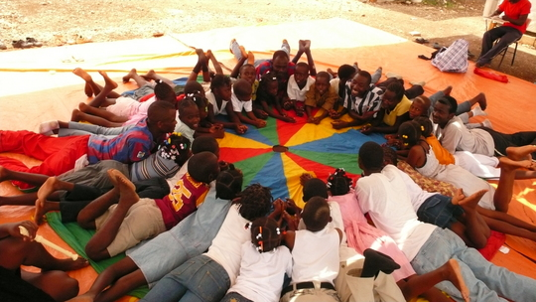
What activities do children like to do?

Slide 12

What activities do children like to do?
Individually reflect on activities you liked as a child? Things that made you happy.
  Or activities your children or children you know like? Maybe even activities that children you are working with now have requested or said they like?
As you think of some activities write each activity on a separate coloured card.
You have 5 minutes...

Slide 13
Categories of child development
Different domains / aspects of development:
  Physical development
  Social & emotional development
  Cognitive:
    Intellectual
    Communication & speech
Notes:
Physical development: this refers to the body increasing in skill and performance and includes:
Gross motor development – e.g. sports, running, skipping, jumping and dancing
Fine motor development – e.g. drawing, building blocks, & puzzles
Social and emotional development:
Story telling and joint play with adults can contribute to bonding with adults – reestablishment sense of attachment
All forms of play with peers (role play, play fighting, with dolls or puppets, sports, etc) can contribute to relationship building with peers and learning about conflict resolution.
Cognitive:
Intellectual development: memory games, puzzles, strategy games (Ludo, chess, etc)
Communication & speech development: reading, talking, group discussions

Slide 14
Activities carried out in CFS in different contexts …
Play & educational activities
Foundation for restarting formal education
Informal education & reintegration for vuln.
Livelihoods activities
Life-skills and behavioural change
Wider work on issues incl. CP & ECCD
Efforts on disaster preparedness & DRR
Some activities extend into early recovery period
Notes:
We need to overcome community, other sectors and even CPiE/ education / gender actors misconceptions of who is welcome in CFS and what CFS are for in order. This will enable us to ensure they have the greatest impact possible on the lives of the most vulnerable children
Depending on the context, CFSs have been used for a variety of purposes such as:
Play activities – including creative play, imaginative play, drawing, sport & exercise, collaborative games, strategy games, etc
Laying a foundation for restarting formal education and supporting national education systems
Informal education and reintegration activities for vulnerable children
Livelihoods activities – though should be used with caution as must not reduce ability of children to have full access to other rights (e.g. education and health rights should not be limited by engagement in dangerous forms of income generating activities)
Life-skills building and behavioural change – encouraging more positive behaviours among girls and boys
Enabling wider work on issues such as child protection, WASH, livelihoods and early child development
Stimulating efforts on disaster preparedness and disaster risk reduction
Some of these activities extend beyond the emergency context into the early recovery period or even into longer‐term development.
Don’t forget they can be used in non-emergency settings, including developed and developing countries

Slide 15
CF Space activities’ child development benefits / outcomes
Skill development
Learn to dealing with emotions
Build nurturing relationships with caring adults & peers
Play and sport as release of stress, fear, sadness or loss
Behavioural change
One activity can contribute to many forms of development
Notes:
Skill development - life-skills, public health, behavioural change. Strategy games can contribute. Building blocks. Puzzles.
Children can establish nurturing and positive relationships with caring adults and peers - They can build positive relations with peers, learning to negotiate, deal with conflict, develop skills for contributing to peace-building when they are grown up. Self-directed or imaginative play is very important in children’s social and emotional development - Children will ‘act out’ events they have experienced in their play, it can help them heal and recover after traumatic events (more about this on the next slide).
Opportunity to play – be it dance, plays sports, sing, or draw, which release of stress, reduces cortisol levels, and ensures stress levels return to normal - Express fear, sadness, loss in safe environment – dealing with the emotions they have been feeling and overcoming the events they have lived through - Sport important for motor control & cognitive ability. Reduce anxiety & cortisol levels. Individual activities such as running, skipping, jumping, dancing. Or group sports such as football, handball, volley ball, basket ball, etc
Behavioural change – public health messaging, life-skills building on issues such as sexual health, games that integrate messaging (e.g. WASH use a version of Snakes and ladders that conveys public health messages) etc

Slide 16
CF Spaces influencing the wide humanitarian response

Slide 17
Advantages of CF Spaces for wider humanitarian response
CFS can be a mechanism for community mobilisation as they’re adapted to local context
Bring children’s needs into prominence by mobilising & supporting communities on behalf of children & by engaging parents / caregivers in effective interactions with children
Enable participation of children in planning, response, M&E of other emergency activities
Notes:
CFS can be mechanism for community mobilization, as they use participatory methods that are adapted to local context & culture
Bring children’s needs into prominence by mobilizing & supporting communities on behalf of children & by engaging parents / caregivers in effective interactions with children
Enable participation of children in planning, response, monitoring & evaluation of other emergency response activities. For example the CF Space children can influence the design of shelter, water, health or food security programmes, by creating children’s clubs who input their views and thus change design of other sector plans. Or children from the CF Space can be involved in awareness raising activities covering topics relating to sectors other than CP, Education or MHPSS.

Slide 18
Examples of CF Spaces in different contexts

Slide 19

Forms CFS take in different contexts
Can you guess where “Zenin syugo,” (“everyone gathering together”), are found? Balae Ndronoa? Where are ‘Kusi Wasi', which means house of joy?
Notes:
ANSWERS: ZS – Japan, BN – Indonesia, CSER – Ivory Coast, KW – Peru - This exercise shows adaptation of the concept to context

Slide 20

CF Space Case studies
Indonesia Floods (2006): Communities & IDPs set up children’s groups run by Islamic leaders, teachers, etc – NGOs give kits.
Ivory Coast Conflict (2007): Adolescent girls, in pre-existing buildings & temporary structures – 200 children per CFS, in shifts/ different classes – livelihoods, life-skills (including child care), theatre, accelerated learning, etc. (2011): CFS in hospital reception areas.
Bangladesh Cyclone (2008): Range of models: i. Older adolescents run activities in designated time slot in school buildings. ii. Adolescents run activities in tents whilst parents do cash-for-work. iii. Pre-existing LNGO children’s clubs increase hours & no. children.
Notes:
Indonesia Floods (2006): Communities & IDPs set up children’s groups run by Islamic leaders, teachers, etc – support from humanitarian agencies came in form of supplies
Ivory Coast Conflict (2007): Adolescent girls (ex-associated with armed forces & groups, child-mothers, disabled, etc) - a group otherwise excluded from humanitarian activities - in pre-existing buildings & temporary structures – 200 children per CFS, in shifts/ different classes – livelihoods, life-skills (including child care), theatre, accelerated learning, etc. In 2011: child friendly spaces in hospital reception areas
Bangladesh Cyclone (2008): Range of models tailored to community needs and actions: i. Activities in designated time slot in school buildings run by older adolescents. ii. Adolescents running activities in tents for small children whilst parents do cash-for-work. iii. Pre-existing children’s clubs increase hours & no. children with additional facilitators
Japan Tsunami (2011): 5-12 year old children. ~25 in a group. High tech materials and games (computers, screens, videos)

Slide 21
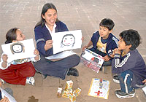
Colombia, UNICEF, 2001 - 2003
“Return to Happiness” programme, for children affected by conflict.
Adolescents as play therapists, working through schools, families and health centres. Not separate space.
Incorporation of local government & church, part of wider holistic activities for PSS.
Model now rolled out throughout region.
Notes:
Colombia: 2001 – 2003 “Return to Happiness” programme, for children affected by conflict. Adolescents as play therapists, working through schools, families and health centres. Not separate space. Incorporation of local government & church, part of wider holistic activities for PSS

Slide 22
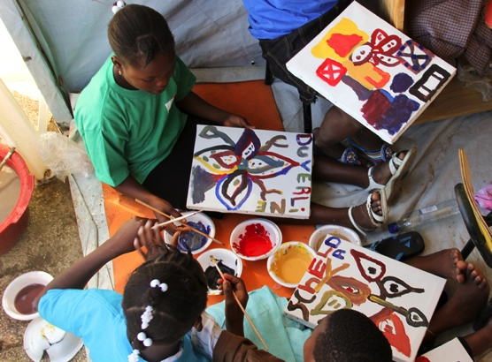
Haiti, earthquake, 2010
SC, UNICEF, WV, IRC, etc.
5 to 24 years of age.
Children receive safe drinking water & 1 meal per day.
Work with parents.
Teams of professionals, including a
social worker, a psychologist and two
counselors.
Notes:
SC, UNICEF, WV
5 to 24 years of age
Children receive safe drinking water & 1 meal per day
Work with parents - They attend sessions on how to determine when their children are at-risk, and they learn skills to prepare them for possible future disasters.
Teams of professionals, including a social worker, a psychologist and two counsellors

Slide 23
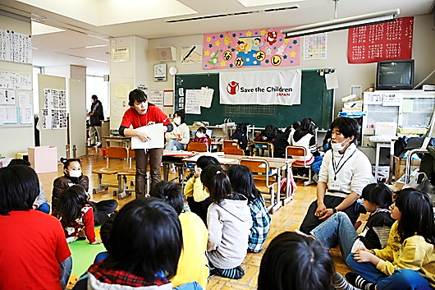
Japan, Tsunami, 2011
Japan Tsunami (2011): 5-12 year old children. ~25 in a group
High tech materials, games (computers, screens, videos)
Play, resilience, life-skills, referral, participation in other parts of humanitarian response
Work with parents

Slide 24
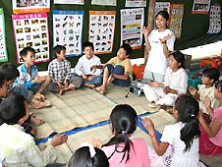
China Earthquake, World Vision, May 2008
World Vision opened Child-Friendly Spaces, giving children an opportunity to participate in games and education.
Zhang Limin, a third grade student, says, “When we play, we just forget about the earthquake”.

Slide 25
When not to have CFS?
Situations where CF Space may not be in best interests of children:
Where children would face greater risk of violence, abduction, intimidation or attack due to CF Spaces
Risk of the forced recruitment of children into armed forces or other groups heightened by children’s participation in CF Spaces
Environments with outbreaks or high incidence of measles or diarrhea and limited water & sanitation facilities
Notes:
Situations where a Child Friendly Space may not be in the best interests of children include:
environments in which there are outbreaks or high incidences of measles or diarrhea and limited water and sanitation facilities;
risk of the forced recruitment of children into armed forces or other groups which might be heightened by children’s participation in Child Friendly Spaces (through abduction on the way to the space or recruitment of children perceived to be skilled because of their participation in the space); and
situations in which children would face greater risk of abduction, intimidation or attack due to the presence of Child Friendly Spaces
- Reference: Save the Children (2008) CFS Handbook

Slide 26
CF Spaces Guiding Principles

Slide 27
Inter-agency Guiding Principles
Children Participate In My Space
C Take coordinated, inter-agency & multi-sectoral approach
P Make CFSs stimulating, participatory, and supportive environments
I Make CFSs highly inclusive and non-discriminatory
M Use CFSs as a means of mobilising the community
S Ensure that CFSs are safe and secure
Notes:
Children in My Place are Safe

Slide 28
Actions to be based on principles
Conduct an assessment.
Organize integrated supports and services.
Provide on-going training and follow-up support for animators and staff.
Monitor and evaluate CFS programs.
Phase out or transition in a contextually appropriate manner.
Notes:
The five principles are essential and should be built into all the actions outlined here. We will over the course of the next three days go into detail on how we can ensure we take this PRINCIPLED approach to each of these actions.
Conduct an assessment – coordinate and inter-agency – identify community strengths and children’s resilience as well as the psychosocial needs
Organize integrated supports and services – work with other sectors and with other CP, education and GBV teams to ensure the support you provide through the CFS is integrated
Provide on-going training and follow-up support for animators and staff – based on needs
Monitor and evaluate CFS programs – continuously monitor, evaluate and learn, putting lessons learnt into practice, identifying ways to overcome challenges you encounter
Phase out or transition in a contextually appropriate manner

Slide 29
Key points

Slide 30
Key points
3 objectives and 5 guiding principles should guide CF Space work of all agencies.
Activities that take place in CF Spaces contribute to relieving children’s stress and supporting positive child development.
CF Spaces can take many different forms, addressing needs of wide range of children and communities.
Notes:
Agencies may have their own ways of working, and implementing child friendly spaces, yet research has shown that all agencies seek to meet the 3 objectives and follow the 5 guiding principles outlined in the Interagency “Guidelines for Child Friendly Spaces in Emergencies”
Activities that take place in CF Spaces (play, sport, creative activity, self expression, socialisation with peers and support from caring adults), all help children to overcome their stress and return to a path of positive childhood development
CF Spaces can take many different forms though often they are narrowly perceived as physical spaces where children aged 6 – 12 come to play. We should challenge this misconception and seek to address needs of all children, especially the most vulnerable and those excluded from other programmes.

Slide 31
Key resources

Slide 32
Key resources
CPWG, Global Education Cluster, INEE, & IASC (2011) Guidelines for child friendly spaces in emergencies.
UNICEF (date unknown) Early Child Development Kit: A Treasure Box of Activities.
Stuart Lester and Wendy Russell (2010) Children’s right to play: An examination of the importance of play in the lives of children worldwide.
Notes:
CPWG, Global Education Cluster, INEE, & IASC (2011) Guidelines for child friendly spaces in emergencies
UNICEF (date unknown) Early Child Development Kit: A Treasure Box of Activities: Activity Guide – Especially the sections entitled “The Power of Play” and “Learning through Play” page i – ii
Stuart Lester and Wendy Russell (2010) Children’s right to play: An examination of the importance of play in the lives of children worldwide

Slide 33

Notes:
This slide is for the end of each session… prompts for questions, check in and even a 5 minute break, ice breaker as needed.

