Slide 1
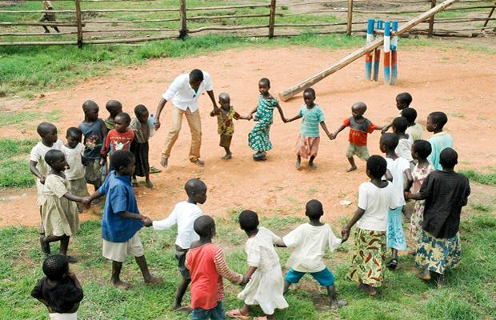
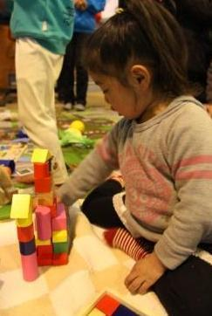
Session 3 – Psychosocial support framework
Child Friendly Spaces (CFS) Module 1

Slide 2
Learning Outcomes
By the end of the session participants will be able…
To define key terms.
Know 4 main categories of symptoms of distress.
To identify at least 3 types of intervention that support children & families who are showing signs of psychosocial distress.
Notes:
By the end of the session participants will …
Be able to define key terms relating to Mental Health and Psychosocial Support (MHPSS)
Know the four main categories of symptoms of distress
Be able to identify at least 3 types of intervention, other than CFS, that support children and their families who are showing signs of psychosocial distress

Slide 3
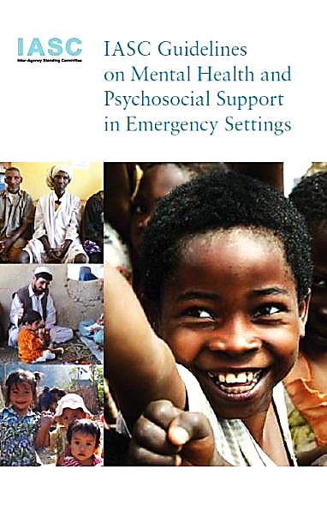
IASC Guidelines on Mental Health & Psychosocial Support in Emergency Settings, 2007
Notes:
Underline that the IASC Guidelines on MHPSS is the key document guiding the content of this session, and supporting all psychosocial support work in emergencies

Slide 4
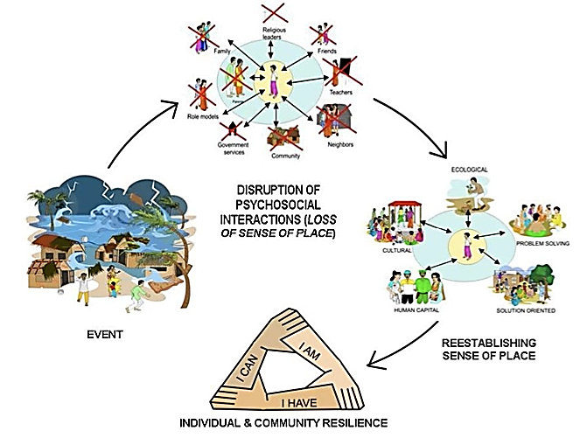
Cycle of psychosocial wellbeing in emergencies
Notes:
This is a diagrammatic representation of the session we will be doing
Talk through the cycle quickly, pointing out that this session’s objectives are to understand what can cause psychosocial distress (event), impact of the event on people’s lives (what is disrupted by the event), how PSS works to re-establish order and finally leads to wellbeing, building on individual resilience and community capacity
In previous session we looked at the wider impact of the disruptive event on the child and community, we will now look specifically at the psychosocial impact and how we respond to re-establish a sense of place and build on resilience
Reference: Diagram taken from: Nancy Baron for IASC Reference Group on Mental Health and Psychosocial Support in Emergency Settings (March 2009) Global Toolkit of Orientation and Training Materials: Used to Disseminate and Implement the Inter-agency Standing Committee Guidelines on Mental Health and Psychosocial Support in Emergency Settings

Slide 5
Do you agree?
“It is good to ask children to write about or draw their experiences of the war / disaster.”
“If a child starts talking spontaneously about what happened during a group activity it is important to let them finish their story and say what is on their mind.”
Notes:
Depending on how talkative the group is either do only these 2 or continue to the next slide and do all 4 (2 on this slide, 2 on the next). SPEND ONLY A TOTAL OF 10 MINS ON THIS ACTIVITY (slide 6 and 7)
“It is good to ask children to write about or draw their experiences of the war / disaster”
NO: Trained professionals may want to directly ask children to write or draw about their experiences so they can give specialised care and support. Others, such as standard CP workers in the field, can give children the opportunity to draw or write, sing, dance or express themselves in ways they wish, but should probably not specify that these ways of expressing themselves must discuss their feelings and experiences of the distressing event. It may raise concerns we are not qualified to deal with. Note, if specific children when given the opportunity do draw or write about whatever they wish, express concerning emotions, fears or distress levels that are more disturbing than images generated by other children of their age, you may want to refer them to someone who can provide specialist support
“If a child starts talking spontaneously about what happened during a group activity it is important to let them finish their story and say what is on their mind”
PARTLY YES PARTLY NO: Whilst it is important to give them the opportunity to talk about their feelings and thoughts, we need to consider two things: 1. the story may upset other children in the group, and 2. the child may not have thought through the repercussions, risks and challenges of sharing their story. They may start their story, and only after starting to tell it realise that it will upset them to share it.
It is best to state that whilst you want to give the child the opportunity to talk, maybe it is best if they want to do this one-to-one, so as not to upset others or get too upset themselves. Ensure you have someone you can refer the child to before offering this option. Make sure you address the child in a kind positive manner and tone, do not cut them off suddenly or be dismissive.

Slide 6
Do you agree?
“All children in emergencies are traumatised and need professional help.”
“Young children (under 5) are so upset by what they have experienced they need adults to take charge and make decisions for them.”
Notes:
“All children in emergencies are traumatised and need professional help”
NO: A very small minority of children are traumatised. Whilst children may have experienced a traumatic event, by far the majority of children will express distress, not trauma. They will be able to recover from the event with a return to routine, rebuilding of bonds (creating attachment) with peers, and family, and some community level support. A very small minority will be traumatised and will need professional help. We will come back to this later.
“Young children (under 5) are so upset by what they have experienced they need adults to take charge and make decisions for them”
PARTLY YES, PARTLY NO: There is not a straightforward yes or no answer to this question.
Whilst children of all ages should be allowed to make certain decisions and participate in choices that affect them, this depends on their age and stage of development. Younger children will find it hard to make certain big decisions, even if these do effect them. For example, which parent to live with if the parents have to move apart. The choice between staying with an aunt or a grandfather if the parents have to flee. Whether or not to carry out a medical intervention that could save their lives, but that could pose a risk.
After an emergency children may find comfort in certain decisions being made for them.
Parents, or guardians should make these big choices for the children when possible. This will give comfort to the child, making them feel cared for. Though it is important to KEEP CHILDREN INFORMED and let them know what choices and decisions have been made on their behalf so as not to cause further distress when there is sudden change without warning

Slide 7

Defining key terms

Slide 8
Defining key terms – 1
  Mental health is psychological state of individuals - a term used by medical practitioners.
  Distress is anxiety, sorrow, or pain - it is a normal and common reaction to an abnormal event.
Notes:
Mental health is a term used by medical practitioners to refer to the psychological state of individuals. Being in good mental health is defined by WHO as: "a state of well-being in which the individual realises his or her own abilities, can cope with the normal stresses of life, can work productively and fruitfully, and is able to make a contribution to his or her community.” Health workers will refer to work they are doing to help address psychological concerns or mental health problems in the same way child protection or education workers refer to psychosocial problems. More clinical and severe concerns (e.g. post traumatic stress disorder, schizophrenia and bipolar disorder) would be categorised as mental health concerns rather than psychosocial distress
Distress: is anxiety, sorrow, or pain, is a normal and common reaction to an abnormal event. A type of stress that is experienced as unpleasant, and causes various stress reactions in the person.
References:
WHO - http://www.who.int/mediacentre/factsheets/fs220/en/ - Definition of Mental Health

Slide 9
Defining key terms – 2: Trauma
“Trauma” clinical term requires specific clinical response
Non psychological professions can’t diagnose trauma
  Describing large number as traumatised is inaccurate
  Refer on cases where individuals:
  Shows strong signs of distress,
  6-8 weeks after response begins see no change or improvement, when others are recovering, and/or
  Threaten physical harm to themselves or others
Notes:
“Trauma” – can refer to an event (a physical injury or something that has happened) or can be way to describe the emotional reaction an individual shows. When describing individual’s reactions, it is important to note it is a clinical term requiring specific clinical responses. Non psychological professionals can’t diagnose trauma. Describing large numbers of the population as traumatised is inaccurate. Its general use is counterproductive to healing as it infers individuals are too affected to recover.
Refer on cases where individuals:
Shows strong signs of distress,
6-8 weeks after response begins you see no change or improvement, when others are recovering, and/or
Threaten physical harm to themselves or others
- Reference: IFRC (2003) Community-based Psychological support: A training manual – In particular paragraph titled “Care with terminology” on Page 28

Slide 10
Defining key terms – 3: Psychosocial Support
  Psychosocial: direct relationship between psychological & social, influencing each other continually. Where…
  Psychological: thoughts, emotions, feelings & behaviour.
  Social: context in which we live, culture, traditions, spirituality, relationships & activities.
There are general psychosocial stressors caused by emergencies & general psychosocial protective factors.
Psychosocial support projects work to reduce stress, & strengthen and use protective factors.
Notes:
Psychosocial indicates direct relationship between psychological & social, each influencing the other continually. Where…
Psychological: mind, thoughts, emotions, feelings and behaviour
Social: context in which we live, culture, traditions, spirituality, relationships with immediate and extended family, community, school and professional activities
There are general psychosocial stressors caused by emergencies
E.g. Economic hardship, Social disruption (separation from family, disappearance of family members, downward change in social role), Physical/psychological violence, Ethnic persecution, Loss of home/ country/ family/ friends / material goods, Danger/abuse, Stress caused by flight / Uncertainty about the future/ etc
And general psychosocial protective factors also exist
Individual coping abilities, Family strength and unity, Social network, Ideological/political/religious consciousness
Psychosocial support projects work as much as possible on the reduction of stress, as well as on strengthening and use of protective factors.

Slide 11
Defining key terms – 4: Psychological First Aid
  Psychological First Aid (PFA) describes a humane, suitable, supportive response to a fellow person who is suffering and who may need support.
  Includes:
  Listening to people, but not pressuring them to talk.
  Comforting people & helping them to feel calm.
  Helping people connect to information, services & social supports.
Notes:
Psychological first aid (PFA) describes a suitable, supportive response to a fellow person who is suffering and who may need support. (IASC, 2007) It is a communication tool, a way of communicating and supporting an individual to help them to get better
PFA involves the following:
providing practical care and support, which does not intrude;
assessing needs and concerns;
helping people to address basic needs (for example, food and water, information);
listening to people, but not pressuring them to talk;
comforting people and helping them to feel calm;
helping people connect to information, services and social supports;
protecting people from further harm.
PFA is NOT:
It is not something that only professionals can do.
It is not professional counselling.
It is not “psychological debriefing” in that PFA does not necessarily involve a detailed discussion of the event that caused the distress.
It is not asking someone to analyse what happened to them or to put time and events in order.
Being available to listen to people’s stories, but not pressuring people to tell you their feelings and reactions to an event.
Reference: WHO (2011) Psychological first aid: Guide for field workers

Slide 12
Psychosocial impact of an emergency

Slide 13
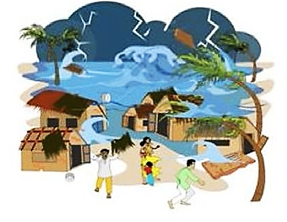
Event
Notes:
The possibility of carrying out this activity depends on the context and the experiences of the participants in the room. It must be adapted to context and consideration needs to be made to ensure it does not cause distress for participants.
Just before turning to this slide find a way to create a disturbance, it could be someone outside the room calling out to someone else, the door being opened and closed, a chair being knocked over, someone walking in clapping hands, music suddenly coming on very loudly or the facilitator dropping a pile of books. Alternatively ask a co-facilitator to leave the room suddenly so that everyone sees or hears as they move and this causes a disruption. The disruption should create some surprise or confusion but not distress. Try to make sure it is not a noise which resembles either gunshots or bomb-blasts as participants may have lived through those noises recently. The aim of this exercise is not to create real distress, but just to make us think about reactions to surprise events.

Slide 14
Impact of event
Traumatic events are powerful & upsetting incidents that intrude on daily life.
Nearly all people show some change after a traumatic / distressing event.
These reactions are normal.
Traumatic events do not lead all those who live through them to be traumatised. The majority will be distressed, only a small number will be traumatised. Each individual reacts differently.
Notes:
Discuss with the group:
Traumatic events are powerful & upsetting incidents, experiences that are life threatening or with significant threat to physical or psychological wellbeing, that intrude on daily life.
A traumatic event involves a single experience, or an enduring or repeating event or events, that completely overwhelm the individual's ability to cope or integrate the ideas and emotions involved with that experience
Distress and / or trauma are normal reactions to a traumatic event. Traumatic events do not lead all those who live through them to be traumatised. The majority will be distressed, only a small number will be traumatised.
Examples of traumatic events include: a flood, cyclone, drought, earthquake, tsunami, mass displacement, conflict, fighting, political violence, civil unrest. Acts of violence such as an armed robbery, war or terrorism, interpersonal violence such as rape, child abuse, or suicide of a family member or friend, involvement in a serious motor vehicle accident
Other less severe but still stressful situations can trigger distress or trauma in some people. Intensity of the event doesn’t necessarily determine degree to which someone is affected, each individual reacts differently. Pre-existing stressors/conditions; the current daily stressors; & traumatic event the individual lived through as well as individual resilience all play a part in the degree to which someone shows distress
Each individual can react differently. The intensity of the event does not necessarily determine the degree to which someone is affected. Pre-existing stressors/conditions; the current daily stressors; and the traumatic event the individual lived through as well as individual resilience all play a part in the degree to which someone shows distress
References: Action by Churches Together Intl (2005) COMMUNITY BASED PSYCHOSOCIAL SERVICES IN HUMANITARIAN ASSISTANCE: A FACILITATOR’S GUIDE

Slide 15
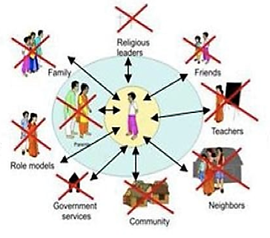
Disrupted lives
Notes:
Ask everyone to get up and walk around, no need to bring their things with them, then ask them to sit in a different place to where they started. Act as if you are going to restart the session. But then, pause, reconsider, and look at them and ask them to get up again and move around again, so they sit elsewhere (still not their original seats). Again, pretend you are going to start session, then seem to change your mind again. Finally ask them to stand up one final (third) time to come back to their original places. Seem undecided and unsure each time you ask them to change position.
When there is a traumatic event, a child’s environment is disrupted
The child’s psychosocial supports and interactions are disrupted and change. They do not have the things they are used to or need.
This leads to a loss of sense of place.
Daily stressors can exist prior to emergency, but can also result from the event (poverty, loss of home and livelihoods, lack of services, etc.) and also contribute to distress or even potentially trauma
The humanitarian response itself may cause distress (the way distributions are targeted or given out, presence of strangers in the community, etc). Efforts should be made to keep this form of stress to a minimum
Each child reacts differently, to different sources of stress that come before, during or after the event

Slide 16
Social outcomes of distress
Social impacts on child
Relations with others (family, friends, teachers)
New or changed roles, opportunities and responsibilities (e.g. caring for siblings, drop out of school, work)
Impact on family functioning
Family tensions
Change in roles & responsibilities, change family dynamic
Impact on community functioning
Reduced resources - divisions and conflicts

Slide 17
Think about a difficult moment or event experienced by a child you know:
    What did the child think?
    How did the child feel?
    How did the child act?
    How did this affect the child’s family?
    Or the child’s community?
Notes:
IMPORTANT NOTE: Remind participants that it is very important that they are careful not to think of things that may distress them, it is better to think of a situation that will not upset you

Slide 18
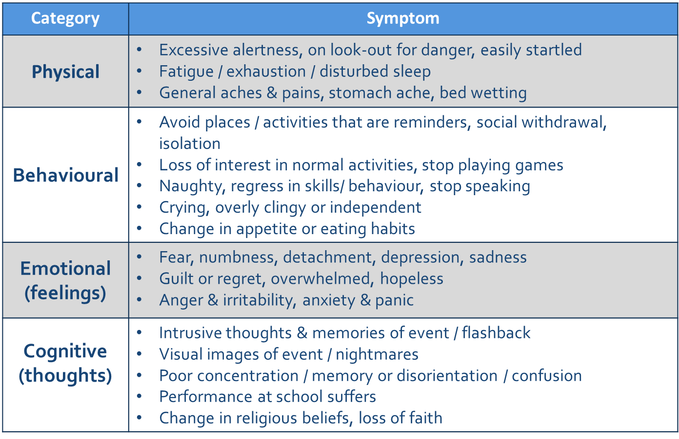
Psychosocial effects of emergencies on children
Notes:
The way distress manifests itself differs by age – refer participants to the relevant handout
Some signs of distress are universal, others vary from one context to another depending on culture
Ask the group if they can identify certain “signs” listed here that they think would not happen in this culture?
Are there additional signs which happen here that are not listed?

Slide 19
These are all normal reactions, and signs of distress caused by abnormal and traumatic events

Slide 20
What or Who helped the child to overcome the difficulty?
(Protective factors)
Notes:
Risk and protective factors we discussed in the last session… are there any additional ones to add now you have a specific example in mind?

Slide 21
Aims of psychosocial support programmes

Slide 22

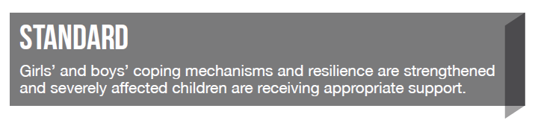

Slide 23
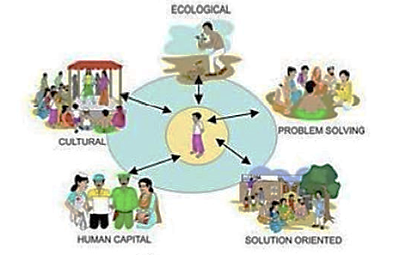
Objective of psychosocial work to…
Re-establish practices & resources disrupted
Notes:
Establish a sense of place for the child within the new community by creating a new sense of order, structure and routine – building on what is familiar, what exists, and the child’s own resilience, as well as giving other new supports

Slide 24
How can we strengthen coping mechanisms & resilience:
Sense of belonging.
Safe place to be.
Relationship with peers & family – mobilise child’s support system – personal attachments.
Intellectual stimulation.
Normal routine / daily life.
Sense of control of own life.
Opportunity to express grief & emotions.
Notes:
A sense of belonging
A safe place to be - Ensure child is in a stable and nurturing family style environment
Relationship with peers
Personal attachments
Intellectual stimulation
Normal routine / daily life - Enhance routine and structure in children’s lives. Re-establishing age and gender appropriate daily routines, including schooling, recreational activities, community activities
Sense of control over one’s life
Opportunity to express grief and other emotions – not to be forced

Slide 25
If you're happy and you know it...
If you're happy and you know it , Clap your hands. Clap, Clap.
If you're happy and you know it , Clap your hands. Clap, Clap.
If you're happy and you know it and you really want to show it
If you're happy and you know it , Clap your hands. Clap, Clap.
... Stamp your feet. Stamp stamp
... Shout hurray. Hurray
... Do all three. Clap clap. Stamp stamp. Hurray
Notes:
If you're happy and you know it
Clap your hands. Clap, Clap.
If you're happy and you know it
Clap your hands. Clap, Clap.
If you're happy and you know it
and you really want to show it
If you're happy and you know it
Clap your hands. Clap, Clap.
If you're happy and you know it
Stamp your feet. Stamp stamp
If you're happy and you know it
Stamp your feet. Stamp stamp
If you're happy and you know it
and you really want to show it
If you're happy and you know it
Stamp your feet. Stamp stamp
If you're happy and you know it
Shout hurray. Hurray
If you're happy and you know it
Shout hurray. Hurray
If you're happy and you know it
and you really want to show it
If you're happy and you know it
Shout hurray. Hurray
If you're happy and you know it
Do all three. Clap, clap, stamp stamp, hurray
If you're happy and you know it
Do all three. Clap, clap, stamp stamp, hurray
If you're happy and you know it
and you really want to show it
If you're happy and you know it
Do all three. Clap, clap, stamp stamp, hurray
[End with round of applause]
[http://www.youtube.com/watch?v=FrsM9WggCdo]

Slide 26
Risk and protective factors…
Activities to strengthen protective factors.
Strengthen community & family care – parenting, address caregivers’ PSS needs.
Promote positive holistic development – CFS activities.
Support child & youth participation to contribute to community – Clubs.
Increase resilience – Lifeskills.
Activities to reduce risk factors.
Ensure safe, secure, stable environment – work with other sectors.
Carry out awareness raising activities.
Notes:
Psychosocial support work contributes to reduction of risk and promotion of protective factors by…
Strengthen family and community care-giving structures for children - Strengthen local networks that enable child protection, care, and wellbeing, such as women’s groups or religious networks
Promote children’s holistic development and age-appropriate physical, cognitive, and emotional competencies - Reduce long-term negative psychological effects
Support children’s and youth’s voice and full participation in all phases of programming
Improve person’s ability to function under stress
Foster a secure and stable environment for children - Reducing risks to children’s safety and emotional well-being while promoting an environment conducive to positive development, effective coping, and resilience
Carry out awareness raising activities so adults (parents, teachers, other adults in contact with children) understand risks to children and how to prevent these
➔ All the above contribute to restoration of practices & resources disrupted by crisis, or even possibly a process of building back better

Slide 27
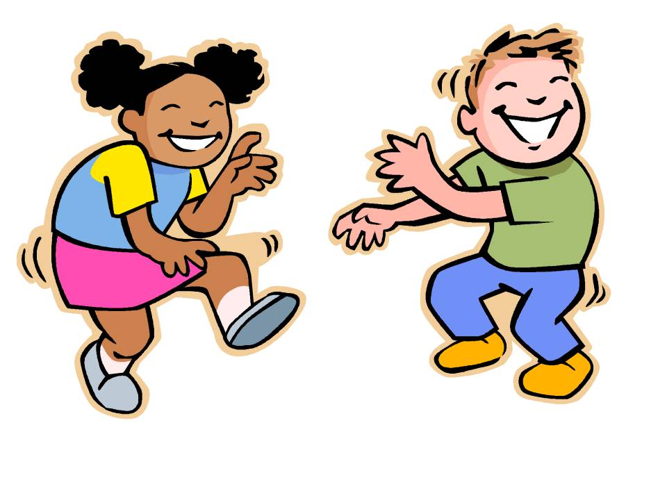
Get up and dance…
Notes:
Ask participants to get up and dance on the spot
For those who are less comfortable doing this, tell them they can sway on the spot, jump, skip, walk around the room, clap, whatever movement makes them feel comfortable

Slide 28
Multi-layered supports

Slide 29
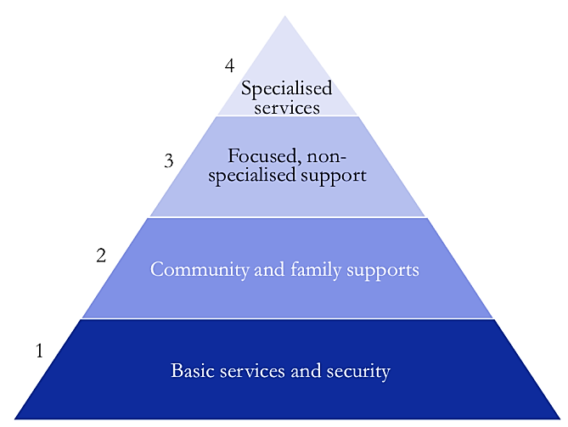
Intervention pyramid for mental health & psychosocial support in emergencies
Children who may cause harm to themselves or others, those with persistent signs of distress, depression, or anxiety.
Children who show normal signs of distress, requiring some support to return to pre-emergency behavior.
Children who need support and routine to re-establish mental wellbeing.
Children with high resilience, show normal signs of distress initially, find own way of coping, return to pre-emergency behaviour quickly.
Notes:
Talk through the diagram above. Highlight the following:
War and natural disasters cause distress for individuals & societies
Most individuals & societies are able to cope
Sometimes levels of distress reach such great proportions people struggle to cope
Trauma happens when an individual cannot cope
The likelihood of speedy recovery increases when appropriate support is provided at an early stage, and the risk of long-term mental health problems is reduced dramatically
All children (and communities) need level one support, this will help PSS wellbeing
All the levels build on each other. Each level needs to be in place for a community to support all children who have varying needs, including helping them to access specialised help
Ask the group to vote for which level they think most children fall into? What level of supports most children need to recover?
IASC Guidelines on Mental Health & Psychosocial Support in Emergency Settings, 2007

Slide 30
Multi-layered supports – activity
Divide into 4 groups - each group assigned one of the four levels
Identify PSS interventions or activities we have been doing at the level of the pyramid you have been assigned.
    Note WHAT actions and WHO has been doing these actions. Write these on green cards (5 mins)
Identify PSS interventions or activities we can do in the future at the level of the pyramid you have been assigned.
    Note WHAT actions and WHO has been doing these actions. Write these on green cards (5 mins)

Slide 31
Multi-layered supports – activity
Divide into 4 groups - each group assigned 1 category of actor (teachers, CFS workers, community-based organisation or camp management)
Identify PSS interventions or activities done by this group. Write these on cards (5 mins).
Note on the cards at what level of the pyramid these activities would happen (5 mins).

Slide 32
Intervention pyramid for mental health & psychosocial support in emergencies
Mental healthcare by MH specialists (psychiatric, nurses, psychologists, psychiatrists, etc). CFS Referral to specialist services for diagnosis & support for those 6-8 weeks after emergency still not showing signs of improvement.
Psychological first aid, basic mental health care by primary healthcare doctors, referral activities in CF Spaces, basic emotional & practical support by community workers.
Promote and / or provide everyday activities such as schooling, activating social networks & communal traditional supports, supportive age-friendly spaces.
Re-establish security, safety & basic services (water, food, shelter & health services) – advocacy for basic services that are safe, socially appropriate & protect dignity.
Notes:
Level 1: The majority need support which addresses daily stressors. The kinds of response activities for this include: Re-establishing security, safety and basic services (water, food, shelter and health services) for the whole community across all sectors of the response & advocacy for basic services that are safe, socially appropriate & protect dignity
Level 2: Support needed by smaller number of children. Promote and / or provide everyday activities such as schooling, activating social networks & communal traditional supports, supportive age-friendly spaces. Process for helping children to access supports they would normally get from community and family. (Support which is disrupted by the emergency). Social and recreational activities for children, including theatre, dance, play, art,
Level 3: Support needed for the still smaller number of children (for example, survivors of gender-based violence or recruitment) who also need more focused individual, family or group action from workers who have received some training in specialised care (e.g. para-social workers). This layer includes psychological first aid – this enables children to find a safe space in which to discuss the experiences they lived through, should they want to. basic mental health care by para-social workers and structured psychosocial groups with children or parents
Level 4: Small percentage of the population who, despite the support already mentioned, cannot bear their suffering and who may have significant difficulties in their basic daily functioning. These children may have pre-existing mental health disorders not related to the disaster but worsened by it. CP actors role is the referral to more specialist services for diagnosis and support. Treatment for this level of trauma and distress require long-term extended, professional and trained support. Starting a counselling process without completing it poses a danger to mental health.
- Reference: CPWG (2012) Minimum standards for Child Protection in Humanitarian Action

Slide 33
Organising MHPS support…
A key to organising mental health and psychosocial support is to develop a layered system of complementary support that meets the needs of different groups, including children with disabilities.
All layers of the pyramid are important and should ideally be implemented at the same time.

Slide 34
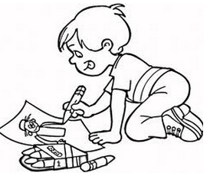
Draw something that makes you happy
Take a piece of A4 paper and draw something that makes you happy.

Slide 35
Key points

Slide 36
Regarding PSS wellbeing
Nearly all children show some change. These are normal reactions to abnormal events.
With access to basic services, support & security majority of children return to normal.
Mild / moderate problems ⬆ after emergency.
Only small % have severe mental illness.
Notes:
Nearly all children will show some changes in emotions, behaviour, thoughts and social relations in the short term
These reactions are normal, and with access to basic services, support and security the majority of children will regain normal functioning
Mild or moderate mental health problems may increase slightly after an emergency
A very small percentage of people will have severe mental illness or trauma - and need specialist care and support.

Slide 37
Regarding our actions
All humanitarian action impacts positively.
CF Spaces one of range of interventions to address PSS needs of children & families.
Addressing psychosocial support needs of affected population requires collaboration across sectors.
Notes:
All humanitarian interventions impact positively or negatively on MH and PSS well-being
Child Friendly Spaces are one of a range of interventions that can be used to address the psychosocial support needs of children and their families in emergencies. Many other PSS options are not directly facilitated by child protection agencies, but are implemented by other actors. For example meeting basic needs for food, water, and shelter can reduce pressure on parents to provide for their families and thus reduce stress. Security services in camps can make people feel safer and reduce distress. Specialist counselling and support through trained mental health care providers.
Addressing PSS needs requires collaboration across sectors, most notably Child Protection, Education, GBV and Health, but also all other sectors contributing to the humanitarian response

Slide 38
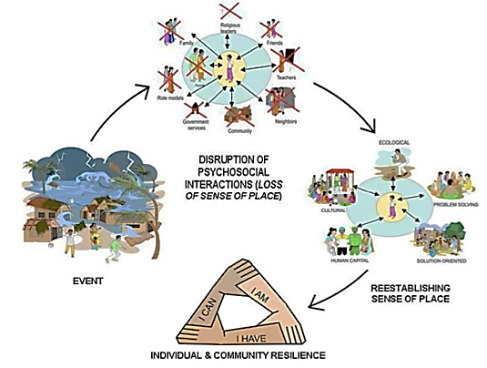
Reflection on the session
Notes:
Discussion in plenary:
Ask participants to think back over the PSS session and consider the different feelings they had when there was…
The gentle calming music when they arrived?
The sudden disturbing “event”?
The exercise where we kept asking them to move from one seat to another?
The singing?
The dancing energiser?
The drawing activity?
Overall how did each of these activities make them feel? Take one or two comments for each question, not more
Do they feel PSS work could help children after emergencies (the shock) to feel better?
Use these discussions to raise the point that to help children after a shock event (the sudden disturbing event) and the following chaos, we need to use different methods to appeal to different children (talking, thinking and reflection, dancing, listening to music, sense of order and structure) in order to make them feel better

Slide 39
Key resources

Slide 40
Key resources
IASC Guidelines on Mental Health & Psychosocial Support in Emergency Settings, 2007.
CPWG (2012) Standard 10 “Psychosocial distress and mental disorders”.
IFRC (2003) Community-based Psychological support: A training manual.

Slide 41

Notes:
This slide is for the end of each session… prompts for questions, check in and even a 5 minute break, ice breaker as needed.

