Slide 1

EDUCATION CLUSTER
Niangoma
Prepared by Group 4

Slide 2
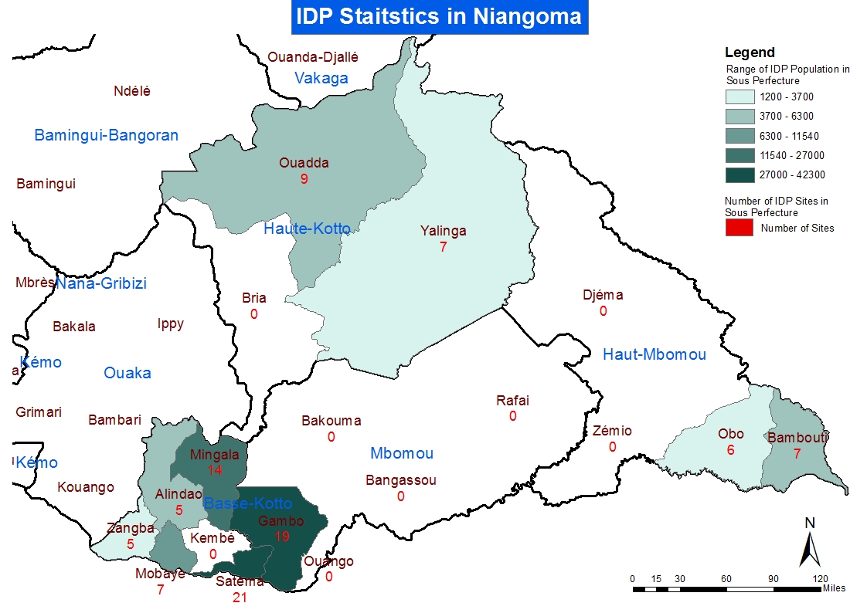

Slide 3
Education Cluster Indicator
Indicators | Unit of Measurement | Target | Achievement | Gap
# of learning spaces established in affected areas | # of classrooms | 1,000 | 545 | 455
# of teachers trained on PSS | # of teachers | 10,000 | 250 | 9,750
# of students provided with learning materials (M/F) | # of students | 500,000 | 20000 | 480,000
# of teachers provided with teaching and learning materials | # of teachers | 10,000 | 75 | 9,925

Slide 4
Response of Education Cluster
Activities | Unit of Measurement | Quantity | # of Beneficiaries
Construction/Rehabilitation of classrooms | # of classrooms | 250 | -
Construction/Rehabilitation of latrines | # of latrines | 126 | 2,100
Distribution of ECD kits | # of kits |  | 1,200
Distribution of recreational kits | # of kits |  | 3,000
Distribution of student learning materials | # of kits | 15,800 | 15,800
Distribution of teaching materials | # of kits |  | 75
Establishment of Temporary Learning Spaces | # of TLS | 520 | 54,500
Payment of teacher incentives | # of stipend package |  | 150
Psychosocial Support | # of awareness sessions |  | 535
School Feeding | # of feeding package | - | 4,500
Training of education personnel (pedagogy) | # of training sessions |  | 600
Training of education personnel (PSS) | # of training sessions |  | 250
Total Beneficiaries |  |  | 82,710

Slide 5
Response of Education Cluster

Slide 6
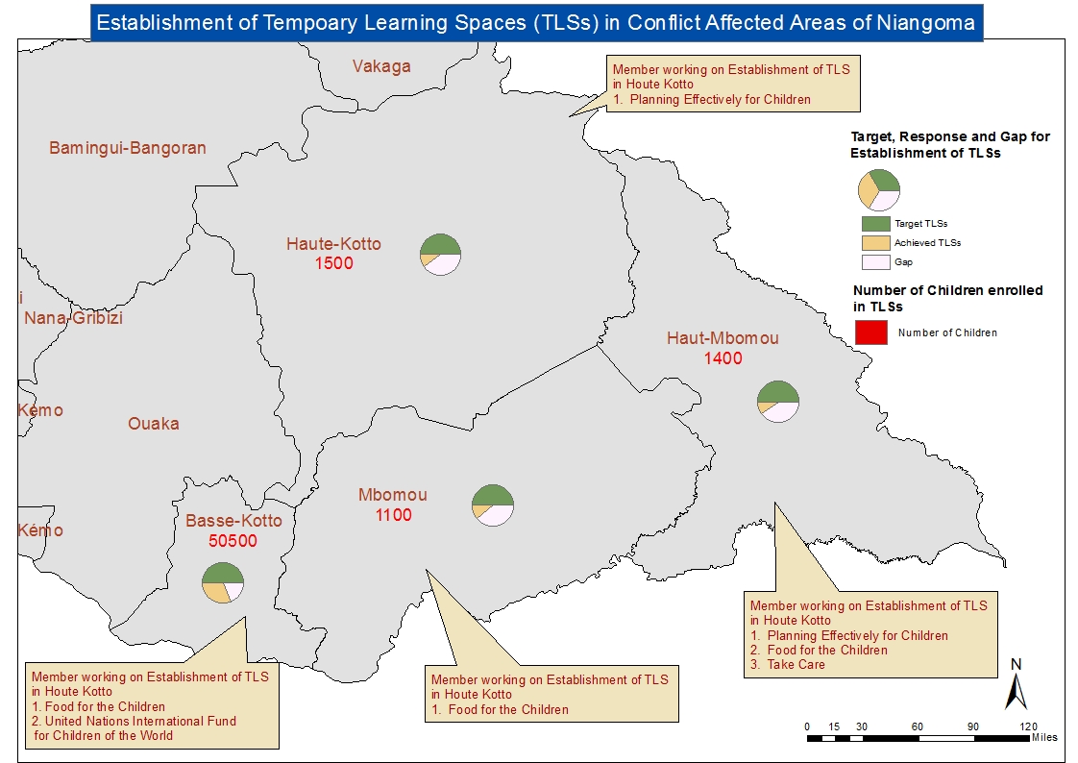

Slide 7
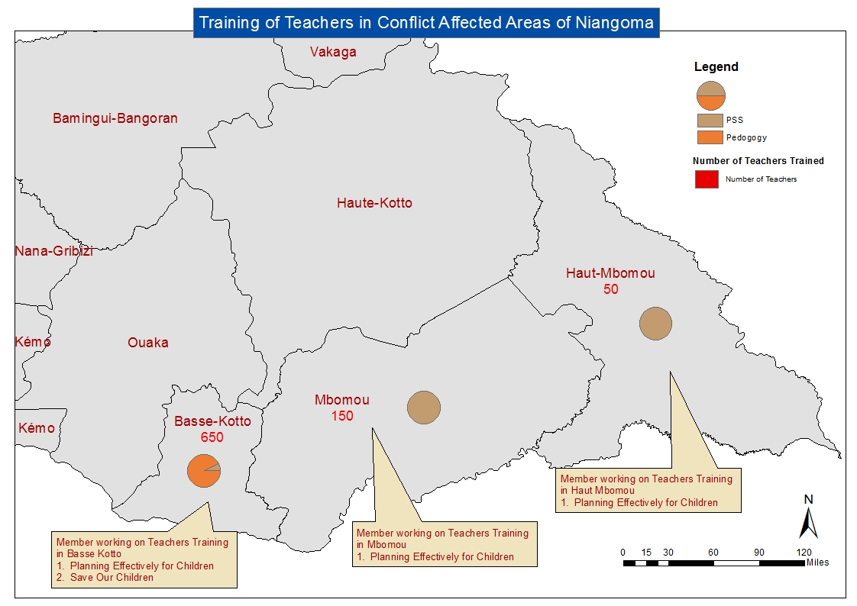

Slide 8

Distribution of Student Learning Materials
15,800
students
reached
500,000 targeted by SRP
Notes:
Activity Total Beneficiaries Targeted by SRP Total Beneficiaries Reached Distribution of Student Learning Materials 500,000 15,800 Activity Total Beneficiaries Targeted by SRP Total Beneficiaries Reached Distribution of Teaching Materials 10,000 75

Slide 9
Distribution of Teaching Materials
75
teachers
reached
10,000 targeted by SRP
Notes:
Activity Total Beneficiaries Targeted by SRP Total Beneficiaries Reached Distribution of Student Learning Materials 500,000 15,800 Activity Total Beneficiaries Targeted by SRP Total Beneficiaries Reached Distribution of Teaching Materials 10,000 75

