Slide 1

Primary Data Collection Methodologies
Notes:
Use two photos / images as cover for session

Slide 2
Session Objectives
Understand team composition, roles and responsibilities and requirements for fieldwork planning
Be able to describe different primary data collection techniques
Know the benefits of each technique and when during the assessment timeline they are most appropriate
Be able to be review potential pitfalls when collecting primary data and ways to overcome/mitigate against them
Have an understanding of ways of asking questions to obtain honest and useful responses
Notes:
Review the session objectives with participants. Highlight that this session focuses on primary data collection from the field (teams, planning, techniques/methodologies and challenges)

Slide 3
Multi-agency composed teams
Mobilising external resources
Encouraging stakeholders to take part
Facilitating consensus
Managing expectations
Ensuring wider buy-in
Promoting the use of the data for decision making
Notes:
In order to conduct our assessments requiring primary data collection, we will need to organize (and train) a field team. Many assessments will have teams composed of individuals from multiple agencies. Here are some issues to plan for when organizing a multi-agency composed team.

Slide 4
Team composition
Sex: Women and men, specifically in geographical areas where access to women is restricted for men (Pakistan, Yemen, etc.)
Ethnicity and religion: specifically where inter-ethnic/inter-religious conflict has occurred (Kyrgyzstan, Rwanda, Bosnia Herzegovina, etc.)
Age: specifically in locations where older persons will be most accessible through other older persons
Organizations: social and technical background to minimize bias, mandate or sector focused assessment
National and international staff: to ensure nothing is missed, misinterpreted, over emphasized or misrepresented.
Notes:
When composing a field team for primary data collection, it is important to ensure that the team members themselves are best suited for collecting the required data. This means knowing who the target groups will be and selecting the appropriate team members.
Some criteria to consider include: sex, ethnicity/religion, age, organizational representation and whether the individual is a national or international staff. There can be several advantages and/or disadvantages for each criteria, so it is important to plan appropriately.
Could ask for any other criteria, for example language skills, also staff skilled with child participatory methodologies for example

Slide 5
TEAM LEADER
Responsibilities:
Facilitate and supervise the team’s work
Manage the logistics and security
Manage and represent the team on site (timing, briefing, interviews, etc.)
Provide contact point for country-level colleagues, other field teams and local authorities .
Ensure that the data collected is complete, checked, compiled and promptly transmitted to coordination level.
Profile:
Leadership capacities
Needs assessment experience
Knowledge of education responses in emergency settings.
Notes:
A team leader should be designated for all assessment teams. This is an extremely important role in ensuring the effectiveness and overall success of an assessment. Review these responsibilities and profile criteria with participants.

Slide 6
 |  |  | 10h00 | 11h00 | 12h00 | 13h00 | 14h00 | 15h00 | 16h00 | 17h00 | 18h00
Team and assessment introduction to local authorities
Selection of translators and key informants
Key informants interview
Direct observation
Team meeting and wrap up
School visits
Focus group discussions
Team wrap up
Community feedback
Team debriefing, questionnaire completion and validation
Notes:
Here is an example of a day’s schedule for an assessment team presented as a Gantt chart.
It is important to plan the day carefully, look where teams can work individually or in pairs to do multiple tasks.
It is also important to map out where you will be for security purposes and ensure that the country office has the plans in case of an incident

Slide 7
Assessment Plan – Need to know, do and have
Mission Objectives
Sample/Site Selection
  What sites will be visited?
  If not possible, how to re route
Methodology
  Questionnaire form(s)
  Techniques
Team Composition
  Roles
  Team assignments
Logistics
  Transport, communications, routing, interpretation, supplies, etc.
Safety
  Clearance, official letter
  Escort?
  Emergency Procedures
  Cash
Pre-Departure
  Training
  Pilot test of the questionnaire
  Briefings
  Equipment Checks
  Contact lists
On site
  Behaviour, introduction to gate keepers
  Meeting frequency
  After site meeting
Reporting/debriefing requirements
Notes:
All assessments should have a solid and concrete assessment plan. The assessment team leader, in coordination with the team members, is responsible for ensuring this plan is developed and carried out. The bullet points on this slide highlight the essential elements to consider when creating an assessment plan.

Slide 8
Resources
Building an Effective Assessment Team
(ACAPS, March 2012)
Assessment Team Job Descriptions
(ACAPS, March 2012)
Notes:
Refer participants to these two resources. The first is an ACAPS technical brief which provides guidance and direction on how to build an assessment team. The second is a set of job descriptions for various members of an assessment team (Assessment coordinator, data entry clerk, driver, etc.); these descriptions include candidate requirements (education, experience, language skills) as well as a description of the job’s roles and responsibilities.
These resources are also linked and referenced in the ‘Additional resources’ section of this facilitator’s guide.

Slide 9
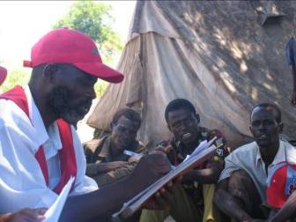
Primary Data Collection
Where are people/
camps?
How many children are there?
What state are the schools in?
What risks do children face
Is the situation getting better or worse?
Who is worst affected and most at risk?
Notes:
Explain to participants that we will now shift from discussing assessment teams to discussing what happens when those teams go to the field: primary data collection

Slide 10
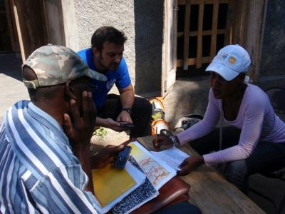
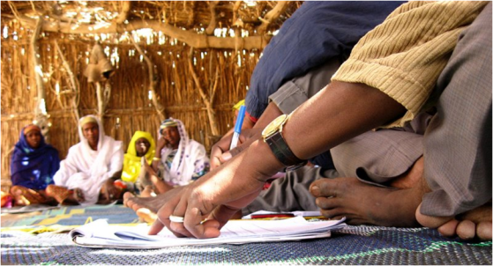
Primary data collection: methods
4 main methods:
Observation
Key informant interviews
Community/focus group discussions
Household interviews/surveys
Initial and Rapid assessments
In-depth assessments
Notes:
We will discuss four main primary data collection methods: observation, key informant interviews, community/focus group discussions and household interviews/surveys.
Notice that different methods are typically used for different types of assessments. Initially we need to identify priority sectors for intervention (Flash Appeal) and to tell the ‘story’; we need to know:
What is happening on the ground (baseline and change) – in general and by key sectors
How are people coping and what are their priority needs
Existing and potential risks
For these initial and rapid assessments we can use observations and key informant interviews. With more time and during in-depth assessments, we can add community/focus group discussions and household interviews/surveys.
These methods will be discussed further on the next slides.

Slide 11
Choice of Method
Use data collection methods that produce the most reliable, “representative” and least biased information.
The choice of the method is based on:
  the type of needs assessment (rapid versus comprehensive)
  the contextual factors,
  e.g. security, access and the availability of time and resources
  the aim of the questions
    e.g. data/ figures(QUANTITATIVE) or an explanation/ understanding (QUALITATIVE)
Notes:
Our choice in data collection methods will depend on various factors; these factors include: 1) type of the needs assessment 2) contextual factors and 3) aim and type of questions being asked.

Slide 12
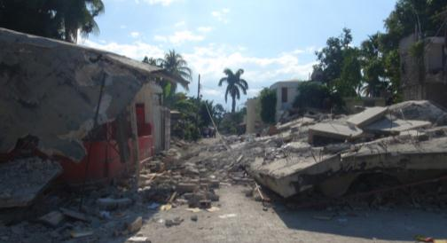
Observation
When is observation appropriate?
All the time!
Two approaches:
  Structured
    Looking for specific behaviour / object / event
  Unstructured
    Looking at how things are done / what exists
Strengths
  Fast
  variety
  Low cost
  Easy to implement
Notes:
Ask participants when they feel that using observation as a method for data collection is appropriate. Answer: All the time!
Explain that there are 2 basic types of observation approaches:
Structured = usually has a checklist, looking for specific behaviour (e.g. how is water being collected?)
Unstructured = looking for issues in general (e.g. security issues observed on the streets)

Slide 13
Observation
Know how observation links with other data collection methods
Know how and where to record observation
Before
Observe from variety of viewpoints
Observe public places (key sites: water points/markets/health and religious centres/factories)
Observe activities (children inside/outside school)
Observe structures (classrooms, latrines)
Use all your senses
Respect culture/gender/impact of the disaster
Record what you see and what you don’t!
During
After
Triangulate observed information
Summarise
Notes:
Review this timeline of observation activities that should take place before, during and after data collection.

Slide 14
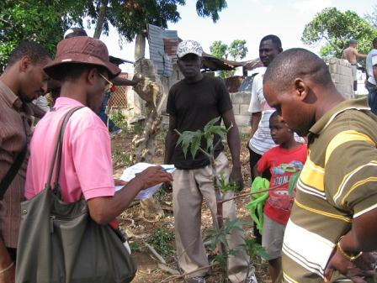
Key informant interviews
When are KI interviews appropriate?
First few weeks
Approach:
  Structured vs. Semi-structured interviews
  Closed vs. Open questions
  Who is ‘key’? Specialists vs. Generalists
Strengths
  fast
  few resources
  holistic overview
  impact perspective
Notes:
Ask participants when key informant (KI) interviews are most appropriate. Answer: during the first few weeks (usually due to time restrictions at the initial/rapid assessments, key informants are used to get a general overview of a situation rather than interviewing individual households for a more specific understanding)
When using KIs, we will have to determine our approach. Briefly explain some of the differences between structured and semi-structured interviews, advantages and disadvantages of closed and open questions as well as the importance of establishing who is ‘key’ when interviewing key informants (i.e. do we want to interview specialists or generalists).
Also review with participants the list of KI strengths and some of the drawbacks (KI might have a biased view, it may be difficult to get KI interviews with excluded groups, does the KI really know the answers to the questions etc.

Slide 15
Key informant interviews
Design questionnaire (involve experts)
Identify sites / KIs (representative, able to provide meaningful information, heterogeneity of experience)
Field test data collection instrument
Before
Be aware of KI’s situation – adapt to their needs
Ensure good communication and informed consent
Remain flexible BUT aware that consistency helps analysis
General Qs then specific– do not induce answers
Take notes!
Allow time – do not end abruptly
Allow questions from KI
During
After
Debrief to compare reliability of KIs and information gathered
Ensure anonymity of data
Notes:
Review this timeline of KI activities that should take place before, during and after data collection.
Additionally, emphasize the importance to:
Quickly meet key leaders upon arrival – explain what you are hoping to do and why
Ask for access and assistance
Drive, fly, walk around the site (get locals to join you)
Look for different types of people
Go to key sites - Water collection points, latrines, communal washing areas, schools, storage facilities, grave sites, markets, health facilities and religious centres…
Select the identified Kis and be aware of the KI’s situation, what activities they are engaged in, and what their surroundings are.
Interview people in a safe place that is convenient to them and adapt to their needs.
Make sure people understand why they were asked to participate as a KI and what will be done with the information they share. Do not raise expectations.
Ensure good communication and informed consent. Participants must understand that they are not required to participate in the interview. Make sure they understand that a lack of participation will not negatively impact them.
The full list of questions may not necessarily be covered during the interview: order may change according to KI BUT consistency in the order of question asked does make data compilation and analysis easier

Slide 16
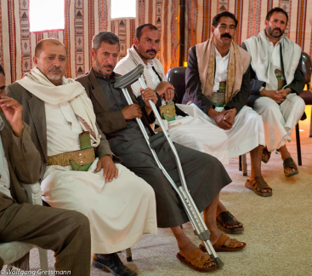
Focus group discussions
When are focus group discussions appropriate?
After initial assessments
Approach:
  Moderated discussion group
  Open-ended questions to provoke discussion
  8 – 12 participants + 2 moderators
Strengths
Understanding community priorities
Identifying variety of opinions
Yield lots of information quickly (1 – 2 hours)
Notes:
Ask participants when focus group discussions (FGD) are most appropriate. Answer: After the initial assessments
FGDs are typically moderated group discussions (with 8-12 participants and 2 moderators) with very open-ended questions that provoke discussion
Review the strengths of FGDs with participants

Slide 17
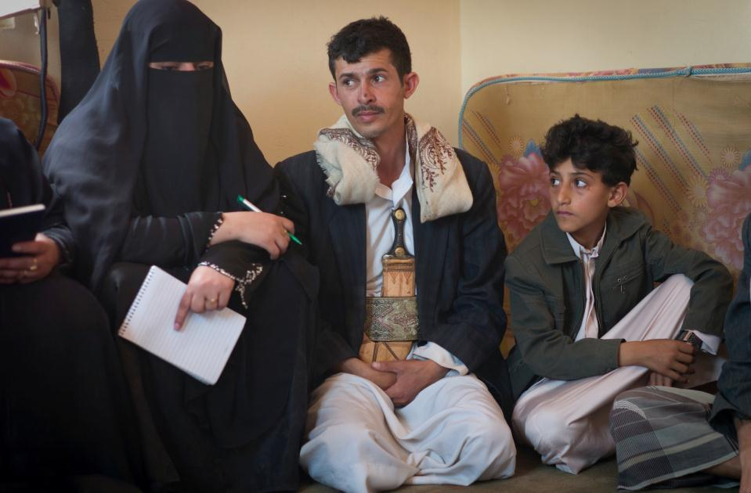
Focus group discussions
Know what questions you want answered and decide which questions you will ask to initiate discussions
Identify sites / FG participants (homogeneous or heterogeneous groups?)
Practice facilitation
Before
Identify private location
Explain process and encourage all to participate
Explain confidentiality of information
Encourage discussion and disagreement
‘Light touch’ facilitation – remain neutral
Be flexible and sensitive
Do not dictate the course of discussion / loose control!
During
After
Debrief to compare information gathered
Write up asap
Notes:
Review this timeline of FGD activities that should take place before, during and after data collection.

Slide 18
Household Interviews/Surveys
When are household surveys appropriate?
Sector-specific assessments
Approach:
  Structured vs. Semi-structured interviews
  Use open and closed questions (not leading ones…)
  Who to interview – head of household / all?
Strengths
  detailed
  useful for sensitive topics
  representative
Notes:
Ask participants when household interviews and surveys are most appropriate. Answer: During sector-specific assessments
Explain that we will typically choose between a structured and semi-structured interviews that use both open and closed questions (depending on our aim). We should always, however, avoid using leading questions.
We will also need to determine who within the houseful to interview (head of the household, everyone in the household, etc.)
Review the strengths of household interviews and surveys with participants

Slide 19
Household Interviews/Surveys
Design questionnaire (involve experts)
Decide methodology for household selection
Field test data collection instrument
Before
Explain purpose and ground rules of interview
Remain flexible BUT aware that consistency helps analysis
Treat interviewee as the expert
Adapt style to different personality types BUT retain control
Guide conversation as naturally as possible
One question at a time!
Allow questions from interviewee BUT don’t let them interview you!
Include observations on interviewee’s mood/body language
During
After
Review notes asap and write up
Notes:
Review this timeline of household interview/survey activities that should take place before, during and after data collection.

Slide 20
Needs Assessment – Bias
Organisational Bias
Mandate
Project
Specialisation
Political
Individual/Cultural
Class
Ethnicity
Religious
Personal history
Language
Gender
Age
Environmental bias
Seasonal
Spatial
Time of day
Location
Notes:
Ask participants to help explain what bias is and how it could potentially affect needs assessments.
Review the three types of needs assessment bias outlined on this slide (organisational, environmental and individual/cultural)
Ask participants for some bias examples they have encountered during assessments.

Slide 21
Good Questions/Bad Questions
“You do not have irrigation systems, do you?”
“What percentage of your income and expenses is spent on food annually?”
“Do you attend Gouzelec school?”
“In our view, it would be too dangerous to organize the distribution here. What do you think?”
“What were the key advantages of the programme for the improvement of food security and the well-being of women, children and the elderly?”
“What form of paid work constitutes the main income-generating activity here (IGA)?”
“How many households need food assistance?”
“What were the major problems of agricultural production this year?”
Were you very happy, moderately happy, unhappy or very unhappy with the assistance you received?
Notes:
Explain that when conducting interview and discussions, it is important to understand the difference between good questions and bad questions.
Review these examples one-by-one and ask participants whether it is an example of a good or bad question and why.

Slide 22
Good Questions
To be used
Clear and direct: How…? Where …?
Why? Why? Only once per question...
Be sure it is understood, especially with an interpreter.
Keep sensitive questions for the end of the discussion
To be avoided
Being too direct
Misleading questions, encouraging people to paint a very pessimistic picture.
Do not influence the answer by assisting the respondent to reply.
Do not formulate questions in a way that supposes a specific line of conduct
Notes:
Review these lists of criteria to be used and avoided for good questions.

Slide 23
Session Summary
Establishing and training a strong field team is essential for successful needs assessments
Use the appropriate collection methodology for the assessment and target group
Ensure those taking out the assessment are properly trained in the methodologies used
Review and correct data directly after collection or at the end of the day
Different methodologies and target groups require a variety of skills and team members
Notes:
Review the summary points with the participants

