Slide 1
Secondary Data Review (SDR)

Slide 2
Objectives
Understand importance of SDR
Know what you need to know and where to look
Understand techniques to “data manage” secondary information
Practice compiling analyzing secondary data
Notes:
1 min *lne
Review the session objectives with the participants. Explain that too often assessment teams dive into primary data collection without first consulting secondary data sources. This session will explore the secondary management, specifically collection and analysis.

Slide 3
Some types of data
  Secondary data:
    Collected by someone else
Primary data :
  Collected by you and your team
Primary-secondary™ data: ???
Notes:
2 min *lne
Help participants understand what secondary data is and how it differs from primary data (i.e. Secondary data is collected by someone else while primary data is collected by you and your assessment team).
When considering secondary data, some people have a tendency to only think of pre-crisis information (data that serve as baseline data from before a disaster). While pre-crisis information can serve as an important source of secondary data, it is NOT the only source; in-crisis information collected from other sources (such as OCHA or other clusters) is also an incredibly important source of information to consider.
Both pre- and in-crisis data will be discussed further during this session.

Slide 4
Types of Secondary Data
Pre-crisis information: these are typically baseline data from before a disaster to serve as comparison
In-crisis information from other sources such as UN OCHA or other clusters
Similar crisis information: from other, similar crises (e.g. another country)
Notes:
2 min. *lne

Slide 5
1. Know what you’re looking for
For secondary data (pre-crisis and in-crisis):
Geographical area (Where)
Affected groups (Who)
Sectors/Domain (What)
Date/Timeline (When)
Notes:
3 min. *lne
The first step in collecting secondary data is to know what you are looking for. So much information exists and is accessible online that valuable time and resources can be wasted by not having clear research questions and topics of inquiry prior to beginning your search.
To help you know what questions to ask, first consider the context of the crisis. Context is king, even when working for a single sector or cluster
Consider the following contextual questions that will help you narrow down your secondary data research:
What has happened? Describe the type of emergency or disaster.
Where did it happen? Identify the geographic areas and environmental conditions.
Who/what was affected, and to what extent? Identify the people and resources affected by the emergency or disaster.
What is the existing context and how might it develop? Describe the security context, access to the zone and existing coordination of response actions

Slide 6
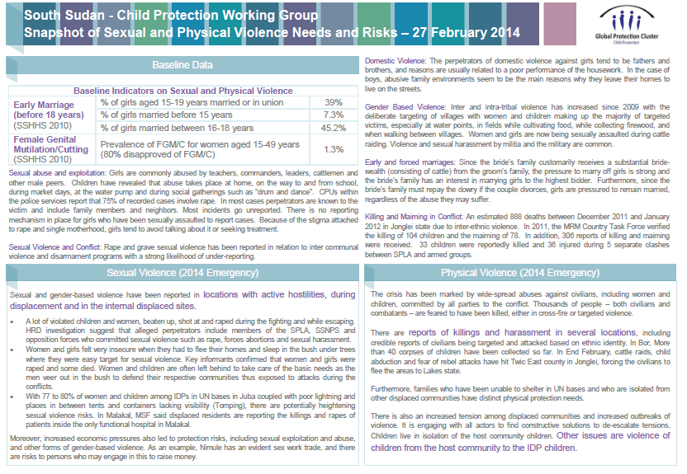
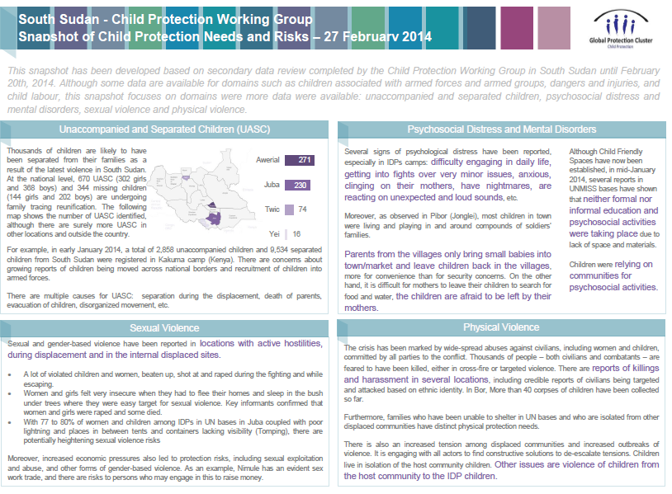
2. Know how you’ll use the data
Planning a response
Prior to an Assessment
Before a meeting
For advocacy/fundraising
Notes:
3 min. Jean
Prior to an assessment: look for what we need to know, which data is missing, etc.
Before a meeting: During your cluster meeting, you have a dedicated time to sexual violence. Not everybody will have the same information and a lor of questions, talking will happened. If you produce and share with them a one page on what we know on sexual violence from the sdr. You will not lose that time talking
For advocacy/fundraising: Partners and donors rely on evidence-based advocacy. You can develop a snapshot based on data from your SDR to show the major needs, use some data for your sitreps.

Slide 7
3. Know where to find it
Field office reports and Reliefweb for the very initial “what and where”
SitReps
Government Ministries
UNESCO (GMR); and UNICEF MICS Survey Report
Partner assessment reports (HR assessment registry, etc.)
Press/media
Colleagues, contacts, networks, etc..
Notes:
4 min. *lne
The second step in collecting secondary data is to know where to find it. Before presenting the bullet points, ask participants what sources they have used in their experience for collecting secondary data.
Sometimes you’ll know your question first and then go and look for it (e.g. in existing documents, asking people, etc.)
This is nice so you don’t waste a lot of time going through hundreds and hundreds of documents/online resources.
Sometimes you’ll have a document that you need to extract all relevant information (e.g. an assessment report); often you will start with the first looking for an answer to a question and come across unrelated, important information
Need to be ready for both have a system for organizing what you find.
CP: Sources for a SDR?
- Common sources of secondary data for social science include censuses, organisational records and data collected through qualitative methodologies or qualitative research. Practically, for the CPiE SDR, review (if available in the country context) CPRA report, Press articles, Assessment reports, SRSG CAAC Report, Child Protection Systems Mapping, International Crisis Group Report, Reports from Human Rights Watch / Amnesty International, Demographic and Health Survey, Documents about similar emergencies, etc.
- If there is already a CP Desk Review, either the current document is used and updated or the SDR template is used where pre-existing information can be consolidated
- If no CP desk review exists, data on the CP situation prior to the emergency should also be included nevertheless priority should be given to post crisis data and if there is time, relevant and most recent pre-crisis data should be reviewed

Slide 8
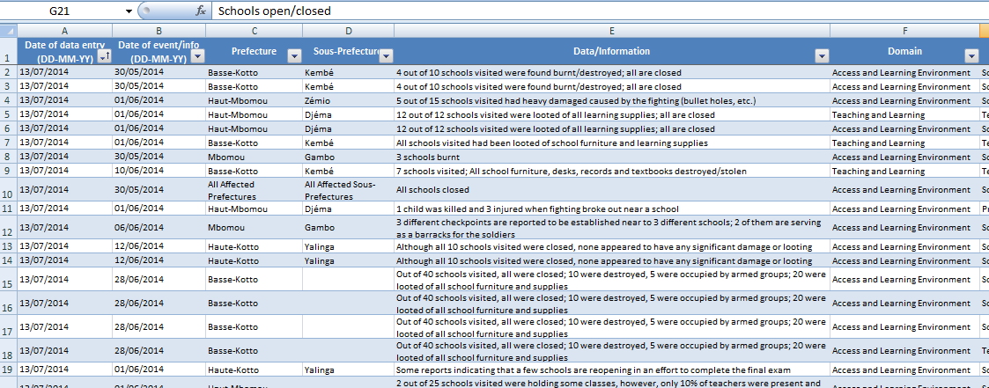
4. Know how to compile/organize your data
Should have a system for organizing the secondary data collected
Notes:
1 min. *lne

Slide 9
5. Know how to assess reliability/credibility
Reliability of source | Credibility of data
A. Completely reliable | 1. Confirmed by other sources
B. Usually reliable | 2. Probably true
C. Fairly reliable | 3. Possibly true
D. Not usually reliable | 4. Doubtful
E. Unreliable | 5. Improbable
F. Reliability cannot be judged | 6. Truth cannot be judged
Reliability → source
Credibility → triangulation
Notes:
2 min. Jean
Pre crisis data is never perfect. You will need to assess your data to make sure it is relevant and to determine what parts of the pre-crisis secondary data you will use. Before reviewing the bullet points, ask participants to give some challenges with pre-crisis data, according to their experiences.
Challenges with pre-crisis data:
May be old
May provide figures without specifying how (or when) collected
Usually national level, at best provincial
Often not disaggregated
Sometimes inconsistent
Figures may not provide the whole story (e.g. student teacher ratio, primary completion rate)
What is the data source? Do they have the required expertise?
How consistent is this with other data (triangulation)
Is the information relevant to the current context or is it out-of-date? Do others with in-depth experience of the local situation find this plausible?
Do the “laws of physics” apply? Is it likely these data could be collected within this timeframe at that location?
What was the purpose of the data collection? Is the document’s coverage of the topic area broad or too narrow?

Slide 10
6. Know how to analyze your data
Looking at the four Ws again:
  When (pre-crisis, in-crisis, similar crisis)
  Where (which regions, districts?)
  What (looking at domains)
  Who (most affected groups)
The SDR analysis Mantra: Summarize, compare, interpret
**Donut Theory**
Notes:
10 min. Jean
Donut Theory:
Focus as much on the hole than on the donut
What you don’t see is sometimes more important than what you see.
No information is extremely important information
More problematic and important is the identification of what is not an issue (e.g. no need to send school books, they are available in fair quantity) and the identification of information gaps (the known unknowns), so they can be looked at in further assessments.
COMPARE:
Very often only a table of key indicators is provided as an account for pre-crisis data collection effort. However, tables of indicators are not enough. Instead of providing only a snapshot of key figures, make the effort to provide context and to build a profile of the situation in the education/CP sector. This entails comparing the situation in education for different socio economic groups or sex, or between different geographical areas, or to compare to the regional average, etc. It is also useful to provide trends over time. For example, if the literacy rate for females is now 85%, what percent was it 5 years ago? This can give a lot of information on the education policy and government efforts undertaken in the last 5 years.

Slide 11
Simulation Exercise:
Secondary Data Review
Notes:
Presentation (28 min). Explain simulation (2 min). Split participants into CP/Ed groups. Explain/Demonstrate SDR matrix (5 min). Exercise: 55 min.

Slide 12
Common pre-crisis information needs
Key indicators and demographic data
Population and area profile
Upcoming events
Education/CP fact sheets (disaggregated enrolment rates, curriculum, language of instruction etc.)
Lessons learned
Notes:
Here are some common pre-crisis information needs that can help direct your secondary data research.

Slide 13
Pre-crisis source quiz
  Where can you find the following information:
  Number of students
  Education policies such as enrolment, exam registration
  Education system (years spent in ECD, primary, secondary, tertiary)
  Literacy rate
  Location of schools in affected areas
  Number of schools per province or district
  Teachers salary scale
  Main reasons for dropout or non-enrolment
  Primary school completion rate.
  Language of instruction
  Student teacher ratio
Notes:
Give participants a ‘pre-crisis source quiz.’ You can do this is plenary or ask participants to discuss each of the bullet points together.

Slide 14
#3 – Assess your data
  Challenges with pre-crisis data:
  May be old
  May provide figures without specifying how (or when) collected
  Usually national level, at best provincial
  Often not disaggregated
  Sometimes inconsistent
  Figures may not provide the whole story (e.g. student teacher ratio, primary completion rate)
Notes:
Pre crisis data is never perfect. You will need to assess your data to make sure it is relevant and to determine what parts of the pre-crisis secondary data you will use. Before reviewing the bullet points, ask participants to give some challenges with pre-crisis data, according to their experiences.

Slide 15
#4 – Build profiles....
National key indicators vs. “affected area” key indicators
Total population vs. specific sub-groups demographic data (past IDPs, refugees, etc.)
Ad hoc characteristics:
Sub-set of socio-economic profiles (farmers vs. pastoralists)
Vulnerable groups (disabled, food insecure, unemployed, food distribution dependents, etc.)
Livelihood zones (urban vs. rural, mountainous vs. riverine)
Categories of the population (Women vs. men, elders vs. youth)
Notes:
Very often only a table of key indicators is provided as an account for pre-crisis data collection effort. However, tables of indicators are not enough. Instead of providing only a snapshot of key figures, make the effort to provide context and to build a profile of the situation in the education/CP sector. This entails comparing the situation in education for different socio economic groups or sex, or between different geographical areas, or to compare to the regional average, etc. It is also useful to provide trends over time. For example, if the literacy rate for females is now 85%, what percent was it 5 years ago? This can give a lot of information on the education policy and government efforts undertaken in the last 5 years.

Slide 16
Secondary Data - in crisis information

Slide 17
Reservoir/Docking Station
Pre-crisis info
In-crisis info
Lessons Learned
Primary Data
ANALYSIS
DISSEMINATION
Notes:
Explain that now we will look at in-crisis data.

Slide 18
Common in-crisis information needs
Is there a problem in core domains? Yes/No, DNK, N/A
Affected education/CP domains
Cross cutting issues and Inter-sector issues
Affected geographical areas
Affected groups and subgroups
How many?
How bad?
Existing or potential threats, vulnerabilities, risks
Notes:
Doing the effort to collate in-crisis secondary data allows us to quickly identify what is reported as being a problem and what is not an issue. Or even what is not applicable in this given situation.
Different crises often share similar in-crisis information needs. Ask participants what their common in-crisis information needs typically are and then review this list.

Slide 19
Know where to find it...
Reliefweb, Alertnet, OCHA, HumanitarianResponse, Media, Blogs, crowdsourcing, meeting minutes, etc..
NGOs, government, UN agencies reports
Colleagues, Contacts, networks, etc..
Notes:
As with pre-crisis data, it is also necessary to know where to find in-crisis data. Ask participants where they typically look first and then review this list with them.

Slide 20
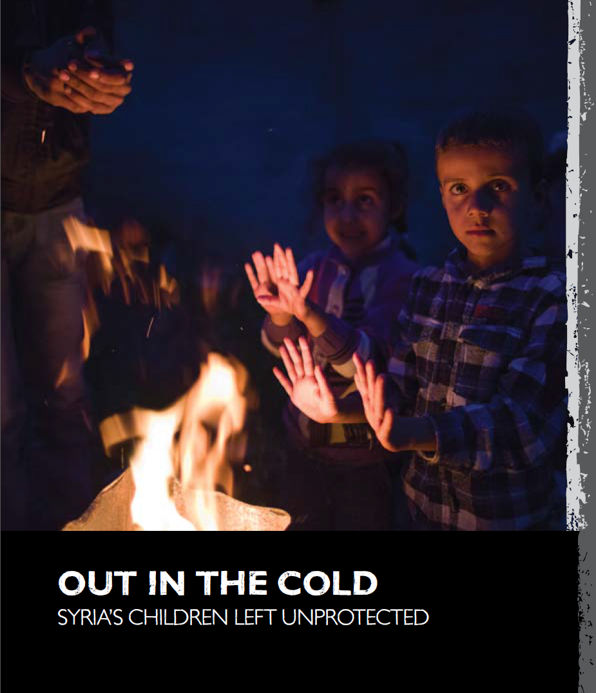

Example of in crisis information
Notes:
Here are two examples of NGO/UN reports from the Syria crisis that can be considered as in crisis secondary data

Slide 21
Capturing needs-related information...
Notes:
This is an example of a “docking station” for in-crisis secondary data. In this spreadsheet, each row represents one piece of information related to needs identified for the crisis (Syria in this example).

Slide 22
Organizing in-crisis secondary data
Essentially, the “four W” attributes :
  Geographical area (where)
  Affected groups (who)
  Sectors (What)
  Date (When)
Ideally, two measures:
  Reliability (how trustable)
  Severity ranking (How bad/severe)
Notes:
Each piece of information in the spreadsheet receives some key attributes:
The geographical area it relates to
The affected group it relates to
The sector or core domain it relates to
The date of the information
In addition, each piece of information receives a reliability level and a degree of severity

Slide 23
Example of severity and reliability classification
Category | Problem? | Action needed? | When?
1 | No | No | -
2 | Problem | No | -
3 | Problem | Monitoring | Immediately
4 | Problem | Intervention | Medium-term
5 | Problem | Intervention | Immediately
Category | Reliability
0 | Reliablity cannot be judged
1 | Usually reliable - UN organisations, large NGO's, miltary entities, Reuters/Alertnet, BBC, CARE, etc
2 | Fairly reliable - Some press sources, NGO's etc
3 | Unreliable - In some cases; government reports, local newspapers
Notes:
In the Syria example are the reliability and the severity scale used to organize the information.
Show participants these examples of how in-crisis information could be classified by these two criteria: severity and reliability.

Slide 24
Credibility, reliability and usefulness of the data
What is the data source? Do they have the required expertise?
  How consistent is this with other data (triangulation)
  Is the information relevant to the current context or is it out-of-date? Do others with in-depth experience of the local situation find this plausible?
  Do the “laws of physics” apply? Is it likely these data could be collected within this timeframe at that location?
What was the purpose of the data collection? Is the document’s coverage of the topic area broad or too narrow?
Notes:
With secondary data, you should always consider its credibility, reliability and usefulness. The following questions can help us determine if our data is credible, reliable and/or useful.

Slide 25
Secondary Data – Lessons Learned

Slide 26
Reservoir/Docking Station
Pre-crisis info
In-crisis info
Lessons Learned
Primary Data
ANALYSIS
DISSEMINATION
Notes:
Explain that lessons learned are also an important type of secondary data.

Slide 27


Example of lessons learned information
Notes:
Present these two examples of lessons learned and ask participants for additional examples or sources of lessons learned information and how information from lessons learned can be used.

Slide 28
Secondary Data – Analysis

Slide 29
What are we looking for?
Who/What
Who is affected? Which group?
Directly or indirectly? Already vulnerable before?
What is “to be affected”? Which domain, which issues?
Who are the most affected
Where are the most affected areas
What are the most affected sectors/domains
What to do next
How Many
Affected population figures
Breakdown per geo. area
Breakdown per group
Breakdown per sector
SADD
Where
Geographical areas affected by the disaster
How much
How bad is the situation
How severe is the impact
Who is moderately or severely affected
Notes:
When analyzing secondary data, it is important to know what we are looking for and what questions to ask.
Analysis is like doing a jigsaw puzzle. You need to reconciliate various pieces of information. Start with the corners.
Review the Who/What, How Many, Where and How Much categories and sub-questions with participants.
Specifically, we should seek to know who are the most affected, where are the most affected areas, what are the most affected sectors/domains and what to do next.

Slide 30
#1 - Identify affected groups
Affected
Displaced
IDP
Non-Displaced
Host
Non-Host
Camp or Camp-Like
Self-Settled Camp
Collective Centre
Notes:
When analyzing secondary data we should identify and map affected groups. Most probably, those affected groups experience different situations in terms of education and might call for differentiated types of responses.

Slide 31
#2 - Issue typology and mapping
Analysis and interpretation
Risks
identified
Current
Potential
Risks not identified
Non existent
Typology
Future
Not known
Key priorities
Early warning
Scenarios
Not applicable
Information gaps
Category
Short term
Long term
Preparedness measures
Contingency measures
Advocacy
To assess next
Response
Salience
Information you know you have | Information you know you don't have
Information you don't know you have | Information you don't know you don't have
Notes:
Secondary data also allows us to identify salient needs. They can be current existing needs, but also future needs (winter coming) or potential needs (fighting resuming and new wave of displacement). Each type leads to a different kind of recommendation.
More problematic and important is the identification of what is not an issue (e.g. no need to send school books, they are available in fair quantity) and the identification of information gaps (the known unknowns), so they can be looked at in further assessments.

Slide 32

#3 - The donut theory...
Focus as much on the hole than on the donut
What you don’t see is sometimes more important than what you see...
No information... is an extremely important piece of information
Notes:
Explain to participants that we should focus as much on the ‘hole’ of the donut (that which we do not see, the information that we do not have) as on the donut itself (the information that we have). Missing information and identified information gaps is an extremely important piece of information.

Slide 33
Secondary Data – Summary

Slide 34
Secondary data review
Allows to:
Clarify assumptions
Identify information gaps
Develop hypotheses - what do I expect to find?
Determine primary data requirements:
  Validate SDR conclusions and/or ‘fill in the blanks’
  Voice of the affected population
  Determine most appropriate interventions
  Assess practicalities of aid delivery
Notes:
From your SDR you should have a good idea of the situation and how the event has impacted various population groups in the main education domains
You will have to make some assumptions (as you don’t know everything!) – make them explicit
Identify any information gaps: knowledge of situation in particular geographical areas / domains / population groups etc.
Hypotheses – these are stories that describe what you expect to find – how the event has impacted people and what they are doing and what they need/want
SDR also allows us to determine our primary data requirements; specifically:
Who do you need to visit to validate your SDR conclusions (hypothesis) “Reality check” of “hypotheses” or assumptions created from secondary data
Get some understanding of issues not well understood from secondary data
Get some idea about immediate priorities of the beneficiaries
Most appropriate interventions
Practicalities of aid delivery (security, access, partners on the ground)

Slide 35
Key principles
Collect data first at national level and afterwards look for disaggregated data for the affected geographic area
Look for important and relevant quantitative information such as census, humanitarian profile, surveys. Get population data to lowest administrative level possible
The more disaggregated the data, the more useful it is for identifying who is most at risk
Use the references generally placed at the end of collected reports and documents to guide to more in depth research
Notes:
Review the key principles of secondary data collection on this slide and the next.

Slide 36
Key principles
Importance of the data vs. the time needed to find it
Collect only what you know you can use. Know the question you’re trying to answer and the data you’re looking for.
Articulate results. Focus on value added for target audience.
Let the data speak to you. Be prepared for redirecting your collection efforts accordingly.
Consider bias and reliability/credibility. Don’t rely on one source only.

Slide 37
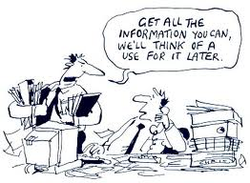
Team organization
From 1 to 5 people, depending on the depth of information required. One SDR leader.
Does not require extensive skills. Can be delegated, but requires coaching.
Divide data collection between pre and in crisis. Do regular check up. In-crisis data driven process.
Can be done remotely.
Can take 0.5 - 2 days.
Preparedness can help
Notes:
Secondary data collection and analysis requires having an SDR team, typically between 1-5 people. Team members do not need extensive skills, but there should be 1 SDR leader who can coach the others and who is experienced in SDR.
Team members should divide tasks and types of data to work more effectively and efficiently; for example, teams could divide pre-crisis and in-crisis data review.
Also keep in mind that SDR should be done in a relatively short amount of time (0.5-2 days), can be done remotely and any preparedness activities can help.

