Slide 1
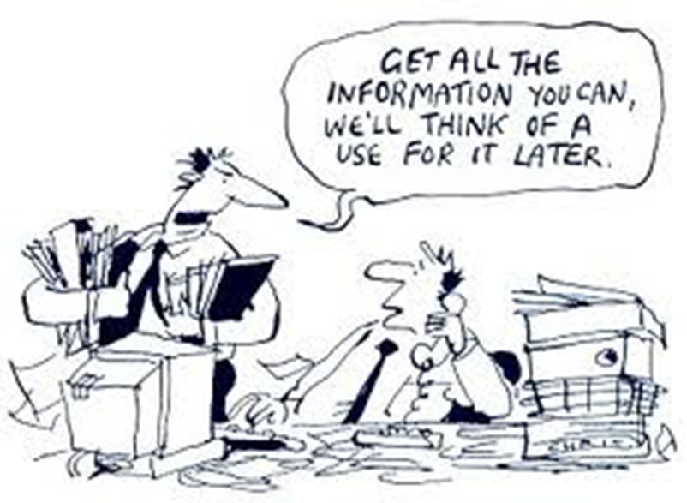
Planning Needs Assessments
Notes:
Use two photos / images as cover for session

Slide 2
Session Objectives
Understand criteria for successful assessments
Ask yourself key questions when designing and planning for assessments
Understand how to use a step by step approach
Notes:
Review the session objectives; emphasize that successful assessments require good planning. This session will cover some key criteria to consider when planning assessments and provide a step-by-step approach to guide our planning.

Slide 3

Rapid Onset Timeline
PHASE1
PHASE 2
PHASE 3
PHASE 4
72 Hours
End week 1
End week 2
End week 3
End week 4
End week 5
MIRA Report (14 days)
Strategic Response Plan (30 days after the first one)
Preliminary Response Plan - HCT (3 - 5 days)
$
Collective needs analysis updated by revising the HNO and if needed, conducting assessments
$
Humanitarian Dashboard
Notes:
Present the MIRA timeline.
Explain that at the end of 72 hours the first MIRA output (the PSD) is due. At 5 days, the HCT Strategic Plan is produced
Flash appeal at 7 days
The second MIRA output (the MIRA Report) is due at the end of Phase 2—14 days.
At the same time the MIRA report is due, the Humanitarian Dashboards (explained further later in the presentation) begin to be produced.
During the third and fourth weeks (Phase 3), in-depth sector of multi-cluster assessments begin
At the end of week 4, the Revised Flash Appeal is typically submitted.

Slide 4
Why coordinate assessments?
promote a shared vision of needs and priorities
establish an understanding of priority needs
increase coverage
use resources more efficiently
obtain a more comprehensive picture of needs
serve as a foundation for planning
promote inter-agency learning
encourage coordination during response
reduce duplication of effort
minimize beneficiary ”assessment fatigue”
better guide donor funding
identify gaps with greater precision
support shared monitoring processes
support consistency between and within cluster/sectors
support assessment preparedness
Notes:
Review the reasons for coordinating assessments. Compare these bullet points with responses participants provided explaining why they are important.

Slide 5
Quotes from the field: Pakistan & Haiti
Pakistan
“We have a proliferation of assessments going on in Pakistan. Nearly each organization does its own assessment, often without any coordination even within their respective cluster. Regularly questionnaires used are badly designed with inappropriate, insensitive and/or misleading questions that do not allow the needed analysis. Hence there is a lot of work needed to get assessments right.”
[Manuel Bessler, OCHA Head of Office, Pakistan]
Haiti
In Haiti, a large number of needs assessments of varying scope were carried out (…) Many assessment teams arrived late and reinforced biased assumptions rather than contributing to a clear picture of the situation and needs.” [Inter‐agency real‐time evaluation in Haiti: 3 months after]
Notes:
Have two participants read the following quotes from Pakistan and Haiti. Ask participants to highlight some of the specific challenges that were faced and provide ideas as to how conducting coordinated assessments could help.

Slide 6
Types of Coordinated Assessment
There are two types of coordinated assessments:
Harmonized Assessment:
This is when data collection processing and analysis is undertaken separately, however the data is sufficiently comparable to be compiled into a single database, and to serve as the subject of a shared analysis.
Joint Assessment:
This is when data collection, processing and analysis form one single process among agencies within and between clusters/sectors. This leads to a single report. (note: also referred to as a 'common assessment‘)
Notes:
Explain to participants the two types of coordinated assessments

Slide 7
Roles and Responsibilities in Coordinating Assessments
The Humanitarian Coordinator (supported by OCHA)
  Responsible for coordinating emergency assessments across clusters/sectors at the country level.
Cluster/Sector Lead Agencies at the country level
  Responsible for coordinating needs assessment and analysis within individual clusters/sectors. They are also responsible for engaging in inter-cluster/sector assessment coordination.
Cluster/Sector Members and individual organizations
  Responsible for undertaking assessments in a coordinated manner and for proactively engaging in the coordination undertaken by the Clusters/Sectors.
Notes:
Remind participants of the UN Coordination structure from Module 1 (Humanitarian Coordination Framework).
Review the coordination roles and responsibilities of the HC, CLAs and cluster/sector members during needs assessments

Slide 8
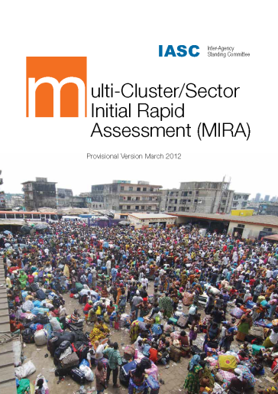
Multi-Sector Initial Rapid Assessment (MIRA)
Sudden-onset emergency—key decisions needs information BUT information is very limited
Humanitarian actors gather information independently: little consolidation and incomplete and conflicting picture of needs
MIRA establishes foundations for stronger and better-coordinated assessment culture
Provides information on needs of population and identifies strategic humanitarian priorities
Enables humanitarian actors to reach common understanding of situation and agree immediately on strategies
Notes:
Key decisions must be made almost immediately following a sudden-onset disaster BUT very limited information is regarding impact, scale and severity available
Humanitarian actors often gather information independently and with little consolidation, resulting in an incomplete and sometimes conflicting picture of humanitarian needs
The MIRA seeks to address this and lay down the foundations for a stronger and better-coordinated assessment culture during crises
Aims to: to provide fundamental information on the needs of affected populations and to support the identification of strategic humanitarian priorities.
It thus enables all humanitarian actors to reach, from the outset, a common understanding of the situation and its likely evolution and to agree immediately on strategies.

Slide 9
MIRA Process
5 stages in the MIRA Process:
Initiating the MIRA
Secondary data analysis
Undertaking primary data collection through a community level assessment
Final inter-sectoral analysis and determining strategic humanitarian priorities
Preparing and disseminating the MIRA outputs, these support
  Initial SRP (3 to 5 days)
  MIRA Report (2 weeks)
  Revised SRP (30 days after initial SRP)
Notes:
Briefly review the 5 stages in the MIRA Process:
Initiating the MIRA
Undertaking the secondary data analysis
Undertaking primary data collection through a community level assessment
Conducting the final inter-sectoral analysis and determining strategic humanitarian priorities
Preparing and disseminating the MIRA outputs
The Preliminary Scenario Definition is based on analysis of secondary data and any primary data available to provide a reasonable picture of the situation
The MIRA Report consolidates the conclusions of the final inter-sectoral analysis of the MIRA.

Slide 10
Characteristics of a good assessment
Relevance: providing information and analysis addressing questions which will influence decisions on what is to be done.
Timeliness: providing information and analysis in time to inform key decisions about the response.
Coverage: adequate to develop an understanding of the range of experiences of various groups.
Credibility: using methods that can be expected to lead to sound conclusions.
Transparency: being explicit about the assumptions made, methods used and information relied on to reach conclusions, and the limits of the data.
Continuity: providing relevant information throughout the course of a crisis. In case of a reassessment, there should be comparability with the data generated by previous assessments.
Notes:
Review each of the characteristics of a good assessment and briefly discuss each with participants to ensure they have a sound understanding of the ideas and the vocabulary.
Explain that each of these characteristics should be considered when planning a needs assessment and each will now be explored and explained further in the next slides.

Slide 11
#1 – Relevance
Day 1
Day 30
Day …
In depth joint assessment
Rapid Joint assessment
Access and learning environment
Teaching and learning
Teachers
Education policy
Community participation
Coordination
Protection
Psychosocial support
Conflict mitigation
Disaster risk reduction
Early childhood development
Gender
HIV and AIDS
Human rights
Inclusive education
Youth
Access and learning environment
Teaching and learning
Teachers
Education policy
Community participation
Coordination
Notes:
Explain that needs assessments should always be relevant. This means that assessments should be based upon the prioritized information needs of upcoming key decisions. A needs assessment is relevant when the topics and content covered, questions posed and data collected and analyzed all seek to provide the essential information required to make these important decisions. The basic rule is: focus on what you need to know, collect only what you need.
The relevance of different topics, questions and data within needs assessments will, therefore, vary according to which decision(s) that particular assessment seeks to inform (which are in turn determined by an emergency’s specific context, phase, etc.). What may not be relevant for a rapid joint assessment during the initial phases of an emergency, for example, may be very relevant later during in-depth joint assessments.
Since both time and resources are scarce—especially during the initial phases of an emergency—irrelevant or unnecessary data and information can impede the decision-making process and slow response. This should be avoided.
Also, rapid assessments provide information and identify information gaps and needs, which form the basis of further assessments; if community participation, coordination and HIV/AIDS are not identified as areas of concern in the rapid assessment and/or are not relevant to the context, those topics should not be part of subsequent assessments.

Slide 12
#2 – Timeliness
Providing information and analysis in time to inform key decisions about the response
Depends on which key decision you’re trying to inform
Initial SDR
Revised
SDR
CERF
CHF
Notes:
Since needs assessments are intended to inform key decisions, assessment findings and results must be available prior to the targeted decision and with enough time to inform and influence its decision-making process. In other words, assessment teams should always be aware not only of which key decisions their assessments are intended to inform but also the deadlines by which the assessment findings must be produced in order to inform those decisions. Teams should then plan for and ensure that all data collection, analysis and reporting procedures for each assessment will meet those deadlines.

Slide 13









#3 – Coverage
Individual level
Household level
Depth of information
Community/Group level
Community level
In depth assessment
Rapid assessment
Time and Cost
Notes:
Good assessments will also have appropriate coverage.
Coverage refers to the various groups within our targeted population; needs assessments seek to understand the experiences and the needs of these groups. The larger the coverage, the deeper our understanding of their experiences and needs.
Determining ‘appropriate coverage’, however, is a balancing act between our information needs (i.e. the depth of information) and the amount of time and resources we have to collect that information.
Due to the quick nature of key decisions at the beginning of a crisis, coverage for rapid assessments typically occurs at the community or group level. While helpful, this information and our understanding of the context and the needs and experiences of the population may not be very deep. During in-depth assessments, the amount of coverage increases and becomes more specific at the household and individual level. These assessments take longer to conduct, but the information is typically deeper and the findings more rich.

Slide 14
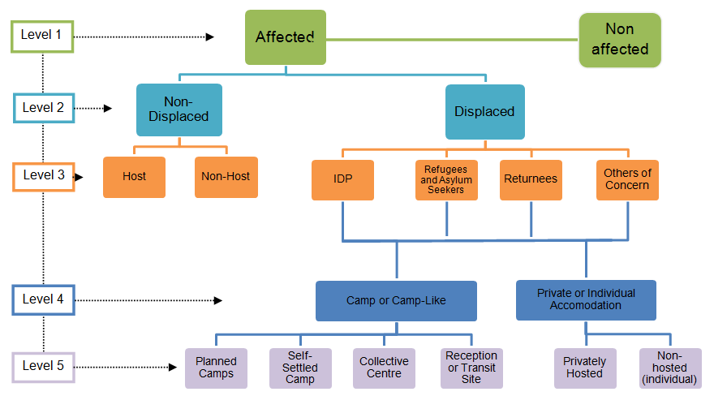
#3 - Different groups, different needs…
Adapted from the guidelines on the humanitarian profile Common Operational Dataset, June 2011
Notes:
Whether our needs assessments are rapid with low depth of coverage or in-depth with a high depth of coverage, we should be aware and take into consideration that different groups within our target population have different needs.
Explain that in the image on this slide, we can see some of the different types of groups.
When planning our assessments, in order to determine the most appropriate level of coverage, we should consider: 1) the different types of groups within our population 2) our information needs and 3) our contextual constraints on time and costs for conducting the assessment.

Slide 15
#4 – Credibility
Participatory focused tools
Individuals Survey
Households Survey
Focus Groups discussions
Key Informants interviews
Direct observations
Secondary data review
In depth assessment
Rapid assessment
Time and Cost
Notes:
Credibility: using methods that can be expected to lead to sound conclusions. Credibility applies to both the design and the methods of your research. Credibility in data collection means that your findings truly represent the phenomenon you are claiming to measure. In qualitative research, the main strategy used to promote the quality, credibility and thus validity of the findings is the adoption of appropriate and well recognized data collection methods.
Due to time constraints, not all data collection methods will be usable at any time. Generally speaking, there is a shift of methods: rapid assessments rely more on expert judgment (from assessment teams and key informants) while in depth assessments seek more to give voice to the affected population and to capture the participants’ points of views in a more participatory approach (focus group discussions, household interviews, etc.).
Rapid assessments are based on secondary data review, direct observation and key informants interview. None of those techniques alone is sufficient, but their common use allow for triangulation of findings.

Slide 16
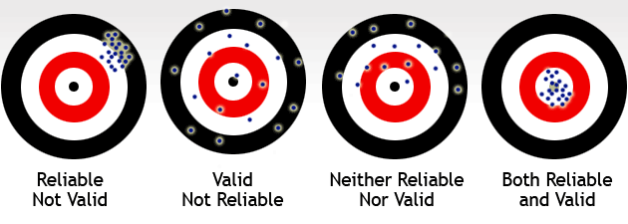
#5 – Transparency
Representative sampling
“Generalizability”
Purposive sampling
Convenience sampling
In depth assessment
Rapid assessment
Time and Cost
Notes:
Transparency: being explicit about the assumptions made, methods used and information relied on to reach conclusions.
This implies careful consideration and communication of:
How accurate are your findings. This is the degree to which your measurements are actually close to the actual true value of what is being measured. Rapid assessments tend to provide the big picture and a more concern on the accuracy of the findings.
How precise are your instruments: the degree to which repeated measurements under unchanged conditions show the same results. In depth assessments provide more precision than rapid assessments.
How generalizable or transferrable are your results (to a broader population or interest or to another setting). Transferability essentially refers to the other situations and contexts where we believe our results are most likely to be relevant and applicable.
The sampling method used will obviously have an impact on how generalizable or transferable your findings will be. We will see in the following sessions that there are three common types of sampling techniques that are used:
A) Convenience sampling is used at the very beginning of a crisis. They imply going where you can go or to the easiest places. They are not recommended because they offer a very low level of transferability. B) Purposive sampling implies targeting areas or group specifically. Sites are selected with a purpose in mind. C) Representative sampling call for random selection of sites to be visited and allow for generalization of findings to the wider population of interest. They are generally used in in depth assessments.

Slide 17
#6 – Continuity
Volume of information
In depth assessment
Rapid assessment
Time and Cost
Notes:
Good assessments will be structured with future reassessments in mind, allowing for continuity from one assessment to the next. Planning for continuity is essential so that data from one assessment can be compared to and analyzed with data from previous assessments. This will require skill in information management to be able to identify changes and trends over time.
While it is true that the volume of data collected from one phase to the next will increase and become more specific, there should be, however, a constant update and monitoring of a key list of issues/indicators from one phase to the next, thus providing continuity between assessments.

Slide 18
Session Summary
6 criteria to consider when planning assessments: Relevance, Timeliness, Coverage, Validity, Transparency, Continuity
Logistics, budget and accessibility will also influence your choices of methodology and sampling
Key question is what do you need to know for what reason?
Notes:
Review the six criteria and encourage participants to use the key steps in this presentation as a guide to planning their needs assessments

Slide 19


