Slide 1

3.3 Interpersonal Skills 1
Working Effectively with Others

Slide 2
At the end of this session, participants will
Appreciate the importance of working effectively with others as a Child Protection Officer
Understand that working effectively with others requires good interpersonal skills
Increase self-awareness – understanding of personal preferences in terms of team roles and leadership styles
Critically assess personal strengths and identify areas for further growth in this area
Notes:
Working in Teams – as a team member or leader
Collective Decision-Making: Facilitation; consensus-building
Managing Conflict

Slide 3
Self-study Exercise 3.3
Review the section on “Working with Others” of the Child Protection Competency Framework and develop next steps for following competencies:
Teamwork
Cultural sensitivity
Accountability
Communication
Building trust
Leadership

Slide 4
Team Roles
Team Roles (Our tendency to behave, contribute, and inter-relate with others in the team)
vs.
Functional Roles (The job we have been hired to do based on our ability, experience, skills)
Self-awareness and awareness of others
Complementarity
Potential for conflict
Notes:
Refer to Belbin questionnaires.
At end – move on to leadership questionnaires…

Slide 5
Leadership Styles
DIFFERENT STYLES DIFFERENT OUTCOMES?
Initiates process or discussion
Involves others
Facilitates consensus building & decision-making
Democratic
Facilitative
Emergent
Waits to see others actions
Laissez-faire
Defer to others
Declines making decision for group
Authoritarian
Initiates task
Directs others
Decisive
Directive
Authoritative
Non-Directive
Delegative
Notes:
Which style could be best adapted to what circumstances? We have a tendency to think of Authoritarian and Non-directive as bad, but each is adapted to other approaches.
Each is adapted to a range of situations, but in most situations we have found (through consultations and documentation at field level) that cluster and AOR leads do best with a facilitative style.
You want to be able to exercise ALL of these styles as appropriate….
Ex: make a large triangle from tape on the floor. Mark the three styles as depicted in the slide. Get participants to stand around the triangle and read statements. For each statement, get participants to self-select which style they would use in that situation and facilitate a discussion on why. There are no right or wrong answers but the decision must be conscious and deliberate and the style must be strategic – choose the one most appropriate to the context (people and situation) – not the style you feel most comfortable with.

Slide 6
Leadership Styles
YOU MAY NEED ALL 3…
Asks questions to involve others
Leads discussion
Tests to see if consensus exists
Encourages others to take responsibility
Democratic
Facilitative
Fades out gradually
Uses silence
Gives non-verbal support
Refuses to make decisions
Confirms commitments
Initiates
Structures
Motivates
Delegates
Reprimands
Directive
Authoritative
Non-Directive
Delegative
Notes:
After ex – as wrap-up.
Which style could be best adapted to what circumstances? We have a tendency to think of Authoritarian and Non-directive as bad, but each is adapted to other approaches.
Each is adapted to a range of situations, but in most situations we have found (through consultations and documentation at field level) that cluster and AOR leads do best with a facilitative style.
You want to be able to exercise ALL of these styles as appropriate….

Slide 7
Leadership Skills
Facilitation
Consensus-building
Resolving disputes
Negotiation
Influencing, persuading, mobilizing
Understanding diverse interests and perspectives
Others?
Notes:
Self-explanatory.
Can use as wrap-up for that part of session or skip through if time is running out.

Slide 8
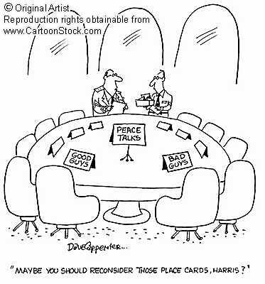
What characteristics help make a good facilitator?
Collective Decision Making – Facilitation
Reputation and credibility
Personal appeal
Relationships, access to influential parties
Facilitation skills
Notes:
We are working to make a humanitarian system work and achieve child protection outcomes. This involves facilitating communication and consensus between groups and individuals - in various formal and informal ways
Refer to roles of CPOs – may be leading sub-cluster or working with partners or internal facilitation within UNICEF. You will be facilitating at some stage when you’re in the field.
Refer to Coordination session – will have an opportunity to practice these skills after lunch.
The collaboration of these multiple actors is usually voluntary: if we want them to implement joint action, there must be buy-in. The collective decisions need to reflect their goals and they have to see it as legitimate. Good facilitation can make the difference between “paper” decisions and true collective action commitments
We need to be aware that other factors also influence our capacity to facilitate collective outcomes. We need to be perceived by stakeholders as credible – if we or our institution have a reputation for dominance, inefficiency or other weaknesses, people are less likely to willingly allow themselves to “be facilitated.”
If we have good relationships with stakeholders, they like working with us, and they see us as individuals/institutions who can help them achieve their own goals, the buy-in and collaboration will be much better.
But even with a good reputation and relationships, we need the facilitation skills to carry the process through to joint action.

Slide 9
What does a Good Facilitator do?
Manage group dynamics
Recognize obstacles to process
Offer alternatives
Identify areas of consensus
Set aside own agenda
Encourage participation
Notes:
Before viewing bullet text:
Ask participants to think of a colleague they have worked with who is particularly good, or bad, at facilitation. Ask them to reflect (can discuss in plenary if time permits):
How do you know that s/he is a good or bad facilitator?
What skills or methods do they use - or lack?
Go through the bullet points
Use this week as an opportunity not only to practice and strengthen your own skills in this area (in all the group work you’ll be doing) but to observe others in an analytical way. Who seems to have a “natural” ability to get buy-in and manage group dynamics? What skills do they use to do this?

Slide 10
Collective Decision Making – Consensus Building
A collaborative decision-making and planning process which encourages discussion from diverse perspectives to:
identify common interests
work towards common goals
reach agreement on operational planning and implementation while allowing for diversity
Notes:
What is a Consensus Process?
A consensus process is an effort in which government agencies and other affected parties seek to reach agreement on a course of action to address an issue or set of related issues. For example, task forces may use consensus to develop recommendations. Stakeholder groups convened by an agency may use consensus to develop legislative recommendations on regulations, or intra-government work groups involving multiple agencies may use consensus to reach agreement.
In a consensus process, representatives of all the necessary interests with a stake in an issue work together to find a mutually acceptable solution. Each process differs because in each case the parties design it to fit their circumstances. However, successful consensus processes follow several guiding principles:
Consensus decision-making -- participants make decisions by agreement rather than by majority vote.
Inclusiveness -- All necessary interests are represented or, at a minimum, approve of the discussions.
Accountability --Participants usually represent stakeholder groups or interests. They are accountable both to their constituents and to the process.
Facilitation -- An impartial facilitator accountable to all participants manages the process, ensures that ground rules are followed, and helps maintain a productive climate for communication and problem solving.
Flexibility -- Participants design a process and address the issues in a manner they determine most suitable to the situation.
Shared control -- Participants share responsibility for setting the ground rules for a process and for creating outcomes.
Commitment to implementation -- The sponsor and all stakeholder groups commit to carrying out their agreement.
Consensus-building emphasizes cooperation in sharing information and airing differences, which provides an opportunity to test assumptions, question our biases and for new ideas to emerge. It also affects how members experience the process and the value of their contributions.

Slide 11
When to Use Consensus Building
To tackle complex problems requiring inter-dependent action
To build stakeholder ownership of priorities and plans
To agree on common standards and joint action among stakeholders with differing views
To maintain “good relations” with stakeholders for future collaboration
Notes:
“Buy-in” is needed from multiple stakeholders – both in the interpretation/analysis of the problem and in the formulation and implementation of the solution.
No one entity has power or control over the solution
Relative balance-of-power among key stakeholders
Use consensus when you want high quality input and commitment, with follow-through, from a group.
Ask yourself, “do I need high quality input and commitment, with follow-through, from the cluster stakeholders, which stakeholders?” If the answer is “yes” then you will need to facilitate a consensus building process with these.

Slide 12
When Not to Attempt Consensus
When humanitarian standards and objectives will be compromised
When another decision making process is more effective
When stakeholders are extremely politicized
When key decision-makers are not at the table
When the solutions are obvious, standardised or already set in motion
Notes:
Consensus is not always appropriate or possible in particular situations.
Refer back to the “leadership triangle” – there may be times when not only is consensus not possible but to attempt it may be harmful for the group. Ask for examples if time permits.

Slide 13
Facilitating Consensus…
Focus on the problem, not the personalities.
Point out common goals and interests
Communicate openly
Listen actively…. to ALL voices
Remain calm and respectful, with a positive attitude towards ALL stakeholders
Maintain “honest broker” status
Remember that those in the discussion are the ones responsible for the outcome, and ultimately the response
Meet individually with key actors/groups to seek views
Notes:
So how do we do it?

Slide 14

What if you get stuck?
Use a “vote” to see degree of support for varying positions
If tensions high, take a break
Gather more information before reconvening
Meet separately with advocates
  They understand consequences of non -consensus
  You understand their underlying position/interests
Agree on how to proceed
  Process
  What is needed in order to agree?

Slide 15
Tips for Leading a
Difficult Conversation
Pick the right time
Be specific
Specify consequences (professional impact, personal impact, etc.)
Be aware of emotions (yours and others) and body language. Manage emotions first!
Use “I” statements – “I feel….”
Separate the person from the behaviour

Slide 16
Tips for Leading a
Difficult Conversation
Ask for the other side of the story
Offer ways to improve
Offer solutions

Slide 17

Tips for Dealing with Difficult Behaviour
Take a step back, stay calm
Diagnose modes; Identify dominant perspectives
Separate Relationship from Substance
  Acknowledge strong feelings
  Clarify intentions
Try to change the game
  Shift to interests
  Shift to options
Notes:
Some things to consider:
What is your preferred or natural style of dealing with conflict?
Which style do you go to when the conflict gets heated?
What key takeaways are you willing to commit to? How will you negotiate difficult
conversations differently in the future?

Slide 18
Tips for Dealing with Difficult Behaviour
Name the game and negotiate the rules
Change the players
Reality test alternatives
Terminate/postpone to return to the issue later

Slide 19
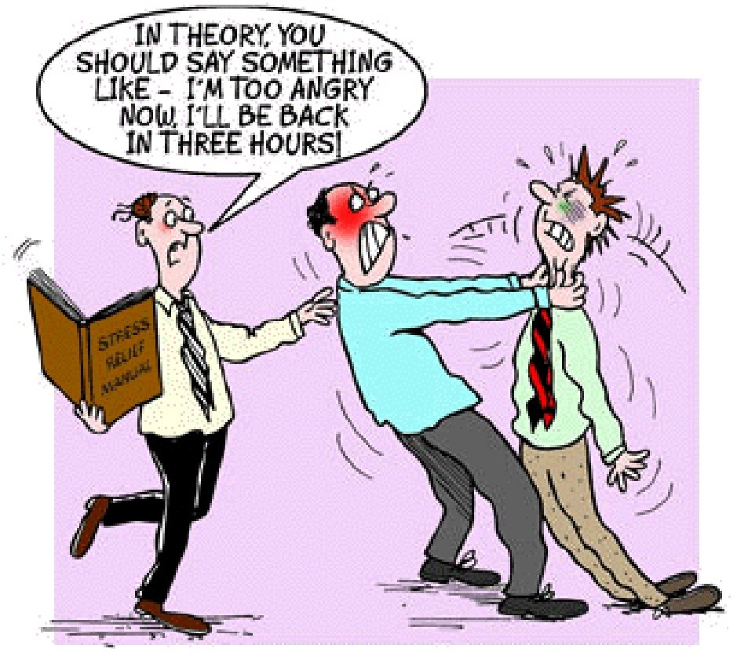
Constructive Outcomes of Conflict
Awareness of problems
Encourages change
Better decisions
Creativity
Energises
Heightens interest
Cohesiveness
Clears air
Understand self
Notes:
5 minutes - Conflict is not ‘bad’ so focus on the positive benefits of conflict.
ASK: “What might those positive outcomes be?”
Refer to “storming” phase

