Slide 1
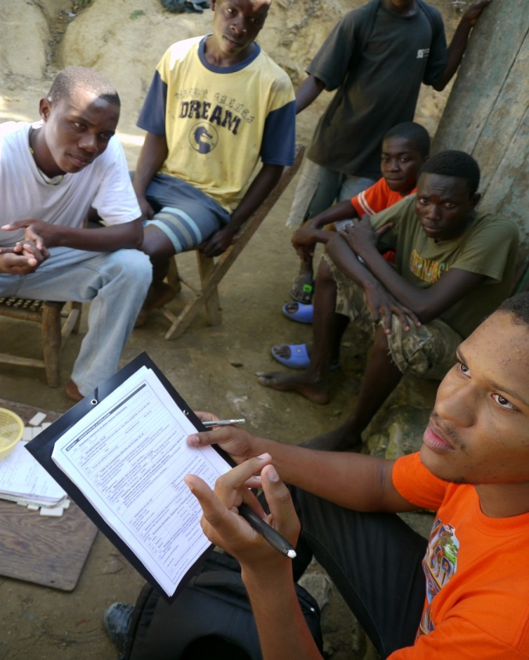

Field Test
CPRA Training - Session 11

Slide 2
Learning outcomes –
At the end of this session, you will be able to:
Notes:
To insert

Slide 3
How to Conduct our Field Test
To be developed by country team

Slide 4


