Slide 1
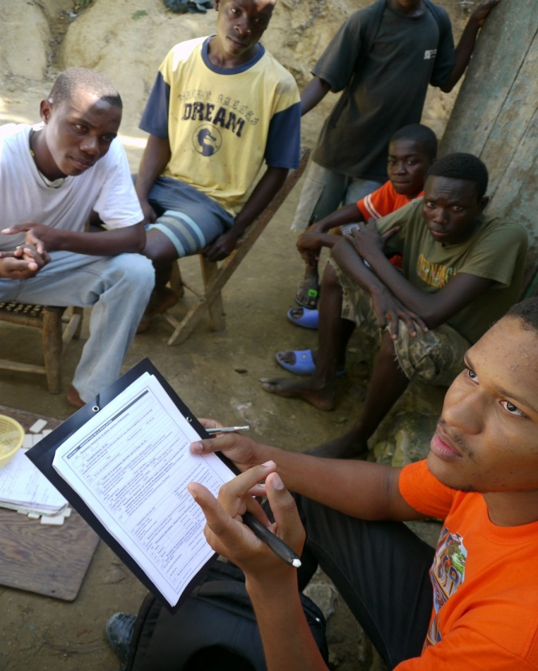

Desk Review, Direct Observation & Site Report
CPRA Training - Session 10

Slide 2
Learning outcomes –
At the end of this session, you will be able to:
Use the generic desk review template to generate a desk review;
Describe how to conduct a Direct Observation;
Create a site report.
Notes:
Handouts: desk review template – and – an example of a desk review (they can be found on CPWG.net).
This session will cover in more detail the three subjects of desk review, direct observation and site report that have been covered in passing during previous sessions.

Slide 3
Desk Review
When to conduct a Desk Review
Ideally it should be done in the preparedness phase – and supplemented with post-crisis information in the first 72 hours (and ongoing) after onset. If no desk review has been done prior to the emergency, it should be done as a first step before any data collection is planned and carried out.
Notes:
Distribute the desk review template and a selected completed desk review.
Explain that desk review compilation is basically a structured approach to synthesizing existing information and putting them into a user-friendly format.

Slide 4
Why do we conduct a Desk Review?
They can answer some of your questions which could reduce the burden of data collection and analysis.
When it is done systematically and at just the right time, it provides good enough information, making data collection unnecessary.
It can also be a helpful resource for programming in case actual data collection is not possible due to resource limitations or logistical and/or security concerns.
It can be used for programming and fundraising in the first phase of the emergency when data collection may not be possible.
Notes:
- For example, when protection systems are in place, much of the data related to CP issues can be collected from existing information management systems and therefore the need to collect such data from the field diminishes.

Slide 5
How to Conduct a Desk Review
As a first step, find out if a desk review has already been done that can simply be updated for your purposes.
If not, use the generic template developed by the global CPWG as a guide to generate a desk review;
The CPWG and the CP Assessment and Measurement Taskforce can support you in the process of developing it.
Notes:
Self explanatory.

Slide 6
Who is responsible for a Desk Review?
Normally, the child protection coordinator (or sub-cluster lead) is responsible to mobilize resources for and oversee the compilation of a desk review. In the absence of a coordinator or a coordination mechanism any child protection actor may lead on this effort.
Technical experts from the global CPWG are also available to support any efforts to compile a CP desk review. Contact info for technical experts can be found on this webpage: http://cpwg.net/advice-support/
Notes:
Self explanatory

Slide 7
Direct Observation
As you may remember, there are two direct observation methods:
Structured Observation (also known as “looking for”); and
Unstructured Observation (also known as “looking at”).
The CPRA combines these two methods.
Notes:
During a Structured Observation, also referred to as “looking for,” the observer is looking for a specific thing, such as a behaviour, an object or an event. For example, looking to see if children are using specific showers marked for the use of children. This method is also used to detect the non-existence of a specific thing, for instance, to see if children are NOT using a designated playground. To guide a Structured Observation, a checklist is normally developed to function both as a reminder and a recording tool.
During an Unstructured Observation, which is also referred to as “look at,” the observer is looking to see how things are done and what things exist. For instance, if an observer is interested in knowing where in the camps children congregate or play, an Unstructured Observation method would be the appropriate. To guide an Unstructured Observation, we develop a set of open-ended questions that will be answered based on observations.

Slide 8
Direct Observation
It is important to plan properly for a DO
Time of day
  Will community members be available?
  Will children be at school?
Location
  Attempt to observe the areas where children are most likely to regularly be
    Paths to school
    Play-areas
    markets

Slide 9


Direct Observation
  Look at each photograph in turn.
  What do you see in the pictures that would be worth noting in your direct observation report?
Notes:
The facilitator should have the same photos ready to be projected on the screen and ask each group what they saw in the photos that was worth noting.

Slide 10
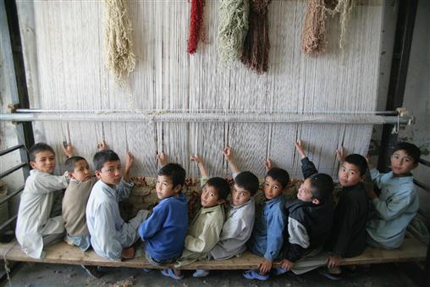

Slide 11
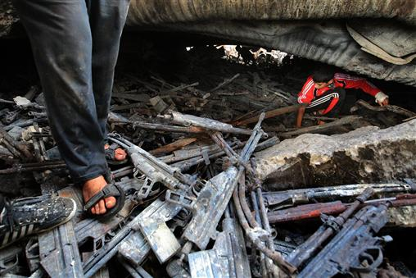

Slide 12
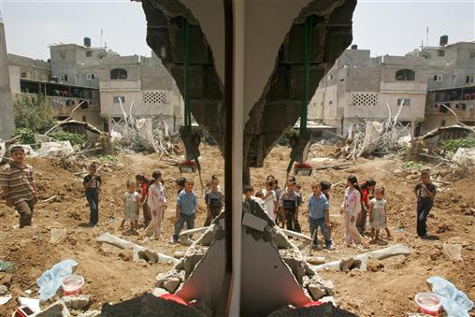

Slide 13
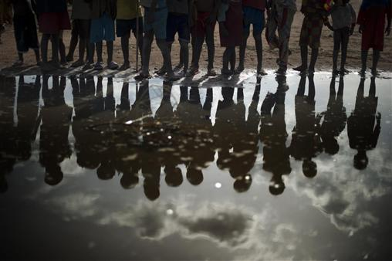

Slide 14
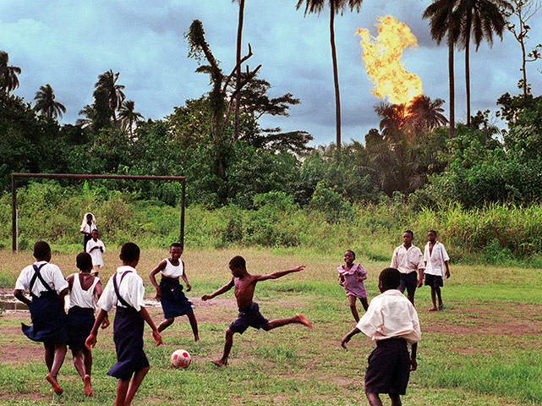

Slide 15
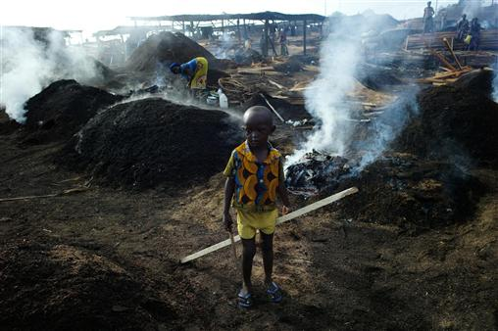

Slide 16
Daily Debriefing Sessions
Review and discuss all filled questionnaires
  Detect potential error patterns in filling the questionnaires;
  Address difficulties in answering questions/sensitive topics.
Discuss logistical concerns/difficulties;
Discuss and refer (if necessary) Urgent Action cases ;

Slide 17
Daily Debriefing Sessions
Detect potential inconsistencies in information provided to different assessors (triangulation) and if necessary, void certain questionnaires that present significant bias on the part of the KI;
Compile site reports (when all the KIIs and the DO forms are filled out for the sites in question);
Prepare for the next day.
Write detailed reports of all discussions and agreements and share with the team the following day.

Slide 18
Data Cleaning
During the daily debriefing:
  The team leader will go through the site report question by question;
  If there are any unclear answers, first discuss with team leader, then if needed return to KI on the same day to clarify.

Slide 19

Site Report
Each site produces a single report that reflects all data collected in that specific site. This report is a compilation of information collected through KIIs and DO. The compilation of data for each site takes place during daily debriefing sessions.
Site report is an integral part of the methodology used in CPRA toolkit.
Site report is not a repetition of Key Informant Interview questionnaire.
Notes:
Already covered in session 5. This is a repeat. See next slide for notes from session 5.

Slide 20
How to compile a site report?
As said before, a site report is a compilation of all data collected in a given site.
Ranking of answers given to multiple-option questions is the most challenging part of this process. Without a ranking, the data entry staff will not have any idea which answers are considered to be more important in that specific site.
Ranking of different answers should be determined based on a combination of how frequently that response was cited in that site and who gave the answer.
Opinion of the evaluators about the topic should not determine the ranking.
Notes:
Note to facilitator: the text below is a repeat from session 5 just as a reminder. Facilitator should decide which parts of it should be repeated to make sure the concept is well understood. The reason for repetition is both the heavy nature of this concept as well as the fact that participants are more familiar with the whole toolkit and are more likely to internalize the idea of site report at this stage.
-------------------------------------------------------------------------------------------------------------------------------------------------------------------------------
The site report concept is slightly difficult. So it is important for the facilitator to have fully understood the methodology and reasoning behind the use of site report.
The site report looks very similar to the key informant questionnaire. But it is not the same thing. The way data is recorded in it is different and it is a compilation of all KI interviews and direct observations in a given site. In some contexts where the CPRA taskforce decides to eliminate certain sensitive issues from the KI questionnaire (such as association of children with armed forces and groups), the theme can still be maintained in the direct observation checklist and then reflected in the site report. In this case, that part of the site report template will be similar to the observation check list (and not the KI questionnaire). This cannot happen if the theme in question is not observable, such as sexual violence.
Data entry is done from site reports (and not from KI interviews or direction observations). Therefore, the data analysis tool should be adapted based on the site report.
Note to facilitator: In some exceptional situations, it might be ok to skip the site report component. But this is not encouraged. This can be decided on a case to case basis in consultation with the CPWG technical advisors.
Reference: the CPRA toolkit, part 2, pages 29 to 45.

Slide 21

How to compile a site report?
Take out the questionnaires that you filled out during the interview exercise. We will simulate a daily debriefing session in which we would like to compile site reports.
Remember during the mock interview we asked you to mark the answers to all questions (and not just the ones you were asking). Now you get to use them.
Notes:
Following steps should be take to prepare the exercise:
Step 1: every should have their questionnaires out,
Step 2: facilitator should assign participants into 3 or 4 groups in which there is a mix of participants who interviewed different key informants during the mock interview session.
Step 3: Ask each group to nominate a mock team leader. The team leader will be responsible to mark the relevant answers in the site report based on the responses that are marked in the participants’ questionnaires. (If you have used some of the participants as Kis in the interview exercise, it might be best to assign them as team leaders since they don’t have a marked questionnaire).
Step 4: Start by compiling the answers to 3-4 questions into the site report in plenary so that everyone understands the process. Try to cover different types of questions such yes-no, age/gender, and multiple answer questions (both coded category and regular). (approx. 10 min)
Step 5: Once you ensure that everyone is comfortable with the idea (more or less), assign each group to one section of the questionnaire and ask them to compile the site report for that section. (approx. 15 min – they don’t need to necessarily finish the whole section)
Step 6: spend a few minute with each group to make sure they got it. If substantive questions comes up during this part of the exercise, make sure you note it somewhere and raise it with the whole group before closing.
Step 6: Ask if anyone has a concern or question before closing. It is not necessary to through everyone’s section. This is more to give them a chance to practice on their own.

Slide 22


