Slide 1


Child Protection Rapid Assessment Training
(Insert location – Insert dates)
Session 1

Slide 2

Welcome and Hello…

Slide 3



Introduction and Expectations –
  Introduce yourself to your pair—tell them your name, your organization, one expectation from the training and one thing you like.
  Each person will then introduce their partner to the group.
Notes:
UNICEF
3

Slide 4
About the Training Team…

Slide 5
Training Learning Outcomes
Develop a clear understanding of the CPRA;
Demonstrate how to access and use key tools within the CPRA toolkit;
Have increased capacity to lead a CPRA; and
Train and support enumerators in use of the CPRA
Notes:
UNICEF
5

Slide 6
Our 4 day agenda…
Tuesday
Wednesday
Thursday
Friday
2
Notes:
UNICEF
6

Slide 7

Methodologies
Adult learning principles
Participatory approaches
Individual and Group Exercises
Lectures
PowerPoint
Discussions in Plenary
Planning
Outside presenters
Readings
Notes:
UNICEF
7

Slide 8
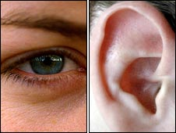
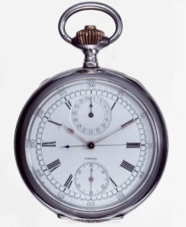



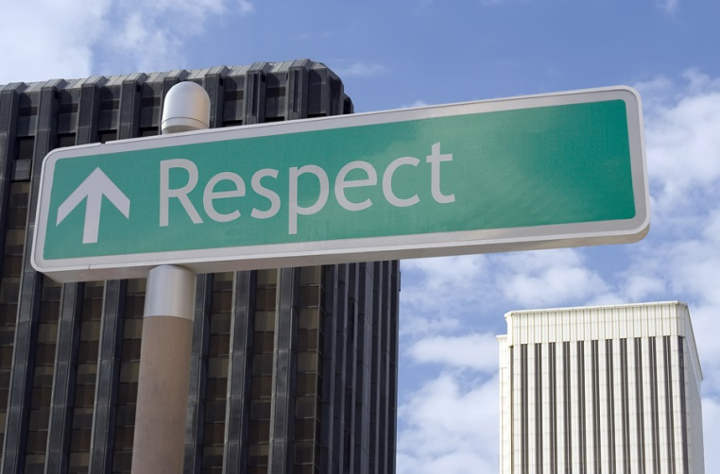
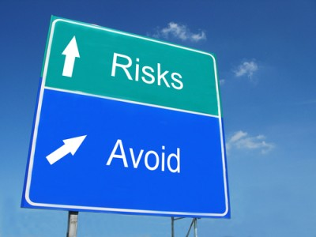
Learning Agreement…

Slide 9
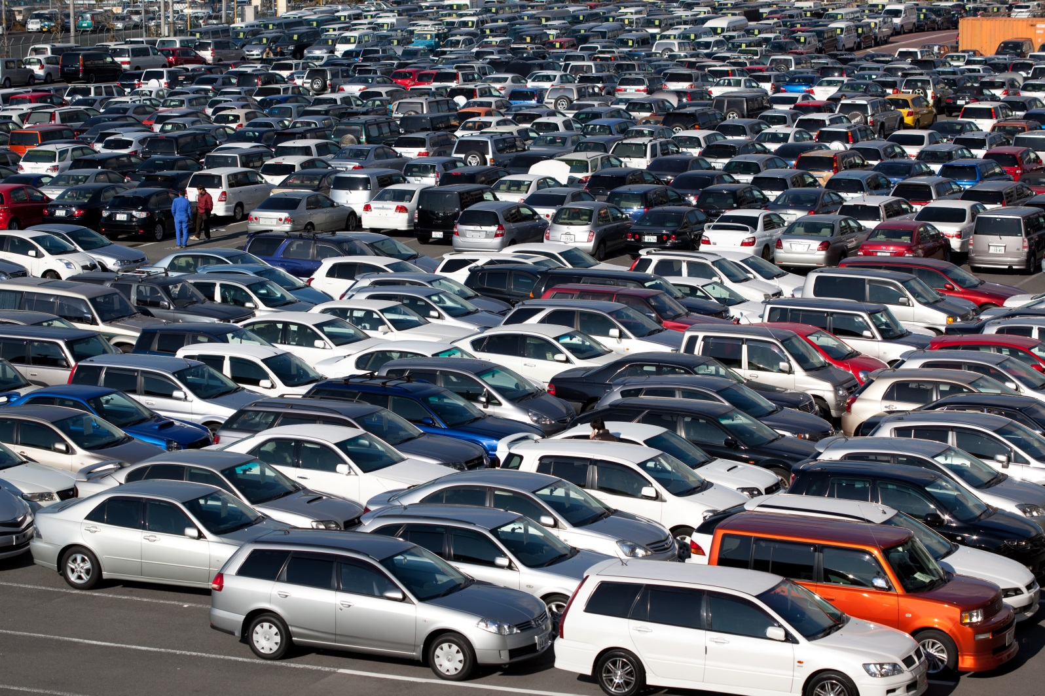
The parking lot…
Notes:
UNICEF
9

Slide 10


