Slide 1
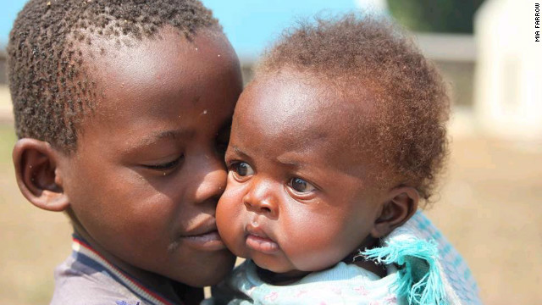

Urgent Action
CPRA Training - Session 7

Slide 2

Learning outcomes –
At the end of this session, you will be able to:
Describe what constitutes an urgent action;
List a number of considerations/techniques for direct interaction with children.
Notes:
From the beginning of this session, emphasize that assessors should not be tasked to find cases. The urgent action procedure is only for cases that assessors might come across during their work. This is a very rare event, so assessors should not be alarmed. But we do have a responsibility to be ready in case we encounter a child that needs an immediate attention.

Slide 3
Urgent Action Needed
In case the assessor(s) encounters a situation where a child or children are in need of urgent protection or other emergency services, they have a responsibility to act. They should act based on guidelines established by the CPWG.
Note1: They should also act based on guidelines established by the CPWG.
Note2: Cases are not to be actively sought during the assessment.

Slide 4
Urgent Action Procedures and Form
You are an assessor, carrying out a KII in a given site. One of your key informants informs you about the presence of an unaccompanied girl of approximately 12 years of age in the site. The key informant explains how the girl is taken advantage of in exchange for food. Your initial investigations reveals that the girl has been left behind by her family who moved in search of food for their animals about two months ago. She was subsequently evicted from her family residence by her father’s creditors.
What are the main steps you will take?
Notes:
Note to facilitator: this scenario is just an example. Ideally, you should come up with a scenario that is culturally and contextually appropriate and relatively common in the context where you are.
- Approximate time: 15 minutes
- The product of this session could act as the draft version of referral pathway that the task force needs to work on to come up with Standard Operating Procedure (SOP) for urgent action cases.

Slide 5
Urgent Action -- Definition
Urgent action case is defined as:
  A child whose life or wellbeing will be in serious danger if we do not act to protect him/her immediately.
Note: In cases where children may be in danger of severe harm, confidentiality may need to be breached. However, this should be done in consultation with senior child protection staff.
Notes:
The definition can be developed in consultation with participants in plenary. If you decide to do so, you can ask participants to write down on post its one word that comes to their head when they hear the term ‘urgent action case.’ Then you will collect them and organize them into groups. For example all words that related to urgency (e.g. immediate, soon, now, etc) will go into one group. Other words for example related to danger or threat will go into another group. Then based on the groups of words you have, you will construct the definition. It does not need to be exactly the same as the one in this slide, but often it ends up being very close.
The only exception to the confidentiality rule is when the life of a child is in immediate risk. But this needs to be discussed and agreed upon by the assessment coordinator.
Nats Note – We need to talk about substantial and immediate risk of harm… not necessarily severity as cumulative harm can be severe but not immediate in nature from this perspective.
Also would suggest a more detailed note on interviewing children using free narrative techniques (which are far safer than probing) and where interviewer will receive more correct information.
See other presentation created by Nats.

Slide 6
Urgent Action -- Procedure
Assessment taskforce is responsible to clearly define urgent action case and operationalize it.
Part of the operationalization process is to come up with a Standard Operating Procedure that outlines the steps that needs to be taken when a case is identified by an assessor.
Notes:
The SOP for urgent action is often very simple. In some cases it is merely a list of contact persons for different regions and or different types of issues. For example, if in region x you encounter an unaccompanied child who is being abused, contact Mr. Y.

Slide 7
Direct Contact with Children
In this CPRA, we will not have direct involvement with children. The following are guidance on dealing with children in URGENT ACTION cases.
Introduce yourself;
Create trust;
Use simple language;
Be patient;
Make sure you have adequate privacy;
Be sensitive to children’s emotions;
Ask the children for permission;
Keep children's views and answers confidential;
Be flexible and creative;
Listen to and respect children's views;
Record exactly what children say;
Lower yourself physically to the level of children, don't stand over them or sit on a chair, sit close to them;
Be self-critical, reflect on your behaviour towards children;
Show interest and respect for children's opinions, knowledge and skills;
Let them do things for themselves, in their own way;
Use methods that allow children to express their views, knowledge and skills.
Notes:
See notes in slide above.
As mentioned before, urgent cases are very rare and assessors will normally not have to interact with children. But if it happens, they need to be aware of basic tenants for a responsible interaction with a child.
Nats additional thoughts on this slide.
Add don’t make promises you can’t keep
Add… you need to tell child if you think confidentiality will need to be breached based on possible info they give. This is so critical for them to have ownership over disclosure. They understand context and situation etc.

Slide 8


