Slide 1
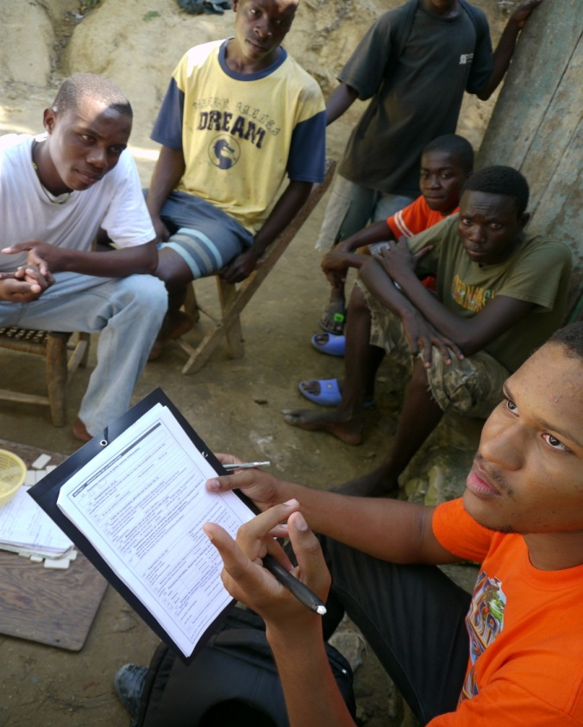

Logistics and Planning
CPRA Training - Session 11

Slide 2
Learning outcomes –
At the end of this session, you will be able to:
Describe the steps required for planning a CPRA;
List the main items that should be included in an assessment plan;
Explain the lessons learned from previous experiences with needs assessments.
Notes:
To insert

Slide 3
Planning and Implementing a CPRA
Before doing anything else, pick up the guide and read it through.

Slide 4
Steps to Plan and Implement a CPRA
Establish CPRA Task Force
Develop an assessment plan
Define roles and responsibilities
Recruit and train the assessment teams
Adapt WWNKs and tools to local context
Carry out data collection
Analysis, interpretation and report writing
Agree on a lead agency
Notes:
All these bubbles will be explained in detail in the following slides.

Slide 5
Step 1: Establish a CPRA Task Force
All involved agencies should commit to take action based on CPRA results and in an inter-agency manner
Define roles and responsibilities of TF members (e.g. data management, report writing, etc.)

Slide 6
Steps to Plan and Implement a CPRA
Establish CPRA Task Force
Develop an assessment plan
Define roles and responsibilities
Recruit and train the assessment teams
Adapt WWNKs and tools to local context
Carry out data collection
Analysis, interpretation and report writing
Agree on a lead agency
Notes:
All these bubbles will be explained in detail in the following slides.

Slide 7
Step 2: Develop an Assessment Plan
Description of sampling methodology and process;
Allocation and composition of assessment teams per site;
Clearly defined roles and responsibilities;
Data management plan;
Logistics and security arrangements;
Standard Operating Procedure for Urgent Action cases;
Budget and Supply list;
Agreement on the parameters of results sharing, including sign off process, at the outset.

Slide 8
Steps to Plan and Implement a CPRA
Establish CPRA Task Force
Develop an assessment plan
Define roles and responsibilities
Recruit and train the assessment teams
Adapt WWNKs and tools to local context
Carry out data collection
Analysis, interpretation and report writing
Agree on a lead agency
Notes:
All these bubbles will be explained in detail in the following slides.

Slide 9
Step 3: Adapt the tools
Adaptation is probably the most important part of the whole process of planning and preparing for an assessment.
There are three main layers to adapting the global CPRA tool to the local context:
    Customizing to the local context
    Translation to the local language
    Operationalization of key terms
Notes:
Customizing to the local context
- Requires thorough knowledge of the context and cultural issues
Could sometimes mean taking a whole section out of the tool (for example sexual violence or association with armed groups have been taken out in some contexts).
- Often times it means adding or changing questions and/or answer options.
Translation to the local language
- In many cases, a translated version of the tool already exists. Make sure you ask the CPWG before spending the resources to translate.
- It is best to get help from people who were involved in adaptation of the tool for translation since they understand the reasons behind the questions.
- If the questions are translated by a non CP specialist, it is best to do a back-translation to makes sure the concepts are well reflected in the translation.
Operationalization of key terms
- This is the process through which we ensure all key terms reflect the intended meaning. Terms such as child, violence, separation, foster care, child labour etc can have very different meanings in different languages. So simple translation is not always enough. Sometimes one word in a language needs to be translated into a whole sentence in another language.

Slide 10
Step 3: Adapt the tools (con’t)
The tools always need adaptation to local context. Main steps in adapting the toolkit are as follows:
  Revise WWNKs;
  Conduct a desk review;
  Revise questions and answer options in KI and DO tools;
  Adapt the site report and the data management tool;
  Translate the questionnaires and contextualize key terms;
  Field test.
Do not use the tools before adaptation.
Notes:
Field testing will provide the assessment team with invaluable information about the context that may not be available otherwise. This will ensure an effective adaptation of the tools that will in turn increase the reliability of the information collected during the assessment.
If time and resources do not allow for field testing it can be replaced with mock-interviews with individuals who have in-depth knowledge of the context.

Slide 11
Steps to Plan and Implement a CPRA
Establish CPRA Task Force
Develop an assessment plan
Define roles and responsibilities
Recruit and train the assessment teams
Adapt WWNKs and tools to local context
Carry out data collection
Analysis, interpretation and report writing
Agree on a lead agency
Notes:
All these bubbles will be explained in detail in the following slides.

Slide 12
Step 4: Recruit and Train Assessment Team
The training of the assessment team will focus on:
  some background information on the emergency and the child protection context;
  key child protection definitions and principles;
  Confidentiality and ethical considerations;
  an orientation on the assessment tools;
  roles and responsibilities of team members,
  reporting and debriefing requirements;
  logistics of data collection and compilation

Slide 13
Steps to Plan and Implement a CPRA
Establish CPRA Task Force
Develop an assessment plan
Define roles and responsibilities
Recruit and train the assessment teams
Adapt WWNKs and tools to local context
Carry out data collection
Analysis, interpretation and report writing
Agree on a lead agency
Notes:
All these bubbles will be explained in detail in the following slides.

Slide 14
Step 5: Data collection and management
One agency or person within the CPRA TF should be assigned to lead on data collection and management;
If data collection is being conducted in a vast geographical area, ensure more localized management of the team;
Data entry should ideally be done concurrently with data collection;
Basic technical expertise including knowledge of excel and statistics is required for data management.

Slide 15
Steps to Plan and Implement a CPRA
Establish CPRA Task Force
Develop an assessment plan
Define roles and responsibilities
Recruit and train the assessment teams
Adapt WWNKs and tools to local context
Carry out data collection
Analysis, interpretation and report writing
Agree on a lead agency
Notes:
All these bubbles will be explained in detail in the following slides.

Slide 16
Step 6: Data analysis, interpretation and report writing
Interpretation requires local knowledge;
Data collection team should ideally be involved in the interpretation process;
IM expertise is required for analysis and report writing. If no in house capacity is available, seek external support (e.g. CPWG);
Multiple reports containing different level of details can be produced for different audiences;
Report writing should be seen as an integral part of the assessment process and not an afterthought.
Notes:
Remind the participants what interpretation is. You can do this by asking them or just telling them. One way of explaining it is: ‘”interpretation is the process of making sense of analysed data and connecting/translating them to programs”

Slide 17
Data Collection Teams
Everyone in the assessment team, including the team leader, is there to collect data.
Team leader has the overall responsibility for each team;
Team leader is responsible to ensure all logistical criteria, including selection of key informants, is met;
Team leader is also charged with chairing the daily debriefing session.
Assessors have the primary responsibility of completing key informant interviews and direct observations.

Slide 18
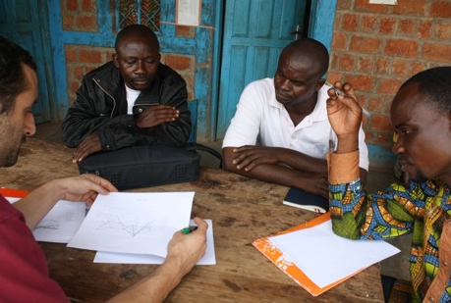
Daily Debriefing Sessions
Find an appropriate location for the debriefing session.
Daily debriefing sessions are one of the most important tasks of the team and are at the core of an efficient data management process.
Daily debriefing sessions have three main objectives:
  Clean the data;
  Address logistical and technical problems;
  Compile site reports

Slide 19
Daily Debriefing Sessions (Con’t)
During daily debriefing sessions, team members will:
Review and discuss all filled questionnaires
  Detect potential error patterns in filling the questionnaires;
  Address difficulties in answering questions/sensitive topics.
Discuss logistical concerns/difficulties;
Discuss and refer (if necessary) Urgent Action cases ;

Slide 20
Daily Debriefing Sessions (Con’t)
Detect potential inconsistencies in information provided to different assessors (triangulation) and if necessary, void certain questionnaires that present significant bias on the part of the KI;
Compile site reports (when all the KIIs and the DO forms are filled out for the sites in question);
Plan and prepare for the next day.
Write detailed reports of all discussions and agreements and share with the team the following day

Slide 21
Who is a Key Informant (KI)
A Key Informant:
can provide information or opinion on a specific subject based on her/his experience and knowledge about the community of interest;
Is not necessarily in position of power;
is not a child.
Notes:
- Facilitator should explain, while child participation should be a key component of CP responses, to avoid putting children in harms way, the CPRA will not involve interviewing children directly. It does promote direct observation of children.

Slide 22
Who is a Good Key Informant
In choosing the key informants, consider whether:
There is reason to believe that they have significant knowledge of the situation of the population of interest;
They will be able to understand the questions;
Their personal experience is representative of the community, and if not whether this will affect their answers. (e.g. having a higher level of education than other community members);
key informant has a dominant ‘agenda’ that significantly biases their answers.
Notes:
As said before, key informant interviews sit at the heart of the CPRA methodology. Therefore, selection of appropriate key informants is the key to receiving the reliable data.

Slide 23
Composition and number of key informants
minimum 3 key informants interviews are recommended for each homogeneous site (of maximum 5000 people).
  If population of the site is more than 5000 or it has a particularly heterogeneous population, select at least 5 key informants;
at least two of the KIs should be working directly with children in some capacity on a day to day basis;
at least one of the KIs should be a woman;
at least one of the KIs should hold some overall responsibility for the population. (e.g. a local chief, camp manager, religious leader, etc.)
Notes:
A homogenous site can be understood as a site where a majority of the population represents similar identity denominations such as socio-economic background, ethnicity, religion and language.
In a site that is exceptionally large, additional KIs should be identified.
E.g. of KIs working with children can be: teacher, community care taker, social worker, etc.

Slide 24
Lessons Learned
Steps not followed: In some cases where the CPRA tool has been used, the steps outlined in the guide were not followed;
Picking and Choosing: In some cases only the Key Informant Interview questionnaires was used;
Common Methodological mistakes:
    No sampling strategy is used;
    Unit of measurement is not defined;
    The KI tool is used for FGDs and to interview children;
    Group interviews are mistaken for FGDs;
    Children are interviewed;
    Too much data is collected and site reports are not used to minimize the data-entry burden.
Notes:
- Steps not followed: most such cases ended up having issues in analysis and report writing phase. Some had to abandon the process all together.
Picking and Choosing: The CPRA toolkit has a coherent logic and should ideally be used as it is described in the guide. But there are situations where actors on the ground decide to only use parts of the CPRA toolkit. In such cases, it needs to be clearly mentioned in the report that the CPRA toolkit was not used as recommended for x and y reason. This will not only help the reader understand the methodology, but will also help the CPWG in adapting the CPRA toolkit in the long run.
Common Methodological mistakes:
Due to time constraint and/or lack of capacity, in many occasions no systematic sample is drawn. This affects the reliability of the data for programming purposes. You can tell participants something to the effect of: ‘now that you are familiar with the sampling method, you have to make sure that a systematic sample is drawn for data collection’
Many practitioners are not familiar with the concept of unit of measurement. Therefore in many occasions data is collected at multiple levels and therefore it is not easy to compile and analyse them. You can say something to this effect: ‘as you know by now, defining the unit of measurement is necessary for a systematic sampling’.
The KI questionnaire is designed for individual interviews with adults. If you decide to conduct FGDs, you will have to develop a new questionnaire. The WWNKs can still be used for this purpose. Also, if you decide to interview children, an appropriate tool needs to be developed for that. The KI questionnaire on exceptions can be used for group interviews. But do not confuse that with a FGD.
Group interviews are different from FGDs. The main value added of FGDs is the natural flow of discussions and openness to emerging themes. But a good FGDs requires very skilled facilitators and a significant amount of time for organization and then analysis. Unfortunately, in most emergency contexts we do not have the time and human resources for this.
As said before, the CPRA does not encourage the use of children in the process. This is primarily to avoid any additional harm to affected children. You should only adopt this methodology if you have the means to ensure the ‘do no harm’ principle and also have the capacity to respond to any possible cases that may arise from the interview process.
There is a tendency to collect data without thinking about the time and energy it takes to manage the data and analyze it. It is important to have a clear analysis plan (as part of your assessment plan) to avoid collecting data that will not be analyzed.

Slide 25
Lesson Learned – Some Cautionary Notes
  Do not collect data from the field unless:
  The information you need is not available from other sources;
  You are familiar with the tool and the methodology;
  You can assign a person to take responsibility for managing the implementation of the assessment from start to end (this can be done through requesting the global CPWG for a dedicated surge capacity);
  Have the time to properly prepare for the assessment and adapt the tools.
Notes:
These are primarily repeats from things that have been discussed before. But it is important to remind the participants that assessments are heavy and time consuming processes. We should not embark on it unless it is necessary and unless we have thought the whole process through.

Slide 26
A sample agenda of a normal day
Arrival at the site (30 min to 2 hours);
Introduction of the team and presentation of objectives to local authorities (30 min);
Selection of Key Informants (30 min to 1 hour);
Selection of appropriate location for the interviews (30 min);
Conducting KIIs (2-4 hours);
Conducting direct observations (concurrent with KIIs);
Daily debriefing session (2-3 hours);
Returning to the accommodation (30 min to 2 hours);
Notes:
Please explain that if an urgent action case comes up, the team leader will be responsible to handle it while others are continuing the work.

Slide 27


