Slide 1


Delivering Training Remotely

Slide 2
How are you doing today?
Use the annotate function to plot yourself on the chart below:
ENERGY - HIGH
ENTHUSIASM - LOW
ENTHUSIASM - HIGH
ENERGY - LOW
Notes:
Session 1: Welcome and Intros

Slide 3
Course objectives
By the end of the course, you will be able to:
Identify good practice for remotely-facilitated training;
Design activities for remote delivery;
Demonstrate how to deliver interactive activities remotely;
Reflect on the roles and technology required for remote training.
Notes:
Session 1: Welcome and Intros

Slide 4
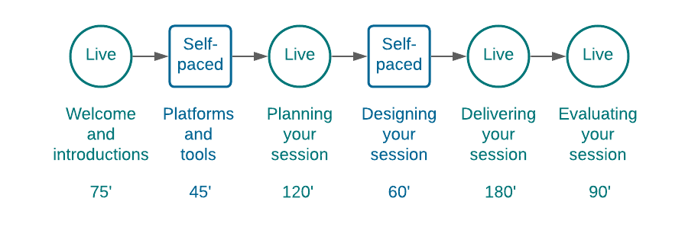
Course structure
Notes:
Session 1: Welcome and Intros

Slide 5
Planning your session
Delivering training remotely
Notes:
Session 2: Planning your session

Slide 6
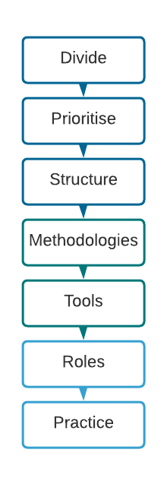
Adapting for remote
Top tips
90-120 minute sessions
5-10 minute break every hour
Add 15% to your timings
Allow contingency
Notes:
Session 2: Planning your session

Slide 7
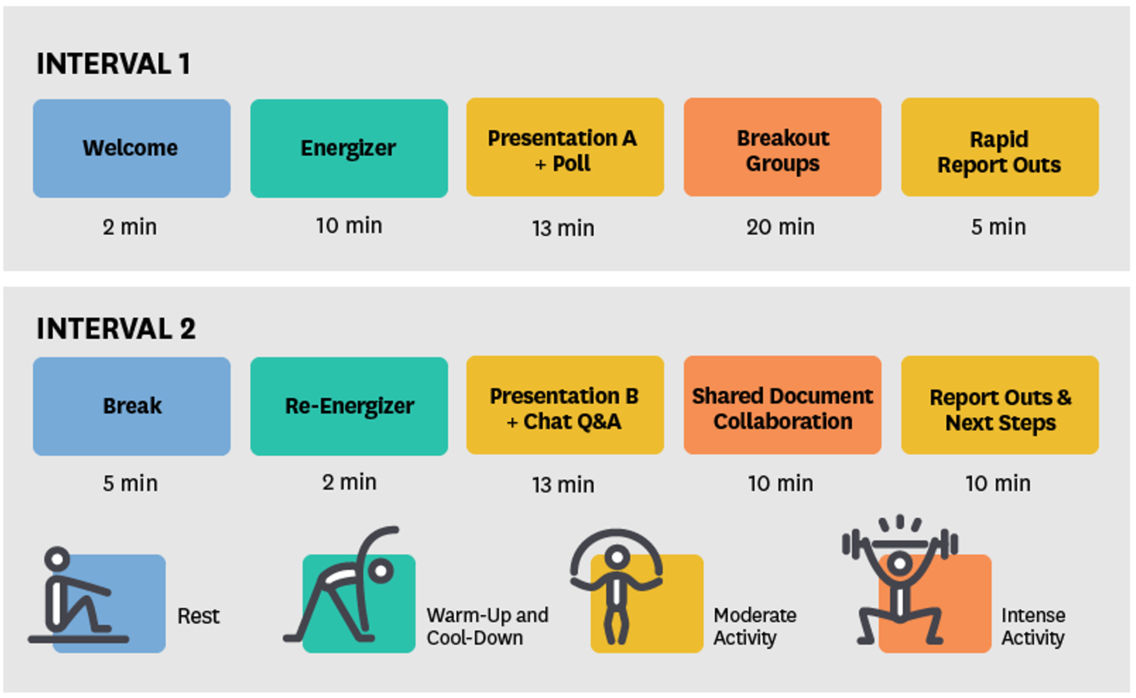
Structuring a session
Option 1
Source: Harvard Business Publishing
Notes:
Session 2: Planning your session

Slide 8
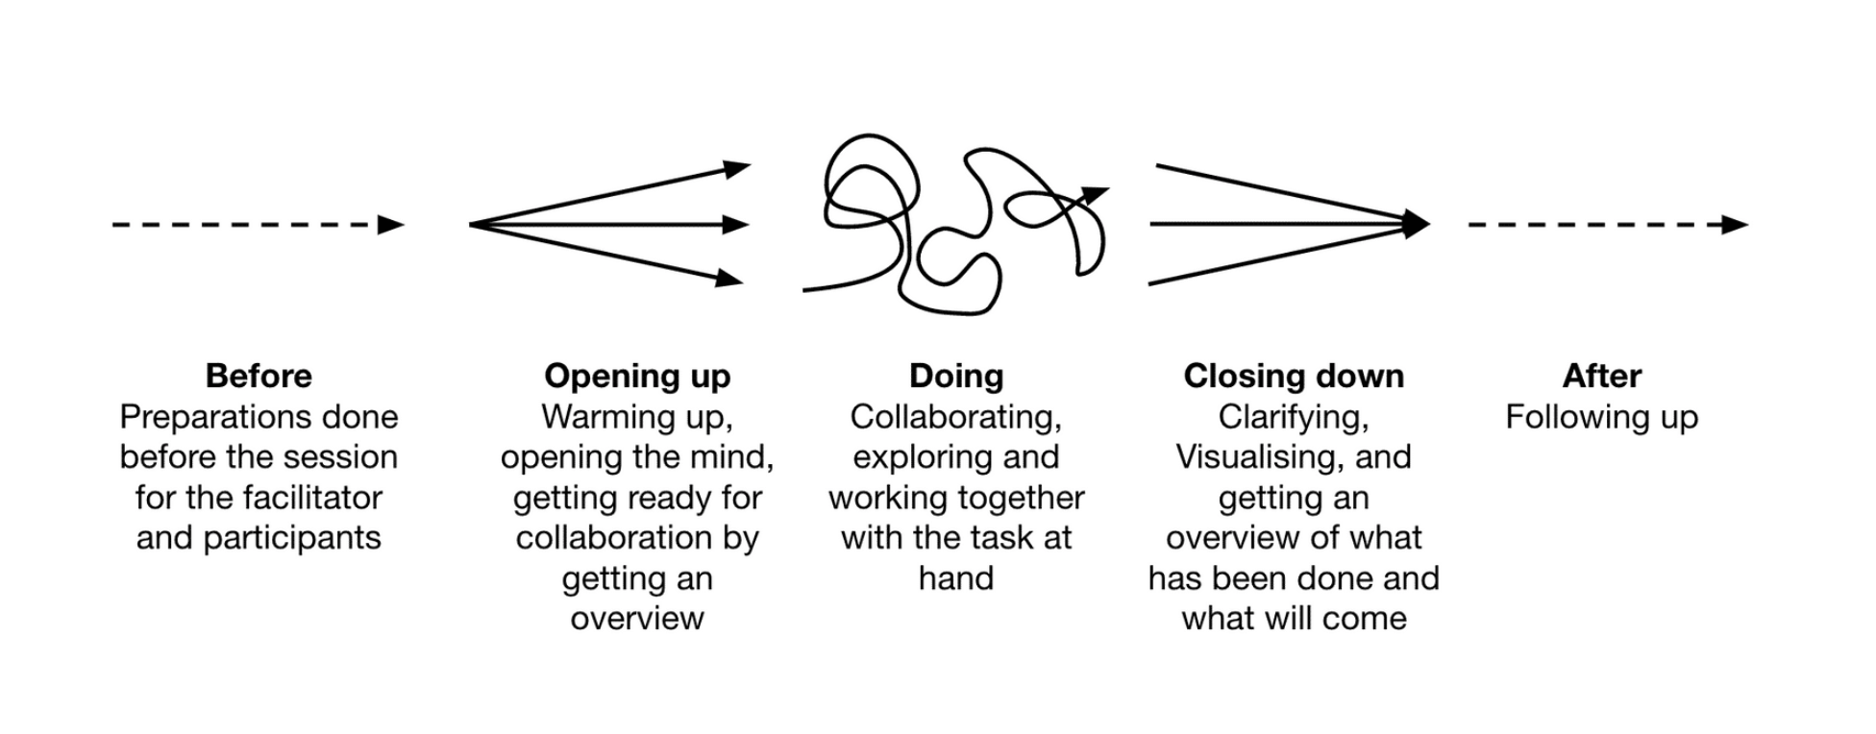
Structuring a session
Option 2
Source: The Hows

Slide 9
Individual reflection
Key learning
What did I learn today?
How can I use it?
What am I reassured about?
What will I try or do differently?

Slide 10

Course structure
Notes:
Session 1: Welcome and Intros

Slide 11
Delivering your session
Delivering training remotely
Notes:
Session 3: Delivering your session

Slide 12
Use the Annotate function to answer the following.
(View Options, Annotate, T)
My current favorite TV show is… | The best thing I can cook is…
My favorite ever holiday was… | When I was little I wanted to be…
People are surprised when they find out I can… | This weekend I am going to…
Notes:
Session 3: Delivering your session

Slide 13
Evaluating your session
Delivering training remotely
Notes:
Session 4: Evaluating your session

Slide 14
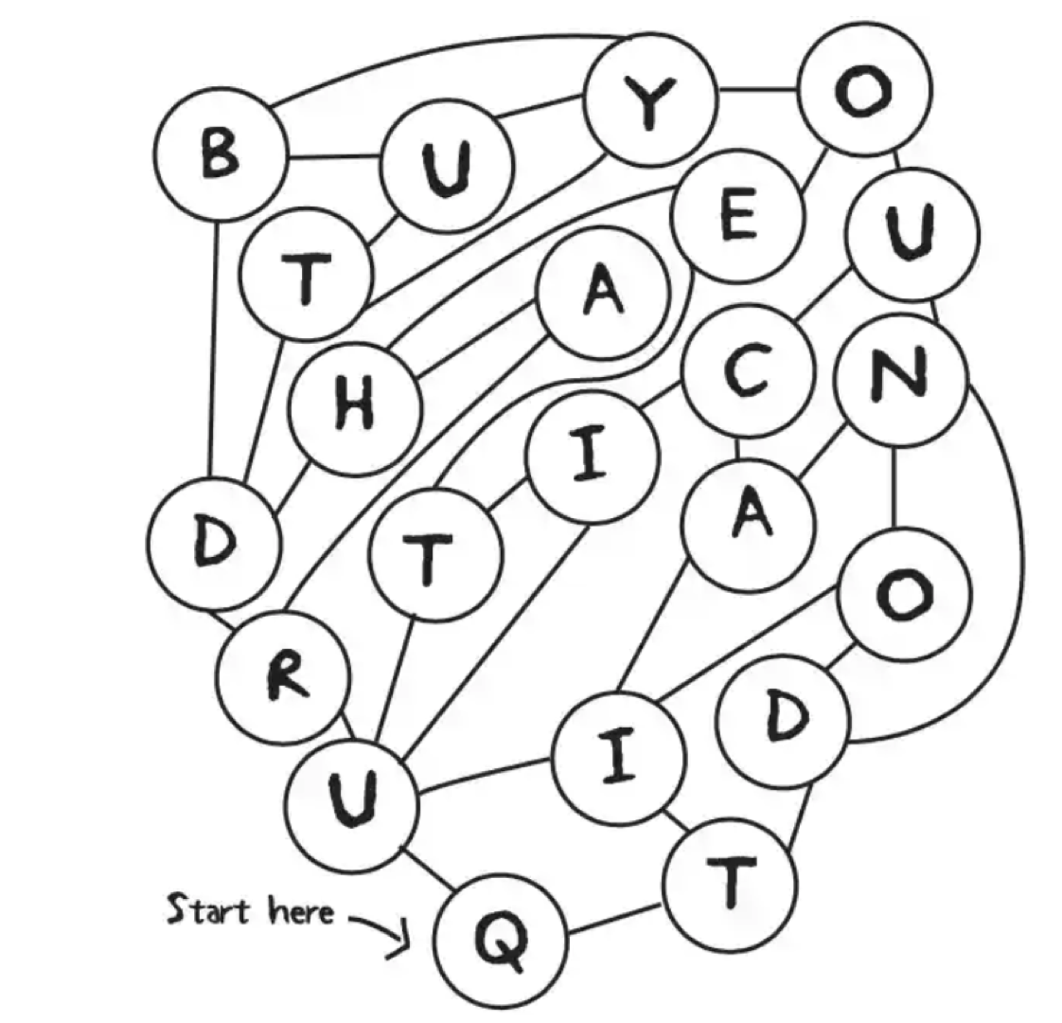
The image shows 22 positions of a ball as it moves around a pitch, joined by lines.
The correct path of the ball starts at Q and then, moving only along the lines, passes through all the other letters, spelling out a phrase of seven English words.
The path passes each letter once and only once.
What’s the phrase?
The answer is quite hard but you can do it!
Notes:
Session 4: Evaluating your session

Slide 15
Evaluating learning
Informal approaches
Methodology | Purpose for participant | Additional purpose for facilitator
Quiz | Introduce and recap the topic | Check understanding and identify any areas that need to be clarified
Facilitation practice | Practice remote facilitation in a safe, learning environment | Observe skills and behaviors
Exercise debriefs | Reflect on, identify and share learning, seek clarification | Check key learning points have been covered and session objectives met
Open questions (e.g. in chat) | To open up or recap a topic | Check existing or new knowledge and understanding
Facilitator visits to breakout rooms | Opportunity to ask questions or seek clarifications | Check understanding of task in hand, observe knowledge and skills in action
Wrap up activities | An opportunity to reflect on the session | Find out what learning points have been most impactful
Notes:
Session 4: Evaluating your session

Slide 16
Assessing skills and behaviors remotely
Top tips
Observation
  Requires sufficient facilitators to observe 2-3 participants each
  Ensure everyone is clear on the competencies
  Soft skills are easier to observe remotely
Alternative, offline methods
  Will be required for some behaviors / competencies
  e.g. Reflective learning journals, line manager feedback, or peer assessments.
Plan ahead!
  Think about this from the start of program design
  Focus on what is realistic and feasible in a remote environment
Notes:
Session 4: Evaluating your session

