Slide 1
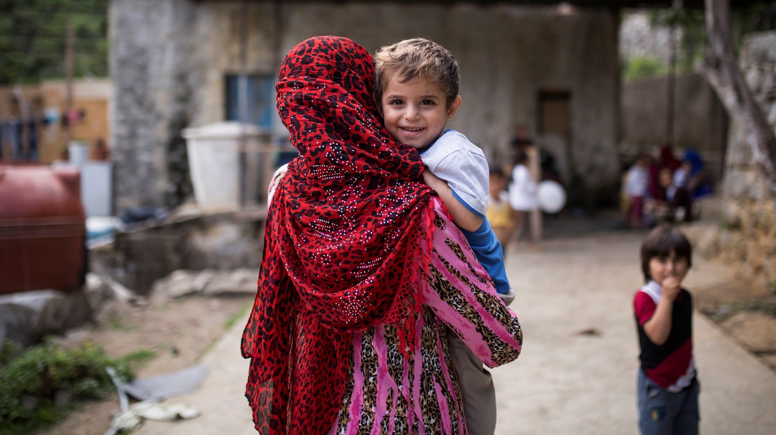


CLOSING
AND NEXT STEPS
Photo: Jacob Russell/ The IRC
Notes:
2 minutes
Say: We have now reached the conclusion of the Supervision and Coaching training!

Slide 2



THE ALLIANCE
FOR CHILD PROTECTION
IN HUMANITARIAN ACTION

Slide 3
OBJECTIVES
OF THE
TRAINING
1.
To enhance case management supervisors’ understanding of the importance and functions of supervision and coaching.
2.
To encourage the use of good practice models and tools in supervision and coaching.
3.
To review and practice supervision and coaching skills using the supervision tools.
4.
To promote staff care and team well-being.
5.
To develop realistic supervision action plans.
Notes:
8 minutes
Say: The overall goal for this training was to increase case management supervisors’ confidence, capacity and support to caseworkers to provide safe, ethical and competent case management services to vulnerable children and their families.
Ask: How did we do with achieving these objectives?

Slide 4

REVIEW AND NEXT STEPS
Review Supervision Action Plans
Materials for Participants on USB Flash Drive
Certificates
Follow-up Workshops, Coaching/Mentoring, Field Visits
Notes:
20 minutes
Say: With the end of our time together, I’d like to invite each of you to look at your Supervision Action Plans one last time.
Instructions: Allow participants 10 minutes to finalize their plans.
Ask: Are there any final actions that you’d like to share with the group?
Invite participants to share any actions that they would like to share with the group, and record them on a flip chart.
Facilitator’s Note: This slide should be developed based on the context and Inter-agency capacity building plans. This slide should summarize the plans for implementation beyond the training.
It is recommend to have an agreement in place for supervisors to participate in a follow-up workshop.

Slide 5

CLOSING ACTIVITY
WE ARE A COMMUNITY OF PRACTICE
Notes:
35 minutes
Instructions:
1. Invite the group to stand in a large circle for a final closing activity
2. Ask each participant to think of 1 skill or resource they have to offer the community of practice
3. Make a loop in the end of the yarn or string and hold it
4. Say one skill or resource that you can offer to the group. Then, toss the ball of yarn to someone across the circle (it will unwind as it goes)
5. Have that person loop the yarn around a finger, and name what he or she can offer the group, then toss the ball to someone else in the circle
6. Each person in turn should catch the ball of yarn, loop it around a finger, say what they can offer, and then toss it to someone else. As the ball unwinds, it creates a web of interconnection
7. Continue until everyone has gotten the ball and the web is nicely filled in (or you run out of yarn, whichever comes first)
8. Once the web-building has ended, play with the web a bit. Have people move it up and down. You could even drop an inflated balloon
Say: The purpose of creating this web together is to help remind each of you that you have skills and abilities to support one another; and more importantly to remind you that none of us are doing this work alone. The work of case management and supervision can be challenging and taxing, but we have each other. Can we all commit to maintaining this community moving forward?

Slide 6

CLOSING
Post-tests
Evaluations
Certificates
Notes:
20 minutes
Distribute:
5.1 Post-test
5.2 Supervision and Coaching Evaluation
Give participants 20 minutes to complete their post tests and evaluations. Once each participant has completed both, invite them to come forward to receive a certificate!

Slide 7
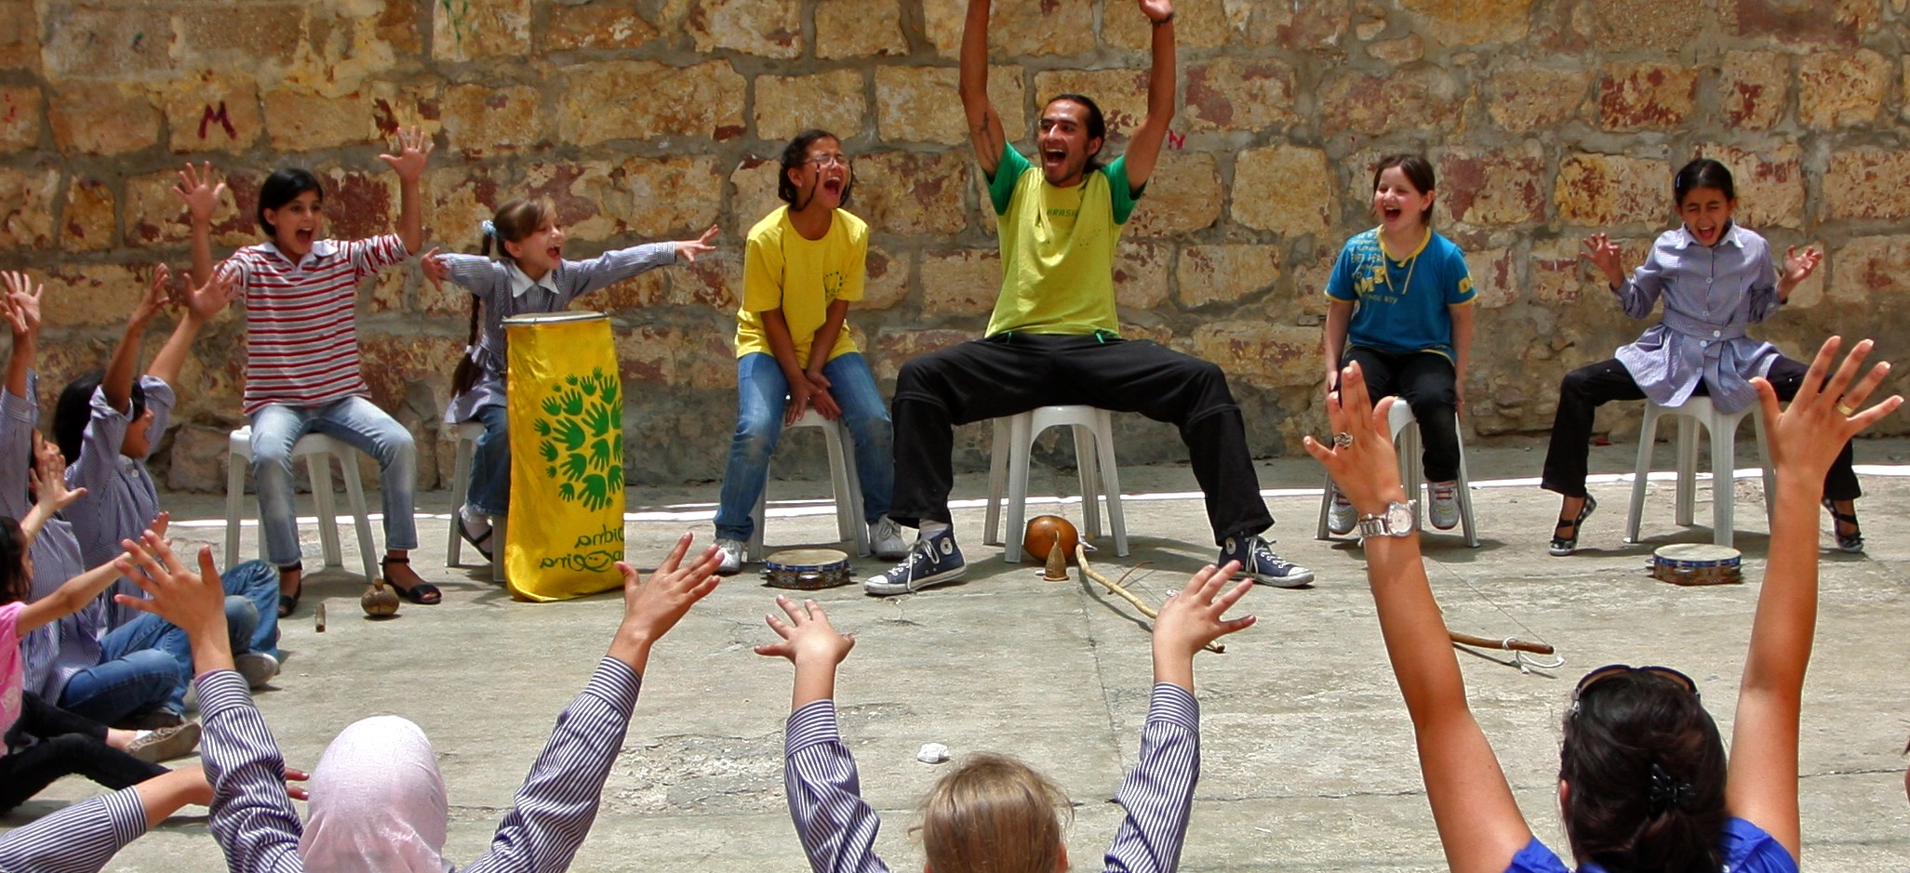
THANK YOU!
Photo: Alaa Ghosheh/ UNRWA
Notes:
5 minutes
Instructions: Conclude the session by thanking all the participants for joining the training! Be sure to thank the sponsors and participating agencies.

