Slide 1
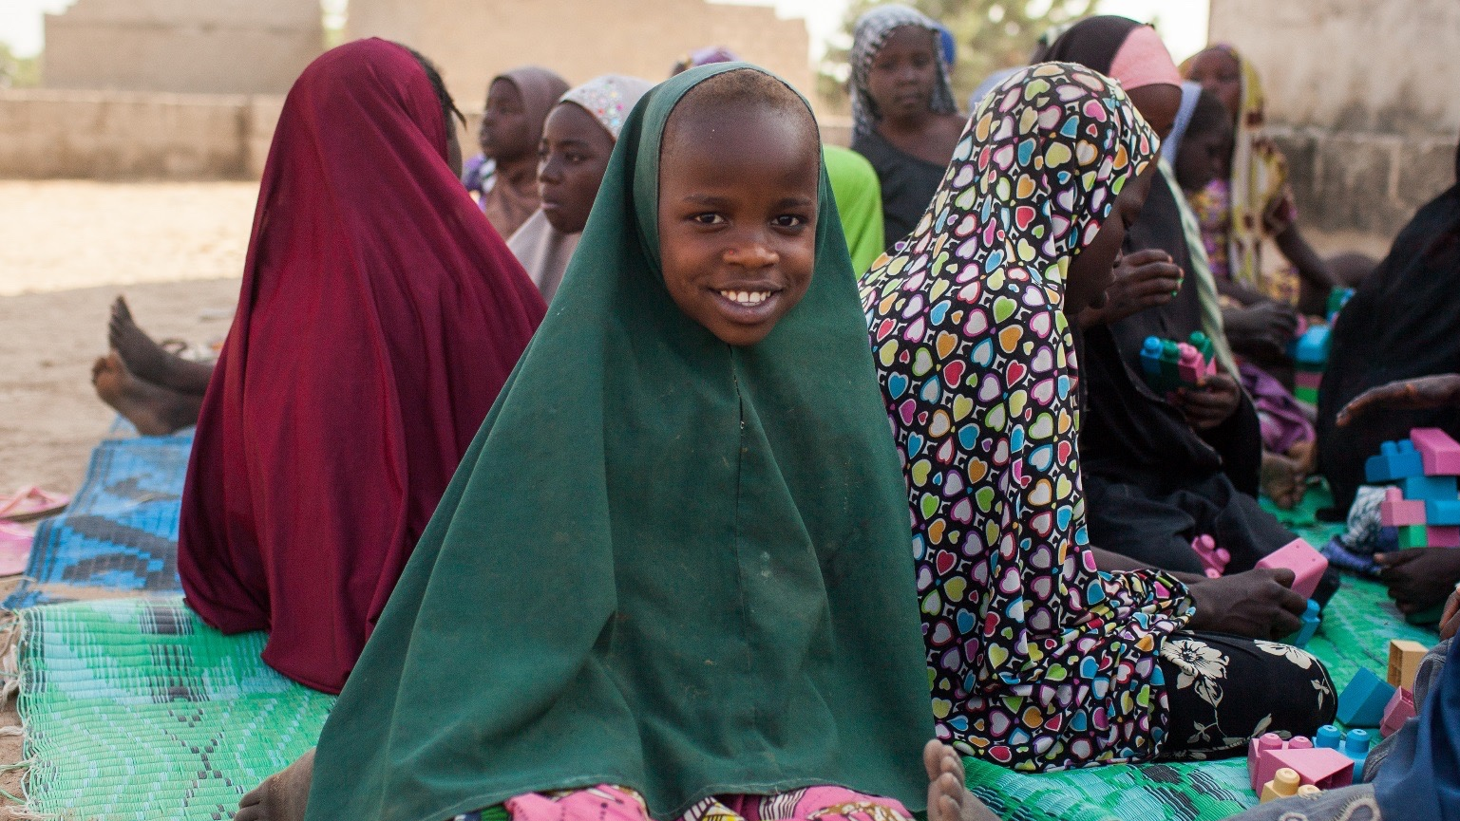


MODULE 4
STAFF CARE AND WELL-BEING
THE ROLE OF CM SUPERVISORS
Photo: Kellie Ryan/The IRC
Notes:
2 minutes
Say: We are now at our final module. During this session we are going to look at supervisors’ roles in promoting a case management team’s wellness. We will spend most of the session developing a team wellness plan using a collaborative activity called a Mandala exercise. But first, we will review some of the basic sources and indicators of stress for child protection case management teams.

Slide 2



THE ALLIANCE
FOR CHILD PROTECTION
IN HUMANITARIAN ACTION

Slide 3
MODULE AIM AND
LEARNING OUTCOMES
Aim:
To explore supervision strategies that support staff care and well-being for case management teams
Learning Outcomes:
Understand the sources and signs of negative stress
Strategize ways to practice self-care as a supervisor
Learn methods for supporting caseworkers
Identify characteristics of a healthy case management team
Develop a team well-being action plan
Notes:
3 minutes
Say: In this module we will look at what well-being looks like for supervisors and their teams. Speaking about stress and wellbeing can sometimes be difficult; so I encourage you to recall some of our group agreements from the first day:
Take care of yourself: Consider your own psychological well-being – if a story would be distressing to share, consider before you start talking about it. If you need to take a break, please do.
Take care of others: Respect and listening, be attentive to others.
Review the aim and outcomes outlined on the slide.
Ask: Are there any questions before we begin?

Slide 4

    Caseworkers and supervisors perform better when they are well supported
  We need to first take care of our own well-being in order to support others
  Child protection case management teams experience high pressure roles. Being a witness to children who have experienced harm can take a toll on supervisors and caseworkers
  Team well-being requires us to be aware of the characteristics of a healthy team, the stressors in our lives and how they affect us, and methods to prevent and respond to their negative impacts on our work
WHY SHOULD WE
TALK ABOUT TEAM
WELL-BEING?
Notes:
5 minutes
Ask: Why is staff-care and wellbeing important?
Generate some ideas from the participants and show the points on the slide. Remind everyone that we can't support others unless we first take care of ourselves.
Key message:
In order to provide the best care and service to children and their families, caseworkers and supervisors need to make sure they are taking care of their own well-being. This requires awareness of the stressors in their lives, as well as learning tools and methods to cope with stress and prevent some of the negative impacts of stress.

Slide 5
WHAT IS STRESS?
"Stress is a state of psychological and physical arousal that comes about as a result of a threat, challenge, or change in one’s environment"
Functional Stress:
Common to all people
Part of everyday decision making and problem solving
Motivates people to be more productive
Managed routinely
The physical and emotional indicators of stress are a normal and natural response designed to protect, maintain, and enhance our lives. It is usually a good thing!
Notes:
5 minutes
Review the points on the slide and ensure understanding.
Say: It is important to know that stress is a natural and normal response. We all encounter and manage stress every day. But what happens when that stress goes beyond what we are capable of managing? That is what we are going to explore next.

Slide 6


NEGATIVE STRESS
Cumulative Stress:
Result of prolonged, accumulated, unrelieved exposure to stressors
Critical Incident Stress:
Caused by extraordinary events which provoke high level of stress in almost everyone involved
“Vicarious” Trauma:
Result of witnessing or learning about others’ traumatic experiences that causes a reaction that mirrors that of the survivor
Notes:
3 minutes
Say: We just talked about day-to-day stress, but what we are going to focus on the negative types of stress, which occurs stress lasts too long, occurs too often, or is too severe; it is the reaction to a challenge, demand, threat, or change that exceeds our coping resources and results in distress.
What makes this different from day-to-day stress is the type or intensity of the stress, as well as the final point highlighted here – that it exceeds our capacity to cope with or manage the stress.
There are three types of negative stress that we are going to discuss today: cumulative, critical incident, and vicarious trauma. These types of stress are all types CP caseworkers and supervisors may experience, and are important for us to understand. Let’s take a look at each of these a little more closely.

Slide 7

CUMULATIVE
STRESS
Result of prolonged, accumulated, unrelieved exposure to a variety of stressors
Most common form of stress experienced by humanitarian workers
When not recognized and managed, can lead to burnout
Notes:
2 minutes
Say: Cumulative stress is the result of prolonged, accumulated, unrelieved exposure to a variety of stressors. It is the most common form of negative stress experienced by humanitarian workers; when not recognized and managed, it can lead to burnout, which we will discuss more in later slides.
Cumulative stress leading to burn out is important to detect as it can have even greater impact than incident stress.

Slide 8

CUMULATIVE
SOURCES OF STRESS
External
Internal:
Personality traits of the individual that might impact your capacity to cope with stress
External:
Stressors related to working conditions; the organization and relationship within the organization; type of work and characteristics of clients
Internal
Notes:
10 minutes
Say: Cumulative stress can be understood as originating from two main sources: internal and external. Internal refers to stress that stems from our own personal characteristics. (For example, previous stressful experiences or being a perfectionist).
External stress refers to stressors from the environment, such as working conditions, organizational factors, the type of work you are doing, or the people we work with as clients or colleagues.
Say: Most people experience a combination of these stressors. But, not everyone who experiences these stressors will experience cumulative stress. Everyone experiences stress in different ways.
Optional Activity (15 minutes)
Distribute 4.1 Sources of Stress and invite participants to complete their stress map individually (10 minutes).
If participants are comfortable sharing, and if there is time, discuss what are the internal and external sources of stress for them as supervisors. Then, explore how these sources of stress might be similar and different for caseworkers

Slide 9
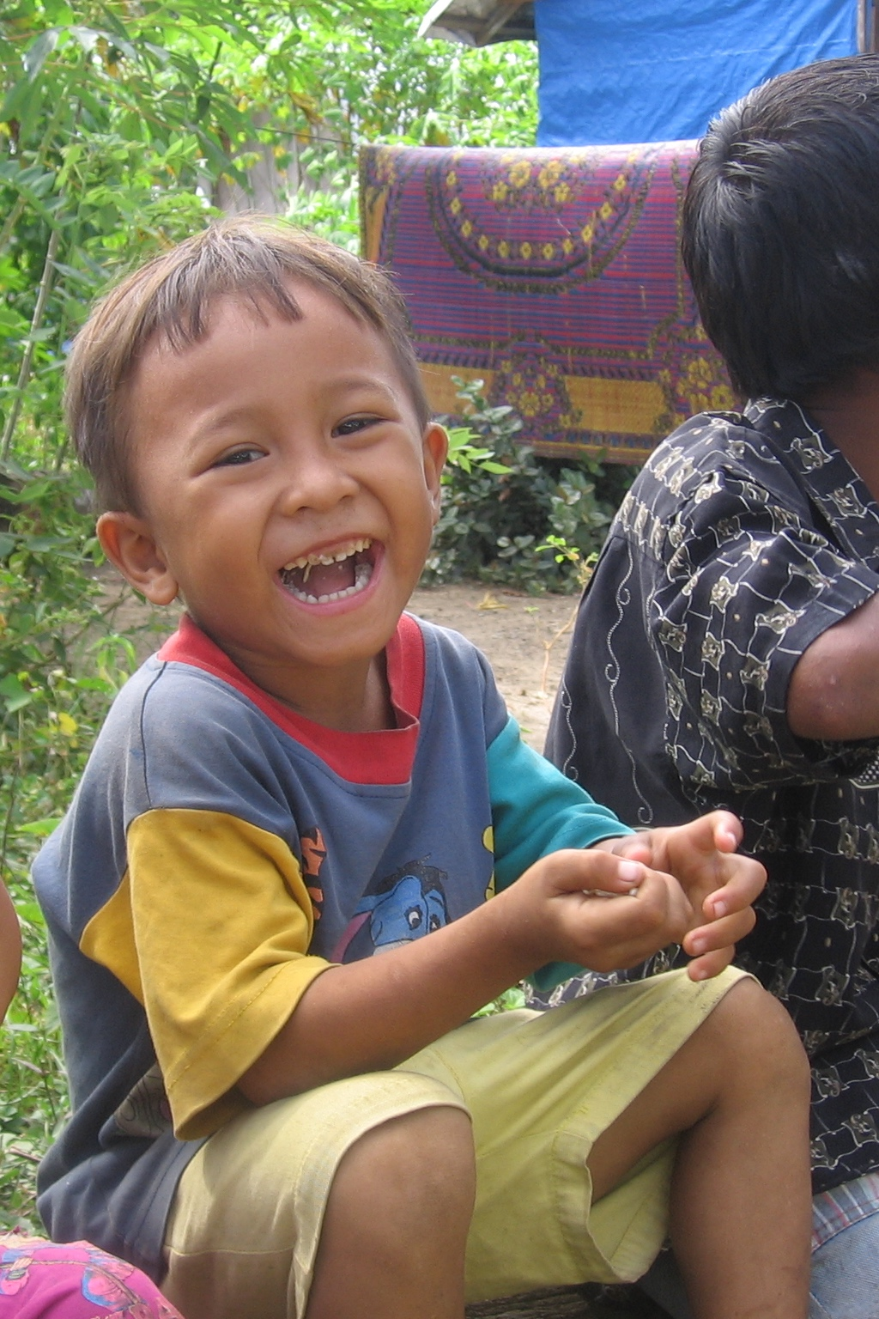
CRITICAL INCIDENT STRESS
Caused by extraordinary events which provoke a high level of stress in almost everyone involved
Sudden and disruptive
Involves actual or perceived threat or loss
Causes a sense of vulnerability
Disrupts the sense of being in control and perception of world as safe and predictable
Photo: Kari Detwiler/ The IRC
Notes:
5 minutes
Say: As discussed before, another form of negative stress caseworkers or supervisors may experience is critical incident stress. Critical incident stress is caused by extraordinary events which provoke high level of stress in almost everyone involved. This is important because while not everyone will experience the stress the same way, critical incident stress is commonly understood as a response to an event in which nearly everyone involved has a stress reaction; it is considered universal in its impact.
When we think of “trauma,” we typically are thinking of events that would cause a critical stress reaction.
Say: There are some key aspects of critical incident stress that are important to note -- it is sudden and disruptive; it involves an actual or perceived threat or loss; it causes a sense of vulnerability; and it disrupts our sense of being in control and perception of world as safe and predictable

Slide 10
VICARIOUS OR SECONDARY TRAUMA
Vicarious trauma, also called secondary trauma or indirect traumatization, is a process of change that happens when the caseworker begins to identify with the children with whom s/he is working that results in changes in the caseworker’s thoughts, feelings, and behaviors that are:
Parallel to those of trauma survivors
Generated from the experiences of clients
Transmitted from clients to workers
Over time, this can cause changes in your physical, psychological, emotional, and spiritual well-being
It can lead to very high, and possibly unrealistic, expectations of yourself and others
Notes:
5 minutes
Say: We identified earlier today that a third form of negative stress is vicarious trauma, also called secondary trauma or indirect traumatization. While not common, vicarious trauma is a risk of humanitarian work as we work closely with individuals who have been through traumatic experiences, and this may be particularly true when working with children who have experienced violence and abuse.
It is important to know that vicarious trauma is a process – it does not happen after one encounter. Rather, it occurs when a caseworker begins to identify with children and families in a way that changes their thoughts, feelings, and behaviors that parallel those of the person who experienced the traumatic experience.
(Adapted from Headington Institute, 2008; Admira Foundation)

Slide 11
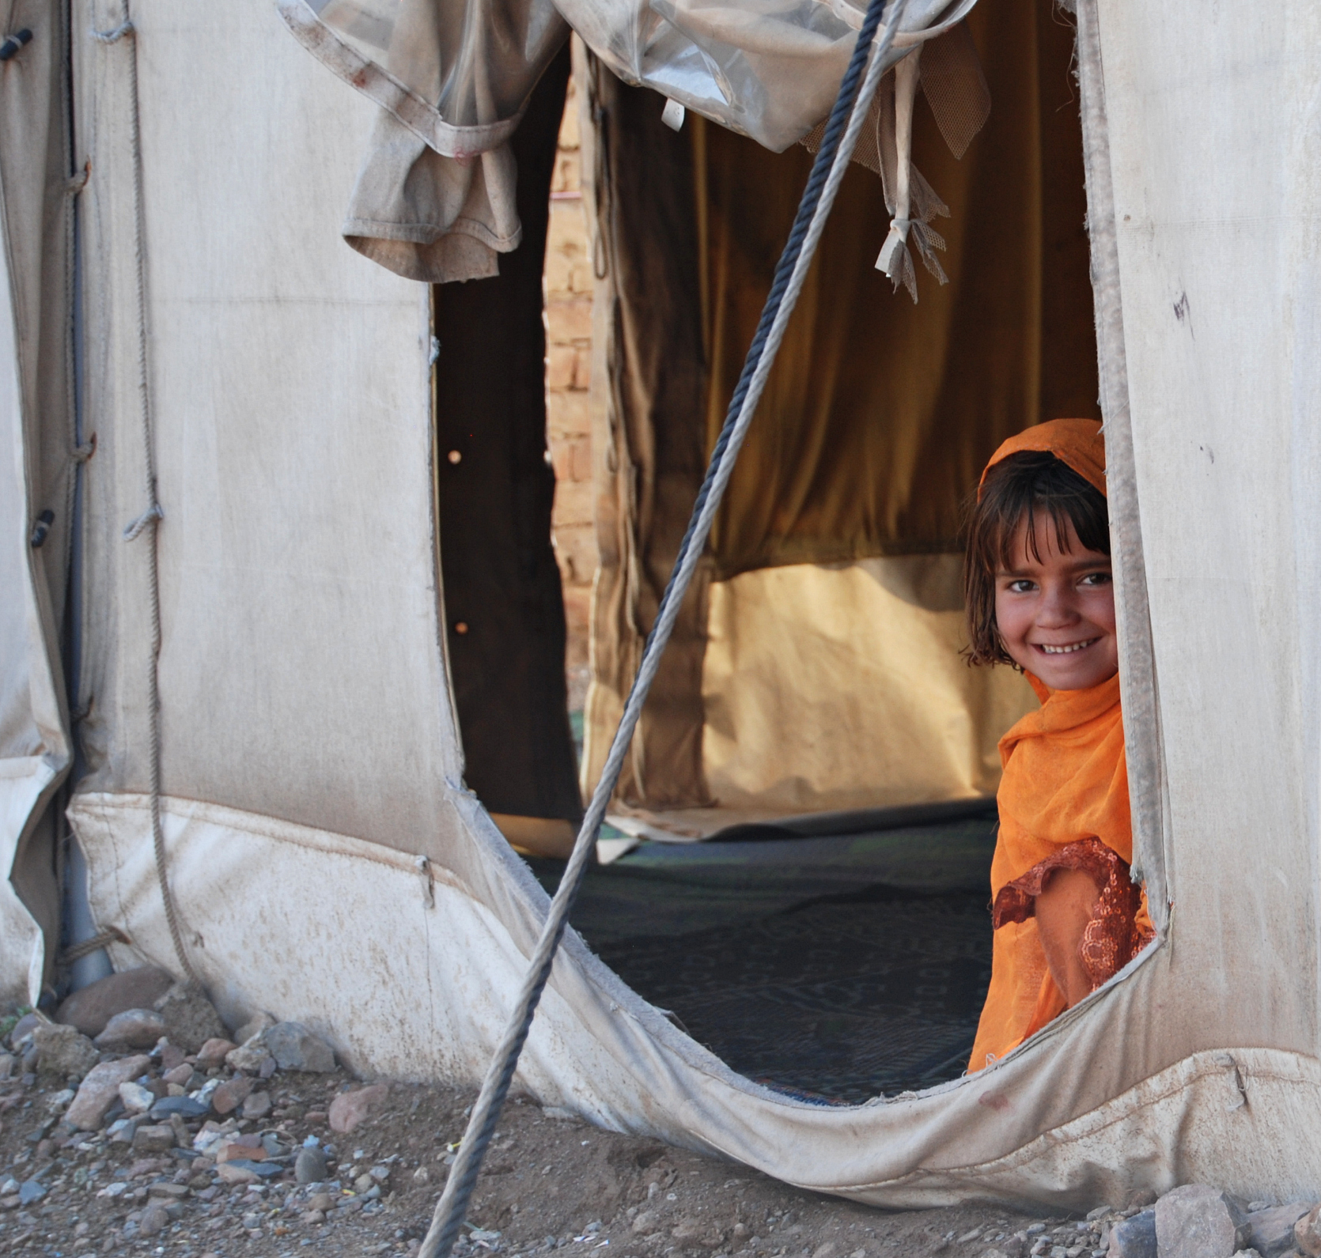

SIGNS OF
NEGATIVE STRESS
Look at the list distributed and
think about yourself and your team
Photo: Ned Colt/ The IRC
Notes:
10 minutes
Say: All of the types of negative stress can lead to changes in our body, mind and spirit. Many of us are familiar with physical reactions, such as headaches or difficulty sleeping. Let’s take a closer look at what the IASC MHPSS Guidelines suggest about signs of negative stress in the categories of:
Physical
Cognitive/ mental
Emotional
Behavioral
Spiritual
Distribute 4.2 Signs of Negative Stress from the IASC MHPSS guideline on signs of stress and allow participants time to review.
Facilitator’s Note:
Be sure to be sensitive during this session for reactions that participants might have. If someone is visibly upset, ask a co-facilitator to provide support.

Slide 12
BURNOUT – COMMON AMONG CHILD PROTECTION SUPERVISORS AND CASEWORKERS
Stress reaction that occurs after prolonged exposure to occupational stressors, such as those identified as sources of cumulative stress
It is a process, not a single event
Occurs as prolonged exposure to emotionally demanding situations with inadequate support gradually depletes an individual’s natural resources for dealing with stress and strain
Like the signs of stress, signs of burnout can manifest in different ways depending on the individual
Notes:
5 minutes
Say: When discussing cumulative stress, we noted that a possible result of cumulative stress is burnout, which we will discuss more here. Burnout is a type of negative stress reaction that occurs over time after prolonged exposure to occupational stressors. When we are regularly exposed to demanding situations with inadequate support, over time we may no longer have the resources to be able to deal with the stress. This can result in burnout.
Review the points on the slide.
Key Message: While burnout is common, it does not remain permanent if people are given the time and space to recover.

Slide 13
QUESTIONS?
Notes:
Check with the participants to see if they have any questions or comments before moving on.

Slide 14
Protective Factors
Positive coping habits Social support Optimism and healthy self-esteem Spirituality Adaptability Curiosity and openness to experience Talents/natural abilities Meaning-making
PROTECTIVE
FACTORS
Headington Institute, 2008
Notes:
5 minutes
Say: We discussed the 3 types of negative stress, as well as the signs, and the sources. As we have seen, the environment, particularly the work environment, can be a major source of stress; but it can also be an environment that supports us and serves as a protective factor. (This is where supervision comes in!)
Review the list of protective factors with the participants and be sure to describe what they mean.
Ask: What would you add to this list?
Say: most of these protective factors can be learned by individuals or implemented in workplaces to prevent negative stress; and ultimately burnout.
Facilitator’s Note:
Meaning-making: being able to connect experiences to something larger than ourselves. Being able to identify our “mission” in the work and the larger reasons and passion at the heart of our motivation

Slide 15
Wellness Reflection:
What are your individual, positive coping habits?
In other words, what do you do, or what can you do to care for yourself?
TEAM
WELL-BEING
STARTS
WITH US!
Notes:
15 minutes
Say: Before talking about supporting your case management teams, we’d like to invite you as supervisor a chance to reflect on your own wellness and coping strategies.
Instructions: Ask participants to take 10 minutes to reflect on their individual, positive coping habits.
Say: Take some time to reflect both on what you already do; and, on what else you might do?
What you can do to care for yourself and manage stress in your work and personal life.
After 10 minutes bring everyone back to plenary and invite anyone who wants to share a reflection. There should be no pressure for anyone to share.
Facilitator’s Note: This can be a group or individual reflection; depending on the participants’ needs.

Slide 16
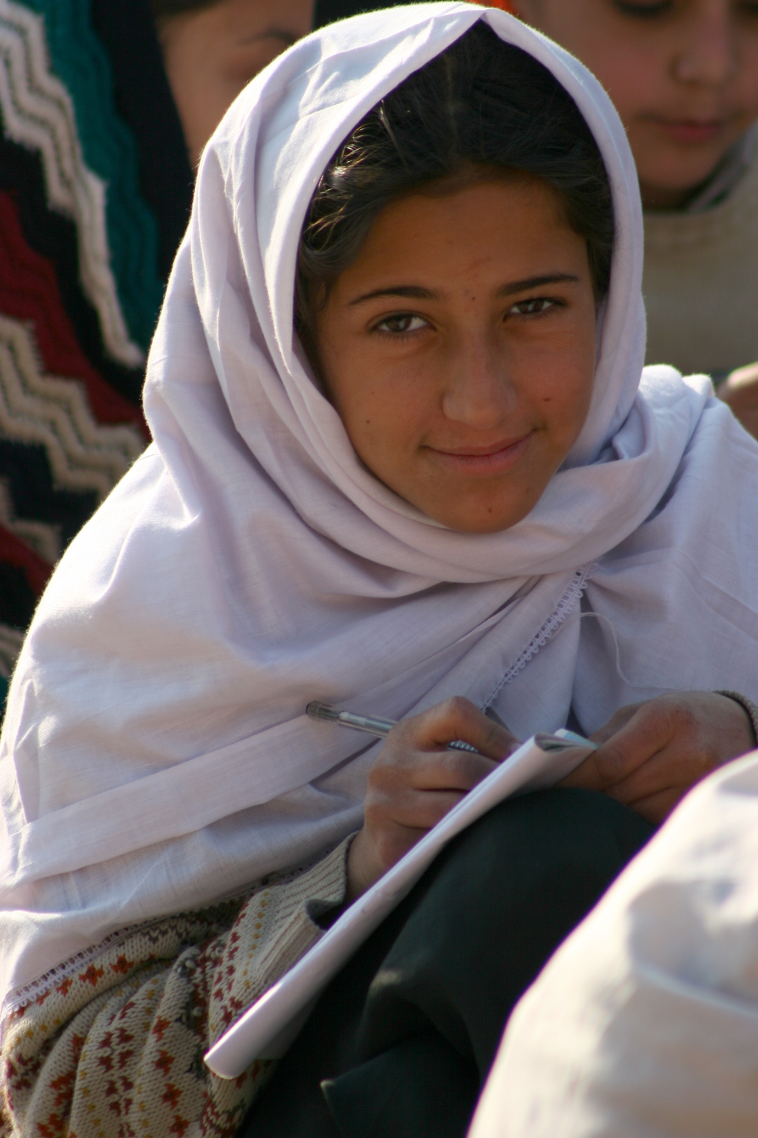

SOME KEY MESSAGES
ABOUT STRESS
The work of case management is rewarding, but also stressful
It is important for supervisors to recognize signs of stress in themselves and in caseworkers, and also protective factors
Supervisors should develop personal and team strategies to address stress and burnout
Individual supervision is a fundamental way to identify and manage stress for both parties
Photo: Rafael Hermoso/ The IRC
Notes:
5 minutes
Say: This slide summarizes and focuses on supervisors role in team wellness.
Review each point and ensure understanding before moving on

Slide 17
How can supervisors promote team well-being?
  With individual caseworkers?
  At a team level?
TEAM
WELL-BEING
STARTS
WITH US!
Notes:
15 minutes
Say: Moving on from our own stress and coping as supervisor, we’re now going to reflect on how supervisors can support their teams.
Instructions:
1. Divide the participants in half; with one group focusing on individual caseworkers; and the other thinking about the case management team.
2. Ask the groups to write their ideas on sticky notes and bring them up to 2 separate flip chart in the front of the room.
3. After 10 minutes, invite one person from each group to report back on the suggestions that were developed from their group.

Slide 18
SUGGESTIONS FOR SUPERVISORS
Regular individual supervision meetings
Develop a coaching attitude and skills
Recognize signs of stress and burnout in caseworkers and respond
Coordinate with HR/management to ensure a protocol for caseworkers showing signs of stress/burnout
Support caseworkers to explore ways to manage stress
Promote a team atmosphere and consider buddy systems
Encourage space to take breaks during work
Set realistic expectations of team
Promote caseworker safety
Promote respectful and effective communication within the teams
Empower and encourage caseworkers
Acknowledge and validate the experience of caseworkers
Be a role model to the case management team!
Notes:
5 minutes
Say: These are a list of suggestions that are considered good practices at the global level. (Reflect on the similarities with the list created by participants in the previous activity.)
Say: Many of these suggestions can be considered protective factors in order to prevent burnout for caseworkers and supervisors
Some key messages:
We have to take care of ourselves well in order to support others.
Individual supervision is a fundamental way to identify and manage stress for a supervisor and caseworker.
Modeling healthy boundaries and self care is one of the best strategies for supervisors.

Slide 19
QUESTIONS?
Notes:
Check with the participants to see if they have any questions or comments before moving on.

Slide 20

An exercise to help you understand your team’s well-being status and to visualize some concrete steps you could put in place to support team.
Steps:
  Brainstorm
  Agree
  Dream
  Reality
  Creative Planning
TEAM
WELLNESS MANDALA
Notes:
2 minutes
Say: For the rest of this module we will be working on the mandala activity. This is an exercise to support you in thinking about your teams’ reality, their needs, and the concrete next steps that you could put in place to improve their “team well-being”.
I will quickly introduce the overall concept of the activity and then we will break into small groups to develop our own mandalas.
Say: Ultimately, we’d like for you to consider doing this activity with your own case management teams in the future during an extended case management meeting!
Distribute the following handouts:
4.3 Team Wellness Mandala Instructions
4.4 Team Mandala Blank
4.5 Sample Mandala
Facilitator’s Notes: Invite participants to review the Wellness Mandala process by following along with handout 4.3 over the next several slides

Slide 21
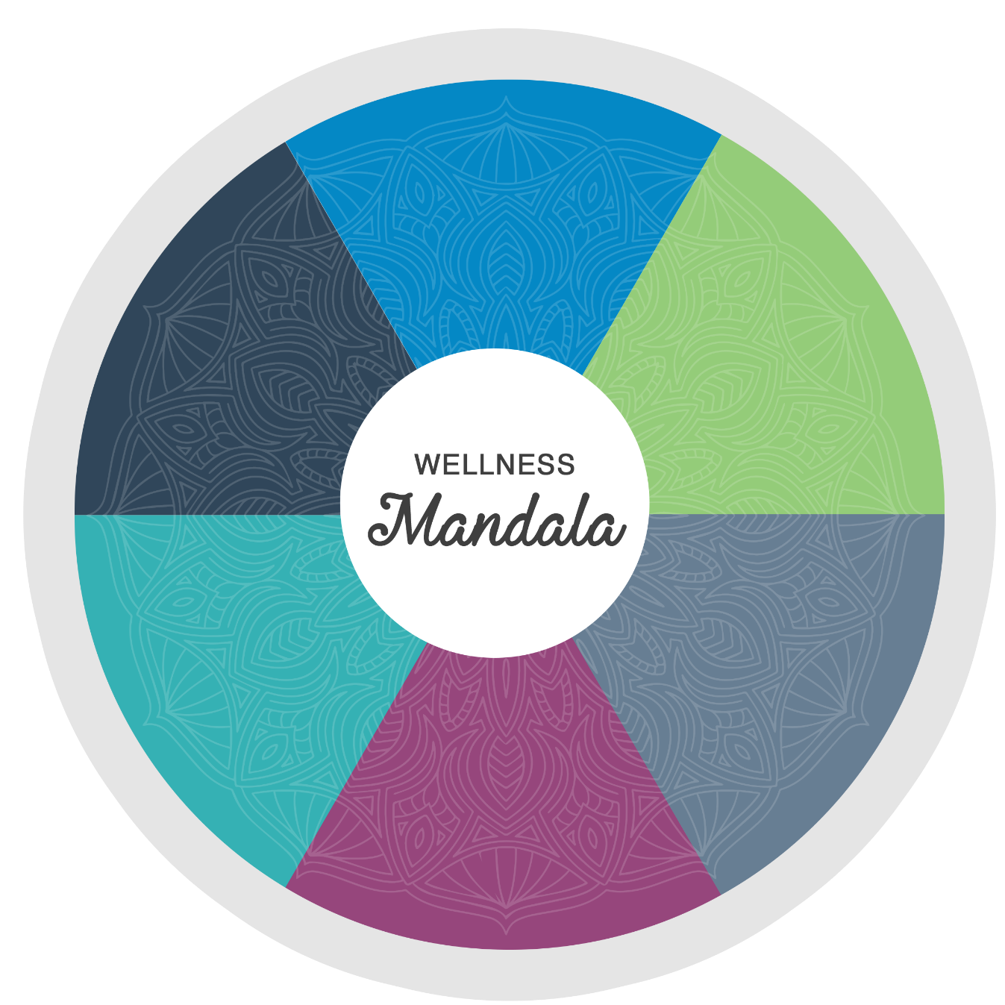
CATEGORY NAME
BLANK
TEMPLATE
CATEGORY NAME
CATEGORY NAME
CATEGORY NAME
CATEGORY NAME
CATEGORY NAME
Notes:
1 minute
Say: We begin the exercise with a blank mandala, such as this one, and the handout that I have distributed.

Slide 22
STEP 1 – BRAINSTORM
What is a healthy team?
What are the characteristics of a healthy case management team?
What does an healthy case management team look like?
Notes:
2 minutes
Say: The first step in the mandala activity is brainstorming what a healthy team looks like for you.
Say: I will walk us through an example before you will go into your groups and develop your own mandalas.
Ask: What does a healthy case management team look like?
Instructions: On a separate flipchart capture the ideas from plenary brainstorm. When you have a few specific suggestions, move onto Step 2
Facilitator’s Note: If necessary, get the brainstorm started by suggesting some answers such as: good skills, knowledge of each other’s strengths, communication, team spirit or identity, natural ability/suitability to the work...

Slide 23
STEP 2 – AGREE
What are the categories of wellness important for your teams?
Organize your ideas from the brainstorming session into approximately 4-6 categories
Write the name of each category on an external section of your mandala
Notes:
2 minutes
Say: once you have gathered suggestions with your team, the next step is to agree on categories. Considering the suggestions that we have developed together, what are some categories we should agree on?
Preparation: In advance, prepare a flip chart with a large blank mandala in order to demonstrate to the large group.
Instructions: List some categories on the sample mandala on the flip chart.
Say: Once the group has agreed on categories, you can label them within the mandala.

Slide 24
CATEGORY NAME
STEPS 1 & 2
STEP 2
CATEGORY NAME
CATEGORY NAME
CATEGORY NAME
CATEGORY NAME
STEP 1
BRAINSTORM
CATEGORY NAME
Notes:
1 minute
Say: It is important to take your time with these first steps, and not to rush through. This is the foundation of the exercise!

Slide 25
STEP 3 – DREAM
How would you like the situation to be in your team for each category?
Be creative! Use symbols, pictures or colors to represent your teams vision.
Capture this description of “how your team could appear” at the outside of each segment of the mandala.
Later, these descriptions become goals in your action plan
Notes:
2 minutes
Say: At this stage, you should have agreed categories placed on the outside of the mandala. The next step is to “dream” together as a team how you’d like the situation to be.
Say: So, for example, if one of your categories is “Communication,” you might dream that healthy communication in your team would mean that everyone on the team uses active listening in team meetings; or, that caseworkers share their concerns or feelings with a supervisor in individual supervision sessions.
Say: For the purpose of the activity, you should use symbols, pictures or drawings to represent these “dreams.”
Instructions: Show the participants on the flip chart mandala some examples (perhaps using the “communication” example) with images or drawing on the outer section of the mandala.
Say: For this step, try and find creative ways to capture the ideas generated earlier and in this phase of the activity. Make sure you take time to agree on a vision for each category.
Facilitator’s Note: Provide prepared magazine pictures, coloured markers, scissors, glue and other tools for the teams to represent their ideal picture of a healthy team. This step should be fun and lighthearted.

Slide 26
STEP 4 – REALITY
What is the situation in your teams right now?
Reflect on the current situation for each of the categories
Take time to reflect personally on your team's well-being and needs for care
Record this description at the inside of each segment. Be creative here too
Notes:
2 minutes
Say: Once you have established your dream healthy team, it’s time to reflect on the reality and the situation for your time now.
Say: In order for this activity to be effective we must be honest and encourage honesty. This can be a difficult conversation because it should highlight problems in each category. Anticipate any sensitivities before you start this step of the activity.
Say: When you are doing this activity with your teams, the ideas for this step can be given anonymously. For example, this input can be given anonymously by collecting sticky notes from each team member individually and discussing them without identifying their origin.
Instructions: Demonstrate on the flip chart that the “reality” will be based in the center. For the “communication” example, perhaps the reality is that everyone talks over each other; or some people yell in the office. Capture a representation of the current situation with prepared images at the inside of the communication segment.

Slide 27
STEP 5 – CREATIVE PLANNING
The space between your current situation and your ideal situation is where you do your planning..
What are some concrete actions you can take to move from the current situation to the ideal situation?
*Start small!
How can you go from where your team is, to where you would like your team to be?
Notes:
2 minutes
Say: the final step is to plan together as a team how to get from the center of the mandala to the vision of a healthy team.
Facilitator's note: (For facilitator’s example mandala) In plenary brainstorm strategies to get from center to outer edge in the communication section (prepare a couple of simple examples such as "in our team, all feedback will happen regularly happen in private, individual sessions" or, " in our team we will not discuss cases outside of work hours").
Say: Now you have the starting point and end point. These are the building blocks of any action plan. Your task now is to think of concrete actions that can be taken to move from the current situation to the desired outcome.
Say: The mandala tool can allow people to think creatively and come up with solutions that might not be obvious. Ideas can be brainstormed here and can become action points for your teams moving forward.

Slide 28
STEPS 3, 4, & 5
CATEGORY NAME
STEP 3
FULLY REALIZED
OUTCOME
STEP 5
CATEGORY NAME
CURRENT
SITUATION
CATEGORY NAME
STEP 4
CATEGORY NAME
CATEGORY NAME
CATEGORY NAME
Notes:
1 minute
Say: So each category will have the “dream” on the outer section of the category, the reality in the center; and some practical action steps in the middle.
Say: Starting with small steps is a great place to begin!

Slide 29
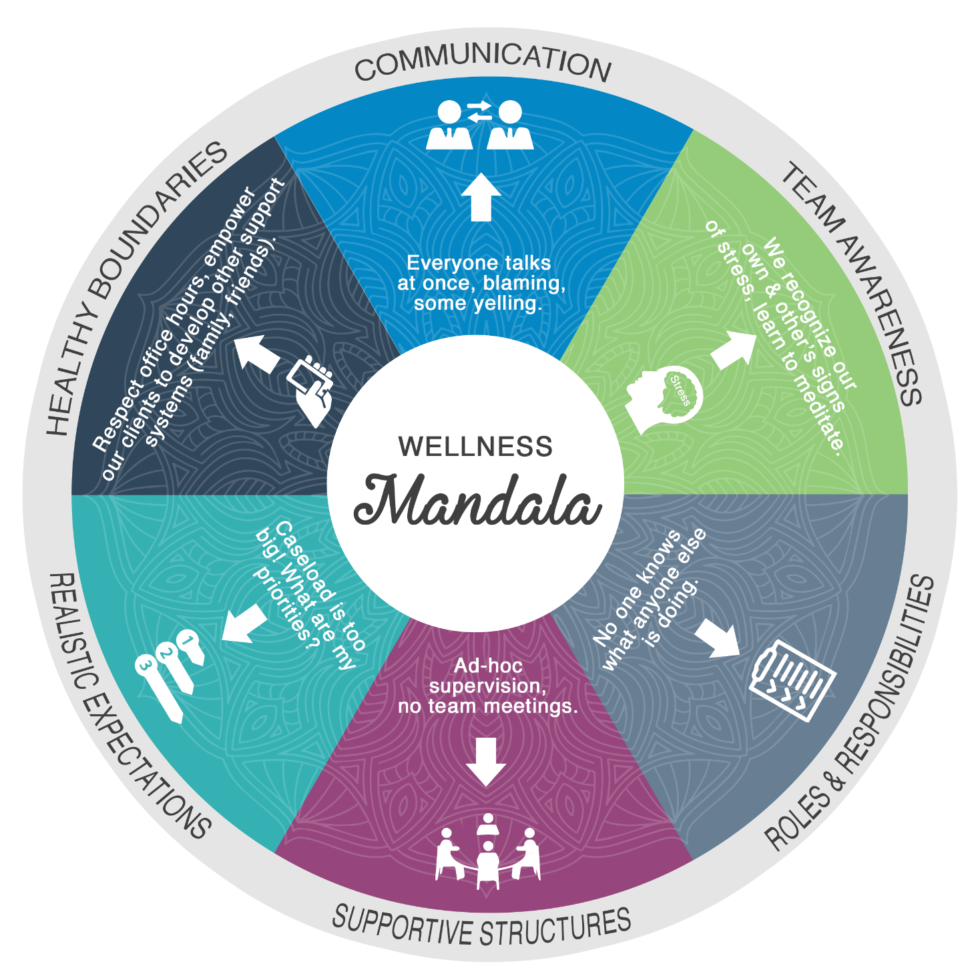
A COMPLETED
SAMPLE WELLNESS
MANDALA
Notes:
85 minutes
Say: Here is a sample mandala that can be used to generate some ideas
Ask: Are there questions about the 5 steps or the overall process?
Say: It is human nature to want to jump ahead to problem-solving and making plans but if we skip any steps we miss an opportunity to learn more about what our team wants and what our team is experiencing in the present. So, please make sure that you take your time with steps 1 and 2!
Instructions: Break participants up into small groups to work on developing mandalas together.
After 60 minutes, bring the groups back together. Use the remaining 15 minutes to invite each group to share a bit about their mandala and any important observations or insights that arose through the process.
Facilitator’s Note: Be thoughtful about the organization of small groups according to your group of participants. If there are many people from the same organization, perhaps they can work together. On the other hand, if there is a mix of donors and implementing partners, be mindful of the potential power dynamics!

Slide 30
REVIEW QUIZ
What is one reason we should talk about staff wellness?
What is stress?
What are some common types of negative stress experienced by supervisors and caseworkers?
What are some signs of negative stress?
What are some characteristics of a healthy, effective child protection team?
What is one thing a supervisor can do to promote team wellness?
Notes:
10 minutes
Say: now we’re going to have an opportunity to review what we discussed in the second module
Facilitator's note: Try to make this activity a fun competition! Give some prizes/ candy at the end to motivate participants.
Always be encouraging when delivering a plenary quiz. Never say an answer is wrong. If necessary, say something like: what we are looking for here is an answer that reflects... Give prizes to everyone who tries even if their answer isn't complete.
Answers:
1. We talk about staff wellness because:
Caseworkers and supervisors perform better when they are well supported.
We need to first take care of our own well-being in order to support others.
Child protection case management teams experience high pressure roles. Being a witness to children who have experienced harm can take a toll on supervisors and caseworkers.
Team wellbeing requires us to be aware of characteristics of a healthy team, the stressors in our lives and how they affect us, and methods to prevent and respond to their negative impacts on our work.
2. Stress is a state of psychological and physical arousal that comes about as a result of a threat, challenge, or change in one’s environment.“ Stress is a natural and normal response
3. Cumulative stress, critical incident stress, vicarious trauma.
4. Signs can be cognitive, physical, emotional, behavioral, spiritual
5. Characteristics: healthy communication, supportive structures, clear roles and responsibilities, boundaries, realistic expectations, boundaries, etc.
6. Promoting team wellbeing:
Regular Individual supervision meetings or coaching.
Recognizing signs of stress and burnout in caseworkers and responding.
Coordinate with HR/ management to ensure a protocol for caseworkers showing signs of stress/burnout.
Support caseworkers to explore ways to manage stress.
Promote a team atmosphere and consider buddy systems.
Encourage space to take breaks during work.
Set realistic expectations of team.
Promote caseworker safety.
Promote respectful and effective communication within the teams.
Empower and encourage caseworkers
Acknowledge and validate the experience of caseworkers.
Be a role model to the case management team!

Slide 31
MODULE AIM AND
LEARNING OUTCOMES
Aim:
To explore supervision strategies that support staff care and well-being for case management teams
Learning Outcomes:
Understand the sources and signs of negative stress
Strategize ways to practice self-care as a supervisor
Learn methods for supporting caseworkers
Identify characteristics of a healthy case management team
Develop a team well-being action plan
Notes:
5 minutes
Review the learning goals we had at the beginning of the module.
Ask if we covered them or if anyone has remaining questions about any of the points.

Slide 32

IS THERE ANYTHING FROM THIS MODULE YOU WANT
TO ADD TO YOUR ACTION PLAN?
Notes:
10 minutes
Instructions: invite participants to add to their Supervision Action Plan from this module.

Slide 33
REFERENCES
Admira Foundation. (n.d.). Module 13: Prevention of Professional Burn-out with Care Workers; Self-Care and Organiztional Care. Retrieved 2017, from Netherlands Centre for Social Development: http://www.pharos.nl/documents/doc/workforcare_module13.pdf
Alliance for Child Protection in Humanitarian Action. (2014). Inter-agency Guidelines for Case Management and Child Protection. Retrieved 2017, from https://resourcecentre.savethechildren.net/library/inter-agency-guidelines-case-management-and-child-protection
Alliance for Child Protection in Humanitarian Action. (2014). Child Protection Case Management Training Manual for Caseworkers, Supervisors and Managers. Retrieved 2017 from: https://resourcecentre.savethechildren.net/library/ia-case-management-training-package
Cox, K. and Steiner, S. (2015). Self-care in social work: A guide for practitioners, supervisors and administrators. New York: NASW Publishing.
Headington Institute. (2008). Stress and Burnout. Retrieved 2017, from Headington Institute: http://headington-institute.org/topic-areas/126/stress-and-burnout
Inter-Agency Standing Committee. (2007). IASC Guidelines on Mental Health and Psychosocial Support in Emergency Settings. Retrieved 2017, from http://www.who.int/mental_health/emergencies/guidelines_iasc_mental_health_psychosocial_june_2007.pdf
Freudenberger, H. J. (1975). The staff burn-out syndrome in alternative institutions.
Psychotherapy: Theory, Research & Practice, 12(1), pp 73-82.
Marsha K. (2004). Supervising Child Protective Services Caseworkers, Chapter Nine entitled ‘Recruitment and Retention’ Salus: Office on Child Abuse and Neglect, Children's Bureau, Caliber Associates.
Social Care Institute for Excellence [SCIE] (2015). Carpenter, J., Webb, C., Bostock, L. and Coomber, C. Research briefing 43. Effective supervision in social work and social care.
Stevens, I (2015). Practicing Supervision in Child Care and Child Protection Agencies. Retrieved 2016, from www.childhub.org

