Slide 1
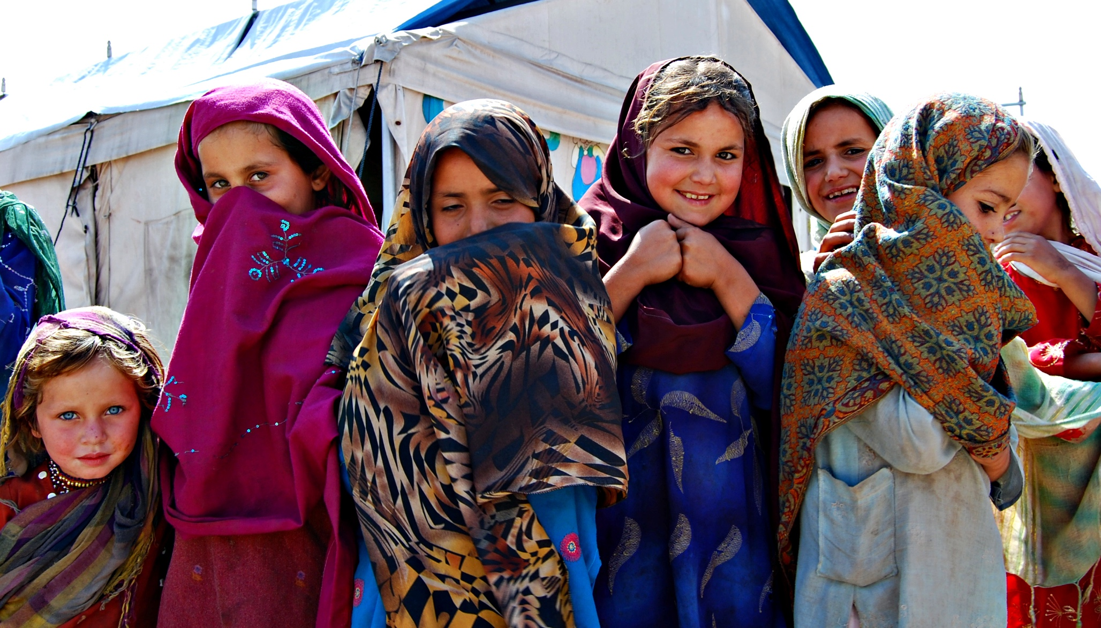


MODULE 3
SUPERVISION AND COACHING SKILLS
Photo: Ned Colt / The IRC
Notes:
2 minutes
Say: Module 2 gave us some structured supervision practice and tools. Module 3 will take our supervision knowledge and practices a step further and will help us consider the skills that are required in order to be an effective supervisor.
We will be looking at the concrete skills supervisors can learn and apply in order to support and coach caseworkers.
Before we start, does anyone have any questions, thoughts or reflections from Modules 1 or 2?

Slide 2



THE ALLIANCE
FOR CHILD PROTECTION
IN HUMANITARIAN ACTION

Slide 3
MODULE AIM AND
LEARNING OUTCOMES
Aim:
To know and apply skills that support the practices of supervision and coaching
Learning Outcomes:
  Review the applied competencies of effective supervisors
  Practice coaching using reflective practice and the GROW model
  Practice giving feedback using effective communication skills
  Apply case management guiding principles in supervision
  Review effective group facilitation skills
Notes:
3 minutes
Review the aim and outcomes outlined on the slide
Say: In this module we will look at some key skills that can support the relationship a supervisor should establish with a caseworker. We’ll be exploring coaching methods, communication skills and reflecting on how to apply guiding principles. In order to practice, we’ll be doing role plays and using case studies.

Slide 4

IDEAL SUPERVISOR COMPETENCIES EXERCISE
Knowledge
Attitude
& Behavior
Optional Activity:
Think back to the mentors/coaches we discussed at the beginning of the training…
Write words or draw on the supervisor diagram to show what knowledge, skills or behaviors they demonstrated.
Skills
Notes:
25 minutes
Say: We have talked about the practices of Supervision, now let's think about the competencies a supervisor should develop in order to be effective.
Remember that competencies include: skills; knowledge; and attitudes/behaviors.
Mentor, coach, role model, helper... these are all words that have been used to describe an ideal supervisor. Now we are thinking about how did they demonstrate these qualities? How did they apply their skills and knowledge?
Read: the instructions on the slide and ensure there are no questions
Knowledge at the head
Attitudes at the heart
Skills at the hands and feet
Give participants 10-15 minutes. When everyone is finished, bring them back to plenary for next step which is on the next slide.
Facilitator’s note:
This exercise can be done in small groups using flipcharts or individually using the Ideal Supervisor template handout. You should gauge the needs of your learners and decide which will be a more effective activity. If there are any issues that might prevent participants from engaging fully in the group activity, use the individual activity instructions below.
Group Activity Instructions: Prepare a large person on a flipchart with plenty of room for words and drawings (could use sticky notes or 3x5 notecards to tape on the person as well)
Individual Activity Instructions: Distribute 3.1 Ideal Supervisor template handout with outline of a person so participants can do this independently

Slide 5

SUPERVISOR
COMPETENCIES
Attitudes/Behaviors:
  Highly regarded professional skills and ethics
  Commitment to the team
  Focused on improving results for children
  Present, reliable, responsive and consistent
  Patient and empathetic
Knowledge:
  Recognizes common concerns/themes among caseworkers
  Knowledge of the functions, practices and skills of supervision
  Case management expertise (at least 2 years of experience)
  Knowledge of the Guiding Principles of case management
  Knowledge of group or team dynamics
Skills:
  Building trust with team and external actors
  Leadership
  Group facilitation
  Non- judgmental
  Ability to consider multiple perspectives
  Encourages reflective practice
  Identifies and builds upon caseworkers’ strengths (strengths-based approach)
  Excellent communication and active listening
  Ability to distinguish between the roles of manager vs. supervisor
  Ability to manage expectations about what is possible in an individual case
Notes:
10 minutes
Say: Here is a list of supervisor competencies that are considered good practice from the global CMTF
Ask: How do these compare to the skills, attitudes/ behaviors and knowledge you thought of?
Key messages:
It takes years to develop these competencies. No one is perfect!
This module is about the application of competencies to the practices of supervision
Distribute: 3.2 Supervisor Competencies handout

Slide 6
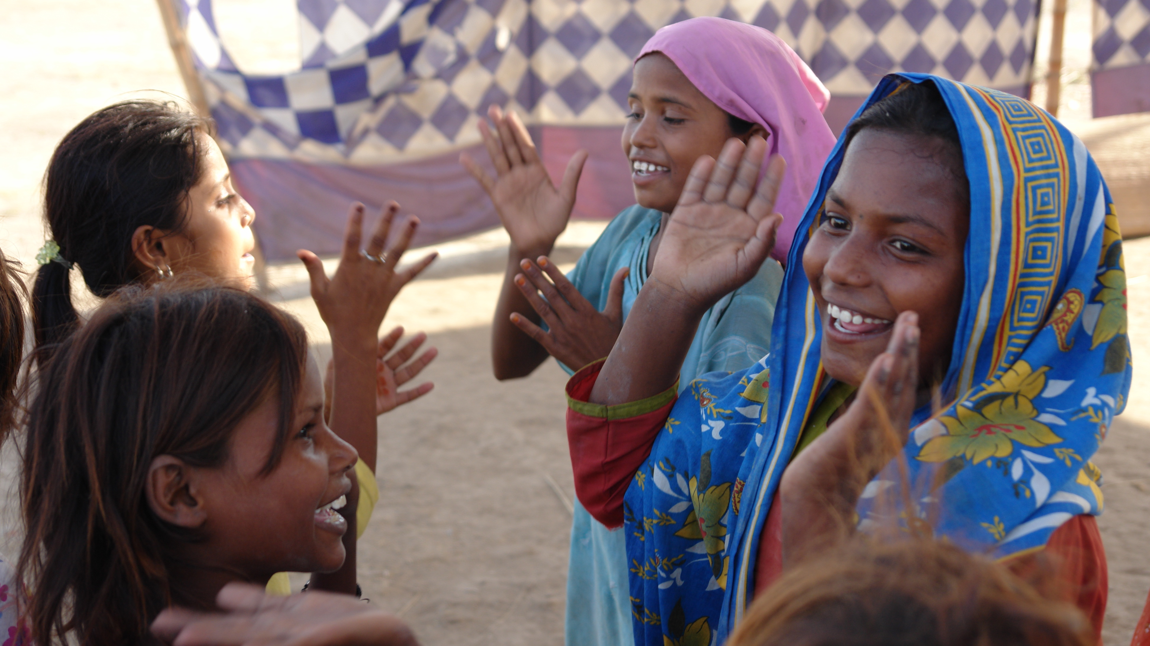
APPLYING SUPERVISION
COMPETENCIES
Active Listening and Communication
Coaching
Giving Feedback
Applying Knowledge of the Guiding Principles
Facilitation
Photo: Selena Marr / The IRC
Notes:
5 minutes
Say: Though we have mentioned several areas of competencies, today we will be focusing specifically on five core skills:
Active Listening and Communication
Coaching
Giving Feedback
Applying Knowledge of the Guiding Principles
Facilitation

Slide 7
QUESTIONS?
Notes:
Check with the participants to see if they have any questions or comments before moving on.

Slide 8

ACTIVE LISTENING SKILLS
Body language
Open, closed and why questions
Rephrasing
Reframing
Reflecting back
Summarizing facts
Notes:
10 minutes
Say: Many of you are familiar with communication skills from previous trainings and professional experiences. We’re going to spend some time review them together and think about how they apply in the supervisor-caseworker relationship.
Ask: "What are active listening skills?"
As participants mention skills, ensure they are understood by all. If no one knows the skills of active listening, explain briefly each of the points on the slide referring to the communication skills checklist.
Ask for descriptions and examples of each skill. Ensure the following key message is covered before moving on.
Say: Using active listening can help supervisors create a trusting relationship with caseworkers and is critical coaching skill.

Slide 9
COMMUNICATION TIPS
Demonstrate empathy for the caseworker’s challenges and concerns
Work from a strengths-based perspective, being sure to highlight what you think the caseworker did well and ask her/him what s/he thinks could have been done differently before you share your feedback
Seek to empower the caseworker by asking her/him to problem-solve instead of immediately providing solutions
Help caseworkers become comfortable with uncertainty
Ask the caseworker if s/he would like to hear your thoughts/reflections before sharing them
Notes:
10 minutes
Say: In addition to active listening, here are a few more tips for communicating with caseworkers, in order to help them reflect on the issues or challenges that they are facing. It is important to encourage caseworkers to think of options first, rather than offering immediate solutions.
Review the points on the slide.
Distribute: 3.3 Communication Skills for Supervisors and review with participants
Key Message: the best approach to supervision is to use active listening and ask thoughtful questions so caseworkers can reflect on their performance, come to conclusions and make decisions in order to develop and improve.

Slide 10
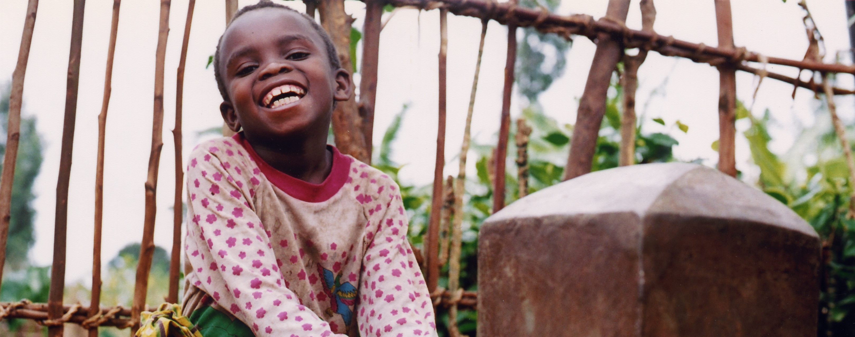
SUPERVISION VIDEOS
https://www.youtube.com/watch?v=ZRlC3SDobDQ&t=23s&index=12&list=PLoGfTRo7nXHSOb3HSc-11e4-UfPkDcytA
https://www.youtube.com/watch?v=93DDC2OSTFw&list=PLoGfTRo7nXHSOb3HSc-11e4-UfPkDcytA&index=18
Photo: Kate Holt /The IRC
Notes:
20 minutes
Say: Before we start practicing our own coaching sessions, let's take a look at these videos. You will see 1 example of ineffective coaching and 1 example of more effective coaching. See if you identify and write down the helpful vs. unhelpful strategies the supervisor is utlizing. The skills might be active listening skills like summarizing or paraphrasing or support skills like empathizing.
Instructions: after watching the videos (or role-plays), ask the participants to reflect on the communication skills demonstrated by the supervisor. What was helpful/ unhelpful?

Slide 11

SUPPORTING CASEWORKERS
Helpful Strategies | Unhelpful Strategies
Listen to caseworkers Identify and clarify stressful issues Encourage expression of emotions Help caseworkers to name and release emotions Identify positives; modify inappropriate expectations; reframing the stressful event | Denial Avoid discussing the issue Minimization Insist that things will get better Blame the caseworker make them feel totally responsible for the situation
Photo: Peter Biro/The IRC
Notes:
10 minutes
Say: Here are some key helpful and unhelpful strategies that can have a significant impact on supporting caseworkers and helping them develop.

Slide 12
INTRODUCING COACHING METHODS
Reflective Practice
GROW Model
Notes:
5 minutes
Say: Remember we said that coaching is a method and an approach. We are going to look at 2 coaching methods called Reflective Practice and GROW. Both methods present ways to help caseworkers solve problems and process their work.
Distribute:
3.4 Reflective Practice Record
3.5 GROW model

Slide 13
REFLECTIVE PRACTICE:
Coaching is about sensitively and skillfully supporting a caseworker's reflective practice with the ultimate goal of improving practice and outcomes for children
Child protection is complex, interpersonal work requiring a great deal of self-awareness to avoid doing harm
Reflective practice, and supervision strategies that support reflective practice, are proven methods to improve outcomes for children
Notes:
15 minutes
Ask: Has anyone used reflective practice before?
Say: The purpose of reflective practice is for caseworkers to think about their actions and experiences in order to continuously learn and develop. Supervisors can support caseworkers in this process by asking the questions outlined in the Reflective Practice Record.
Review the points on the slide
Instructions: Refer to the reflective practice handout and provide 10 minutes for participants to individually complete it while thinking of 1 specific difficult case they worked on. Make sure no one feels pressured to share their reflections.
Say: The reflective practice record is an excellent way to begin the process of thinking about challenging cases and practice issues. Caseworkers can use this tool to gain self-awareness and supervisors can use it as a model to guide an individual session.

Slide 14
COACHING USING
THE GROW MODEL
.
Groups of 3:
Role plays using GROW model and
active listening 10 minutes
  G Set a GOAL for the session
  R Establish the current REALITY
  O Identify OPTIONS
  W Decide the next steps
  that WILL happen
Notes:
10 minutes
Say: The GROW model is the second coaching tool that uses active listening skills to help caseworkers solve problems they are struggling with through reflection. It can be particularly helpful to address specific problems, or issues that need to be immediately addressed through ad-hoc supervision.
Review the GROW handout and explain to participants the 4 stages. Supervisors can use selected sample questions, but do not need to use all of them.
Instructions: Invite participants to break up into groups of 3 for a 10 minute role play activity using the GROW model. (One person playing the supervisor, the other the caseworker and the third as an observer.)
(Participants can use 1 specific difficult case or situation they have been in.)

Slide 15
KEY LEARNING POINTS
ON COACHING
Use your active listening and communication skills
Let caseworkers try to find solutions to problems first
Do not pass judgment
Give input and concrete advice when needed
Offer potential suggestions and alternatives
Reinforce useful strategies that have worked previously
Notes:
15 minutes
Plenary Debrief instructions: Bring the participants back together and ask them the following questions on the two Coaching tools:
How did you find the two Coaching tools?
How did you find the exercises?
How do you see the relationship between these two tools and the active listening/ communication skills we discussed?
Review: the points on the slide
Key Message: Supervisors do not need to always have perfect answers or solutions. Supervision is a process and each case can present new challenges and complexities.
It is important for supervisors to facilitate conversations with case workers and build trust between each other to enable them to confidently apply case management good practice.

Slide 16
QUESTIONS?
Notes:
Check with the participants to see if they have any questions or comments before moving on.

Slide 17

Photo: Peter Biro/The IRC
PROVIDING FEEDBACK TO CASEWORKERS
Photo: Kevin McNulty /The IRC
Notes:
5 minutes
Say: We have now reviewed communication and coaching skills, and now we will shift to another skill that many supervisors find challenging: giving feedback.
Say: Feedback is sharing our observations about a caseworkers skills, knowledge or attitudes/behaviors. It is a necessary and expected part of supervision. But to be most effective, it should be given with skill and sensitivity.

Slide 18


WHY IS FEEDBACK
IMPORTANT?
The purpose of feedback is to work toward improvement in practice and positive change for children
Effective feedback increases the likelihood of change as it highlights strengths as well as weaknesses, and clarifies key issues for practice
It is important to try to build the skills and support a culture where the giving and receiving of feedback is welcomed and practiced on a daily basis
Notes:
5 minutes
Review the points on the slide and check understanding before moving on.
Key message: Feedback should be focused on improving practice so we better serves and protect vulnerable children.

Slide 19
CONCERNS WITH
GIVING FEEDBACK
When we have to tell someone something that may be difficult to hear, we may hesitate:
Will they get very upset?
How will we deal with it?
Will it affect our relationship in future?
Will they listen to what we say, or will they distort it?
Will it really affect the way they behave?
Notes:
5 minutes
Ask: Has anyone been a position to give feedback but found it difficult?
Say: It is normal to feel uncomfortable giving feedback. Especially constructive feedback.
Review the points on the slide.

Slide 20

FAILURE TO GIVE CONSTRUCTIVE FEEDBACK CAN RESULT IN:
No change in the caseworker’s behaviour.
The caseworker continuing to be unaware of the issue.
A confrontation in the future.
Increased tension that can build and ultimately lead to conflict.
Problems in the supervisor-caseworker relationship or within the team.
Potential harm to children or families (in the most extreme cases).
Photo: Kellie Ryan /The IRC
Notes:
5 minutes
Say: While most people feel some apprehension or discomfort giving constructive feedback, failure to provide feedback can have negative consequences. There are very good reasons we need to develop the skills to give effective feedback. This means learning to manage our delivery of feedback!
Review the points on the slide and check if there are any questions.

Slide 21

FEEDBACK
Feedback helps caseworkers learn about:
Themselves
How their behaviour affects others
The context of their work
Constructive Feedback:
Increases self-awareness
Offers options and encourages development
Feedback is a gift! It’s important to learn to give and receive it.
Photo: Peter Biro/The IRC
Notes:
5 minutes
Review the points on the slide. Check understanding before moving on.

Slide 22

GIVING FEEDBACK
ROLEPLAY
(Name) started working as a caseworker with your organization over one year ago. You have seen her grown in her skills as a caseworker and she has been committed to her work with children. A month ago however, two caseworkers left the team and (Name) caseload increased significantly.
Last week, when you asked (Name) about a problem with a referral, she snapped at you saying that she does not have the time to figure it out.
Other caseworkers have been coming to you complaining about (Name) saying she has becoming really difficult to work with. You have also noticed that she has been missing a lot of documentation in case files and has missed follow-up sessions with three children. You are concerned about (Name) and about the impact it seems to be having on colleagues and children.
Photo: Kulsoom Rizvi /The IRC
Notes:
35 minutes
Say: We have discussed the importance of feedback and have also explored some techniques; now we’ll take some time to practice. You are going to role-play a situation where feedback is given and received.
Instructions:
Break up participants into teams of three (roles of CW, Supervisor and observer) to practice role-playing the scenario. The supervisor will be an individual supervision session with the caseworker. Give 10- 15 minutes for the groups to role-play.
Invite the observers to give feedback to the supervisor in the small group.
Bring the participants back and ask one team to volunteer to role-play for the large group (10 minutes).
As the facilitator, be sure to create a safe space for role-plays in front of the large group!
Emphasize that this is a difficult case study, and we are all here to learn together
(15 minutes) After the role-play, first ask the “supervisor” to express how s/he felt, followed by the “caseworker”. Allow time for the rest of the group to comment on what they thought went well; and what they might suggest to do differently the next time, as well as room for asking questions. As the facilitator, ensure that positive and constructive feedback is offered.
Facilitator’s Notes:
Prior to the exercise, name your caseworker!
*Be sure that you ask groups to volunteer to role-play in front of their colleagues! No one should ever be forced to role-play in front of a group if they are uncomfortable.

Slide 23

FEEDBACK PRINCIPLES
Positive and constructive feedback should be a part of an ongoing supervisor - caseworker relationship
Give feedback sooner than later! Otherwise, issues can build and intensify
Be prepared:
  Feedback should be provided in an individual session
  Be clear in advance on what you want to say and select priority areas
Acknowledge strengths and good work
Be clear and specific: Talk about and describe specific behaviors, giving examples where possible
Don't make assumptions about motives. Always be curious and listen!
When giving constructive feedback, brainstorm together alternatives and leave caseworker with choices or options
Offer strategies or opportunities to improve
Notes:
10 minutes
Say: Here are a few suggestions for providing effective feedback as a supervisors.
Review the points on the slide
Distribute Tips for Giving Feedback handout
Key Message: "Constructive" does not mean negative. It comes from the verb "to construct" or "to build.“ Constructive means helping a caseworker build new options when the strategies they tried didn't lead to the outcomes they wanted for children.

Slide 24
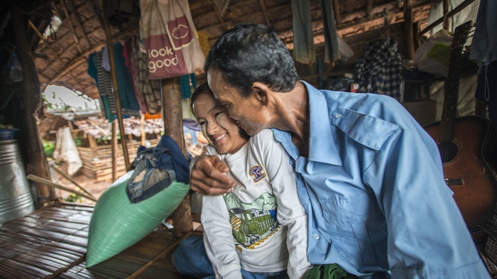
KEY LEARNING ON FEEDBACK
FEEDBACK IS A GIFT! IT HELPS US
LEARN, INCREASES SELF-AWARENESS AND
SUPPORTS OUR DEVELOPMENT.
Photo: Peter Biro/The IRC
Notes:
5 minutes
Ask: Does anyone have any questions or comments about giving feedback?
Facilitator’s Note: If there is time; it may be worthwhile to also spend some time reviewing how to receive feedback. This can be applicable for all of us; since all professionals should benefit from feedback.
Receiving Feedback:
Listen without interrupting.
Be aware of your non-verbal responses.
Be open – receptive to new ideas and approaches.
Understand the message – paraphrase what has been said so you’re sure you understand.
Reflect and decide what to do – you may not take it on board but people need to feel their views are being considered.
Follow-up.

Slide 25
QUESTIONS?
Notes:
Check with the participants to see if they have any questions or comments before moving on.

Slide 26

APPLYING CASE MANAGEMENT GUIDING PRINCIPLES
Photo: Donna Morris /The IRC
Notes:
10 minutes
Say: We are now going to spend a brief amount of time thinking about the relationship between the case management guiding principles and supervision.
Ask: Who can remind me of some of the key CM guiding principles?
Quick plenary review of the guiding principles of case management (Facilitator’s Note: It is assumed that the majority of participants should be familiar with the guiding principles already as supervisors. If it appears that they need a more in-depth review; take the time to prioritize this conversation.)
Distribute: 3.8 CM Guiding Principles
Say: The key to effective Supervision is having sound knowledge of the principles and practices of case management; and the supervision skills and behaviours to apply them in individual and group settings.

Slide 27
SMALL GROUP SUPERVISOR
SCENARIOS
As a supervisor, consider:
Which guiding principle(s) apply to this scenario?
How could you respond as a supervisor?
  How quickly should you respond?
  What is the appropriate setting (group or individual)?
  What practice or tools will you apply?
  What skills might you use?
Notes:
30 minutes
Say: We are now going to discuss some practical examples of applying guiding principles as supervisors.
Instructions:
Break up participants into 7 small groups.
Distribute one scenario to each group.
Provide each group 10 minutes to discuss the questions listed on the slide
4. Invite each group to present their scenario and summarize their discussion with the large group.
Facilitator’s Note:
As the facilitator, be sure to emphasize the range of guiding principles to consider for each scenario, any specific communication or other skills they should apply and the guidance on providing feedback.
Scenario 1: One of the caseworkers on your team keeps calling you outside of working hours to talk about relationship problems with her husband.
Scenario 2: You discover that the caseworker referred a case without the consent of the child or caregiver
Scenario 3: A caseworker on the team has been telling caregivers that corporal punishment is an acceptable form of discipline, and when you ask him about it he states, “my parents did that to me.”
Scenario 4: You discover that one of the caseworkers is taking gifts from a child’s family for services
Scenario 5: During an observation, you notice that the caseworker is blaming the child in an indirect way. The child is clearly upset and affected
Scenario 6: One of the caseworkers on the team has been overheard making discriminatory statements about refugees in the community. She has several refugee children and families in her caseload and you worry that she is treating them differently than other children
Scenario 7: You have noticed a clique forming in your team where 3 of the caseworkers are having coffee together without telling the others. One caseworker came to you and said she felt excluded because she noticed them leaving one day and asked to join and they said ”no, sorry we have to discuss a case.”

Slide 28


KEY MESSAGES ABOUT
GUDING PRINCIPLES
Supervisors should be confident in applying the guiding principles and in facilitating conversations with caseworkers to consider what is in the child’s best interest
Supervisors do not need to know all the answers or solutions - this is a reflective learning process and each case presents new challenges and complexities
Notes:
5 minutes
Review the points on the slide.

Slide 29

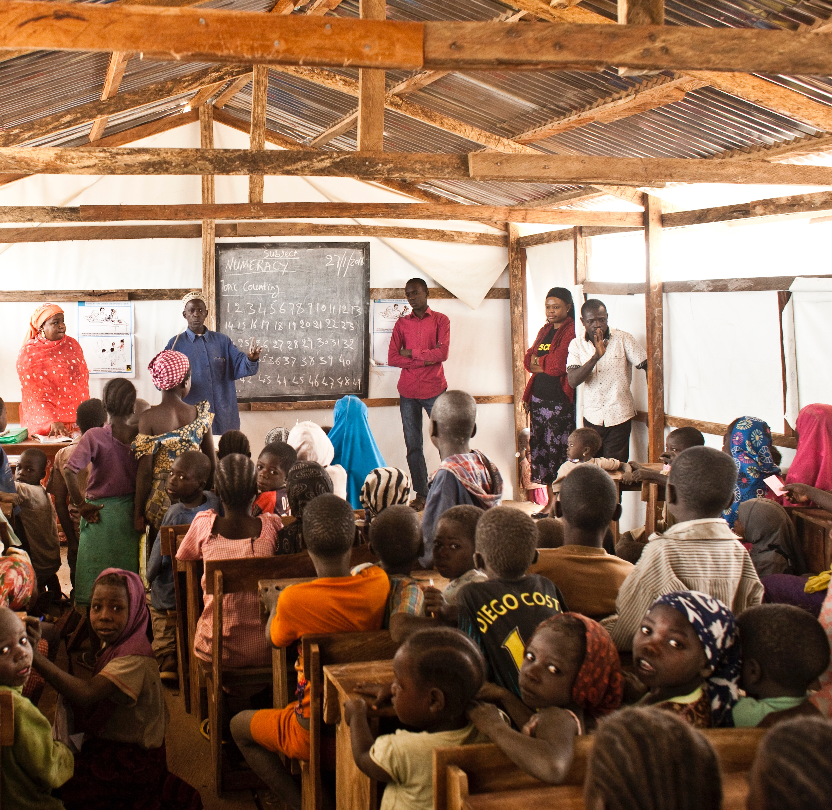
  GROUP
  FACILITATION
  SKILLS
Photo: Peter Biro/The IRC
Notes:
5 minutes
Say: The final skill we will be reviewing today is group facilitation. Recall that yesterday, we spoke about case management meetings, which is the most common group supervision practice.
Say: In order to facilitate an effective meeting, many facilitation skills are required. During this session, we are going to share some facilitation tips and give you a chance to think through and plan a case management meeting.

Slide 30
Group facilitation is not an easy task
Supervisors are responsible for balancing:
Content:
Agreeing on the goals/priorities of the meeting
Tip: use the case management meeting tool
Process:
Ensuring productive participation from all the individuals in the room
Guiding individuals with different personalities and work styles to a common outcome
Relationships:
How team interacts with each other and the supervisor
RELATIONSHIPS
PROCESS
CONTENT
Notes:
15 minutes
Say: If you have participated in a well-run meeting, you might think group facilitation is easy. What is more likely true is that you had an experienced and skilled facilitator! Facilitators are responsible for 3 major tasks: First they are responsible for content; second they are responsible for the process; and third they are responsible laying the groundwork to support effective work relationships. Let's explore that a bit.
Ask:
"What do we mean by content?"
Examples for facilitator: agenda; managing discussions that go off topic...
"What do we mean by process?"
Examples for facilitator: equal participation, time management, making group decisions and agreeing on ways forward...
"What do we mean by relationship?"
Examples for facilitator: how individuals will relate to each other, manage differences of opinion, listen and respond to each other think about "ground rules" or the "learning agreement" we all set at the beginning of this training.
Say: Several skills that were reviewed during the active listening and communication skills sessions can also be utilized for group facilitation. For example; inviting for caseworkers to speak first and then using summarizing, paraphrasing and "I" statements...

Slide 31

WHAT MAKES A GOOD FACILITATOR?
Photo: Peter Biro/The IRC
Notes:
10 minutes
Ask: From your previous experience, what do you think makes a good facilitator?
Instructions: Collect participants’ suggestions on a flip chart in the front of the room.
Facilitator's Note: this exercise can be done in plenary, or in small groups- according to the available time.

Slide 32

GROUP FACILITATION TIPS
Create an open, inclusive environment
Encourage participation and contributions
Be prepared for anything
Know who is in the room
Set guidelines
Give clear instructions
Use active listening and clear communication
Manage time
Pay attention to the rise and fall of energy
Be flexible and be able to adapt quickly
Be curious
Meet basic needs
Photo: Kulsoom Rizvi /The IRC
Notes:
10 minutes
Say: Here are some suggested tips about good group facilitation, to add to the ones you suggested.
Facilitator’s Notes: Below or more in depth explanations of the points on the slide:
Create an open, inclusive environment: When planning a group session and while you’re in the room facilitating, you need to find ways for the entire group to be on an equal playing field.
Encourage participation and contributions: Finding ways for everyone in the group to participate is a key component to getting the group to buy in and own the process—inclusivity is the name of the game.
Preparation: As a facilitator, it’s your job to guide a group through a process, making it easier for them to accomplish the goal at hand. Having a structure and general idea of what direction you’re going in will help you do just that. However, as we’ve all learned in life, nothing ever goes perfectly as planned! You need a plan and a back-up plan and possibly a few more plans just in case your other plans don’t work or something breaks. Having options to pull from will provide you with flexibility and allow you to change things up based on the group’s needs
Know who is in the room: being aware who’s in the room is an essential skill for effective facilitation. Find out as much as you can about who will be in the room before you get there. The more you know about the group, the individual personalities and the dynamics at play, the better you’ll be able to plan for a successful session and a positive experience
Set guidelines: As a facilitator, you need to help set a tone for the behaviours and attitudes of the session. You can think about these guidelines yourself or you can simply ask the group what behaviours and attitudes will help them get the most out of the experience. Try to push for concrete ideas and clear guidelines.
Give clear instructions: So much of facilitating is asking a group of people to accomplish a task—and that’s a whole lot easier with good instructions. Clear instructions make it easier for your group to get to the outcome you’re looking for.
Active listening: In an effective group session, the facilitator needs to make sure everyone has a chance to be heard and to hear each other. The best way to do that is to flex your active listening skills and encourage your group to do the same.
Manage time: Facilitators need to plan out how long the different components of your session will take and how long your group will have to reach the session’s goals. At times, facilitators will need to limit the conversation to a few comments; rather than allowing everyone to share their thoughts and opinions.
Pay attention to energy: It’s simply a fact of life that sometimes a group of people walk into a room and convey an energy—maybe it’s tired, lethargic, excited, hyper, silly, negative, shy, nervous—whatever! Sometimes the facilitator will need to match the activity you have in mind with the energy of the group and sometimes you need to find ways to boost a low-energy group’s enthusiasm and excitement.
Flexibility and Adaptability: Part of the facilitator’s job involves checking in with your group on progress and process. Think about how often they might need a break. Make a point to periodically ask how everyone is doing and whether it’s time for a break. You’ll also need to think about your agenda and whether you’re on track to accomplish everything you planned. It might be necessary to adjust and cut activities in order to achieve the larger objectives.
Be curious: This means challenging assumptions and judgments. If a word or action is being interpreted, find out what was intended.
Meet basic needs: This can be as simple as providing a snack, beverage and a bathroom break. It helps your group members feel comfortable, supported and understood.

Slide 33

KEY MESSAGES
ABOUT GROUP
FACILITATION
Be prepared, anticipate potential challenges
Establish the process (agenda, time frame, ground rules)
Manage the process (ensure equal participation, principles of feedback)
Use active listening and communication skills to summarize, manage different opinions and identify areas of agreement
Effective facilitation skills can be learned and developed with practice
Photo: Peter Biro/The IRC
Notes:
5 minutes
Review the points on the slide. Check understanding before moving on.
Distribute 3.10 Group Facilitation Tips
Key Message: Just like the other skills we reviewed today, group facilitation requires ongoing practice and reflection. We encourage you to seek feedback from participants after facilitating a meeting so you can continue to develop your skills and confidence.

Slide 34
QUESTIONS?
Notes:
Check with the participants to see if they have any questions or comments before moving on.

Slide 35

REVIEW QUIZ
What are some active listening skills?
What is the purpose of Reflective Practice?
What is the GROW model
Name 5 feedback principles.
What are some risks associated with not providing constructive feedback?
Facilitation requires a balance of 3 things; can you name them?
Notes:
10 minutes
Say: now we’re going to have an opportunity to review what we discussed in the third module
Facilitator's note: Try to make this activity a fun competition! Give some prizes/ candy at the end to motivate participants.
Always be encouraging when delivering a plenary quiz. Never say an answer is wrong. If necessary, say something like: what we are looking for here is an answer that reflects... Give prizes to everyone who tries even if their answer isn't complete.
Answers:
1. Active Listening Skills:
Body language.
Open, Closed and Why questions.
Rephrasing.
Reframing.
Reflecting back.
Summarizing facts.
2. The purpose of reflective practice is for caseworkers to think about their actions and experiences in order to continuously learn and develop
3. GROW= G Set a GOAL for the session.
R Establish the current REALITY.
O Identify OPTIONS.
W Decide the next steps that WILL happen
4. Feedback Principles:
Positive and constructive feedback should be a part of an ongoing supervisor - caseworker relationship.
Give feedback sooner than later! Otherwise, issues can build and intensify.
Be prepared:
Feedback should be provided in an individual session.
Be clear in advance what you want to say and select priority areas.
Acknowledge strengths and good work.
Be clear and specific: Talk about and describe specific behaviors, giving examples where possible.
Own the feedback and use "I" statements.
Don't make assumptions about motives. Always be curious! Ask.
When giving constructive feedback, brainstorm together alternative behaviors and leave caseworker with choices or options.
Offer strategies or opportunities to improve.
5. Risks:
No change in the caseworker’s behaviour.
The caseworker continues to be unaware of the issue.
A confrontation in the future.
Increased tension can build and, ultimately lead to a conflict.
Problems in the supervisor-caseworker relationship; or within the team.
Potential harm to children or families; in the most extreme cases
6. Content, process, relationship

Slide 36
MODULE AIM AND
LEARNING OUTCOMES
Aim:
To know and apply skills that support the practices of supervision and coaching.
Learning Outcomes:
  Review the applied competencies of effective supervisors.
  Practice coaching using reflective practice and the GROW model.
  Practice giving feedback using effective communication skills.
  Apply case management guiding principles in supervision.
  Review effective group facilitation skills.
Notes:
5 minutes
Review the learning goals we had at the beginning of the module.
Ask if we covered them or if anyone has remaining questions about any of the points.

Slide 37

WHAT ACTIONS TO DEVELOP SUPERVISOR SKILLS WILL
YOU ADD TO YOUR ACTION PLAN?
Notes:
10 minutes
Instructions: invite participants to add to their Supervision Action Plan from this module.

Slide 38
REFERENCES
Alliance for Child Protection in Humanitarian Action. (2014). Inter-agency Guidelines for Case Management and Child Protection. Retrieved 2017, from https://resourcecentre.savethechildren.net/library/inter-agency-guidelines-case-management-and-child-protection
Alliance for Child Protection in Humanitarian Action. (2014). Child Protection Case Management Training Manual for Caseworkers, Supervisors and Managers. Retrieved 2017 from: https://resourcecentre.savethechildren.net/library/ia-case-management-training-package
Goleman, D. (1995). Emotional Intelligence. London: Bloomsbury.
Kadushin, A. and Harkness, D. (2002) Supervision in Social Work (4th edition) New York: Columbia University Press.
Milne, D. (2007) Evidence based Clinical Supervision: Principles and Practice. Oxford: Blackwell. Morrison, T. (2005) Staff Supervision in Social Care (3rd Ed). Brighton: Pavilion
Morrison, T. (2007) Emotional intelligence, emotion and social work: context, characteristics, complications and contribution. British Journal of Social Work, 37 (2), pp 245–263.
Parsloe, E. (1995). Coaching, Mentoring and Assessing: A practical guide in developing competence. London: Nicholls Pubs.
Phillips, A. (2013) Developing Assertiveness Skills for Health and Social Care Professionals. London: CRC.
Stevens, I (2015). Practicing Supervision in Child Care and Child Protection Agencies. Retrieved 2016, from www.childhub.org
Westergaard, J. ‘Getting the most from support and supervision: Attitudes and skills for supervisors and supervisees.’ (pp 57-70). Chapter in Reid, H.L. and Westergaard, J. (Eds.) (2006.)Providing Support and Supervision: An Introduction for Professionals Working with Young People. London: Routledge.
Wilkinson, R. (2015). Essential Supervisory Skills: The Supervisor's Toolbox 4th Edition. Retrieved 2017, from https://www.tacoma.uw.edu/sites/default/files/sections/HumanResources/documents/supervisors_toolbox_5th_edition.pdf
Wonnacott, J. (2012). Mastering Social Work Supervision. London: Jessica Kingsley.

