Slide 1
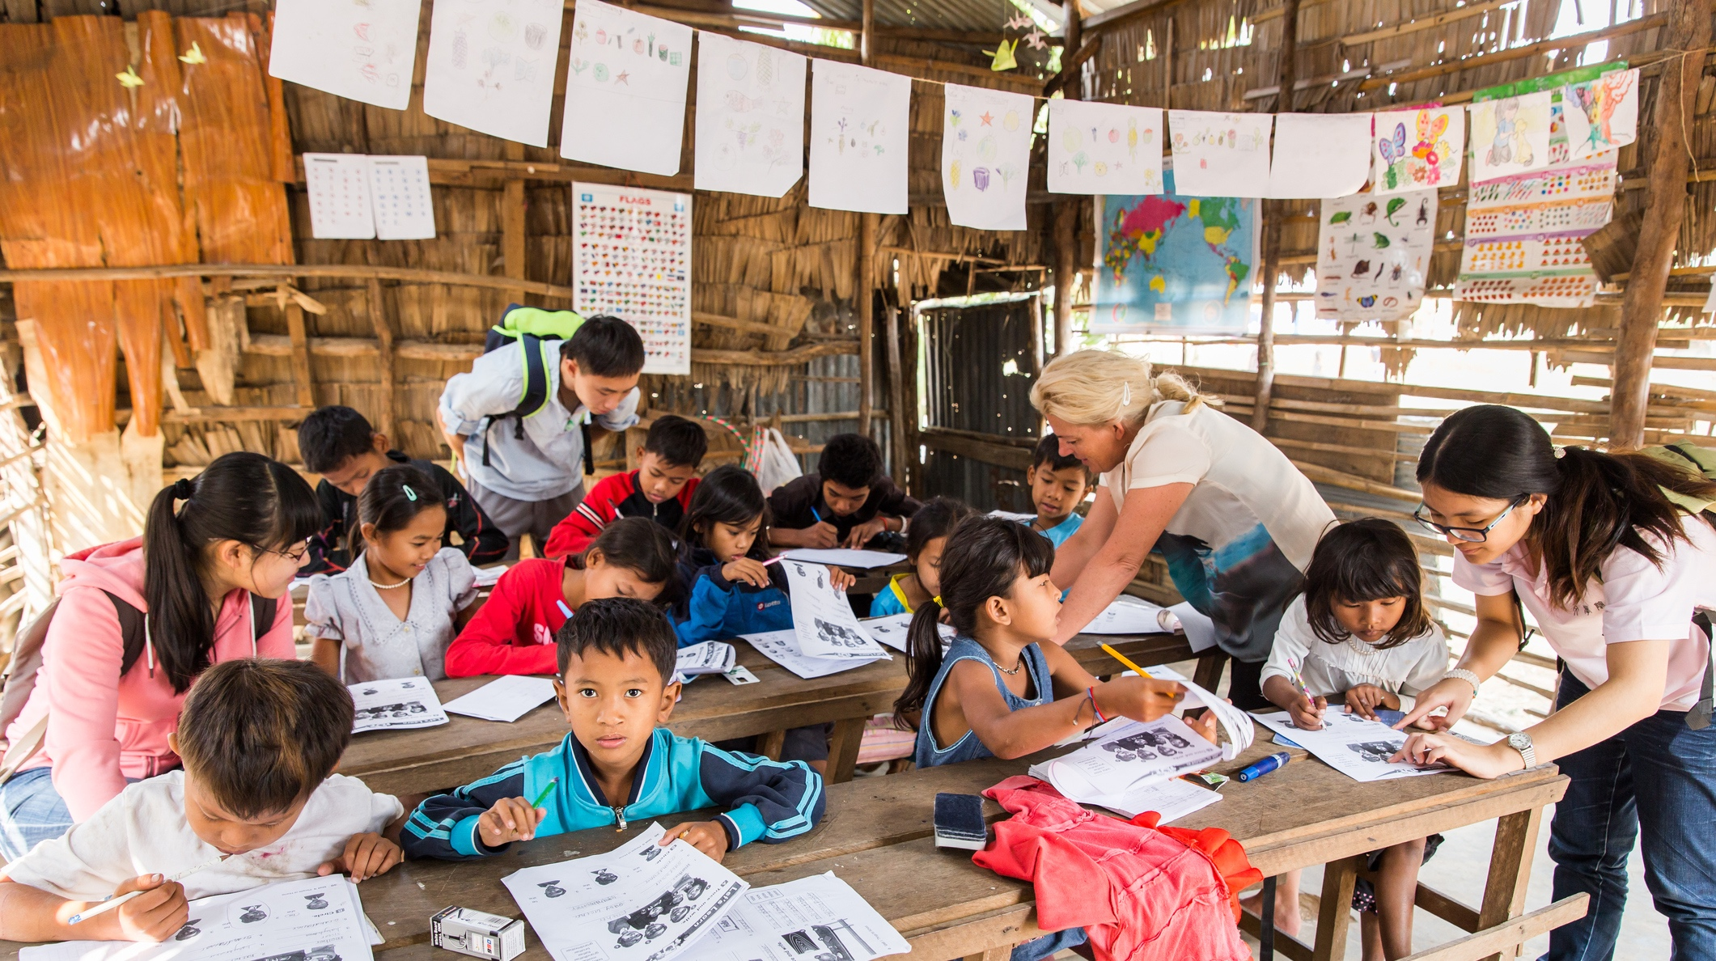


MODULE 1
DEFINING SUPERVISION AND COACHING
WITHIN CHILD PROTECTION CASE MANAGEMENT
Notes:
5 minutes
Say: Throughout this training we will be exploring supervision practices in our contexts, and those that are promoted as good practice in the Interagency Case Management Guidelines (abbreviated as IA CM Guidelines).
In the first module we will review some of the basics of child protection case management supervision and coaching. We will also introduce the main themes that will be covered over the training.
Throughout the training, we will remind you to reflect on supervision as it is now in your context. We will provide opportunities for you to begin developing supervision action plans to help you achieve global practice standards in your places of work- you will continue to revisit your action plans and they will continue to develop over the training.
Ask: Any questions before we get started?

Slide 2



THE ALLIANCE
FOR CHILD PROTECTION
IN HUMANITARIAN ACTION

Slide 3
MODULE AIM AND
LEARNING OUTCOMES
Aim:
Understand good practices of supervision and coaching within child protection case management
Learning Outcomes:
Understand supervision as a relationship and coaching as a method
Know the three functions of supervision
Identify what is working well in your contexts and identify existing challenges
Begin considering your CM Supervision Action Plan
Notes:
5 minutes
Review: the aim and the learning outcomes, elaborating on each point as necessary.
Key messages:
We will take time to identify what is already working well in addition to discussing common existing challenges with supervision in our contexts
This is intended as a practical training and we will not only identify challenges but present effective and practical strategies to address those challenges throughout the training
You will be encouraged to create your own plan to promote supervision in your own context through an action plan
Ask: Any questions before we move on?

Slide 4

1.
SUPERVISION
IN OUR
CONTEXTS
What do people in your context think of when they hear the term “supervisor”?
2.
Why is supervision important in case management?
In small groups, take 15 minutes to answer the following questions on flip chart paper
What are some main tasks and responsibilities of
Case Management Supervisors?
3.
Notes:
20 minutes
Say: Before we begin talking about the global guidance, we first want to understand Supervision in our contexts.
Instructions:
Break up participants into small groups to explore these questions together. (Facilitator Note for Question 1: Participants should think beyond CP case management to respond to this question, and rather consider the broader cultural context. In many cultures, “Supervisors” are seen as enforcers of rules/ controlling/ ordering their employees)
Ask each group to compile their responses on a flip chart and hang them on a wall together.
Thank the participants and explain to them that over the course of the module, we will revisit these responses.

Slide 5
1.
SUPERVISION
IN OUR
CONTEXTS
What do people in your context think of when they hear the term “supervisor”?
2.
Why is supervision important in case management?
What are some main tasks and responsibilities of
Case Management Supervisors?
3.
Notes:
5 minutes
Instructions: Ask participants to share their responses from their flipcharts to Question 1 “What do people in your context think of when they hear the term “Supervisor”?”

Slide 6

INTERAGENCY DEFINITION OF SUPERVISION
“Supervision is a relationship that supports the caseworker’s
technical competence and practice, promotes well-being and
enables effective and supportive monitoring of casework.”
Photo: Kellie Ryan/The IRC
Notes:
10 minutes
Say: This is the inter-agency definition of child protection case management supervision. We will take a moment to discuss differences in the way supervision is understood in many contexts.
What we tend to see is that “supervision” in many different cultures is seen as a managerial or boss-like relationship in which one person gives orders and directions, even within Child Protection Case Management​. However, the CM Guidelines present a very different definition of this role!
Often supervision is considered a hierarchal role above that of a caseworker. The inter-agency definition encourages us to see the relationship between supervisor and caseworker as collaborative and complementary rather than hierarchical.
Ask: What do you think of this definition? What does this concept of a “relationship” add to the definition of supervision?
Ask: What is important about a relationship if it is to support caseworkers?
Say: Lets discuss more what we mean by the supervisor-caseworker relationship. When we think of this relationship between the supervisor and the caseworker we are talking about the supervisor supporting the caseworker to do effective child protection case management. The caseworker is the active participant in the work with children and families. The supervisor is behind them supporting them and helping them develop the skills, knowledge and attitudes that make them good at their job.
Some words that might describe this supportive relationship are mentor, model, guide. What word might you use to describe this relationship? Is there a word in your culture or in your language that reflects this?

Slide 7
COACHING IS AT THE HEART OF THE
SUPERVISOR–CASEWORKER RELATIONSHIP
1.
What is coaching?
A method?
An attitude? Or, a way of being?
What does coaching look like in supervision?
Why is the idea of coaching important within supervision?
2.
3.
Supervisor/Caseworker
Relationship
Notes:
15 minutes
Say: If we understand that supervision is a relationship, then we can begin to think of coaching as being at the heart of supervision.
Coaching is a method AND an attitude, or way of being: Coaching can involve “coming alongside” the case worker to help on specific skills and can involve modeling good practice.
Ultimately, coaching is an attitude that places the caseworker as the driver of their own development and the expert at recognizing and overcoming their own strengths and challenges. The supervisor role as coach is to use specific practices to help the caseworker recognize their strengths and challenges and assist them to set and realize realistic goals towards achievement.
(If appropriate for the context share the analogy of a football coach.)
We will be talking more about coaching skills and putting them into practice in the coming days.
Ask: Any questions before we move on?

Slide 8


SHARED
RESPONSIBILITIES OF SUPERVISION
  Supervision is a two-way street; both sides must invest time and attention to gain benefits.
Transparent and Honest
Proactive, Responsive and Engaging
Trusting
Collaborative
Confidential
Clear Communication Channels
Supervisor
Caseworker
Notes:
10 minutes
Say: Supervision is not a passive process for the caseworker, nor the supervisor. Both have responsibilities and an active role to play.
Like any good relationship, both parties must actively participate. Both have roles and responsibilities to ensure supervision is effective. We will explore this more in the coming modules.
Both supervisors and caseworkers need to share and invest time to make the relationship successful.
It might take time and effort to build these collaborative relationships; but there needs to be safety in order to develop trust.

Slide 9
1.
SUPERVISION
IN OUR
CONTEXTS
What do people in your context think of when they hear the term “supervisor”?
2.
Why is supervision important in case management?
What are some main tasks and responsibilities of
Case Management Supervisors?
3.
Notes:
5 minutes
Ask participants to share their responses from their flipcharts to Question 2 “Why is supervision important in case management”?”

Slide 10
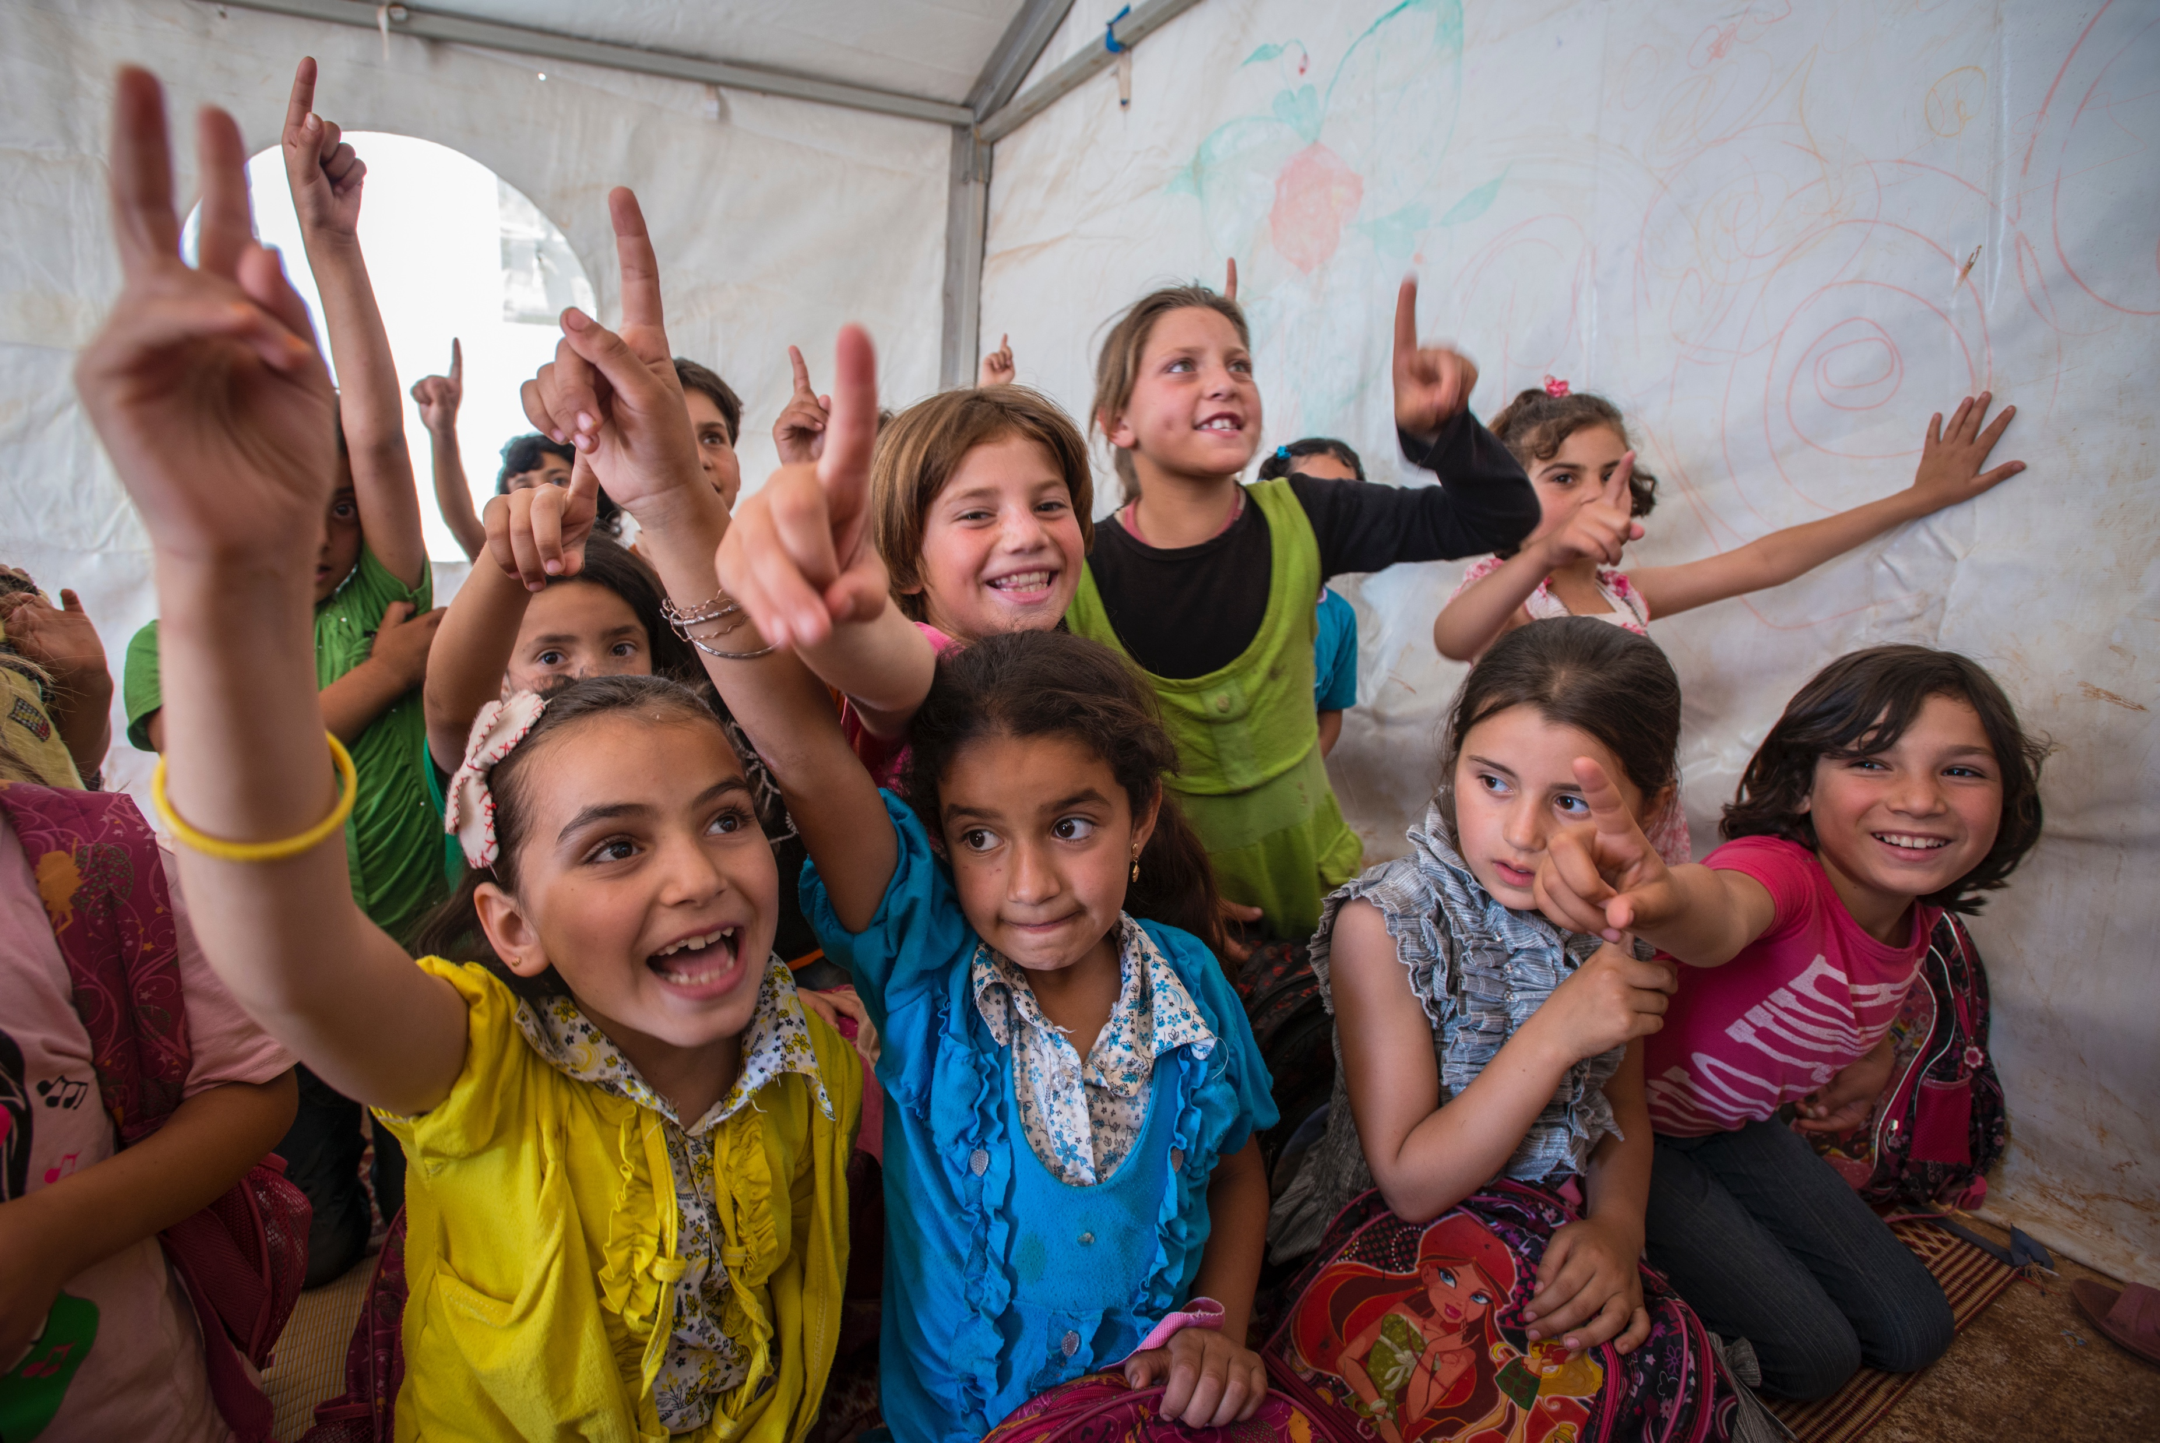
WHY IS SUPERVISION SO IMPORTANT?
“Few jobs, when performed well, can help improve the lives of so many children and families. On the other hand, when performed poorly, it can exacerbate the risks to the safety and well-being of children.”
US Department of Health and Human Services. (2004).
=
Photo: Peter Biro/The IRC
Strong Supervision
Positive Outcomes
Notes:
5 minutes
Say: What we know from the global evidence is that supervision directly relates to positive outcomes for the children we serve
Key messages:
Just as children’s best interests are at the center of the case management process; they should also be at the center of supervision.
Child protection work is not easy and it will take time for caseworkers develop their competencies throughout their career. Caseworkers should have time and space to reflect or think about what they are doing well, what they could be doing better, and which areas they want to improve or request support. It is through supervision that caseworkers can continue refreshing and reflecting on their knowledge, skills, and attitudes.
Read the quote if appropriate:
“Child Protection supervisors are responsible for ensuring that positive outcomes are achieved for children and families through the delivery of competent, sensitive, and timely services, and that the agency’s mission and goals are accomplished”
Ask: Any questions before we move on?

Slide 11
EVIDENCE
  Helps caseworkers think clearly – even when tensions are high.
  Helps caseworkers manage the emotional demands and stress of the job.
  Helps caseworkers to maintain professionalism and prevent over or under involvement.
  Aids critical thinking and reflective practice.
  Supports caseworker safety in the field.
  Reduces stress of supervisors.
Research consistently demonstrates that formal one-on-one supervision helps to protect children.
Brandon et al (2005; 2008; 2009; 2012)
Notes:
10 minutes
Say: there is evidence that supports this relationship between supervision and positive outcomes for children.
*Note: One-on-one, consistent formal supervision is the practice that has been studied by researchers.
Read: out each statement and ensure understanding before moving on.
Facilitator Note: The slide summarizes several references that are included in the annex. Highlight any of the following points if appropriate:
Caseworkers who are well supported, receive formal supervision and have access to training are more likely to think clearly
Effective and accessible supervision is essential if staff are to be helped to put in practice the critical thinking required to understand child protection issues, to explain interventions and to cope with the emotional demands of the job
Caseworkers who have formal supervision are more able to be aware of their intuition and to reflect on their work
Formal supervision is needed to help the caseworker to recognize the impact of hostility and to guard their own safety
Supervisors who hold regular formal supervision with their caseworkers deal more effectively with the stress of their work
Ask: Are there any questions before we move on?

Slide 12
1.
SUPERVISION
IN OUR
CONTEXTS
What do people in your context think of when they hear the term “supervisor”?
2.
Why is supervision important in case management?
What are some main tasks and responsibilities of Case Management Supervisors?
3.
Notes:
5 minutes
Ask participants to share their responses from their flipcharts to Question 3 “What are some main tasks and responsibilities of Case Management Supervisors?”

Slide 13
3 FUNCTIONS OF SUPERVISION
Bus Stop | 15 minutes
1. Accountability and Administrative:
Ensuring competent, accountable practice of staff.
2. Educational and Professional Development:
Ensuring staff are continually updating their knowledge and skills.
3. Supportive:
Ensuring the emotional and psychological well-being of your staff.
Notes:
20 minutes
Say: Supervision has been divided by researchers, academics and practitioners into three key functions.
Review the 3 functions on the slide.
Say: We are going to take some time to think more deeply about these functions through a “Bus Stop Exercise.”
Preparation: In advance, place the three prepared flipcharts around the room with enough space between each to allow for people to move around easily. Each flipchart should have a function written at the top:
1. Administrative and Accountability
2. Educational and Developmental
3. Supportive
Say: In your own time, go around to each of these charts and write what you think we mean by each function. Use, specific examples such as “allocating and monitoring case loads” for the Administrative function.
Instructions:
1. Ensure everyone is clear on the exercise then tell them they will have 10-15 minutes.
2. When everyone is finished, call them back to plenary for the debrief (5 minutes)

Slide 14

Human resources
Planning, assigning and overseeing the quality of case work
Coordinating with other actors
Documentation
Reinforcing safety and ethical standards
ADMINISTRATIVE AND
ACCOUNTABILITY
FUNCTION
Notes:
5 minutes
Read out each, comparing with the lists developed by participants. Check for understanding and make sure to elaborate as necessary as below:
Human resources: recruitment and orientation, collaborating in the performance management process
Planning and assigning and overseeing the quality of case work: overseeing case loads among team members and ensuring caseworkers are following the case management standards and process according to standard operating procedures
Coordinating with other actors: advocacy, updating the service directory, referrals
Documentation: ensuring the quality of case files, in line with timeframes and compliance with laws, policies and standard operating procedures
Reinforcing safety and ethical standards: for caseworkers to perform their jobs; as well as emphasizing the agency’s child safeguarding policy
Facilitator’s Note: the responsibilities of supervisors for the administrative/ accountability function will vary according to the staffing structure of the organization (if the supervisor is the direct line manager, or not.)

Slide 15
EDUCATIONAL
AND PROFESSIONAL
DEVELOPMENT
FUNCTION
Assess competencies
Collaborate on personal learning plans
Promote reflective practices
Reinforcement of guiding principles
Encourage self-awareness
Notes:
5 minutes
Read out each, comparing with the lists developed by participants. Check for understanding and make sure to elaborate as necessary as below:
Assess competencies: in the next module, we will review a Capacity Assessment tool that supports supervisors’ understanding of caseworkers knowledge, attitudes and skills
Collaborative on personal learning plans: create professional development plans & strengthen capacity on an on-going basis: regular consistent check-ins
Promote reflective practice, critical thinking, and decision making - we will share some tools to support reflective practice
Reinforcement of guiding principles: both caseworkers and supervisors should know and understand how to implement the guiding principles of case management. Through the supervisor-caseworker relationship, discussions about guiding principles should occur regularly.
Encouragement of self-awareness and sensitivity

Slide 16
SUPPORTIVE
FUNCTION
Creation of a safe space for reflection
Promotion of self-care
Having empathy and normalizing feelings
Reinforcing realistic expectations and healthy boundaries
Recognition and encouragement
Notes:
5 minutes
Read out each, comparing with the lists developed by participants. Check for understanding and make sure to elaborate as necessary as below:
Safe Space: We are not only concerned with emotional safety for the case worker to reflect on their practice. As mentioned in the administrative function slide, we are also always considering safety issues, for both children and caseworkers, when meeting and working with particular children (e.g., remote or insecure locations, potential unsafe environments or risky family dynamics).
Self Care: Supervision helps promote self care in many ways: Including by providing a safe space for reflection on the impact of work on wellbeing and the impact of wellbeing on work.
Normalizing Feelings: Acknowledging and normalizing feelings helps caseworkers cope with the stress of their work by giving them a safe place to express and reflect upon the difficult and complex situations they encounter.
Boundaries: Supervisors role model good professional boundaries and can also help caseworkers notice when their boundaries need attention.
Recognition: It is an important human need and without it people quickly lose motivation.
Ask: Any questions before we move on?

Slide 17
EFFECTIVE SUPERVISION
BALANCE OF THE
3 FUNCTIONS
SUPPORT
ADMINISTRATIVE
DEVELOPMENT
Notes:
10 minutes
Say: It is important to ensure a balance of all 3 supervision functions and it is also important to understand their interdependence. For example, without establishing the safe and confidential relationship that is part of the support function, the supervisor might not be aware of the caseworker’s development needs, and areas that he/she would like training on.
Key messages:
If one function is not applied, the stool would be imbalanced.
Each function is critical and interdependent on the others.
Say: A primary goal of this training package on supervision is to help supervisors identify and address any imbalances in their practice.
Say: Globally, there is a significant tendency for the Management/ Administrative Function to be prioritized over development and support. One of the objectives of this training is to reinforce the importance of all three functions. In order for caseworkers to provide quality CM to vulnerable children, all three functions of supervision must be provided by supervisors.
3-5 minute Private Reflection Exercise (if there is time)
Ask: Where do you see your strengths or habits as a supervisor? Do you dedicate more time or place a higher importance to one or another of these functions? Take some time to privately note your thoughts on these questions.
Say: You will revisit this in the coming modules and as you develop your action plans.

Slide 18
QUESTIONS?
Notes:
Check with the participants to see if they have any questions or comments before moving on.

Slide 19
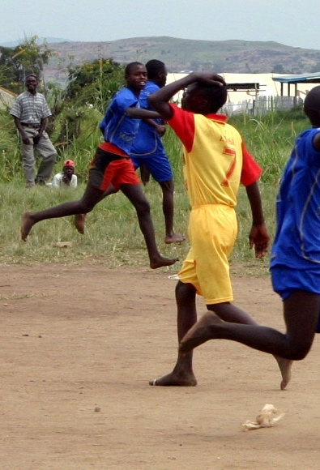
SUPERVISION STRUCTURES
Suggested ratio:
  1 supervisor: 5-6 caseworkers
Individual supervision on a regular basis
  1 hour per week (ideal)
  No less than 1 hour every two weeks
Carried out by someone who has at least 2 years of child protection and case management experience
Complemented by weekly case management meetings
Supervisor can be different than line manager such as an external agency/consultant if confidentiality measures are put in place
Photo: Shahrzad Joharifard/The IRC
Notes:
10 minutes
Say: Building on the IA definition and the 3 functions of supervision; the CM Guidelines also have some suggested supervision structures. This slide provides some general guidance about structuring supervision into a case management team’s work plan.
Read each point and check for understanding
Key messages:
Individual Supervision is irreplaceable and critical in case management practice.
Ratios should be adjusted if necessary and can be agreed upon in an inter-agency coordination forum.
Frequency and length of individual supervision should be adjusted on caseworker experience and situation

Slide 20
SUPERVISION STRUCTURES
Manager & Supervisor
Caseworker
Caseworker
Caseworker
Manager
Supervisor
Caseworker
Caseworker
Caseworker
Direct line manager also takes the role of supervisor within a case management team
Case management capacity building officer or partner takes the role of supervisor within a case management team. This person can be either internal or external to the team
Notes:
10 minutes
Say: Remember that in order to meet the functions of supervision, the relationship has to be one of safety and trust. For this reason, The CM Guidelines also mention that it may be preferred that the supervisor is not the direct line manager in order to promote a safe space where the caseworker can speak openly and to ensure the supervisor has adequate/necessary qualifications or experience in the field of child protection and case management.
Allow time for a discussion about these different potential supervision structures.
Both structures present challenges and benefits, but regardless of the one within your organization, it is critical to have clear roles and responsibilities.
Say: In module 3, when we are looking at Supervision Skills, we will be talking about how to ensure a safe, confidential, encouraging environment for supervision to be effective.
Distribute 1.1 Definition and Functions of Supervision and review together

Slide 21
AND STRATEGIES OF SUPERVISION
CHALLENGES
After reviewing the core functions and
responsibilities of supervision:
What are the challenges of supervision?
Notes:
10 minutes
Say: Now that we understand the IA definition and functions of supervision, I’d like to take some time to discuss what is preventing us from reaching quality supervision within our context and organizations.
Small Group exercise
(10 minutes in groups, 10 minutes each group for plenary.)
Instructions:
1. Ask each group of participants (at each table) to answer the question “What are the challenges of supervision?”
2. Instruct each group to compile their responses on sticky notes (1 challenge per sticky note.)
3. When each group has compiled all the challenges, ask one group member to bring them to a flip chart in front of the room and read aloud to the large group.

Slide 22
COMMON CHALLENGES IN SUPERVISION
Staffing structures
  Supervisors are expected to manage large teams
  Supervisors are expected to only perform the administrative function (makes balancing management and supervision difficult)
  Supervisors are expected to oversee multiple projects/teams
Knowledge and experience of supervisors
Caseworkers fear criticism, so they withhold concerns
Time constraints
Lack of funding and commitment from organization
Blurred boundaries between supervisor and caseworker
Unrealistic expectations for what can be accomplished in the context
Distance, communication and transportation costs
Caseworkers expect supervisor to have a solution for every problem
Lack of supervision and guidance for supervisor
Notes:
10 minutes
Say: Here is a partial list of common challenges found globally in CP case management programs.
Ask: How do these challenges compare with those you identified in your small groups?
Key messages:
This training is meant to help you begin to practically address some of these challenges
There is not always an immediate solution to every problem
We will think about short term and longer term strategies. (For example, some challenges can be addressed in the next few days through learning new skills while others might require shifts in your organization’s structure and staffing ratios)

Slide 23
STRATEGIES
AND CHALLENGES OF SUPERVISION
Promising Practices:
What is working well with supervision in your context?
What are supervisors doing well?
Notes:
10 minutes
Say: Although there are many challenges that supervisors are facing in our contexts, there are already many things that supervisors are doing well already!
Ask:
What is working well with supervision in your context?
What are supervisors doing well?
Facilitator’s Note:
Encourage participants to focus on supervision as it has been defined in the previous slides (rather than broader case management issues.)
Mention that identifying promising practices is one way of using a strengths-based approach. Identifying and using strengths is a strategy to solve difficult problems.

Slide 24
COMMON STRATEGIES IN SUPERVISION
Build in regular supervision as an integral part of the working relationship
Recruit supervisors who have experience as caseworkers and can demonstrate technical competence
Build a supportive and safe atmosphere
  Always treat concerns and questions with respect, both ways
  Remember you are on the same team — goal is the child’s best interest
  Empower caseworkers to find and propose creative solutions to the challenges
Remember it is the supervisory relationship that makes a big difference
Be creative about finding or creating professional development opportunities
Notes:
5 minutes
Say: To add to your list of promising practices, here are some common strategies tried and successful in other contexts. We will be speaking about more of these strategies in depth throughout course of our training and how they might fit into your contexts.

Slide 25
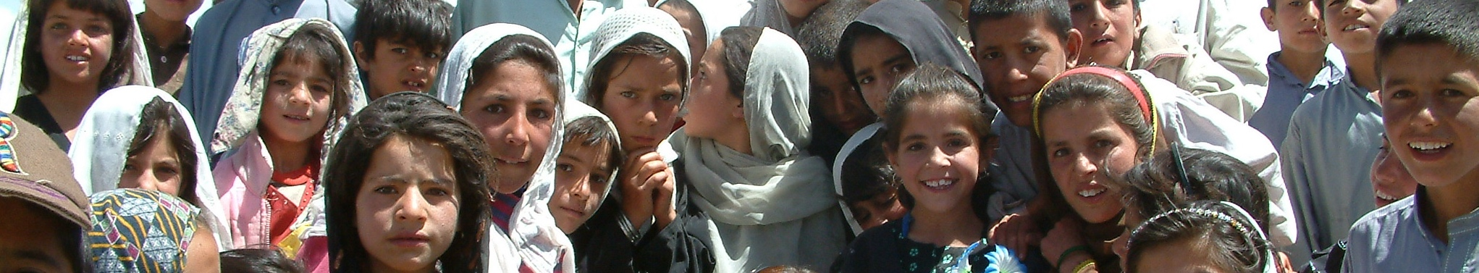
Key Message:
SUPERVISION IS A PROTECTIVE PRACTICE
Children should remain at the center of the supervision process
Protects children and families from caseworkers who have inadequate experience, are careless, or who breach professional boundaries
  Protects caseworkers from making mistakes, burn-out or over/under involve themselves which may cause harm to children
If caseworkers are encouraged and supported to reflect on their practice, a culture of openness and transparency is more likely to be fostered, resulting in better outcomes for children
Photo: The IRC
Notes:
5 minutes
Read and ensure understanding of any points that weren't captured in the discussion.

Slide 26

REVIEW QUIZ
What is case management supervision?
What are the three functions of supervision (and briefly what does each function entail)?
Name a reason why supervision is important?
What are some suggested supervision structures from the IA CM Guidelines?
Name a challenge to supervision from your context.
What is an example of a supervision strategy or promising practice from your context?
Notes:
10 minutes
Say: now we’re going to have an opportunity to review what we discussed in this first module
Facilitator's note: Try to make this activity a fun competition! Give some prizes/ candy at the end to motivate participants.
Always be encouraging when delivering a plenary quiz. Never say an answer is wrong. If necessary, say something like: what we are looking for here is an answer that reflects... Give prizes to everyone who tries even if their answer isn't complete.
Answers:
Correct answer is the IA definition. It should mention: a relationship
The 3 functions are: administrative, development, support
The role of consistent, quality supportive supervision directly relates to positive outcomes for the children we serve.
The suggested structures include:
Suggested ratio: 1 supervisor : 5-6 caseworkers.
Individual supervision on a regular basis.
1 hour per week.
No less than 1hour every two weeks.
Complemented by weekly case management meetings.
Supervisor can be different than line manager such as an external agency/consultant if confidentiality measures are put in place.
5. Any challenges from the discussions wins the prize
6. Any strategy or promising practice from the discussions wins the prize

Slide 27
MODULE AIM AND
LEARNING OUTCOMES
Aim:
Understand good practices of supervision and coaching within child protection case management.
Learning Outcomes:
Understand supervision as a relationship and coaching as a method.
Know the three functions of supervision.
Identify what is working well in your contexts and identify existing challenges.
Begin considering your CM Supervision Action Plan.
Notes:
5 minutes
Review the learning goals we had at the beginning of the module.
Ask if we covered them or if anyone has remaining questions about any of the points.

Slide 28

DO YOU HAVE ANY INITIAL THOUGHTS
FOR YOUR ACTION PLAN?
Notes:
10 minutes
Hand out the Supervisor’s Action Plan (if it wasn't handed out in Introduction module).
Say: We will be spending time reflecting on an action plan for our contexts throughout the training. For this module, I’d like to encourage you to reflect on the definition of supervision, the functions of supervision and the challenges in your context and write down any initial thoughts for your action plan.
The action plan will be a living document throughout the training and now is a time for making rough note or documenting initial thoughts. We will "fine-tune" or "perfect" our plans over the coming days.

Slide 29


REFERENCES
Alliance for Child Protection in Humanitarian Action. (2014). Inter-agency Guidelines for Case Management and Child Protection. Retrieved 2017, from https://resourcecentre.savethechildren.net/library/inter-agency-guidelines-case-management-and-child-protection
Alliance for Child Protection in Humanitarian Action. (2014). Child Protection Case Management Training Manual for Caseworkers, Supervisors and Managers. Retrieved 2017 from: https://resourcecentre.savethechildren.net/library/ia-case-management-training-package
Australia Associaltion of Social Workers. (2014). Supervision Standards. Retrieved 2017, from https://www.aasw.asn.au/practitioner-resources/related-documents
Carpenter, J. et al. (2012) Effective Supervision in Social Work and Social Care. SCIE, Research Briefing 43
Edmunds, H. (2012). A Model for Reflective Practice And Peer Supervision Groups. Sussex Health Partnership
Hawkins P. and Shohet, R. (2007). Supervision in the Helping Professions (3rd.Edition). Milton Keynes: Open University
Kadushin, A. and Harkness, D. (2002) Kadushin, A. and Harkness, D. (2002) Supervision in Social Work (4th edition) New York: Columbia University Press.
Morrison, T. (2005) Staff Supervision in Social Care (3rd ed) Brighton: Pavilion
National Association of Social Workers and Association of Social Work Boards. (2013). Best Practice Standards in Social Work Supervision. Retrieved 2017, from National Association of Social Workers: https://www.socialworkers.org/LinkClick.aspx?fileticket=GBrLbl4BuwI%3d&portalid=0
Stevens, I (2015). Practicing Supervision in Child Care and Child Protection Agencies. Retrieved 2016, from www.childhub.org

