Slide 1
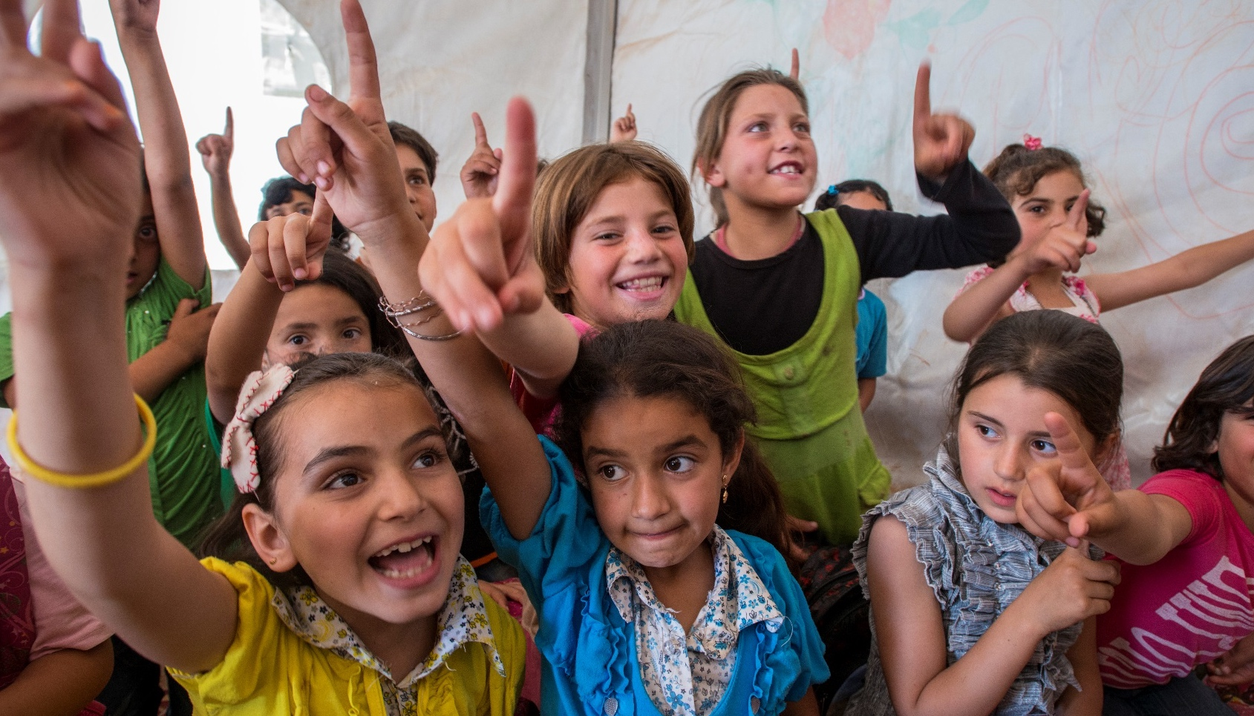


Child Protection Case Management
Supervision & Coaching Training
Date
Location
Photo: Peter Biro/The IRC
Notes:
20 minutes
Distribute: 0.0 Supervision and Coaching Pre-test and allow time for participants to complete (if not accomplished prior to the training)
Instructions:
Warmly welcome the participants!
As the facilitator introduce yourself.
If possible, invite sponsor or local official to welcome participants.

Slide 2



THE ALLIANCE
FOR CHILD PROTECTION
IN HUMANITARIAN ACTION

Slide 3



CASE MANAGEMENT TASK FORCE
Created under the CPWG in 2012 with the development of the CPMS
Since 2016 operating under the Alliance for Child Protection in Humanitarian Action
MEMBERS:
  CP AOR
  CPIMS Steering Committee
  International Rescue Committee
  Plan International
  Save the Children
  Terre des hommes
  UNICEF
  UNHCR
  War Child - Holland
Notes:
5 minutes
Say: The source of the training package is the Case Management Task Force, under the global Alliance for Child Protection in Humanitarian Action.
Review: The points on the slide.
Key Message:
This training package is one of four key resources that have been developed under the CMTF. The others include:
Interagency CM Guidelines
Interagency CM Training package
Child Protection Minimum Standards (standard 15 is about Case Management)

Slide 4
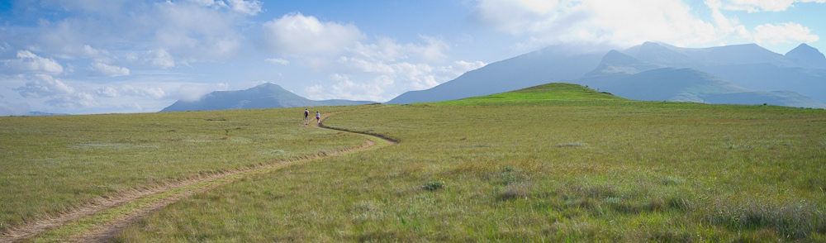
WELCOME
Icebreaker:
Think back in your journey becoming the Child Protection professional you are today…
Who is a person who guided, supported and coached you?
Notes:
40 minutes
Instructions: Invite participants to stand in a circle and introduce themselves by:
Name
Organization
Role
A mentor (a person who guided, supported, and coached you) and something about this person that has remained with you.
Why you are interested in the workshop
Following all the participant introductions, thank them for sharing.
Say: None of us would be the Child Protection professionals we are today without our mentors. I’d like to encourage you to keep your mentor in mind throughout the training as role-models for what we are striving toward as supervisors within case management.

Slide 5
OBJECTIVES
OF THE
TRAINING
1.
To enhance case management supervisor’s understanding of the importance and functions of supervision and coaching
2.
To encourage the use of good practice models and tools for supervision
3.
To review and practice supervision and coaching skills using supervision tools
4.
To promote staff care and team well-being
5.
To develop realistic supervision action plans
Notes:
10 minutes
Say: The overall goal for this training is to increase case management supervisors’ confidence, capacity and support to caseworkers to provide safe, ethical and competent case management services to vulnerable children and their families.
Review the 5 objectives with the participants

Slide 6
TRAINING AGENDA
Insert agenda here
Notes:
10 minutes
Distribute: 0.1 CM Supervision Training Agenda and briefly review it with participants.

Slide 7
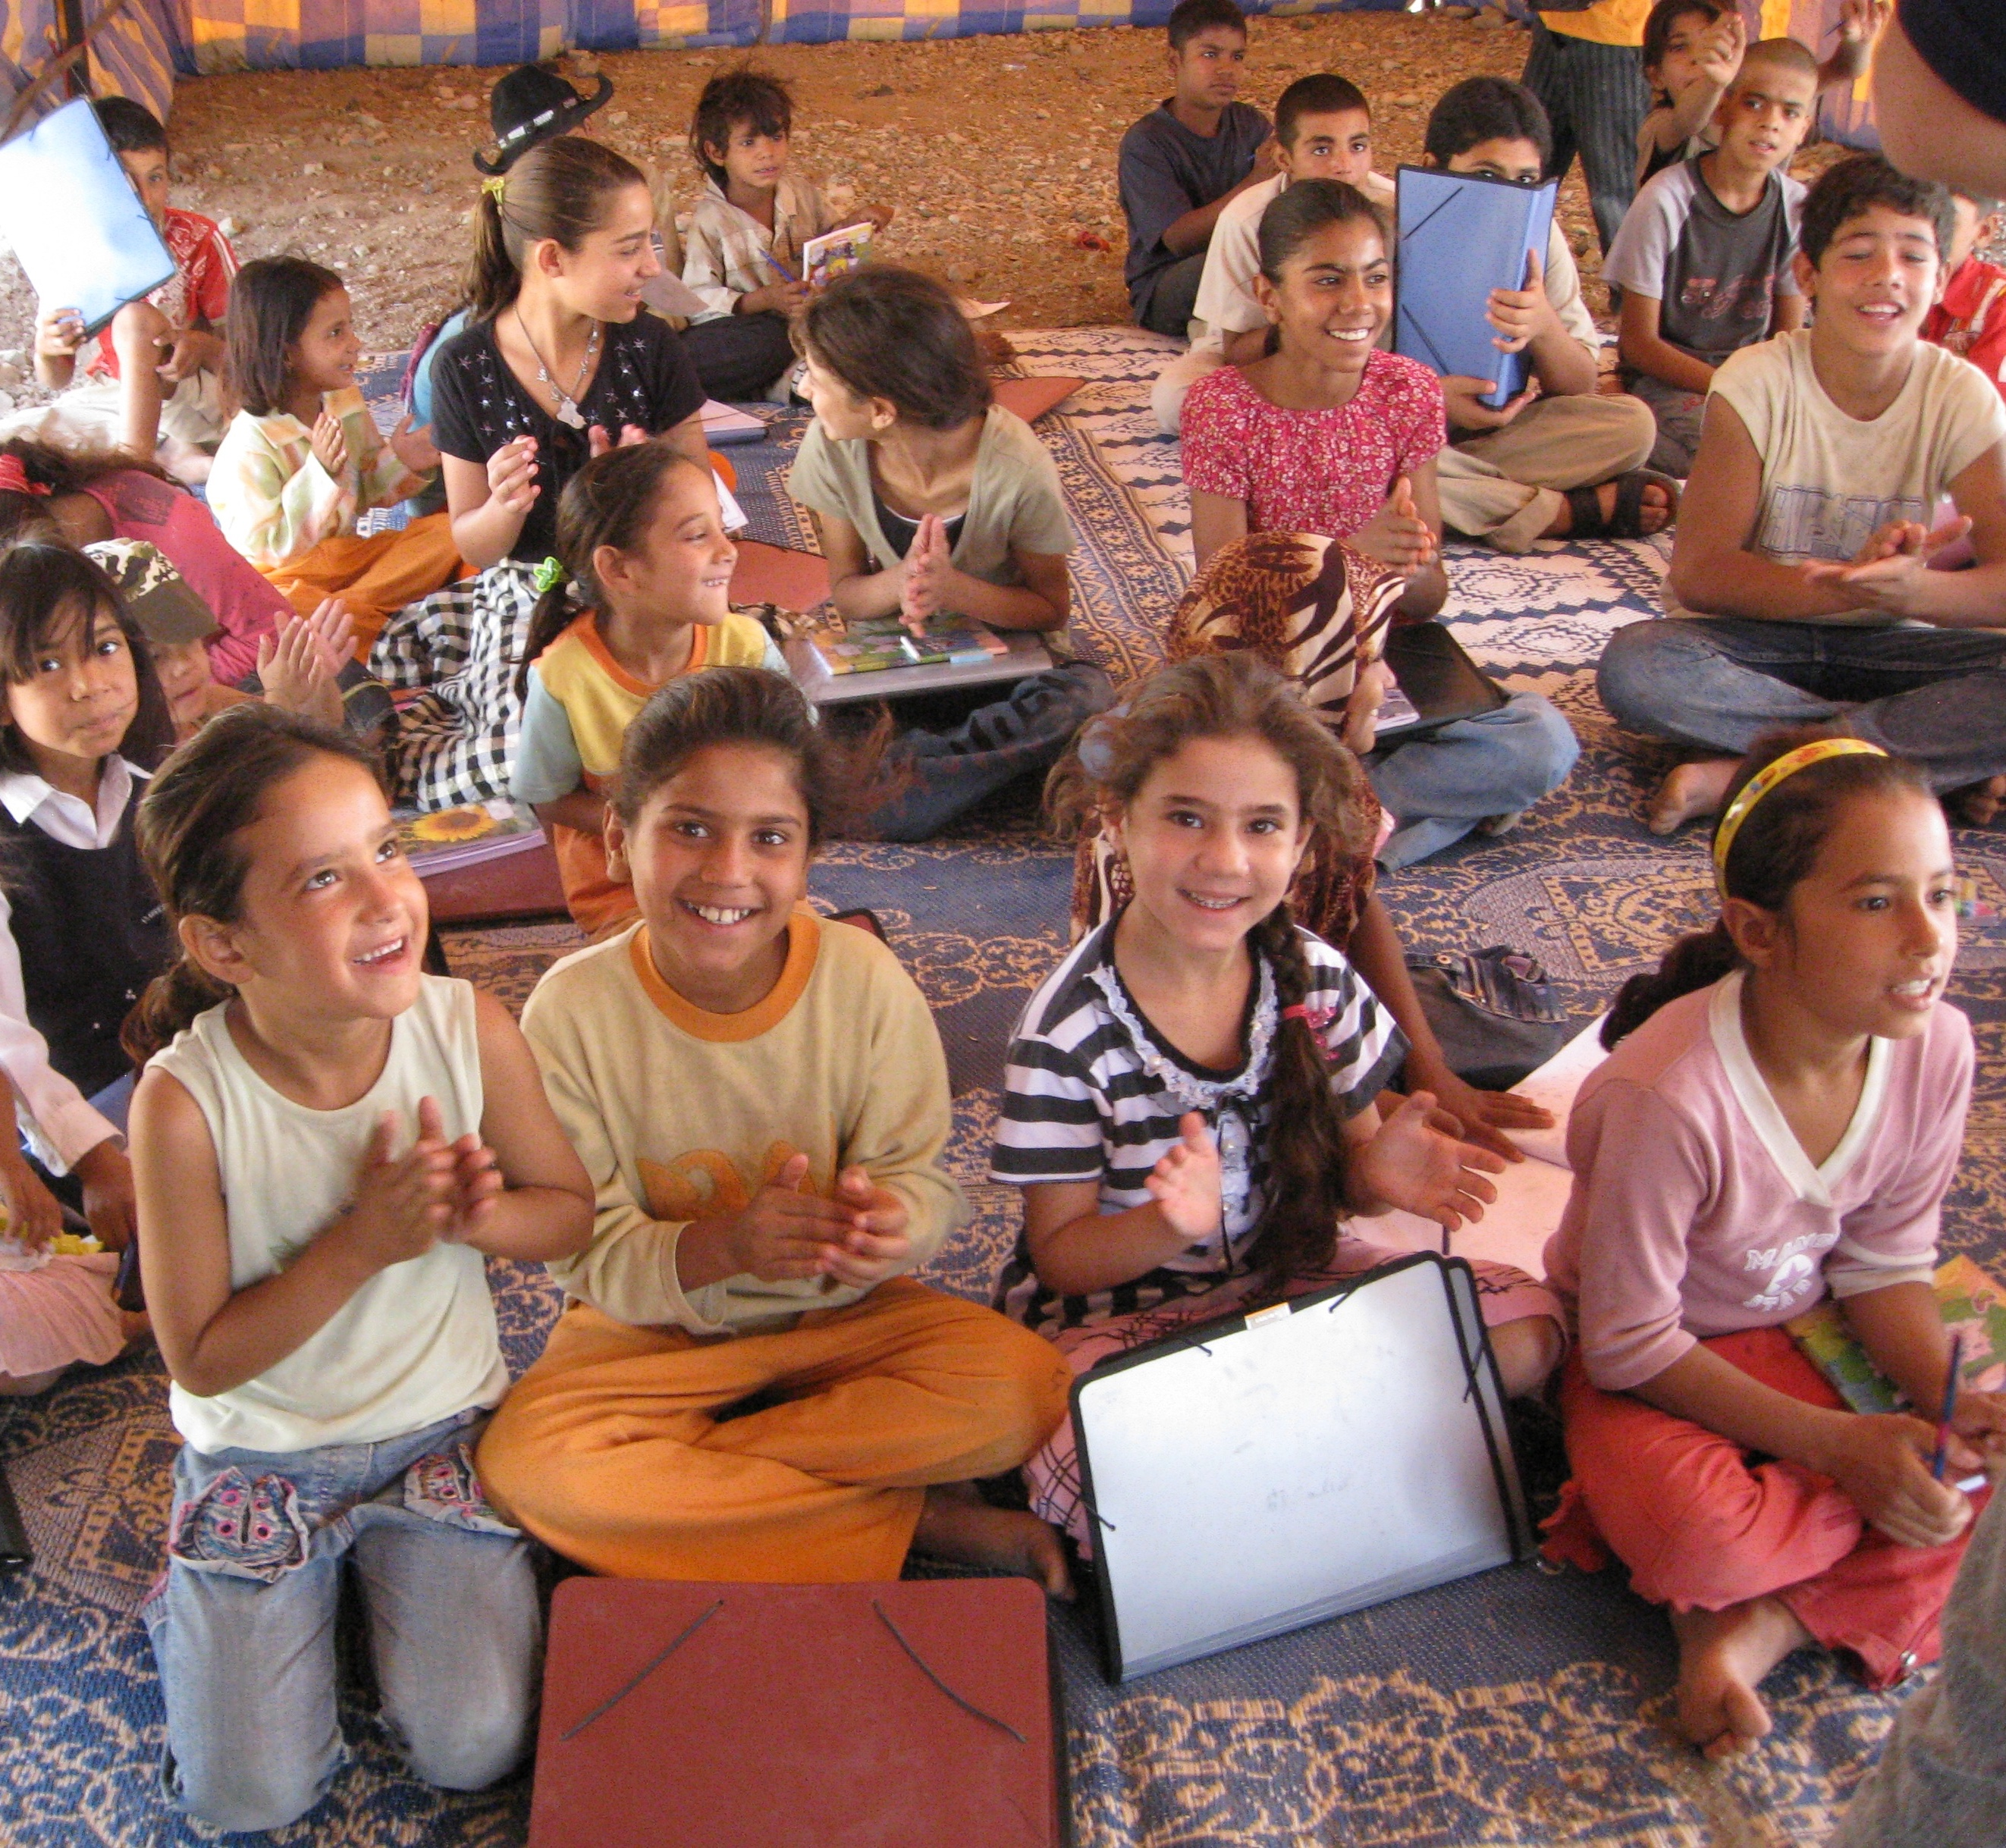
SUPERVISION ACTION PLANS
Goal:
To help supervisors put knowledge and skills into practice, we will be taking time at the conclusion of each day to work on action plans
Action plans will include points for you as an individual supervisor and also points for your team
Photo: Jessica Malter/The IRC
Notes:
10 minutes
Distribute: 0.2 CP CM Supervision Action Plan and review with participants
Say: The purpose of the Supervision Action Plan is for each of you to take opportunities throughout the training to:
Think and plan about how you would like to put the information from the training into action within your own team and organization.
The planning can take place in 3 areas: 1) actions to be taken personally as supervisors 2) actions to be taken with your case management teams 3) resources needed
Say: There will be an opportunity to fill in your action plan at the conclusion of each module.

Slide 8
GROUP
AGREEMENTS
Open to Sharing Ideas and Opinions
Non-judgmental Environment
Group Safety
Notes:
15 minutes
Say: Before we begin, we are going to establish some group agreements for how we want to work together in this training. This is important, as we would like to create a fun, safe and inclusive learning environment, where everybody get a chance to learn as much as possible. Who has some suggestions for the group?
Ask for suggestions and write them on a flip chart. Prompt for more ideas, ensuring that respect, confidentiality, open participation are included – and making sure that ideas such as ‘respect’ are broken down into what they look like in practice (e.g. ’What does it look like when we respect each other?).
Instructions: Be sure to establish a “parking lot” and explain its use.

Slide 9
PARTICIPATING TOGETHER
Can we agree on these ways of working together?
TAKE CARE OF
YOURSELF
PROTECT CONFIDENTIALITY
EQUALITY &
RESPECT
TAKE CARE OF
OTHERS
Remove identifying information from any case stories
shared.
Honor different ideas,
opinions, experiences
and histories
Stretch, get water
and get up as needed.
Listen, engage
and be attentive.
Notes:
5 minutes
Ask: Can we agree on these ways of working together?
Ensure the following points are mentioned in plenary or covered another way:
Take care of yourself: Consider your own psychological wellbeing – if a story would be distressing to share, consider before you start talking about it
Take care of others: Respect and listening, be attentive to others
Confidentiality: Do not mention names or other identifying information when sharing examples or case studies
Equality of participation and respect for diversity – Listening and mutual respect for different ideas, opinions and experiences
NO cell phones/laptops
Acknowledging expertise in the room on context (best practices, global tools)

Slide 10

HOUSEKEEPING
Break & Lunch Locations
Bathrooms
Phones, Computers, Essential Calls
Notes:
5 minutes
Instructions: Review housekeeping issues. Let participants know where bathrooms are, where breaks will take place, and review agreements around the use of computers and phones (if participants need to send an urgent email, where this should happen, for example). This is also the time to review hotel arrangements, per diems, travel, etc. if any of these are relevant.

