Slide 1


Tools and techniques to support caregivers and families
MODULE 3 OF LEVEL 3: FAMILY STRENGTHENING IN CASE MANAGEMENT
Notes:
WELCOME
Welcome participants to the training
1

Slide 2
Facilitation guidance
Notes:
INTRODUCTION
This module focuses on tools and techniques caseworkers can utilize to support family strengthening, and is the third module of three in the family strengthening in case management training. This training is part of the Level 3 trainings in the Inter-Agency Child Protection Case Management Training. Before participating in this training, participants should have completed Level 1 and Level 2 modules.
This module explores the following key topics:
Supporting attachment and bonding with young children
Building positive relationships with children
Building parents/caregivers emotional and empathetic skills
Creating a predictable and secure environment through family rules and routines
Strengthening social support networks
Basic money management tools
Relaxation and self-care techniques to support caregivers
The facilitation guidance can be found in the notes of each slide.
CONTEXTUALIZATION
It is important to take the following steps to contextualize this module before delivering it:
Session 2 Slide 16 "Ways to promote attachment before a baby is born" - Local and cultural practices may be added to this slide where relevant.
Session 2 Slide 17 "Ways to promote attachment once baby is born" - Local and cultural practices may be added to this slide where relevant.
Session 2 Slide 18 "Games for babies and toddlers" - Add local games to the participant workbook where relevant.
Session 2 Slide 22 "When to refer" - Update the notes based on local referral pathways and SOPs.
Session 3 Slide 26 "Positive attention" - Local activities may be added to the notes.
Session 3 Slide 31 "Role-play: child-led play" - The script can be adapted to the context.
Session 4 Slide 43 “Plenary discussion” Remove one image – whichever one is least representative of your context.
Session 4 Slide 48 "4 steps of empathy role play" - The scenario can be adapted to the context.
Session 4 Slide 49 "Think and share" - Adapt the suggested situations in the facilitator notes to the context.
Session 4 Slide 51 "Empathy for all children" - The script can be adapted to the context.
Session 7 Slide 84 "Tool: Ecomap" - Edit the names and roles in the ecomap based on the context.
Session 7 Slide 86 "Support groups" - Adapt based on whether there are support groups or an equivalent in your context.
CONTINUED →
2

Slide 3
Facilitation guidance
Notes:
Session 8: Basic money management tools. This session should be contextualized based on whether or not Cash and Voucher Assistance (CVA) is available in your context, as the tools should be used in line with CVA processes and timelines in contexts where this is the case, or they can be used more flexibly in contexts where money management tools are being used to support families with money management without CVA.
Session 8 Slide 92 "Types of household expenses" - Examples should be contextualized.
Session 8 Slide 93, "When and where should you use these tools?" - Adapt the “when” section based on whether or not clients are accessing or will be accessing CVA in the context.
Session 8 Slide 97 Remove this slide in contexts where families do not receive CVA."
Session 8 Slide 99-102 “Money matters tools" - Update the amounts in the scenario based on what would be realistic in the context (it does not need to be very accurate; it can be rough estimations)
Session 9 Slide 107 "Caregiver stress" - This story can be adapted to the context.
Session 9 Slide 110 "Coping strategies" - This may be adapted based on local norms and practices.
Session 9 Slide 112 “Relaxation and self-care techniques toolbox" - The techniques in the participant workbook should be adapted to the context.
PREPARATION
The following items are needed to deliver this module in a face-to-face training environment:
One workbook per participant
One feedback form per participant.
Projector and laptop
Flipchart, tape, and pens
OVERVIEW
Duration: TBC
Module aim: To equip participants with tools and techniques to provide direct family strengthening support to caregivers and families
Module learning objectives - at the end of this sessions, the participant will be able to:
Demonstrate parenting techniques and tools which can be used with parents, caregivers and children to support family strengthening.
Describe how caregivers can use relaxation and self-care techniques to manage stress.
Explain ways of working with families to map and strengthen social support networks.
Describe how tools can be used to support money management with families.
Sessions:
Supporting attachment and bonding with young children
Building positive relationships with children
Building parents/caregivers emotional and empathetic skills
Creating a predictable and secure environment through family rules and routines
Strengthening social support networks
Basic money management tools
Relaxation and self-care techniques to support caregivers
CONTINUED →
3

Slide 4
Facilitation guidance
Notes:
Child Protection Minimum Standards:
Standard 16: Strengthening family and caregiving environments
Standard 14: Applying a socio-ecological approach to child protection programming
Standard 17: Community-level approaches
Standard 18: Case management
Standard 19: Alternative care
SOURCES
CPWG. (2014). Child Friendly Spaces Training Package.
UNICEF. Falling in Love: Promoting Parent-Child attachment. Short e-course.
Harvard University. 5 Steps for Brain-Building Serve and Return. Center on the Develop Child.
World Health Organisation. (2022). Guide for Integration of Perinatal Mental Health in Maternal and Child Health Services.
International Rescue Committee. (2016). Safe Healing and Learning Spaces Toolkit: Parenting Skills Intervention Trainers Manual.
International Rescue Committee. (2016). Safe Healing and Learning Spaces Toolkit: Parenting Curriculum for Children.
Save the Children. (2021). Money Matters: A toolkit for caseworkers to support adult and adolescent clients with basic money management. https://resourcecentre.savethechildren.net/document/money-matters-toolkit-caseworkers-support-adult-and-adolescent-clients-basic-money/
WHO. (2016). INSPIRE: Seven Strategies for Ending Violence Against Children.
The Alliance for Child Protection in Humanitarian Action. (2021). Growing Strong Together: A Parenting Support Program to Support the Reintegration of Children and Prevent Their Recruitment.
4

Slide 5
SESSION 1
Module opening
Notes:
SESSION 1 DURATION: 0h15
5

Slide 6
Module aim
To equip participants with tools and techniques to provide direct family strengthening support to caregivers and families
Notes:
EXPLANATION
Present the slide
6

Slide 7
Learning objectives
38
  Demonstrate parenting techniques and tools which can be used with parents, caregivers and children to support family strengthening.
Describe how caregivers can use relaxation and self-care techniques to manage stress.
Explain ways of working with families to map and strengthen social support networks.
Describe how tools can be used to support money management with families.
Notes:
EXPLANATION
This module is all about using tools and techniques to support caregivers and children to strengthen families as part of direct case management support.
At the end of this sessions, the participant will be able to…
Present the slide
Does anyone have any questions or need clarification?
You can find these on Workbook page 38: Learning objectives
7

Slide 8
Agenda
1/2
Module opening
15 minutes
Supporting caregiver attachment and bonding with young children
1 hour 30 minutes
Building positive relationships with children
2 hours
Building parent’s/caregiver’s emotional and empathetic skills
1 hour
Creating a predictable and secure environment through family rules and routines
1 hour 30 minutes
Notes:
EXPLANATION
Present the slide
8

Slide 9
Agenda
2/2
Non-violent discipline strategies for caregivers
1 hour 10 minutes
Strengthening social support networks
1 hour
Basic money management tools
1 hour 30 minutes
Relaxation and self-care techniques to support caregivers
1 hour 20 minutes
Module closing
30 minutes
Notes:
EXPLANATION
Present the slide
Provide orientation to the module including practical / housekeeping information (e.g. breaks, location of toilets etc.).
9

Slide 10
SESSION 2
Supporting caregiver attachment and bonding with young children
Notes:
SESSION 2 DURATION: 1h30
______________________________________________________________________________
EXPLANATION
During this session, we will be looking at how you can support caregivers and babies/young children in the process of building their attachment and bonding.
This could potentially strengthen two of the protective factors we looked at during module 1:
Healthy caregiver-child relationships
Responsive and supportive caregivers
10

Slide 11

Minimum Standards for Child Protection in Humanitarian Action
PRINCIPLE 1: SURVIVAL AND DEVELOPMENT
The stimulation and attachment that occur in predictable, nurturing relationships are crucial to all aspects of a baby’s and young child’s development. Humanitarian actors must consider the effects of both the emergency and the response on (a) the fulfilment of children’s right to life and (b) children’s physical, psychological, emotional, social and spiritual development. Children must be supported to use their own strengths and resilience to maximize their opportunities for survival and development in humanitarian crises.
Source: Alliance for Child Protection in Humanitarian Action. (2019). Minimum Standards for Child Protection in Humanitarian Action
Notes:
EXPLANATION
Attachment is mentioned at the very beginning of the Minimum Standards for Child Protection in Humanitarian Action, in the first sentence of the first principle.
Present the slide
Can anyone explain what we mean by attachment?
11

Slide 12
What is Attachment?
The strong and enduring emotional connection between an infant & his/her caregiver during the infants first years of life.
Notes:
EXPLANATION
The strong and enduring emotional connection between an infant & his/her caregiver during the infants first years of life.
Attachment is characterised by reciprocal affection & the tendency of young infants to seek physical closeness to their primary caregiver.
12

Slide 13
Why is attachment relevant to child protection?
Notes:
EXPLANATION
Can anyone tell me why caregiver attachment and bonding with young children is relevant to child protection?
Attachment provides us with lifelong strategies to be able to respond to threats and dangers
Attachment is one specific and circumscribed aspect of the relationship between a child and caregiver that is involved with making the child safe, secure and protected
Attachment can have a long-term impact on a child’s well-being, development and relationship with their caregivers
Therefore, working on infant attachment set the foundations for longer term family strengthening and child protection in the future
13

Slide 14
Attachment and male caregivers
Secure attachments generate joy
Insecure attachments generate distress
Notes:
EXPLANATION
Babies and young children can develop different attachments with the significant people in their lives, including their fathers
The security of these attachments impacts the baby or child simultaneously: secure attachments generate joy; insecure attachments generate distress. For example, dis-engaged and remote father-child interactions as early as the third month of life have been found to predict behavior problems in children when they are older
Often a child will be securely attached to one parent but not the other. Under some circumstances, a secure attachment with one parent can ‘buffer’ the child against an insecure attachment with the other; and while children with insecure attachments to both parents do worst, children with two secure attachments do best.
14

Slide 15
Attachment and bonding
Have you noticed parents that don’t seem to have a close bond with their infants?
What kinds of behaviors did you observe in such a parent that made you think so?
What kinds of things can you do to help promote bonding and attachment between mothers and fathers and infants?
Are there gender differences in what is expected of men’s and women’s emotional expression and caregiving?
Notes:
INTRODUCTION
We will now look at attachment and bonding in the context of the families you are working with.
Divide participants into groups of 3-5 people
In your groups, discuss the questions on the slide.
GROUP DISCUSSION (10-15 minutes)
Provide 10-15 minutes for participants to complete
PLENARY DISCUSSION
Ask volunteers to share their responses
Note the responses on a flipchart
We are now going to look at some of the ways we can promote bonding and attachment in more detail.
15

Slide 16
Ways to promote attachment before a baby is born
Talk and sing to the baby, using a nurturing voice.
Touch the baby as he or she starts kicking in utero.
Start talking about names for the baby.
After delivery, have skin-to-skin contact with your baby
Notes:
ADAPT FOR CONTEXT
Local and cultural practices may be added to this slide where relevant.
______________________________________________________________________________
EXPLANATION
You may find yourself working with pregnant women and their partners, including those who may be more vulnerable (e.g. adolescent girls)
You can share some basic tips to help build some of the foundations for attachment during pregnancy
Present the slide
Talk and sing to the baby
Babies start listening to sounds in utero and can recognize both their mother’s and their father’s voice.
Skin-to-skin contact
Skin-to-skin contact is the practice where a baby is dried and laid directly on the mother’s bare chest after birth, both of them covered in a warm blanket and left for at least an hour or until after the first feed.
Skin-to-skin contact can also take place any time a baby needs comforting or calming
Skin-to-skin calms and relaxes both mother and baby, regulates the baby's heart rate and breathing, stimulates the release of hormones to support breastfeeding, and helps the baby to better adapt to life outside the womb.
Skin-to-skin with fathers or other immediate caregivers can also promote bonding and has the same benefits of regulating the baby’s temperature and heartbeat.
PLENARY DISCUSSION
What do you think of these tips?
Are these things that you could share with pregnant mothers and their partners?
Can you think of any others that are missing?
16

Slide 17
Ways to promote attachment once baby is born
Offer her/him a range of different facial expressions
Talk and babble with the baby
Hold them close
Gently moving his/her arms and legs while talking to and looking at her/him
Play together
Touch or massage the baby
Respond to their needs
Notes:
ADAPT FOR CONTEXT
Local and cultural practices may be added to this slide where relevant.
______________________________________________________________________________
EXPLANATION
You can share these tips to caregivers that can support the attachment with their baby when they are born
Present the slide
Talking and babbling to the baby
Use a variety of high and low pitches and soft to loud tones.
Using different facial expressions
Make facial expressions while talking and babbling
Copy his/her facial expressions
Touching or massaging the baby
Using gentle touch while telling him/her what you are doing.
It is important to reassure parents/caregivers that bonding can take time and it’s ok to not feel an instant connection.
These activities will help to develop that bond and attachment.
17

Slide 18






Games for babies and toddlers
39-
42
Notes:
ADAPT FOR CONTEXT
Add local games to the participant workbook where relevant.
______________________________________________________________________________
EXPLANATION
As a baby grows, the parents/caregivers can begin to play more games.
This supports the development of their bond and the baby’s brain
Guide participants to Workbook page 39-42: Games for babies and toddlers
Divide participants into pairs
With your partner:
Choose one game to teach to each other
Teach the other person as if you are teaching the game to a caregiver. (10 minutes)
Give each other feedback on whether it went well, whether it was easy to understand and any way to improve.
PARTNER WORK (10 minutes)
Provide 10 minutes for participants to complete
PLENARY DISCUSSION
What did you think of the games that you did read?
Are there other local games that you think could also support caregiver bonding with babies and young children? What about local songs or rhymes?
You can refer to this list of games any time you are working with a caregiver with a young child
This can be especially useful in cases where the caregiver and child may benefit from additional support to bond and form an attachment.
18

Slide 19
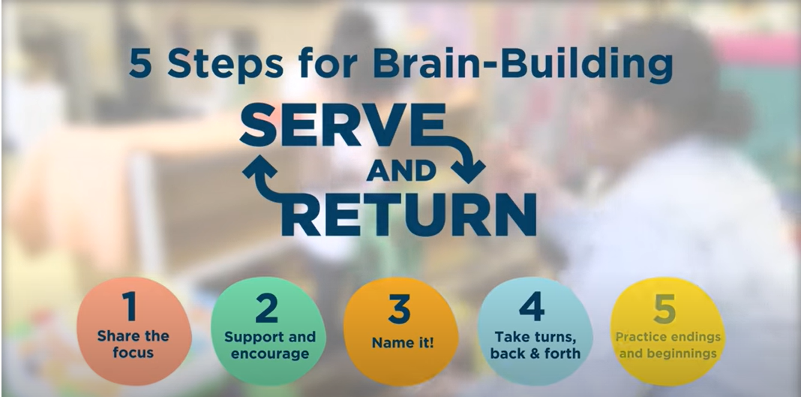
Serve and return: a practical technique for caregivers
Notes:
FACILITATOR NOTE
The video can be played with auto-translated subtitles, or the video transcript can be downloaded and translate and read along with the video.
In cases where it isn’t possible to play, you can explain it using the next slide.
______________________________________________________________________________
VIDEO
We are now going to look at a technique for interacting with children called serve and return.
Play the video: https://www.youtube.com/watch?v=KNrnZag17Ek&t=1s
19

Slide 20

Serve and return
When a child focuses their attention on something
Share the focus
Return the serve by supporting and encouraging
Give it a name
Take turns…and wait. Keep the interactions going back and forth.
Practice endings and beginnings
Notes:
EXPLANATION
Notice the serve and share the child’s focus of attention
Is the child looking or pointing at something? Making a sound or facial expression? Moving those little arms and legs? That’s a serve.
The key is to pay attention to what the child is focused on.
You can’t spend all your time doing this, so look for small opportunities throughout the day—like while you’re getting them dressed or waiting in line at the store.
Return the serve by supporting and encouraging.
You can offer children comfort with a hug and gentle words, help them, play with them, or acknowledge them.
You can make a sound or facial expression— like saying, “I see!” or smiling and nodding to let a child know you’re noticing the same thing.
Or you can pick up an object a child is pointing to and bring it closer.
Give it a name!
When you return a serve by naming what a child is seeing, doing, or feeling, you make important language connections in their brain, even before the child can talk or understand your words.
You can name anything—a person, a thing, an action, a feeling, or a combination.
If a child points to their feet, you can also point to them and say, “Yes, those are your feet!”
Take turns…and wait.
Keep the interaction going back and forth.
Every time you return a serve, give the child a chance to respond.
Taking turns can be quick (from the child to you and back again) or go on for many turns.
Waiting is crucial. Children need time to form their responses, especially when they’re learning so many things at once. Waiting helps keep the turns going.
CONTINUED →
20

Slide 21
Extra slide for facilitator notes
Notes:
Practice endings and beginnings.
Children signal when they’re done or ready to move on to a new activity.
They might let go of a toy, pick up a new one, or turn to look at something else.
Or they may walk away, start to fuss, or say, “All done!”
When you share a child’s focus, you’ll notice when they’re ready to end the activity and begin something new.
PLENARY DISCUSSION
Ask what do you think of this technique?
Would you feel confident explaining it to caregivers?
21

Slide 22

When to refer
  Feeling sad, crying easily or more than usual
  Finding no pleasure in experiences or activities that were once enjoyed
  Lacking energy or motivation
  Worrying or “thinking too much”
  Sleeping more or less
  Eating more or less
  Reduced concentration
  Difficulty in making decisions
  Feelings of guilt or hopelessness
  Feeling worthless
  Thinking that something bad is about to happen or that the future is hopeless
  Thoughts of self-harm or suicide
  Non-specific body aches and pains and other physical symptoms
  Feeling troubled by memories or dreams about bad experiences
  Some symptoms may be more specific about the baby:
        Unable to stop worrying about the baby
        Feeling unable or unwilling to care for the baby
        Negative thoughts about the baby
Notes:
ADAPT FOR CONTEXT
Update the notes based on local referral pathways and SOPs.
______________________________________________________________________________
EXPLANATION
In some cases, you may work with new parents / caregivers who are struggling to bond with young children, or who are showing signs mental health concerns, such as post-natal depression or anxiety.
In cases where you are concerned, it is important to seek more specialized support, either through MHPSS or medical services. This is even more urgent if you think the child is at risk.
PLENARY DISCUSSION
What kind of signs do you think could indicate that there is a problem?
Symptoms of poor mental health during the perinatal period may include…
Click to reveal the slide
Present the slide
In cases where you recognize these signs, it is best to speak to your supervisor and/or speak to the caregiver about your concerns (if safe and appropriate) to then refer to a mental health professional, where available.
22

Slide 23
Key learning points
The stimulation and attachment that occur in predictable, nurturing relationships are crucial to all aspects of a baby’s and young child’s development.
There are various ways attachment can be promoted before and after birth with caregivers and infants, including through play.
Serve and return is a technique caregivers can use when interacting with their children.
Notes:
EXPLANATION
Present the slide
Does anyone have any questions or need clarification?
23

Slide 24
SESSION 3
Building positive relationships with children
Notes:
SESSION 3 DURATION: 2h
______________________________________________________________________________
EXPLANATION
This module is about building positive relationships with children, primarily through the use of three parenting tools.
While the previous session focused primarily on infants and young children, this session looks at children of all ages.
This session also supports two of the protectives factor we discussed in module 1:
Healthy caregiver-child relationships
Responsive and supportive caregivers
24

Slide 25

Golden rule of psychology: children need and want adult attention
No attention
Desirable behavior
“Positive nurturing is nourishing the aspects of life we want.”
Dr. Steven Bavelok
The Nurturing Parent Program
Negative / violent attention
Undesirable behavior
Positive / praising attention
The removal of attention (ignoring) decreases children’s behaviors (desirable or undesirable).
Notes:
EXPLANATION
All children want attention from their parents and from other adults they love and respect.
Children can learn to get attention in both positive and negative ways and attention can reinforce both positive and negative behaviors.
When a parent praises a child for a good behavior – such as sharing – that behavior is encouraged by the parent.
Negative behaviors – like hitting – can also be reinforced by attention (either negative or positive).
If a parent gives more attention when children are misbehaving, then it is the negative behaviors that are reinforced.
If a child whines and cries because the parent will not buy them a sweet, and the parent keeps arguing with the child, this is negative attention and it reinforces the child’s whining!
The more positive attention that parents give to positive behaviors, the less that children will seek attention through negative behaviors.
Parents need to be strategic about what behaviors they are giving attention to.
25

Slide 26
Positive attention
Can you think of some ways parents and caregivers can pay positive attention to their children?
When are the best times during the day for them to pay positive attention to children?
What are the best kinds of activities they can use to pay positive attention to children?
Notes:
ADAPT FOR CONTEXT
Local activities may be added to the notes.
______________________________________________________________________________
PLENARY DISCUSSION
Facilitate a discussion with the questions on the slide
Complement the responses with the following examples:
Playing with their children
Having dinner or breakfast together
Praise for completing their chores or homework
Taking a walk and talking together
These are questions you can also discuss with caregivers.
Parents also need to be strategic about giving attention!
When children misbehave in ways that are annoying, but not harmful to themselves or others, parents can ignore that misbehavior.
If no one listens to a child who whines, then there is no point for the child to continue whining.
When parents yell at or hit children who whine, they are providing them with negative attention and thus reinforcing that negative behavior.
We will look at this more in the session on discipline strategies.
26

Slide 27


Three parenting tools
Playing
Praising
Spending quality time
Notes:
EXPLANATION
We are going to talk about 3 different parenting tools that you can share with parents and caregivers
This can help them encourage more positive behaviors in their children and decrease negative behaviors.
The tools are…
Present the slide
27

Slide 28
Playing with children
How can playing with children encourage their positive development and behavior?
Notes:
PLENARY DISCUSSION
How can playing with children encourage their positive development and behavior?
Complement the responses with the next slide
28

Slide 29
What do children and parents learn through play?
Parents learn more about their children’s likes and preferences, skills, and abilities.
Parents playing with children improves children’s self-esteem; children feel they are important to their parents!
Children learn social skills such as taking turns and sharing.
Children learn how to use their imaginations – play fosters creativity!
Notes:
EXPLANATION
Present the slide
29

Slide 30
Tips on how parents/caregivers can play with children
Sit near your child and on their level.
Follow your child’s lead and take their suggestions of what to play.
Pace the play to suit your child’s developmental level.
Have fun and laugh together!
Encourage creativity
Explore dreams and hopes for the future through imagination
Describe and talk about what children are doing
Coach positive peer and sibling play
Encourage independent problem-solving
Give positive attention and approval to play
Stop inappropriate play immediately
Avoid power struggles
Notes:
EXPLANATION
Here are some guidelines that you can share with parents on how they can play children.
Present the slide
Avoid power struggles
A power struggle is an argument that takes place because the people involved are fighting about who will control and dominate the relationship.
For example:
A 7-year-old child is playing a game with his parent
The child decides that he wants to play a different game
The parent tells the child they have to finish this game first
The child argues that he wants to play the new game
The parent responds by arguing that they should finish playing the first game
If the goal of play is to have fun, learn and build relationships with children, then we need to avoid arguments whenever possible!
PLENARY DISCUSSION
Can you think of caregivers you work with who would benefit from these tips?
What kind of caregivers and families are they?
30

Slide 31
Role-play: child-led play
43
Notes:
ADAPT FOR CONTEXT
The script provided in the workbook is a sample script.
Adapt to your context or create your own
Change the names to ones that are familiar in your context
______________________________________________________________________________
INTRODUCTION
We will now do a role play
Ask for 2 volunteers, preferably one male and one female.
Guide the volunteers to Workbook page 43: Role-play – child-led play
Instruct the role players in private:
In this role-play, the person playing the ‘parent’ needs to be really bossy and direct everything the ‘child’ does.
For example, if you are playing with a ball in the role-play, the parent might insist that the child throw or kick it a certain way for a specific number of times; or, if you are playing marbles, the parent will tell the child they are doing it wrong and insist that they do it correctly.
I will stay close by to help out in case you get stuck.
ROLE PLAY
Provide 5-10 minutes for the volunteers to prepare
Have the volunteers to present the role play
CONTINUED →
31

Slide 32
Extra slide for facilitator notes
Notes:
PLENARY DISCUSSION
Ask the role players - How did it feel?
We will re-do this practice.
Instruct role players in private:
This time, the parent must follow the child’s lead and play whatever the child wants to play.
The parent should some kind words to the child while they are playing. For example:
Wow son! Look at you kicking that ball!
You are going to be a great football player someday!
I love playing with you and am so happy you are my son!
Thanks for playing with me and taking turns sharing the ball.
ROLE PLAY
Have the volunteers to present the role play in front of the group.
PLENARY DISCUSSION
Ask the role players - How did it feel?
Ask the other participants – Can you share positive comments to the role players for their participation?
Facilitators should praise them as well!
INTRODUCTION
Divide participants into groups of 3 people
With your group:
Find some materials in this room or outdoors to create some kind of game or something to play with a child.
Practice child-directed play
Take turns playing the ‘parent’, ‘child’ and ‘coach’
Concentrate on child-directed play! Only practice the positive parent–child interactions in this role-play.
GROUP WORK (15-20 minutes)
Provide 15–20 minutes for participants to complete
PLENARY DISCUSSION
What did you like about this kind of play?
What did you find hard?
When you share this with parents or caregivers:
You can re-enact these two role plays with them being the children and you being the adult
Alternatively, you can explain the scenarios to them and ask how they think the child and parent feel in each scenario.
32

Slide 33
Praise
Notes:
PLENARY DISCUSSION
What is praise and why is praise good for children?
Praise is telling a child that you like something that he or she is doing.
Praise shows love and affection.
Praise helps children build self-esteem and confidence.
Praise helps children build healthy social and emotional connections!
How does praising children make parents feel?
Praise helps parents feel good about their children and builds positive relationships.
Praise reinforces desirable behaviors: parents spend less time punishing or disciplining children because the child spends more time seeking parent’s positive attention.
Examples of praise statements:
I am so proud of the way you are doing your homework so carefully.
Thank you for completing your chore and being so responsible.
That is very polite.
I am so glad you are my son/daughter.
33

Slide 34
Effective praise and encouragement
43
Decide what values, positive character traits or new behaviors are most important for a child to develop at various stages of development.
Look for opportunities to reinforce them.
Describe exactly what a child did to elicit praise.
Try to give praise as soon as you notice good behavior. Prompt praise is best because the child will be most aware of what they did to deserve it.
Don’t hesitate to praise children daily. A child needs to know that their parent has noticed the good habits they are developing.
Praise children for trying hard. Don’t wait for perfection!
You can also praise children nonverbally with a hug or smile!
Notes:
EXPLANATION
Present the slide
PLENARY DISCUSSION
What are some other ways to nonverbally praise children?
What are some of the praise statements?
Write the responses on a flipchart.
INTRODUCTION
Divide participants into pairs
Guide participants to Workbook page 43: Behavior and praise statements
With your partner, think of a specific praise statement for each of the behaviors on the list
PARTNER WORK (15 minutes)
Provide 15 minutes for participants to complete
PLENARY DISCUSSION
Invite volunteers to share their responses
Complement with the possible responses below
______________________________________________________________________________
POSSIBLE RESPONSES
Doing well in school.
“I am so proud that you are working hard and doing well in school.”
Being kind to siblings.
“It makes me so happy to see you spending time with your younger sister.”
Completing homework.
“Good job for completing your homework. You are so smart!”
Completing chores or housework.
“Thank you for completing your chore. It really helps our family when you help out.”
34

Slide 35
Role-play: Praise
Notes:
INTRODUCTION
Ask for 3 volunteers – 1 male and 2 females if possible, or 2 males and 1 female.
Instruct the volunteers out loud:
Two will play ‘children’ (ages 7 and 8).
The ‘children’ will play cooperatively
The person playing the ‘parent’ will offer praise statements
I will be available to help out, if needed
You can model this first, if the volunteers need an example.
ROLE PLAY (3 minutes)
Have the volunteers to present the role play
PLENARY DISCUSSION
After about 3 minutes, stop the role-play
Ask the ‘children’ - How did it feel to be praised?
Ask the ‘parent’ – How did it feel to praise?
Ask the group – Share positive comments to the role players for their participation
Facilitators should praise them as well!
INTRODUCTION
Divide the participants into pairs
With your partner:
Practice the following scenario – a parent monitoring a child doing homework.
The parent can make statements such as:
Wow, you are really concentrating!
You are so smart.
I am proud of you for doing your work so carefully.
You have 15 minutes to complete this practice
Make sure you have the opportunity to play both roles
CONTINUED →
35

Slide 36
Extra slide for facilitator notes
Notes:
PARTNER WORK (15 minutes)
Provide 15 minutes for participants to complete
PLENARY DISCUSSION
How did it feel when you were the child receiving praise?
What did the parent find hard about praising?
What approaches could you use to discuss praise with caregivers?
Could you act out a scenario with them?
Or discuss some of the values and traits they’d like to reinforce and find opportunities together of how and when they could reinforce these through praise?
36

Slide 37
Quality time
Among the families you are working with, how do you think caregivers see quality time with their children? Is it something that is valued?
Do children and caregivers in many of the families you are working with spend quality time together?
Has the emergency/crisis had any impact on how much quality time caregivers and children are able to spend together?
Notes:
PARTNER DISCUSSION
Turn to the person beside you and discuss the questions on the slide
37

Slide 38
The benefits of quality time
  Passing on cultural traditions and customs.
  Teaching life skills such as cooking and taking care of animals.
  Children feel valued and important and this increases self-confidence and self-esteem.
  Parents and caregivers have the opportunity to learn about and help their children solve problems.
Notes:
EXPLANATION
When you are discussing quality time with families, you can highlight some of the following benefits…
Present the slide
38

Slide 39
Quality time
Notes:
INTRODUCTION
Let’s think about what quality time could look like practically.
Divide participants into pairs
With your partner, come up with a list of 5 or 6 activities that parents/caregivers can do with their children, and do together as a family.
PARTNER WORK (5 minutes)
Provide 5 minutes for participants to complete
PLENARY DISCUSSION
Invite volunteers to share their responses
Complement with the possible responses on the below
When you are discussing the benefits of quality time with caregivers and potentially helping them to factor that into their routine, do you think you could do this same brainstorming exercise with caregivers?
If so, which of the suggestions we have discussed here do you think you would take forward into those conversations?
Other tips you can share with caregivers:
Spending time with your children does not mean asking a lot of questions about how they feel or expecting something from them.
If the children want to talk, then use the opportunity. But, do not be the first one to ask. Give them time to open up to you, unless you feel that they are visibly upset about something.
Spending quality time is a nurturing and loving practice. It means being fully available and giving children the sense that they are the priority in your life.
______________________________________________________________________________
POSSIBLE RESPONSES
Cooking and eating dinner together
Going for a walk
Going shopping at the market together
Telling or reading stories
39

Slide 40
Reflection
What kind of situations would they be helpful in?
Can you think of families that you work with who would benefit from learning more about these three parenting tools?
Notes:
PARTNER DISCUSSION
Turn to the person beside you and discuss the questions on the slide
PLENARY DISCUSSION
Invite volunteers to share their responses
Complement with the possible responses below
______________________________________________________________________________
POSSIBLE RESPONSES
Families where caregivers are struggling with behavioral issues.
Families where one or both caregivers is less engaged in parenting and would benefit from support on how to become more involved.
Families where relationships between caregivers and children could be improved.
Families where children need psychosocial support.
Any family where caregivers would like to learn more about these techniques or get new ideas for ways to engage with their children.
40

Slide 41
Key learning points
All children want attention from their parents and from other adults they love and respect.
Three tools for caregivers which can support their relationships with their children encourage positive behavior are: playing, praising and spending quality time.
Notes:
EXPLANATION
Present the slide
41

Slide 42
SESSION 4
Building parents/caregivers emotional and empathetic communication skills
Notes:
SESSION 4 DURATION: 1h
______________________________________________________________________________
EXPLANATION
This session is about helping parents/caregivers build emotional and empathetic communication skills
Which of the protective factors do you think this links to?
Responsive and supportive caregivers
Healthy caregiver-child relationships
42

Slide 43
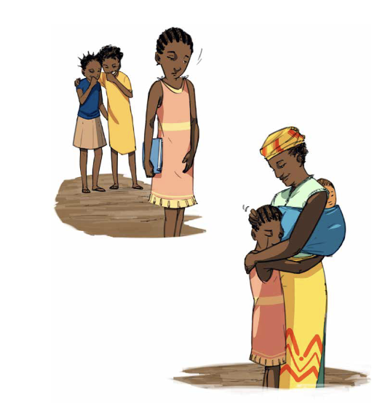
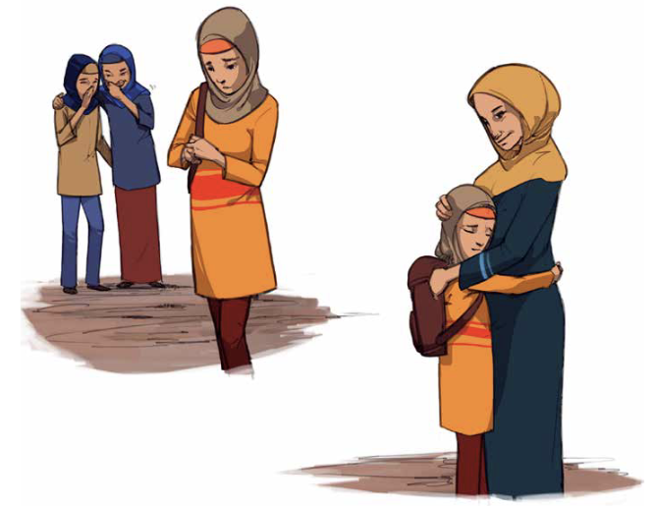
Plenary discussion
Notes:
ADAPT FOR CONTEXT
Remove one image – whichever one is least representative of your context.
______________________________________________________________________________
PLENARY DISCUSSION
In this picture you see a mother hugging her child.
What do you think happened to this child?
What do you think the mother might be saying to her child?
Friends are making fun of the girl. Her mother is comforting her.
What would be your reaction if it was a boy?
Would it be different?
43

Slide 44

Empathy
A human characteristic that allows us to understand and feel for our fellow human beings
It is the ability to perceive the emotions, needs, and desires of another person, to understand and act with care.
It involves being able to walk in the shoes of another person and feel what it is like.
Both boys and girls need their parents to show empathy.
Notes:
PLENARY DISCUSSION
Write the word empathy on a flipchart
What do you think empathy means?
Write the key words from participant responses on the flipchart
Click to reveal the slide
Present the slide
44

Slide 45
Why is empathy necessary for being a parent/caregiver?
Empathy creates positive feelings and relationships.
Everyone experiences problems and hard feelings, and we all need help dealing with those feelings, especially children!
When you are empathetic with your child:
They will be more likely to talk with you when they have a problem
You are modelling how they can be empathetic with others
Notes:
EXPLANATION
Why is empathy necessary for being a parent/caregiver?
Click to show answers
Present the slide
45

Slide 46
Steps of empathy
Validate or honor the feeling
Identify the feeling
3
1
2
4
Determine the reason
Help the child with their feelings. Take action and find a solution if appropriate.
Notes:
EXPLANATION
You are going to learn a technique for increasing empathetic responses
This will help children and adolescents handle difficult feelings and learn to problem-solve.
This is something you can share with parents and caregivers to help them:
Understand why children behave in a certain way
React in a healthy and constructive manner
Step 1. Identify the feeling
The first step is to try to identify or label what someone is feeling.
When parents validate a feeling, they should first identify it or label it.
Naming the child’s feeling helps them identify their own emotions.
For example, the parent/caregiver could say, “Sarah, you look like you are sad right now – are you?”
Step 2. Determine the reason
For example, the parent/caregiver could say, “Why are you sad? I would really like to help if I can.”
Sarah can tell the parent/caregiver or she may choose not to right now.
They can say to Sarah, “Feel free to come and talk to me when you are ready.”
Step 3. Validate or honor the feeling
Sarah might have had a disagreement with a friend or felt rejected by her peers at school.
The parent/caregiver should not dismiss that reason.
They should acknowledge and respect the ‘why’.
If they belittle their daughter or son, they might not talk to the parent/caregiver about their feelings anymore.
CONTINUED →
46

Slide 47
Extra slide for facilitator notes
Notes:
Step 4. Help the child with their feelings. Take action and find a solution if appropriate.
They can brainstorm with their child what, if anything, needs to be done.
Sometimes the situation may require the parent and the child to come up with possible actions that may help remedy the situation.
They can help the child find an appropriate solution, but should refrain from giving options right away.
This will help the child develop problem-solving skills.
Sometimes the situation does not need an action other than just comforting their child or sharing in their joy.
Remember that taking action for older children and adolescents can often mean just listening to them.
What do you think about these steps? Can you see them being useful steps for some of the parents/caregivers you are work with?
47

Slide 48
Role play: 4 steps of empathy
44
Validate or honor the feeling
Identify the feeling
3
1
2
4
Determine the reason
Help the child with their feelings. Take action and find a solution if appropriate.
Notes:
ADAPT FOR CONTEXT
The script provided in the workbook is a sample script.
Adapt to your context or create your own
Change the names to ones that are familiar in your context
______________________________________________________________________________
INTRODUCTION
Let’s practice the 4 steps.
Guide participants to Workbook page 44: Role play – 4 steps of empathy
Ask for 2 volunteers to do a role play:
One will play the ‘parent or caregiver’
One will play the ‘13-year-old daughter’
The scenario
The 13-year-old daughter is being sexually harassed in the community by teenagers much older than her.
The volunteers can follow the script or create their own
ROLE PLAY
Have the volunteers present the role play
Coach the role players in front of the big group
PLENARY DISCUSSION
Ask the “13-year-old daughter”:
How did you feel to have your feelings acknowledged and validated?
How did you feel to know that your ‘parent’ was going to help you?
Ask the ‘parent’:
How did it feel to respond to your ‘daughter’ in this way?
48

Slide 49
Situations for help and for listening
What are situations for children that would require adult help, and situations that might just require listening?
Notes:
ADAPT FOR CONTEXT
Adapt the suggested situations in the facilitator notes to the context
______________________________________________________________________________
PLENARY DISCUSSION
What are situations for children that would require adult help, and situations that might just require listening?
Complement with the following possible responses:
Situations that require help
Problems at school
Drug or alcohol use
Sexual harassment
Sexual activity, sexually transmitted disease
Situations that may require help or just listening:
Argument with a friend
Problems at school with peers
Sadness about missing home
49

Slide 50
Empathy for all children
Notes:
PLENARY DISCUSSION
We have talked a bit about typically developing children and the problems they may face, but what about children experiencing a mental or physical disability?
Children with disabilities need care and support just like any other child.
Let’s imagine for a moment what it would be like to be a child who learns more slowly than others, who is unable to walk or cannot hear.
What assistance or understanding would we want from our caregivers?
There are different kinds of barriers in families and communities that can get in the way of providing adequate educational, social, and physical opportunities for children with disabilities.
Can you think of some of these barriers?
Help walking to school for a blind child.
The ability to play games with other children for a child who cannot walk.
Attitudes of other children towards boys and girls with disabilities.
Children with disabilities need their caregivers to be empathetic, loving, and nurturing in order to understand and help overcome barriers to participating in important family and community activities that make us feel connected to the people and world around us.
50

Slide 51
Role play: Empathy for all children
44
Notes:
ADAPT FOR CONTEXT
Adapt the script to the context
______________________________________________________________________________
INTRODUCTION
Divide participants into pairs
Guide participants to Workbook page 44: Role play - Empathy for all children
With your partner, role play the scenario or you can create your own
PARTNER WORK (5 minutes)
Provide 5 minutes for participants to complete
Walk around and observe/coach participants while they are doing this.
This will be a new skill for many of them. Do not hesitate to make them practice as much as needed. This is very important session.
PLENARY DISCUSSION
How would you use the 4 steps of empathy with a boy who is disabled?
Invite participants to brainstorm in plenary
With your partner, repeat the scenario with a boy who is disabled
PARTNER WORK (5 minutes)
Provide 5 minutes for participants to complete
PLENARY DISCUSSION
How did it feel as a ‘parent’ responding to your ‘child’ this way?
How did it feel as a ‘child’ to have your ‘father’ respond in this way?
51

Slide 52
Key learning points
Both boys and girls need their parents to show empathy.
The four steps of empathy is a practical way to support parents/caregivers to increase empathetic responses to help children and adolescents handle difficult feelings and learn to problem-solve
Notes:
EXPLANATION
Present the slide
52

Slide 53
SESSION 5
Creating a predictable and secure environment through family rules and routines
Notes:
SESSION 5 DURATION: 1h30
______________________________________________________________________________
EXPLANATION
In this session, we look at how we can how we can support parents/caregivers to create a predictable and secure environment through family rules and routines.
Can anybody remember which protective factor this supports?
Caring and protective environments
Healthy caregiver-child relationships
53

Slide 54
Having clear roles and expectations
Children tend to have their needs met appropriately and equally.
Children are allowed to express developmental needs.
Parents take ownership of their own behavior.
Parents are not solely dependent on emotional support from their children.
Notes:
EXPLANATION
Part of creating a predictable and secure environment is ensuring that all members of the household have clear roles and expectations.
When all members of the household have appropriate and clear roles and expectations:
Present the slide
PLENARY DISCUSSION
Can anyone share examples of what are the expectations of children and adults in your home?
54

Slide 55
Tools for caregivers
Family rules
Family meetings
Notes:
EXPLANATION
Now we have looked at roles and expectations, we will now look at two specific tools/techniques to support this.
Family rules
Family meetings
Family rules
Creating family rules and agreements will promote a predictable and secure environment for children.
Children have a sense of control and security when they know what is expected from them.
Family meetings
Family meetings will keep the lines of communication open and support collaborative problem solving.
55

Slide 56
Family rules and agreements
Promote predictability and a sense of security for children
Co-create the rules
Communicate the rules clearly
Make sure rules are age-appropriate
Encourage the following of rules with praise
Involve the children, particularly adolescents, in creating the rules
Adults must also follow the family rules
Ensure rules in the house should be fair and equal between all family members, including boys and girls
Notes:
EXPLANATION
Children ages 3 and above need to be informed about family rules.
Adolescents need guidance and freedom in order to develop healthy adult habits.
Present the slide
Co-create the rules
For adolescents, it will be more effective to involve them in creating the family rules.
If the child or adolescent follows a rule or a request, the parent should thank and praise them.
This way, the child will know what kind of behavior is expected of them!
Adults in the home must also follow the family rules.
For example, if there is a rule about using kind words with family members, then adults need to be good role models and use kind words, too!
56

Slide 57
Guidelines for effective rules
The rules tell children what they can do as well as what they should not to do.
The rules are developmentally-appropriate.
The rules are few and expectations are clear.
Adolescents have more freedom and rules are reviewed often.
Parents use rules to guide new behaviors and keep children safe and healthy!
Notes:
INTRODUCTION
Present the slide
What are some rules that would be appropriate for a 7-year-old?
If participants generate rules that are not developmentally appropriate, invite the whole group to discuss this and create developmentally appropriate ones.
Write the rules on a flipchart
Ask for 2 volunteers to do a role play
One will play the ‘parent’
One will play the ‘7-year-old child’
The scenario
The parent explains the rules to a 7-year-old child.
ROLE PLAY
Provide a few minutes for the volunteers to prepare
Invite the volunteers to present the role play
PLENARY DISCUSSION
Ask the ‘parent’ – how did it feel to give the rules?
Ask the ‘child’ – how did it feel to have the rules explained?
CONTINUED →
57

Slide 58
Extra slide for facilitator notes
Notes:
EXPLANATION
The ‘parent’ needs to explain the rules of the house in a clear, positive, polite manner. For example, a parent might say the following:
“I am really proud of you and I want to continue to help you do well at home and with your friends, so I want to tell you about our family rules. There are 3 important rules in our house – they are rules for everyone in the house, not just you!”
Specify if some rules are different for boys and for girls
“The first rule is to treat everyone in the house with respect by using kind words, the second is that everyone will do their chores, and the third is that everyone will wash their hands before eating.”
Setting consequences
When rules are set and agreed on, parents do not need to threaten children with punishment, because children will know the predetermined consequences.
For example, parents may establish a rule that children will go to bed at 8 o’clock. If they do not follow this rule, they will not be allowed to play outside the next day (or must go to bed even earlier the following night).
Parents must make sure they follow through with the consequences so the child learns that it is better to follow the rules than not.
Consequences for children are most effective when they are immediately given and short-term in length.
Rewarding good behavior
If children comply with the rules, parents should show appreciation for the good behavior by rewarding children with outside play with the parent or choosing what the family will eat for dinner.
Parents don’t need to reward children every time, but occasional rewards go a long way in reinforcing their good behavior!
58

Slide 59
Creating and explaining rules
          3-5 year-old
          6-9 year-old
          10-13 year-old
          14-15 year-old
Notes:
INTRODUCTION
Divide participants into 4 groups
Assign an age range for each group:
3-5 year-old
6-9 year-old
10-13 year-old
14-15 year-old
With your group, generate 3-5 rules for your assigned age range
GROUP WORK (15 minutes)
Provide 15 minutes for participants to complete
PLENARY DISCUSSION
Invite the groups to share their responses and complement other groups
59

Slide 60
Role play: Helping children learn from mistakes
45
Notes:
INTRODUCTION
When family rules are set up and agreed on, parents/caregivers do not need to threaten, yell, or use harsh physical discipline because a child broke the rules or made a mistake.
This is a normal part of being a child. This is part of the learning process!
Mistakes are opportunities for learning, so when caregivers/parents stay calm, they can help children learn from their mistakes.
Let us practice helping children learn from their mistakes.
Ask for 2 volunteers to do a role play
One will play the ‘parent’
One will play the ’11-year-old boy’
Guide the volunteers to Workbook page 45: Role play - Helping children learn from mistakes
The scenario
A parent tells the child that they noticed that the boy had broken an agreement.
The boy explains why he broke the agreement.
The parent reminds the boy why it is important to fulfill his agreement.
The boy explains how he will fulfill the agreement.
The parent praises the boy and says that they will see how the boy fulfills his agreement the following week.
Role players can use the script or create their own
ROLE PLAY
Provide a few minutes for the volunteers to prepare
Invite the volunteers to present the role play
60

Slide 61
Establishing effective consequences
5
R
Respectful. It shouldn’t be humiliating for the child.
Related to the misbehavior.
Reasonable in duration and immediately after the misbehavior.
Revealed in advance. Agree on the rules together.
Ask the child to Repeat the consequence back to you.
Notes:
EXPLANATION
In some cases, in may be necessary to implement consequences to reinforce a rule.
Present the slide
Does anyone have any questions or need clarification?
61

Slide 62
Think and share
What are some consequences you would suggest if children break the rules for each of the age groups?
Notes:
PLENARY DISCUSSION
What are some consequences you would suggest if children break the rules for each of the age groups?
Write the responses on a flipchart
Complement with the possible responses below
______________________________________________________________________________
POSSIBLE RESPONSES
For older children:
Removal of privileges (such as not being allowed to go out with friends)
Additional chores
Specific example for a younger child:
If the child is refusing to wash their hands, they can’t have dinner until they wash their hands
If the child won’t play with a toy nicely, the toy is temporarily taken away
62

Slide 63
Family meetings
Family meetings gather all the family members.
Regular family meetings are a great way to keep the lines of communication open between parents and children, particularly adolescents.
Older children and adolescents can:
Have a space to voice their changing developmental needs
Discuss household responsibilities as they get older
Find solutions to improve family life
Parents can:
Get updates on how children are doing in school
Divide up the household chores
Have fun together as a family
Notes:
EXPLANATION
Now we will move on to look at the second technique: family meetings.
Present the slide
PLENARY DISCUSSION
Why is it important to create time to meet as a family?
Complement participant responses with the possible responses below.
______________________________________________________________________________
POSSIBLE RESPONSES
Strengthens the sense of belonging to a family.
Makes children feel valued and loved.
Creates and maintains positive parent–child relationships.
Encourages children to express their points of view, their frustrations and concerns in a positive way. This makes them feel listened to.
Promotes equality among family members and reduces power struggles.
63

Slide 64
Effective family meetings
They are regular and not only set up to manage a family crisis.
Parents/caregivers keep an open discussion until family consensus is found, even if it takes more than one meeting to find a solution.
All concerns and questions are welcomed, as common or extraordinary as they may be.
The meetings are not too long – 30 minutes is a good average time.
Older children are genuinely able to talk and be listened to.
Notes:
EXPLANATION
Present the slide
It is important, especially for older children, that they get a chance to speak and express their thoughts and ideas.
64

Slide 65
Family meetings in 4 steps
Step 1
Start with a round of positive feedback on family life.
Step 2
Follow up on solutions adopted from the last meeting
Step 3
Give everyone the chance to add to the agenda items
Step 4
Enjoy family time together, have fun!
Notes:
EXPLANATION
Step 1
Family meetings always start best with a round of positive feedback on family life.
Ideally, each family member has a chance to say something positive about every other family member.
This encourages children and teenagers to appreciate good times they spend together, to express gratitude and appreciate other family members.
For example, “Esther, thank you for preparing dinner yesterday and John, I appreciated how you looked after your younger brothers while I was at the market.”
Step 2
The family follows up on the solutions adopted during the last meeting.
For example, “We agreed during our last meeting that everybody should be home by 6 o’clock. How did it work this week? Did everybody arrive home on time?”
Step 3
All agenda items are identified.
Everyone gets a chance to say what they would like to talk about.
All conflicts and issues will not be solved but this is to give an opportunity to give space to anybody to share their thoughts and listen.
Listening doesn’t mean that we agree but it is an opportunity to better understand each other’s perspectives.
Items on the agenda are not necessarily issues; they can also be family projects.
For example, “Gertrude, you expressed your frustration at not being able to come to the market with me. As you know, for security reasons, we cannot let you go. Is there something else that you would like to do that would be safer? Would you like to attend weekly classes at the Safe Healing and Learning Space?”
Step 4
Enjoy family time together.
Have fun, plan family events together.
For example, “Who has an idea for something fun we can do together? What about taking a walk and having a picnic together next Saturday?”
65

Slide 66
Reflection
Do you think family rules and family meetings could be effective tools to promote a protective and caring environment?
Can you think of any families you are working with who you would like to use these techniques with? What kind of families could benefit from these techniques the most?
Are there any adaptations we would need to make to these techniques to make them appropriate and effective in this context?
Notes:
PARTNER DISCUSSION (5 minutes)
Turn to the person next to you and discuss the questions on the slide
Provide 5 minutes for participants to complete
PLENARY DISCUSSION
Invite volunteers to share their responses
66

Slide 67
Key learning points
Creating family rules and agreements promotes a predictable and secure environment for children.
The four steps can be used to support family meetings which keep the lines of communication open and support collaborative problem solving.
Notes:
EXPLANATION
Present the slide
67

Slide 68
SESSION 6
Non-violent discipline strategies for caregivers
Notes:
SESSION 5 DURATION: 1h10
______________________________________________________________________________
EXPLANATION
We are going to look at non-violent discipline strategies for caregivers.
68

Slide 69

Discipline
Discipline means to teach:
Values and principles
Behaviors to be a good community member
Notes:
PLENARY DISCUSSION
What is discipline?
Can you describe your idea of discipline?
EXPLANATION
Click to reveal the definition of discipline
Present the slide
Children need to be guided by parents to become good community and family members.
Parents should:
Guide their children’s behavior through daily routines and household rules
Set household rules, use their attention strategically and follow through with consistent consequences for negative behavior
Make clear to children what is expected of them
Children should:
Feel confident that they can look to parents for guidance
Know which values/principles will help them thrive, for example:
Respect for others
Caring for the most vulnerable
Loving family and community
Respecting yourself
Learning to be happy
69

Slide 70

Discipline with dignity v/s corporal punishment
Corporal punishment
teaches the use of violence
creates fear in children
Disciplining with dignity
respects children
nurtures life lessons
Notes:
EXPLANATION
Harsh physical discipline teaches the use of violence and creates fear in children.
Discipline with dignity respects children and nurtures life lessons
70

Slide 71


Parental strategies to help children behave non-aggressively
Ignore
Time out
Notes:
EXPLANATION
During this session, we will be covering two discipline strategies:
Ignore
Time out
The goal of the activity is to encourage parents/caregivers to think about how their actions (nurturing and not nurturing) have lasting effects on children.
When implementing these strategies, parents/caregivers can also teach children self-control and a calm reaction through modelling
71

Slide 72
Think and share
What are some types of misbehavior that parents can ignore?
Notes:
PLENARY DISCUSSION
We will start by looking at the ignore strategy.
What are the types of misbehavior that parents can ignore?
Complement the responses with the next slide
72

Slide 73
‘Ignore’ strategy
Ignore is not just the lack of praise - it is the removal of all attention, positive and negative!
If a child is whining and you are telling her to stop or giving her an angry look, you are not ignoring her!
Notes:
EXPLANATION
Parents can ignore misbehavior that is not harmful for the children or others. Typically, parents can ignore a tantrum.
Present the slide
73

Slide 74
How to ignore inappropriate behavior
Ignore the negative behavior immediately
After you have told the child to stop yelling and use a quiet voice, if they keep yelling, ignore.
Ignore consistently Once you start ignoring, keep ignoring until the whining or arguing stops.
Praise your children once the negative behavior stops.
Notes:
EXPLANATION
Ignore the negative behavior immediately.
For example, if your child starts complaining because they want a sweet and you do not have money for a sweet
After you have explained that the child can not have one, don’t pay any attention to the complaining
Don’t say anything, don’t look at the child, don’t even smile.
You might even turn your back and start doing a chore around the house.
You do not need to hit or shout at the child
Ignoring them will send them the message that their crying will not work to get the sweet and eventually they will stop
Ignore consistently
Ignoring might sound easy but it can actually be very difficult
Children don’t like being ignored, and sometimes when you start ignoring them, they will act up even more!
They will try different things to see if they can get your attention. For example, they might start to cry or yell even louder.
Make sure you keep ignoring those negative behaviors.
You don’t want to start ignoring and then give your attention when they start yelling louder. That will teach the child to get your attention through negative behavior, such as yelling or screaming loudly.
The most important part of ignoring: PRAISE your child once the negative behavior stops.
So if she is yelling, as soon as she stops, tell her: “I really like it when you are quiet and kind,” or “Thank you for calming down.”
This will teach your child that negative behavior gets no attention, but positive behavior gets a lot of attention.
Some behaviors cannot be ignored – for example, when the child is hurting someone else or themselves.
Such behavior can require other techniques such as a time-out, losing a privilege, and so on.
74

Slide 75
Time-outs
A time-out space is a separate area with no contact or communication with adults or other children.
Notes:
EXPLANATION
When a child has exhibited a negative behavior (particularly aggressive behavior like hitting, kicking or biting), parents can place the child in a ‘time-out space’
A time-out space is a separate area with no contact or communication with adults or other children.
Parents should keep the child in time-out until he or she has calmed down.
Remember that young children love attention and, in a time-out, parents remove all attention.
‘Time-out’ will only work if ‘time-in’ is quality time.
75

Slide 76
Conditions for an effective time-out
Time out works best for children between the ages of 3 and 10.
Explain what time out is to the children before using it.
Follow through with the time-out.
Be sure to explain clearly the reason for a time-out.
Make sure you have an appropriate area to use for time-outs.
Everyone in the home needs to understand and respect the rules of time out.
Re-engage the child as soon as he or she calms down.
Establish (if possible) the duration of a time-out.
Notes:
EXPLANATION
Before using a time-out, certain conditions need to exist:
Present the slide
Explaining the reason for a time-out
For example, “You hit your brother, and that is not acceptable, so you have to go to time-out.”
For example, “From now on, when you hit or hurt another person, you will need to take a time-out to calm down.”
Follow through with the time-out
Once the child has been informed about the time-out, they must go, no matter what they do or say.
The child may say, “I promise to be good now,” or “But I love you!”
The caregiver should ignore such statements and lead the child to the timeout place peacefully (or with minimum force, such as calmly taking the child by the arm or carrying the child).
An appropriate area for time-outs
The area should be quiet and away from other people engaging in fun activities.
Respect the rules of time-out
No one should talk to or interact with the child until time-out is over and the child has calmed down.
Re-engage the child
Parents should give positive attention to any good behavior they observe after time-out ends.
76

Slide 77
Duration of time-out
It usually takes a child 3 minutes to calm down.
A child is ready to come out of time-out when he or she:
          No longer yells and screams
  Sits quietly
  Breathes slowly and peacefully
Notes:
EXPLANATION
The caregiver should, establish, if possible, establish the duration of a time-out.
The caregiver should remind the child that time-out starts when they are quiet. Help the child take deep breaths to calm down.
Present the slide
After time-out, the caregiver should praise the child for calming down and redirect their activities appropriately.
77

Slide 78
Role play: time-out
Notes:
INTRODUCTION
Ask for two volunteers to do a role play
One will role-play the “parent”
One will role-play the “child”
Scenario
The ‘parent’ initiates a time-out for the ‘child’
The ‘child’ tries to avoid the time-out; they might whine, protest, sulk, blame others, promise to be good, complain of illness – anything to avoid the time-out.
The ‘parent’ gently but firmly leads the ‘child’ to the time-out place.
ROLE PLAY (15-20 minutes)
Provide a few minutes for the volunteers to prepare
Invite the volunteers to present the role play
Coach the volunteers during the role play in front of the whole group
PLENARY DISCUSSION
Ask other participants to provide praise and constructive feedback after the role-play.
Ask the ‘parent’ – how did you feel about giving a time-out?
Ask the ‘child’ – how did you feel getting the time-out?
When you share this strategy with caregivers, ask them to think about a good time-out space they can use in their homes.
Does anyone have any questions or need clarification?
78

Slide 79
Key learning points
Parents can ignore misbehavior that is not harmful for the children or others and then praise the child once the behavior stops.
Time-out can be used as a strategy to improve children’s behavior and help them calm down.
Notes:
EXPLANATION
Present the slide
79

Slide 80
SESSION 7
Strengthening social support networks
Notes:
SESSION 7 DURATION: 1h
80

Slide 81
Plenary discussion
What does the term “social support” mean to you?
Notes:
PLENARY DISCUSSION
What does “social support” mean to you?
Write the responses on a flipchart.
EXPLANATION
We do not have an inter-agency definition for social support
However, the American Psychological Association defines social support as:
The provision of assistance or comfort to others, typically to help them cope with biological, psychological, and social stressors.
Support may arise from any interpersonal relationship in an individual’s social network, involving family members, friends, neighbors, religious institutions, colleagues, caregivers, or support groups.
It may take the form of practical help (e.g., doing chores, offering advice), tangible support that involves giving money or other direct material assistance, or emotional support that allows the individual to feel valued, accepted, and understood.
81

Slide 82
What social support can mean for parents/caregivers in practice
Sharing difficulties and feelings with other people they trust
Spending time with friends or family
Benefiting from other people’s insights and knowledge
Connecting with community organizations or agencies to receive support
Sharing experiences with people who have faced similar challenges
Being heard and understood
Practical help with child-care or other tasks
Notes:
EXPLANATION
Present the slide
Why do you think social support may be important for parents and caregivers?
All of these forms of social support can be very powerful in reducing difficulties and distress.
82

Slide 83
Tool: Who is in your circle
47
SUPPORT CIRCLE
DESIRED CONNECTIONS
Notes:
INTRODUCTION
We are now going to try a very simple exercise
This can be done with caregivers to explore their social support system
It helps us understand the people we have in our lives who can support us.
Guide participants to Workbook page 47: Tool – Who is in Your Circle
In your workbook:
Draw or write down the people who are in their support circle.
People to include could be family, friends, neighbors, supportive people in the community, and key workers in the community they interact with (e.g., a teacher at their child’s school)
Outside the circle, draw or write a connection you would like to make. (e.g., if you would like to make friends with more parents of young children.)
INDIVIDUAL WORK (5 minutes)
Give participants 5 minutes to complete the exercise.
PLENARY DISCUSSION
Would anyone like to share their circle of people as an example?
This can be used to:
Facilitate a discussion on where caregivers can go for support
Plan for how caregivers can connect with people to support them if there is a gap.
83

Slide 84
Tool: Ecomap
Dad
Sophia
sister
Sarah
sister
Michael
friend
Mom
Emily
family
Rebecca
mentor
Michelle
Taylor
family
Strong
Energy
Reciprocal
Weak
Strenuous
Hannah
friend
Leila
aunt
Bella
friend
Ms. W
teacher
Mohamed
cousin
Notes:
ADAPT FOR CONTEXT
Edit the names and roles in the ecomap based on the context.
For the video play, captions can be auto-translated, or the transcript can be downloaded and translated for the facilitator to read.
______________________________________________________________________________
EXPLANATION
An ecomap is another tool
It maps out a person’s support network, but it also explores all the ties in the support network.
It helps us analyze the strong and weak relationships
It helps us identify which relationships we may want to strengthen that can be a positive resource for wellbeing, care, and growth.
VIDEO
Play the video: https://www.youtube.com/watch?v=xTjrkFneXr8
84

Slide 85
Tool: Ecomap
48
Strong
Energy
Reciprocal
Weak
Strenuous
Notes:
INTRODUCTION
Guide participants to Workbook page 48: Tool – Ecomap
In your workbook, draw your own ecomap on the template provided
INDIVIDUAL WORK (10 minutes)
Provide 10 minutes for participants to complete
PLENARY DISCUSSION
How did you feel about drawing on your social support network?
Was there anything that surprised them?
Could it be useful?
It is possible that caregivers might find it difficult to disclose difficult or troublesome relationships and the reasons behind them.
It may trigger negative feelings
Remember to reassure them by reaffirming confidentiality, your role as a caseworker, and the purpose of family strengthening.
Make sure you are building trust and adopting positive communication.
85

Slide 86
Support groups
“Strengthen caregivers’ social networks by supporting or establishing social groups, peer-to-peer support groups, self help groups or alternate communication methods”
Source: Alliance for Child Protection in Humanitarian Action. (2019). Minimum Standards for Child Protection in Humanitarian Action
Notes:
ADAPT FOR CONTEXT
Adapt based on whether there are support groups or an equivalent in your context.
______________________________________________________________________________
EXPLANATION
One of the recommended actions under Standard 16 in the Minimum Standards for Child Protection in Humanitarian Action is to strengthen caregivers’ social networks by supporting or establishing social groups, peer-to-peer support groups, self-help groups, or alternate communication methods.
In some cases, it may not be the role of caseworkers themselves to establish these groups
However, caseworkers can refer parents/caregivers to these groups where they exist
Where appropriate, caseworkers can establish support groups
In the Syrian refugee response in Iraq, case management supervisors ran support groups for child protection cases facing common risks or vulnerabilities.
An example was a support group for adolescent mothers
Note that they made sure to follow confidentiality protocols.
Support groups could be particularly beneficial for parents and caregivers who:
Have limited support networks (which can be uncovered through the previous two exercises)
Are facing particular challenges.
PLENARY DISCUSSION
Is there anything like this in your context?
Is this something that you think any of the parents/caregivers you work with would benefit from?
86

Slide 87
Key learning points
Social support networks can have a major impact on the wellbeing of parents/caregivers
Mapping parent/ caregiver social support networks can help plan for ways to build improved social support.
Support groups can be an effective way to support parents/caregivers, including specific support groups for vulnerable/at-risk caregivers
Notes:
EXPLANATION
Present the slide
87

Slide 88
SESSION 8
Basic money management tools
Notes:
SESSION 8 DURATION: 1h30
______________________________________________________________________________
PREPARATION
It is recommended to print the Money Matters toolkit for all participants.
It is available in English, Arabic, French, Spanish, and Ukrainian.
A Word version is also available so that it can be translated into other languages, as required.
https://resourcecentre.savethechildren.net/document/money-matters-toolkit-caseworkers-support-adult-and-adolescent-clients-basic-money/
ADAPT FOR CONTEXT
This session should be contextualized based on whether or not Cash and Voucher Assistance (CVA) is available in your context.
If CVA is available, the tools should be used in line with CVA processes and timelines.
If CVA is not available, the tools can be used more flexibly in contexts where money management tools are being used to support families with money management without CVA.
______________________________________________________________________________
EXPLANATION
During this session, we will look at how you can use the Money Matters Toolkit to support caregivers and families with basic money management.
Why do you think this topic is relevant to family strengthening in case management?
88

Slide 89
Potential effects of empowering families economically
Reductions in children witnessing intimate partner violence in the home
Reductions in physical violence towards children by parents or other caregivers
Reductions in early and forced marriage of young girls
Reductions in intimate partner violence
Increases in social norms and attitudes that disapprove of intimate partner violence
Notes:
EXPLANATION
Present the slide
Income and economic strengthening interventions can benefit children by:
Reducing child maltreatment
Increasing women’s access to economic resources strengthens household economic status in ways that can prevent the abuse and neglect of children.
For example, it enables women to increase investments in their children’s education, thereby improving school attendance, a protective factor violence against children.
Decreasing intimate partner violence (IPV)
This minimizes the likelihood that children witness such violence and suffer the consequences, including the potential that children themselves become victims or perpetrators of violence.
89

Slide 90


The Money Matters Toolkit
Notes:
EXPLANATION
This tool is for use when child protection case management clients receive cash and voucher assistance (CVA) as part of their child protection case management response.
The tool can also be used by caseworkers to support clients not receiving CVA with basic money management.
The toolkit provides sample scripts and tools, which we will look at in detail during this session.
90

Slide 91

What do the tools do?
Support caseworkers to help their clients reflect on and manage their financial needs and habits
Notes:
EXPLANATION
The toolkit supports caseworkers in helping their clients to:
Reflect on:
The different needs of varied members of the household to encourage decisions that may benefit those who are most at risk or marginalized within the home.
How decisions are made on money spent, who is making decisions, and why those choices are made
The costs incurred are for basic needs and should be prioritized in the interests of all members of the household.
Be more aware of their regular and intermittent expenses and keep track of these
Prioritize expenses and spend within their income
Identify more cost-effective spending habits
Save contingency funds to cover any financial shocks
91

Slide 92




Types of household expenses
Regular and fixed expenses
Regular and variable expenses
Occur infrequently but are predictable
Shock expenses and unexpected expenses
Notes:
ADAPT FOR CONTEXT
Examples should be contextualized
______________________________________________________________________________
EXPLANATION
There are different types of expenses that a household needs to cover, which the tools will look at.
Regular and fixed expenses
These are easy to plan for.
They include costs such as rent and school enrollment fees
Regular and variable expenses
These are expenses we know will happen, but we cannot be sure how much they will cost or when they will be charged.
This includes food, electricity bills, telephone bills, school materials, etc.
Occur infrequently but are predictable
These include taxes insurance payments, etc.
Shock expenses and unexpected expenses
These are surprises you did not expect.
As such, you cannot plan for them and do not know how much they will be.
There is a need to set aside money for unplanned costs.
This may include new medical health issues; damage to your home; lost crops; etc.
92

Slide 93
When should you use these tools?
CVA
In contexts where clients access CVA:
Before CVA has started
Once just after CVA has started
At intervals throughout the duration of the CVA
Before the CVA is due to end
One final time after the CVA has already ended
In contexts where there is no CVA but clients would like support with money management:
Any time, based on the client’s preferences and availability.
Notes:
ADAPT FOR CONTEXT
Adapt based on whether or not clients are accessing or will be accessing CVA in the context.
______________________________________________________________________________
EXPLANATION
Present the slide
93

Slide 94

Where should you use these tools?
LOCATION CONSIDERATIONS
Adherence to safeguarding standards
Accessibility
Safety
Privacy and confidentiality
Notes:
EXPLANATION
The caseworker should use this tool with their clients in the same space where they always run their case meetings with them.
The location is most likely to be:
In the caseworker’s own organization's offices
In the offices of a partner organization
In the client’s home
Clients should be involved in the choice of locations for the discussions. Each client may have a different preference.
Four main factors should be considered in the location:
Adherence to safeguarding standards
The space must allow for compliance with organizational safeguarding procedures.
Where children are involved in the meeting, the caseworker must be visible to others, so no unacceptable behavior is possible without being observed.
Accessibility
Settings should be chosen that can be easily, safely, and confidentially accessed by the client and any individuals accompanying them.
This should take into account both the physical space and the route that would be taken to get to and from that space.
For example: 1) Clients with physical disabilities should have access to transport to reach the space and should physically be able to enter the space. 2) Clients of a certain gender or ethnicity must not be exposed to high risks of violence on route to or at the space.
Safety
The use of the tool must take place in a location where the confidentiality of the caseworker, the client, and their household members can be maintained.
CONTINUED →
94

Slide 95
Extra slide for facilitator notes
Notes:
Privacy and confidentiality
Case management meetings should happen in a space that ensures privacy.
Those outside the room should not be able to hear the discussions taking place inside.
It may be necessary to carry out the discussions by telephone
This may be due to ongoing generalized risks that cannot be mitigated
For example, when a region is affected by an infectious disease outbreak (e.g., COVID), on-going security concerns, or active conflict.
95

Slide 96
Talking about needs within the home
What are the needs of girls? boys? children with disabilities? young babies? older adolescents? your biological children living in another household? someone else’s biological children living in your household? older people in the home? adults with disabilities?
Who spends the household income?
How do you make decisions at home?
Who decides how income is spent? Do you ask boys and girls what they need? Do you ask your spouse what they want or need?
Notes:
EXPLANATION
When talking about household expenses, remind the client to consider the full range of needs for all members of the household.
Always ask if there are specific needs for certain individuals in the household
96

Slide 97
Sample scripts
CVA
Sample script 1
Before CVA starts
Sample script 2
After CVA starts
Sample script 3
During CVA
Sample script 4
Before CVA ends
Sample script 5
After CVA ends
Notes:
ADAPT FOR CONTEXT
Remove this slide in contexts where families do not receive CVA.
______________________________________________________________________________
EXPLANATION
There are several scripts available that you can use to support conversations with families before and after they have received cash assistance.
These are available in the Money Matters Toolkit
There are different time intervals to support the client
All of these should be factored into the caseworker’s ongoing meetings
It’s for the caseworker and client to decide how often they want to go through the tool.
It is recommended to meet with the client:
One week before the distribution
Ideally, within 1 to 2 days after distribution
At regular intervals during the program duration
Within one month after the last distribution has been completed
97

Slide 98
Tools
TOOL 1
TOOL 2
TOOL 3
TOOL 4
TOOL 5
What are the child’s and family’s needs?
Prioritizing household expenditure
Income tracking table
Expenditure tracking table
CVA exit handout
Notes:
EXPLANATION
There are five tools available in the Money Matters Toolkit
We will look together in more detail at tools 1-4.
98

Slide 99
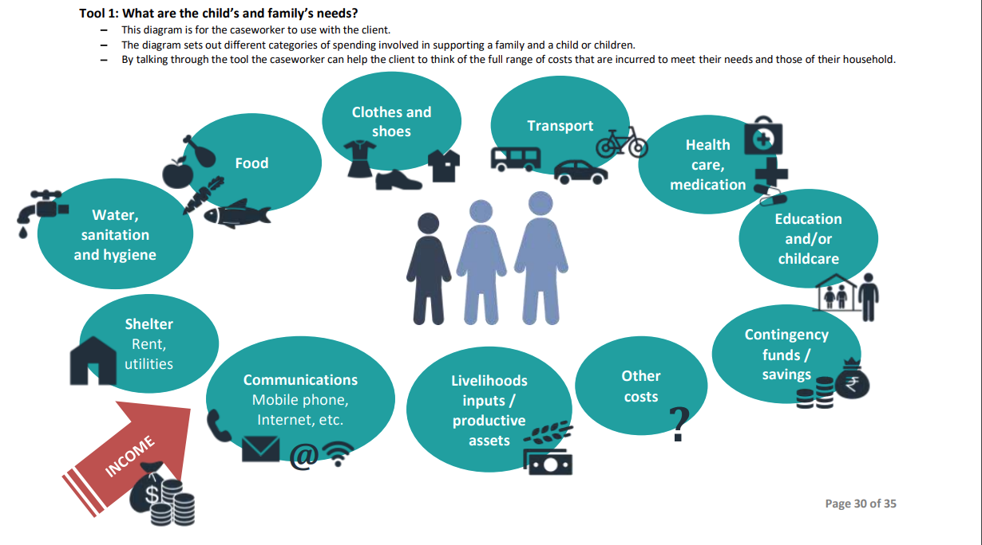
Tool 1: What are the child’s and family’s needs?
49
TOOL 1
Notes:
ADAPT FOR CONTEXT
For translation, the image can be edited in the Word version of the money matters toolkit and transferred back to the PPT.
See page 30 here: https://resourcecentre.savethechildren.net/pdf/Money-Matters-Toolkit-Word.docx/
Arabic, Spanish, French and Ukrainian versions already exist here:
https://resourcecentre.savethechildren.net/document/money-matters-toolkit-caseworkers-support-adult-and-adolescent-clients-basic-money/
______________________________________________________________________________
EXPLANATION
Tool 1 is for the caseworker to use with the client.
Guide participants to Workbook page 49: Tool 1 – What are the child’s and family’s needs?
The diagram sets out the different categories of spending involved in supporting a family and a child or children.
By talking through the tool, the caseworker can help the client think of the full range of costs that are incurred to meet their needs and those of their household.
99

Slide 100
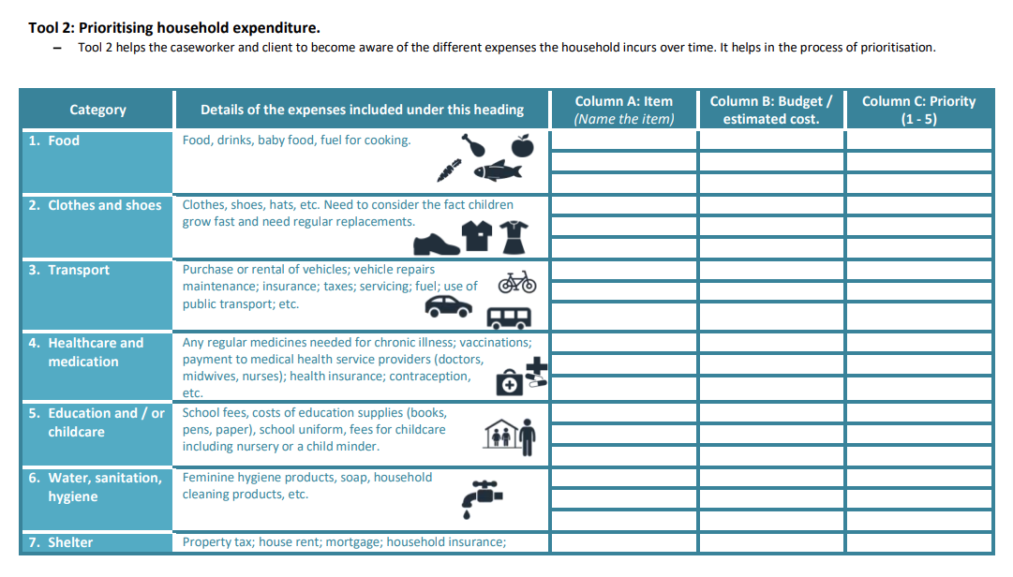
Tool 2: Prioritizing household expenditure
50-
51
TOOL 2
Notes:
ADAPT FOR CONTEXT
For translation, the image can be edited in the Word version of the money matters toolkit and transferred back to the PPT.
See page 31 here: https://resourcecentre.savethechildren.net/pdf/Money-Matters-Toolkit-Word.docx/
Arabic, Spanish, French and Ukrainian versions already exist here:
https://resourcecentre.savethechildren.net/document/money-matters-toolkit-caseworkers-support-adult-and-adolescent-clients-basic-money/
______________________________________________________________________________
EXPLANATION
Tool 2 helps the caseworker and client to become aware of the different expenses the household incurs over time.
Guide participants to Workbook pages 50-51: Tool 2: Prioritizing household expenditure
It helps in the process of prioritization.
Priority levels
1 - Very essential: Item is necessary for the development, wellbeing, and health of individuals in the household.
2 - Essential
3 - Useful / good to have
4 - Good to have, but not immediately needed: Purchase of the item could be delayed.
5 - Non-essential: An item that is desired or wanted but is not essential to any household members’ development, wellbeing, or health.
100

Slide 101
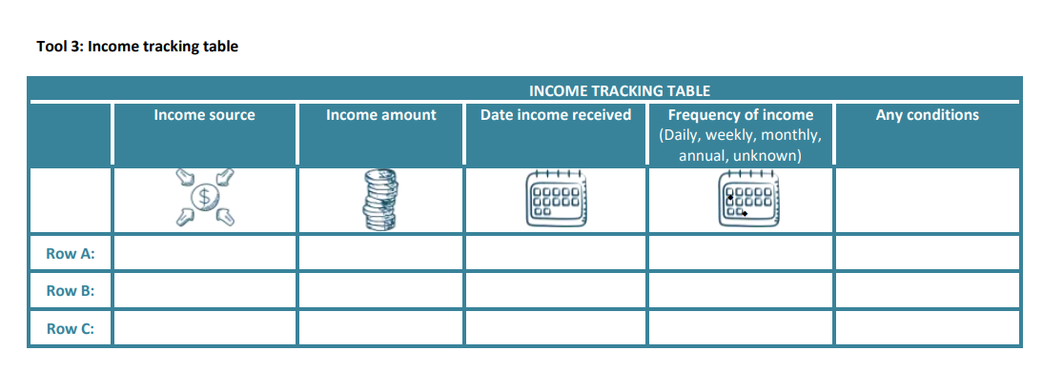
Tool 3: Income tracking table
52
TOOL 3
Notes:
ADAPT FOR CONTEXT
For translation, the image can be edited in the Word version of the Money Matters Toolkit and transferred back to the PPT.
See page 33 here: https://resourcecentre.savethechildren.net/pdf/Money-Matters-Toolkit-Word.docx/
Arabic, Spanish, French, and Ukrainian versions already exist here:
https://resourcecentre.savethechildren.net/document/money-matters-toolkit-caseworkers-support-adult-and-adolescent-clients-basic-money/
______________________________________________________________________________
EXPLANATION
Completing this table in Tool 3 will enable you to see together how much money the client and their household receive over a day, week, and month.
Guide participants to Workbook page 52: Tool 3 - Income tracking table
This will help the client to see if they can afford to cover all their costs.
Ask the client:
“What income do you and your household have?”
“Have you had any new income sources since we last met?”
Complete the table as the client answers questions or have the client complete the table if they feel comfortable writing.
How to complete the income-tracking table
For Row A, Row B, Row C, etc.… Complete each row with a different income source.
Explain each of the columns one by one to the client.
“Income source”: where the money is coming from
“Date income received”: The date the income has already been received or when in the future it will be received.
“Frequency of income”: How frequently this income is expected to be received by the household. Is it daily, weekly, monthly, annual, or of an unknown frequency.
“Any conditions”: Details of any conditions relating to how the income must be spent.
101

Slide 102
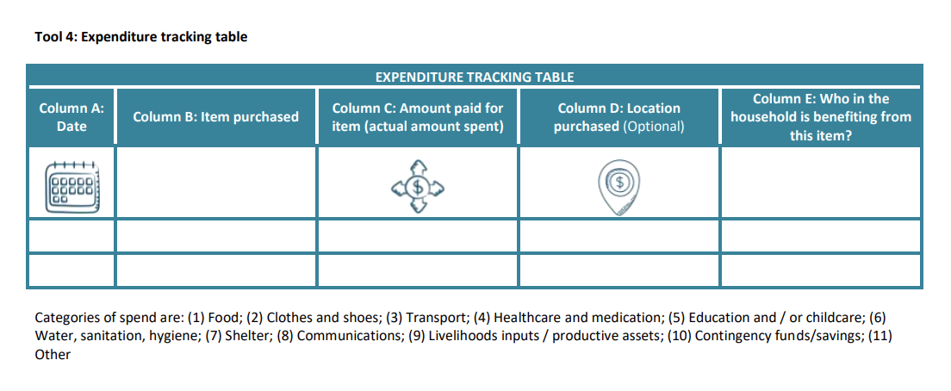
Tool 4: Expenditure tracking table
52
TOOL 4
Notes:
ADAPT FOR CONTEXT
For translation, the image can be edited in the Word version of the Money Matters Toolkit and transferred back to the PPT.
See page 34 here: https://resourcecentre.savethechildren.net/pdf/Money-Matters-Toolkit-Word.docx/
Arabic, Spanish, French, and Ukrainian versions already exist here:
https://resourcecentre.savethechildren.net/document/money-matters-toolkit-caseworkers-support-adult-and-adolescent-clients-basic-money/
______________________________________________________________________________
EXPLANATION
Guide participants to Workbook page 52: Tool 4: Expenditure Tracking Table
Completing this table in Tool 4 will:
Help you see together how much money the client spends over a day, week, and month
Help the client see where most of their money goes.
Explain to the client:
The form is not to be filled in now,
Rather, it should be filled in as the client spends money over time
The details will then be reviewed together at the next meeting
CONTINUED →
102

Slide 103
Extra slide for facilitator notes
Notes:
Explain the expenditure tracking table columns one by one for the client
“Column A: Date”: Note the day or date they spent the money.
“Column B: Item Purchased”: Name the item purchased.
“Column C: Amount paid for item”: Write the full cost of the item.
“Column D: Location purchased (optional)”: This is optional. Note the name of the shop where they purchased the item. This may help in figuring out if some places consistently charge higher prices than others.
“Column E: Who in the household is benefiting from this item?”: This can help identify whose needs are considered priorities within the household.
Explain to the client what will happen in the next session:
During the next session, you will review the table together.
If the client has realized that they do not have enough income, you can identify together:
Where money can be saved
What costs can be delayed?
What expenses can be prioritized?
Have the client go home with the table
Advise the client to fill in as often as possible, as many details as they can in the tracking table.
Advise the client that they should list spending done with the CVA and all other sources of income they receive.
Allow the client to ask questions about filling out the form.
103

Slide 104
Money matters tools
50-
52
TOOL 2
TOOL 3
TOOL 4
Prioritizing household expenditure
Income tracking table
Expenditure tracking table
Notes:
ADAPT FOR CONTEXT
Update the amounts in the scenario based on what would be realistic in the context (it does not need to be very accurate; it can be rough estimations)
______________________________________________________________________________
INTRODUCTION
Now we will practice using three of the tools.
Divide participants into groups of 2-3 people
Guide participants to:
Workbook pages 50-51: Tool 2: Prioritizing household expenditure In your groups, practice filling out tools 2-4
Workbook page 52: Tool 3: Income Tracking Table
Workbook page 52: Tool 4: Expenditure Tracking Table
GROUP WORK (20 minutes)
Provide 20 minutes for participants to complete
PLENARY DISCUSSION
How did you find the exercise?
Do you think these tools could be useful with clients?
104

Slide 105
Key learning points
Economic empowerment can reduce physical violence against children by parents or other caregivers and violence in the home.
Caseworkers can support families with money management through the use of scripts and money management tools, as well as through referrals to cash and voucher Assistance and other economic programs.
Notes:
EXPLANATION
Present the slide
105

Slide 106
SESSION 9
Self-care and relaxation techniques to support caregivers
Notes:
SESSION 9 DURATION: 1h20
______________________________________________________________________________
EXPLANATION
We will now begin our last session, which focuses on self-care and relaxation techniques to support parents/caregivers.
106

Slide 107
Caregiver stress
Anousheh is a hardworking man, a loving and caring father of three, and a husband, but recently things around him got really complicated.
He lost his job because of the war, and his economic situation worries him. He fears he will not have enough money to pay the school fees of the children, and maybe he will not manage to ensure a roof over their heads in the next few months.
The birth of his last son does not make things easy. The baby is often crying at night and seems inconsolable.
The relationship with his other two older children is also getting more difficult; they spend most of their time out of the house, and when they are in the house, there are often arguments.
The risk by attacks of the armed group on the village makes him feel in a constant state of alertness and danger.
Notes:
ADAPT FOR CONTEXT
This story can be adapted to the context.
______________________________________________________________________________
PLENARY DISCUSSION
Ask a participant to read the story on the slide.
How do you think Anousheh feels?
Which emotions is he probably experiencing?
Why have you chosen this emotion? What makes you think that Anousheh feels that?
In what other situations could one feel a similar emotion?
Write the emotions on a flipchart
CONCLUSION
Anousheh is probably feeling a range of different emotions
Some days, he might feel angrier
Other days, he might feel more stressed or insecure
Other times, he might even be happy, despite the situation.
Sometimes he might struggle to figure out what he is feeling.
This is completely normal!
107

Slide 108
Consequences of stress
Changes in his/her behavior (aggression, isolation, silence)
Dizziness
General aches and pains
Griding teeth, clenched jaw
Headaches
Indigestion or acid reflux symptoms
Increase in or loss of appetite
Muscle tension in the neck, face, or shoulders
Problems sleeping
Racing heart
Cold and sweaty palms
Tiredness, exhaustion
Trembling/shaking
Weight gain or loss
Upset stomach
Anger or irritability
Anxiety
Change of mood
Sadness or depression
Feeling overwhelmed
Isolation
!
!
!
!
Notes:
PLENARY DISCUSSION
What consequences do you think that the situation Anousheh experiences might have for his wellbeing?
How well does he sleep?
How well does he eat?
What does he do during the day?
EXPLANATION
Situations like the ones in which Anousheh finds himself can cause a lot of stress and have long-lasting consequences for a person’s wellbeing.
Being a parent is very hard, and there are many instances in which parents/caregivers might feel overwhelmed and insecure.
The external environment might add additional pressure on them, just like in the case of Anousheh. For example:
Economic challenges
An unstable environment
War
Family tensions
These external factors can generate stress, and the body reacts with physical, mental, and emotional responses.
Stress is a normal part of life, but it is dangerous when it continues without relief.
In some instances, stress can become so much a part of our lives that we stop realizing that it is even there.
108

Slide 109
Caregiver impact on children
How do you think Anousheh’s situation impacts his family life?
How does he behave with his wife when he is feeling stressed?
How does he behave with his sons? What about his daughters?
Notes:
PLENARY DISCUSSION
Guide a discussion based on the questions on the slide
EXPLANATION
When caregivers/parents are worried or stressed, it affects the children.
Children, especially younger ones, mirror their parents’ emotions. If parents are stressed and behave aggressively, they can be aggressive.
When caregivers/parents are worried or stressed, the children may adopt undesired behaviors or do things they think will help the situation, which may have negative consequences.
Even when caregivers/parents do not yell when stressed, children feel the tension, which can place them in a constant state of danger. This is very unhealthy for their brain development.
Therefore, learning to cope with stress is important for:
Our own wellbeing
The creation of a positive and stable family environment
Parents/caregivers have to be able to care for themselves in order to care for others
109

Slide 110
Coping strategies
Keep a positive attitude
Accept that there are events that you cannot control
Be assertive instead of aggressive. Name your feelings, opinions, or beliefs instead of becoming angry, defensive, or passive.
Learn and practice relaxation techniques.
Exercise regularly.
Eat healthily.
Set limits and say no to requests that could create excessive stress in your life.
Get enough rest and sleep.
Seek out social support. Spend time with those you love.
If the problem is bigger than you, seek external help!
You are not alone.
Positive coping strategies
Notes:
ADAPT FOR CONTEXT
This may be adapted based on local norms and practices.
______________________________________________________________________________
PLENARY DISCUSSION
People can use positive or negative strategies to cope with stress.
What do you think are some negative strategies that Anousheh could use to deal with stress?
He could hit or shout at his children to make them behave.
He could smoke
What could some positive coping strategies be?
Click to show the slide
Present the slide
How do positive coping strategies help Anousheh?
Coping strategies will not change Anousheh’s situation: the problems that cause the stress do not go away, but these strategies can help him stay calm.
When we are calm, we react better to the issues that cause our stress, and we can make better decisions.
We can better reflect on the causes of our stress and try to find ways to solve it, or ask for help from family, friends or specialized agencies when needed.
What coping strategies do you utilize to calm yourself down when you feel stressed or overwhelmed?
110

Slide 111
What is relaxation?
A mental and physical state in which the individual is able to feel relieved from strain or tension
Notes:
EXPLANATION
We will now look at relaxation and some relaxation / self-care techniques that we can share with parents/caregivers.
Present the slide
Reaching a relaxed state means to bringing our emotions to a calmer, more peaceful state.
When stress affects a person’s normal functioning, relaxation has proven to be effective in lowering stress.
We are going to experiment with some relaxation exercises that you can teach parents and caregivers.
111

Slide 112
Relaxation and self-care techniques toolbox
53-
57
Notes:
ADAPT FOR CONTEXT
The techniques in the participant’s workbook should be adapted to the context.
______________________________________________________________________________
INTRODUCTION
Divide participants into groups of 3 people
Guide participants to Workbook page 53-57: Relaxation and self-care techniques toolbox
This is a ‘toolbox’ of relaxation and self-care techniques
You can share this with parents and caregivers.
You may recognize these as a lot of them were also self-care techniques for caseworkers shared during the level 1 and level 2 case management training modules.
In your groups:
Select 1-2 relaxation techniques to teach each other
Take turns teaching the techniques to your team members, who will pretend to be caregivers
GROUP WORK (15 minutes)
Provide 15 minutes for participants to complete
PLENARY DISCUSSION
What did you think of the relaxation and self-care techniques?
Did you find some that you think would be helpful for caregivers?
Does anyone know any others which are missing?
112

Slide 113
Key learning points
Being a parent is a very hard task, and there are many instances in which parents/caregivers might feel overwhelmed and insecure.
When caregivers/ parents are worried or stressed, it affects the children in the home.
Caseworkers can discuss coping strategies with parents/caregivers, share relaxation techniques, and refer.
Notes:
EXPLANATION
Present the slide
Does anyone have any questions or need clarification?
113

Slide 114
SESSION 10
Module closing
Notes:
SESSION 10 DURATION: 0h30
114

Slide 115
End of Module
58
Review learning objectives
Reflection and feedback
Closing
Notes:
INTRODUCTION
Guide participants to Workbook page 58: Learning Objectives
It’s important to take the time to review the learning objectives (Workbook page 38) and reflect on your achievements at the end of this training.
Some learning objectives might require some more information, practice, or support from the supervisor to be fully achieved.
Look back at today’s training and answer the questions on the learning objectives in your workbook.
INDIVIDUAL WORK (5 minutes)
Provide 5 minutes for participants to complete
PLENARY DISCUSSION (5 minutes)
Invite volunteers to share their reflection
INTRODUCTION
Continue on Workbook page 58: Reflection
What surprised you? What was challenging? What would you like to learn more about?
Write down your reflections.
INDIVIDUAL WORK (5 minutes)
Provide 5 minutes for participants to complete
PLENARY DISCUSSION (5 minutes)
Invite volunteers to share their reflection
Thank the participants for their participation
115

