Slide 1


Technical Competencies
LEVEL 2 MODULE 5
Notes:
WELCOME
Welcome the participants
Ensure everyone signs the attendance sheet
1

Slide 2
SESSION 1
Module opening
Notes:
SESSION 1 DURATION: 0h30
______________________________________________________________________________
EXPLANATION
We will open this module by reviewing:
The agenda
The objectives
A recap of the previous module
2

Slide 3
Module aim
To enhance participants’ understanding of the different technical and methodological knowledge, attitudes, values and skills that must be acquired to adequately support children and families facing protection concerns.
Notes:
EXPLANATION
Present the slide
3

Slide 4
Agenda
Module opening
30 minutes
What is the formal child protection system in my context?
1 hour
Break
Which child protection risks are common in my context?
2 hours
Lunch
How do I analyze complex child protection risks and prioritize needs?
1 hour 45 minutes
Break
How do I plan and manage my caseload?
1 hour
Module closing
30 minutes
Notes:
EXPLANATION
Present the slide
Remind participants of the learning agreement
4

Slide 5
Recap exercise
Draw what you remember of Module 4 Communication and MHPSS skills
Notes:
INTRODUCTION
As always, we start with a quick recap of the previous module!
Divide participants into groups of 3-5 people
Give an A4 or flipchart to each group
In your groups:
Decide on a key learning point from Module 4: Communication and MHPSS
Draw it on the paper
Prepare to present your drawing to the rest of the participants, who will guess what the key learning point is
GROUP WORK (10 minutes)
Provide 10 minutes for participants to complete
PLENARY ACTIVITY (15 minutes)
For each presenting group:
Invite them to show their drawing
They cannot speak – the drawing must speak for itself!
The other groups needs to guess what the key learning point is
If the guess is right:
The group who guessed gets 1 point
The group who drew the key learning point also gets 1 point
5

Slide 6
Learning objectives
69
Explain formal and informal elements of a child protection system
Identify prevalent child protection concerns in your context
Demonstrate child protection analysis
List strategies to manage a caseload
Notes:
EXPLANATION
Present the slide
Does anyone have any questions or need clarification?
You can also find this on Workbook page 69: Learning objectives
6

Slide 7



Competency framework review
Knowledge
Attitudes and values
Skills
Notes:
PLENARY REVIEW
Refer back to the competency framework as discussed during Module 1.
Review the behavioural indicators of:
Self-awareness and self-management
Diversity and inclusion
Accountability and integrity
7

Slide 8
SESSION 2
What is the formal child protection system in my context?
Notes:
SESSION 2 DURATION: 1h
8

Slide 9
Plenary discussion
What is a child protection system?
Notes:
PLENARY DISCUSSION (5 minutes)
Can anyone explain in their own words what is meant by a child protection system?
9

Slide 10

Child protection system
A formal and informal structure across all social sectors – especially social welfare, education, health, security and justice that has been created to prevent and respond to violence, abuse, neglect and exploitation of children.
A child protection system contains a set of actors and things working together:
Laws, policies and regulations
Government and local
authorities
Non-governmental actors
and agencies
Communities
Families
Children
Notes:
EXPLANATION
This is the formal definition of a child protection system according to UNICEF:
“Certain formal and informal structures, functions and capacities that have been assembled to prevent and respond to violence, abuse, neglect, and exploitation of children.
A child protection system is generally agreed to be comprised of the following components: human resources, finance, laws and policies, governance, monitoring and data collection, as well as, protection and response services and care management.
It also includes different actors – children, families, communities, those working at sub-national or national level, and those working internationally.
Most important are the relationships and interactions between and among these components and these actors within the system. It is the outcomes of these interactions that comprise the system.”
Notice the different elements of a child protection system:
Formal and informal
Structure (set of things or actors working together)
Prevent and respond
Source: United Nations Children’s Fund, United Nations High Commissioner for Refugees, Save the Children and World Vision. (2013). A better way to protect all children: The theory and practice of child protection systems, conference report. (p.3).
10

Slide 11
Applying a socio-ecological approach
Socio-cultural norms
Society
Community
Family
Child
Child
Notes:
EXPLANATION
Socio-ecological model vs child protection systems
These are complementary frameworks
They seek to achieve the same goal - a holistic, integrated approach to protecting children
The informal elements of the child protection system (children, families, communities) are some of the most important systems in humanitarian context
This is because the system often comes under pressure during an emergency or crisis.
11

Slide 12
Child protection system in your context
70
FORMAL
INFORMAL
Notes:
EXPLANATION
We will try to map out the child protection system in our context.
Divide participants into groups of 4-5 people
Give each group a flipchart paper
In your groups:
Map out the child protection system in the area where you are working
Designate what is part of the formal and informal system
GROUP WORK (25 minutes)
Provide 25 minutes for participants to complete
When finished, have the groups hang up the flipcharts around the room
PLENARY DISCUSSION (20 minutes)
Invite each group to present
Everyone should stand around their flipchart
The group should present a layer of the formal and informal child protection system
Invite participants to complement each other and take notes on Workbook page 70: Child protection system
Complement with the guidance on the next page
CONTINUED →
12

Slide 13
Extra slide for facilitator notes
Notes:
ADAPT FOR CONTEXTUALIZATION
Prepare and draft the child protection system in the local context including:
International laws and regulations
National laws and regulations
Competent government authorities (national, governorate or district level) for Social Welfare and Child Protection, Education, Health, Safety and Security, Justice.
International, national and sub-national non-governmental actors and agencies
Community structures and associations
______________________________________________________________________________
GUIDANCE
International Laws:
United Nations Convention rights of the child
International Humanitarian Law (includes protection of children) – for example prohibits use of children in armed conflict
Geneva convention
National laws and regulations:
…
…
…
Government departments and local authorities:
…
…
…
Non-governmental organisations and civil society agencies:
…
…
…
Community structures and associations:
…
…
…
13

Slide 14
Key learning points
Both formal and informal actors work together to prevent and respond to violence, abuse, neglect and exploitation of children.
The informal elements of the child protection system (children, families, communities) are some of the most important systems in humanitarian context
Notes:
EXPLANATION
Present the slide
14

Slide 15
SESSION 3
Which child protection risks are common in my context?
Notes:
SESSION 3 DURATION: 2h
15

Slide 16
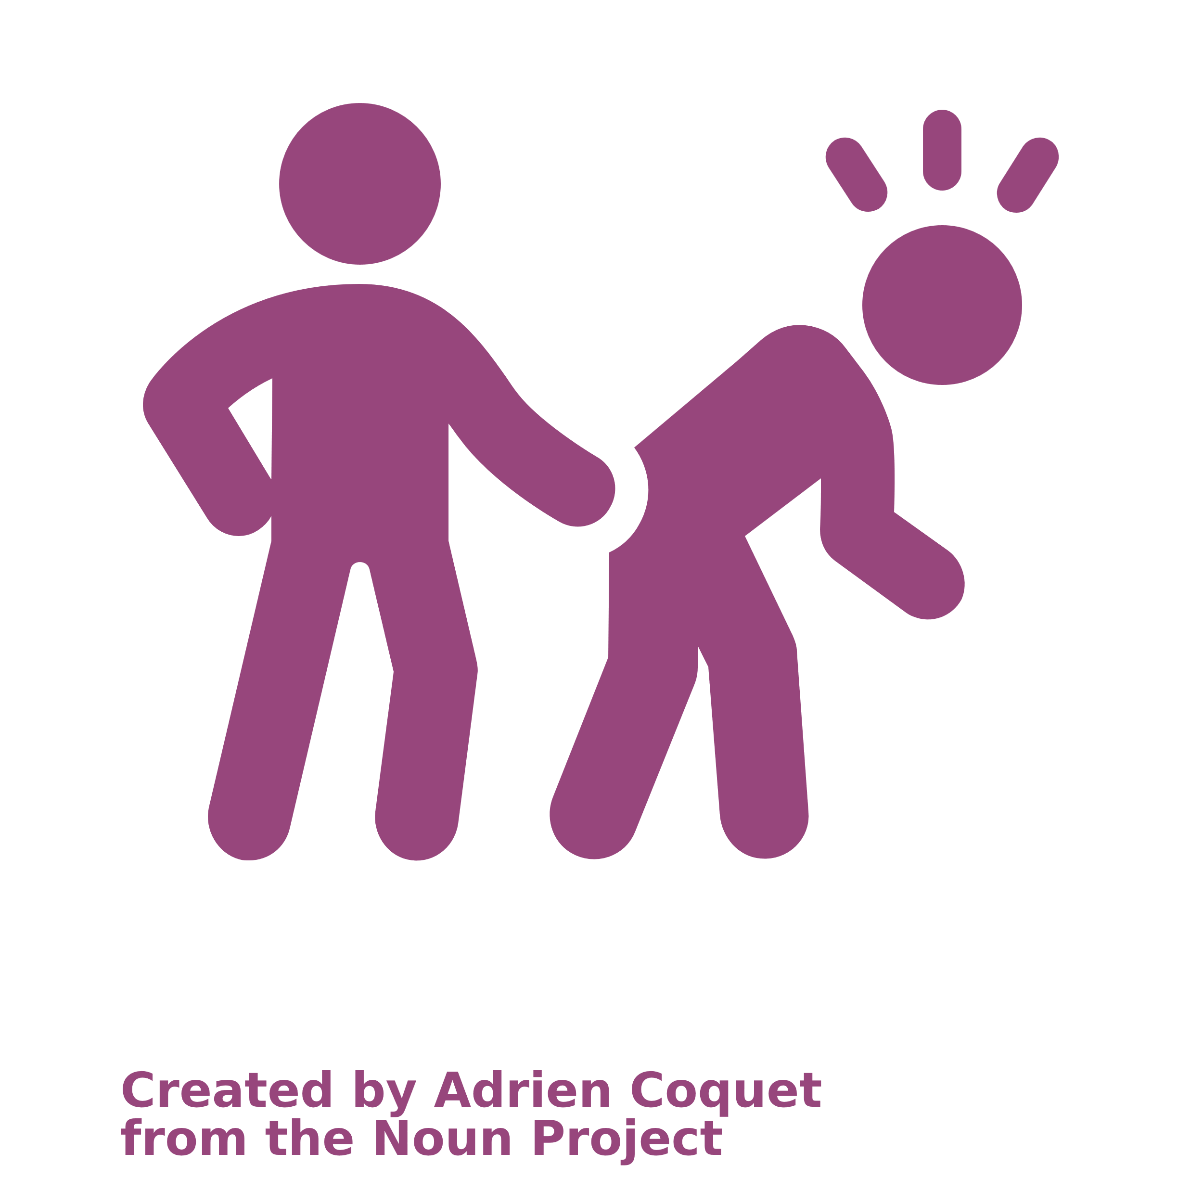
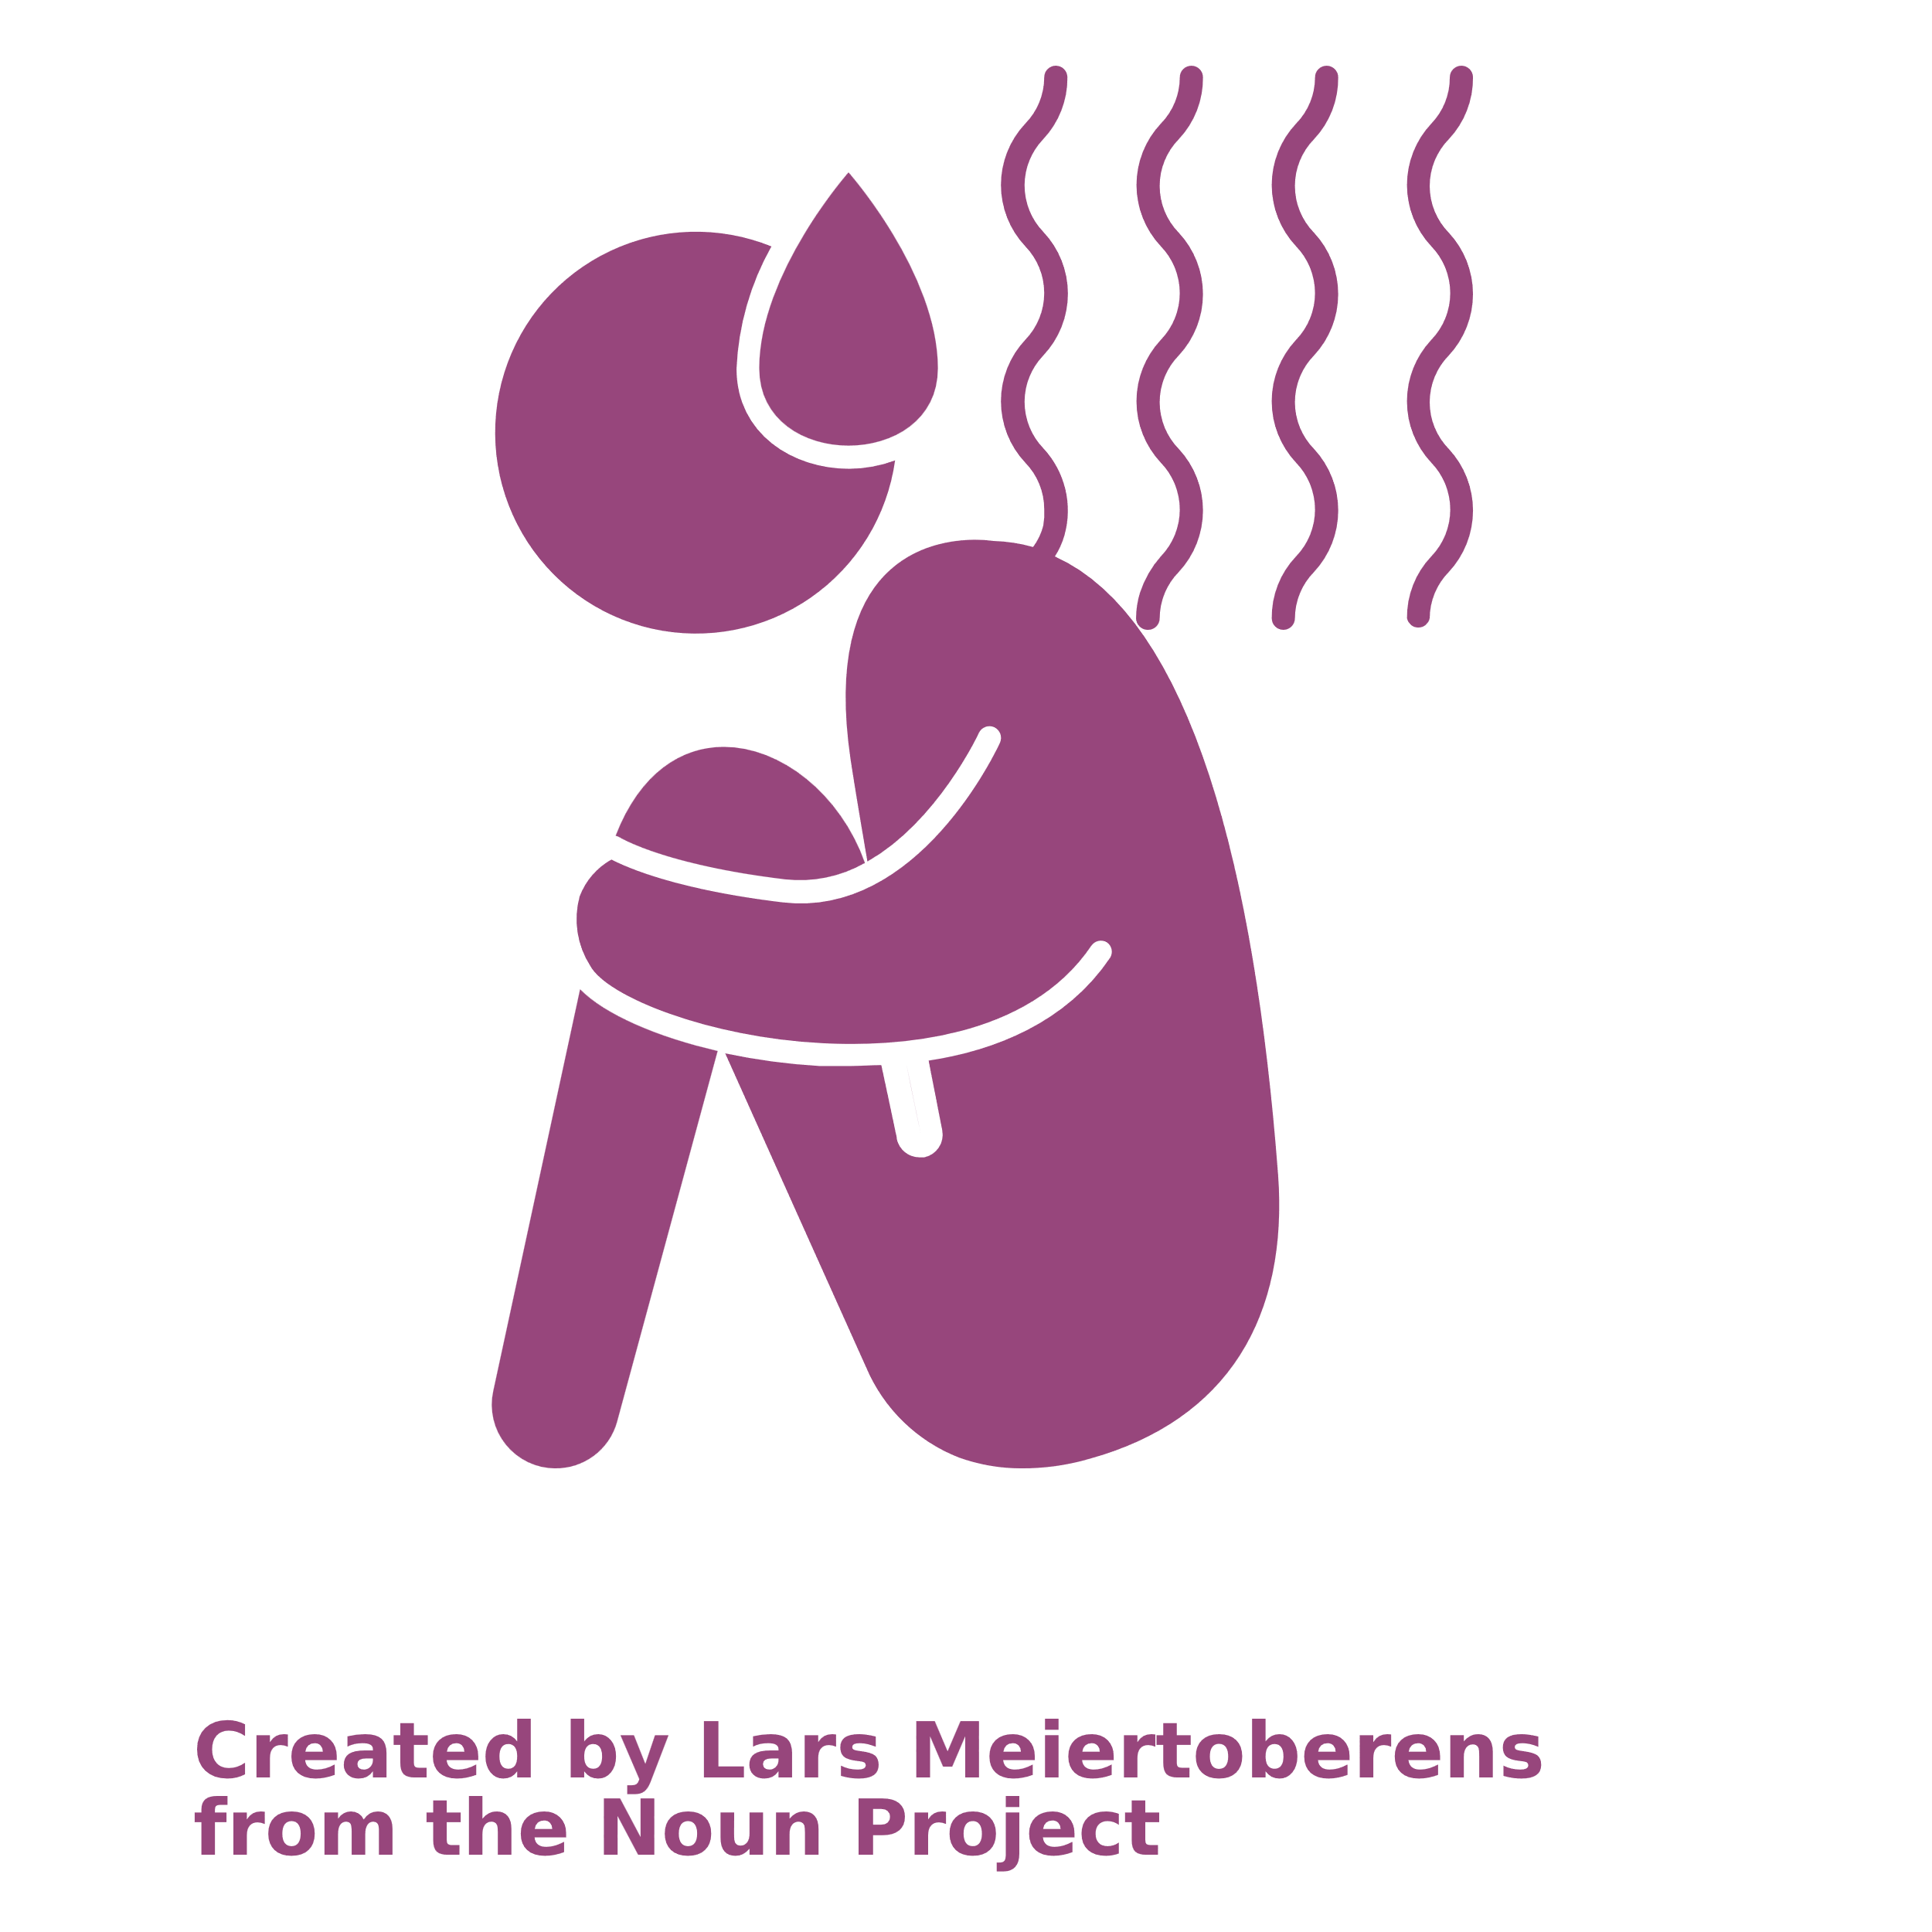
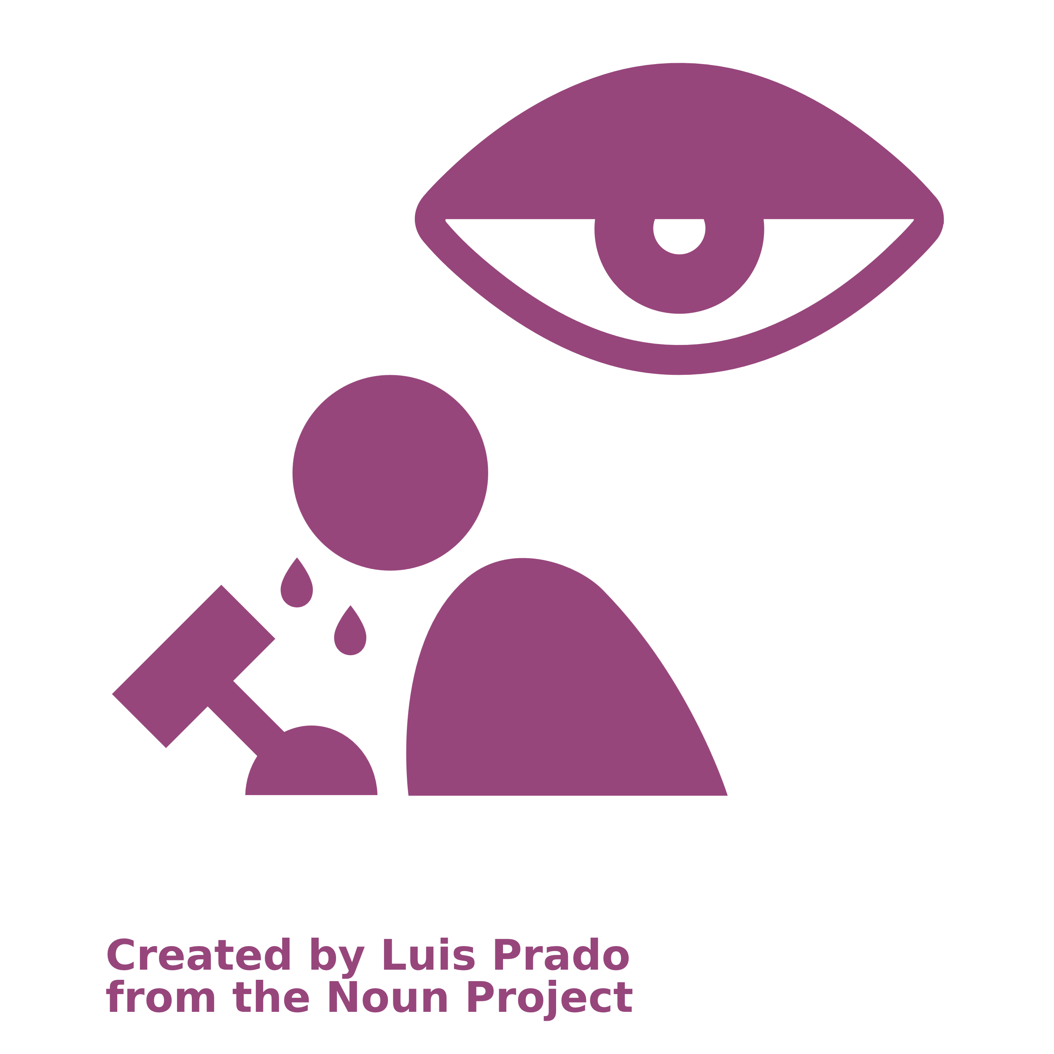

Child protection concerns (recap)
1
2
3
4
Notes:
PLENARY DISCUSSION (10 minutes)
We know that through case management we try to address the individual needs of children and families facing protection concerns.
Let us start with a quick recap of the different child protection concerns we learned about in Level 1
Can you remember the four types of child protection concerns? Explain them in your own words.
If the participants mentioned violence and abuse, ask if they remember the different types of violence and abuse
Review and complement the ideas shared based on the next slide
16

Slide 17
Child protection concerns (recap)
1
2
3
4
VIOLENCE
ABUSE
NEGLECT
EXPLOITATION
Notes:
EXPLANATION
Violence
All acts that involve the intentional use of power or force (verbal or physical) against a child
The act either results in harm or a high likelihood of harm to child’s safety, well-being, dignity, and development.
Abuse
A deliberate act with actual or potential negative effects on a child’s safety, well-being, dignity, and development.
This act is committed in the context of a relationship of responsibility, trust, or power.
Physical abuse or violence: The use of violent physical force to cause actual or likely physical injury or suffering (e.g. hitting, shaking, burning, physical torture)
Sexual abuse or violence: All forms of sexual violence (e.g. rape by any perpetrator, sexual exploitation, indecent touching and exposure, using sexually explicit language towards a child, showing children pornographic material)
Emotional abuse or violence: Humiliating and degrading treatment (e.g. bad name calling, constant criticism, belittling, persistent shaming, solitary confinement, isolation)
Neglect
The intentional or unintentional failure to protect a child from actual or potential harm to their safety, well-being, dignity and development or failure to fulfil a child’s rights, while having the clear responsibility for the well-being of the child and the capacity, ability and resources to do so.
Exploitation
When an individual in a position of power and/or trust takes or attempts to take advantage of a child for their own personal benefit, advantage, gratification, or profit.
This personal benefit may take different forms: physical, sexual, financial, material, social, military, or political.
17

Slide 18

Vulnerabilities
VULNERABILITIES
“For child protection, vulnerability refers to individual, family, community and societal characteristics that reduce children’s ability to withstand adverse impact from violations of and threats to their rights.”
Source: Alliance for Child Protection in Humanitarian Action. (2019). Minimum Standards for Child Protection in Humanitarian Action
Notes:
PLENARY DISCUSSION
Present the slide
Vulnerabilities are characteristics that make a person less able to withstand or defend themselves against the adverse or negative impact of violations or threats, such as violence, abuse, neglect end exploitation.
What are some examples of vulnerabilities? You can refer to the power wheel on Workbook page 32: Power wheel.
18

Slide 19
Understanding child protection concerns
71
Review the child protection concerns listed on your case management forms and in your Standard Operating Procedures (SOPs)
Notes:
ADAPT FOR CONTEXT
Contextualize and adapt to local SOPs.
Adapt the number of “top most prevalent child protection risks” depending on group size:
Top 3 for ~15 participants
Top 4 for ~20 participants
______________________________________________________________________________
INTRODUCTION
Divide participants into pairs
Guide participants to Workbook page 71: Child protection concerns
With your partner:
Review the protection concerns
Discuss which concerns are violence, abuse, exploitation, and neglect
Discuss the vulnerabilities that are included
PARTNER WORK (5 minutes)
Provide 5 minutes for participants to complete
PLENARY DISCUSSION (15 minutes)
What are the most prevalent, most occurring, child protection risks in the area where you provide case management?
Through discussion, guide the groups to agree on a top 3-4 of most prevalent child protection risks in their context
If participants don’t agree in discussion, you can organize a vote
19

Slide 20
Child protection analysis
72
How would you define or explain this protection concern? Create a definition.
Who is vulnerable? What are the characteristics of the children or families facing this protection concern?
Who is responsible for these protection concerns? Who is causing them?
Notes:
INTRODUCTION
In level 1 we learned to do a child protection risk analysis of the cases of children who are facing child protection concerns.
But, child protection risks can also be analyzed on a community and society level.
We will practice this now
In groups, we will analyze each child protection concern of our top 3-4 child protection concerns so that we can better understand them.
Divide participants into 4 groups
Assign one protection concern of the top 4 listed in the plenary discussion to each group.
Hand out a flipchart to each group
Guide participants to Workbook page 72: Child protection analysis
In your groups:
Discuss the protection concern further and reply to each question
Write down your responses on a flipchart and be prepared to present it
When discussing the second question, make sure to include demographics, population groups, geographic locations, and level of exposure to the child protection concern.
GROUP WORK (25 minutes)
Provide 25 minutes for participants to complete
Check in with groups to make sure their replies are specific
PLENARY DISCUSSION (40 minutes)
For each group:
Spend 5 minutes for them to present their analysis
Provide 1 minute for other participants to complement or ask questions
20

Slide 21
Child protection analysis
Case Management Teams (caseworkers and their supervisors) should understand the child protection concerns children and families face. They should consider the adverse impact on their rights, and their strengths and capacities to cope.
Conducting child protection analysis and understanding child protection concerns can:
Support the prioritization of child protection risks
Support problem-solving and decision making to better address child protection risks
Notes:
EXPLANATION
Child protection analysis provides a better understanding of:
The child protection concerns
Who is vulnerable to them and why
What is their impact
Who is responsible or causing them
This information is very useful for caseworkers and case management supervisors to better address the needs of children and their families who face them.
Present the slide
21

Slide 22
Key learning points
Child protection analysis gives a better understanding of the child protection concerns, who is vulnerable and why, what is their impact and who is responsible or causing them.
Child protection analysis can help caseworkers to better address the needs of children and their families
Notes:
EXPLANATION
Present the slide
22

Slide 23
SESSION 4
How do I analyze complex child protection risks and prioritize needs?
Notes:
SESSION 3 DURATION: 1h45
23

Slide 24

Child protection risk analysis
RISK FACTORS
Child protection concerns
Vulnerabilities
PROTECTIVE FACTORS
Strengths
Care and support
Strengths
Care and support
Notes:
EXPLANATION
Present the slide
Children will experience protection concerns differently depending on:
Their other characteristics (strengths and vulnerabilities)
The care and support they receive
When analyzing a child protection risk, we need to consider both:
The risk factors (vulnerabilities and child protection concerns)
Protective factors (strengths, care and support)
This model is a visualization of the risk analysis:
The child in the middle is trying to stay standing
Risk factors such as vulnerabilities and child protection concerns are weighing them down.
The risk factors are cumulative. The more risk factors – the higher the risk.
Protective factors such as strengths, care and support are helping the child to stay standing.
The protective factors carry the weight that the risk factors might put on the child.
24

Slide 25
Child protection risk analysis – case study
73-
75
RISK FACTORS
PROTECTIVE FACTORS
Notes:
ADAPT FOR CONTEXT
Adjust the risk level based on local Case Management SOPs
Adapt the case study in the presentation and in the workbook as needed
______________________________________________________________________________
EXPLANATION
We will again practice doing a child protection risk analysis, using a case study.
Guide participants to Workbook page 73-75: Child protection risk analysis – case study
Divide participants into groups of 3-5 people
In your groups:
Review Jolie’s assessment information
Fill out the child protection risk analysis
Remember to only fill in the factors that are stated in the scenarios. Do not invent or assume any factors!
GROUP WORK (20 minutes)
Provide 20 minutes for participants to complete
While participants work, draw the model on a flipchart
PLENARY DISCUSSION (10 minutes)
Ask for a volunteer of each group to share their responses
If you divided the participants in 4 groups, each group can present one of the risk analysis elements (strengths, care and support, vulnerabilities, protection concerns)
Write their responses on the flipchart containing the model
What risk level would you give to Jolie’s case?
Review and complement with the responses on the next page
______________________________________________________________________________
CONTINUED →
25

Slide 26
Extra slide for facilitator notes
Notes:
RESPONSES
Protection concerns
Physical violence or abuse
Sexual violence or abuse
Rape
Abandonment
Vulnerabilities
Abandoned
Psychosocial distress
Mental disorder
Child in residential care
Strengths
Documentation
Finished primary school, currently at secondary school
Care and support
Residential care
(Father and mother, but they don’t currently provide care)
One friend at the care center
Accepting community
26

Slide 27
Immediate needs of a child
Safety
Mental health
Care arrangement
Physical, sexual & reproductive health
Basic needs
Notes:
EXPLANATION
Recall the immediate needs of a child that require an urgent response from Level 1.
A caseworker will initially assess if the child is safe from harm and if the child has any urgent needs that need to be addressed immediately.
These needs can be organized into 5 categories.
Present the slide
Physical health, sexual and reproductive health: Injuries, illness, disease, pregnancy, etc.
Mental and emotional health: A child's ability to manage and cope with emotions, the will to live, the presence or absence of nurturing/supportive relationships, etc.
Safety: Any immediate risk of harm to the child
Care arrangement: The type of living, care or custody arrangement the child is currently in (for example: who is taking care of the child, what are the living conditions, etc.)
Basic needs: The essentials or elements needed for survival, health, and safety such as food, water, housing, clothing, etc
In the case of Jolie there are few immediate needs that need to be prioritized:
Safety
Physical and sexual reproductive health
Mental health care
27

Slide 28
Identify and prioritize the needs
76
Safety
Friends, contact with peers
Positive self-esteem & confidence
House, shelter
Health (physical, SRH)
Health (mental, emotional)
Food and water
School or education
Hygiene
Family, care, care arrangement
Civil documentation
Other needs?
Love and affection
Free time, play
Stability
Notes:
ADAPT FOR CONTEXT
Adapt the case study in the presentation and in the workbook as needed
______________________________________________________________________________
EXPLANATION
Present the slide
Are there other needs that should be added?
Some needs are more urgent and most be prioritized above other needs.
Identifying and prioritizing needs should be done with the participation of the child, parent or caregiver, as they know best what they need.
INTRODUCTION
Divide participants into pairs
Guide participants to Workbook page 76: Child protection risk analysis – case study (part 3: child protection needs)
With your partner:
Prioritize the needs of Jolie
At the bottom, write the needs that are most basic and should be prioritized if they are not being met or only partially met
GROUP WORK (15 minutes)
Provide 15 minutes for participants to complete
PLENARY DISCUSSION (10 minutes)
Ask for volunteers to share their responses
Review and complement with the guidance on the next page
______________________________________________________________________________
CONTINUED →
28

Slide 29
Extra slide for facilitator notes
Notes:
GUIDANCE
Jolie’s immediate needs (first and absolute priority) that require urgent response include:
Safety (address the risk of retaliation from perpetrators)
Sexual reproductive and physical health (health care to prevent STD and treat injuries)
Mental health
Jolie’s other needs, from highest to lowest priority:
Stability (living in different centers)
Safety (prevent Jolie from unsafe situations when she explodes and needs a time-out from the center)
Love and affection (contact with parents and family-based care)
School and education
Contact with peers / free time and play
29

Slide 30
Prioritization of needs
Positive self-esteem & confidence
Not met?
Partially met?
Fully met?
Free time, play
School or education
Civil documentation
Love and affection
Family, care, care arrangement
Friends, contact with peers
Stability
Food and water
Safety
House, shelter
Hygiene
Health (mental, emotional)
Health (physical, SRH)
Notes:
EXPLANATION
Present the prioritization of needs as shown on the pyramid.
Basic needs are at the bottom
These are required for a child’s survival
Other needs are above
These are also essential for a healthy development of a child
These include love and affection, care, and stability
When prioritizing, we need to also check if these needs are:
Not met
Partially met
Fully met
Ideally all these needs should be met, aiming for a child to develop to their full potential.
30

Slide 31
Key learning points
When analyzing a child protection risk, both the risk factors (vulnerabilities and child protection concerns) and protective factors (strengths, care and support) need to be considered
The needs of the child must identified and prioritized with participation of the child, parent or caregiver.
Notes:
EXPLANATION
Present the slide
31

Slide 32
SESSION 5
How do I plan and manage my caseload?
Notes:
SESSION 5 DURATION: 1h
32

Slide 33
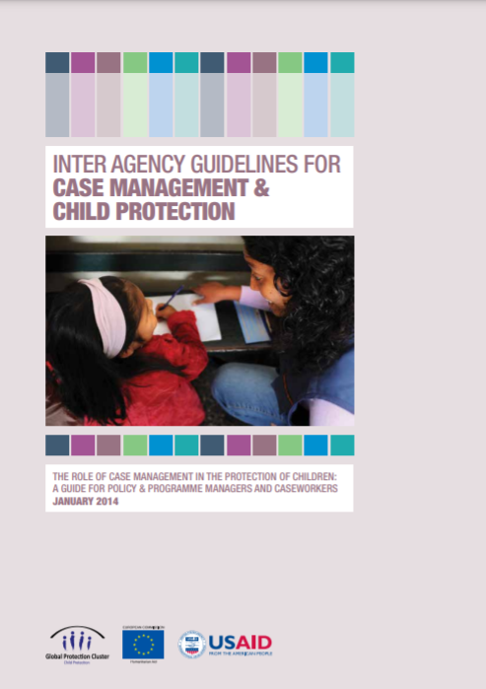
Guidelines on caseload
Caseworkers must have a reasonable caseload, reflecting their skills and capacities.
The number of cases allocated to each caseworker should not be more than 25. A caseworker should not take on more cases than they can handle, but the number of cases a caseworker can handle depends on:
Responsibilities of the caseworker
Accessibility of the area of intervention
Complexity of the caseload and the interventions
Source: Alliance for Child Protection in Humanitarian Action. (2014). Inter-agency Guidelines for Child Protection & Case Management
Notes:
ADAPT FOR CONTEXT
Adapt to local case management Standard Operating Procedure (CM SOP)
______________________________________________________________________________
EXPLANATION
Present the slide
A caseworker should not take on more cases that they can handle, ensuring accountability and quality.
The Inter-Agency case management guidelines state 25 cases as an indication.
However, it is possible that a caseworker can handle less cases.
A case will require more or less time depending on:
The responsibilities of the caseworker
For example, case management is not only about making referrals but can include providing psychosocial support.
For example, if the caseworker also needs to enter data on their cases separately or if it’s integrated in a Child Protection Information Management system
The accessibility of area of intervention
For example, if house visits require the caseworker to travel a large distance or for long hours
For example, if it’s not possible to sometimes follow up remotely due to no network connection
The complexity of the caseload and the interventions
Some cases are more complex than others
Some children face higher risks
Some require more intensive support and regular follow up
33

Slide 34
Complexity of the caseload
HIGH RISK
COMPLEX
LOW RISK
Notes:
PLENARY DISCUSSION (10 minutes)
Each child is different and has different needs. Not a single child’s case is the same!
A high risk and complex case that requires intensive support and regular follow ups will weigh more on a caseworker’s caseload than a low risk case.
Do you agree or disagree with this statement?
How is this reflected within your own caseload?
Do you have a mix of low risk and higher risk cases, very complex to a bit more straightforward?
34

Slide 35
Plenary discussion
77
How do you work on your cases while managing and keeping track of your caseload?
Notes:
EXPLANATION
Since you now have experience in child protection case management, we will share our practices working on our cases while keeping track of our caseload.
Divide participants into pairs
Guide participants to Workbook page 77: Managing a caseload
With your partner:
Discuss how you manage your cases and keep track of your caseload.
Share your practices and write them down
PARTNER WORK (10 minutes)
Provide 10 minutes for participants to complete
PLENARY DISCUSSION (5 minutes)
Encourage participants to share their responses
Write their responses on a flipchart
35

Slide 36
Tools to keep track of your caseload
78-
80
Supervisors or managers should review the caseload of individual workers to ensure it is manageable at least once every 2 weeks.
Overview list of cases
Case file checklist tool
Notes:
EXPLANATION
Some tools can help you and your supervisor to keep track of your caseload.
Overview list of cases:
It can be very helpful for you and your supervisor to have an overview of all your active cases.
You can create a list yourself or use the tracker provided when you use a child protection information management system like Primero (CPIMS+).
The list should contain basic information such as:
Case code (not the name of the child), gender, age, risk level, area or location where the child lives (not the exact address)
Which case management step you currently are - this helps you to track progress
Supervisors or managers should review the caseload of individual workers to ensure it is manageable at least once every 2 weeks.
Case File Checklist Tool
This should be used as a guide for supervisors to review a single child protection case.
This tool is part of regular coaching, and feedback should be provided in individual supervision sessions.
Guide participants to Workbook page 78-80: Case file checklist tool
Review the tool together
36

Slide 37
How to prioritize case work
Important
PLAN IT
! ! !
DO IT ASAP
DROP IT
DELEGATE IT
!
Not important
Not urgent
Urgent
Notes:
EXPLANATION
As a caseworker, you will have a long to do list, many actions to take, and many issues to address.
It is important to prioritize these actions.
A tool that can help you in this is the Time Management Matrix.
Present the slide
Urgent & important:
This include actions and casework that need to be implemented as soon as possible.
For example
Immediate needs that require a rapid response as discussed earlier and in Level 1 Module 5
High risk cases that need an immediate response
Some actions can’t wait. You will need to adjust your schedule and make time to respond rapidly.
Not urgent & important:
Some actions or casework are important but not urgent - they can wait a bit.
However, it’s important not to forget about them or keep postponing them.
Not urgent but important actions need to be planned - book time in your agenda to implement them.
For example, obtaining civil documentation can be a long process.
It is not urgent, so you don’t have to immediately drop everything to apply, but it is very important.
Include this in your case planning and take time to fully complete the application.
CONTINUED →
37

Slide 38
Extra slide for facilitator notes
Notes:
Urgent & not important:
Some tasks are urgent but not important for you as a caseworker, such as tasks that don’t require child protection technical expertise.
For example, making a phone call to a service provider to check if they are open, or to providing numbers for reporting to your line manager.
Whenever possible, try to delegate urgent but not important tasks.
Not urgent & not important:
Lastly, there are tasks or actions that are not a part of your responsibility as a caseworker.
For example, buying new clothes for the child is not urgent nor important for the caseworker to do
As discussed earlier, it is important to remember your role and not become overwhelmed with tasks that aren’t your responsibility.
Drop tasks that are not urgent and not important.
Source: Adapted from Covey, S. (1989). The seven habits of highly effective people. New York: Simon and Schuster.
38

Slide 39
Key learning points
A caseworker should not take on more cases than they can handle. Quality of the support remains the priority
A supervisor should support a caseworker in tracking and managing their caseload
A caseworker needs to manage their time well, prioritizing action points based on urgency and importance
Notes:
EXPLANATION
Present the slide
39

Slide 40
SESSION 6
Module closing
Notes:
SESSION 6 DURATION: 0h30
40

Slide 41
Learning objectives
Explain formal and informal elements of a child protection system
Identify prevalent child protection concern in your context
Demonstrate child protection analysis
List strategies to manage a caseload
Notes:
EXPLANATION
Present the slides
Refer back to today’s training
41

Slide 42
End of module
81
Review learning objectives
Reflection and feedback
Closing
Notes:
INTRODUCTION
Guide participants to Workbook page 81: Learning objectives
It’s important to take the time to review the learning objectives (Workbook page 69) and reflect on your achievements at the end of this training.
Some learning objectives might require some more information, practice or support from the supervisor to be fully achieved.
Look back at today’s training and answer the questions on the learning objectives in your workbook.
INDIVIDUAL WORK (5 minutes)
Provide 5 minutes for participants to complete
PLENARY DISCUSSION (5 minutes)
Invite volunteers to share their reflection
INTRODUCTION
Continue on Workbook page 81: Reflection
What surprised you? What was challenging? What would you like to learn more about?
Write down your reflections.
INDIVIDUAL WORK (5 minutes)
Provide 5 minutes for participants to complete
PLENARY DISCUSSION (5 minutes)
Invite volunteers to share their reflection
Thank the participants for their participation
42

