Slide 1


Strengthening Community-level Approaches to Child Protection in Humanitarian Action
CAPACITY-BUILDING PACKAGE INTRODUCTION

Slide 2



Strengthening Community-level Approaches to Child Protection in Humanitarian Action
Name of Workshop
Date of Workshop
Location

Slide 3
Community-level Child Protection
Task Force (CCP TF)
Background
Formed in 2016 to address gaps in guidance and tools on Community-based Child Protection (CBCP), and the need for more interagency coordination
Co-chaired by Plan International and World Vision International
Almost 30 member organizations and institutions, as well as individuals
Collect evidence and lessons learned
Develop guidance and facilitate research
Knowledge-sharing among practitioners, donors, and academics
Objectives
Notes:
This background is optional for a presentation. You may refer participants to the website for more information. https://alliancecpha.org/en/community-level-child-protection-task-force
Ask participants to consider why the name of the TF has been changed in 2019. The shifting focus to having higher levels of engagement have changed how we describe our work, which has led to a change in the name of the CPMS Standard 17, the TF, and this initiative.

Slide 4
Strengthening Community-level
Child Protection Initiative
Background
Review Committee comprised of CCP TF members formed for technical guidance
Interagency Systematic Review of Literature to develop evidence-based guidance and capacity-building materials
  Key Considerations
  Reflective Field Guide
  Definitions document
  Capacity-building package with face-to-face modules
  Online learning videos series
Pilot Country seed funding
Notes:
This is a brief overview of the main activities and products of the initiative.

Slide 5
Strengthening Community-level Child Protection Initiative
Pilot Countries:
Sudan
Philippines
Work with sub-national Child Protection Coordination mechanisms so guidance and capacity-building materials:
  Are informed by promising practice at the country level
  Meet the needs of field-level practitioners
  Increase practitioners’ confidence and skills when working with communities to deliver high-quality community-level child protection approaches

Slide 6
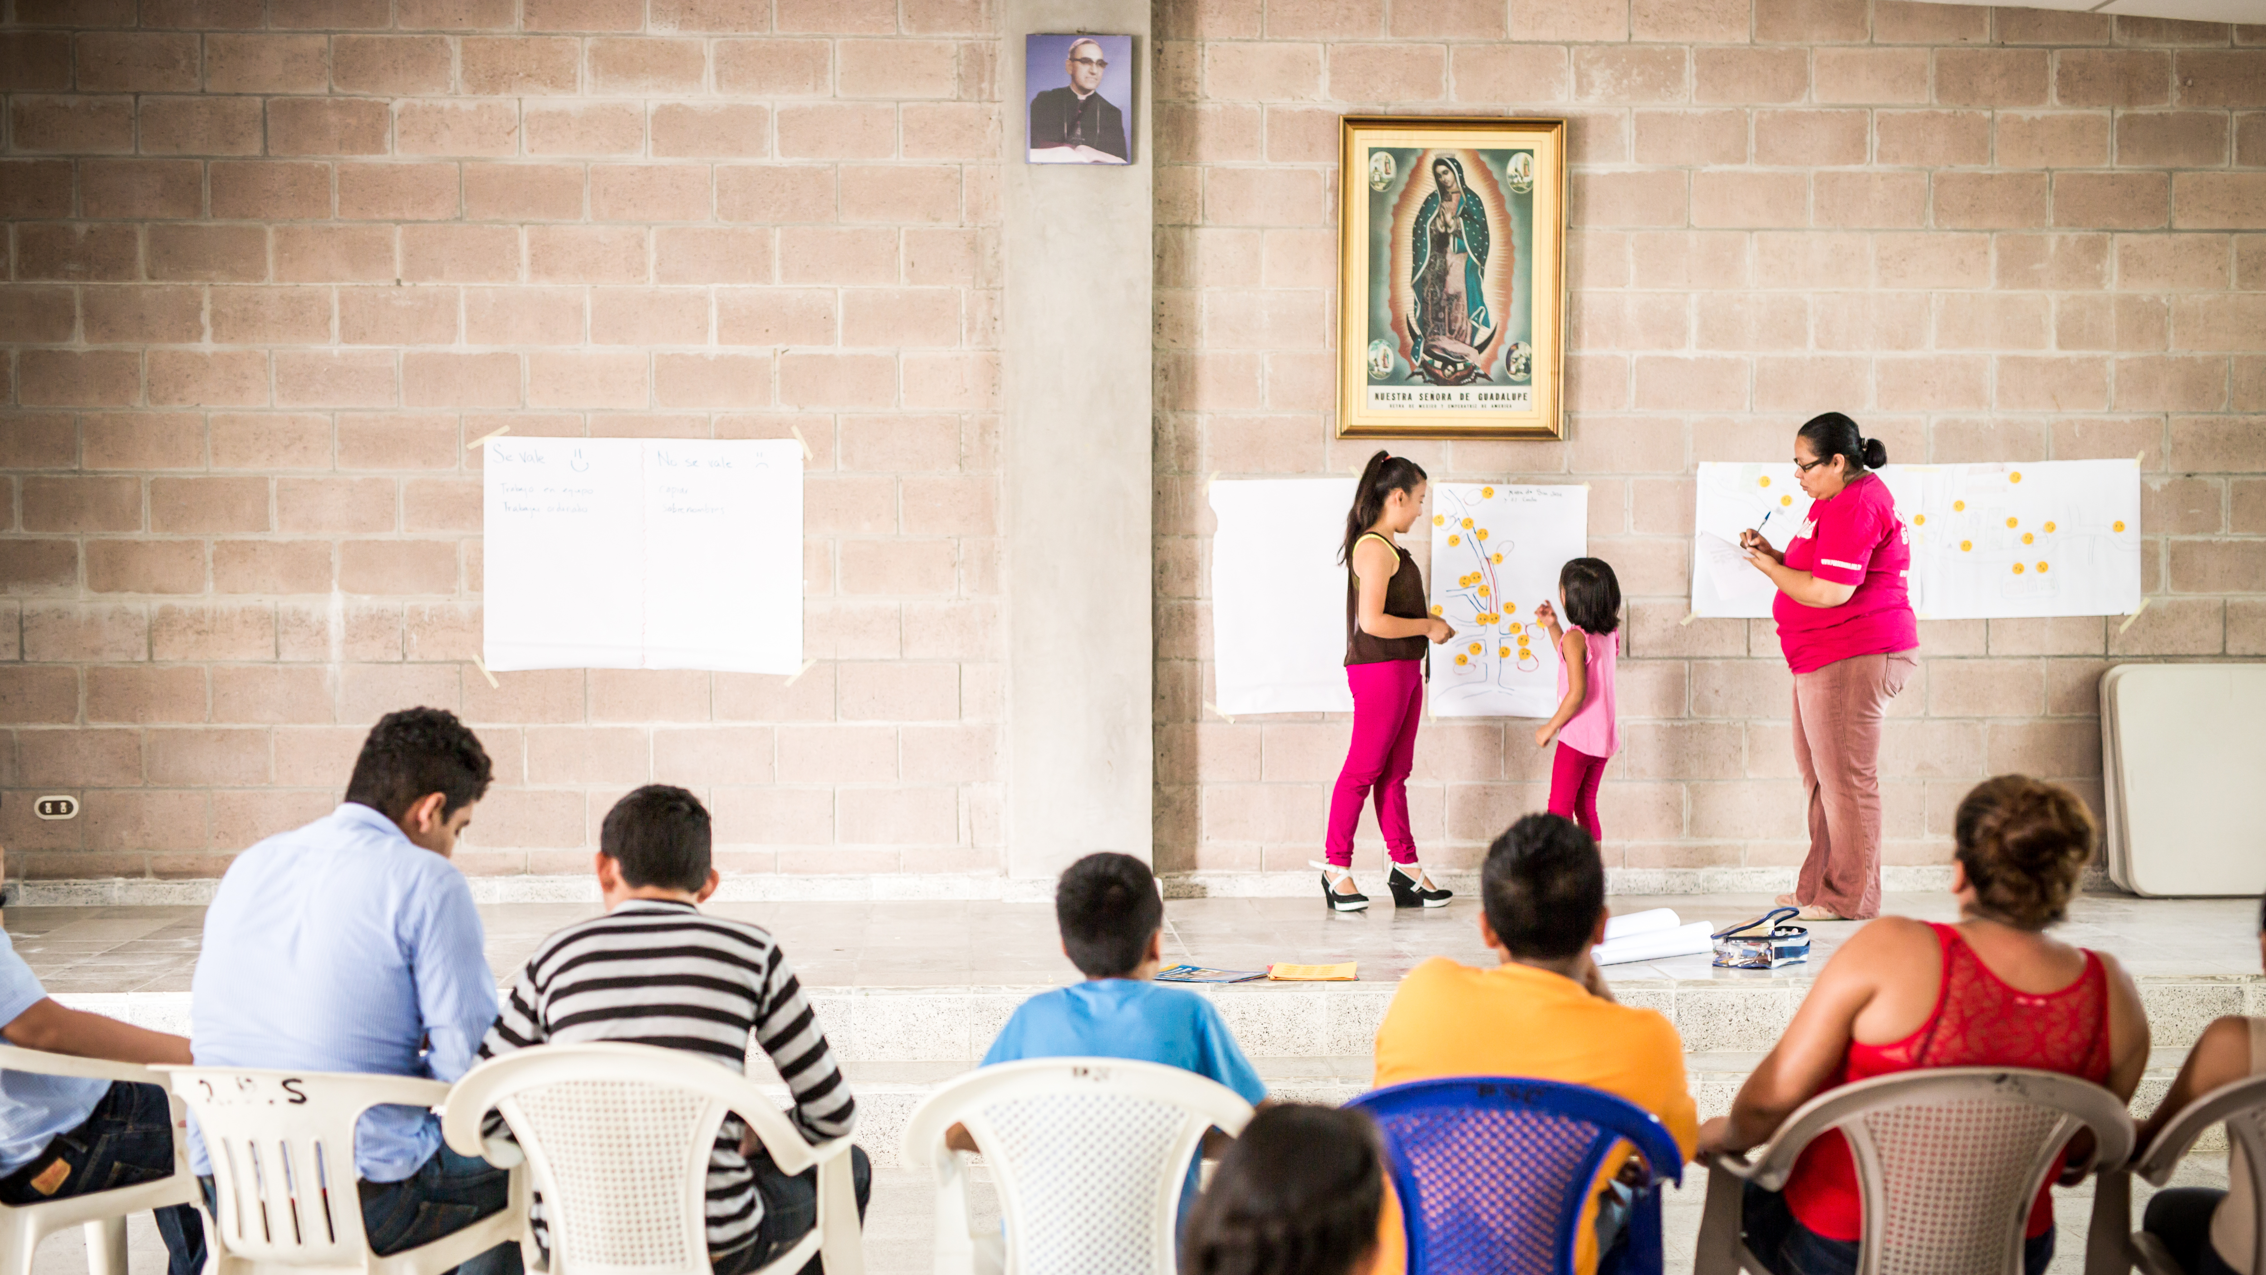
Contents of the Capacity-Building Package
Photo Courtesy of Plan International
Notes:
Explain to participants that there are two main components to the package:
Strengthening Community-level Approaches to Child Protection in Humanitarian Action: Face-to-Face Capacity-Building Materials
Community-level Child Protection Online Learning Series

Slide 7
Face-to-Face Capacity-Building Materials
Strengthening Community-level Approaches to Child Protection in Humanitarian Action
Module 1: Foundations of Promising Practice
M1.S1: Community-level Approaches to Child Protection: Defining Our Work
M1.S2: Framework for Community-level Child Protection Approaches: Social Ecology
M1.S3: Framework for Community-level Child Protection Approaches: Child Protection Systems
M1.S4: Key Considerations for Effective Community-level Child Protection
M1.S5: Part 1: Where Are We Now? Analyzing Our Community-level Approaches
M1.S5: Part 2: Where Do We Want to Go?
Module 2: Enhancing Our Capacities for Community Engagement
M2.S1: Methods and Approaches to Strengthen Community-level Child Protection – Foundations
M2:S2: Facilitating Discussions on Children’s Risks and Protection
M2.S3: How Do We Understand Existing Protection Capacities and Risks in the Community?
M2.S4: How to Identify Risks Associated with External Support
M2.S5: Understanding Community Concepts of Child Protection
M2.S6: Prioritizing Child Protection Risks
M2.S7: How to Create Meaningful Opportunities for Child Participation
M2.S8: Action Planning with Communities
M2.S9: Facilitating Linkages between Informal and Formal Child Protection Systems
M2.S10: Reflecting on the Quality in Our Community-level Child Protection Programming
M2.S11: Community-level Child Protection in Humanitarian Action: The Need for a Shift in Mindset Considerations for More Facilitative Community-level Approaches for Practitioners

Slide 8
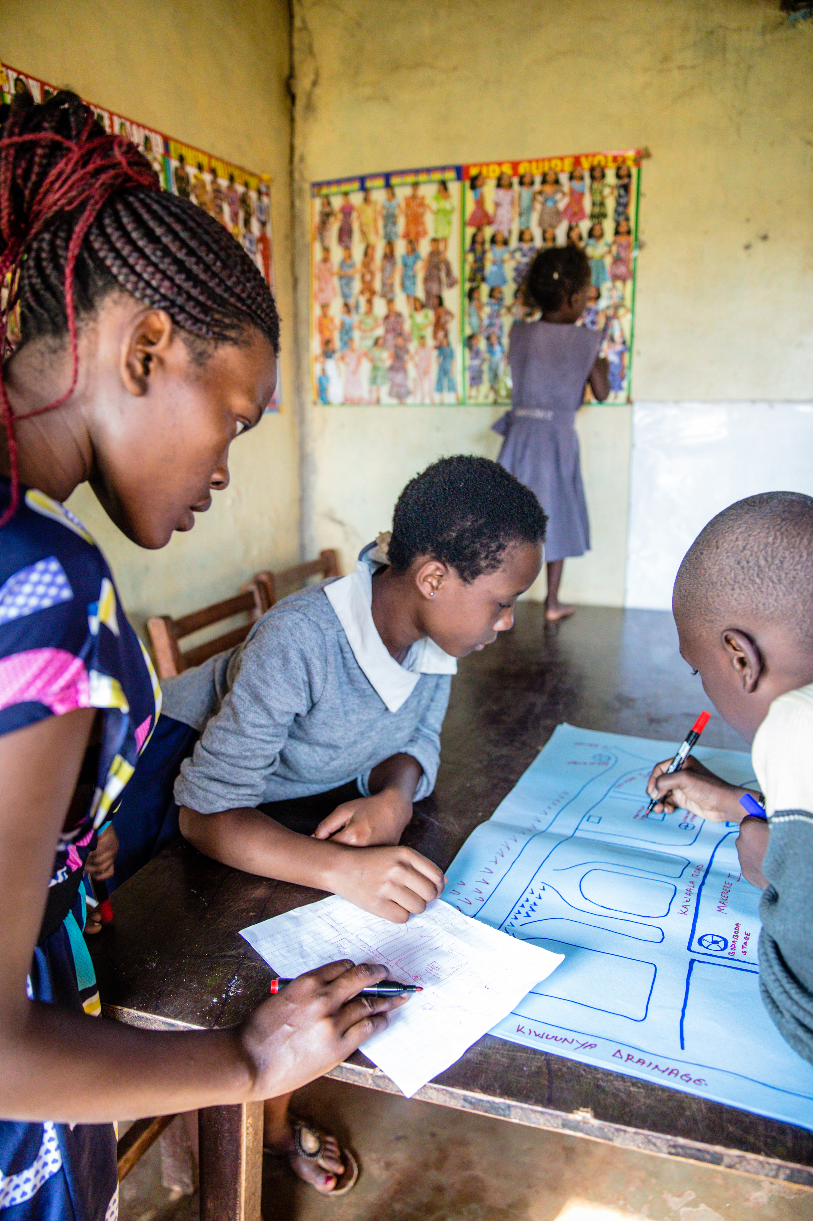
Community-level Child Protection
Online Learning Series
Goal: to inspire the operationalization of CPMS Standard 17 and the new interagency resource, Reflective Field Guide: Community-level Approaches to Child Protection in Humanitarian Action by:
Increasing visibility, accessibility, and familiarity with key terminology and concepts
Guiding practitioners to reflect on current practices in light of research and learning
Encouraging child protection actors to engage in peer-led conversations on linking the practical usage of resources highlighted in the series to reflections around shifting our way of thinking about and working with communities in humanitarian settings.
Photo Courtesy of Plan International
Notes:
This video series is a companion to the Reflective Field Guide: Community-level Approaches to Child Protection in Humanitarian Action, the Face-to-Face materials, and the Minimum Standards for Child Protection in Humanitarian Action (CPMS) Standard 17.

Slide 9
Community-level Child Protection Online Learning Series
Video 1:
Operationalizing Standard 17: Community-level Child Protection Approaches
Video 3:
Key Considerations to Community-level Child Protection Approaches
Video 2:
Reflecting on Your Current Community-level Programming
Video 4:
Community-level Child Protection in Humanitarian Action: The Need for a Shift in Mindset
Notes:
NOTE: These are still being finalized.

Slide 10
Aim and Objectives
Capacity-Building Workshop

Slide 11

Capacity-Building Workshop
Contents of the Capacity-Building Package
Notes:
Explain to participants that there are two main components to the package:
Strengthening Community-level Approaches to Child Protection in Humanitarian Action: Face-to-Face Capacity-Building Materials
Community-level Child Protection Online Learning Series

Slide 12
Aim & Outcomes
Aim
The aim of this workshop is to enhance the knowledge and skills of CP practitioners to confidently implement effective community-level approaches.
Learning Outcomes
Increased knowledge of the key factors influencing promising practice
Reflection on participants’ own attitudes, dispositions, and approaches
Enhanced capacities to use participatory methods, tools, and approaches that contribute to effective community engagement
Notes:
This introduces participants to the content of the Field Guide, and practical application of methods and approaches to promising practice. Capacity building will focus not just on technical skills, but particularly on behavioral competencies, including the soft skills necessary for successful community engagement.

Slide 13
Learning Agreement

Slide 14






What should we agree to for a productive workshop?
Write your suggestions on Post-it® notes
Notes:
We will be exploring important elements of community engagement, and the attitudes and behaviors we need to cultivate to strengthen our approaches. We see this group of facilitators and participants as a community and can begin cultivating those attitudes and behaviors grounded in humility, respect, and listening.
In many settings there are familiar methods to doing this type of agreement exercise, such as calling out suggestions and the facilitator writing those down. Use a method suggested by participants that they are comfortable with.

Slide 15
Housekeeping
Information about the workshop rooms and facilities
Meals
Accommodations (if relevant)
Transport
Other

Slide 16
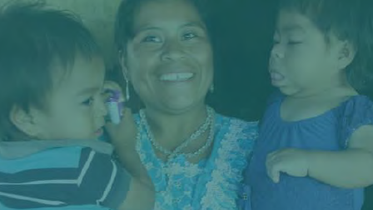
Thank you!
Thank you!

