Slide 1
Prevention of Separation Learning Package

Slide 2
Session 1
Introduction

Slide 3
Training Agenda

Slide 4
Module Aim
Participants understand prevention related elements from the UASC Handbook and Toolkit and the ACE Toolkit within the framework of the 3 Levels of Prevention described in the CPHA Primary Prevention Framework

Slide 5
Session
Learning
Objectives
Explain the origin of the Prevention Addendum to the UASC Handbook
Describe what is meant by primary prevention

Slide 6
What is primary prevention?
Primary prevention is about identifying and addressing trends or patterns of risk facing children within the population, as opposed to identifying individual cases of children at risk for service provision. Primary prevention aims to reduce the risk of harm for all children within a population or a sub-group of the population.

Slide 7
What does “at the population level” in primary prevention mean?
A population can refer to a whole society or a part of it. For example, a specific geographic community, and include all the children within that community. It can also refer to a sub-group of children within the broader society. For example, all children living in refugee camps within a country, or all children aged one to five years old in the broader society.

Slide 8
Session 2
Overview of Primary Prevention Framework

Slide 9
Learning Objectives
Explain how the Primary Prevention Framework applies to prevention of family separation in humanitarian action
List the three levels of prevention and provide an example of each when applying to prevention of family separation
Give examples of the CPHA Prevention Principles
Give examples of key elements for primary prevention of family separation in the programme cycle

Slide 10
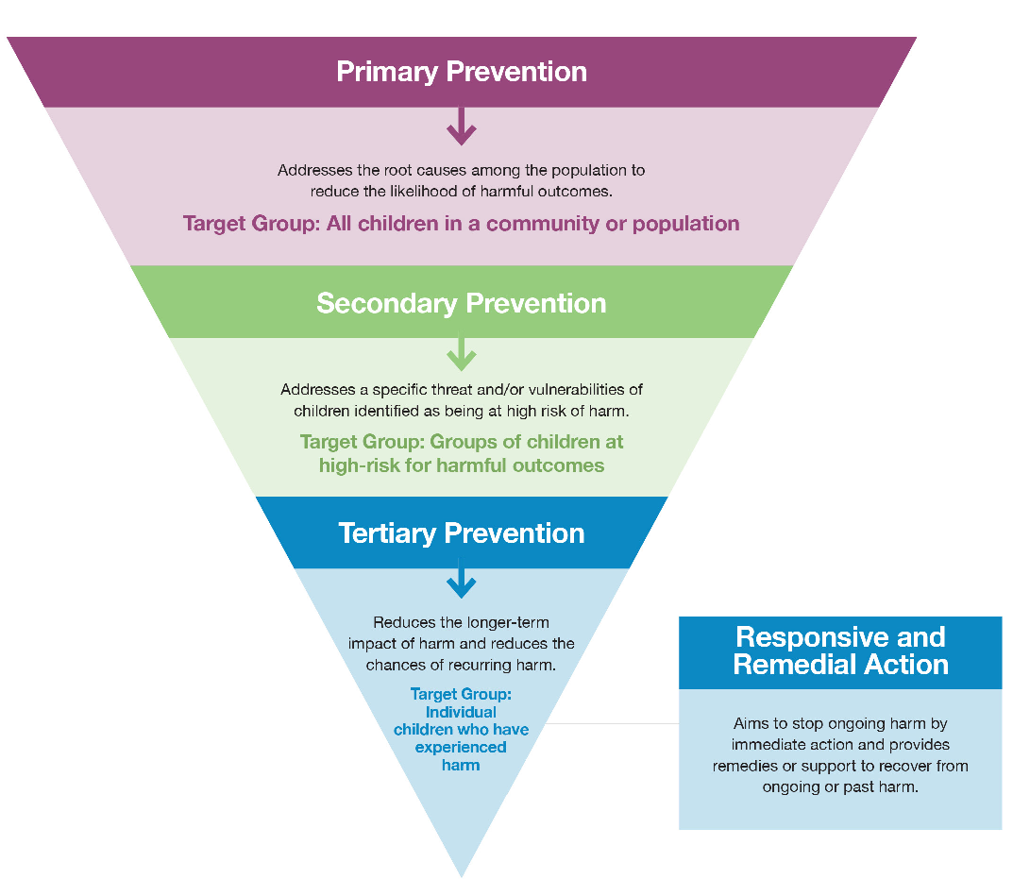

Slide 11
Prevention level | Target group
Primary prevention – addresses the root causes among the population to reduce the likelihood/incidence of family separation | All children in a community or population or all children of a sub-group (e.g., refugee/internally displaced populations, girls or boys of a certain age)
Secondary prevention – addresses the specific threat and/or vulnerabilities of children identified as being at risk of family separation | All children identified as being at high risk of family separation
Tertiary prevention – aims to mitigate the longer-term impact of family separation, including preventing re-occurrence of separation and other forms of harm | Children already separated from their parent(s)/primary caregiver(s)

Slide 12
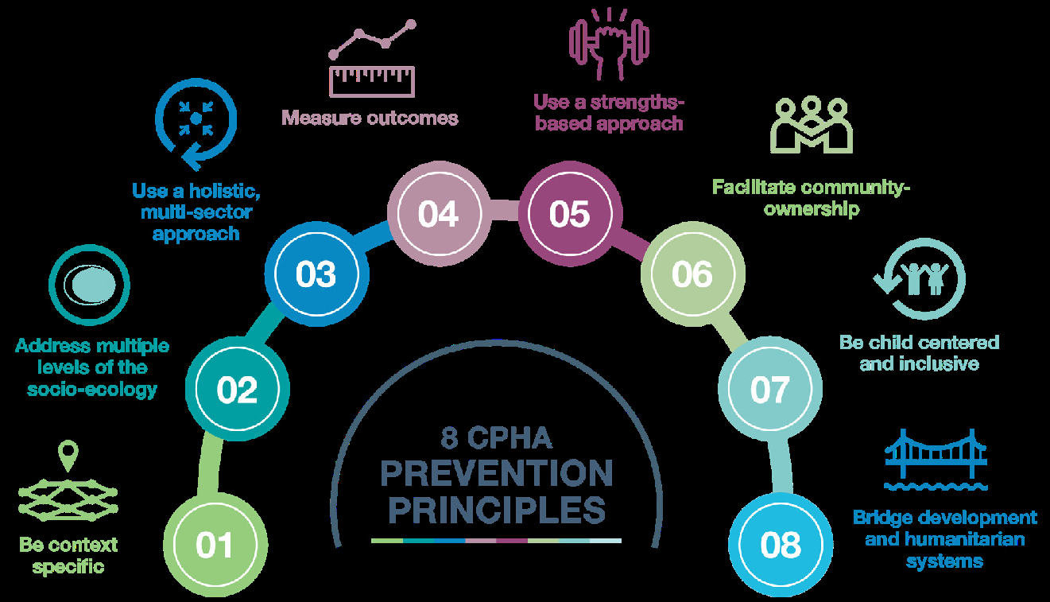

Slide 13
Session 3
Applying the Primary Prevention Framework to prevention of family separation
3.1 Primary Prevention

Slide 14
Learning Aim and Objectives
  Module Aim: Participants understand prevention related elements from the UASC Handbook and Toolkit and the ACE Toolkit within the framework of the 3 Levels of Prevention described in the CPHA Primary Prevention Framework
  Learning Objectives:
  Explain primary prevention in the context of family separation
  Give examples of risk and protective factors relating to family separation at the population level (based on socio-ecological model of the CPMS)
  Suggest ways to prevent separation and preserve family unity (based on socio-ecological model of the CPMS)

Slide 15
Session 3 Activity 2 – Case Study Primary Prevention
Group Work

Slide 16
Session 3.2
Prevention of family separation – secondary prevention

Slide 17
Learning Objectives
  Explain secondary prevention in the context of family separation
  Give examples of risk and protective factors relating to family separation at group/individual level
  Suggest ways to prevent separation and preserve family unity

Slide 18
Applying secondary prevention to prevention of family separation
Secondary prevention – addresses the specific threat and/or vulnerabilities of children identified as being at risk of family separation
The target group is all children identified as being at high risk of family separation

Slide 19
Secondary prevention target groups
adolescents identified as at risk of migration for labour
families with children with disabilities
families with a child identified as at risk of child marriage
adolescents at risk of recruitment
children identified as at risk of abuse or neglect in the home
Vocational training for adolescents identified as at risk of migration for labour;
Community groups supporting the preparation of families with children with disabilities at risk of having to flee from conflict with measures to prevent separation;
Economic/livelihoods support to families with a child identified as at risk of child marriage;
Mentoring for adolescents at risk of recruitment into armed forces or armed groups.
Parenting support sessions or home visits for parents of children identified as at risk of abuse or neglect in the home;

Slide 20
Activity 2 Session 3.2 Case Study Secondary Prevention
Group Work

Slide 21
Session 3.3
Prevention of family separation – tertiary prevention

Slide 22
Learning Objectives
Explain tertiary prevention in the context of family separation
Give examples of risk and protective factors relating to UASC
Suggest ways to mitigate impact and prevent further harm, including re-occurrence of child family separation

Slide 23
Applying tertiary prevention to the prevention of family separation
Tertiary prevention – aims to mitigate the longer-term impact of family separation, including preventing re-occurrence of separation and other forms of harm
The target group is children already separated from their caregiver(s)/parent(s)/ primary caregivers

Slide 24
Primary Prevention | Secondary Prevention | Tertiary Prevention
Investment into the national care system in making available a range of appropriate, preferably community-based alternative care; promoting quality standards and monitoring of all care arrangements | Supporting the preparation of vulnerable families at risk of having to flee from conflict to avoid becoming separated (e.g., placing wrist bands on young children with identity details) | Case management services for children who are separated from parents/primary caregivers
Registration of displaced populations, including caregivers and their children at e.g., border crossings | Referral to youth mentoring programme for adolescents at risk of family separation | Supporting family contact for separated children where reunification is not possible or in their best interests at that time (e.g., due to security concerns)
Provision of social protection programmes and socio-economic support: cash transfer schemes and livelihood support | Parenting support sessions or home visits for parents of children identified as at risk of abuse or neglect in the home | Reintegration support for children associated with armed forces and armed groups
Support gatekeeping measures to limit placement of children in residential care as a last resort | Vocational training for adolescents at risk of migration for labour | Preparation of child and family prior to family reunification, especially after long separation or if returning to changed circumstances (e.g., remarriage of a parent)

Slide 25
Activity 3 Session 3.3 Case Study Tertiary Prevention
Group Work

Slide 26
RISK FACTORS
Society
Community
Socio-cultural norms
Family
Child
PROTECTIVE FACTORS

