Slide 1
Prevention Focal Point Training
Alliance for Child Protection in Humanitarian Action

Slide 2
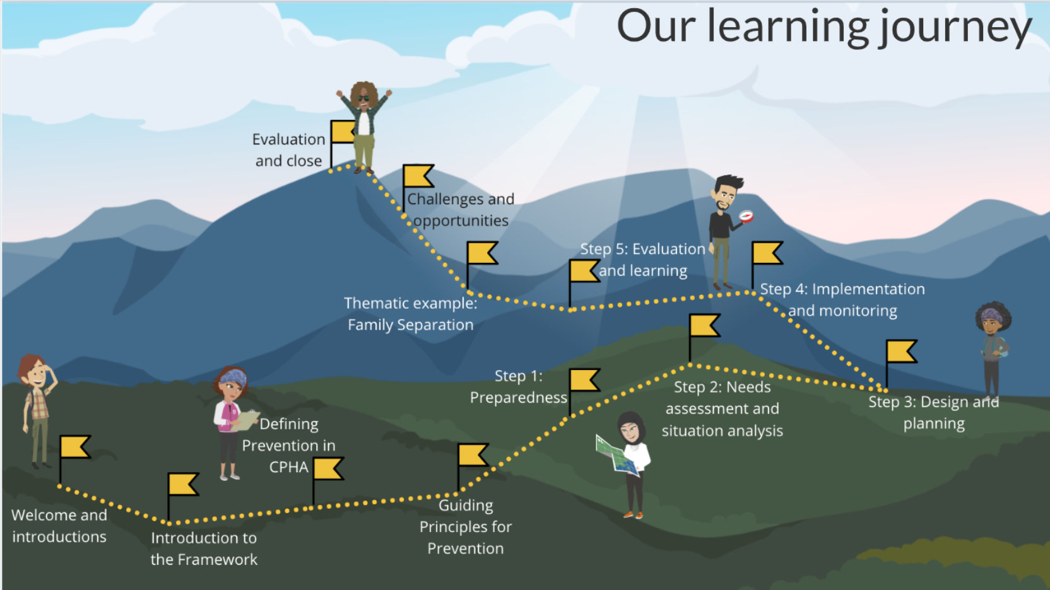
Learning journey

Slide 3
Course objectives
By the end of the course, you will be able to:
Differentiate between the three levels of prevention in child protection in humanitarian action and provide examples of each
Discuss ways to apply the prevention guiding principles throughout the programme cycle
Demonstrate participatory ways to identify risk and protective factors with community members
Demonstrate how to analyse risk and protective factors to inform prevention programme design
Select appropriate primary prevention strategies
Reflect on the challenges, opportunities and benefits of primary prevention programming in their own work and context
Identify their next steps to roll out the framework and the support available

Slide 4
Defining prevention in CPHA
By the end of the session, you will be able to:
Explain the three levels of prevention and provide an example of each
Explain the importance of primary prevention

Slide 5
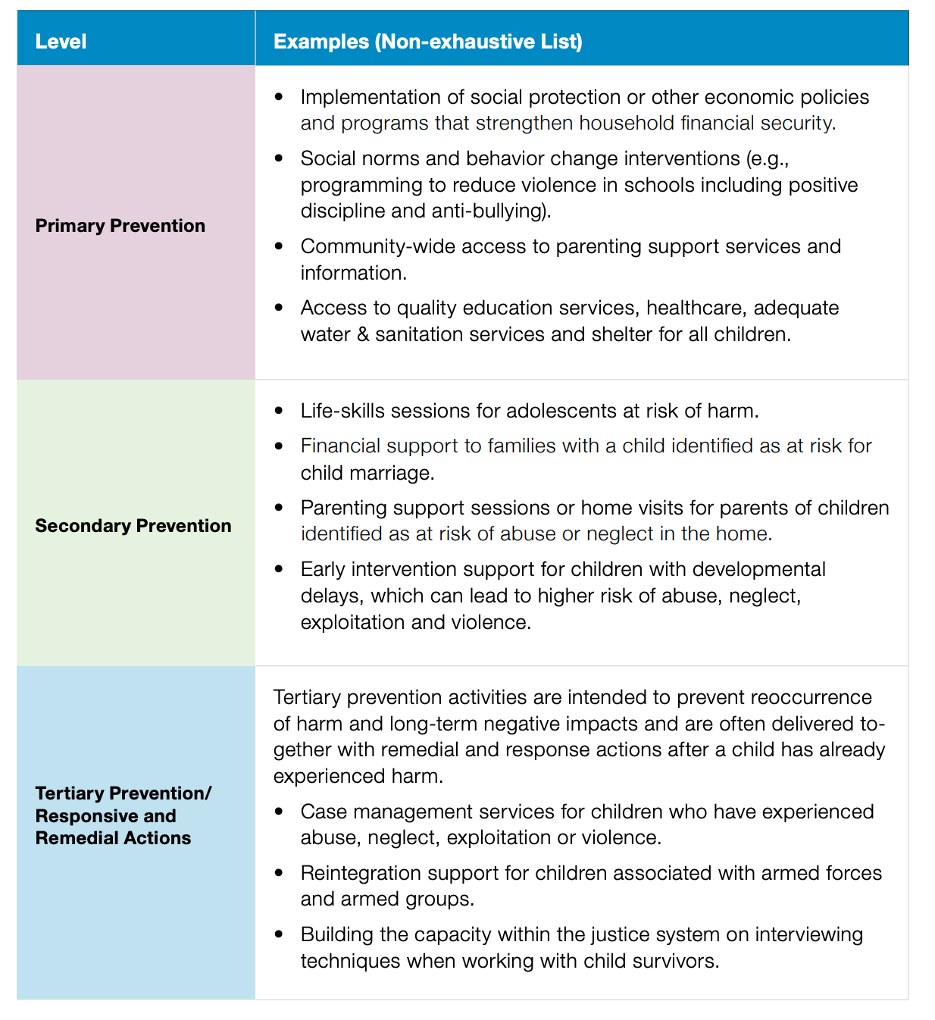
Levels of prevention

Slide 6
Introduction to the framework
By the end of the session, you will be able to:
Describe how and why the Primary Prevention Framework for CPHA was developed
Recall the key findings of the desk review which informed the framework

Slide 7
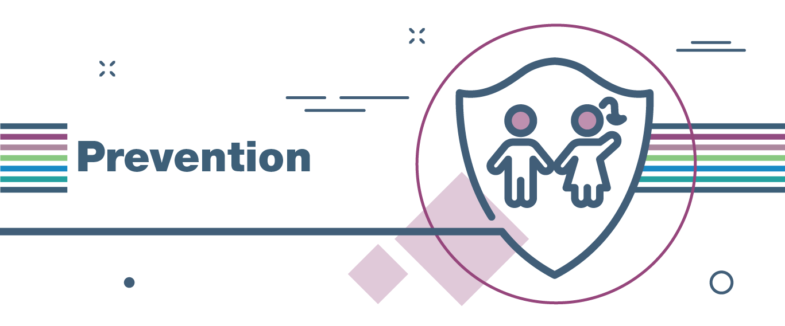
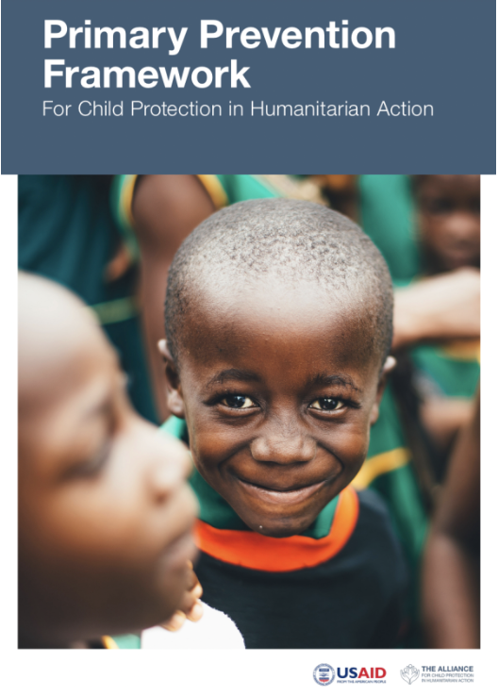
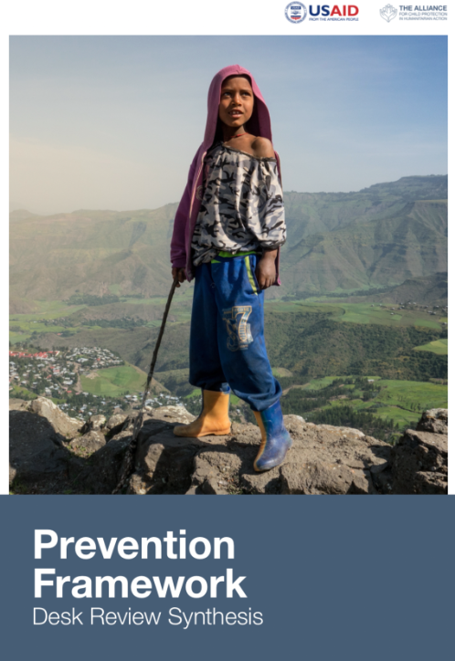
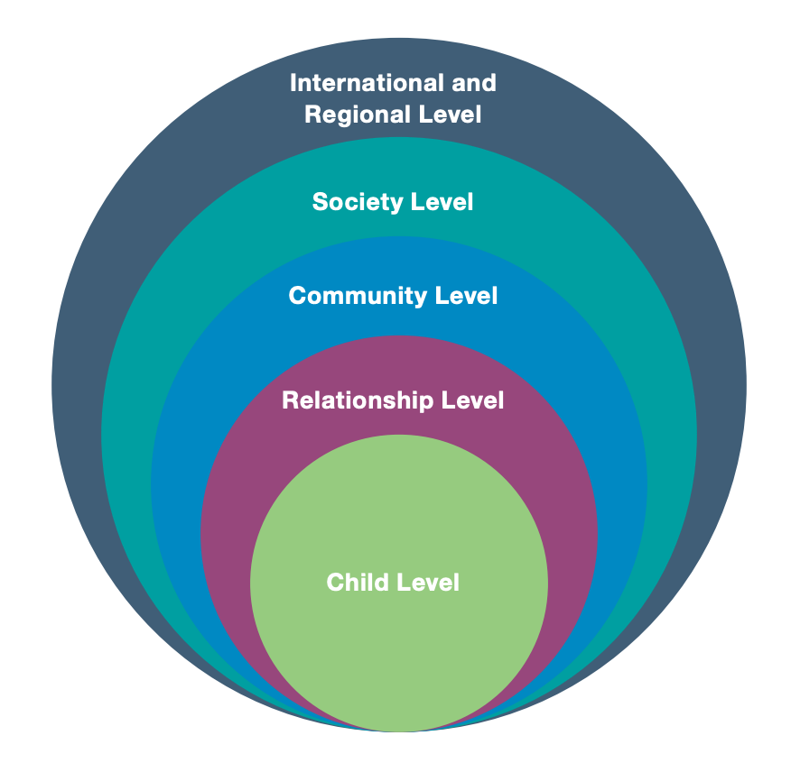

Slide 8
Guiding principles for prevention
By the end of the session, you will be able to:
Describe the eight principles for effective primary prevention interventions

Slide 9
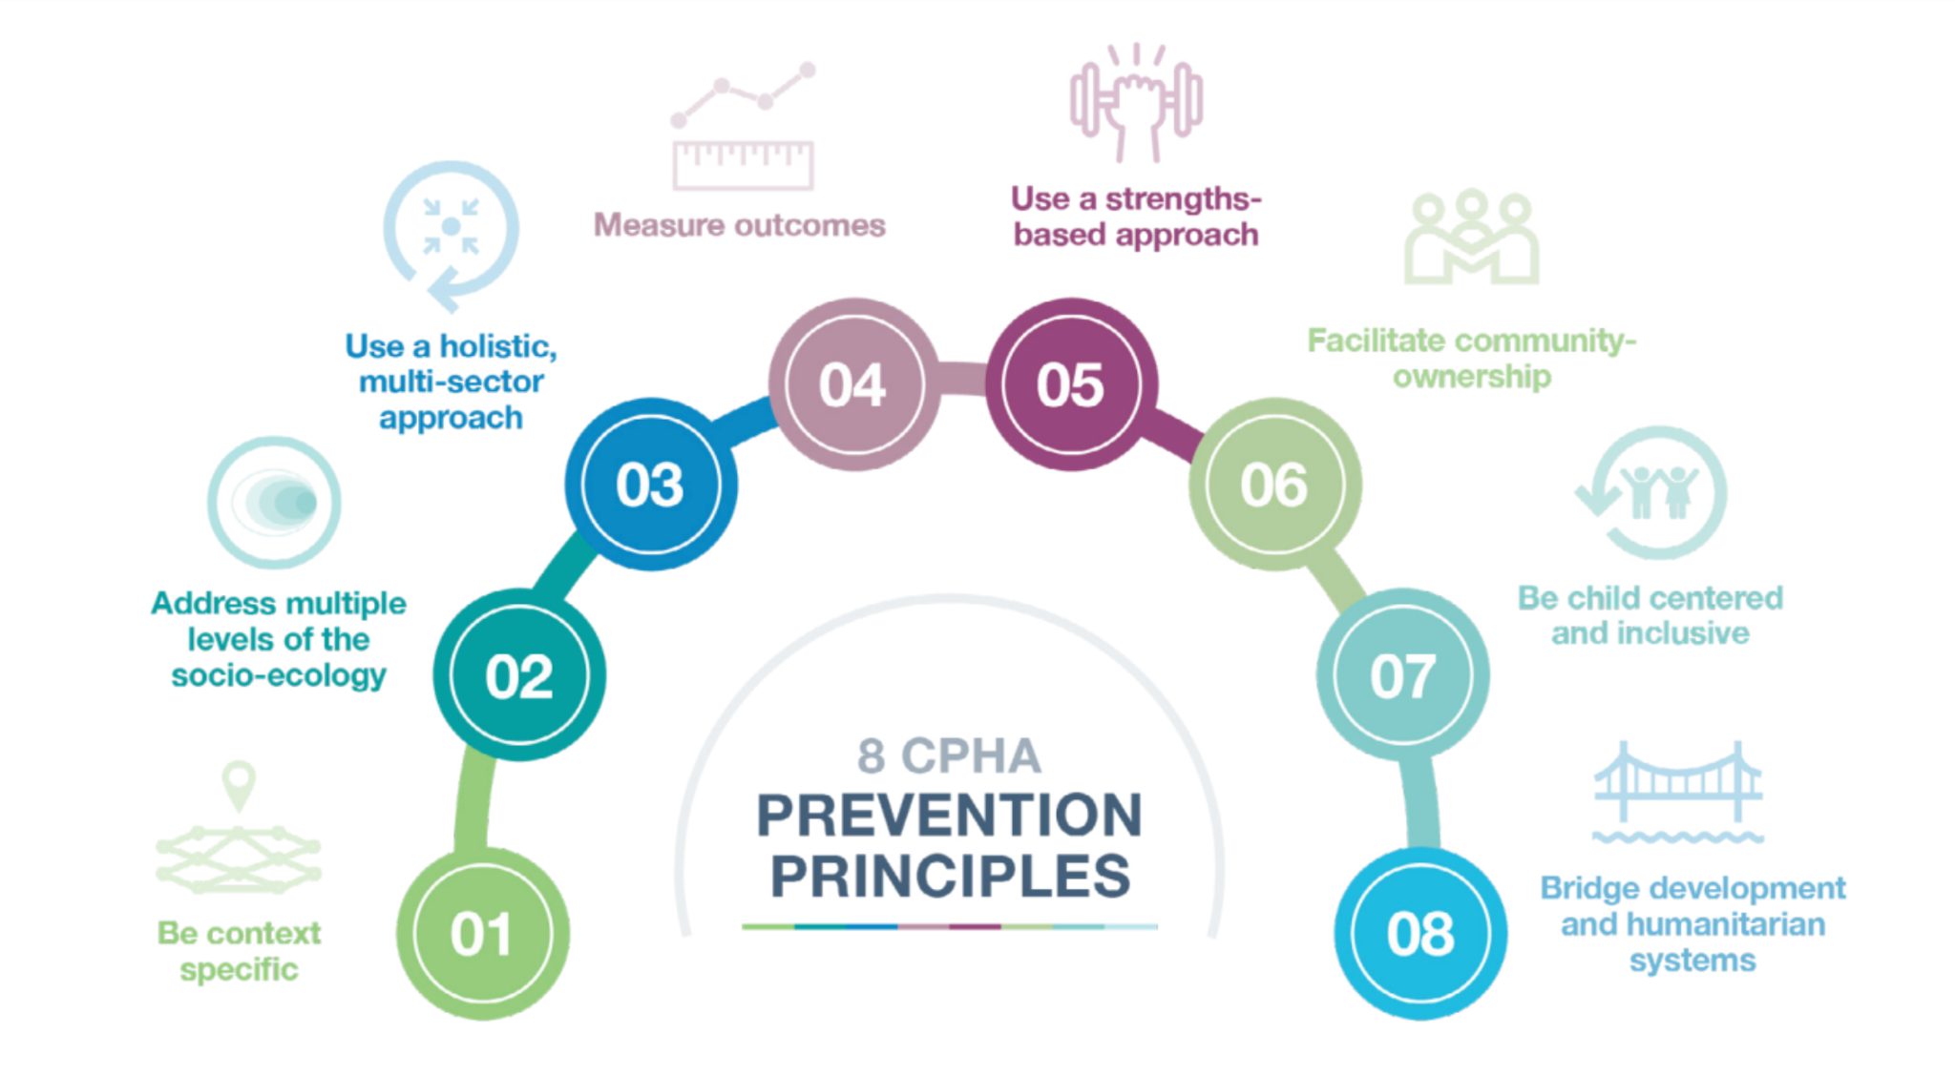

Slide 10
Step 1: Preparedness
By the end of the session, you will be able to:
Explain the key actions for prevention programming that take place in the preparedness phase
Identify common risk and protective factors in your context
Reflect on how the guiding principles for prevention can be applied in the preparedness phase

Slide 11

Key action 1
Understand and document risk and protective factors related to the types of harm that children experience now and those they may experience during a potential crisis.
Notes:
Desk reviews should identify existing harmful outcomes and associated risk and protective factors, which may be exacerbated during a potential crisis. Desk reviews should also consider new types of harmful outcomes that may emerge during a crisis (or the exacerbation of an existing crisis) and the associated risk and protective factors. Desk reviews document the preventative services and supports already in place to address these factors. Inter-agency and intersectoral desk reviews should be prioritized wherever possible.

Slide 12

Key action 2
Include actions to address risk and protective factors in multi-sectoral preparedness plans.
Notes:
Preparedness plans should be developed with local and community actors such as health centers and schools. Multi-sectoral assessment and data collection tools that are developed jointly by Child Protection, Education, Health, MHPSS, GBV, Livelihoods and Food Security and others will better include information on risk and protective factors.
Preparedness plans should include information on who will implement preventative actions in a humanitarian response, how they will be resourced and how existing prevention services and supports may need to be adapted in the crisis scenario. Preparedness plans should also include actions to prevent harmful outcomes that are likely to occur in a crisis. For example, any scenario that involves displacement should prioritize the prevention of family separation. A scenario that includes lockdowns should prioritize preventing violence to children within homes.

Slide 13


Key action 3
Advocate for and invest in primary prevention preparedness actions pre-crisis.
Notes:
Humanitarian, development and Government actors should work together to take actions that will build the capacity of children, families and communities to prevent harm to children when a crisis occurs. The actions should be based on identified risk and protective factors. Additionally, existing social protection and prevention interventions can be prioritized for continued and increased funding in emergency preparedness plans. For example, this could include continuing national-level social protection measures (e.g., child and family benefits), strengthening child protection systems to adapt to a crisis through supplemental funding and training, or continuing community and civil society prevention efforts such as the running of parenting support groups.

Slide 14

Key action 4
Take early action to prevent harm at the beginning of a crisis.
Notes:
Early actions are those taken in response to a trigger that signals that a crisis is likely near. These early actions either mitigate the impact of a crisis or improve the response.15 Early warning systems allow for action to be taken based on the potential risk of harm to children, rather than need. For example, as the likelihood of displacement due to armed conflict increases, it can be assumed that family separation and psychosocial distress are likely. Early action to prevent separation and mitigate psychosocial distress can be taken, even before confirming the prevalence of the unaccompanied and separated children and distress.

Slide 15
Case study
The people in the conflict affected areas of Cabo Delgado, a northern province of Mozambique, continue to face widespread insecurity and ongoing military operations, damaged infrastructure, tattered local economies, loss of livelihoods, human rights violations, including forced recruitment, kidnapping, and conflict-related sexual violence. There are 384,316 children who have been displaced since the beginning of the conflict. They make up around 51% of the displaced population in Cabo Delgado. (UNICEF, 2022). They are one of the most vulnerable groups among the affected population. 3,218 children are fleeing the conflict alone. (IOM, February 2022). This can increase their exposure to serious protection issues. Existing services have limited capacity to deliver necessary services for unaccompanied and separated children (UNHCR, 2022). In areas of displacement, school closures due to conflict (Relief Web, 2022) and overall limited availability of secondary education (Save the Children, 2021) are leaving IDP children out of school. This may contribute to exposure to risks. On-going attacks on schools (ACLED Curated Data: Africa, July 2022) are a grave violation of children’s rights and increase the possibility of injuries and maiming. Save the Children reported a rapid increase in the number of child marriages in Cabo Delgado. Although prohibited by Mozambican law, this is common practice in Cabo Delgado. Data from 2017 shows that the Province had the highest rate of child marriage in Mozambique at the time. (Instituto Nacional de Estatistica and UNICEF, 2021). This is in part the result of (i) limited access to education and (ii) the lack of a sustainable durable solution in a protracted crisis setting. The loss of civil documentation and birth certificates (Save the Children, 2021) may further expose children to protection risks such as child marriage. Economic hardship can also be linked to increasing protection incidents reported in Cabo Delgado, such as the increase of children married (as reported in risk 2). The prospect of a reduction in the overall assistance of food items, combined with lack of economic integration sets a dangerous trend in which the overall vulnerable profile of the displaced population in Cabo Delgado (composed of around 80% of women and children) is placed in a situation of increased risk. Human Rights Watch reported that hundreds of children have been kidnapped by NSAG and trained in combat in locations across Cabo Delgado. There are unverified reports of girls who have been abducted and forced to marry members of the non-state armed groups. The protection cluster, including child protection, gender-based violence partners, and PSEA network, has been working with other clusters to ensure that protection is central to the response. In this connection, the Protection Cluster has worked with the Community Engagement and Accountability to Affected Population Working Group (CE/AAP WG) to ensure that IDPs with specific needs are identified, meaningfully consulted as well as prioritized by the humanitarian response. The Protection Cluster and its partners have also been working to ensure strengthening of local systems and provide trainings to authorities at the district, provincial and national level.
Notes:
www.globalprotectioncluster.org/sites/default/files/2022-11/20221114_pc_prot_analysis_cd_final_cleared_gpc_1.pdf

Slide 16
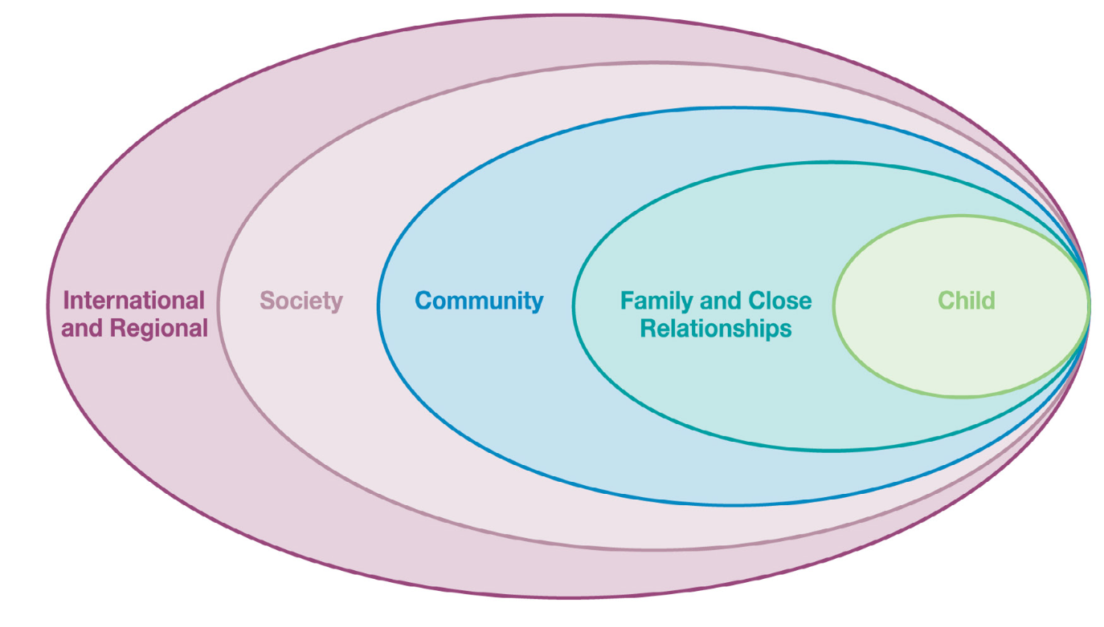
Socio-ecological model

Slide 18
Step 2: Assessment and situation analysis
By the end of the session, you will be able to:
Explain the key actions for identification and ranking of risk and protective factors prior to prevention programming
Demonstrate at least one participatory method for conducting community-led analysis of risk and protective factors
Reflect on how the guiding principles for prevention can be applied in the needs assessment and situation analysis phase

Slide 19


Key action 1
Use existing information to take immediate action while further assessment is undertaken.
Notes:
When information and analysis on harmful outcomes and the risk and protective factors are available in desk reviews or other sources pre-crisis, this information can be used immediately to design primary prevention interventions. When monitoring identifies that there is a significant change in the risk and protective factors or the type of harmful outcomes in the context, updated assessments and analysis can then be conducted to better adapt programming.

Slide 20

Key action 2
Gather existing information from multi-sector sources on harmful outcomes to children in the context.
Notes:
Risk and protective factors relate to a child’s holistic well-being and are found in all sectors.18 Data on child well-being is often already being collected by other sectors and can be used in joint analysis of harmful outcomes and risk and protective factors. Where relevant data is not already being collected, advocacy for the inclusion of data collection on children’s well-being within all sectors is needed. It is essential that child protection and other sector actors discuss and jointly analyze this data to inform the design of effective interventions. This includes sectors involved in the provision of education, health care, water and sanitation, livelihood support, shelter, nutrition and other services to children.

Slide 21

Key action 3
Analyze harmful outcomes for children and their associated risk and protective factors.
Notes:
A list of commonly identified risk and protective factors can be found in Annex 1. However, each culture and context will have specific risk and protective factors and vary in the degree of impact each factor has on harmful outcomes. For example, in one context, family separation may be linked to a lack of secondary education opportunities while in another family separation may be linked to the need to flee during seasonal flash flooding. Information on risk and protective factors can be included into assessments that feed into Humanitarian Needs Overview (HNO) exercises in coordination with other sectors.

Slide 22
Selecting approaches
What methods were used to consult with the community?
What other/additional methods could have been used?

Slide 23
Community consultation
Identify harmful outcomes
Plan your questions and which groups to consult
Conduct the consultation (FGD)
  Identify risk and protective factors
  Rank risk and protective factors
30 minutes in total

Slide 24
Debrief
What worked well about this method?
What was challenging?
What adaptations would I make to apply this in my own context?

Slide 25
Design and planning
By the end of the session, you will be able to:
Explain the key actions for prevention programming that take place in the design and planning phase
Demonstrate how to use the risk and protective factors prioritisation tool
Demonstrate how to develop a logical framework for a primary prevention programme
Reflect on how the guiding principles for prevention can be applied in the design and planning phase

Slide 26

Key action 1
Develop a contextualized theory of change to prevent harm based on the identified risk and protective factors.
Notes:
Effective child protection programming, whether prevention or response focused, is rooted in a theory of change that is context specific. The theory of change in prevention programming demonstrates how changes in risk and protective factors will reduce harmful outcomes for children. This information comes from assessment and analysis conducted in Step 2. Effective theories of change are informed by assessments by and with communities that have identified which protective and risk factors are most important in relation to the type of harm to be prevented.

Slide 27

Key action 2
Identify result level outcomes and indicators that measure changes in risk and protective factors.
Notes:
Measuring change in the reduction of harmful child protection outcomes in the population can be challenging or even impossible due to challenges in data collection, population movement, restricted access and insecurity and shorter project cycles. Prevention can also be difficult to measure as it is the absence of something of occurring. Instead, we can measure prevention indirectly through result outcomes. Result outcomes measure a reduction in risk and an increase in protective factors.
An example of a result outcome could be “children who have been displaced report an increased sense of belonging in the host community” or “the laws prohibiting child labor are better enforced.”
Then, using the agreed theory of change (IF we do X, THEN y), we assume that achieving the desired change in risk and protective factors will lead to prevention of harm. Annex 3 provides a sample logical framework as one example. Where possible, outcomes that directly evaluate prevention of harmful outcomes or improvement in dimensions of well-being will provide more robust evidence of change.

Slide 28
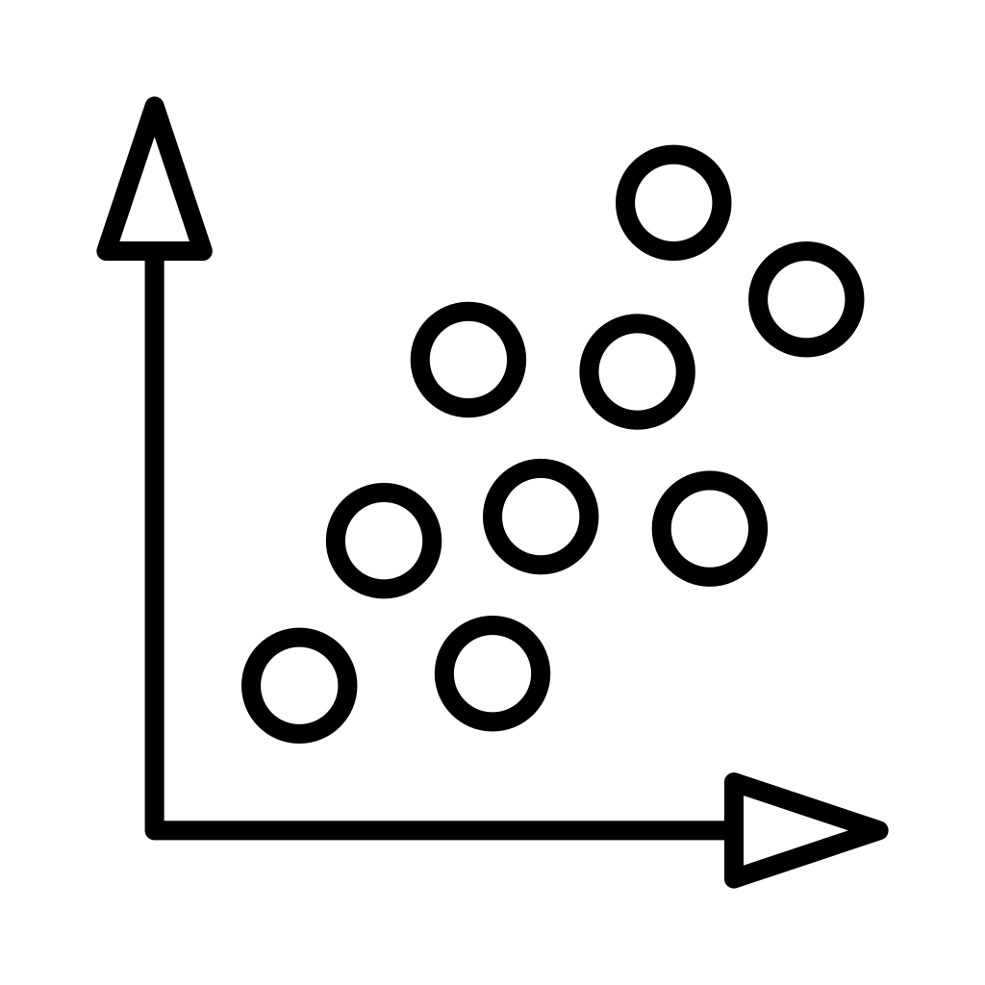
Key action 3
Be strategic in selecting the risk and protective factors that will have the most impact and are feasible to address.
Notes:
Due to budget and resources constraints, it will never be possible to address all risk and protective factors. Humanitarian actors can prioritize the main risk and protective factors leading to harm based on three criteria: 1) the impact that addressing the factor will have on preventing harm, 2) the feasibility of addressing the risk or protective factors; and 3) intersection across multiple harmful outcomes. Impact ranking should be done in close collaboration with communities, families and children. Those factors that will have the greatest impact and are feasible to address should be prioritized. In addition, because often we are addressing multiple types of harm, factors that are common across multiple types of harm (intersecting factors) should also be considered a priority. See Annex 4 for a sample tool to prioritize factors according to impact and feasibility as well as intersection across multiple types of harm.

Slide 29
Prioritisation tool
Identify risk and protective factors
Score each factor for:
  impact
  feasibility
Plot the scores on the chart
Prioritise high impact high feasibility factors
Repeat for additional harmful outcomes to be prevented

Slide 30
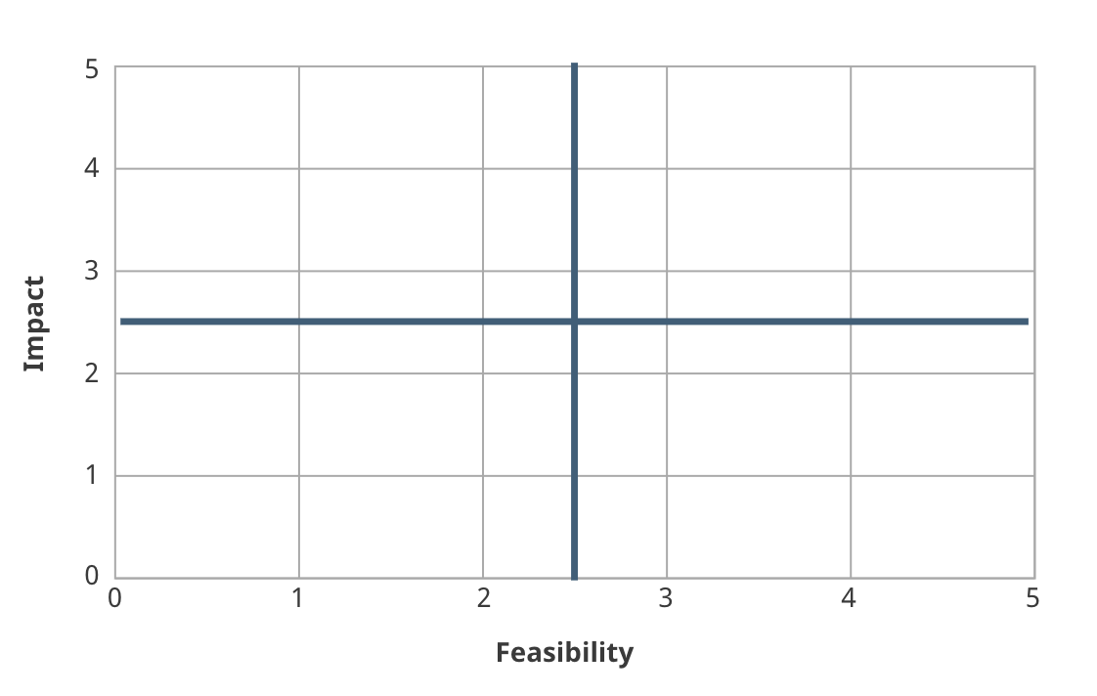
Access to secondary school
Food security
Positive relationship with caregiver
Poverty

Slide 31
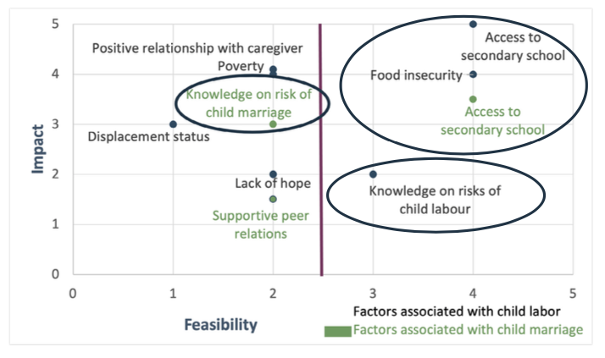

Slide 32
Theory of change
IF we do this activity,
THEN this change will happen,
BECAUSE of these factors.

Slide 33
Reflect and debrief
Thinking about the activity, discuss:
What went well?
What was challenging?
What questions you have?
10 minutes

Slide 34
Implementation and monitoring
By the end of the session, you will be able to:
Explain the key actions for prevention programming that take place in the implementation and monitoring phase
Reflect on how the guiding principles for prevention can be applied in the implementation and monitoring phase

Slide 35

Key action 1
Monitor changes in risk and protective factors during implementation.
Notes:
In humanitarian crises, situations can evolve rapidly. Setting up monitoring systems with children, families, community members and other stakeholders can help identify changes in risk and protective factors that were identified during the assessment phase. For example, while access to formal schooling may have been identified as a protective factor during an initial assessment, schools could become unsafe due to risk of recruitment into armed forces or risk of violence on the routes to and from school. These new risks will need to be addressed and the program approach and theory of change adapted.

Slide 36
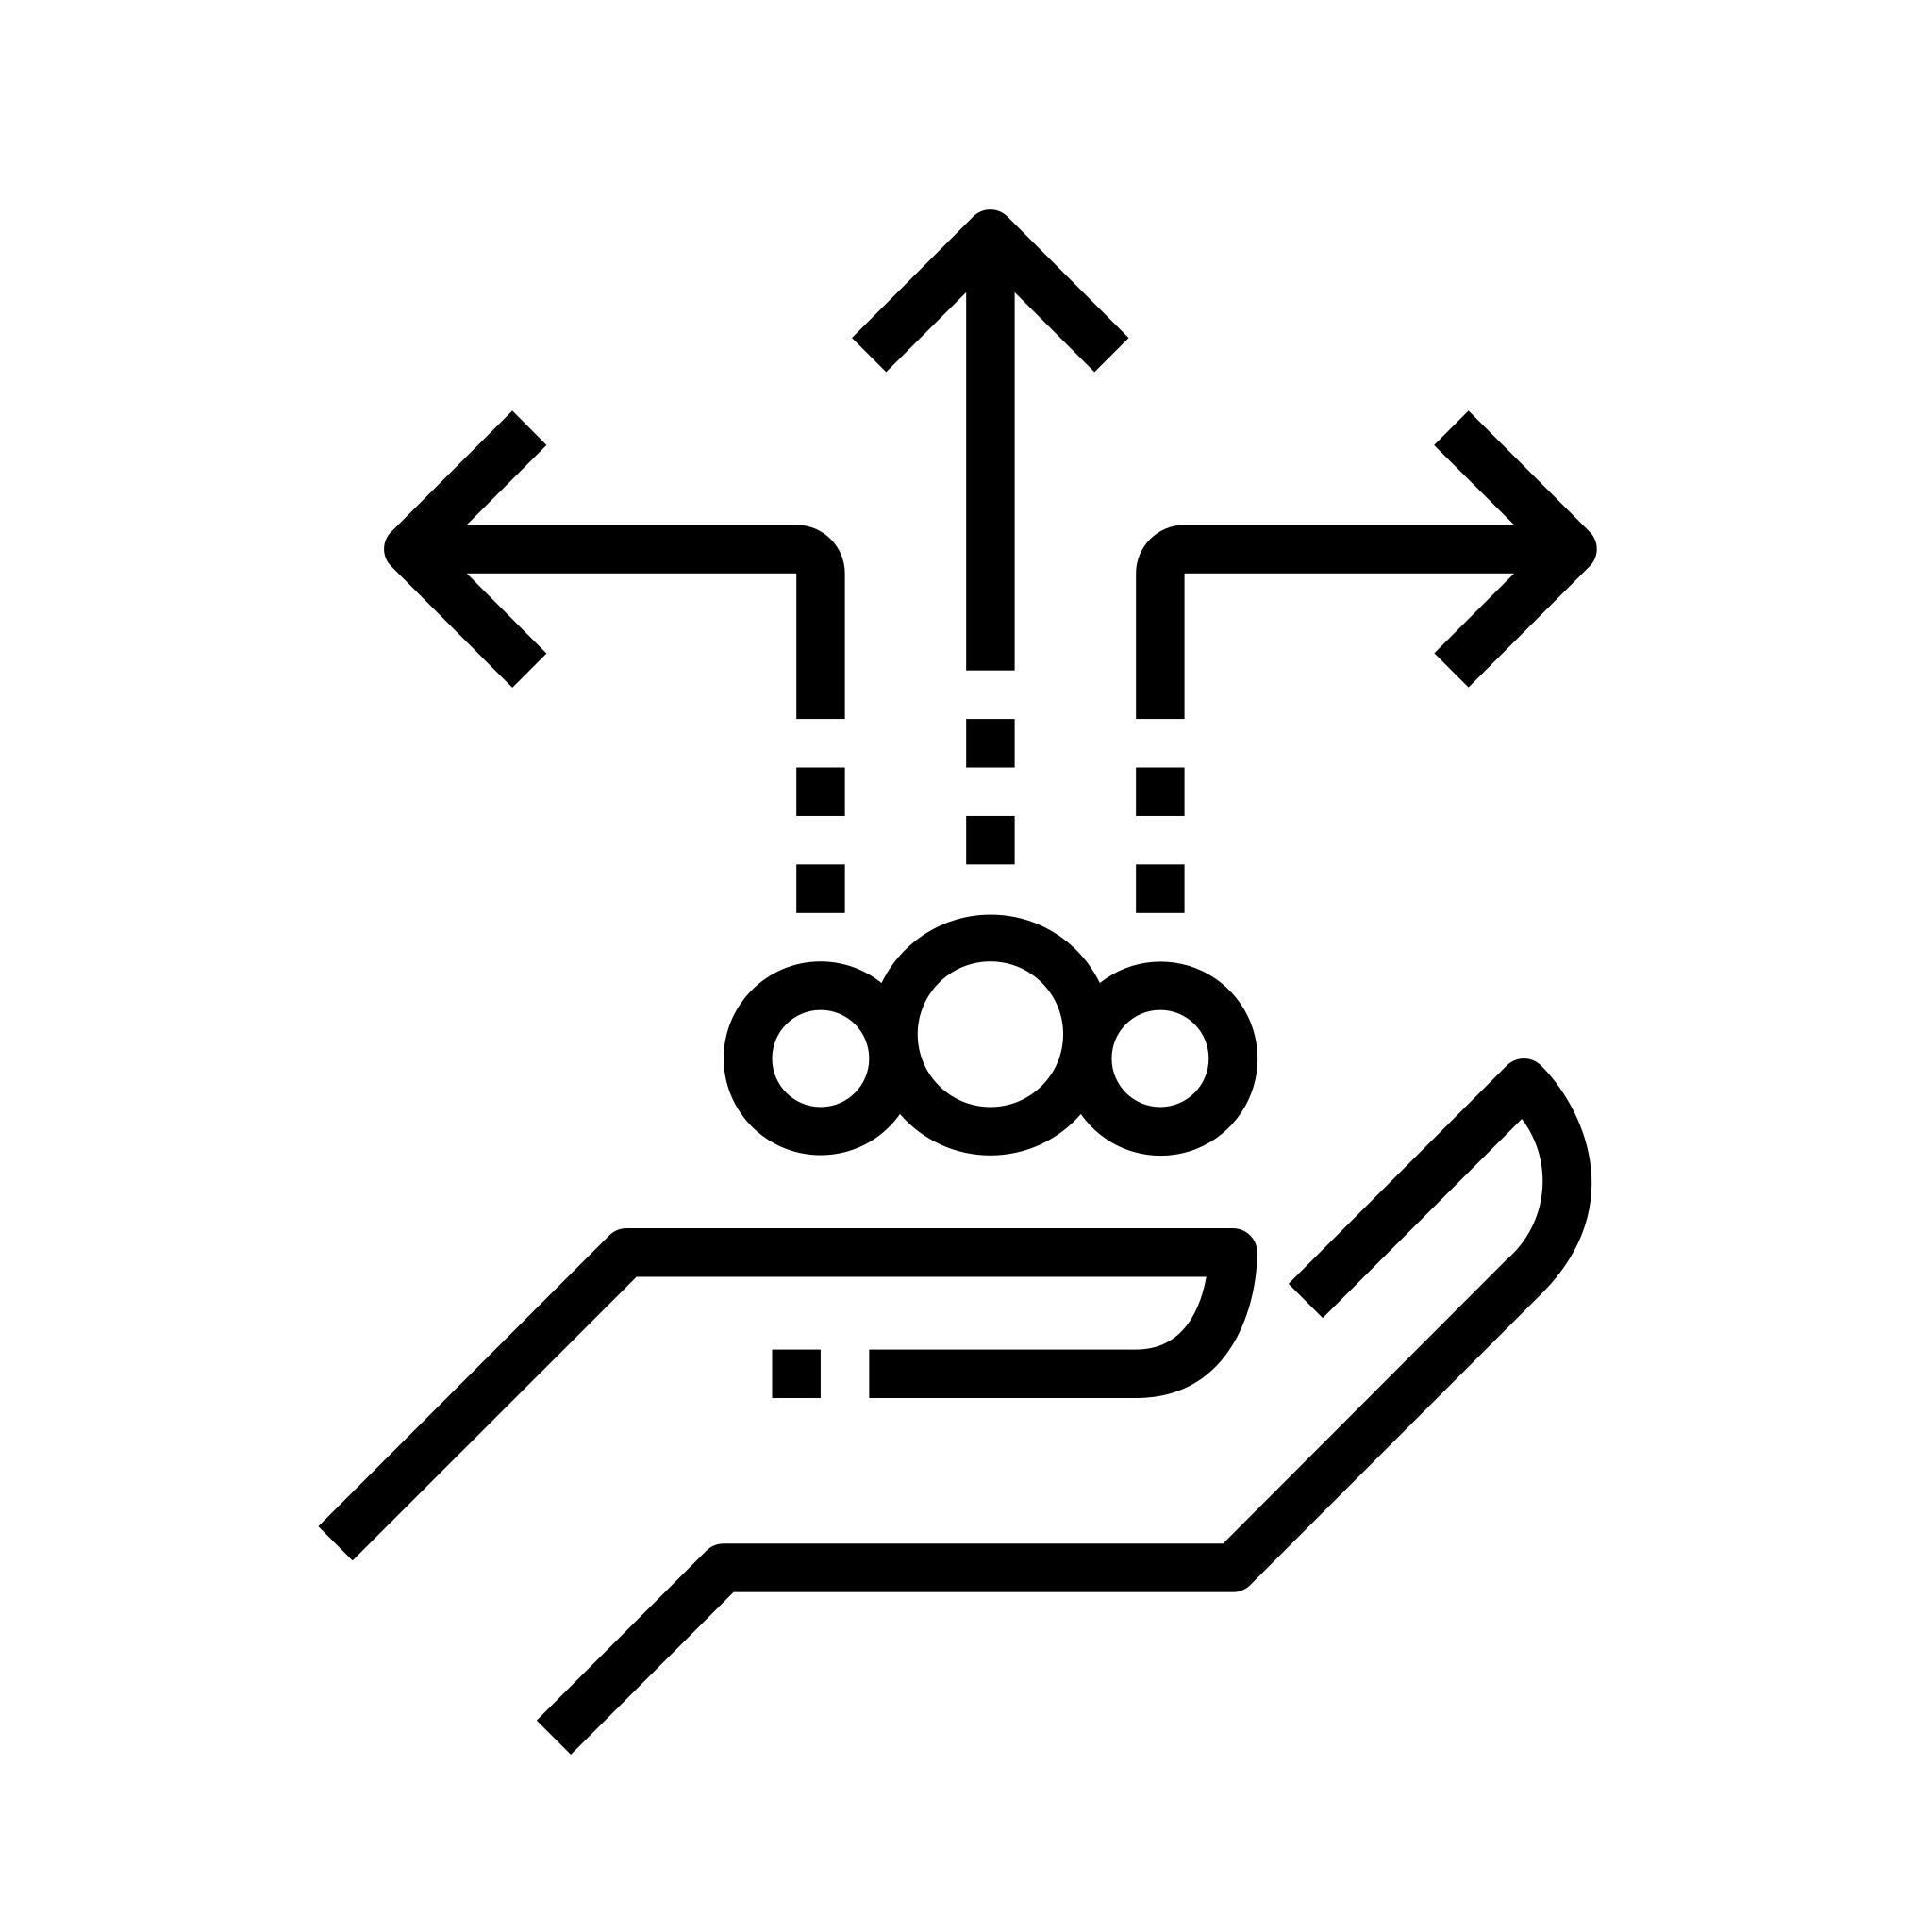
Key action 2
Adapt prevention interventions based on monitoring data.
Notes:
Feedback on effectiveness, quality and perceptions of any interventions should be collected systematically, on an on-going basis through interaction with service providers and users.
Quantitative information can include output monitoring (e.g., attendance information or number of distributions made, etc.).
Qualitative information can be regularly reviewed as well and include information shared through child and community feedback mechanisms, observations from project staff or those participating in the project or post-service user feedback surveys.
Monitoring of progress related to result outcomes should be led by communities and include children wherever possible. We will talk more about monitoring in the session on step 5.

Slide 37
Evaluation and learning
By the end of the session, you will be able to:
Explain the key actions for prevention programming that take place in the evaluation and learning phase
Consider possible methodologies for evaluation of primary prevention programmes
Reflect on how the guiding principles for prevention can be applied in the evaluation and learning phase

Slide 38

Key action 1
Evaluate changes in result outcomes at the level of risk and protective factors.
Notes:
In all programs and projects, the change in result outcomes from the baseline to post-intervention should be evaluated. In some contexts, particularly where there is insecurity, lack of access or short funding cycles, this may be the only level of evaluation possible.

Slide 39

Key action 2
Evaluate the prevention of harmful outcomes.
Notes:
The evaluation of progress towards the prevention of harmful outcomes should be conducted where the security situation allows and access to communities is possible. Safety for staff and community members should be considered when deciding if it is feasible to evaluate changes in sensitive issues, for example children associated with armed forces and armed groups or gender-based violence. Evaluations should focus on if there was a reduction in harmful outcomes, rather than the process or quality of the intervention itself (e.g., levels of participation, ownership or satisfaction with a service or support), which can be evaluated in parallel.

Slide 40

Key action 3
Estimate the contribution of the prevention interventions on identified changes (reduction or increase) in the harmful outcome targeted by the program.
Notes:
Harmful outcomes to children are influenced by a wide variety of factors in the environment that cannot all be addressed by one program. Outcome harvesting and contribution analysis can estimate the contribution of the interventions.

Slide 41
Evaluation methodologies
Most Significant Change
Contribution analysis
Outcome harvesting

Slide 42
Group exercise
Read each scenario and discuss:
Which methodology is being used?
What might be the advantages and disadvantages of that methodology?

Slide 43
Applying the framework for the prevention of family separation / child recruitment
By the end of the session, you will be able to:
Explain primary prevention in the context of family separation / child recruitment
Give examples of Risk and Protective Factors relating to Family Separation / Child recruitment at the population level
Suggest ways to prevent separation & preserve family unity / prevent recruitment of CAAFAG

Slide 44
Group exercise
Read the case study and discuss:
What type of primary prevention measures would you suggest to address the root causes?
Think about:
Root causes
Risk factors
Protective factors

Slide 45
Challenges and opportunities
By the end of the session, you will be able to:
Describe opportunities and challenges associated with prevention programming in child protection in humanitarian action in their own context
Advocate for primary prevention programming

Slide 46
Preparing to deliver Prevention training
By the end of the session, you will be able to:
Reflect on the role of the trainer/facilitator
Describe the aim, objectives, structure and content of the Primary Prevention Framework introductory and in-depth trainings
Define the target audience of the introductory and in-depth trainings
Consider the preparation required before delivering an effective training

Slide 47
Introductory training agenda - remote
Day 1 |  |  | Day 2
Welcome and Intros, objectives and expectations | 45 min |  | Recap and quiz | 20 min
Break | 5 min |  | Integrating Prevention into Programme Management Cycle | 90 min
Defining Prevention in CPHA | 75 min |  | Break | 5 min
Break | 5 min |  | Challenges and Opportunities for prevention programming in CPHA | 30 min
Prevention Guiding Principles | 45 min |  | Conclusions and Evaluation - show where to find resources, CoP | 30 min

Slide 48
Introductory training agenda - in-person
Welcome and Intros | 40 mins
Objectives and Expectations | 20 mins
Defining Prevention in CPHA | 75 mins
Break | 15 mins
Prevention Guiding Principles | 50 mins
Integrating Prevention into Programme Management Cycle (I) | 40 mins
Break | 60 mins
Integrating Prevention into Programme Management Cycle (II) | 90 mins
Break | 15 mins
Challenges and Opportunities for prevention programming in CPHA | 60 mins
Conclusions and Evaluation | 30 mins

Slide 49
In-depth training agenda - remote
Session 1 | Session 2 | Session 3 | Session 4
Welcome and introductions (60) | Step 1: Preparedness (90’) | Step 3: Design and planning (160’) | Step 5: Evaluation and learning (80’)
Intro to the framework (45’) | Step 2: Needs assessment and situation analysis (120’) | Step 4: Implementation and monitoring (60’) | Thematic example: Applying the framework for prevention of family separation (75’)
Defining prevention in CPHA (60) |  |  | Challenges and opportunities (90’)
Guiding Principles for prevention (15’) |  |  | Learning review (45’)

Slide 50
In-depth training agenda - in-person
Day 1 | Day 2 | Day 3
Welcome and introductions (60') Intro to the framework (45') | Recap (30') Step 2: Needs assessment and situation analysis (120') | Recap (30') Step 5: Evaluation and learning (80')
Break | Break | Break
Defining prevention in CPHA (60) | Step 3: Design and planning (60') | Thematic example: Applying the framework for prevention of family separation (75')
Lunch | Lunch | Lunch
Guiding Principles for prevention (15') Step 1: Preparedness (90') | Step 3: Design and planning cont. (100') | Challenges and opportunities (90')
Break | Break | Break
 | Step 4: Implementation and monitoring (60') | Course evaluation and closing (45')
Review of day 1 (30') | Review of day 2 (15')

Slide 51
Target audiences
Introductory training
In-depth training
Mid level
CPHA practitioners
Want introductory knowledge
Mid to senior level
CPHA practitioners
Want stronger knowledge and skills
Role in capacity strengthening of others
Role in advocating for prevention programming

Slide 52
Implementing the Prevention framework
By the end of the session, you will be able to:
Consider their next steps for implementing the framework
Identify potential obstacles and discuss mitigation measures
Identify the support required for their next steps and relate this to what is available from the Alliance

Slide 53
RACI diagrams
 | Project Manager | CP Officer | Global CP Adviser | Country Director
Draft report narrative | R | C | C | A
Develop budget | R | I | C | A
Design questionnaire | R | C | C
Schedule FGDs | A | R | C

