Slide 1

TRAINING PACKAGE
INTERAGENCY TOOLKIT: PREVENTING AND RESPONDING TO CHILD LABOUR IN HUMANITARIAN ACTION

Slide 2
SESSION 9: CHILD PROTECTION: EFFECTIVE GROUP ACTIVITIES FOR WORKING CHILDREN

Slide 3
LEARNING OUTCOMES
By the end of the session you will be able to:
Identify 4-5 potential challenges in the context which prevent working children from accessing group activities
Give examples of how working children can be effectively included in group activities
Identify ways to strengthen design of group activities to reach working children

Slide 4

HOW DO WORKING CHILDREN IN THE CONTEXT...
DISCUSSION
Spend their time?
Have opportunities to access group activities?
Face barriers that prevent them from accessing group activities?
Is there a difference for…
  Children who work legally, children in child labour, children in the WFCL?
  Girls and boys?
  Age, disability, ethnicity, refugee status, etc.?

Slide 5
GOOD PRACTICE GUIDANCE FOR GROUP ACTIVTIES
IDENTIFY COMMON BARRIERS
Fixed location and timing
Demands of work
Needs and interests
Financial barriers
Age and gender inclusion
Social isolation
Restricted mobility and decision making; imposed restrictions
Notes:
Explain that the combination of having fixed times and locations for child protection group activities with the often-high demand on children’s time from their work at home and/or in the workplace is commonly on of the most significant barriers to children’s attendance. Equally groups activities may not adequately reflect their needs and interests as children and adolescents in child labour have very different experiences to their peers who don’t work. Children’s attendance at groups activities may incur costs both in terms of lost time or income from work itself, or through direct costs of attending activities such as transport or materials. Older children and adolescents may also not want to access group activities if these also include much younger children, or when their involvement in activities will lead to, or exacerbate social stigma. Finally, there are barriers which can be heavily gendered, and may happen to both girls and boys depending on the context. Girls, particularly adolescent girls face social isolation and restricted mobility and decision making in many humanitarian contexts, and boys particularly those who are working in the WFCL, bonded labour or hazardous industrial labour may also have their mobility and decision making restricted and face social isolation. Barriers must always be analysed through a gender lens.

Slide 6
GOOD PRACTICE
GUIDANCE
FOR GROUP ACTIVTIES
GROUP ACTIVITIES TO REACH CHILDREN IN CHILD LABOUR
Consultation
Outreach
Flexible and safe timing and locations
Adapt content
Work with others, mobilise in communities
Build trust: Understand demands, grow from short, gradual consistent contact to greater connections
Notes:
Explain:
Consultation including the involvement of working children and their caregivers in creating a programme of activities that meets the schedules, needs and interests of working children. may require negotiation with employers to explore whether activities can take place before, during or after work time or at the workplace.
Outreach may be needed for at-risk children and their families outside regular target areas, or who work in highly affected communities, or who are isolated for other reasons, and not able or allowed to attend regular services, for instance hard-to-reach boys and girls, home-bound girls, children working in fields or on the streets.
Flexible locations of group activities for instance where working children live and work, or in other places which are accessible and known to children in child labour such as spaces in the community or drop-in centres or through mobile approaches in locations where children work, can help improve attendance. Flexible schedules and timings also help make services more accessible, with availability during work breaks, outside regular work hours or on weekend days.
Content should be adapted to the needs of children in child labour which are inclusive, gender and age responsive.
Mobilising working children to attend group activities by linking with other actors and community-level groups and individuals can help identify where and how to reach out to at-risk children.
Above all focus on building trust with children in child labour and their caregivers, this can help cement the relationships which facilitate children’s attendance at group activities. Start with short moments of contact and work gradually and consistently towards working children’s attendance that allows them and their families to receive services and support and to connect with peers. Understand the demands on children’s time and consider starting with shorter activities (40 to 60 minutes) given that children in child labour may have less concentration than their school-going peers.

Slide 7
GOOD PRACTICE GUIDANCE
FOR GROUP ACTIVTIES
MEETING SPECIFIC NEEDS AND INTERESTS OF WORKING CHILDREN
Age, gender, ability, ethnicity
Psychosocial needs
Social and peer support opportunities
Interests and abilities
Tailored information
Identification and connection with case management and multi-sectoral services
As young parents/caregivers
Participant to facilitator ratio
Notes:
Child protection actors implementing group activities should take account of:
Age, gender, ability, ethnicity
Psychosocial support needs such as building self-esteem, strengthening communication skills, or their socio-emotional competencies;
the opportunities they have for peer and other social supports locally such as peer groups or youth networks;
participation in activities which meet their needs and interests such as literacy and numeracy classes, leadership and/or employability skills, or learning about harm reduction strategies related to specific work, or their specific interest to “learn and earn” where recreational and life skills activities can be combined with skill building or income generating activities;
the provision of age appropriate and child friendly information on education and children’s right to be free from child labour and other forms of exploitation, including context-specific child labour risk factors and the ways in which children can protect themselves from work-related hazards and risks. Information on age-appropriate work for children and legislation which is there to protect them, and information on available services, learning opportunities, and the roles and responsibilities of various actors in the context;
Identifying children in, or at risk of child labour through group activities by including information about work and school attendance in registration forms, identifying the barriers working children face to support, ensuring group activities are connected with child protection case management services and that mutual identification and referrals take place for children in or at risk of child labour, and connecting children in child labour and their families with multi-sectoral services including quality learning opportunities and multi-sectoral services. While group activities can provide access to informal learning, they can also support children and adolescents build the skills needed to access continued formal learning opportunities, and link with education providers.
Group activities can be an important part in the referral pathway of multi-sectoral services such as mental health support, legal counselling, health, nutrition and sexual and reproductive health and rights (SRHR) services, food security and livelihoods services or early childhood development services and others which meet the needs of children and adolescents who are parents/caregivers of younger children, siblings, or elderly household members such as providing alternative (child) care or protection services.

Slide 8
GOOD PRACTICE GUIDANCE
FOR GROUP ACTIVTIES
PSYCHOSOCIAL CONSEQUENCES
Psychological abuse and violence, belittlement, harassment
Stigmatisation, discrimination, marginalisation
Isolation, limited freedom of movement and social integration, separation from caregivers
Negative sense of personal security, identity, future perspective, stress, low self-esteem, a sense of helplessness, and further mental health problems
Notes:
Children often experience severe psychosocial consequences when they are in child labour and work or live in an environment where they are belittled and harassed or experience psychological violence and abuse. Cumulating over time, children may suffer stigmatisation, marginalisation and discrimination from their peers and within their communities, particularly if they differ in appearance or behaviour to other children in their communities. Children in the worst forms of child labour (WFCL) particularly often experience extremely stressful events such as separation from their parents, injury, sexual violence and other traumatic situations.
Children who work in extremely dangerous situations and in exploitative and abusive conditions where they are abused, degraded, and rejected by employers, peers, and others risk psychosocial distress caused by isolation, limited freedom of movement, social integration with others and separation from their primary caregivers who can ensure a child’s welfare and healthy development. Children in these situations may become highly depend on their employers for their basic needs and have little power to escape maltreatment.
Children’s sense of personal security can be negatively impacted by child labour as can their personal identity and value, affecting how far children are able to shape their futures. This can lead to serious emotional expressions including stress, low self-esteem, helplessness and sometimes strong or overwhelming negative feelings.

Slide 9








GOOD PRACTICE GUIDANCE
FOR GROUP ACTIVTIES
PSYCHOSOCIAL FACTORS IN CHILDREN’S WORK
Job content
Workload and work pace
Work schedule
Control
Environment and equipment
Interpersonal relationships at work
Precarious working conditions
Home-work interface
Notes:
Job content helps determine motivation in the workplace. A lack of variety and repetitiveness, under using skills, meaningless work, high levels of uncertainty, conflicting demands, and a lack of opportunity to learn and develop new skills, experiences and self-esteem all lead to poor psychological and physical health, boredom, anxiety, depression and resentment, undermine self-worth, and leave children ill-prepared for the demands of adult life.
Both work overload and under load (the amount of work and the difficulty of the work) can include work where children are machine pacing, high levels of time pressure, and continually subject to deadlines can have a problematic impact on child labourer’s psychosocial health. Long working hours and the physical effort and strain of many jobs where children carry heavy physical loads without aids, or work in conditions where they sit on the floor or in confined spaces for a long time contribute to children experiencing stress, high levels of and stress related illnesses.
Child labour which involves : Shift work and long working hours, including at night with unpredictable, inflexible or unsociable schedules, which may also conflict with work/home demands, can interrupt and reduce sleep patterns causing fatigue and exhaustion, stress, and impaired intellectual development affecting education and disruption of family relationships. Girls are especially at risk as they have a greater burden for household activities and economic activities at the same time, and generally have lower rate of school attendance and completion.
Children in child labour often face low participation in decision making and a lack of control over their workload, pacing and what is happening to them. Sometimes being forcibly moved, unable to maintain regular contact with important social or emotional bonds, cultural routines, and social practices, relationships and daily routines, has been related to experiences of anxiety, depression, stress, apathy, exhaustion, poor physical health and low self-esteem. Greater control and participation in decision-making can lead to greater satisfaction and higher feelings of self-esteem.
Psychological and physical health are closely related. Inadequate, unsuitable or poorly maintained equipment and poor environmental working conditions for children all play a key part in children’s psychological health. Chemical, physical, ergonomic, biological and psychological hazards are often found in combination in child labour.
Well-recognised hazards which impact mental health include toxic substances which impact developing nervous system and children’s psychological functioning. Unhealthy workplaces increase stress, fatigue and demoralisation. Dangerous tools, can induce stress and fear of accidents, or trauma by suffering or witnessing serious incidents, and serious injuries or permanent impairments in work related accidents may increase the risk of isolation or stigmatization. Age, maturity and vulnerability all affect how children are affected. Generally, younger children may be at greatest risk, but adolescents can be exposed to multiple hazards, use dangerous equipment, and may often work longer hours. A lack of training and adult supervision all contributes to higher risks.
Relationships in the workplace with employers (who are often also parents), supervisors, clients or peers, play an important role in the life of a child who is in child labour’ both positively and negatively. While support and attachment at work can have a positive effect, children are vulnerable to maltreatment, abuse and violence, sexual harassment, bullying, stigmatisation, threats, isolation, exclusion, a lack of social support, and feelings of powerlessness against those who are meant to protect them, can lead to stress, impairment of health and well-being, depression, anxiety, and loss of concentration.
Precarious working conditions all impact children’s psychological well-being. Unpredictable treatment from employers, role ambiguity, multiple tasks within the workplace, a responsibility for others, career stagnation, cycles of uncertain and poorly paid income, under promotion or over promotion, a lack of formal ‘contracts’, entitlement to sick leave, holiday pay, job security, with little or no legal options against exploitation or opportunity to complain or leave.
Conflicting demands of work and home have a significant impact on children. Children, especially girls have a heavy burden of responsibility when caring for family and siblings alongside other work. Children may also have more than one job and competing demands from both workplaces. For many children, parents or other family members are also their employers, and their homes are their workplace, meaning there are few restrictions on the demands that are made on them. While family-based work can strengthen psychological well-being, where family work is excessive, exploitative or abusive, family-based child-workers can be at even greater risk than children working outside their families, as they are denied their primary source of emotional security, socialization and learning. Evan if children don’t work in a family setting, the home-work interface can serve to decrease or increase psychosocial impacts. Parents can play an important role in mediating the impact of work on their children through support and encouragement or place them at greater risk where they have unreasonable expectations and are punished for not fulfilling them. Humanitarian crisis can magnify risks as many families feel they no choice or little power to prevent the exploitation of their children, low levels of support at home, a breakdown of social networks, disruption to familiar surroundings and disruption in education/schooling, are all familiar consequences of humanitarian crisis.

Slide 10
ACTIVITY
CONSIDER YOU OWN GROUP ACTIVITIES FOR CHILDREN
In session 6 you identified and discussed group activities in the context of children and how to reach children in or at-risk of child labour.
Discuss how to improve current approaches, and discuss group activities that better meet the needs of children in or at-risk of child labour.
Identify specific improvements around:
  Access and attendance, support to promote engagement
  Suitability of activities
  Meeting age and gender-specific needs
  Meeting additional psychosocial and developmental needs

Slide 11
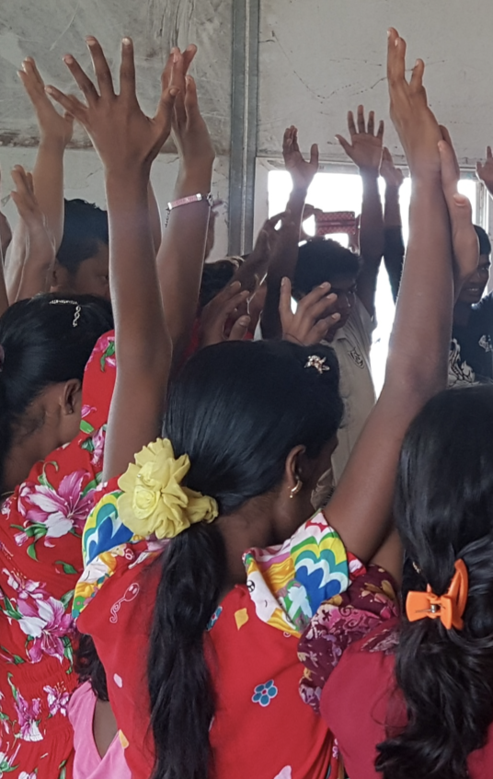
Inclusive and engaging activities: Supporting children in child labour through CFS in Myanmar
Free play activities
Structured activities
  Life skills
  Living in Harmony
  Extended and Continuous Education and Learning
  Adolescent Skill Building Package
  Youth Bank
  Forum Theatre
Supporting parents and caregivers (Modern Family Package, Parent and child events, CPG, caring environment package)

Slide 12
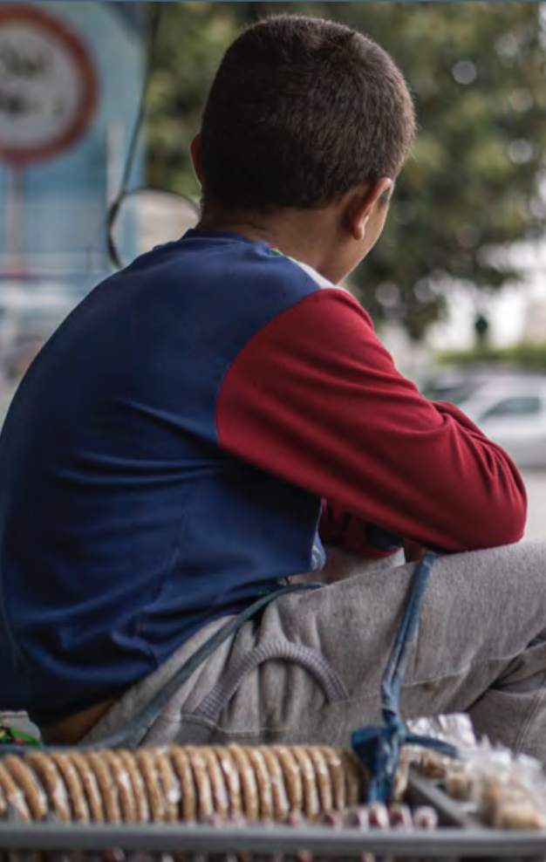
Identification and referral through group activities: SHLS in Lebanon for Street Children
Safe space located close to children’s work
Outreach, regular opening, mobile, training
Comprehensive multi-sectoral services (social and emotional learning; basic literacy; case management; a help desk and hub for information on all agency services)
Case management for high-risk cases
Solution-based decision making
Work with caregivers
Strong advocacy for caregivers’ entitlements and extra support
Referral and support for economic development

Slide 13
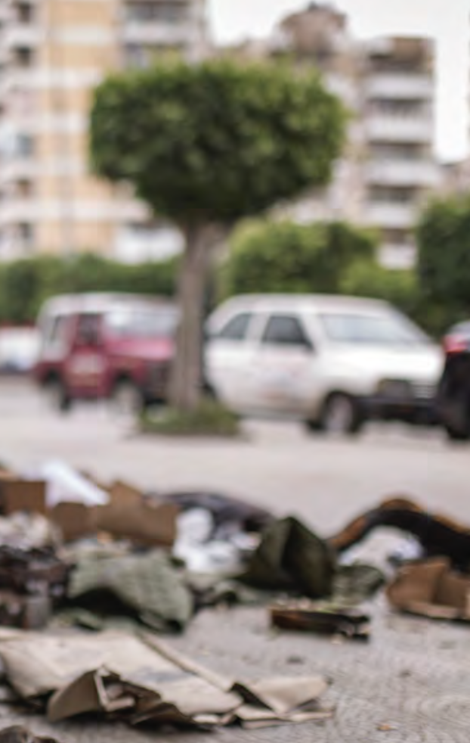
Risk mapping with children – discussions/activities around safety: SHLS in Lebanon for Street Children
Safety mapping as a PSS activity for children in child labour to support each child in mitigating the risks they face
Conducted by case worker and case manager when child is high risk
Sit with each child, draw a map of home and work, routes from home to work, and around work, etc.
Add in who is on the route, where they are safe/unsafe, and who makes it so
Put in place additional plan to mitigate identified risks and provide alternative routes, people, and places, etc.

Slide 14
KEY MESSAGES
Group activities alongside multi-sectoral services can positively enhance working children’s well-being and resilience.
While group activities are a very common CP intervention, children who are working or who are in child labour often have limited access.
The nature of child labour often forms barriers to access.
Group activities should put in place special measures to meet the specific needs and interests of working children, including their socio-emotional and psychosocial needs.
Notes:
Group activities alongside multi-sectoral services for families can positively enhance workings children’s wellbeing and resilience and reduce their stress levels.
While group activities are one of the most common and crucial humanitarian interventions to support children’s and adolescents’ socio-emotional development, those who are working or who are in child labour often do not have access to these activities.
The nature of their work often forms barriers to accessing the fixed locations and times at which safe spaces operate, and activities do not adequately reflect their needs and interests.
Group activities should put in place special measures to meet the specific needs and interests of working children including their socio-emotional and psychosocial needs.

